Slide 1
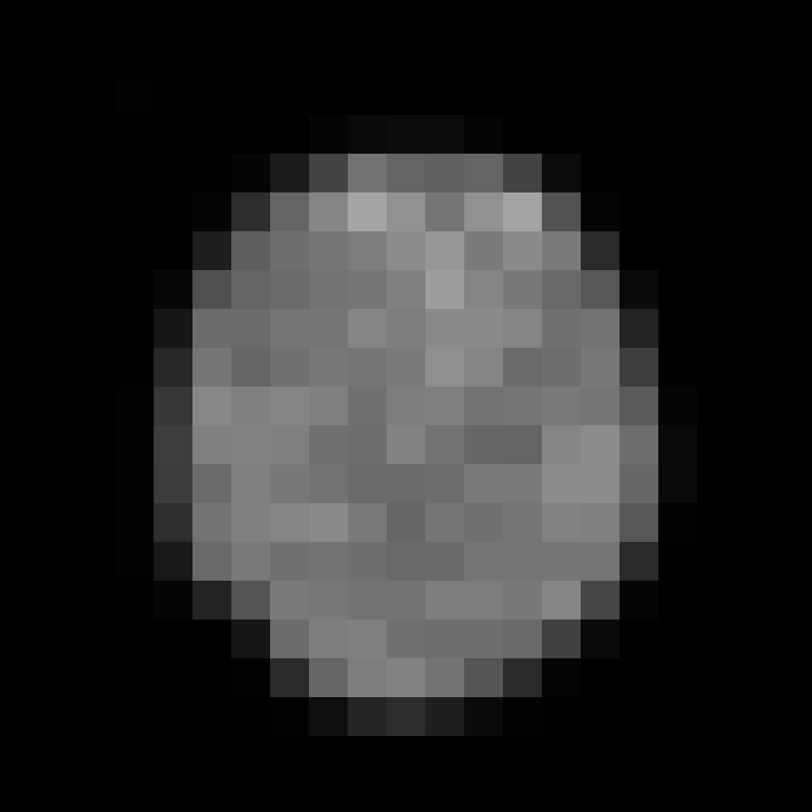
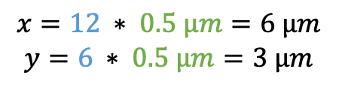

Index * Calibration = Calibrated coordinate
dx
$$x=12 ∗ 0.5 µm=6 µm$$
$$y=6 ∗ 0.5 µm=3 µm$$
Origin (0,0)
(0,0)
dy
3 dx
2 dy
$$Area = 3 dx ∗ 2 dy$$
Notes:
Example image: xy_8bit__nucleus_calibrated.tif

Slide 2
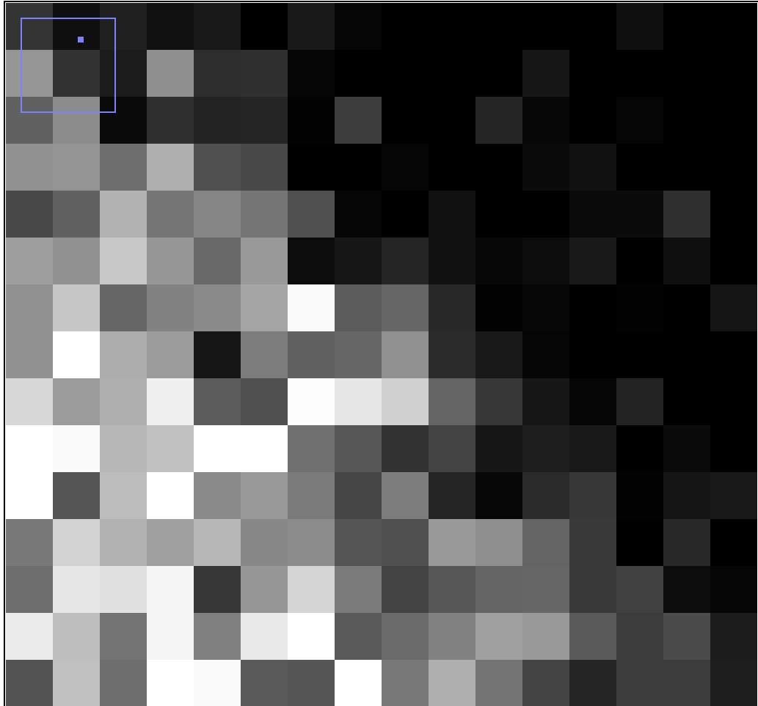
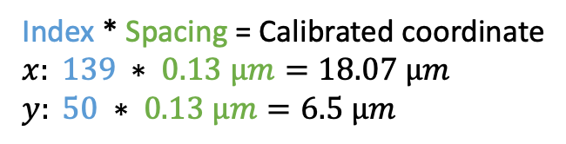
Spacing dx
Index * Spacing = Calibrated coordinate
$$x: 139 ∗ 0.13 µm=18.07 µm$$
$$y: 50 ∗ 0.13 µm=6.5 µm$$
Origin (0,0)
Spacing dy
(0,0)
3 dx
2 dy
$$Area = 3 dx ∗ 2 dy$$
Notes:
Example image: xy_8bit__nucleus_calibrated.tif

Slide 3

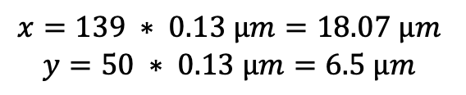
Spacing, dx
Location = Index * Spacing
$$x=139 ∗ 0.13 µm=18.07 µm$$
$$y=50 ∗ 0.13 µm=6.5 µm$$
Spacing, dy
3 dx
2 dy
$$Area = 3 dx ∗ 2 dy$$
Voxel depth, dz
Notes:
Example image: xy_8bit__nucleus_calibrated.tif

