Slide 1
Filter Convolution

Slide 2
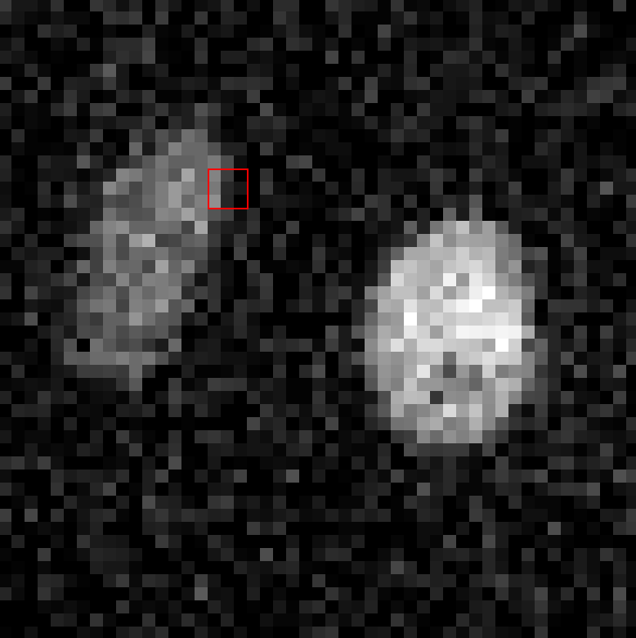
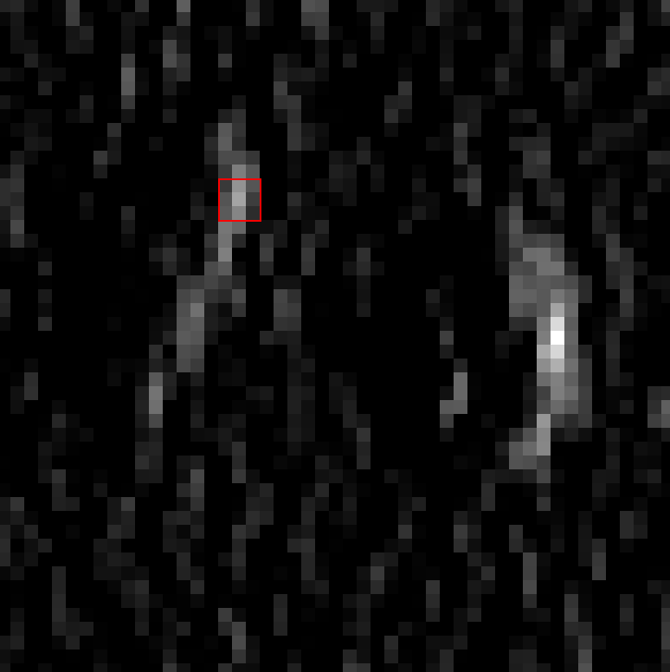
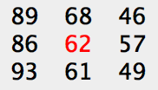
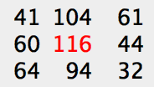
Image Processing: Convolution Filters
3x3 Kernel
+1 0 -1
+1 0 -1
+1 0 -1
+ 89 + 86 + 93
- 46 - 57 - 49
= 116
Notes:
Image Restoration is one application of so-called Image Processing

Slide 4
-1 | 0 | +1
-1 | 0 | +1
-1 | 0 | +1
-1 | -1 | -1
0 | 0 | 0
+1 | +1 | +1
TODO: Use normalised weights
1 | 1 | 1
1 | 1 | 1
1 | 1 | 1
-0.1 | 4 | 6 | 4 | 1
4 | 16 | 24 | 16 | 4
6 | 24 | 36 | 24 | 6
4 | 16 | 24 | 16 | 4
1 | 4 | 6 | 4 | 1
1 4 6 4 1
4 16 24 16 4
6 24 36 24 6
4 16 24 16 4
1 4 6 4 1
Notes:
LoG 5x5 Kernel: [[-0.1 -0.3 -0.3 -0.3 -0.1] [-0.3 -0. 0.6 -0. -0.3] [-0.3 0.6 2. 0.6 -0.3] [-0.3 -0. 0.6 -0. -0.3] [-0.1 -0.3 -0.3 -0.3 -0.1]]

Slide 5
