Slide 1
Image formation and artefacts course

Slide 2
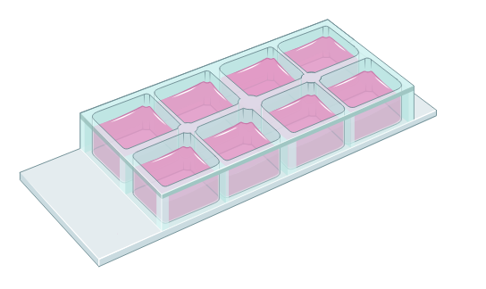
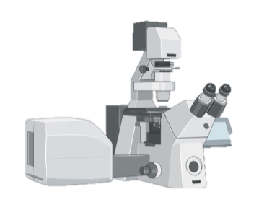

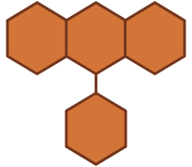

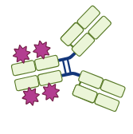



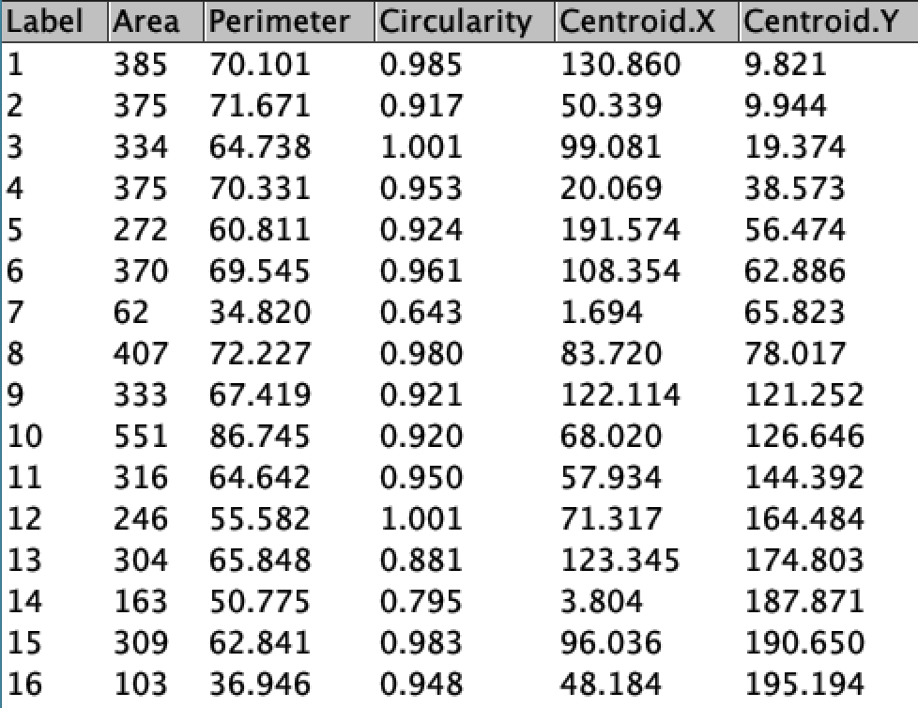
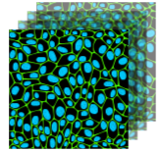
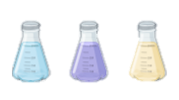


Sample preparation
Data acquisition
Data analysis
Fluorophore
Labelling
Live/Fixation/Mounting
Resolution/PSF
Sampling
Crosstalk
Aberrations
Illumination
reality
Chromatic
Astigmatic
Optimal Nyquist sampling
….
405nm
514 nm
Bright and dim areas
reality
image

