Slide 1
Stitching

Slide 2
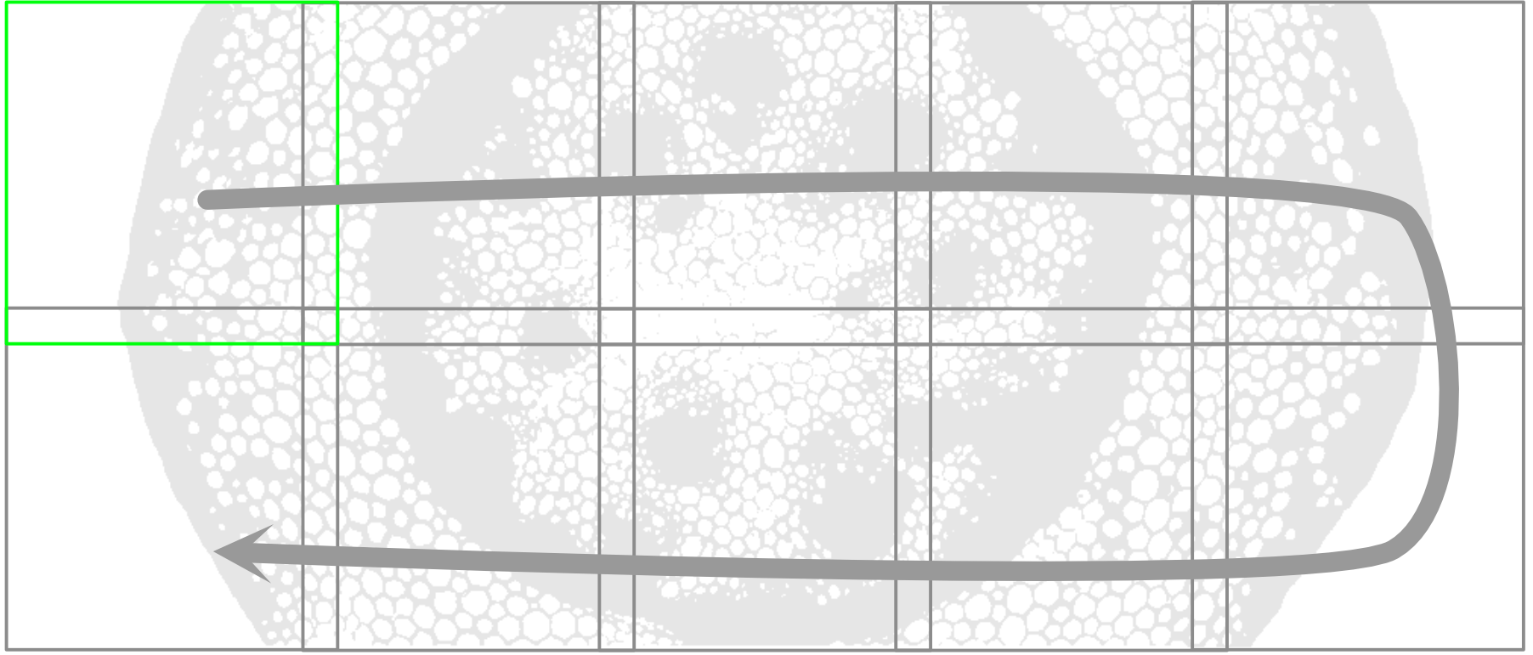
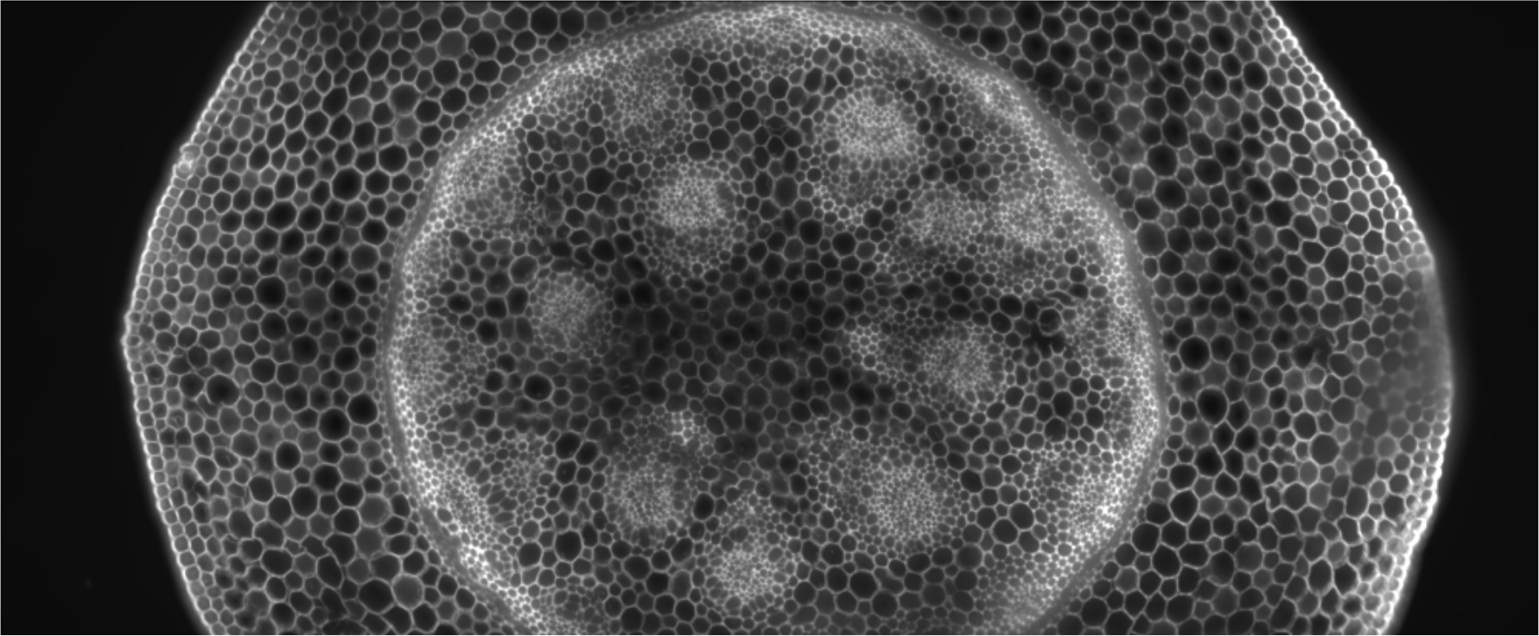
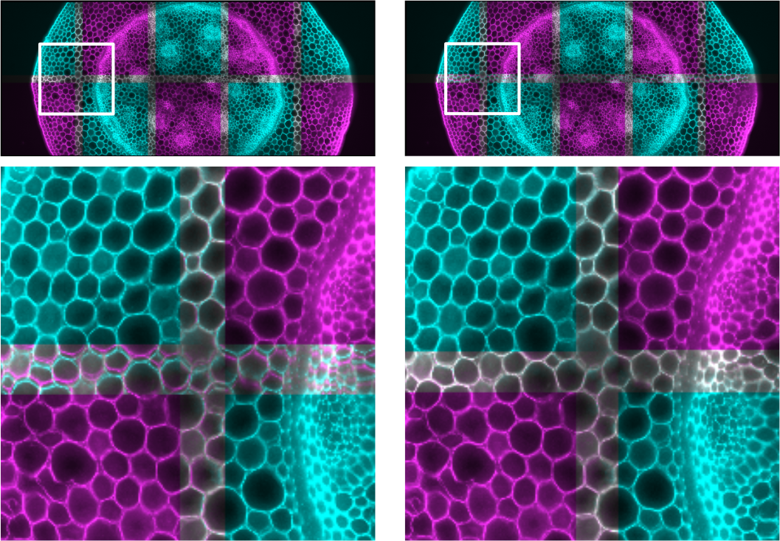
overlap
STITCHED IMAGE
{
tile
scanning direction
Blending (e.g. using projections)
image tiles
if required flat-field correction
align by position
register to refine alignment

