Slide 1
Sampling

Slide 2
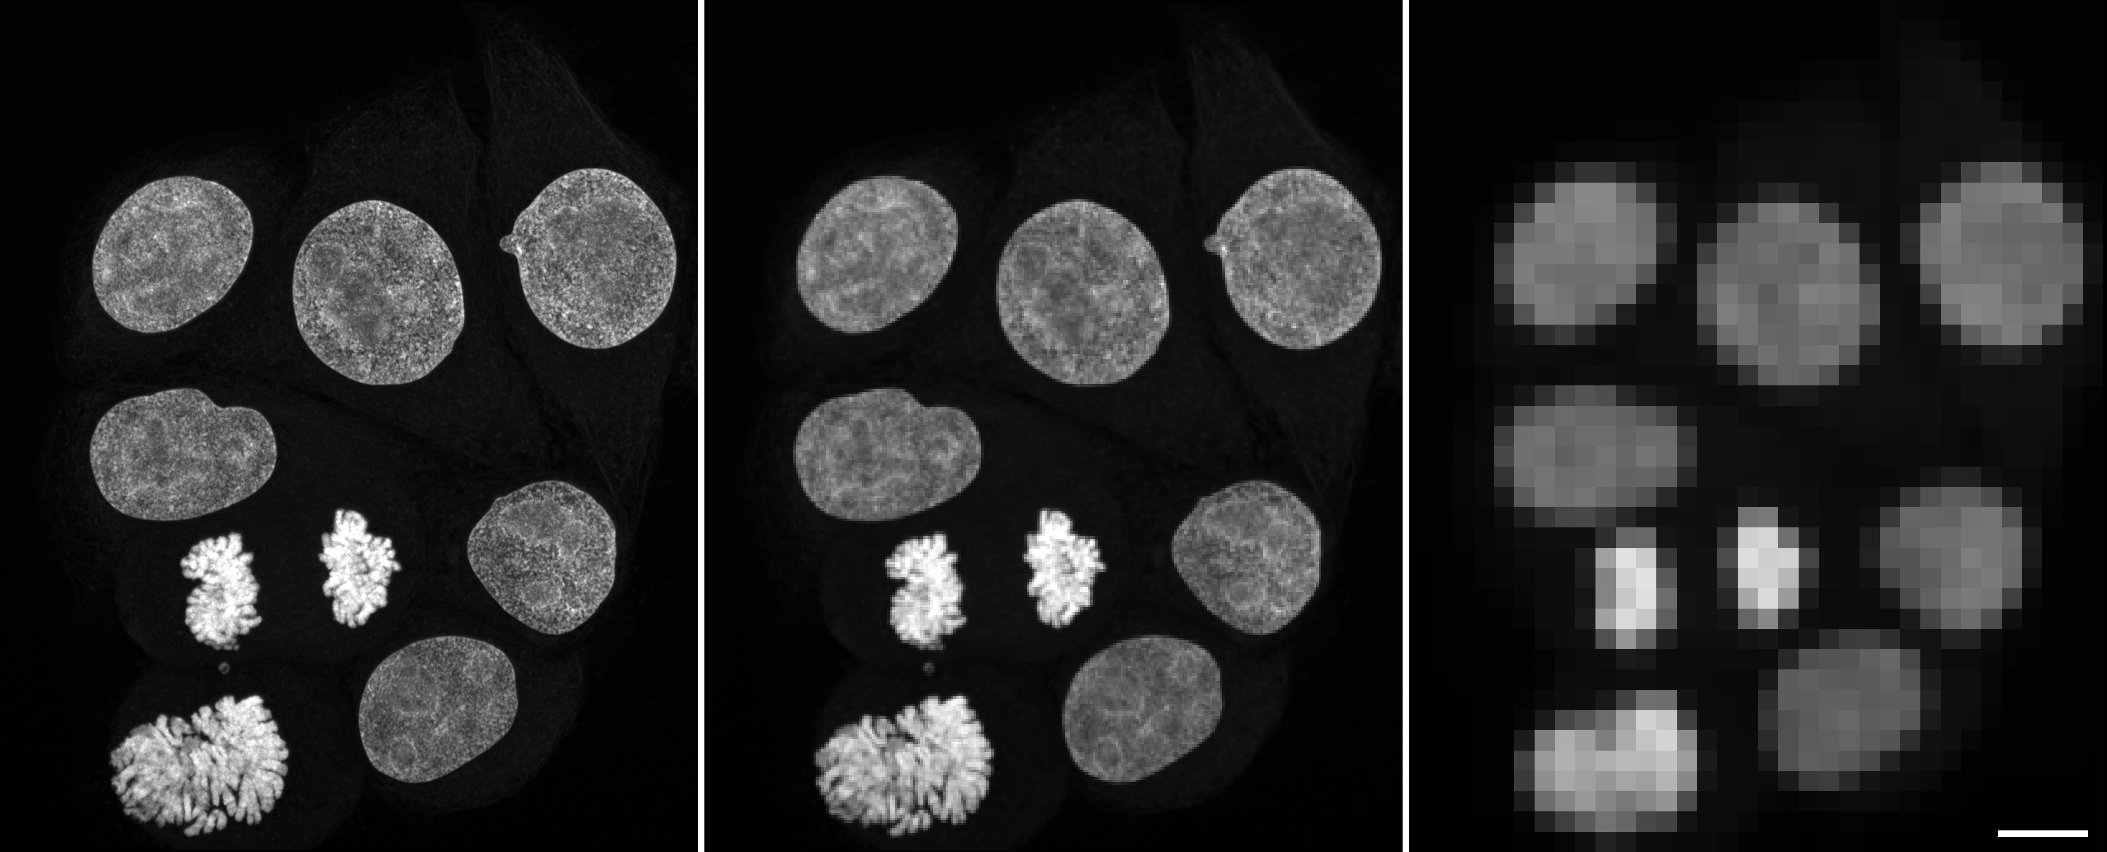

Pixelsize
Resolution
Speed
Sensitivity

Slide 3
