Slide 1
Image File Formats

Slide 2
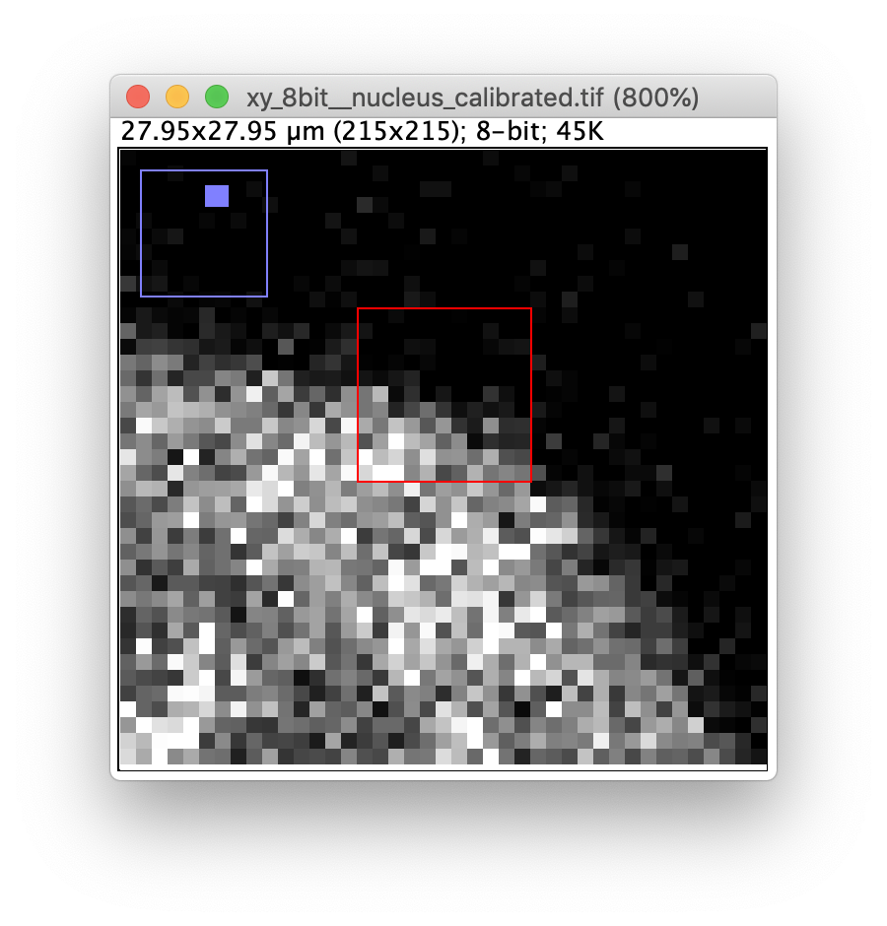
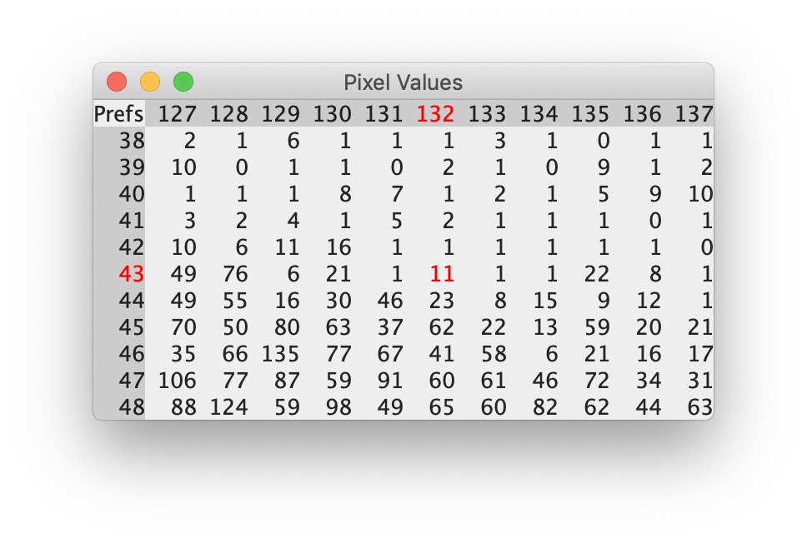
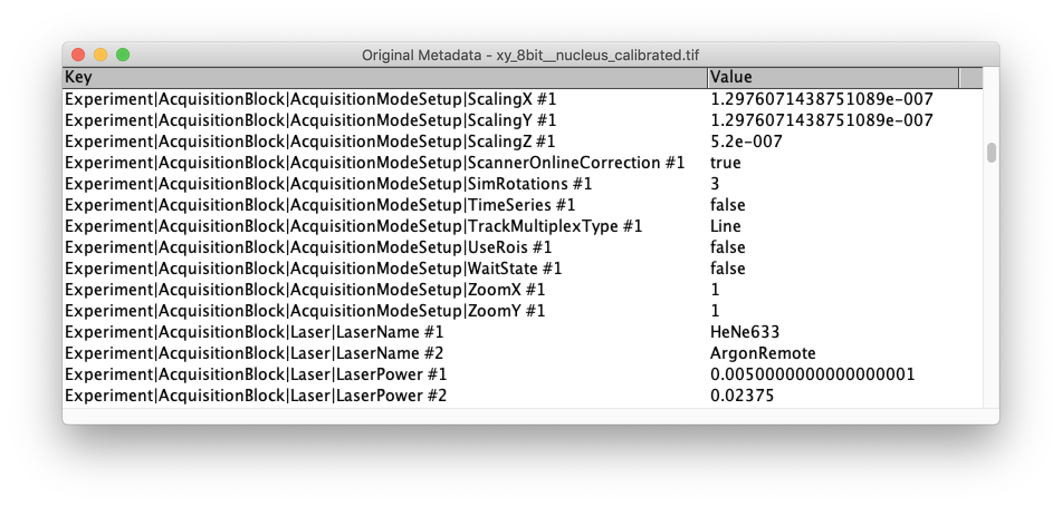

Slide 3
Metadata
Data
011100...10010100101000100000000000001000000000100010101000001010...
Pixel data start
Pixel data type (bit-depth)
Image dimensions
Compression
Pixel physical size
Microscope name
…
Width
0 | 8 | 2 | 42
10 | … | … | …
… | … | … | …
Height

