Slide 1
Connecting Claude Code to Gmail, GitHub, Notion and Linear
☕
HW3 · Working With Third Party Services
Josh Sieg (solo project) · Prof. Rosenthal · October 2026
github.com/NEW-JoshM-Sieg/JoshSieg-ServerAssignment
Notes:
This project connects Claude Code to four cloud services through official MCP connections, downloads their data into a documented local format using a reusable skill, and searches all of it from one local dashboard.

Slide 2
Three steps: connect, export, search
1
2
3
Connect
Export
Search
Claude Code talks to Gmail, GitHub, Notion and Linear through MCP, the protocol that lets an AI use a service's own tools.
A project skill downloads items into dataExports/ in one documented format, with full metadata, every time.
A local dashboard reads those files and searches one service or all four at once, labelling every result by source.
Notes:
The project runs in three stages. Each stage was done in its own Claude Code conversation, as the assignment requires.

Slide 3
Test accounts tell one story: Riverstone Coffee
New throwaway accounts for every service, filled with realistic data about a fictional Hudson Valley coffee roaster launching an online store and a limited Holiday Blend.
12
10
11
13
Gmail
GitHub
Notion
Linear
emails: 9 from "Dana", plus welcome emails
repos with READMEs and 22 issues
pages: plans, notes, directories
issues in 2 projects, with comments
Recurring people link the services: Dana Whitfield (operations), Marcus Lee (web developer), Priya Raman (designer), Tom Becker (importer), Elena Ortiz (wholesale customer). One search for "Dana Whitfield" finds emails, repos, pages and issues.
Notes:
Test data was created in a separate Claude Code conversation (Conversation A). Gmail emails were sent by hand from a second test account, because the Gmail connector can read and draft but cannot send.

Slide 4
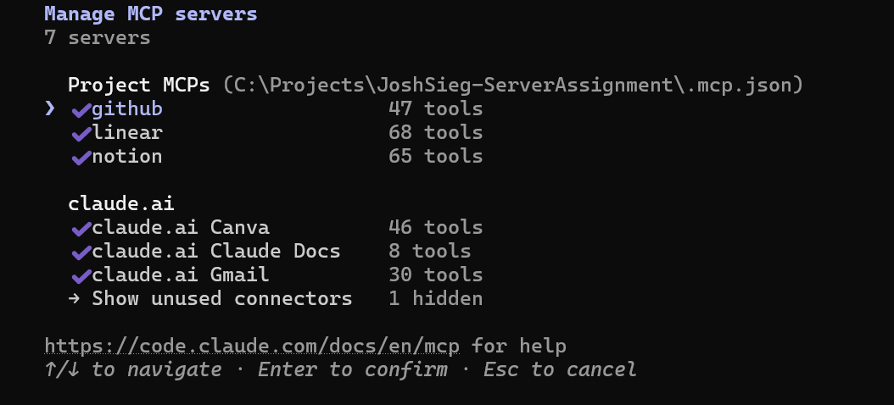
All four services connected in Claude Code
GITHUB
Official remote server by GitHub · token from an environment variable
NOTION
Official hosted server by Notion · browser sign-in (OAuth)
LINEAR
Official hosted server by Linear · browser sign-in (OAuth)
GMAIL
Anthropic's Gmail connector · Google's own server only accepts paid Workspace accounts
/mcp in Claude Code: every server shows ✓
Notes:
GitHub, Notion and Linear are configured in .mcp.json. Google's Gmail MCP server is a Developer Preview that only accepts Google Workspace accounts, so as Prof. Rosenthal suggested, Gmail uses Anthropic's own Gmail connector, which Claude Code loads from the claude.ai account.

Slide 5
A public repo with no secrets in it
✓
Tokens stay outside the repo
✓
Browser sign-in for the rest
.mcp.json only says ${GITHUB_PAT}; the token lives in a Windows environment variable.
Notion, Linear and Gmail use OAuth, so no password or key exists in any file.
✓
Security emails filtered out
✓
Only test identities
Login alerts, recovery notices and a GitHub verification code were skipped and noted in the export log.
Every account is a throwaway made for this assignment; .gitignore blocks common secret files.
Notes:
The repository is public, so security was designed in: no credentials are stored in files, and the download skill refuses to save account-security emails.

Slide 6
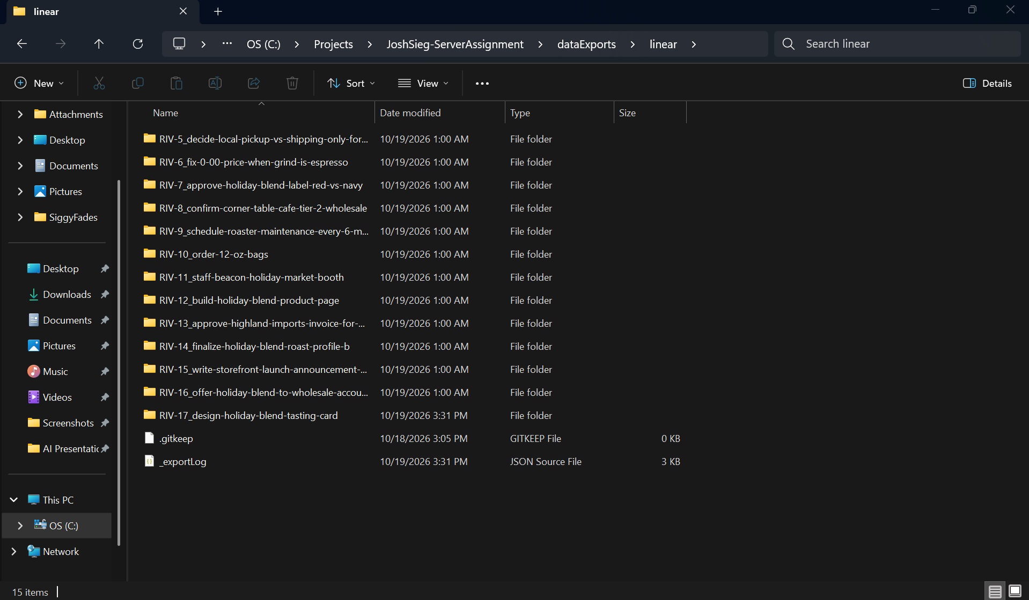
One folder per item, named so it is unique
GMAIL
received-time_sender_id/ metadata.json, body.txt, body.html
GITHUB
owner__repo/ metadata.json, README.md, issues.json, commits.json
NOTION
title-slug_id/ metadata.json, content.md
LINEAR
RIV-5_title-slug/ metadata.json, description.md, comments.json
dataExports/linear: one folder per issue, plus _exportLog.json
Notes:
Every item gets its own folder: structured metadata in metadata.json beside readable content. Folder names come from permanent IDs, so downloading an item again updates the same folder instead of creating a duplicate. The full specification is localStorageFormats.md.

Slide 7
Every item records what it is and how it got here
{
"subject": "Holiday Blend - green coffee confirmed",
"from": { "name": "Dana Whitfield", "email": "…" },
"to": [ { "email": "joshmsiegman@gmail.com" } ],
"received_at": "2026-10-19T04:08:01Z",
"labels": [ "CATEGORY_PERSONAL", "INBOX" ],
…
"_export": {
"schema_version": "1.1",
"exported_at": "2026-10-19T04:43:25Z",
"export_run_id": "2026-10-19_04-43-25_gmail",
"source_query": "Inbox, last 7 days, no security notices",
"mcp_tools_used": [ "search_threads", "get_thread" ]
}
}
Same shape every time
Missing fields are written as null, never dropped, so software can rely on them.
UTC timestamps
ISO 8601 with Z; original headers kept verbatim too.
Traceable
The _export block names the request, run, server and tools behind each file.
Notes:
A shortened metadata.json for one email. The _export block appears in every item for every service.

Slide 8
The download skill enforces the format
.claude/skills/download-service-data/SKILL.md
1
2
3
4
5
›
›
›
›
Read the spec
Fetch full items via MCP
Write a batch file
Helper saves folders
Validator checks all
node …/scripts/validate_exports.js
OK: all exports follow localStorageFormats.md
(first run: 10 Gmail · 10 GitHub · 10 Notion · 12 Linear)
Why scripts, not just instructions: the helper applies every naming rule identically, and the validator proves the result matches the documented format before anything is committed.
Notes:
CLAUDE.md tells Claude Code to use this skill for any download. The skill reads localStorageFormats.md first, so the spec is the single source of truth.

Slide 9
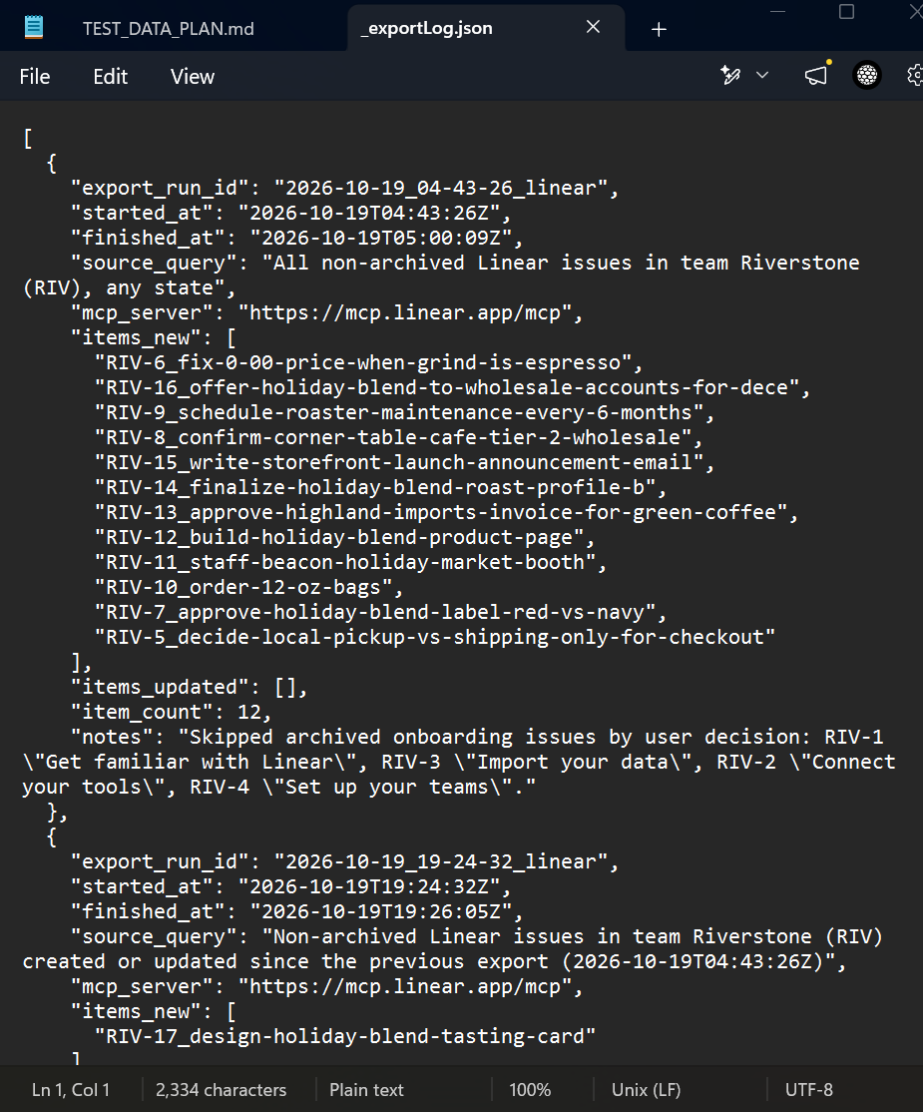
A fresh conversation reproduced the format exactly
Run 1 · Conversation B
Asked for everything; 12 Linear issues saved. Real data led to schema 1.1: Notion IDs share their first 8 characters, so names now use the last 8.
Run 2 · Conversation C (after /clear)
Prompt was only "download any new or updated data since the last export". Same format, same Gmail filter, new items in all four services.
Improved by the second run
It missed a new GitHub issue, so the skill now checks issue update times, not only code pushes.
Notes:
The export log shows two runs from two separate conversations. The second prompt never mentioned the format; the skill supplied it.

Slide 10
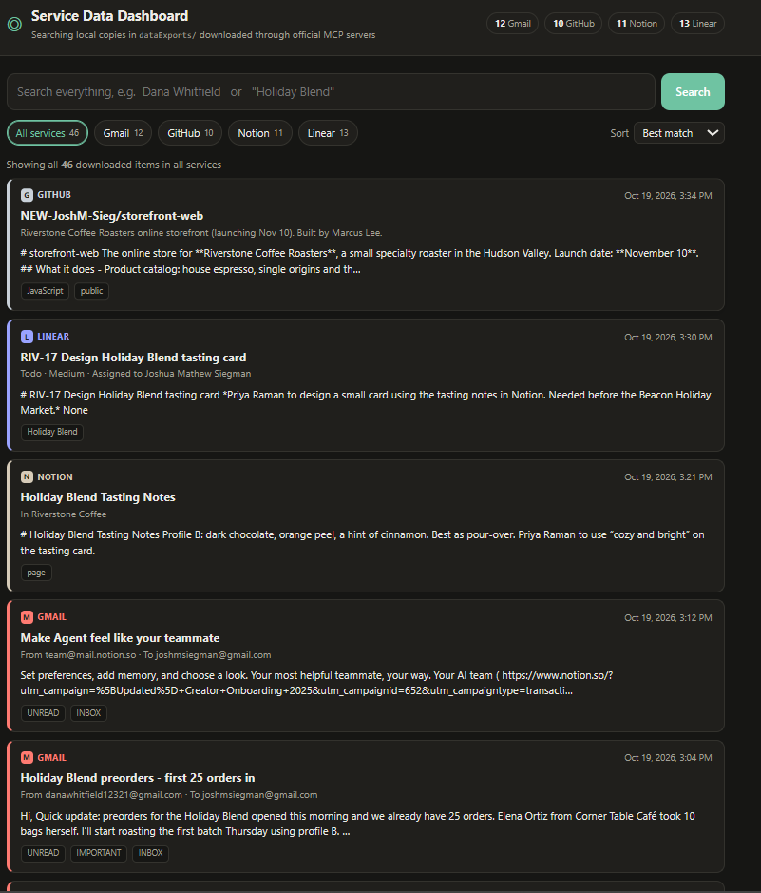
A local dashboard over all 46 downloaded items
Search everything at once
All words must match anywhere in the item; quotes for exact phrases.
Narrow by service
Chips for Gmail, GitHub, Notion and Linear show match counts.
Always labelled
Each card carries a coloured service badge; details link back to the original.
Runs locally
node dashboard/server.js, no installs; reads dataExports/ on every search.
Notes:
The dashboard is a small Node server with no dependencies. It reads the exported files directly and never contacts the services.

Slide 11
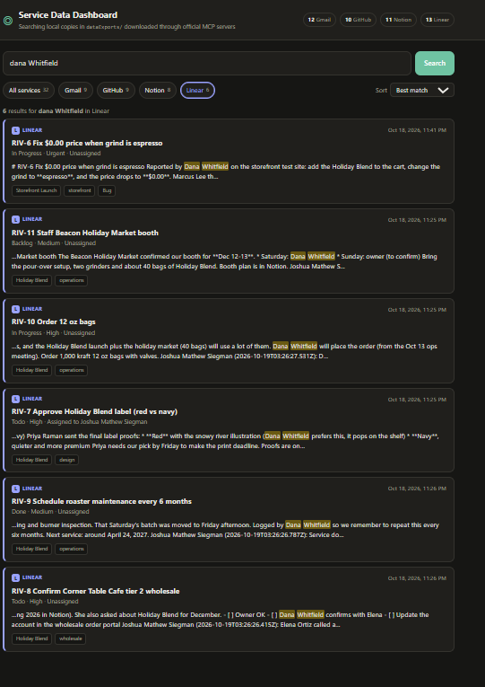
One search, every service: "Dana Whitfield"
32 matches across all four services
GMAIL
9
GITHUB
9
NOTION
8
LINEAR
6
Clicking the Linear chip narrows the same search to its 6 issues (left), with matches highlighted.
Notes:
Counts come from the chips in the dashboard for the search "Dana Whitfield".

Slide 12
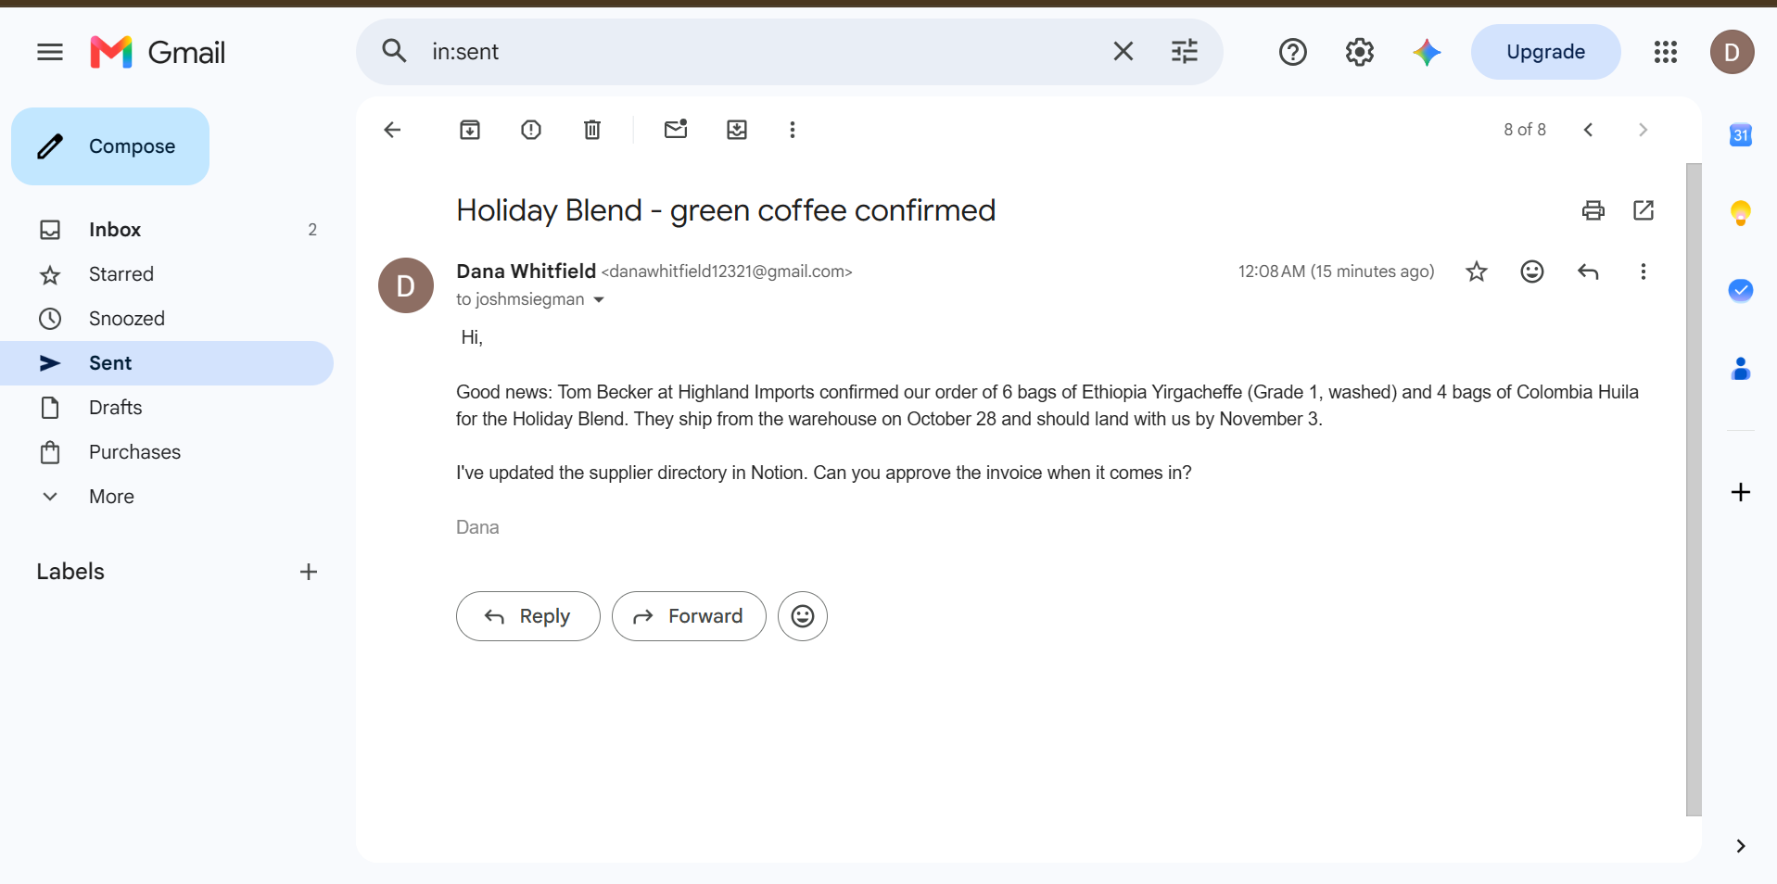
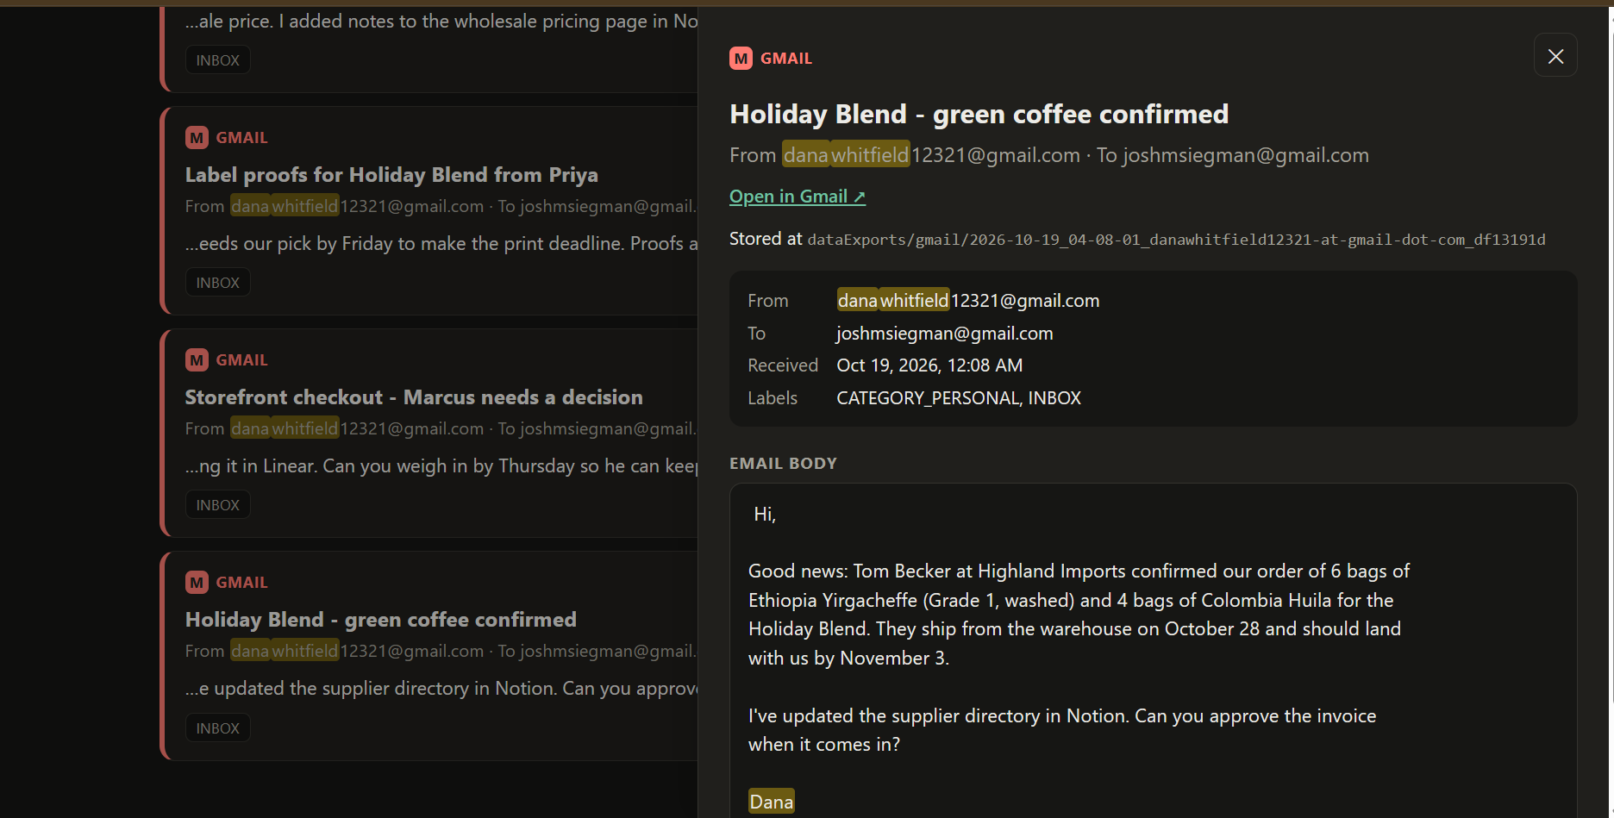
Gmail: original content and the dashboard
ORIGINAL
DASHBOARD (localhost:3000)
Gmail: "Holiday Blend - green coffee confirmed"
Same email in the dashboard, with sender, time, labels and body
Notes:
Left: the item on the Gmail website. Right: the same item after download, read from dataExports/ by the local dashboard.

Slide 13
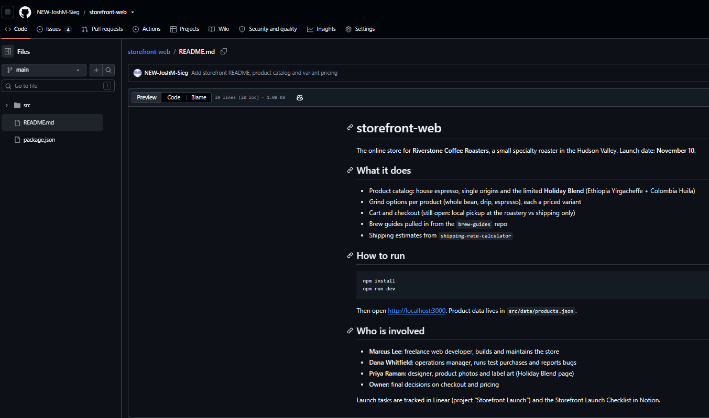
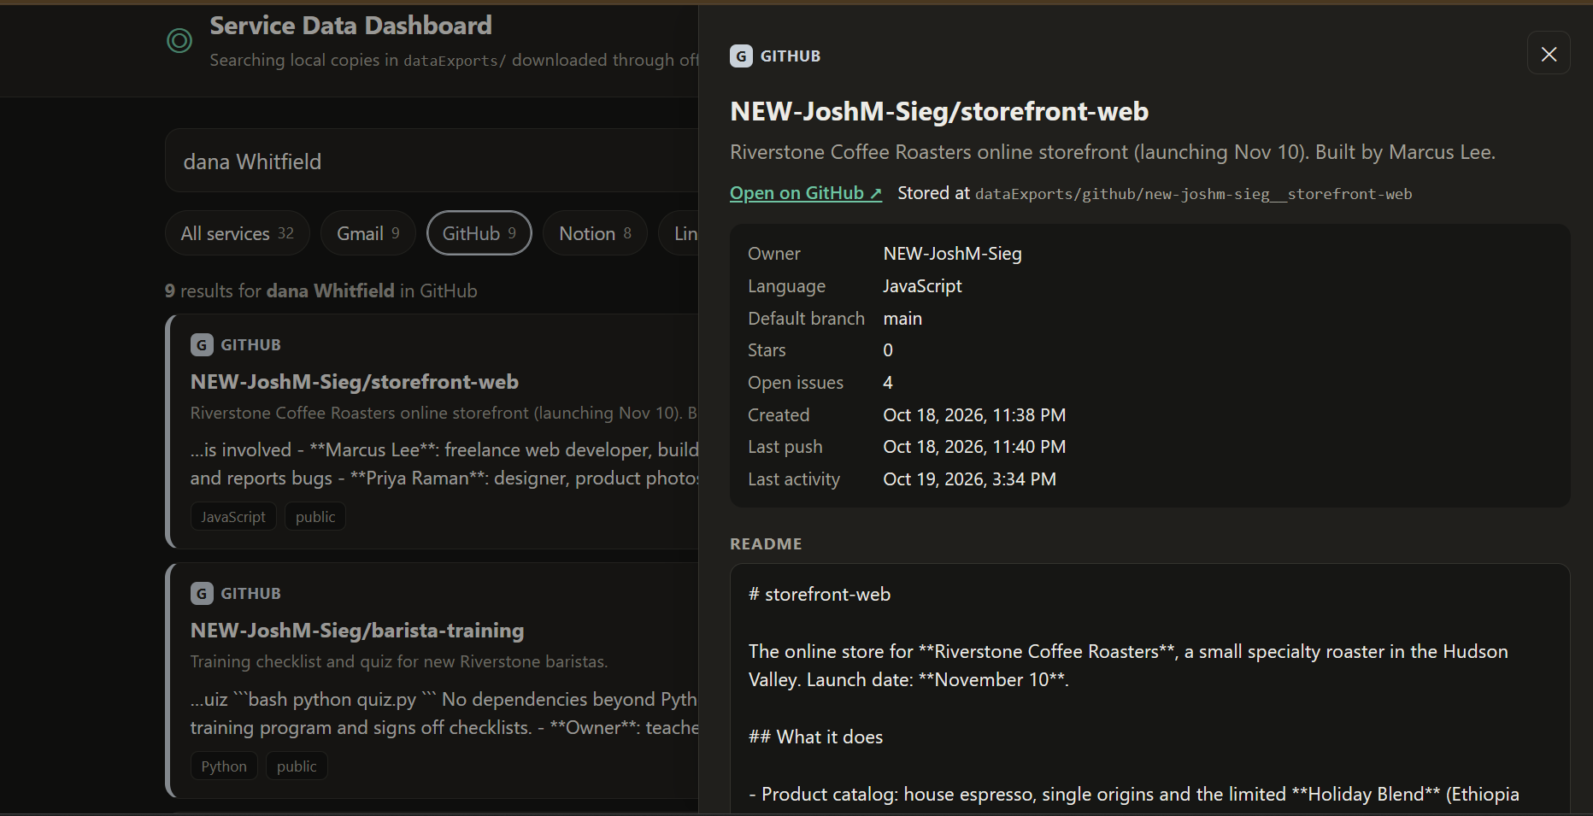
GitHub: original content and the dashboard
ORIGINAL
DASHBOARD (localhost:3000)
GitHub: storefront-web README
Same repo in the dashboard, with metadata and README
Notes:
Left: the item on the GitHub website. Right: the same item after download, read from dataExports/ by the local dashboard.

Slide 14
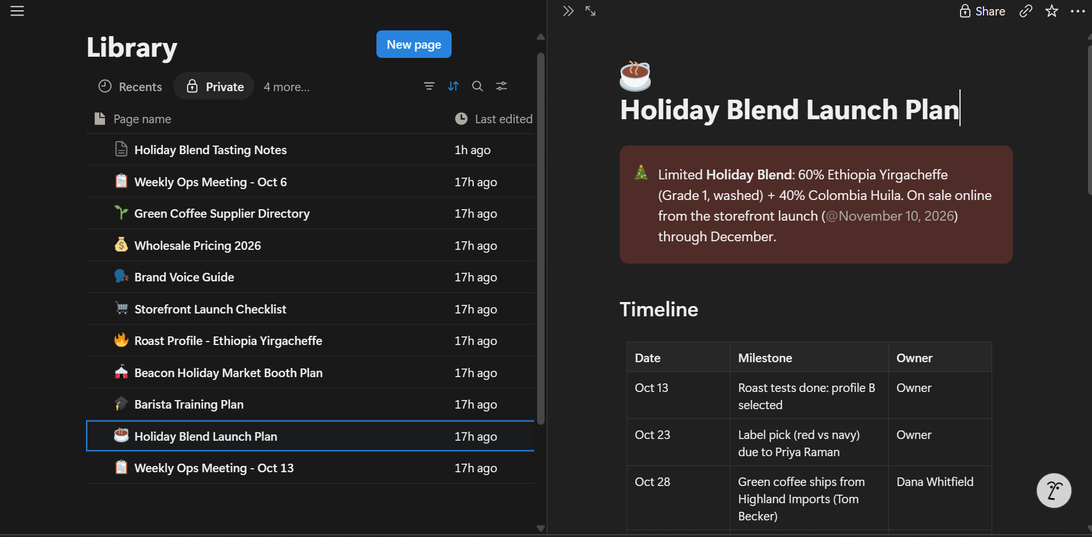
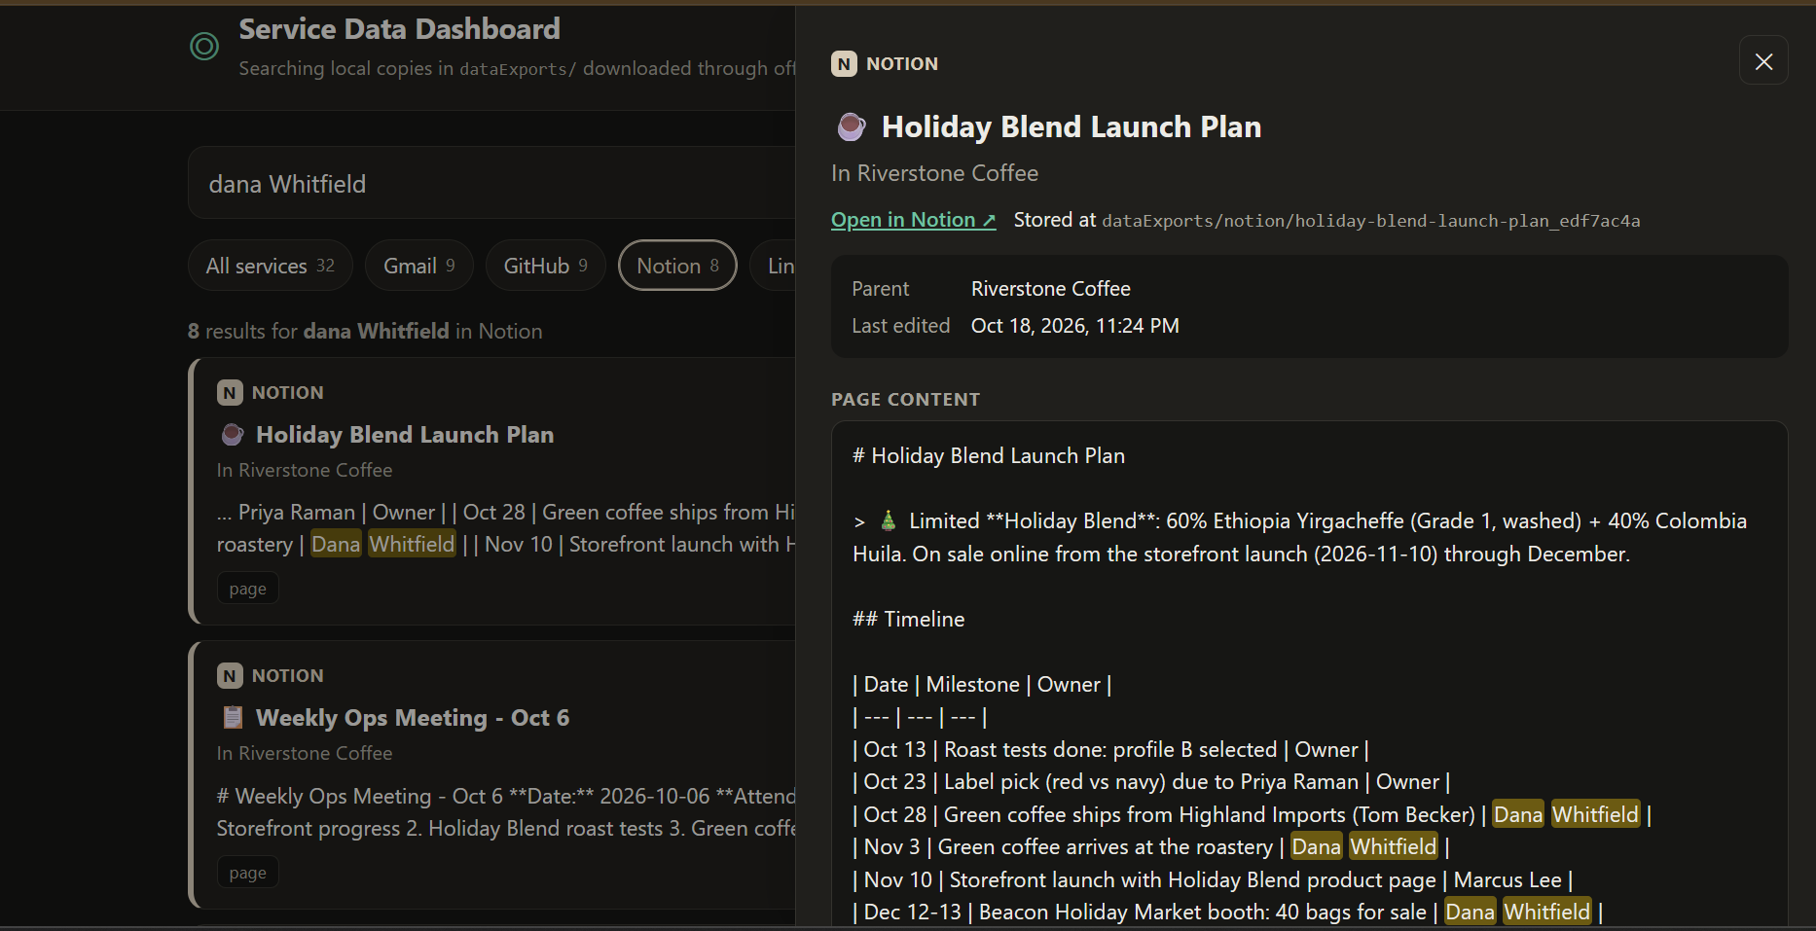
Notion: original content and the dashboard
ORIGINAL
DASHBOARD (localhost:3000)
Notion: Holiday Blend Launch Plan
Same page in the dashboard, converted to Markdown
Notes:
Left: the item on the Notion website. Right: the same item after download, read from dataExports/ by the local dashboard.

Slide 15
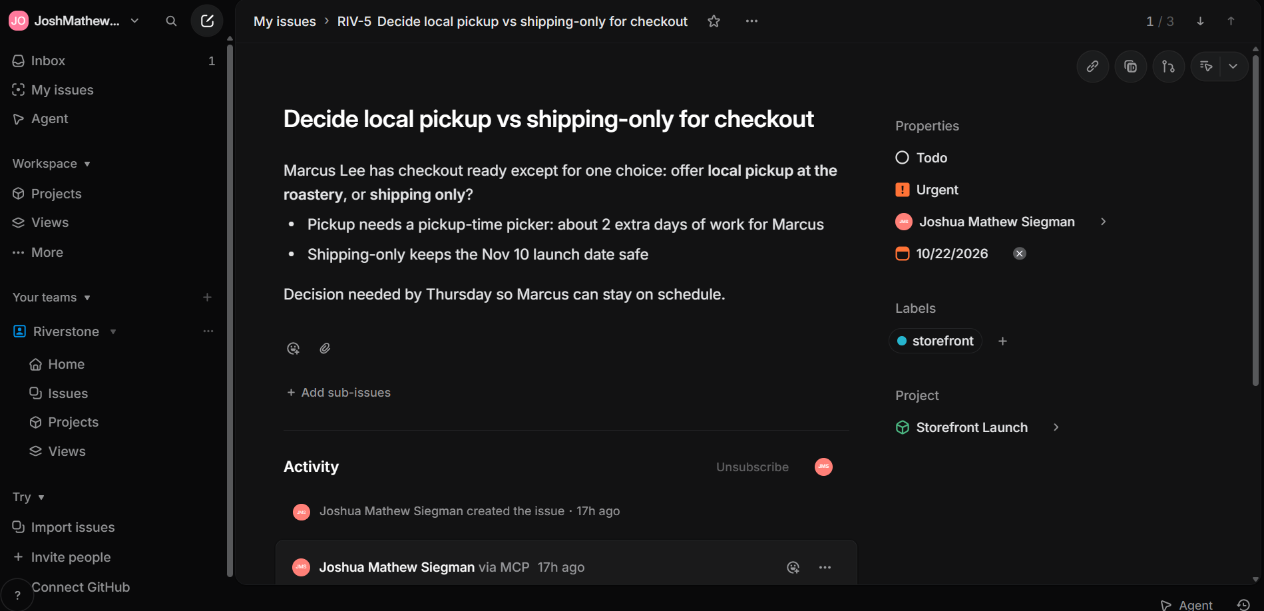
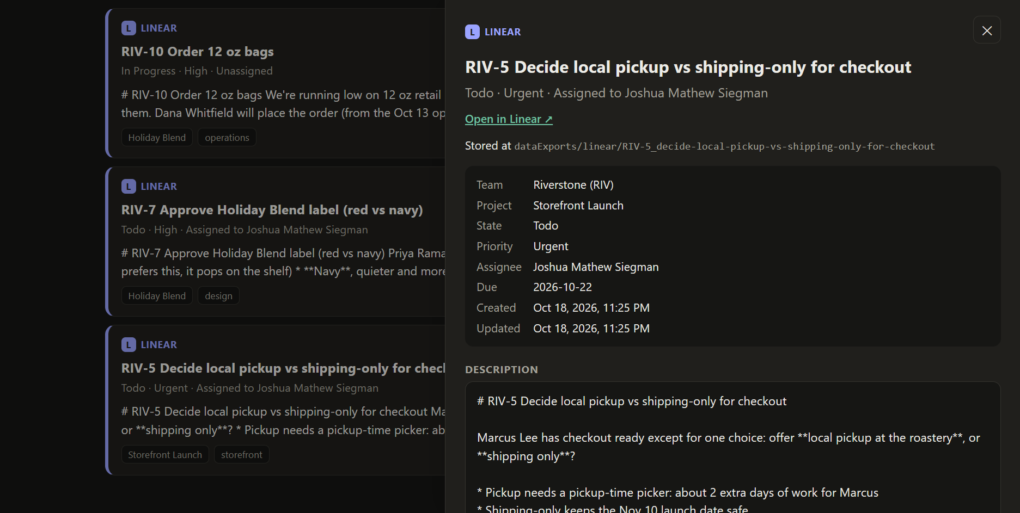
Linear: original content and the dashboard
ORIGINAL
DASHBOARD (localhost:3000)
Linear: RIV-5 pickup vs shipping decision
Same issue in the dashboard, with team, project, state and priority
Notes:
Left: the item on the Linear website. Right: the same item after download, read from dataExports/ by the local dashboard.

Slide 16
What I learned
1
"Official" can mean restricted
2
Real data tests the spec
Google's Gmail MCP server needs a paid Workspace account, so Gmail used Anthropic's connector instead.
Notion IDs and archived Linear issues forced documented changes (schema 1.1).
3
Skills need testing too
4
Public repos need privacy rules
The second run exposed a GitHub blind spot, now fixed in the skill.
Security emails and verification codes are filtered before anything is saved.
Notes:
Each of these came from a real problem during the project and is documented in the repository.

Slide 17
Try it yourself
github.com/NEW-JoshM-Sieg/JoshSieg-ServerAssignment
node dashboard/server.js → http://localhost:3000
Spec: localStorageFormats.md · Skill: .claude/skills/download-service-data
Notes:
Everything, including data, skill, MCP configuration, dashboard and documentation, is in the public repository.

