Slide 1
Agile with Scrum
Xiaoying Bai
Department of Computer Science and Technology
Tsinghua University, Beijing, China
October 11, 2014

Slide 2
Outline
Agile
Scrum
JIRA Agile
Scrum Case Study
Summary

Slide 3
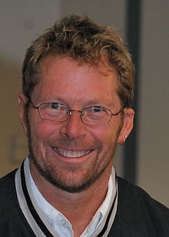
Doing Engineering….
Creating a trade-off solution
in the face of
conflicting demands.
Alistair Cockburn

Slide 4
Software Development is ……
Resource-limited
cooperative game of
invention and communication
Alistair Cockburn

Slide 5
Agile Alliance
“We are uncovering better ways of developing software by doing it and helping others do it. Through this work we have come to value:
Individual and interactions over processes and tools
Working software over comprehensive documentation
Customer collaboration over contract negotiation
Responding to change over following a plan
That is, while there is value in the items on the right, we value the items on the left more. ”
“Manifesto for Agile Software Development”,
K. Beck, et al., 2001.

Slide 6
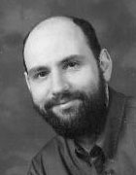
“The New Methodology” by Martin Fowler
Adaptive rather than predictive
Heavy methods tend to try to plan out a large part of the software process in great detail for a long span of time, this works well until things change. So their nature is to resist change.
The light methods, however, welcome change. They try to be processes that adapt and thrive on change, even to the point of changing themselves.
People-oriented rather than process-oriented
They explicitly make a point of trying to work with peoples' nature rather than against them and to emphasize that software development should be an enjoyable activity.

Slide 7
Agile Principles
Our highest priority is to satisfy the customer through early and continuous delivery of valuable software.
Welcome changing requirements, even late in development. Agile processes harness change for the customer’s competitive advantage.
Deliver working software frequently, from a couple of weeks to a couple of months, with a preference to the shorter timescale.
Notes:
Individual
Team
Continuous delivery

Slide 8
Agile Principles
Business people and developers must work together daily throughout the project.
Build projects around motivated individuals. Give them the environment and support they need, and trust them to get the job done.
The most efficient and effective method of conveying information to and within a development team is face-to-face conversation.

Slide 9
Agile Principles
Working software is the primary measure of progress.
Agile processes promote sustainable development. The sponsors, developers, and users should be able to maintain a constant pace indefinitely.
Continuous attention to technical excellence and good design enhances agility.

Slide 10
Agile Principles
Simplicity – the art of maximizing the amount of work not done – is essential.
The best architectures, requirements, and design emerge from self-organizing teams.
At regular intervals, the team reflects on how to become more effective, then tunes and adjusts its behavior accordingly.

Slide 11
Agile Methods
Agile methods:
Scrum
Extreme Programming
Adaptive Software Development (ASD)
Dynamic System Development Method (DSDM)
…
Agile Alliance
A non-profit organization promotes agile development

Slide 12
Scrum - an agile process
SCRUM is an agile, lightweight process for managing and controlling software and product development in rapidly changing environments.
Iterative, incremental process
Team-based approach
developing systems/ products with rapidly changing requirements
Controls the chaos of conflicting interest and needs
Improve communication and maximize cooperation
Protecting the team form disruptions and impediments
A way to maximize productivity

Slide 13
History of Scrum
1995:
analysis of common software development processes → not suitable for empirical, unpredictable and non-repeatable processes
Design of a new method: Scrum by Jeff Sutherland & Ken Schwaber
Enhancement of Scrum by Mike Beedle & combination of Scrum with Extreme Programming
1996:
introduction of Scrum at OOPSLA conference workshop
2001:
publication “Agile Software Development with Scrum” by
Ken Schwaber & Mike Beedle
Successful appliance of Scrum in over 50 companies
Founders are members in the Agile Alliance
Notes:
Successful = increase in productivity, satisfied/ happy team

Slide 14
Scrum Framework
Roles
Process
Artifacts
Product Manager
Sprint planning
Product backlog
ScrumMaster
Sprint review
Sprint backlog
Team
Sprint retrospective
Burndown charts
Daily scrum meeting

Slide 15
The Roles
Product Owner who represents the stakeholders
Ensure that the Scrum Team works with the right things from a business perspective
Scrum Master who maintains the processes and works similar to a project manager
Scrum Team which includes the developers
Self-organized and the members have joint responsibility for the results

Slide 16
Scrum Overview
Creating a
backlog
The Sprint Phase
Daily Scrum
Product
Backlog
Sprint
Backlog
Sprint
Working increment
Of the software

Slide 17
Product
Owner
Scrum Master
Scrum
Team
Transfer the highest prioritized goals to a Sprint Backlog
Daily Scrum
Maintain
Product
Blacklog
Burn-down chart
A
Sprint
Demo and Evaluation
Sprint Retrospective
Transfer the highest prioritized goals to a Sprint Backlog
Other
Sprints

Slide 18
Product Backlog
The requirements
A list of all desired work on the project
Ideally expressed such that each item has value to the users or customers of the product
Prioritized by the product owner
Reprioritized at the start of each sprint
The functionality and prioritization may change over time

Slide 19
Product Backlog Example
Backlog Item | Estimate
Allow a guest to make a reservation | 3
As a guest, I want to cancel a reservation | 5
As a guest, I want to change the dates of a reservation. | 3
As a hotel employee, I can run RevPAR reports (vevenue-per-available-room) | 8
Improve exception handling | 8
….. | ….

Slide 20
A Scrum Sprint
Sprint Planning
Commit to certain functionality & estimate
Produces Sprint Backlog
Daily Scrum
15 minutes @ start of day
What have you done since last Scrum?
What will do before next Scrum?
What obstacles?
Notes:
Daily scrum helps bring the team together and holds each member accountable to the rest of the team – builds on sense of collective ownership. Reveals problems that can be solved together and keeps team members from waiting on each other.

Slide 21
A Scrum Sprint
Sprint
Team does the work!
Sprint Review
Show off completed functionality
Sprint Retrospective
What went well during the Sprint?
What could be improved for the next?
Notes:
Sprint: team members have responsibilities: attend Daily Scrum, keep work updated in Sprint Backlog, communicate!
Sprint Review: informal demo, whole team participates, afterwards Product Owner determines whether or not to deploy new functionality

Slide 22
Sprint Goal
A Short statement of what the work will be focused on during the sprint.
Sprint 7
Sprint 8
Implement basic shopping cart functionality including add, remove, and update
The checkout process – pay for an order, pick shipping, order gift wrapping, etc.

Slide 23
Sprint Backlog
Individuals sign up for work of their own choosing
Estimated work remaining is updated daily
Any team member can add, delete or change the sprint backlog
Work for the sprint emerges
If work is unclear, define a sprint backlog item with a larger amount of time and break it down later
Update work remaining as more becomes unkown

Slide 24
Sprint Backlog Example
Tasks | Mon | Tue | Wed | Thur | Fri
Code the user interface | 8 | 4 | 8
Code the middle tier | 16 | 12 | 10 | 4
Test the middle tier | 8 | 16 | 16 | 11 | 8
Write online help | 12
Write the foo class | 8 | 8 | 8 | 8 | 8
Add error logging |  |  | 8 | 4

Slide 25
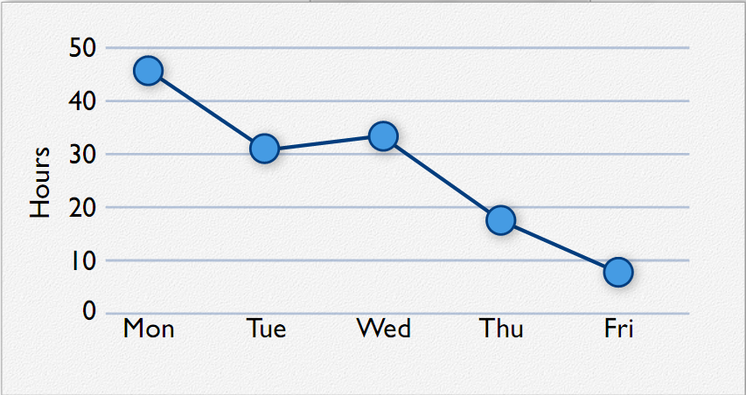
Sprint Burndown Chart
A burn-down chart is used to mark day-by-day how much work that is left

Slide 26
Demo and Evaluation
The Sprint ends with a demonstration during which functioning software is run before a larger group
This is the basis for a Evaluation Meeting that in tern is the starting block for the next Sprint

Slide 27
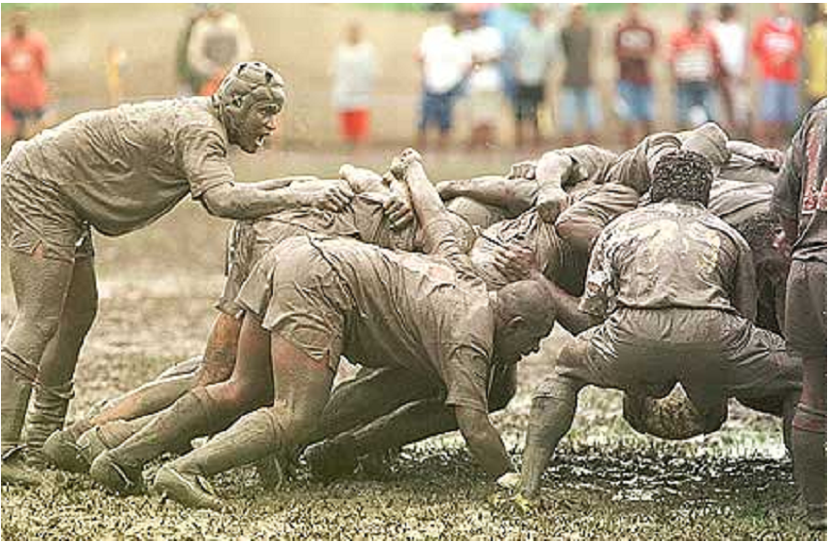
Where does the word Scrum come from?
Scrum is a rugy term for the close-knit shoulder-to-shoulder formation a rugby team forms to jointly move the ball forward.

Slide 28
Outline
Agile
Scrum
JIRA Agile
Scrum Case Study
Summary

Slide 29
JIRA Agile – A process support tool
Do not put the Product Backlog into JIRA
The product owner keep it personally
Using a Project in JIRA, add the Sprint Backlog as prioritized tasks
Board
Sprint
Epic
Version
Issues
Issues
Issues

Slide 30
System
Admin
Project
Lead
Team
Member
Create Project
Assign Project Lead
And Team members
Plan
Mode
3. Planning
4. Start Sprint
Work
Mode
5. Deal with issues
5. Deal with issues
Report
Mode
6. Reporting
6. Reporting

Slide 31
Basic Concepts
Board
A board displays issues from one or more projects, giving a flexible way of viewing, managing and reporting on work in progress.
Issue
An issue typically represents a user story.
An issue could be: New Feature, Task, Improvement, Bug, Epic, Story
Sprint
A Sprint – also known as an iteration – is a short period in which the development team implements and delivers a working milestone version.
Go to the Plan Mode to prioritize the issues in the backlog and allocate them to the sprints.

Slide 32
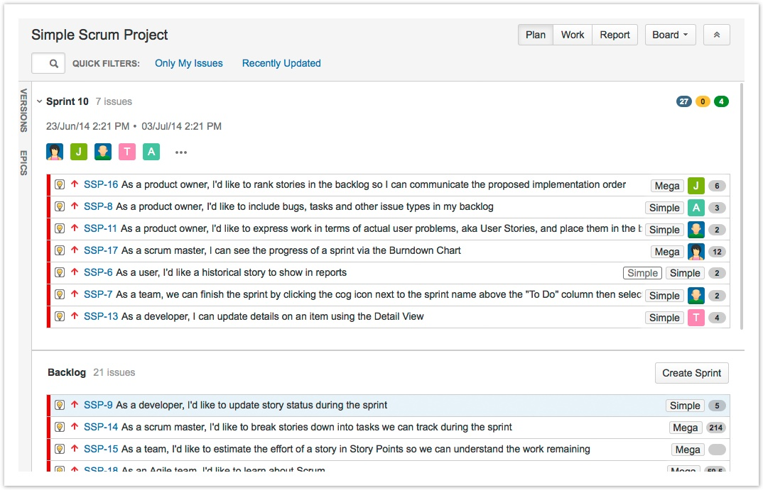

Slide 33
Basic Concepts
Epic
An epic captures a large body of work.
It is essentially a large user story that can be broken down into a number of smaller stories.
It may take several sprints to complete an epic.

Slide 34
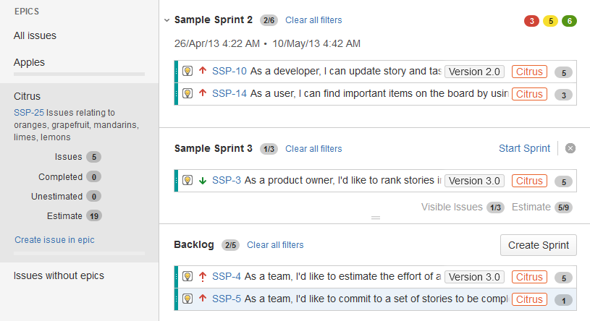

Slide 35
Basic Concepts
Version
A version is a set of features and fixes released together as a single update to your product.
Assigning issues to versions help you plan the order in which new features (stories) for your product will be released to your customers.
A version may span multiple sprints.

Slide 36
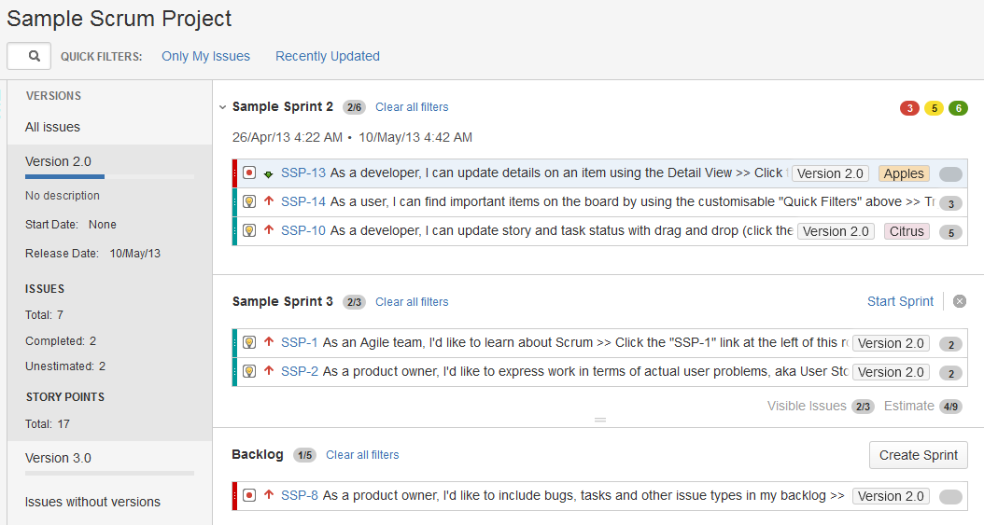

Slide 37
Plan Mode
Prioritize the Backlog
Estimate stories
Create Sub-Tasks
Create new issues
Organize via Epics
Identify the workload for specialists
Plan versions
Start the sprint

Slide 38
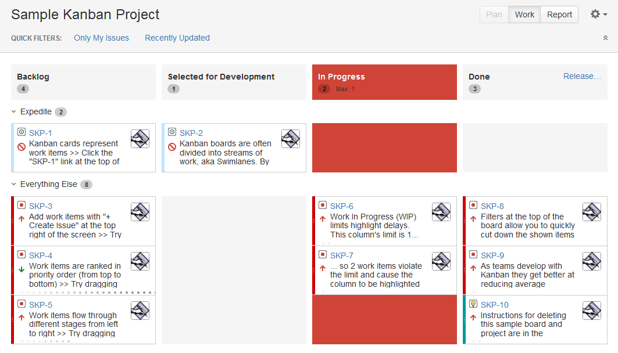
Work Mode
Transition the issues through a series of statuses.

Slide 39
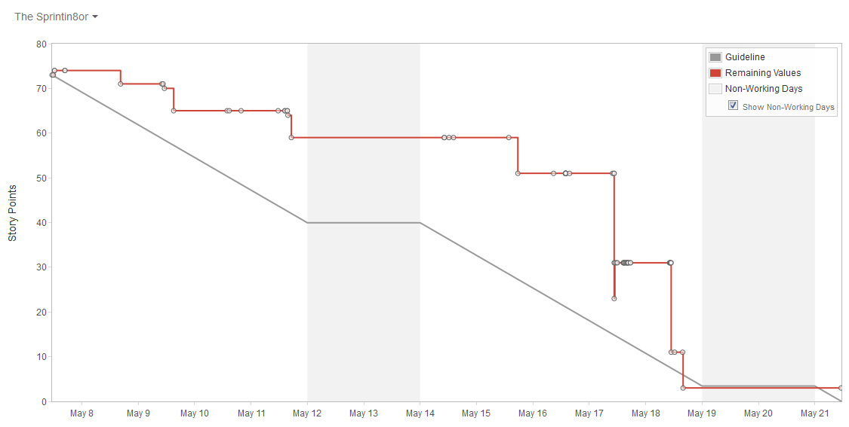
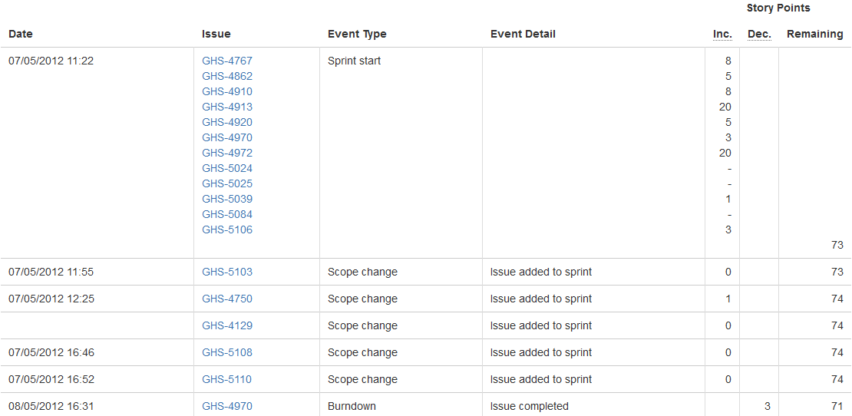
Report Mode – Burndown Chart
The amount of work remaining

Slide 40
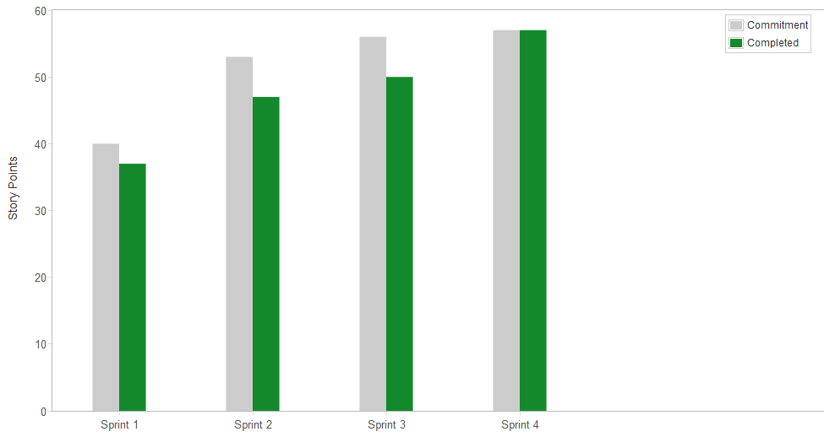
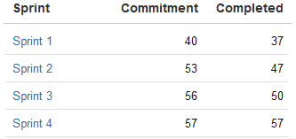
Report Mode – Velocity Chart
velocity = (37 + 47 + 50 +57) / 4 = 48

Slide 41
Connect to Stash
System
Admin
Project
Lead
Team Member
Create
Agile Project
2. Create
Stash Project
3. Link Agile Project
To Stash Project
3. Link Issues to
Development branches
3. Link Issues to
Development
branches

Slide 42
Scrum Case Study: NCSU Libraries

Slide 43
NCSU Toolbox
Product & Sprint backlog: JIRA
Requirements: Confluence + JIRA
Sprint planning: Google docs + JIRA
Daily Scrum
Sprint demo: Product Team meetings
Sprint retrospective
Notes:
What are some of the specific tools from the Agile / Scrum toolbox that we use?

Slide 44
Iteration done simply
6 week iteration
1 week planning
4 weeks development
Re-align as necessary
1 week testing / release
Notes:
In iteration done simply at NCSU Libraries, one cycle is a 6 week iteration that generally goes plan -> do -> align -> test -> Release. Just because follow that order, doesn’t mean that we only do things in that order though; focus on planning at the outset but continue to plan as needed throughout the cycle, focus on clearing testing at the end but make every effort to test as we go.
In particular, the week focused on planning and testing at the beginning and the end helps give us a buffer when estimating how much work we can complete so that we can handle support emergencies that come up.

Slide 45
Sprint Planning
Use 1 week to plan across multiple projects
Day 1
High level overview of upcoming projects out 3 – 6 months
Prioritize projects for the next iteration based on IT staff input
Notes:
One of the more challenging aspects of trying to work in the Scrum mindset has been planning work for a given cycle. As I’ll mention when discussing challenges, this is because we work across multiple projects within a given sprint, each of which has its own product owners, and functionality which might not yet have been fleshed out well enough to estimate.

Slide 46
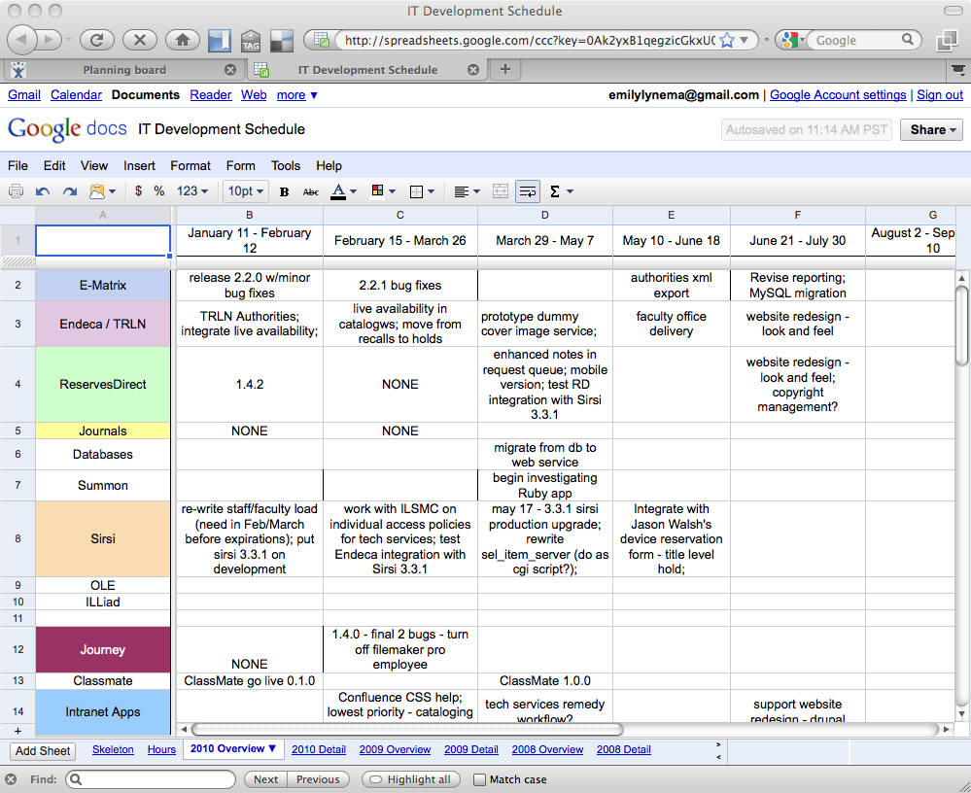

Slide 47
Sprint Planning
Days 2 – 5
Meet with product owners for each prioritized project
All team members who will be participating
Outline work
Prioritize work
Collaboratively estimate work

Slide 48
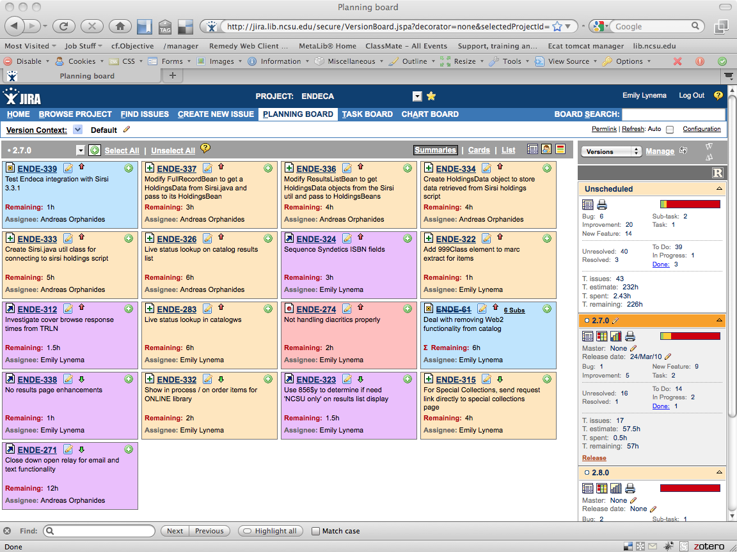
Notes:
Outcome is a set of fully estimated tasks in JIRA for a given release. We use a release in JIRA to represent the work that will be accomplished in a given iteration. This is essentially our sprint backlog. Our product backlog is the ‘Unscheduled’ set of tasks in JIRA. We sometimes use future release designations to help give high level relative priorities to the future work.

Slide 49
Sprint Planning
Day 6
Re-prioritize based on estimates & time available
Scope down at project or work level

Slide 50
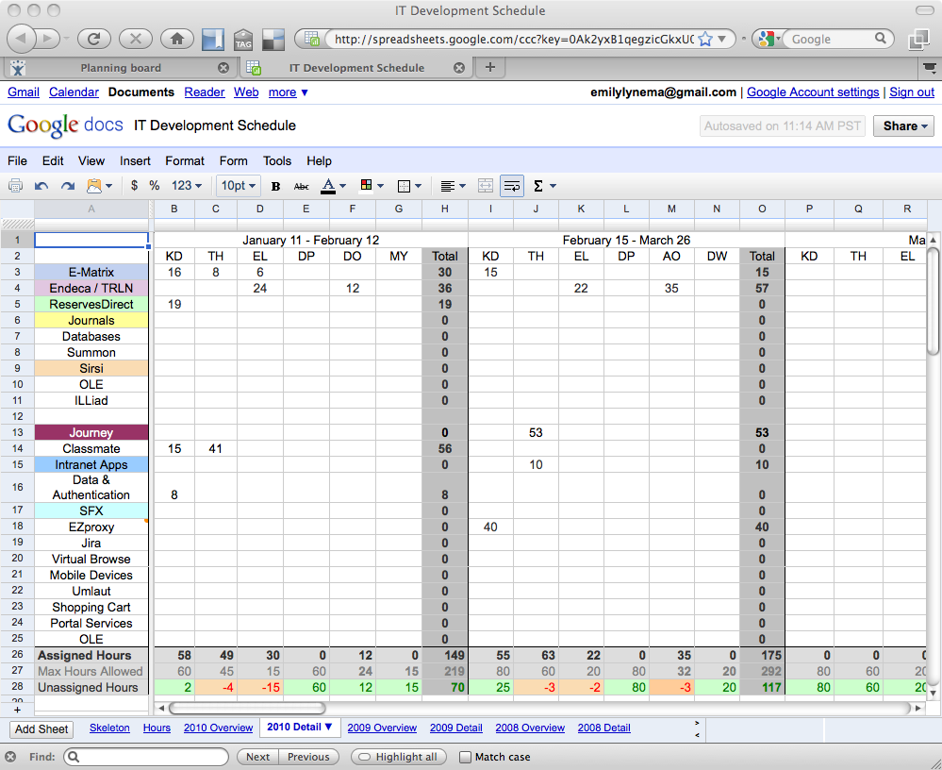

Slide 51
Development
Get it done
Daily scrum 10 – 15 minutes
Identify obstacles and priorities
Emphasize collaboration
Weekly review
How does progress look for cycle?
Requires estimation and work logging
Subversion -> JIRA integration
Notes:
Weekly review – a non-SCRUM approach to handle changing requirements and other external support factors while still being able to complete *something* at end of sprint.

Slide 52
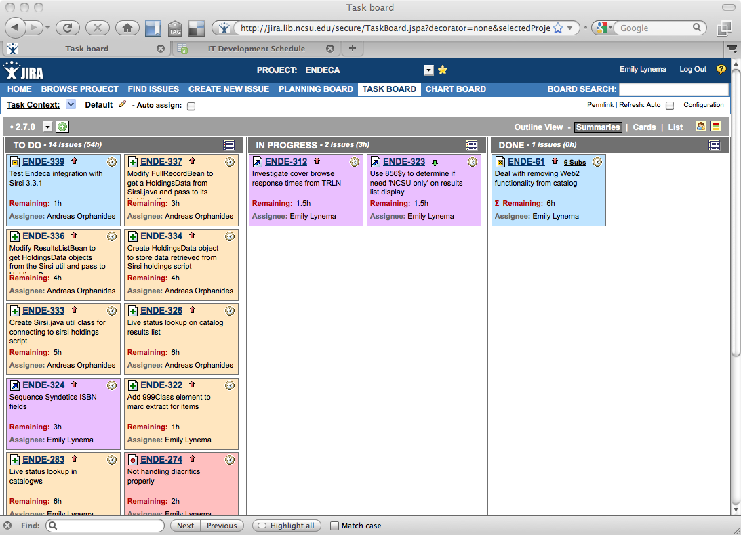
Notes:
JIRA taskboard where we spend our time. Shows tickets unstarted, in progress, completed, and visually see where the balance of work remains.

Slide 53
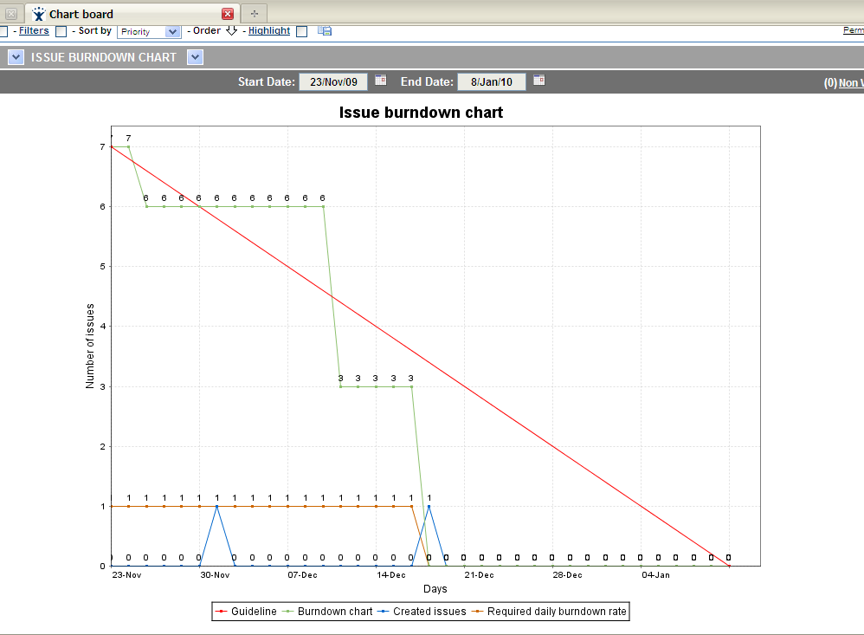
Notes:
Burn-down chart – shows amount of work remaining over time and velocity towards goal – must have both estimates and time remaining for this to be helpful

Slide 54
References
Mike Cohn, Getting Agile with Scrum.
Emily Lynema, Iterative Development: Done Simple, NCSU Libraries.
Agile tutorials, http:// www.mountaingoatsoftware.com.
Atlanssian manual, https://confluence.atlassian.com/display/AGILE/

Slide 55
More Reading
Schwaber, Ken. Agile project management with Scrum. Vol. 7. Redmond: Microsoft press, 2004.
Highsmith, Jim, and Alistair Cockburn. "Agile software development: The business of innovation." Computer 34.9 (2001): 120-127.
Schwaber, Ken. "Scrum development process." Business Object Design and Implementation. Springer London, 1997. 117-134.
Fowler, Martin, and Jim Highsmith. "The agile manifesto." Software Development 9.8 (2001): 28-35.
Agile Software Development, CrossTalk, October 2002.

Slide 56

Thank you!
Xiaoying Bai
Ph.D, Associate Professor
Dept. DS&T, INLIST
Tsinghua University
Beijing, China, 100084
Phone: 86-10-62794935
Email: baixy@tsinghua.edu.cn

