Slide 1
Golf Cart bring-up progress
National Taiwan University
Autoware LSV meeting, August 2026

Slide 2
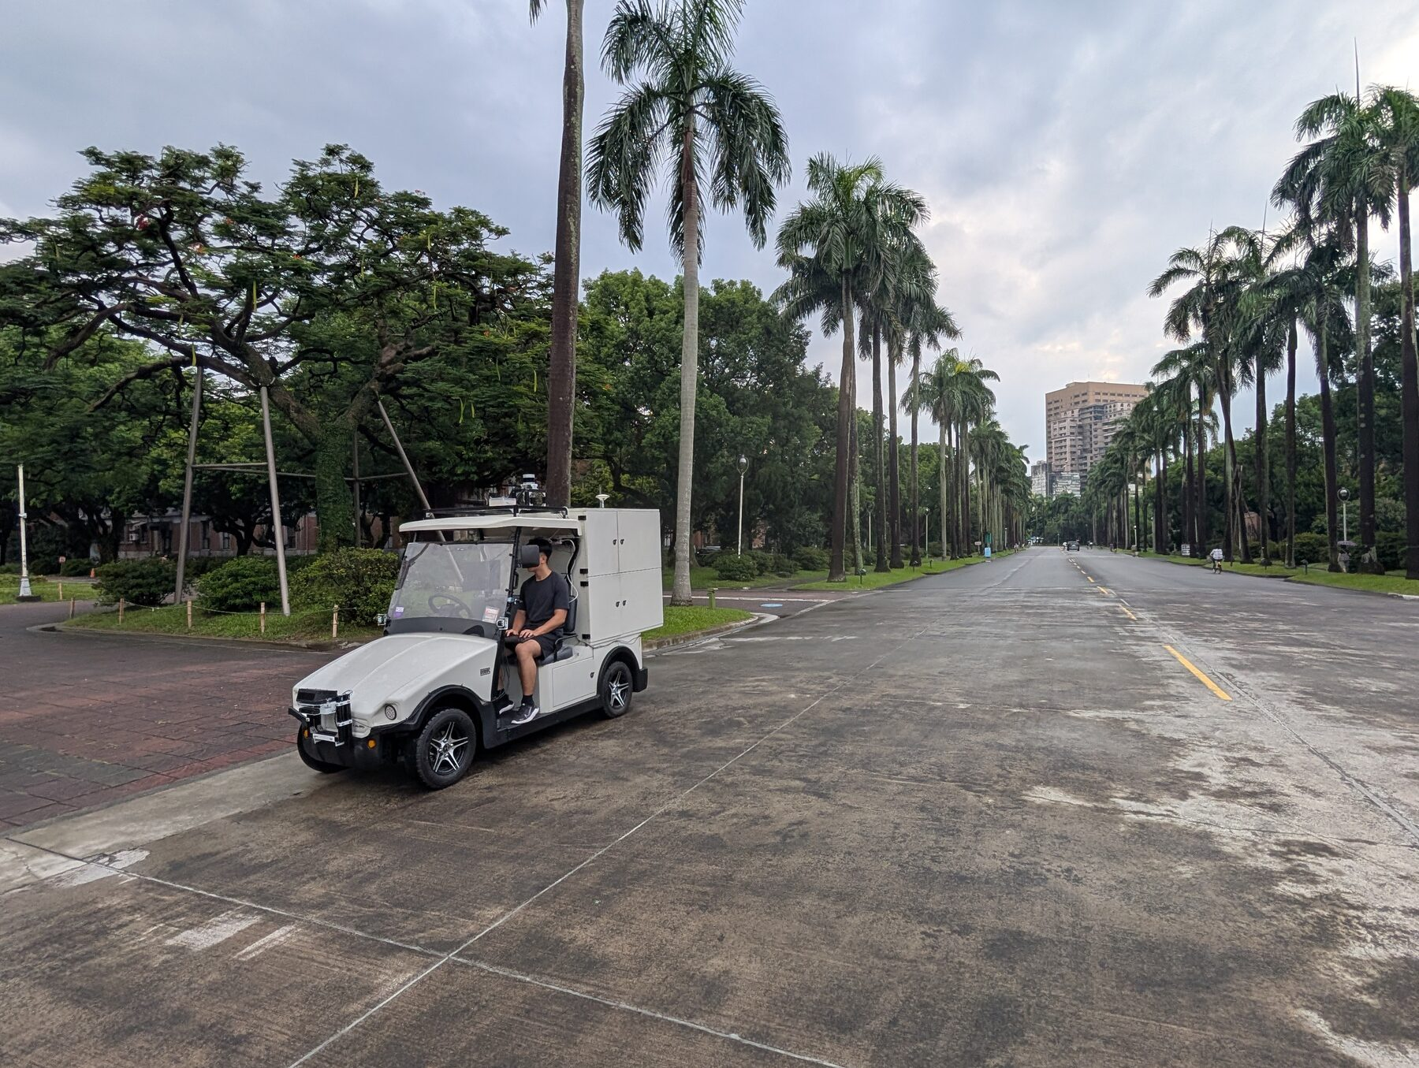
Vehicle platform
A low-speed campus vehicle on a Turing Drive VCU, with an Autoware stack across two machines.
Bring-up sequence:
1. Sensors
ready
2. Two-host system
ready
3. Vehicle interface
in progress
4. Map preparation
ready
5. Data collection
done, data flawed
6. Autonomous run
not started
Currently operating at NTU.

Slide 3
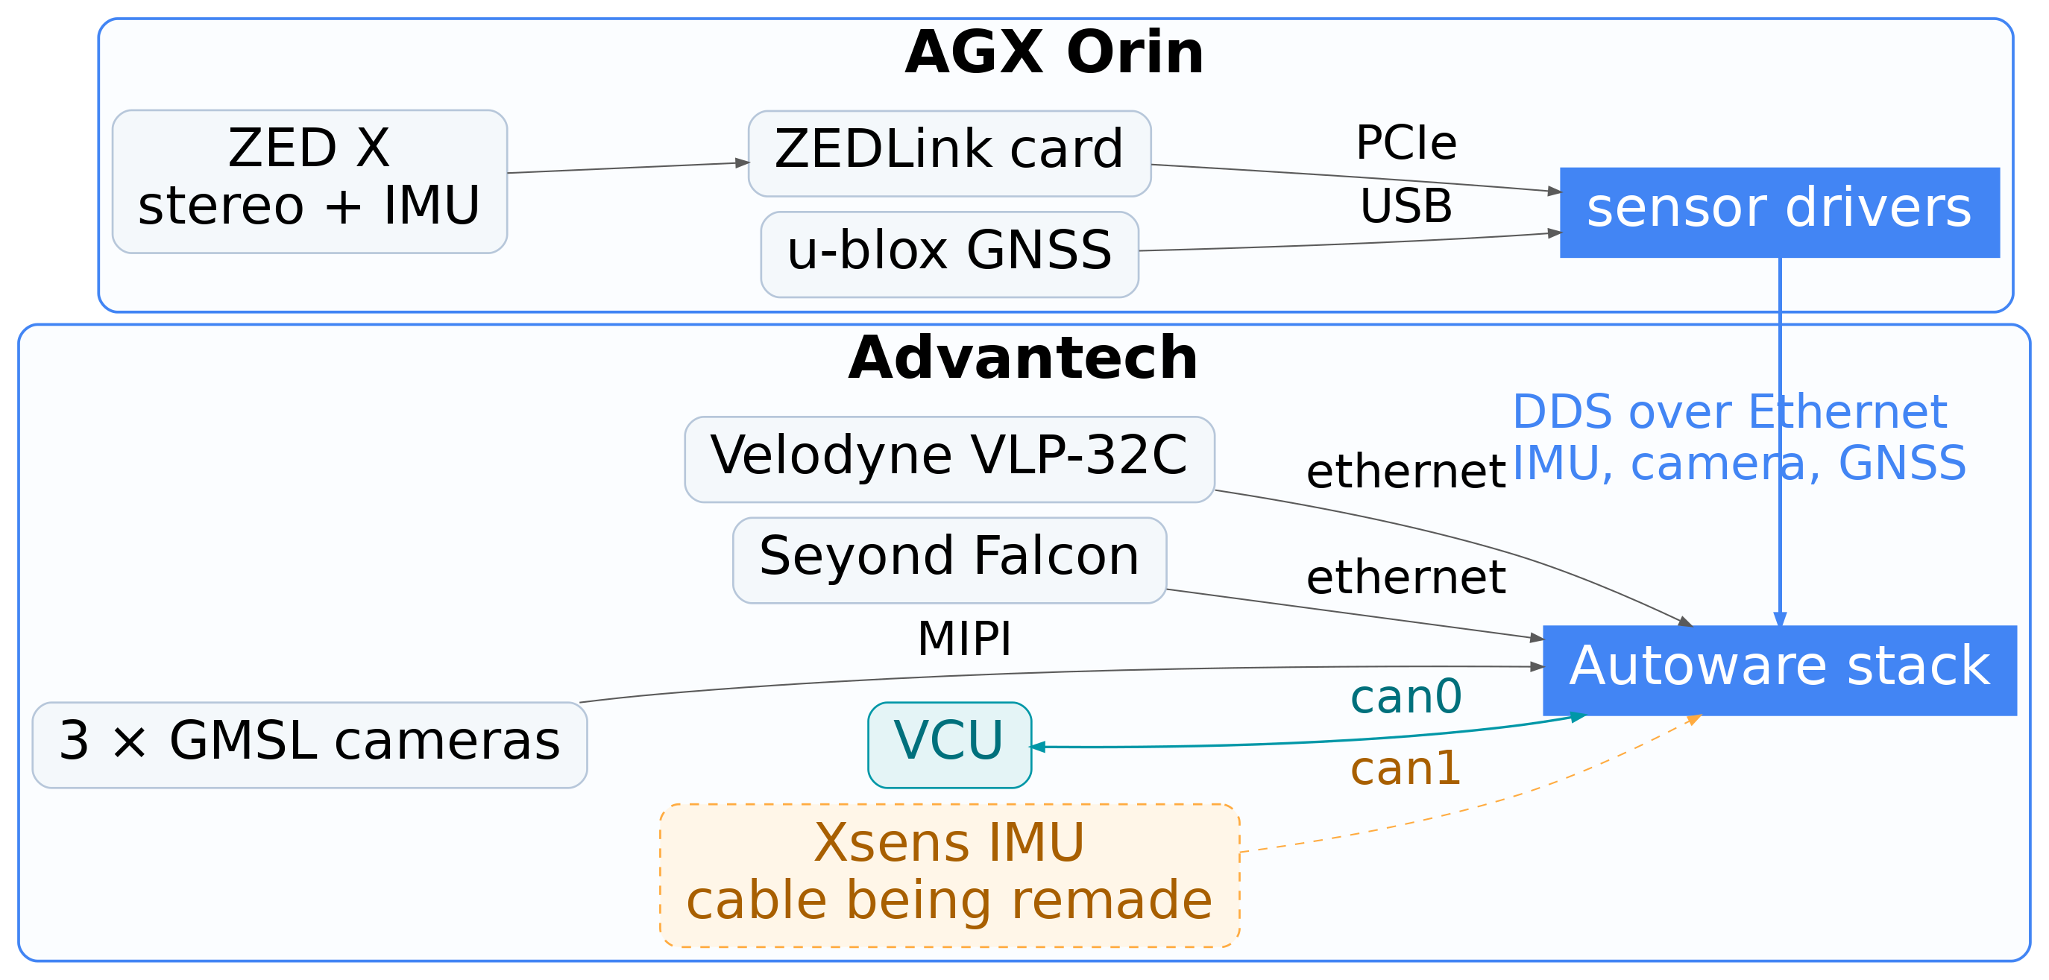
System architecture
sensor
software
vehicle control
not in service

Slide 4
Sensor integration
All sensors publish, across both hosts.
Sensor | Host | Feeds
Velodyne VLP-32C | Advantech | NDT scan matching, perception
Seyond Falcon | Advantech | perception
3 GMSL cameras | Advantech | perception, recording
ZED X stereo + IMU | Orin | the IMU the stack runs on today
u-blox GNSS | Orin | pose initialisation
Turing Drive VCU | Advantech | velocity, gear, subsystem states

Slide 5
Multi-host orchestration
ROS 2 provides no equivalent of ROS 1's machine tag, so orchestration is ours to supply. It is in place and operational.
Single instance, no orphaned processes
• play_launch reclaims orphaned processes when a launch terminates, and brings the stack up in ~20 s against ~60 s for ros2 launch
• systemd user units around it: singleton by construction, KillMode=control-group takes the whole tree down
Uniform environment on either host
• one CycloneDDS profile per role, plus a config/host marker file
• scripts/env.sh reads it, and every shell and every unit sources it
• so any shell is correctly configured on open, and no operator needs to track which host they are working on
just launch-all starts both hosts and returns; just stop-all shuts them down.

Slide 6
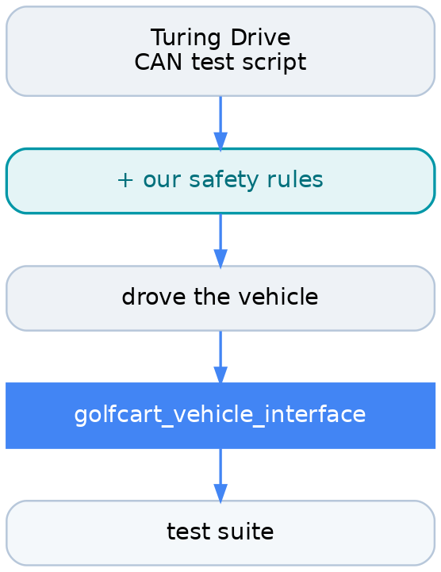
Vehicle interface
Developed from the vendor's own test code rather than from a specification. Every stage exists in the repository.
The safety constraints are our addition:
• target speed is clamped non-negative; reverse is gear R
• gear P forces speed and steering angle to zero, re-applied each cycle
• ESTOP release is never bound to a key the terminal cannot emit
A test suite sits above it: keyboard control, a command service, and trajectory replay.

Slide 7
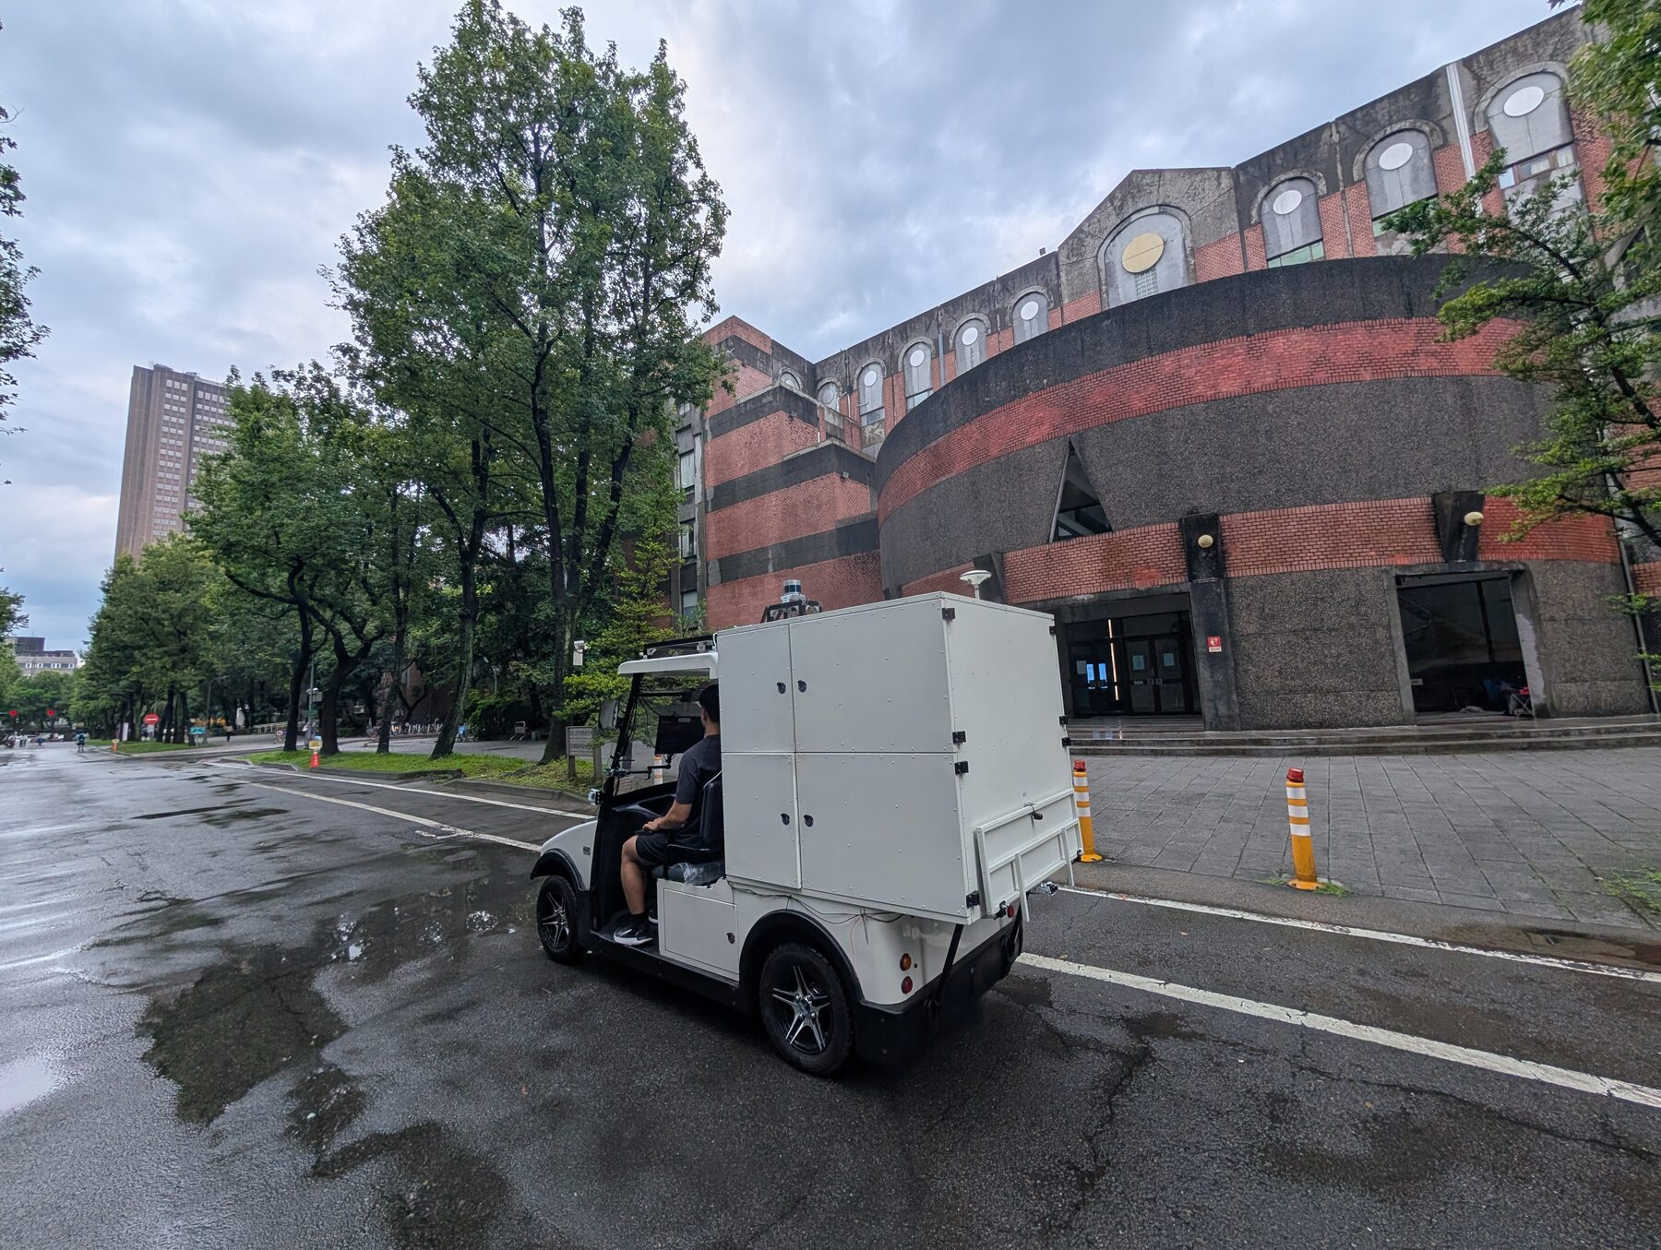
Data acquisition
Three runs at NTU. Each host records independently, writing only the topics for the devices it owns; the bags are merged afterwards.
Only first-hand driver output is recorded. Derived topics are excluded, so replay recomputes them under current parameters rather than those fixed at record time.
Replay is a single command, just ntu-test run: bag paused for /clock, then stack, RViz and initial pose, in the required order.

Slide 8
Integration findings
Three findings relevant to comparable deployments.
• The vendor's default oToCam setup enables the cameras and disables every USB port. A workaround now provides both. The .ko files remain ABI-bound to kernel 5.15.148-tegra, so a JetPack update silently reverts it.
• The Xsens IMU cable has failed and is being remade. The stack currently uses the ZED X built-in IMU, which resides on the other host and crosses the network at 100 Hz.
• The u-blox GNSS is hosted on the Orin, the Advantech having no free USB port. A second localization input is therefore also remote, for an unrelated reason.

Slide 9
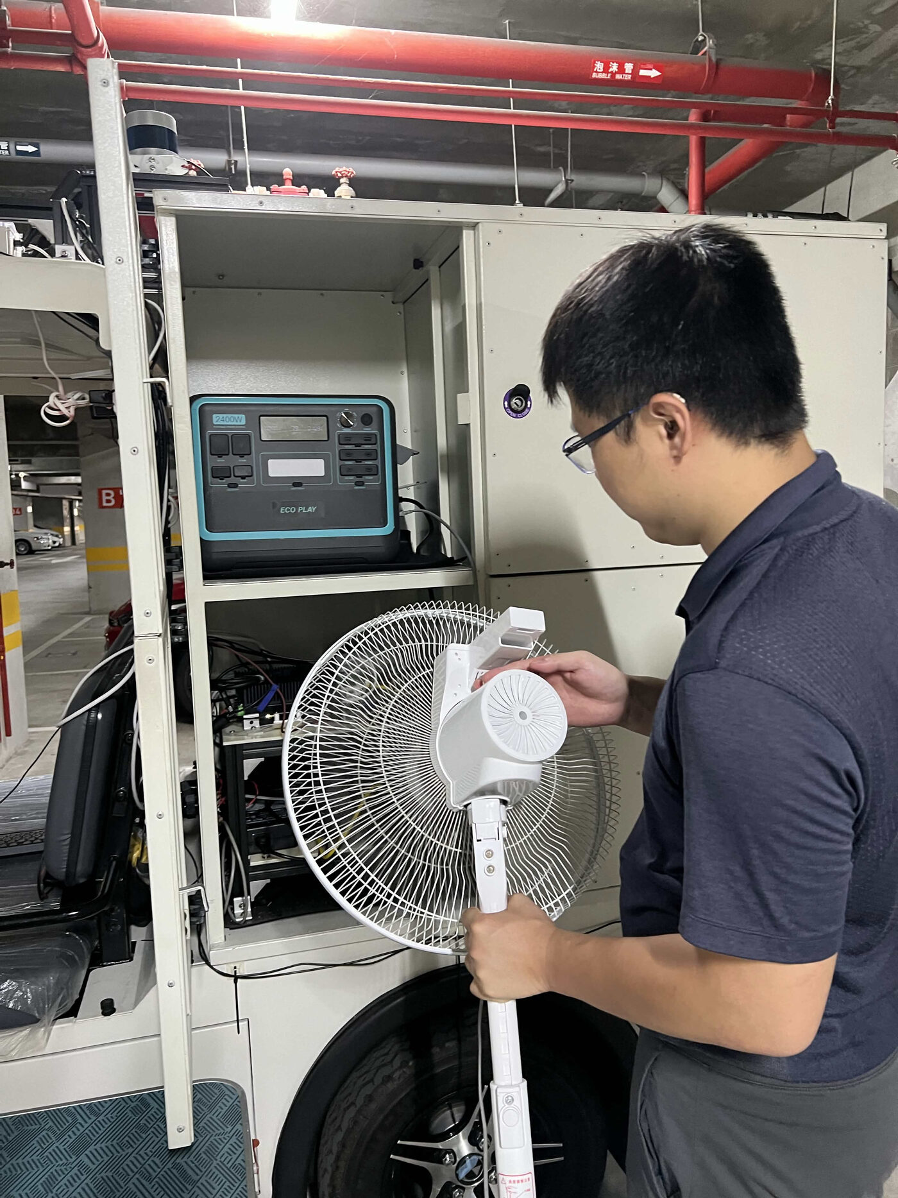
Compute and thermal limits
The three GMSL cameras emit UYVY at 1920x1280, 30 fps, while the consuming nodes require RGB or JPEG. A conversion is therefore unavoidable. nvvidconv was evaluated; the conversion still incurs CPU cost per camera.
This load contributes to the thermal saturation shown here, and is part of the rationale for splitting the stack across two hosts.
Mitigation in progress: github.com/newslabntu/gmslcam, which removes that stage.

Slide 10
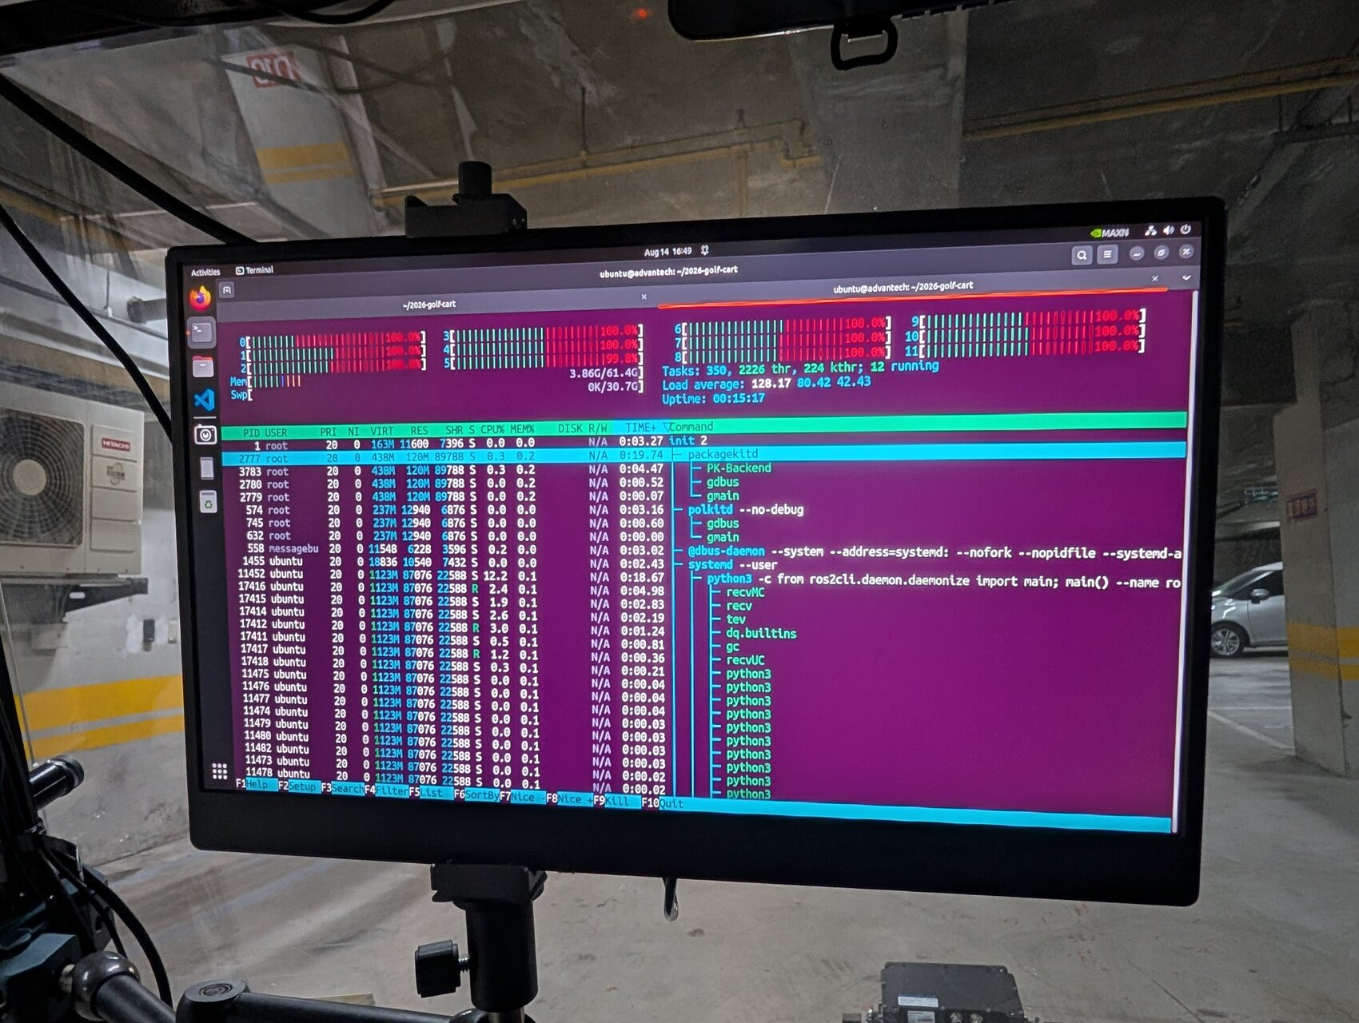
Start-up contention
play_launch is fast because it spawns without rate limiting. On a host already at its limit this produces a thundering herd, and the machine becomes unresponsive, requiring a power cycle.
Rate-limiting the spawns is the obvious remedy, and measurement rejects it: roughly 10% fewer runnable tasks for more than double the start-up time, forfeiting the advantage the tool was adopted for.
The shipped mechanism is a 1 GiB MemAvailable floor, engaging only as the host approaches exhaustion.
Constrain the resource that is exhausted, not the spawn rate.

Slide 11
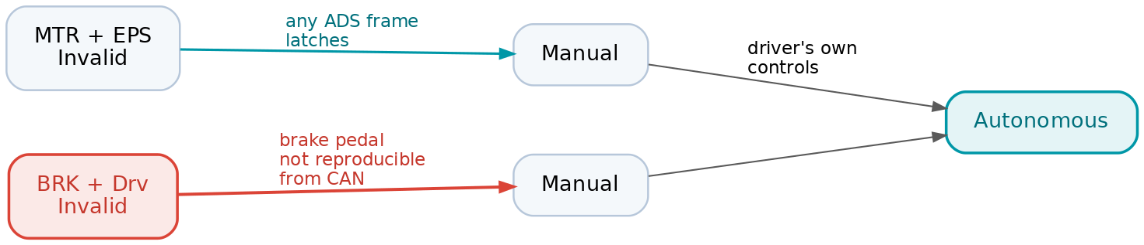
Autonomous engagement and VCU state entry
There is no vehicle_cmd_gate external selector. The interface issues no commands until all four subsystems report autonomous, and no service call can override this.
After a VCU restart, BRK and Drv initialise as Invalid, and only a brake-pedal press was observed to clear them. Not reproducible over CAN.
Unattended autonomous start-up is therefore blocked. This requires clarification from the vendor rather than further work on our side.

Slide 12
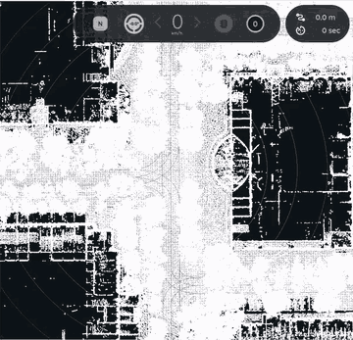
NDT localization
The first successful NDT initialisation and tracking run on the NTU map. Initialisation from GNSS, and convergence to 0.14 m while stationary.
Tracking then degrades within seconds of the vehicle moving. Tuning was evaluated against scan-to-map residual rather than the NVTL score: the change that most improved accuracy in fact reduced NVTL.
The cause has been identified, and lies upstream of NDT in the recording: 45% of scans cover only part of a revolution, and scans arrive 376 ms stale. Neither is a localization parameter.
Both are addressed in the next collection run, which records raw LiDAR packets.
Scan aligned to the map at 11 km/h, 2x.

Slide 13
Bring-up status
Step |  | Outstanding issue
Sensors |  | partial LiDAR scans; Xsens cable under repair
Two-host system |  | none
Vehicle interface |  | the VCU will not enter its autonomous state over CAN alone
Map preparation |  | PCD and lanelet2 supplied by Turing Drive, downsampled at runtime
Data collection |  | the recordings carry the sensor defects above
Autonomous run |  | dependent on the vehicle interface issue
State
ready
ready
in progress
ready
done, data flawed
not started

Slide 14
Next steps
• Establish with Turing Drive what clears the Invalid brake state after a restart. All remaining work on the autonomous run depends on this.
• Record raw LiDAR packets and verify the VLP-32C rotation configuration against the hardware, then repeat the localization work on sound data.
• Migrate the sensor kit to gmslcam, eliminating the per-camera CPU conversion.
TSN is a separate line of work, available for discussion if of interest.

