Slide 1
Launch Manifest
Declaring and Auditing the ROS 2 Communication Graph play_launch — Phase 31

Slide 2
Manifest in 30 Seconds
version: 1
nodes:
talker:
pub: [chatter]
listener:
sub: [chatter]
topics:
chatter:
type: std_msgs/msg/String
pub: [talker/chatter]
sub: [listener/chatter]
exports:
output: [talker/chatter]
One manifest per launch file. Topics wire endpoints. Names are relative.

Slide 3
Manifest Structure
nodes: endpoint declarations (pre-remap names)
topics: wiring + type + QoS + channel contract
includes: child scopes (name = namespace, manifest path)
imports: subscriber dependencies (what we need from outside)
exports: publisher outputs (what we provide to parent)
io: scope-level timing contract

Slide 4
Wiring: Topics Connect Endpoints
nodes:
cropbox_filter:
pub: [output] # pre-remap name
sub: [input]
topics:
cropped: # → <ns>/cropped
type: PointCloud2
pub: [cropbox_filter/output]
sub: [ground_filter/input]
contract:
rate_hz: 10
Endpoint names = node's internal topic names (before <remap>)
Topic gives the real name and wires pub ↔ sub
contract: = channel-level quality bound (rate, deadline, drops)

Slide 5
Composition: Includes and Scope Hierarchy
includes:
lidar: # name = ROS namespace
manifest: tier4_.../lidar_perception.launch.yaml
camera:
manifest: tier4_.../camera_perception.launch.yaml
topics:
lidar_objects:
pub: [lidar/output] # child's export
sub: [fusion_node/lidar_in]
imports:
input: [lidar/input, camera/input]
exports:
output: [tracker/tracked]
Parent wires children explicitly via topics. No implicit accumulation.

Slide 6
I/O Patterns in Autoware
Pipe (1→1)
on_arrival — cropbox, centerpoint
Fusion (N→1)
all_ready + timestamp — concat_pointclouds
Source (0→N)
periodic — lidar_driver (10 Hz)
Timer-driven
periodic + state inputs — tracker (10 Hz)
Feedback cycle
on_arrival + state — NDT ↔ EKF
All from the same primitives —
no enumerated pattern types.

Slide 7
Node I/O Contract
# Simple pipe
centerpoint:
io: { latency_ms: 30 }
# Fusion — all inputs synchronized
fusion_node:
io:
trigger: all_ready
correlation: timestamp
tolerance_ms: 50
latency_ms: 20
# Timer-driven with state inputs
tracker:
io:
state: [fused]
trigger: { periodic: 10 }
freshness_ms: 200
io: only adds annotations to sub:/pub:
No redundancy — timing and roles are separate from topology.

Slide 8
Contract Primitives
Input roles (per sub: endpoint)
role: trigger (default) — fires computation
role: state — read-latest when triggered
consume: N — messages per firing
min_count: N — readiness precondition
Trigger
on_arrival — any trigger-input (default)
all_ready — barrier, all must arrive
periodic: N — timer at N Hz
Correlation (2+ trigger inputs)
timestamp — match by header.stamp
latest — most recent of each
Timing bounds
latency_ms — trigger → output
freshness_ms — max input data age
Drop tolerance
max_consecutive_drops
max_drop_ratio over window

Slide 9
Topic Channel Contract
topics:
detected_objects:
type: DetectedObjects
pub: [centerpoint/objects]
sub: [tracker/input]
contract:
rate_hz: 10
deadline_ms: 150
max_drop_ratio: 0.05
Two separate concerns:
Node io: computation — how fast input → output
Topic contract: channel — what the link promises

Slide 10
Full Pipeline: Top-Level Manifest
includes:
sensing:
manifest: tier4_.../sensing.launch.yaml
perception:
manifest: tier4_.../perception.launch.yaml
planning:
manifest: tier4_.../planning.launch.yaml
topics:
pointcloud:
pub: [sensing/pointcloud]
sub: [perception/input]
tracked_objects:
pub: [perception/output]
sub: [planning/input]
Scope budgets:
sensing: source, 10 Hz
perception: 85 ms
lidar: 50 ms
camera: 30 ms
planning: 100 ms
Critical path:
max(50,30) + 20 + 100
= 170 ms

Slide 11
Working with Launch Files
Manifest loaded alongside <include> — parser resolves namespace
Endpoint names match <remap from="..."> in launch XML
Warn if remap is missing
Same manifest reused across different namespace contexts
Partial coverage: missing manifest = no auditing for that scope
Full ROS 2 compatibility — manifests are sidecar files, not replacements

Slide 12
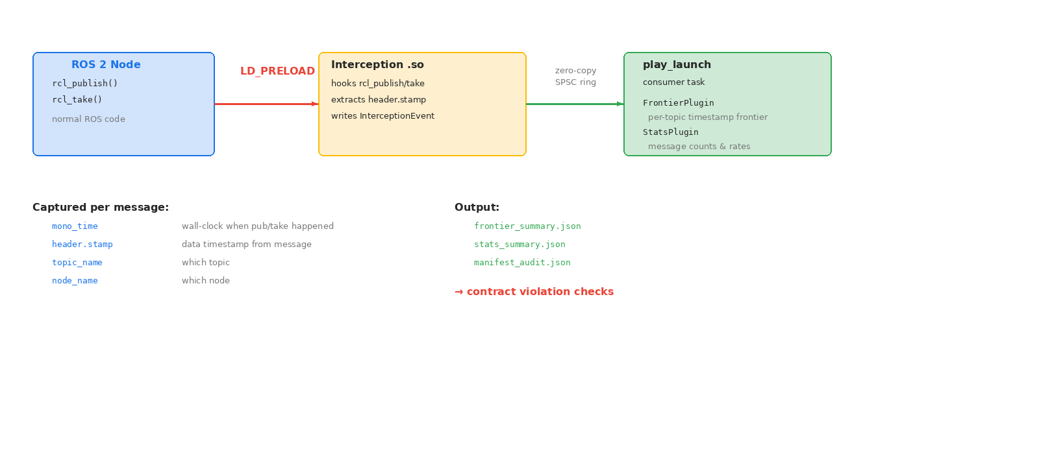
Contract Violation Detection via RCL Interception

Slide 13
What the Monitor Checks
Node io: checks
latency_ms: pub_time - take_time ≤ bound
freshness_ms: pub_time - stamp ≤ bound
Topic contract: checks
rate_hz: interval ≈ 1/rate
deadline_ms: interval ≤ deadline
max_drop_ratio: drops/total ≤ ratio
Assumption | Guarantee | Diagnosis
OK | OK | Nominal
OK | FAIL | Node bug
FAIL | OK | Node robust
FAIL | FAIL | Upstream problem

Slide 14
Scope Budget Verification
Critical path = longest path in DAG → O(V+E)
scope.io.latency_ms ≥ longest_path(imports → exports)
Composition rules:
Series: sum of latencies
Parallel: max of branches
Periodic: period + jitter
Checked statically at parse time — before any node starts
Algorithm: topological sort + dynamic programming (petgraph)

