Slide 1
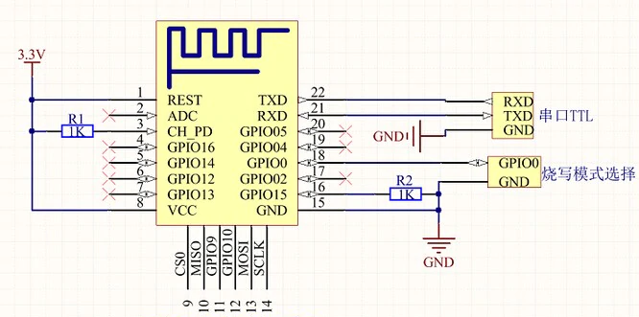

SDA
SCL
MPU6050
220𝞨
220𝞨
220𝞨
220𝞨
+
R
G
B
3.3V
3mm LED
5mm
RGBLED
3.3V out
5V
in
5V
-
5V to 3.3V 電源模組
段數開關
micro USB母
3.3V
GND
GND
GND

