Slide 1
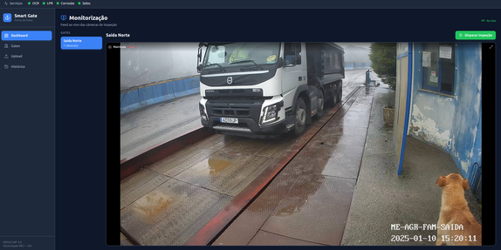
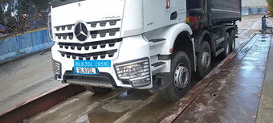
SMART GATE
NEXUS · Port Scene Analytics (WP 3.6)
One inspection for plate, container code, seal, and corrosion at the port gate
Tiago Caridade Gomes · António José Ribeiro Neves · Daniel Duarte Canedo
IEETA / DETI · University of Aveiro

Slide 2
Port gates are inspected by hand today
For every truck that passes, four checks are made:
One truck at a time
Each check is done separately, as the trucks go through.
No shared record
Nothing links the four checks to the same truck, gate, and moment.
1
License plate
2
Container code (ISO 6346)
3
Seal
4
Corrosion

Slide 3
The NEXUS project
NEXUS is a national innovation agenda for the green and digital transition of transport, logistics, and mobility, funded by Portugal's Recovery and Resilience Plan.
35
Sines
WP 3.6
partners in the consortium
led by the Port of Sines Authority
Port Scene Analytics, in the Smart Gates & Terminals pillar
Within WP 3.6, IEETA developed four computer vision models for the gate. Smart Gate brings them together in one platform.

Slide 4
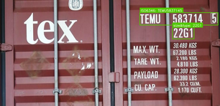
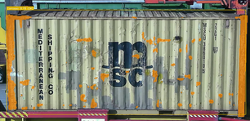
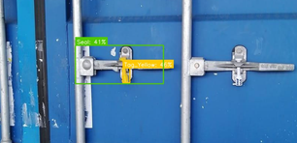
The four technologies
Mod. 1 [1]
Mod. 2 [2]
Mod. 3 [3]
Mod. 4
Container code
Corrosion
License plate
Seal detection
Reads the ISO 6346 code
Estimates corrosion from the image
Reads the truck's plate automatically
Checks seal presence

Slide 5
One Inspection Event
These four technologies don't share a language: different response times, different formats, some instant, some take seconds. Smart Gate runs them in parallel and merges their results.
Code
Smart Gate
Receives the trigger, crops each module's region of interest, and calls all four in parallel
Event
Results, status, and alerts
Cameras
One or more per gate, IP or USB
Corrosion
Plate
Seal
All tied to the same truck, gate, and moment. The full system is deployed with Docker Compose on a GPU server.

Slide 6
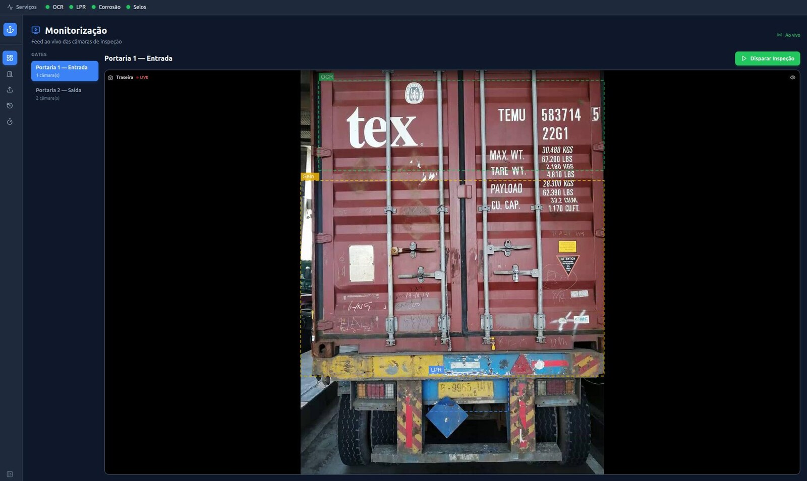
Live video from each gate
Real-time camera stream, as seen by the operator before an inspection fires.
Each module's region of interest is drawn as a dashed line over the image.
The stream reconnects automatically if the camera drops.

Slide 7
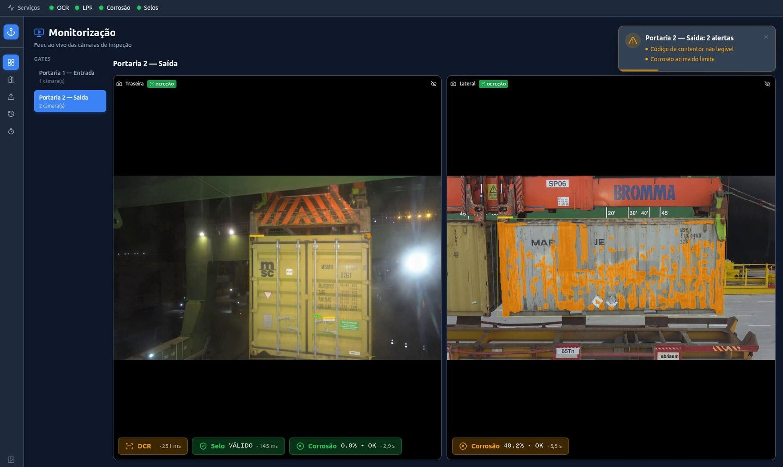
Results and alerts in one view
Annotated images from every camera at the gate.
One card per module, with its result and response time.
Alerts when something is wrong: here, an unreadable container code and corrosion above the threshold.

Slide 8
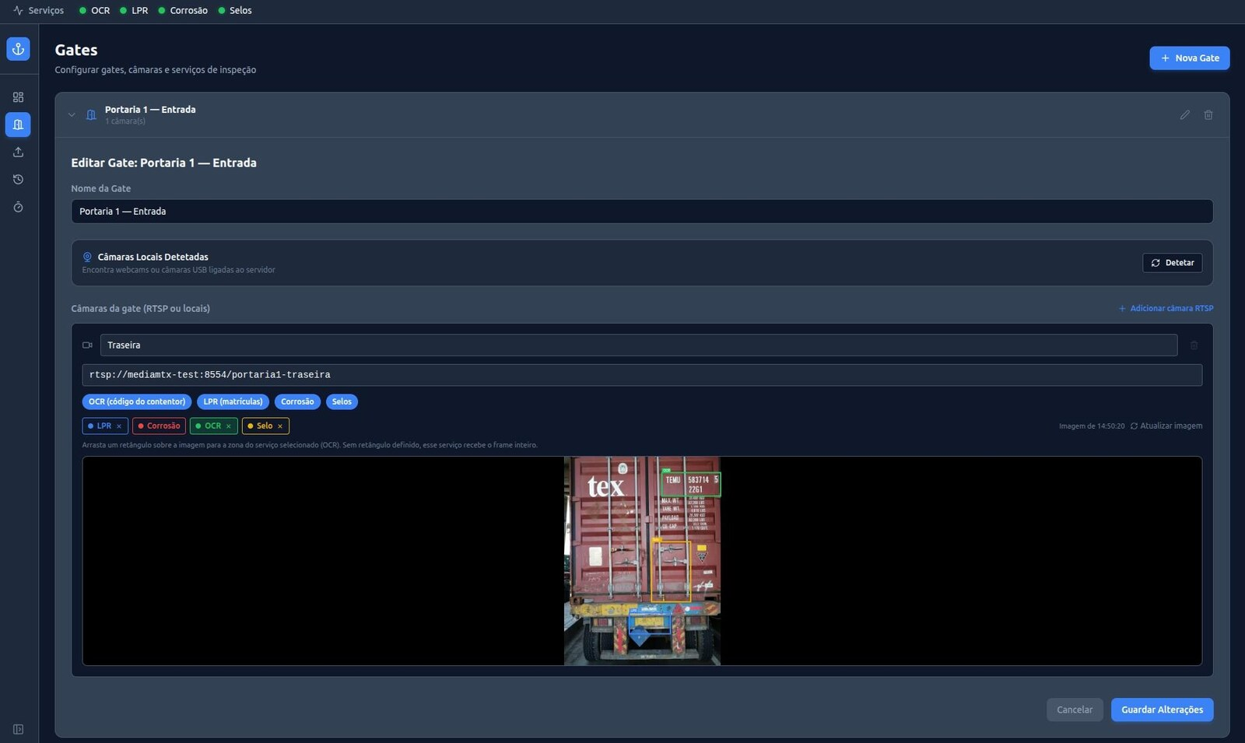
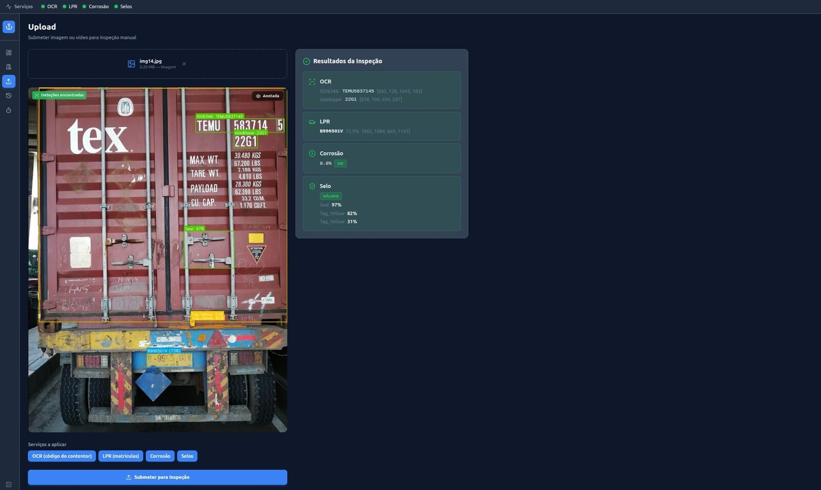
Gate setup and file upload
Gates
Cameras, the modules assigned to each camera, and one region of interest per module.
Upload
An image or a recorded video, analyzed by the four modules.

Slide 9
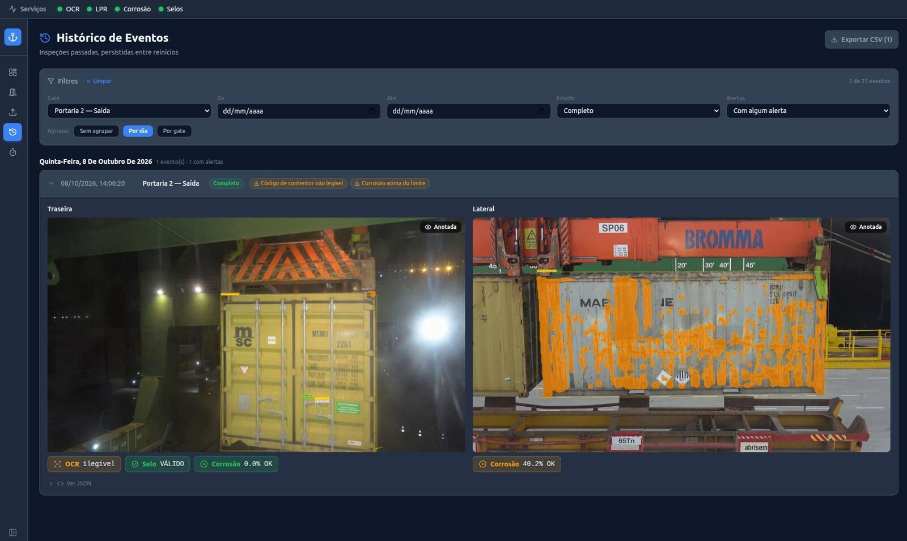
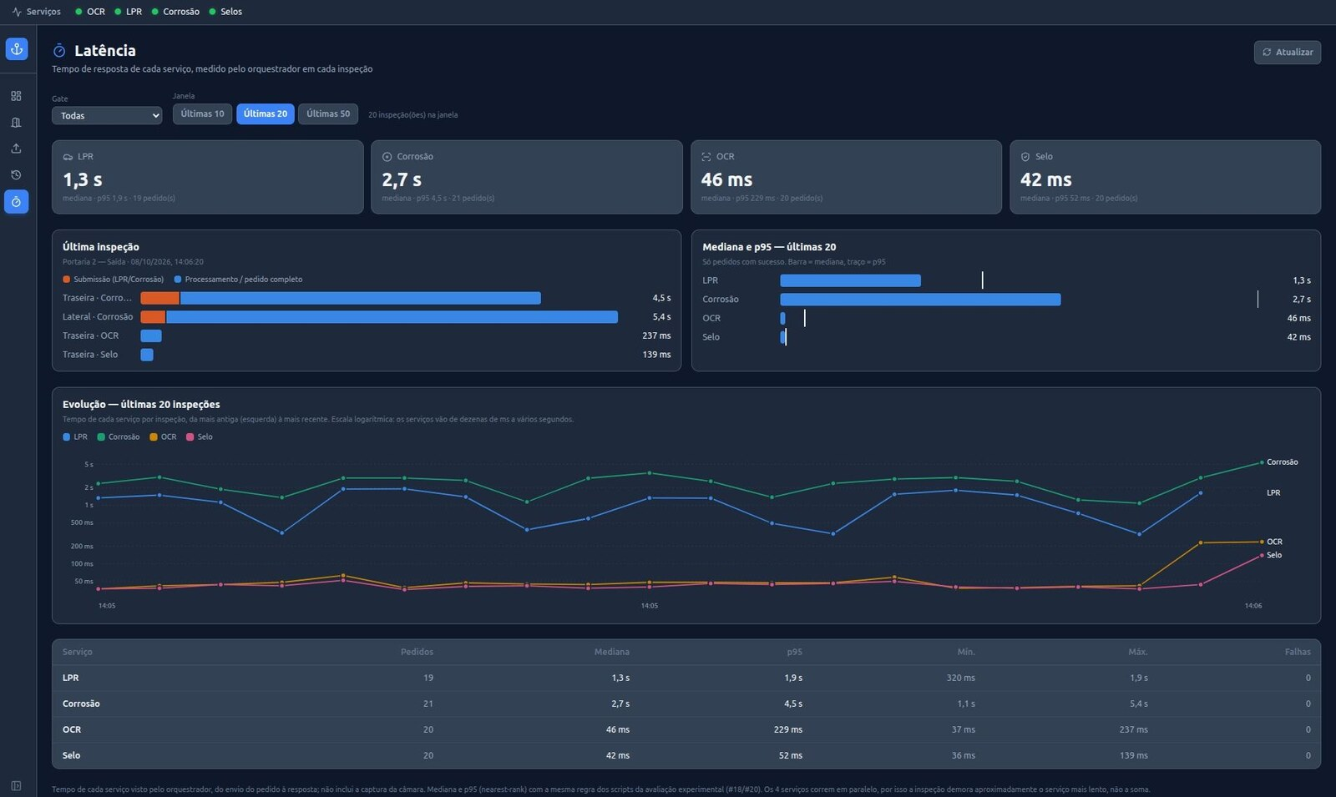
History and response time
History
Stored inspections, filtered by gate, day, status, and alerts, with CSV export.
Latency
Median and 95th percentile per module, and changes across inspections.

Slide 10
Tested end to end
4–5 s
7.5 s
median time for a full inspection with all four modules and one camera
with two cameras at the same gate; about 15 s with four
3
100%
rounds of tests: response time, several cameras per gate, and failures
of the failure scenarios tested still produced an inspection event
Laboratory tests on a GPU server, with emulated cameras streaming real port images.

Slide 11
Why Smart Gate
1
One record per truck
Plate, container code, seal, and corrosion in a single inspection event, with alerts.
2
Keeps working when something fails
If a module or a camera fails, the others still answer and the event shows what is missing.
3
Built for real gates
Several cameras per gate, a region of interest per module, live video, and a full history.
4
Easy to deploy
The whole system, with the four models, starts with one command on a single GPU server.

Slide 12
Thank you
SMART GATE
Four AI models, one platform, one inspection event per truck.
Tiago Caridade Gomes · António José Ribeiro Neves · Daniel Duarte Canedo
IEETA / DETI · University of Aveiro

Slide 13
References
[1]
J. Santos, D. Canedo, A. J. R. Neves, “Automating Code Recognition for Cargo Containers,” Electronics, vol. 14, no. 22, art. 4437, 2025. doi.org/10.3390/electronics14224437
[2]
D. Ornelas, D. Canedo, A. J. R. Neves, “Semantic Segmentation of Corrosion in Cargo Containers Using Deep Learning,” Sustainability, vol. 17, no. 14, art. 6480, 2025. doi.org/10.3390/su17146480
[3]
D. Ornelas, J. Santos, D. Canedo, A. J. R. Neves, “License Plate Recognition in Port Scene Analytics,” RECPAD 2025, Aveiro, Portugal, pp. 159–160.

