Slide 1
A Survey on Blockchain Technology: Different Approaches and On-going Development
Navjot Sharma(A20376692)

Slide 2
Outline
Background
Purpose of Survey
Problem Statement
What is Blockchain Technology
Blockchain History
Components, Working and Properties
Different Approaches in Different Domains
Pros and Cons
On-going Development
Future of Blockchain
Q&A

Slide 3
Background
Since Bitcoin- as first application of Blockchain technology has received recognition throughout the world and has proven to be decentralized solution for financial industries.
It is believed that Blockchain has a potential to become an asset for non-financial industries too, with its features, such as:
No downtime required
Makes falsification extremely hard
Inexpensive system.

Slide 4
Purpose of Survey
This paper aims to:
Write a survey on Blockchain.
Identify each Block Chain based on its domain like insurance, energy trading, ride sharing, etc.
Identify the pros and cons of different approaches to Block Chains.
Summarize the progress of on-going development.
Discover promising industries, which will be disrupted by Blockchain in future.

Slide 5
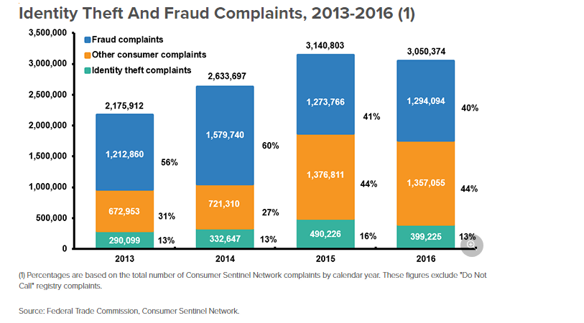
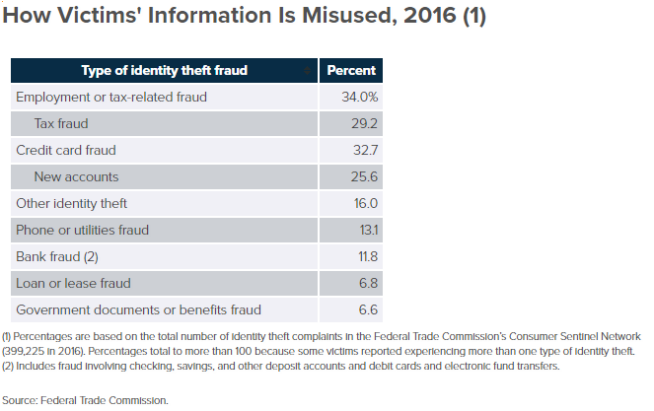
Problem Statement: Why Blockchain?

Slide 6
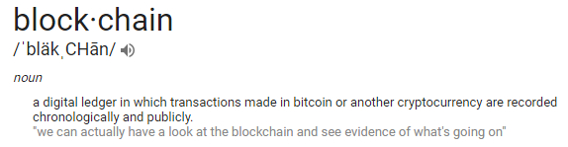
What is Blockchain?
Enables transaction between individual participants without involvement of a third party.
Components of a Block:
Data,
Hash
Hash of pervious block(to create the chain of blocks)
How Blockchain Secure themselves?
Using Hashing
Using Proof of Work(generally 10 mins in case of Bitcoin)
By being distributed i.e. a Peer to Peer network.
Notes:
Data- depends on the type of blockchain, e.g. In case of Bitcoin; data is : sender, receiver and amount to be transferred.
Hash: can be considered as a fingerprint, identifies a block and all its components and is always unique, once a block is created its hash value is calculated, If something changed in a block then it will cause the value of hash to be modified, this means the whole block is changed.
Previous block hash: makes block secure by creating a chain of blocks, if one block changes, this makes the next block invalid, coz it doesn’t have the value of a previous block.
Only Hashing cannot help to make the blockchain secure, coz with today’s technology we can very easily tamper with one block and recalculte hashes for other blocks, to make the blocks valid again.
To mitigate this blockchain has something called proof-of-Work POW: it slows down the creation of new blocks. In bitcoin it takes 10 mins to calculate the required POW and add new block to the chain.

Slide 7
Blockchain History
This technology was originated in 1991 as Digital timestamps -> like Notary
In 2009, adapted by Satoshi Nakamoto, to create digital cryptocurrency called “Bitcoin”
In 2015, Ethereum Launched, Ethereum builds on Bitcoin designed as an operating system for smart contracts
Notes:
Notary: to timestamp the digital documents so that no one could tamper with them. But not used then

Slide 8
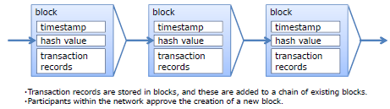
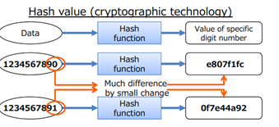
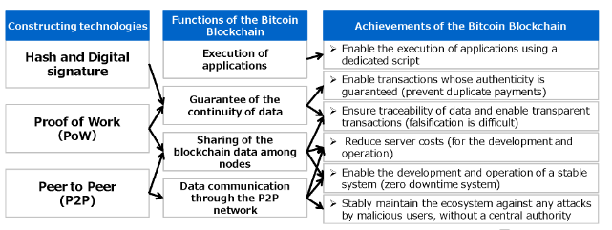
Blockchain Components and Working

Slide 9
Properties of Blockchain
Decentralized –P2P
Public
Fault tolerant
Enables the transfer of value
Distributed Database
Cryptographically secure by design

Slide 10
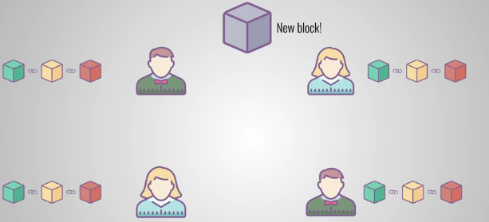
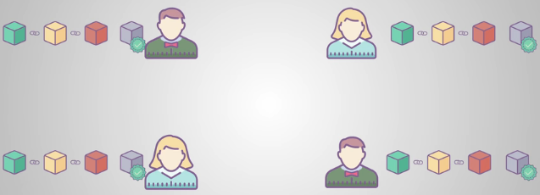
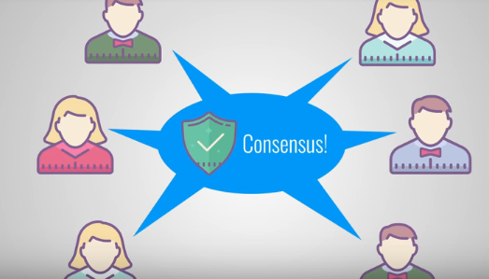
An Example
Notes:
Everyone can join P2P network, node can verify that everything is still in order.
Step 1- New block gets added to the whole P2P network
2- Each node verifies the block to make sure it hasen’t been tampered with, if everything, is fine then each node add this new block chain to their respective chain.
Step 3- consensus gets created by All the nodes in this network, to agree on which blocks are valid and which are not, this is basically an algorithm for Byzantine General problem. An agreement among the untrustworthy nodes, POW is one of the consensus strategy.
Blocks that are tampered, are successfully removed from the network. Therefore to successfully tamper with the blockchain, you need to:
Tamper with all the blocks on the chain
Redo the POW for each of the block
Take control of >50% of the P2P n/w.
Then only the tampered block will be accepted by P2P network. -> almost Impossible to do above

Slide 11
Different Approaches in Different Domains
Finance
Stock Exchange: BitShares, Overstock Peer-to Peer Banking: ROSCA Remittance Services: Bitpesa- for developing countries Abra – for Muslims Toast – for Immigrants Bitcoin trades: itBit, Coinffeine
Insurance
P2P Insurance Social Insurance Network- Guevara, Friendsurance Digital ID- ONENAME, OpenID Connect
Ride Sharing
Real-time Ridesharing: La’Zooz , Arcade City
Medical
Genetic Storage- Genecoin Medical Records BitHealth, Gem, Tierion DNA recording- DNA.Bits
Govt Sector
Voting: Democracy.Earth follow.myvote.com- for voter registration, verification and counting Budgeting: Consensys- In Dubai Basic Income- Circles for universal basic income
Supply Chain Mgmt
Peer-to- Peer Market – OpenBazaar Supply Chain – SkuChain, Fluent, Provenance, Blockverify
Asset Management
Land Registration: Factom
Energy Management
TransactiveGrid and Ethereum
Notes:
TransactiveGrid and ethereum – Allows customer to buy and sell energy from each other in a centralized way
A ROSCA is a rotating savings and credit association (ROSCA). A group of individuals who agree to contribute for a defined period in order to save and borrow together. This is a form of combined peer-to-peer banking and peer-to-peer lending and usually between immigrant communities in a developed country or communities in a developing country.
applications to create or store genetic and medical record data using for example Genecoin, which allows individuals to securely back up their own DNA by recording it on the blockchain or, DNA.Bits which aims to provide access to large samples of anonymised medical records and genetic data through the blockchain.
A number of digital ID schemes are emerging, including ONENAME, and OpenID Connect, a protocol combining an identity layer and an authorisation server, which allows clients of all types (e.g. developers) to request and receive information about authenticated session and end-users across websites and apps without having to own or manage password files

Slide 12
Pros and Cons based on different Approaches
PRO’s
No need for middleman – banks, government or lawyers.
1 Bitcoin = 6925 USD today, which has increased over time , and is expected to become $20260 in next two years.
Transactions are verified by a huge P2P network
Transactions are irreversible
Anything with a value to it can be transferred and saved safely and confidentially - without any modification
Cryptocurrency is not affected by economic crisis – (money in bank can be frozen in such crisis)
CON’s
Lot of resistance, because people are currently employer by the institutions that serve as intermediaries
Scammers take advantage of anonymity of conducting transaction, e.g. can offer to multiply your bitcoin or Ransomeware malware
Still possible to Hack or manipulate system.
People still are unaware of cryptocurrency as a valid payment method like money
Transactions are irreversible
Notes:
Finance
Supply chain Management
Healthcare
Insurance
Critical Infra/Energy trading
Ride Sharing
Education

Slide 13
On-going Development and Research Challenges
Research Challenges:
Add new functionality to Blockchain
Store more info
Require different settings than original Bitcoin
Business solutions
Make it scalable – size of transaction
Use Blockchain to develop more utilities
Blockchain Thunder:
The technology enables users and vendors to send and receive payments without touching the main block chain. Even in the prototype phase, Thunder has the potential to facilitate secure, trustless and nearly instant payments, unleash the power of microtransactions and allow the network to handle heavy loads, and increase user privacy.
DIGITAL ASSET RESEARCH LAB
Blockchain recently partnered with the Centre for Cryptocurrency Research and Engineering (IC3RE) at Imperial College London to launch the Digital Asset Research Lab, a leading international centre for ongoing research and application activity related to cryptocurrency and block chain technology.

Slide 14
Future of Blockchain
Industries that Blockchain is /will be disrupting in coming years:
Forecast-
Will change how we do research, consulting analysis and forcasting
Example= Augur, used to place bets in a decentralized way, bet on anything from sports, stocks to elections.
IOT-
Samsung and IBM want to create a decentralized network of IOT devices using blockchain
Will eliminate the need for central location to handel communication for IOT devices.
Devices could communicate directly, update s/w, manage Bugs and monitor energy usage.
Cloud Storage
Using blockchain make cloud storage more secure from hacks
Storj.io -> Decentralized cloud storage
Public Benefits:
Govcoin- UK based company, helping the Govt to distribute public benefits using Blockchain
Realestate
Ubiquity
Charity:
Bitgive- Make sure no corruption

Slide 15
References
[1] Statistics for Identity theft/cybercrime as identified by Federal Trade Commission (FTC)
https://www.ftc.gov/news-events/press-releases/2017/03/ftc-releases-annual-summary-consumer-complaints
https://www.iii.org/fact-statistic/facts-statistics-identity-theft-and-cybercrime
[2] Swan M. Blockchain: Blueprint for a New Economy. “ O’Reilly Media, Inc.”; 2015
[3] Nakamoto S. Bitcoin: A peer-to-peer electronic cash system. Consulted. 2008;1(2012):28.
https://link.springer.com/chapter/10.1007%2F978-1-4614-2110-8_2
[4] Meti- Survey on Blockchain Technologies and services - Information Economy Division Commerce and Information Policy Bureau
http://www.meti.go.jp/english/press/2016/pdf/0531_01e.pdf
[5] Thesis by Satoshi Nakamoto – Bitcoin: P2P https://bitcoin.org/bitcoin.pdf
[6] Identity theft management
https://medium.com/@philfrancis77/blockchain-the-byzantine-general-problem-and-the-future-of-identity-management-6b50a2eb815d
[7] Blockchain implementations:
https://medium.com/@gaurangtorvekar/7-blockchain-technologies-to-watch-out-for-in-2017-4b3fc7a85707
[8] 19 Industries The Blockchain Will Disrupt
https://futurethinkers.org/industries-blockchain-disrupt/

Slide 16

THANK YOU!

