Slide 1
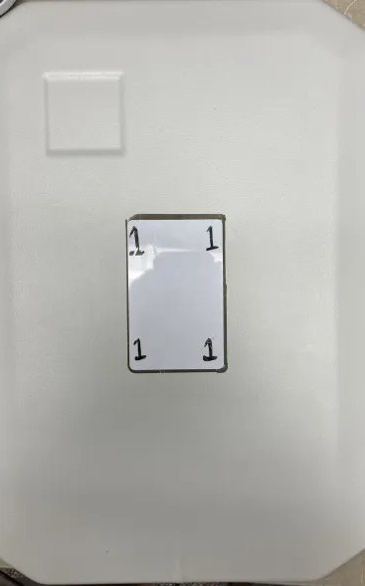
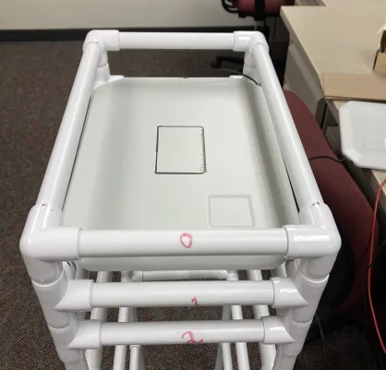
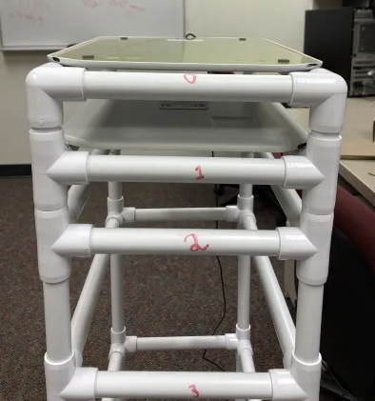
Experiment Setup
Card is labeled and placed in the black outline on the receiver antenna
Receiver antenna is placed on the spot labeled 1 and facing up with the antenna square toward the labeled 1 on the holding structure
Transmitter antenna is placed facing down on the top of the holding structure with the square toward the label

Slide 2
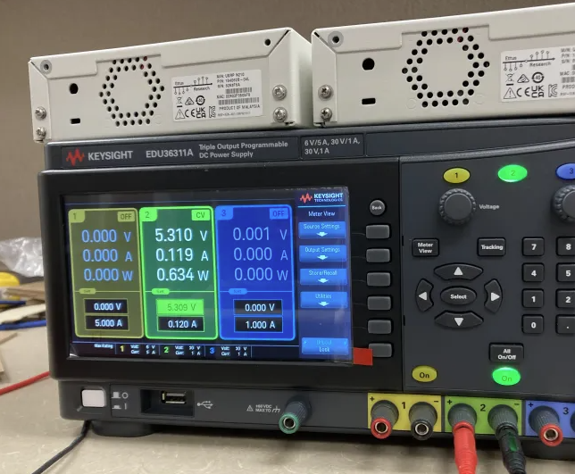
Experiment Setup
Transmitter antenna is connected through an amplifier to USRP
Amplifier is powered from DC power supply (set to ~5.279V/0.12A then varied until ~.633W is outputted

Slide 3
Data Collection
TxandRx.m is used to transmit the inventory command, receive the data, find the card’s response, splice the data to get 330 samples, and save the resulting data to a .mat file
Center Frequency used is 13.56 MHz
Transmit sample rate is 12.5M
Receive sample rate is 2M
The .mat file transmitData.mat is the data for an inventory command
The .mat file 2MHZcardSignal.mat is data from a known card signal used for the findsignal() function
Note: 2MHZcardSignal.mat sometimes cannot find the signal from a new card. When this happens, I must manually get new data for 2MHZcardSignal.mat with the new card.

