Slide 1
Unlocking the Secrets of ID Cards: Exploring Wireless Magic of Near Field Communication with Software-Defined Radios
Dickson Akuoko Sarpong and Hongzhi Guo

Slide 2
Outline
Introduction
NFC Basics
Applications of NFC
Waveform and Properties
Equipment and Software
Introduction to Software Defined Radio (SDR)
Arduino with NFC technology
Communication between Reader and Tag
Data Acquisition and Analysis Workflow
Bit Representation and Coding
Conclusion

Slide 3
Introduction
- In this session, we will delve into:
Principles and Applications of NFC:
Understanding how NFC enables wireless data exchange over short distances.
Exploring everyday applications of NFC, such as contactless payments and smart card access.
Introduction to Software Defined Radio (SDR):
Learning about SDR as a tool for capturing and analyzing NFC signals in detail.
Arduino’s compatibility with NFC:
Learning how to interface Arduino with NFC devices.
Practical Exercises:
Gaining hands-on experience with capturing, analyzing, and understanding NFC signals using Arduino and SDR technology.

Slide 4
NFC Basics
Overview:
Near Field Communication (NFC) is a short-range wireless communication technology that enables the exchange of data between devices when they are brought close together, typically within a few centimeters operates at a frequency of 13.56 MHz
Functionality:
Enables data exchange over distances of just a few centimeters.
Utilizes inductive coupling between loop antennas to facilitate secure, contactless transactions.
Advantages:
Ease of Use: Simple to implement and operate.
Security Features: Provides a secure method for data transfer, ideal for a wide range of applications.

Slide 5
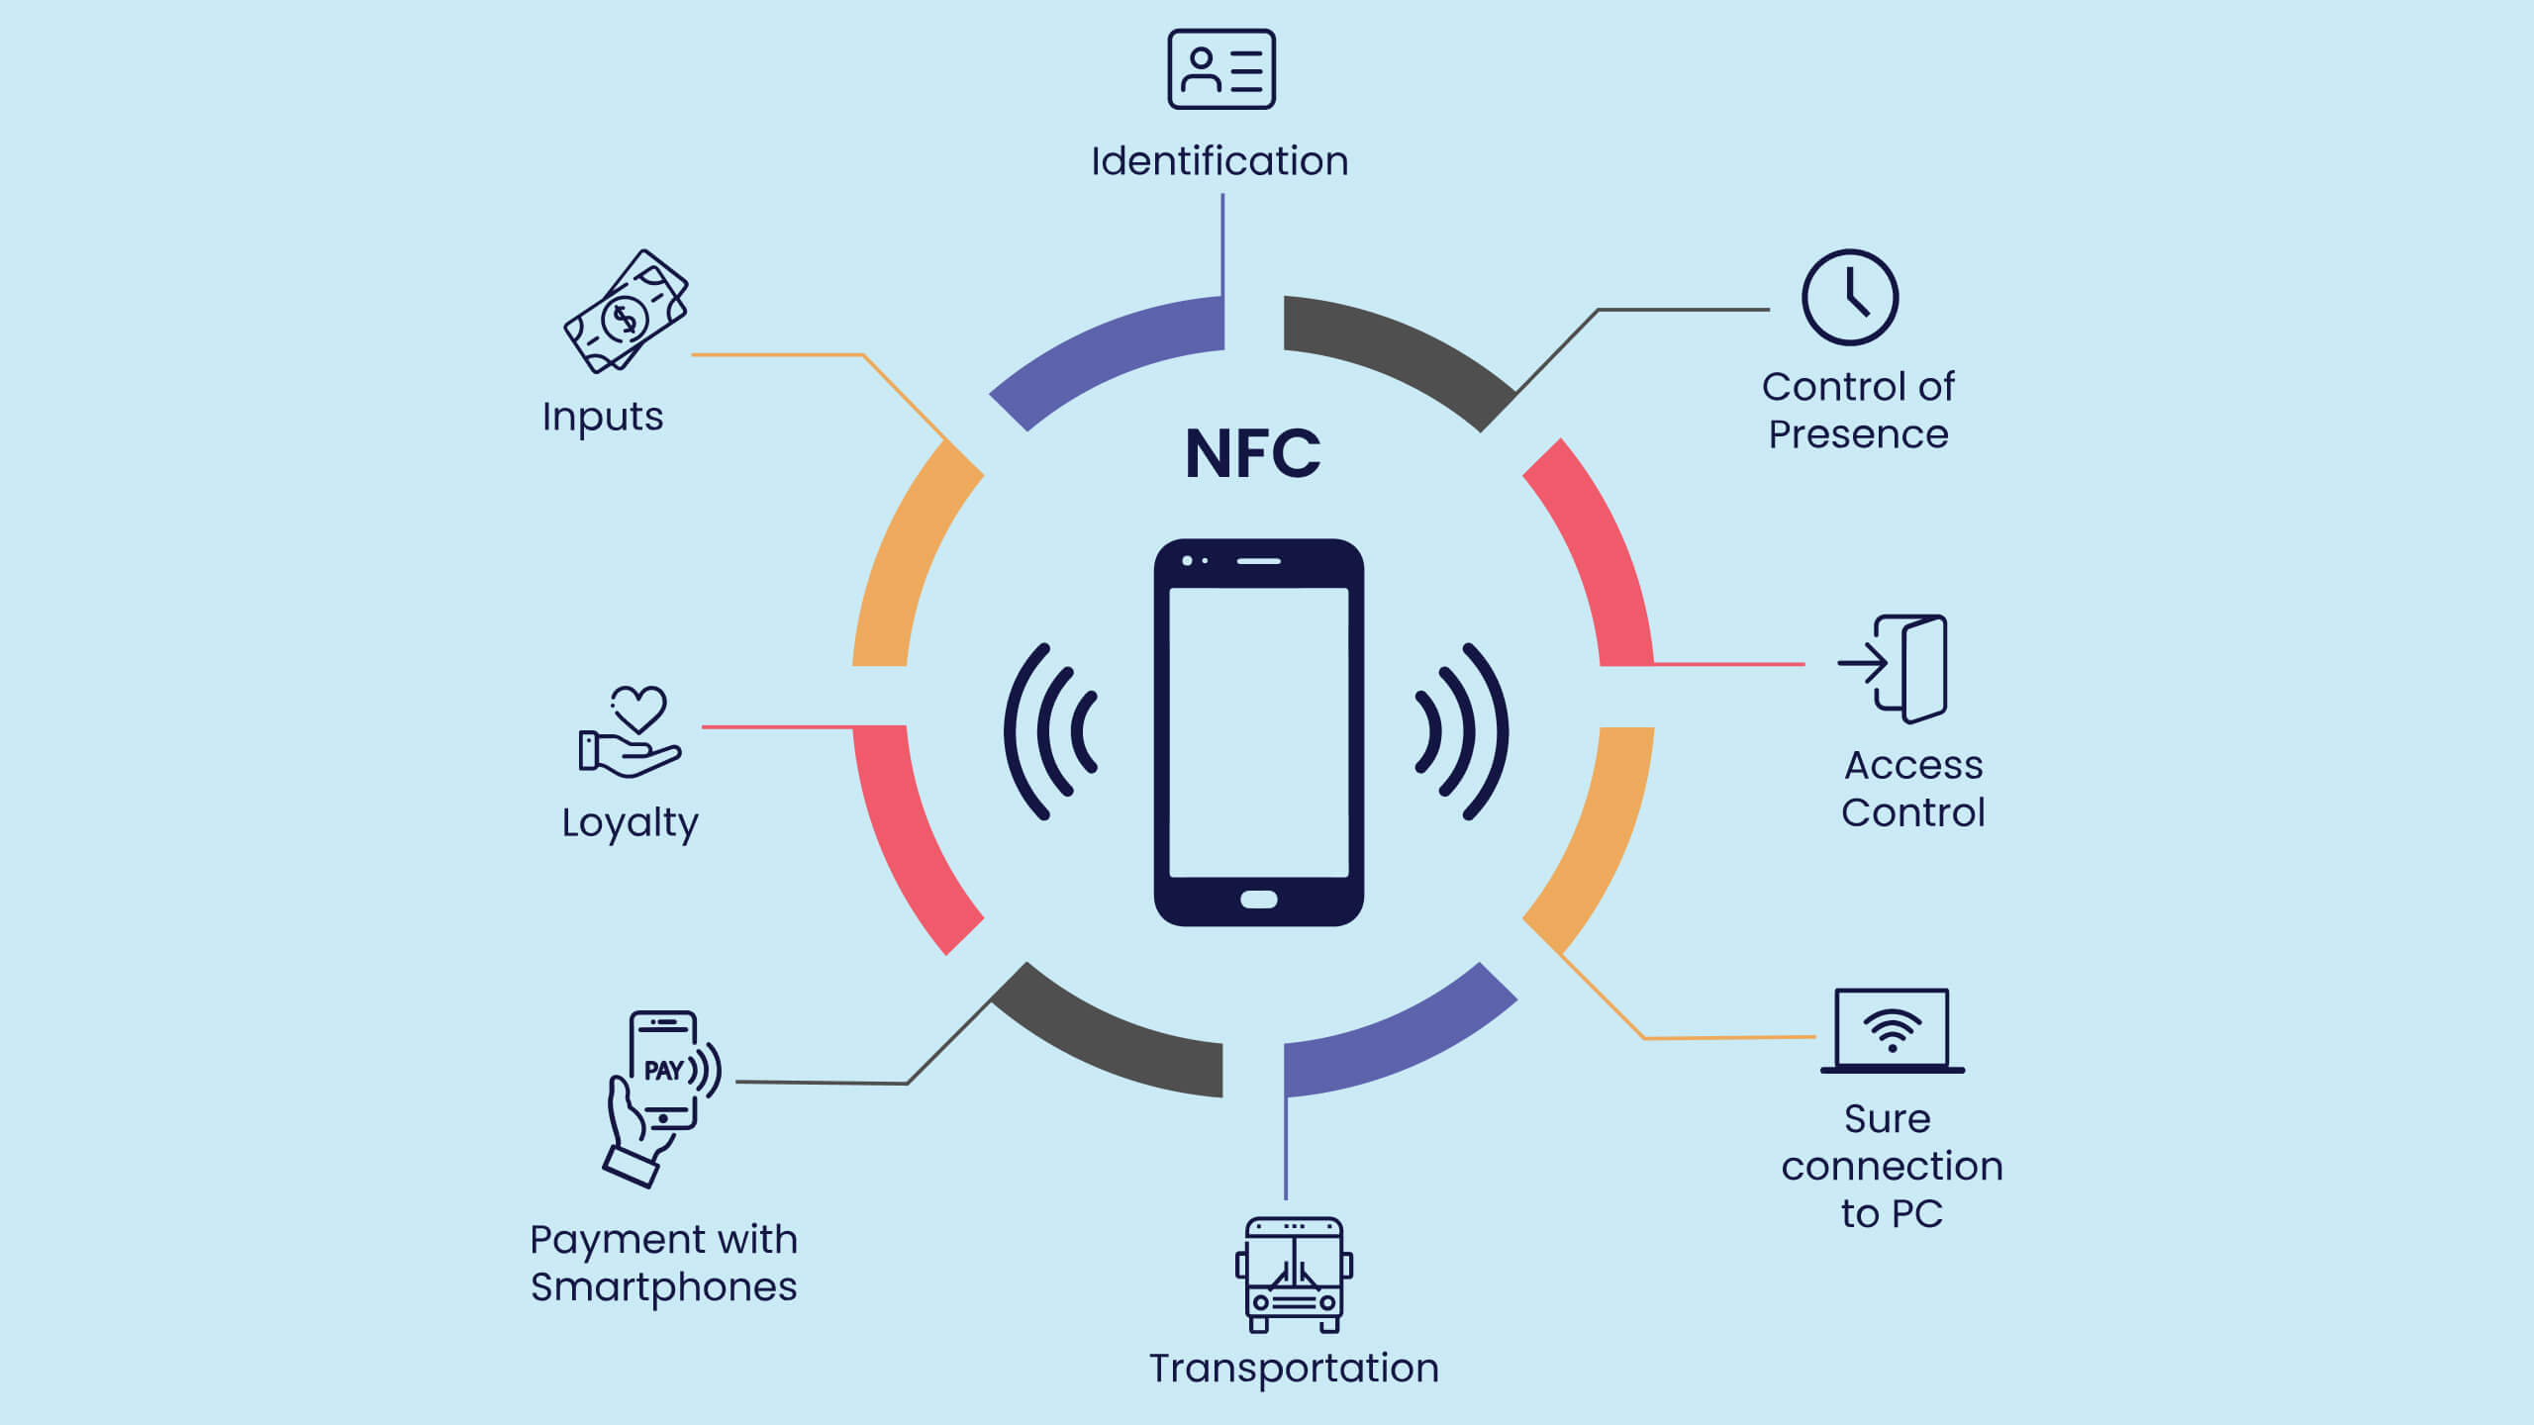
Applications of NFC
https://www.rfid-smart.com/blog/rfid-journal/nfc-facts-and-applications-that-will-broaden-your-mind.html

Slide 6
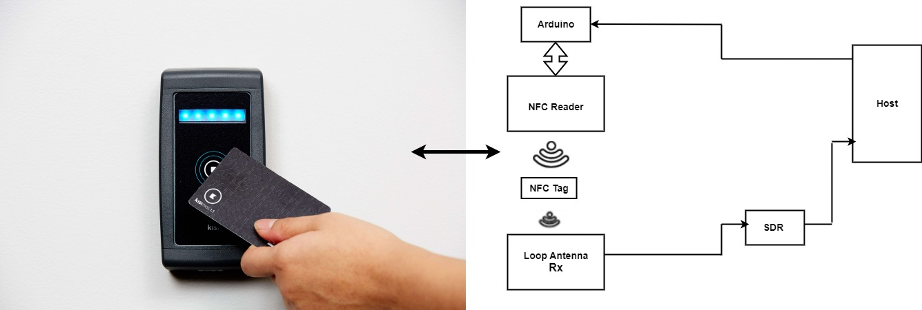
NFC Contactless Payment System with Signal Analysis Setup

Slide 7
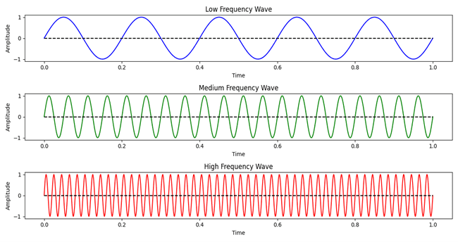
Waveform and Properties
- What are waveforms?
Visual representations of signals used in telecommunications to convey information.
Examples: sound, video, data.
Signals are transmitted through mediums like air and cables.
Receivers convert the signals back into their original form (e.g., sound, image).
- Types of waveforms:
Sine waves: Smooth, periodic oscillations.
Square/rectangular waves: Abrupt transitions between voltage levels.
Triangular/sawtooth waves: Linear voltage changes with time.

Slide 8
Waveform and Properties
- Key properties of waveforms:
Wavelength (λ): Distance between two consecutive points in a wave that are in phase.
Amplitude: Maximum strength or height of the wave, relating to signal intensity.
Frequency: Rate at which a waveform repeats itself per second (measured in Hertz).
Period: Time it takes for one complete cycle of the wave.
Phase: Relative timing or alignment of a waveform with respect to another waveform.

Slide 9
Significance of Waveform Properties
- Understanding waveform properties is crucial for:
Signal analysis: Extracting information and meaning from signals.
System optimization: Improving efficiency and performance of telecommunication systems.
Troubleshooting: Identifying and resolving signal issues.
- Applications:
Telecommunications: Ensuring clear transmission of voice, data, and video.
Signal processing: Filtering, amplifying, and manipulating signals for various purposes.
Data analysis: Understanding patterns and trends in data represented as signals.
By analyzing properties like wavelength, amplitude, frequency, and phase, we gain valuable insights into signal behavior and optimize telecommunication systems for better performance.

Slide 10
Equipment and Software
- In this session, we will use several essential tools and software:
Hardware: PN5180 NFC Reader, Arduino Uno, ISO15693 NFC Tag, RTL-SDR Dongle, jumper wires, and optionally, a breadboard.
Software: Arduino IDE for coding, PN5180 library, SDR Sharp for signal capture, and Python for signal processing.

Slide 11
Introduction to Software Defined Radio (SDR)
- Overview
Transceiver programmable for various signals.
Software performs radio signal processing tasks.
- Key Features:
Versatility and adaptability in radio systems.
Functions like a desktop computer with reprogrammable devices.
- Flexibility Through Software:
Receives/transmits radio protocols via updates.
Efficient spectrum utilization without hardware changes.
- Communication Solutions:
Addresses diverse needs: data transmission, voice calls, etc.
Cost-effective for providers, developers, and users.
- Advantages:
Unparalleled flexibility, upgradability, and security, enables multifunctionality and adaptability.

Slide 12
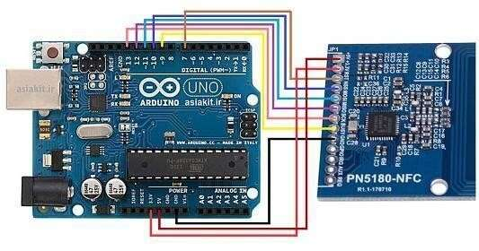
Arduino with NFC technology
- Hardware Setup:
Connect the PN5180 NFC reader to the Arduino Uno.
Ensure the correct wiring setup for power, ground, and data connections.
- Software Installation:
Install the necessary libraries in the Arduino IDE.
These libraries will provide functions to initialize the NFC reader and detect tags.
- Code Upload:
Write or upload the appropriate code into the Arduino IDE.
Upload the code to the Arduino, enabling it to scan for ISO15693 tags.
- Operation:
The Arduino will read the unique identifiers (UIDs) of detected tags.
Display the UID information in the Serial Monitor within the Arduino IDE.
- Outcome:
This setup allows for efficient detection of NFC tags and retrieval of their data

Slide 13
The Communication between the Reader and the Tag.
Every transaction is initiated by the reader, and only one participant (either the reader or the transponder) communicates information at any given time.
A data packet starts with a start-of-frame (SOF) signal and ends with an end-of-frame (EOF) signal. A data packet enclosed by an SOF and an EOF is termed a frame.

Slide 14
PN5180 Reader to ISO15396 Tag Communication
Transaction Initiation: Reader always initiates communication. Only one participant (reader or transponder) is active at any given time.
Data Packet Structure: Data packets are enclosed by a Start-of-Frame (SOF) and End-of-Frame (EOF) signal.
- Start-of-Frame (SOF): The SOF pattern utilizes two modulation pauses. The position of the second pause determines whether the frame uses the "1 out of 256" or "1 out of 4" data coding mode.
- Two Pulse-Position Data Coding Modes:
"1 out of 256" mode: 1 byte transmitted in 4.833 milliseconds, resulting in a data rate of 1655 bits per second (bps).
The byte's value is conveyed by the position of a modulation pause within the 4.833 milliseconds timeframe.
"1 out of 4" mode: 2 bits transmitted within 75.52 microseconds, equivalent to a data rate of 26,484 bps.

Slide 15
PN5180 Reader to ISO15396 Tag Communication
Start of Frame 1 out of 4
Start of Frame 1 out of 256
µ
µ
~9,44
s
~9,44
µ
s
~9,44
µ
s
µ
~9,44
s
~9,44
µ
µ
s
µ
~37,76
s
~37,76
s
~37,76
s
µ
~37,76
s

Slide 16
PN5180 Reader to ISO15396 Tag Communication Data Packet in the 1 out of 4 Coding Mode
Byte Transmission: A byte is transmitted by concatenating four 2-bit transmissions, with the least significant 2 bits sent first.
Pulse Position Modulation: The position of a modulation pause within the 75.52 microseconds timeframe indicates the value of the 2 bits being transmitted.

Slide 17
PN5180 Reader to ISO15396 Tag Communication Data Packet in the 1 out of 4 Coding Mode
“00”
Pulse position for
µ
~9,44
s
µ
~9,44
s
µ
~75,52
s
“01”
Pulse position for
(
1 = LSB
)
µ
~28,32
s
µ
~9,44
s
µ
~75,52
s
“10”
Pulse position for
(0
= LSB
)
µ
~47,20
s
µ
~9,44
s
µ
~75,52
s
“11”
Pulse position for
µ
~66,08
s
µ
~9,44
s
µ
~75,52
s

Slide 18
PN5180 Reader to ISO15396 Tag Communication End of Frame
Duration: The EOF pattern transmission lasts for 37.76 microseconds.
Consistency: The EOF pattern is identical for both "1 out of 256" and "1 out of 4" coding modes.
Structure: The EOF pattern consists of one modulation pause.
µ
µ
~9,44
~9,44
s
s
µ
~37,76
s

Slide 19
PN5180 ISO15396 Tag to Reader Communication
Frequency Usage: The transponder communicates with the reader using one or two subcarriers, with frequencies of 423.75 kHz and 484.25 kHz. The choice of using one or two subcarriers is indicated in the request data frame.
Data Rate: The data rate of the response frame is determined by the data rate flag in the request data frame. A low data rate is around 6600 bps, while a high data rate is approximately 26,500 bps.

Slide 20
PN5180 ISO15396 Tag to Reader Communication
- Start of Frame (SOF) Transmission
- Single Subcarrier (High Data Rate):
The SOF is sent in roughly 151 microseconds.
The transponder doesn't modulate for 768 cycles, then modulates for 16 cycles and repeats this pattern 24 times.
This is followed by logic 1.
- Two Subcarriers (High Data Rate):
The SOF is transmitted in approximately 149.8 microseconds.
Like the single subcarrier case, the transponder doesn't modulate for 14 cycles, then modulates for 16 cycles, repeating this 27 times.
This is followed by logic 1

Slide 21
PN5180 ISO15396 Tag to Reader Communication Start of Frame
Tag to Reader SOF, single subcarrier.
Tag to Reader SOF, two subcarriers.
µ
µ
µ
µ
µ
µ
~55,75
s
~56,64
s
~37,46
~56,64
s
s
~56,64
s
~37,76
s

Slide 22
PN5180 ISO15396 Tag to Reader Communication Data Packet Transmission with Single Subcarrier
- It transmits one bit within 37.76 microseconds using a single subcarrier.
Logic 0 Encoding
16 cycles of modulation followed by 256 cycles of no modulation, repeated 8 times.
Logic 1 Encoding
No modulation for 16 cycles, followed by 16 cycles of modulation, repeated 8 times.
µ
~18,88
µ
s
~18,88
s
µ
~37,76
µ
s
~37,76
s

Slide 23
PN5180 ISO15396 Tag to Reader Communication Data Packet Transmission with Two Subcarriers
It transmit one bit within 37.76 microseconds using two subcarriers for redundancy.
Logic 0 Encoding
Subcarrier 1: 16 cycles of modulation followed by 16 cycles of no modulation, repeated 8 times.
Subcarrier 2: 14 cycles of modulation followed by 14 cycles of no modulation, repeated 9 times.
Logic 1 Encoding
Subcarrier 1: No modulation for 16 cycles, followed by 16 cycles of modulation, repeated 8 times.
Subcarrier 2: 14 cycles of no modulation followed by 14 cycles of modulation, repeated 9 times.
µ
µ
~18,58
~18,88
s
s
µ
µ
~37,46
~37,46
s
s

Slide 24
PN5180 ISO15396 Tag to Reader Communication End of Frame
Single Subcarrier
It transmit a logic 0, alternating between 16 cycles of modulation and 16 cycles of no modulation for a total of 24 times. This is followed by 768 cycles of no modulation.
Two Subcarriers
Subcarrier 1: Transmit a logic 0, alternating between 16 cycles of modulation and 16 cycles of no modulation for a total of 24 times.
Subcarrier 2: Transmit a logic 0, alternating between 14 cycles of modulation and 14 cycles of no modulation for a total of 27 times.
µ
µ
µ
~37,46
s
~56,64
s
~55,75
µ
µ
µ
s
~37,76
s
~56,64
s
~56,64
s

Slide 25
Inventory Request and Response Commands
SOF | Flags | Inventory | AFI | Mask Length | Mask value | CRC16 | EOF
 | 8 bits | 8 bits | 8 bits | 8 bits | 0-64 bits | 16 bits
SOF | Flags | DSFID | UID | CRC16 | EOF
 | 8 bits | 8 bits | 64 bits | 16 bits
Inventory request format
Inventory response format

Slide 26
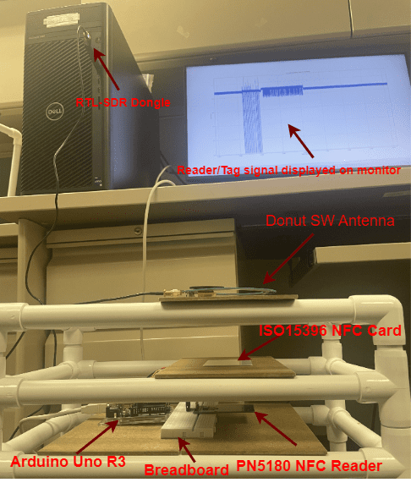
Measurement Setup

Slide 27
Data Acquisition and Analysis Workflow
Signal Generation: The NFC-PN5180 reader transmits a signal to the ISO15396 tag.
Signal Capture: The SDR dongle receives the signal and captures the raw IQ samples.
Data Saving: SDR# software saves the captured IQ samples to a file for further processing.
Data Analysis: Python with libraries is used to read, process, and visualize the IQ samples, allowing for analysis of the NFC signal characteristics (e.g., amplitude, frequency, modulation, framing).
(Examples of visualized signals can be shown using the provided graphs)

Slide 28
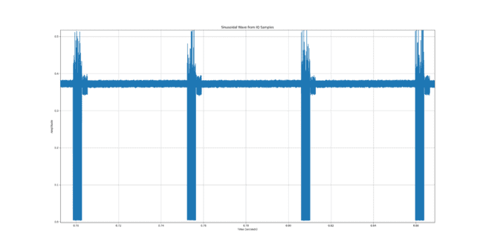
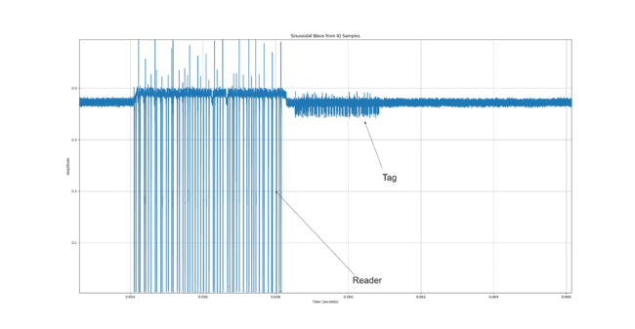
Data Acquisition and Analysis Workflow

Slide 29
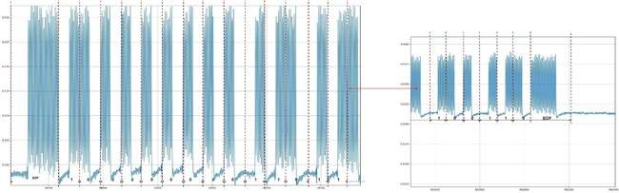
Bit Representation and Coding
In NFC communications, data is encoded using Manchester coding, a method ensuring synchronization and error minimization. Each bit is represented by a transition: a '0' has a high-to-low transition, while a '1' has a low-to-high transition within a bit period. This encoding is used in the response signals sent by the tag to the reader, maintaining data integrity. Understanding bit representation and coding is essential for analyzing NFC data frames and ensuring accurate communication. An example of encoded data from tag (frame) is shown using the provided graph.

Slide 30
Why the need for Data Acquisition and Signal Analysis?
Improved Data Security
Enhanced Signal Integrity
Optimized System Efficiency
Detection of Anomalies and Unauthorized Access

Slide 31
Conclusion
In conclusion, we successfully demonstrated the use of Near Field Communication (NFC) technology interfaced with Software Defined Radio (SDR) for signal capture and analysis. The experiment not only provided hands-on experience with NFC and SDR but also highlighted the importance of signal processing in understanding wireless communication. The results confirm that SDR, combined with Python-based signal analysis, is a powerful tool for exploring and understanding NFC technology.

Slide 32

Scan for Link to Website

Slide 33


Thank you for your attention
This project is supported by National Science Foundation under grant no. 2341846 and 2310856.
University of Nebraska – Lincoln
School of Computing
Department of Computer Science
https://computing.unl.edu/

