Slide 1
NFDI4BioImage TA3 Hackathon @ UoC

Slide 2
REMBI / Mapping
Tom Boissonnet, Vanessa Fuchs, Astrid Schauss, Andrea Schrader, Monica Valencia, Peter Zentis

Slide 3
REMBI
REMBI = REcommended Metadata for Biological Images
REMBI publication: https://rdcu.be/dsDc6.
At this Hackathon, we used a REMBI template which is used at CAi at HHU Duesseldorf.
The CAi REMBI template is adapted from the REMBI table in the supplementary information of the REMBI publication: https://doi.org/10.1038/s41592-021-01166-8.

Slide 4
Questions
REMBI and ARC:
Should REMBI go into an ARC?
Can we map ARC metadata to a REMBI template?
Can we cherrypick the metadata of the ARC to extract the REMBI aligned metadata?
Which metadata is required when submitting to an imaging repository that expect users to use REMBI? Add also other imaging-related metadata available in the ARC?
Organization of data in OMERO - using tags:
Organization of data in OMERO (project/dataset compared to tags vs. key-value-pairs) for easier mapping to and from ARC.
omero-arc-exporter related: How to handle "tags" in OMERO -> selection of metadata (subsets) for an ARC

Slide 5
Progress
Getting more acquainted with the concepts and tools
Navigated in an ARC, explored Swate, discussed about the use of templates and appropriate ontology.
Started documentation: current state of the art and the steps done for this topic at the Cologne Hackathon.
Collected possible paths of data for OMERO-ARC users:
How to import images/stacks in OMERO (e.g. do not upload tiff but lif files)
Possible combination of workflows and runs triggered from an ARC with OMERO - tools consuming input data from OMERO, retrieving output data and exporting this again into an ARC. Does this make sense?
Guidance for OMERO, learned about REMBI template, used @CAi (Vanessa Fuchs, Tom Boissonnet):
Started bringing a dataset from the example ARC into OMERO. (https://git.nfdi4plants.org/natural-variation-and-evolution/microscopy_collection/map-by-seq_clsm-stacks)

Slide 6
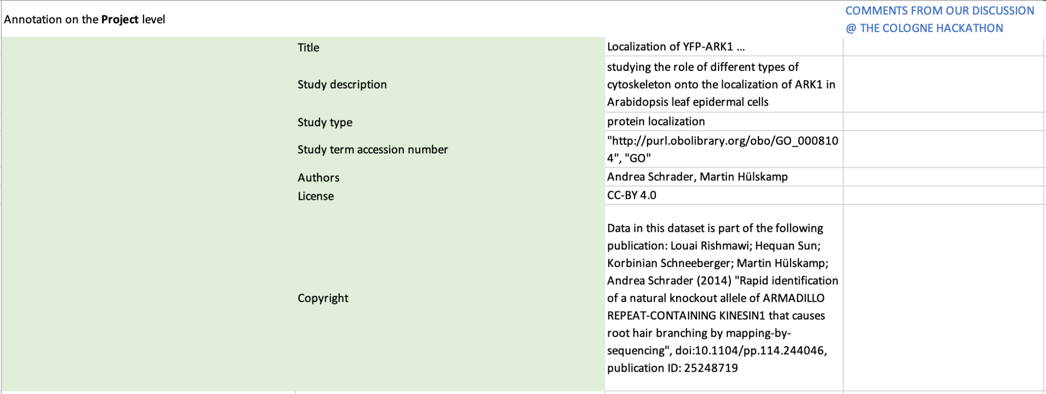
REMBI example
We used Andrea’s ARC/OMERO-data to fill in a REMBI template:

Slide 7
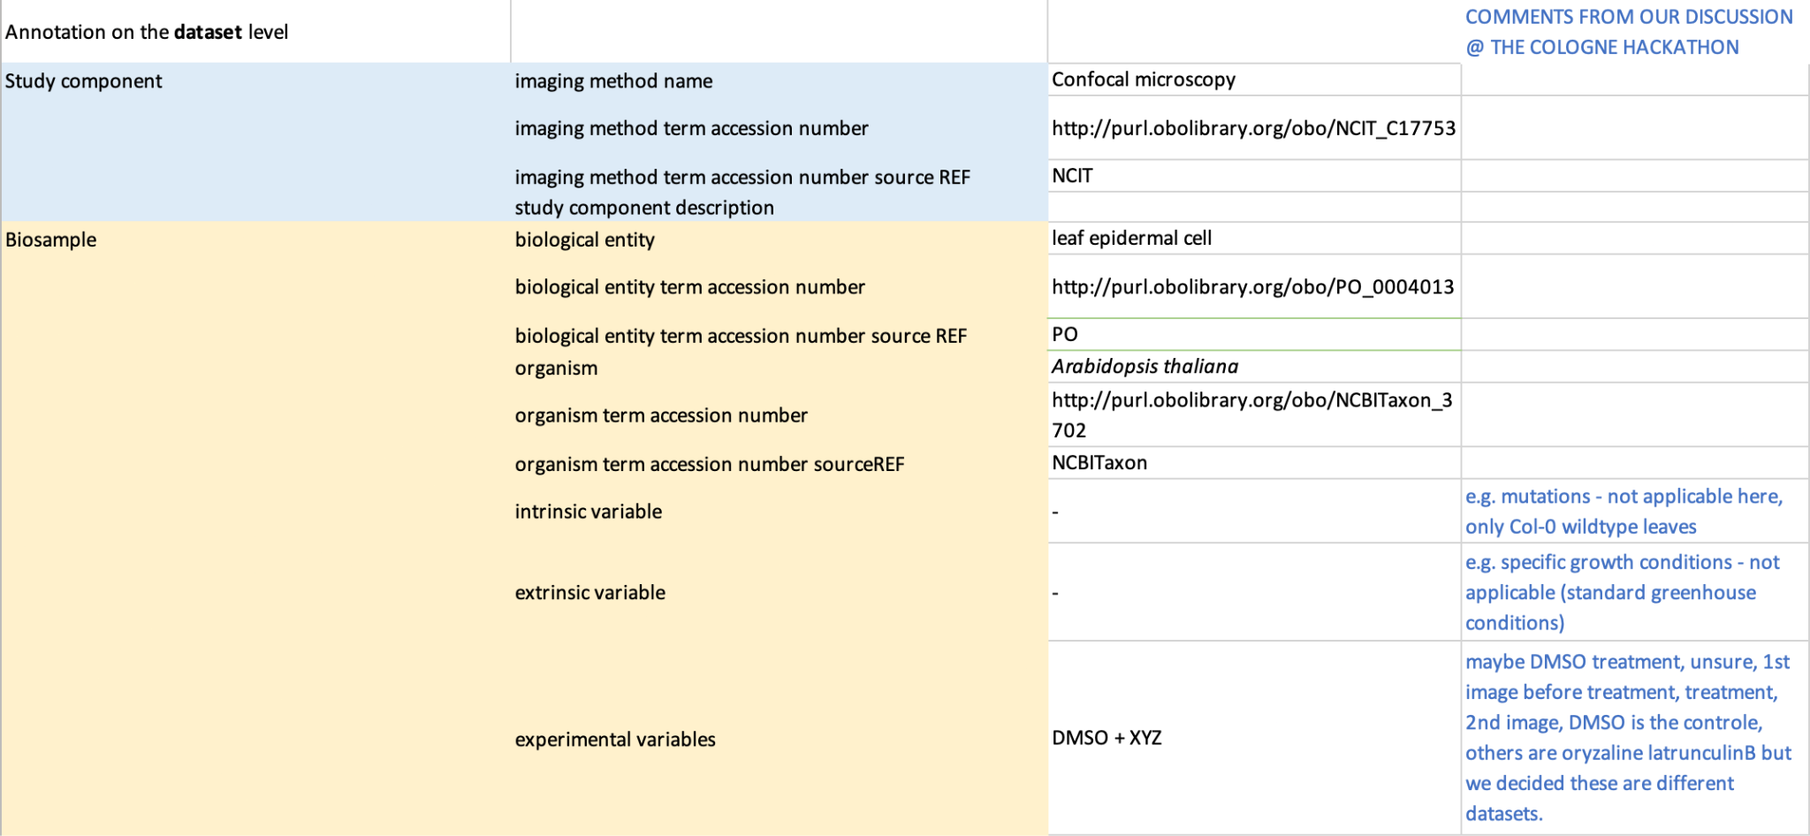
REMBI example
We used Andrea’s ARC/OMERO-data to fill in a REMBI template:

Slide 8
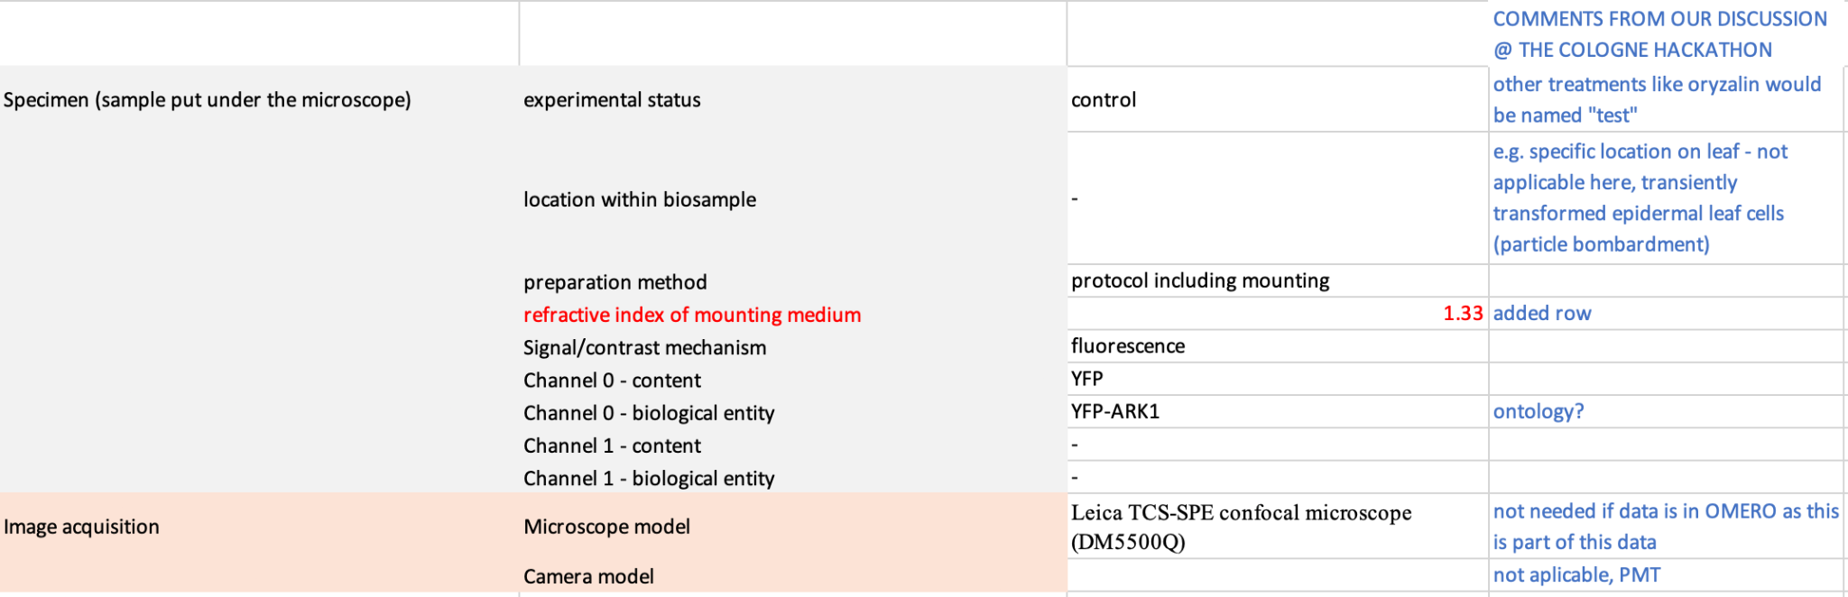
REMBI example
We used Andrea’s ARC/OMERO-data to fill in a REMBI template:

Slide 9
Export ARC (REMBI) metadata
Discussions at the Cologne Hackathon -> Tasks at the de.NBI Hackathon
Default of exporting ARC metadata for an image to OMERO
Task: Mapping between assay files and OMERO objects (what mapping do we have)
Task: Enabling to select subsets (Study, Assay)
Is it possible to assign REMBI to selected metadata in the ARC
Task: having a REMBI-SWATE-Table/-Template
Task: Provide terms and add REMBI-specific terms to the DataPLANT container ontology
Example: “Characteristic [REMBI - intrinsic variable]”

Slide 10
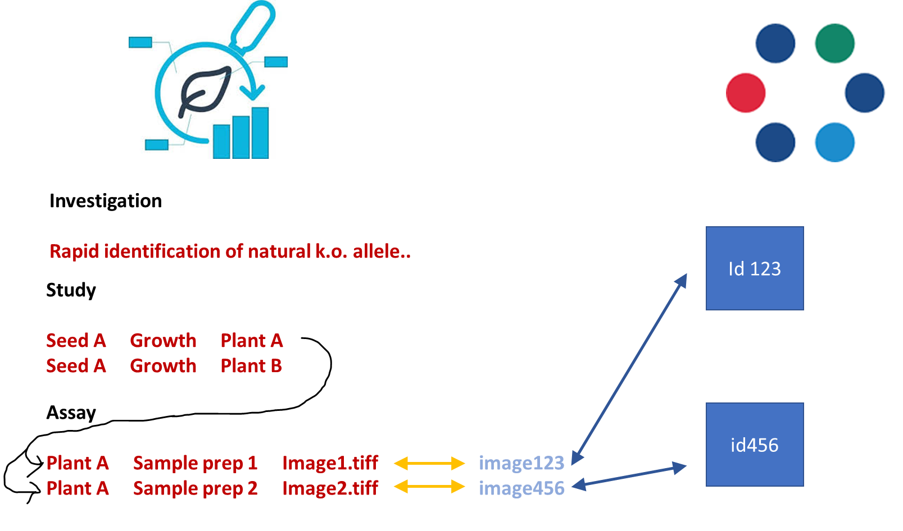
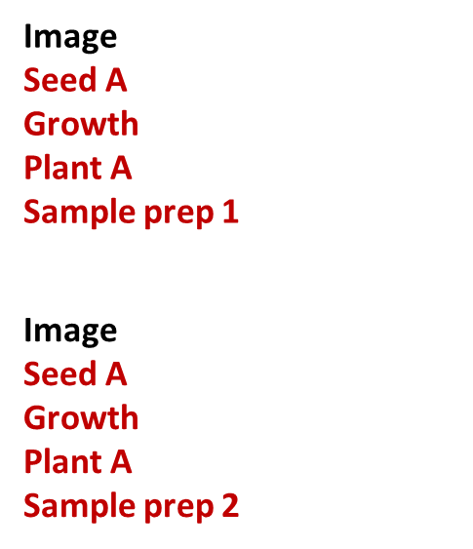
Metadata in ARC and OMERO
https://www.fz-juelich.de/de/ibg/ibg-4/aktuelles/meldungen/arc-overview.jpg
https://www.openmicroscopy.org/img/logos/ome-logomark.svg

Slide 11
OMERO-REMBI to RDF (Tom)
Progression: … 1%
RDF, need to have (some of) the REMBI terms defined / specified
(RO Crate) https://www.researchobject.org/ro-crate/
Then with OMERO.rdf , we can make a REMBI extension to map the REMBI keys to RDF
REMBI v2?

Slide 12
Outlook
With use cases
Use the current "Import KV from csv" script in OMERO to import the key-value pairs from an ARC-style isa.investigation.xlsx (script for this purpose: Peter/Tom) (https://github.com/cecad-imaging/omero-arc-testdata/tree/main)
With use cases
Go the reverse way, i.e. do all above steps for export out of OMERO into structure:
Use the OMERO-ARC-exporter
(https://github.com/cmohl2013/omero-cli-transfer/tree/arc)
Continue with OMERO-RDF

