Slide 1
NFDI4BioImage TA3 Hackathon @ UoC

Slide 2
Interoperability
Eik Dahms, Lukas Weil, Christoph Möhl, Michele Bortolomeazzi, Niraj Kandpal, Mohamed Abdrabbou, Josh Moore, Jens Wendt

Slide 3
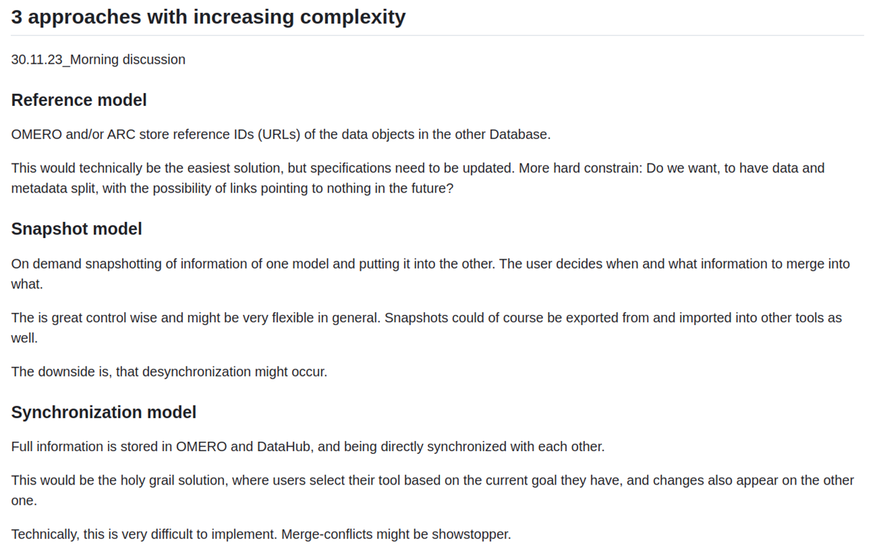
OMERO-ARC-Interaction

Slide 4
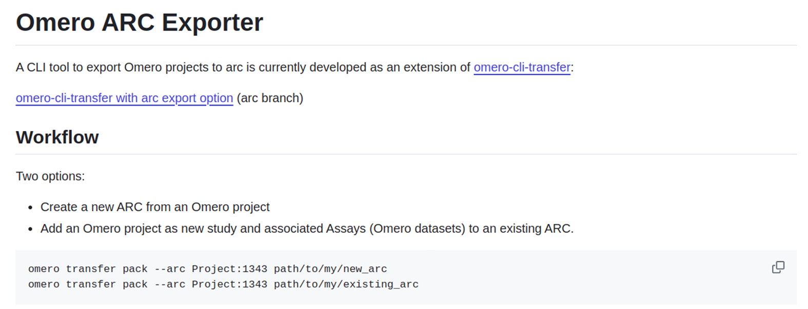
Snapshot model use case

Slide 5
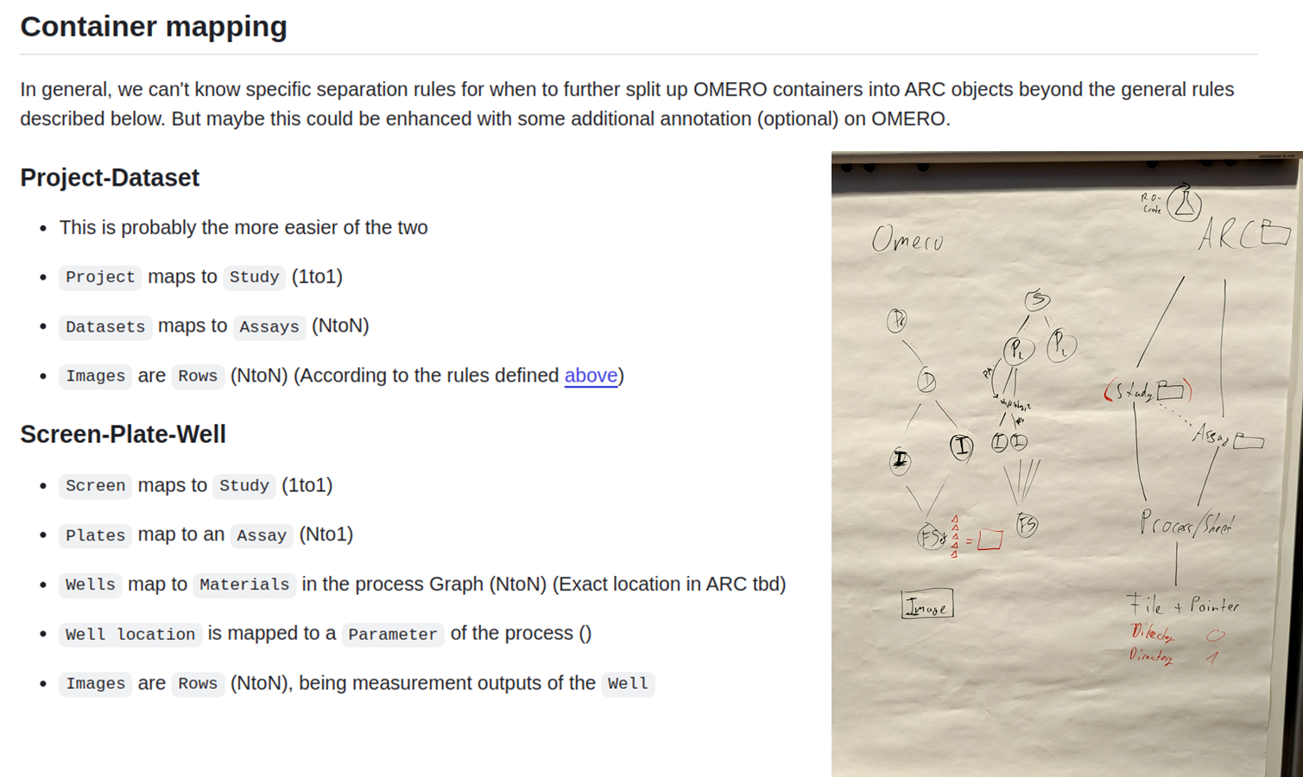

Slide 6
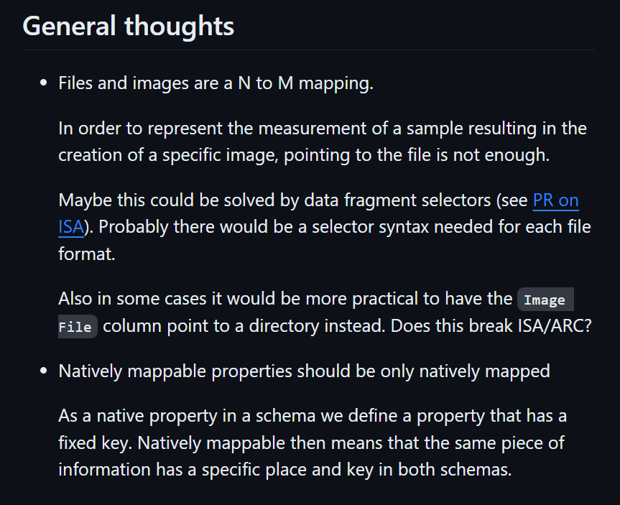
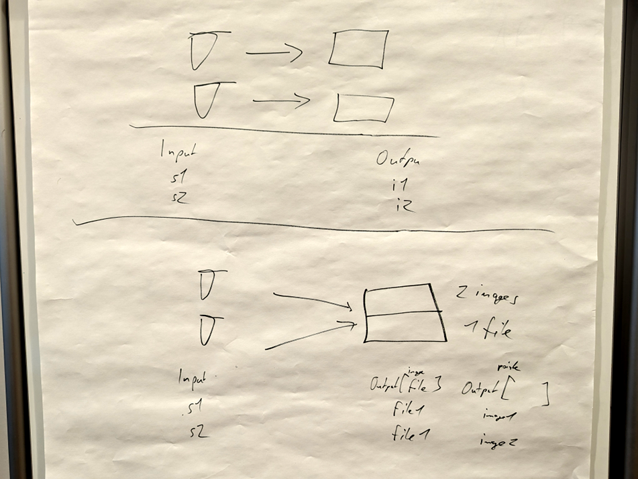
Image mapping

