Slide 1

Annotated Research Context
Heinrich Lukas Weil
Notes:
Hello and welcome to my presentation. I want to introduce you to the Annotated Research Context, or ARC in short.

Slide 2



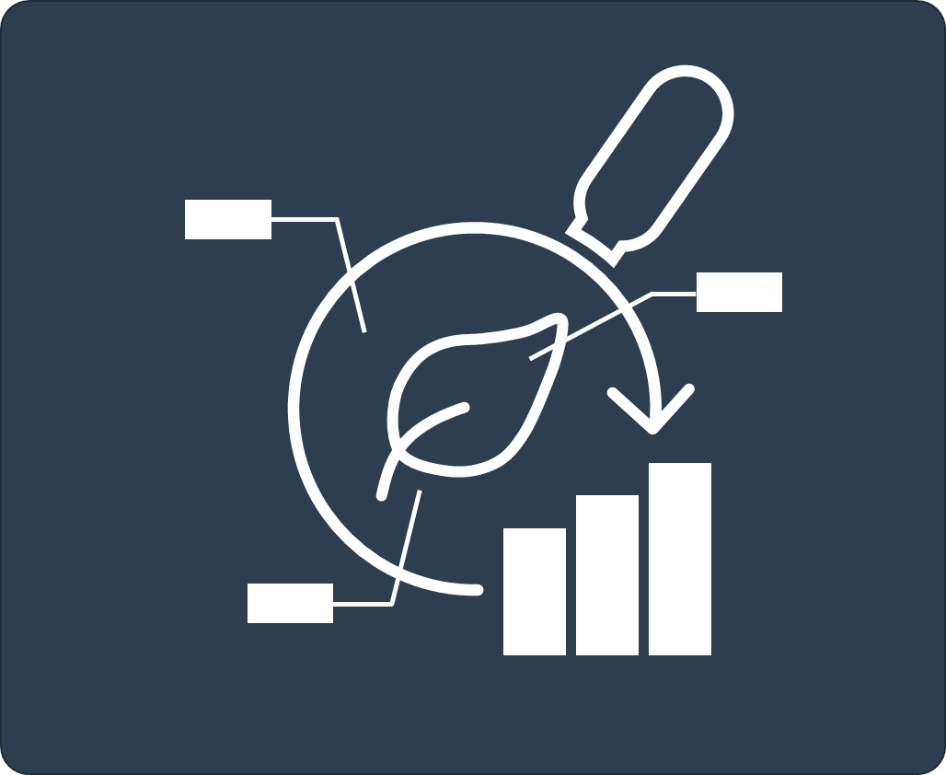
Bag your research in an ARC
(Annotated Research Context)
experimental data
computation
intensity
CAGAGGTGA
=
m/z
CAGAG
AGAGG
GAGGT
AGGTG
GGTGA
annotation
Your entire investigation in a single unified bag
https://github.com/nfdi4plants/ARC-specfication
Notes:
ARC is a structured container for storing, versioning and annotating research data

Slide 3



Bag your research in an ARC
(Annotated Research Context)
experimental data
computation
intensity
CAGAGGTGA
=
m/z
CAGAG
AGAGG
GAGGT
AGGTG
GGTGA
annotation
The content as diverse as your research
https://github.com/nfdi4plants/ARC-specfication
Notes:
The ARC is a general scaffold, which can be filled with any kind of research data.

Slide 4



FAIR in practice
data
communication
=
data collaboration
data structure

Slide 5


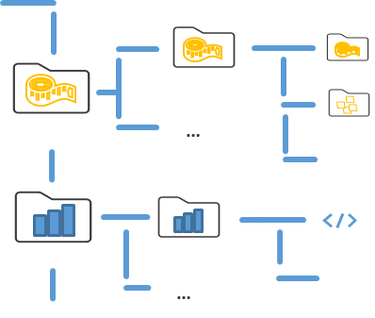
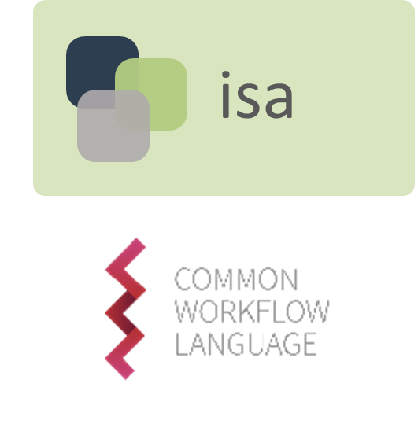
What is an ARC?
+
+
Notes:
As I said, the ARC is a structured container, so let‘s take a quick look into the structure.

Slide 6
Everything is a file
descriptor
data
Descriptor files provide context for the data files and are simply layered on top
Notes:
The structure of the ARC follows one central design principle. everything is a file.

Slide 7
“Everything is a file“ as single point of access
user
descriptor
specializes data-views
user
data
input view
output: exchange/query/representation
(meta)data
Notes:
This allows for easy access and manipulation of the information, without requiring a tool.

Slide 8
ARCs as single point of access
user
specializes data-views
user
input view
output: exchange/query/representation
(meta)data
Notes:
By structuring the files and their position, tools can easily consume ARCs too. These can then provide a flavour of access or provide other functionalities.

Slide 9
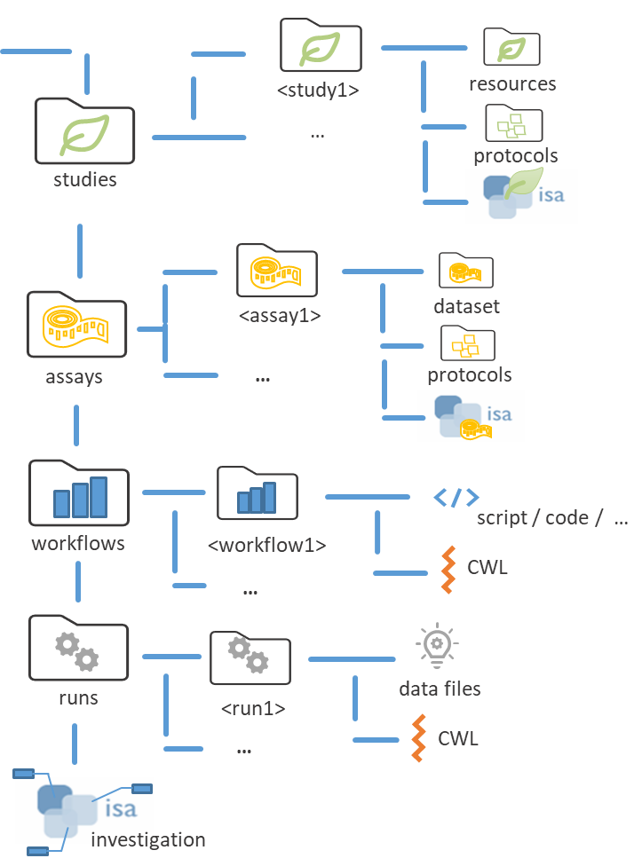
A real-world ARC is a folder structure
sample material or data
measurement data
computation / tools
processing results
Notes:
With the principle of „everything is a file“ in mind. The natural solution is a folder structure, which not only tools, but also humans understand intuitively.

Slide 10
What is an ARC?
+
+
Notes:
The file structure guarantees the file position. Now lets‘s talk about the usage of existing standards

Slide 11





ARC is built on top of existing standards
<study1>
resources
…
protocols
isa
studies
<assay1>
dataset
assays
…
protocols
workflows
<workflow1>
script / code / …
…
CWL
runs
<run1>
data files
…
CWL
investigation
Notes:
Implementing these standards allow us to understand the context of the data. For experimental data annotation we use ISA, for computational workflows we use CWL. Contextualizing the whole ARC into an RO-Crate is also one goal.

Slide 12
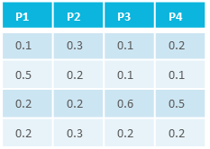
ARC is built on top of existing standards
characteristics
C₁
C₂
C₃
…
C_{n}
studies
material
samples/data
process
P₁
P₂
P₃
…
P_{n}
intensity
m/z
assays
samples
measurement
workflows
<study/assay>
result files
<run1>
<workflow1>
result files
runs
<run2>
<workflow2>
administrative metadata
Notes:
Let‘s take a closer look into experimental workflow annotation using ISA.

Slide 13
Everything is a file
Source
Parameter [´parent term’]
Sink
descriptor
´child term’
=
´child term’
´child term’
´child term’
´child term’
A
B
C
D
data
Descriptor files provide context for the data files and are simply layered on top
Notes:
Again, everything is a file. The same holds true for the descriptor files that contextualize the data. In the case of ISA-XLSX, this contextualizing metadata is stored in tabular form.

Slide 14
Combining annotation building blocks
characteristics
C₁
C₂
C₃
…
C_{n}
characteristic [tissue]
material
samples/data
´value term’
building block
characteristic [organism]
parameter [time]
+
+
Sample
Data
…
´value term’
´value term’
modular schema
Notes:
Each sheet describes the flow from input entities to output entities. For example from a sample to data, which we could consider a measurement. In between the input and the output, we describe parameteres of this processing. Both the headers and values in this table can be picked from any ontology, leading to a great amount of varibality.

Slide 15
Annotation by flattening the process graph
Source
Parameter [´parent term’]
Sink
´child term’
´child term’
´child term’
´child term’
´child term’
A
B
C
D
Low-friction metadata annotation
Familiar spreadsheet, row/column-based environment
Notes:
In tabular form it looks like this.

Slide 16
Annotation principle
Sample
Parameter [instrument model]
Data
´TripleTOF4600 ’
´TripleTOF4600 ’
´TripleTOF4600 ’
´TripleTOF4600 ’
´TripleTOF4600 ’
A
B
C
D
Low-friction metadata annotation
Familiar spreadsheet, row/column-based environment
Notes:
For example

Slide 17
Templates and checklists
=
Input
Parameter [´parent term’]
Output
´child term’
´child term’
´child term’
´child term’
´child term’
A
B
C
D
Checklists and requirements can be displayed as templates
Notes:
In specific experimental setups, similar bits of information arise. To group them and make them available when describing these experimental setups, templates can be used.

Slide 18
Realization of lab-specific metadata templates
measurements
processing
=
analysis
intensity
m/z
Sink
P1
P2
P3
…
Pn
Source
AGGTG
AGAGG
CAGAGGTGA
CAGAG
CAGAG
GGTGA
AGAGG
GAGGT
GAGGT
AGGTG
CAGAGGTGA
GGTGA
Sink
P1
P2
P3
…
Pn
Source
Notes:
A template is a prebuilt collection of headers for a specific experimental workflow.

Slide 19
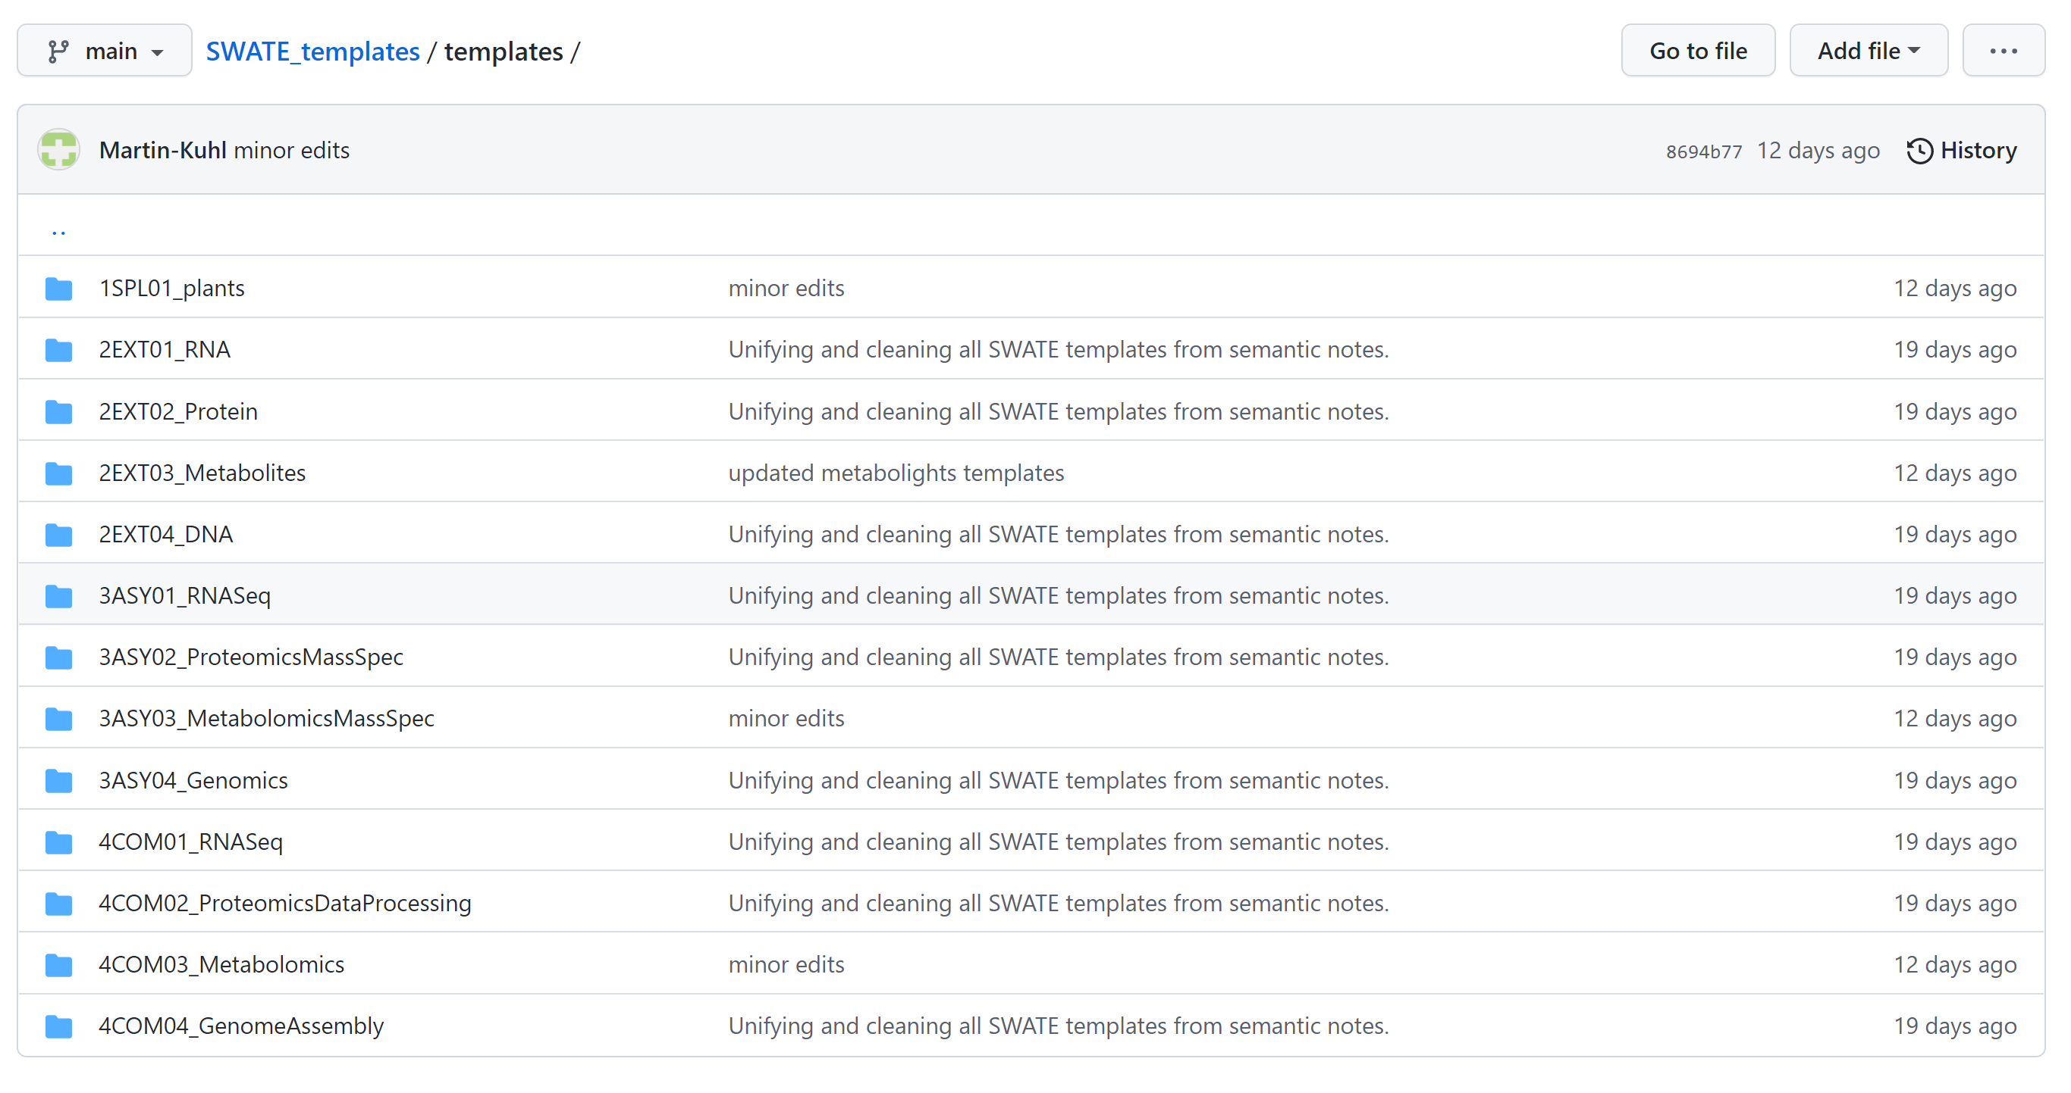
Available templates
https://github.com/nfdi4plants/SWATE_templates/tree/main/templates

Slide 20
ARC integrative model
+
+
Notes:
Now let‘s shortly talk about versioning

Slide 21
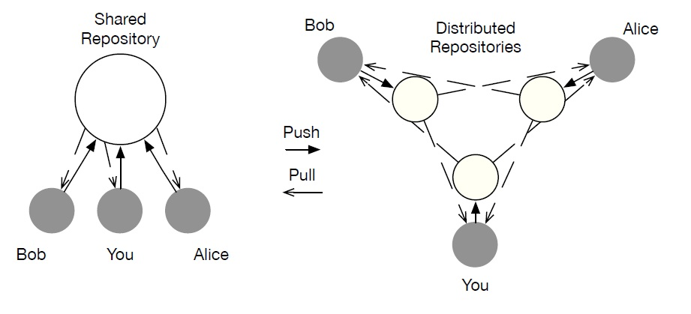

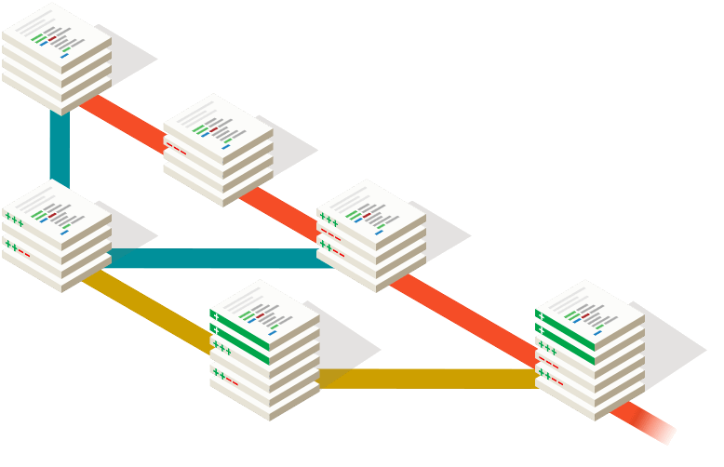
Data-centric collaboration using Git
Notes:
For versioning, we use git, which is a powerful tool for keeping track of, distributing and collaborating on your ARC

Slide 22

Continuous integration
build
test
check-in
result
result
Notes:
Besides those integrated capabilites, platforms based on git usually provide continuous integration. Continuous integration is basically an automatically triggered, computational pipeline.

Slide 23
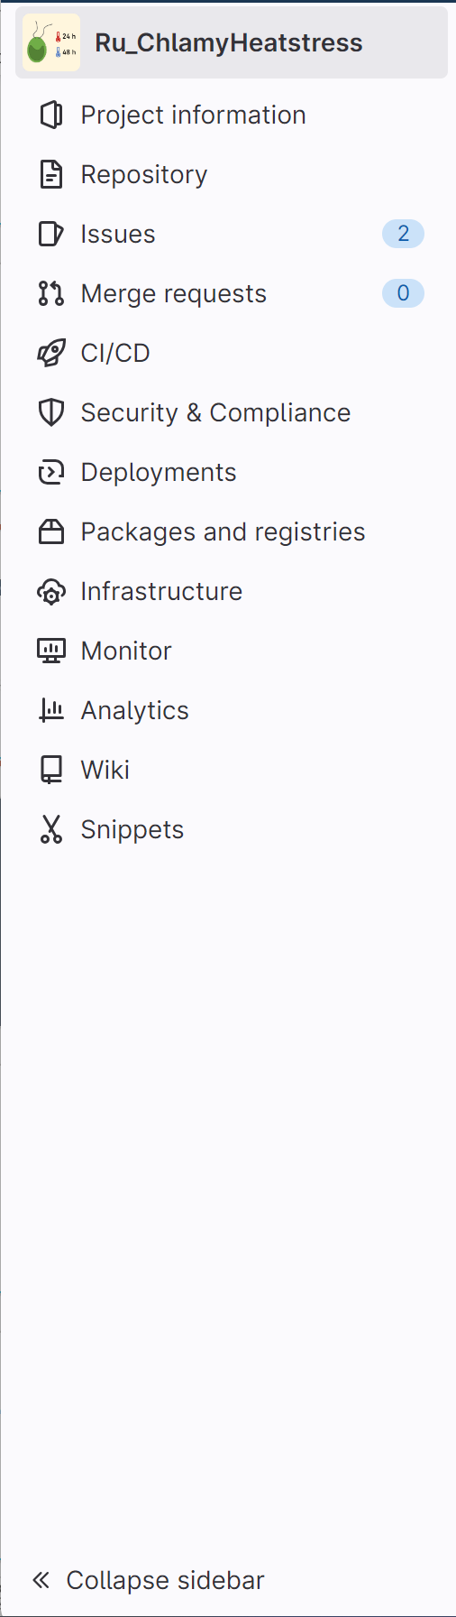
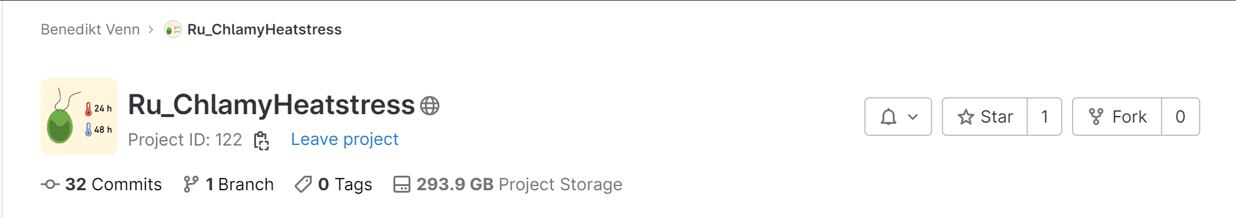
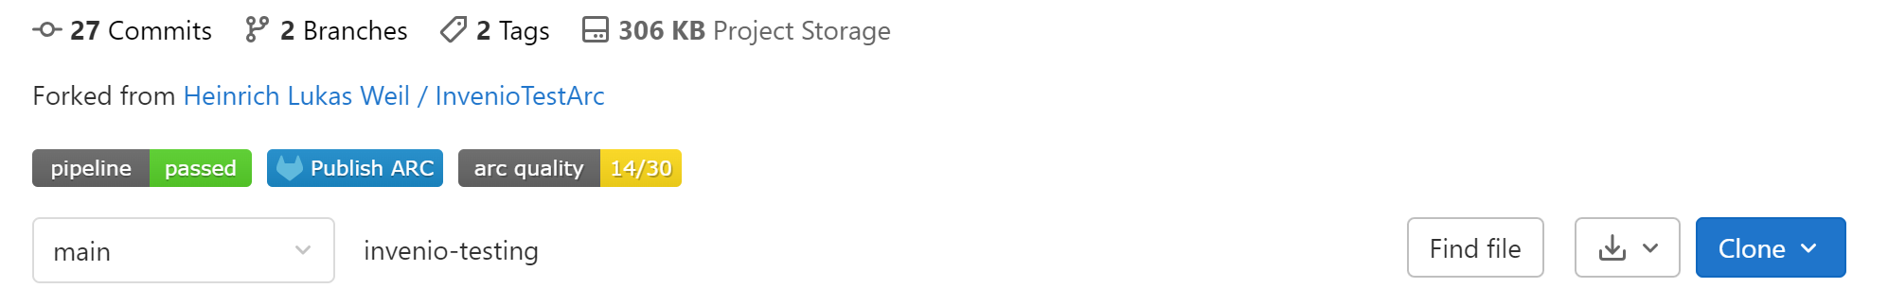
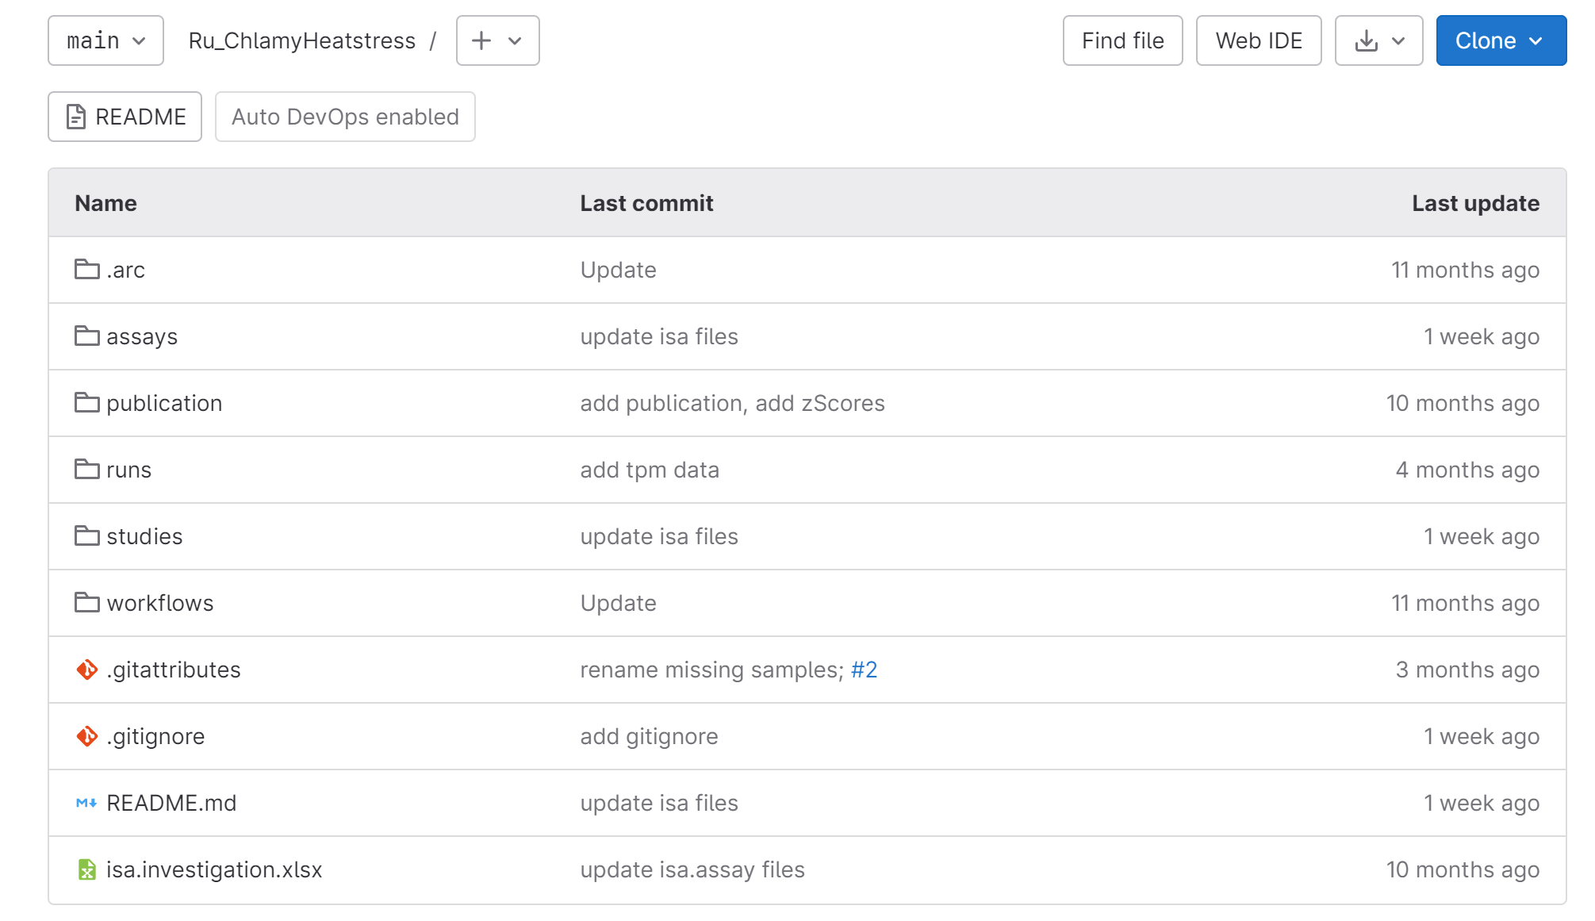
ARCs allow structured collaborative research
(even across disciplines)
Notes:
One trigger for example might be updating your data online. One possible outcome might be the creation of badges, showing you the state of your ARC.

Slide 24
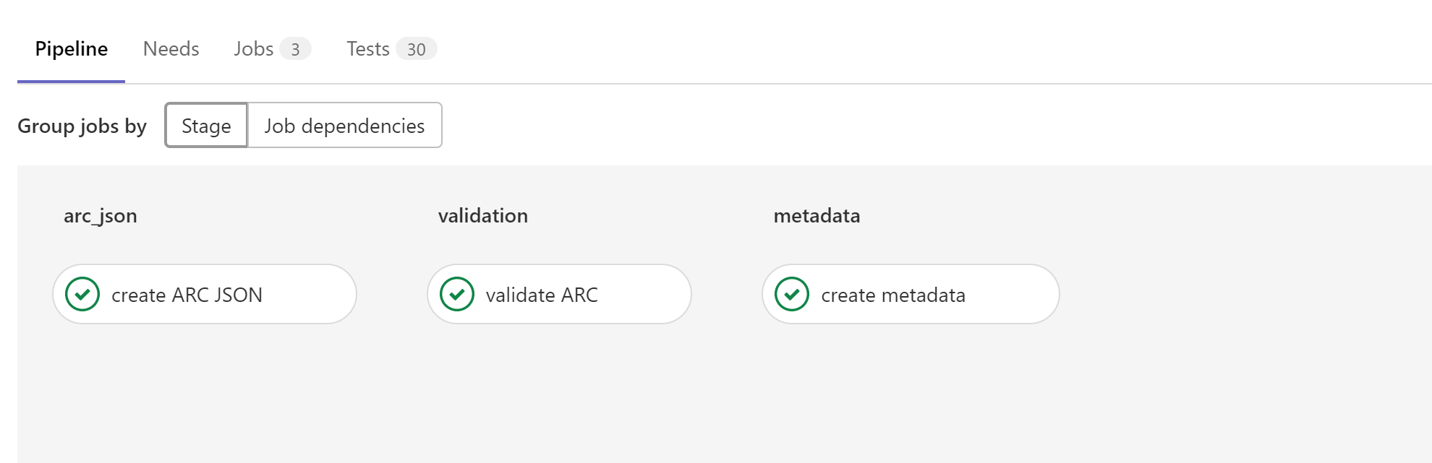
Notes:
Under the hood, different validations might take place. Besides standard structural validation, one can also validate against a predefined checklist, basically checking that the content of the ARC matches the color it is supposed to have.

Slide 25


ARCs can be published seamlessly
tools
write
read
dataset search
ISA-Tab
*
edit
CWL
RO-Crate
ARC
*
*post-commit
data publication

Slide 26
What is an ARC?
+
+
Notes:
So with this I want to wrap up the introduction of the structure and just shortly mention 2 possible integrative workflows.

Slide 27



Facility operator workflow
facility operator
<assay>
dataset
Growth
protocols
Growth
…
…
studies
studies
Proteomics
Proteomics
assays
…
assays
…
<assay2>
…
…
investigation
investigation
Persistence and identity is ensured by ARC – versioning system

Slide 28

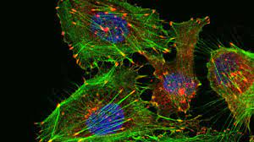
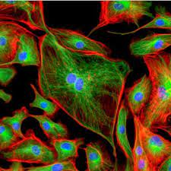
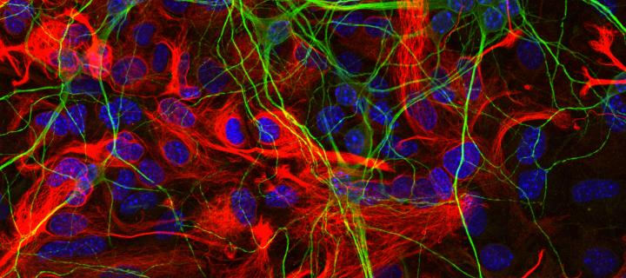
Facility operator workflow
facility operator
Imaging
assay
dataset
Growth
protocols
Growth
…
…
studies
studies
Proteomics
Proteomics
assays
…
assays
…
Imaging
…
…
investigation
investigation
Persistence and identity is ensured by ARC – versioning system

Slide 29
Extended functionality workflow
Growth
Growth
…
…
studies
studies
Proteomics
Proteomics
assays
assays
Imaging
Imaging’
…
…
…
…
investigation
investigation
Persistence and identity is ensured by ARC – versioning system

Slide 30
RO-Crate: ARC interaction model
tools
write
read
ISA
*
user
CWL
RO-Crate
(or ISA-Json)
ARC
specializes data-views
*post-commit
input view
output: exchange/query/representation
(meta)data

Slide 31
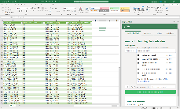





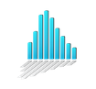

DataPLANT metadata tool chain
GitHUB
external
ontologies
Nfdi4plants ontology
Excel + swate
ARCcommander
Swate Ontology DB
(MySQL/MariaDB)
Swobup Service
converter
GitHUB
EBI: MetaboLights
metadata templates
repositories
Notes:
ARC ecosystem already has a solid tool foundation, allowing productive integration.

Slide 32
Thank you for your attention
.. and looking forward to the hacking

