Slide 1
NFDI4BioImage TA3 Hackathon @ UoC

Slide 2
3D Slicer / Neuroglancer (+OMEROzarr)
Torsten Stöter & Julia Thönnißen (Josh Moore)

Slide 3
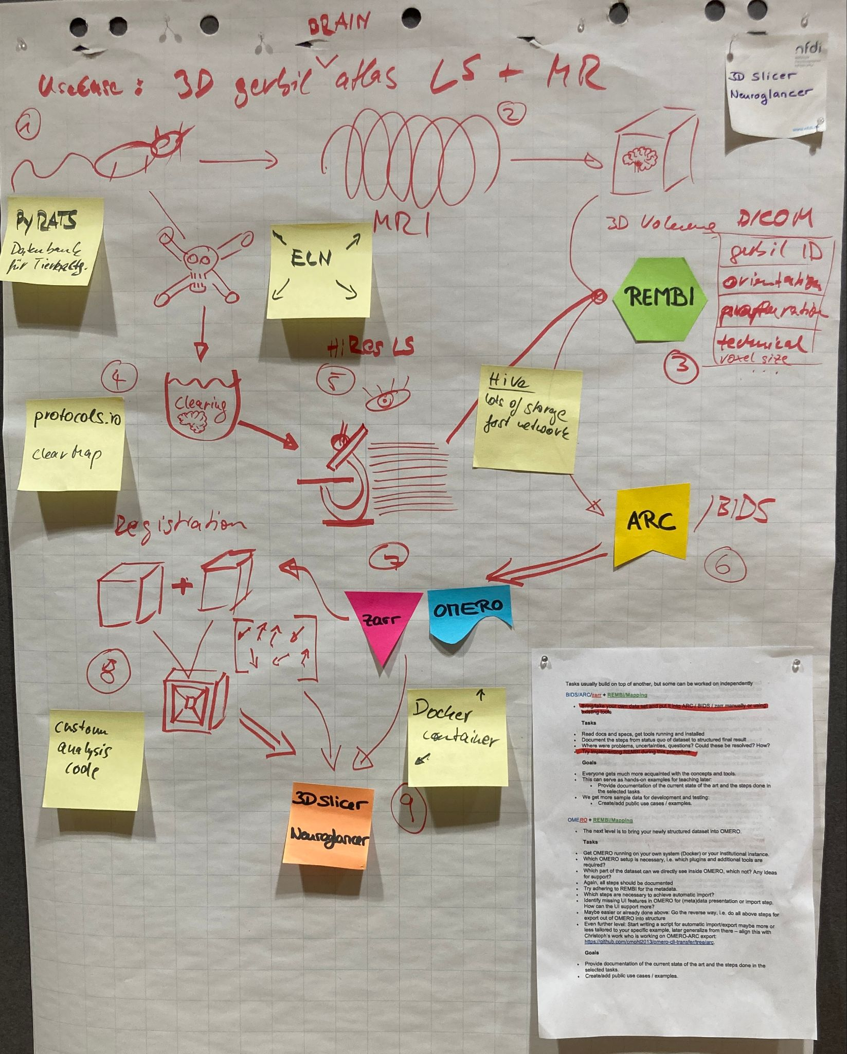
Workflow
Use case
3D gerbil brain atlas
Modalities
Lightsheet (LS)
Magnetic Resonance Imaging (MRI)
Goal
Visualize LS and MRI in neuroglancer

Slide 4

Setup
Install and start OMERO + omero-web-zarr
Install and start neuroglancer
Upload an example image to OMERO
Enter zarr URL as source in neuroglancer

Slide 5
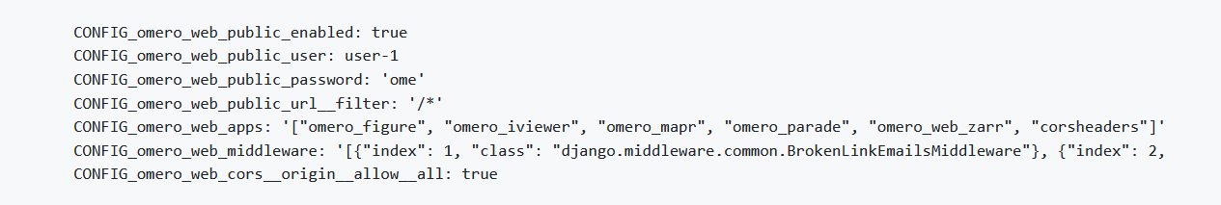
Challenges
Make dataset public

Slide 6
Challenges
Make dataset public
Cross-Origin Resource Sharing (CORS)

Slide 7
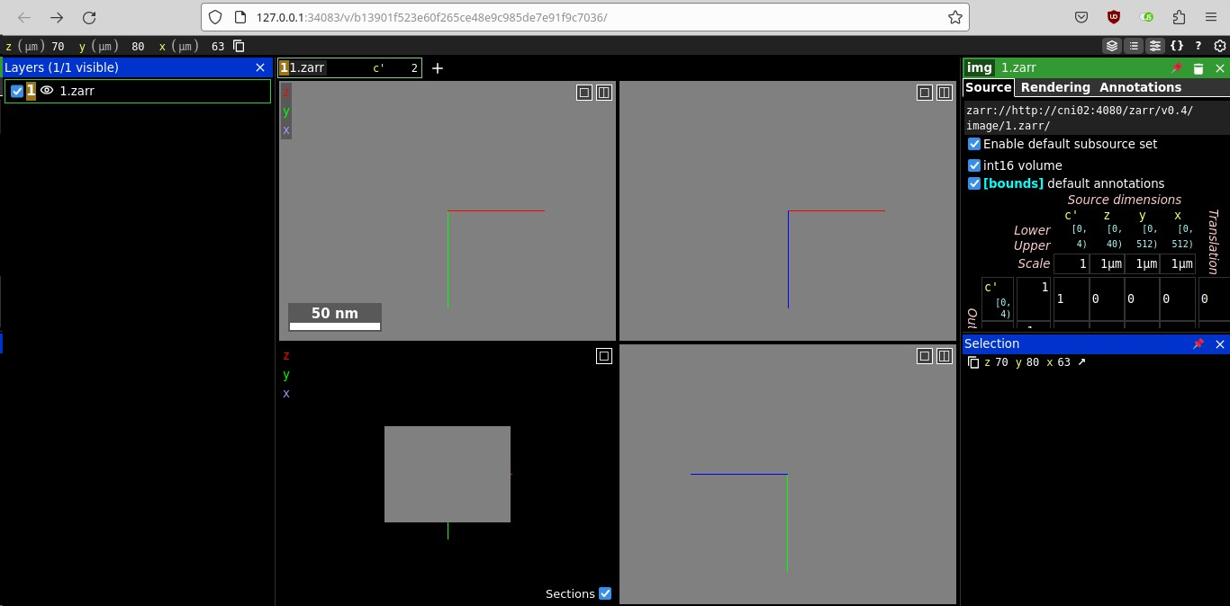
Challenges
OMERO on http
Make dataset public
CORS
http vs. https
local neuroglancer on http

Slide 8
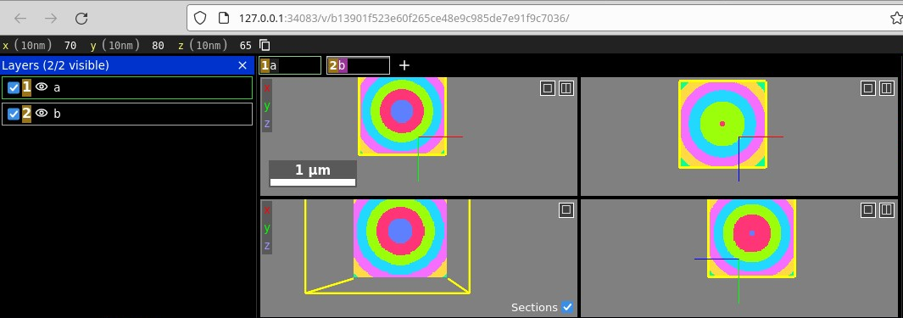
Challenges
Make dataset public
CORS
http vs. https
Viewer position
Viewer position does not align automatically to new image → adjust manually or directly start neuroglancer with zarr source

Slide 9
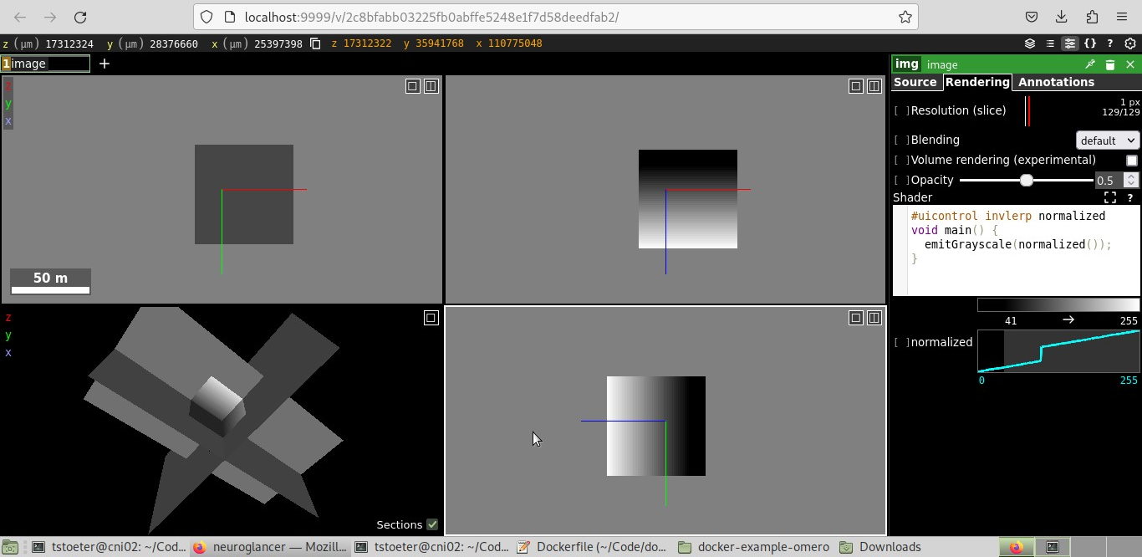
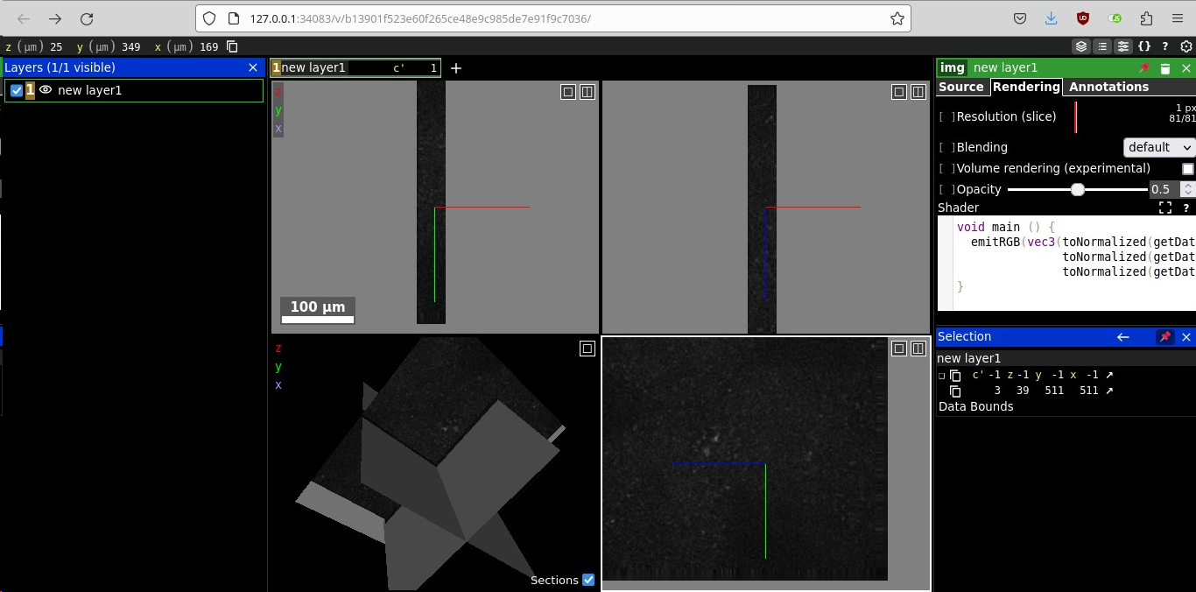
Challenges
8 bit grayscale
Make dataset public
CORS
http vs. https
Viewer position
16 bit signed integer + Shader
8 bit RGB

Slide 10
Outlook
Next steps are to get a production ready installation
Automate starting the Neuroglancer web server for any image ID
Improve shaders for 16bit and multi channel images and include sliders (documented in tutorial)
Add an "Open in Neuroglancer" button or context menu to images in OMERO
Test the reverse proxy approach, are logins and cookies preserved?
Compile a separate OMERO plugin for the Neuroglancer integration

