Slide 1

ADA SEMANTIC PUBLISHING PIPELINE CONNECTING COMPUTATIONAL PUBLISHING FOR COLLECTIONS #CP4C – USING QUARTO

Slide 2
DEMO & RUNNING QUARTO
Open Notebook – xSketchbook: Computational Publishing
Computational Publishing for Archives (Quarto) – GH Page Demo
You can fork the repo here, and there are instructions on the repo to install and make a book, as well as a for a Docker container.

Slide 3


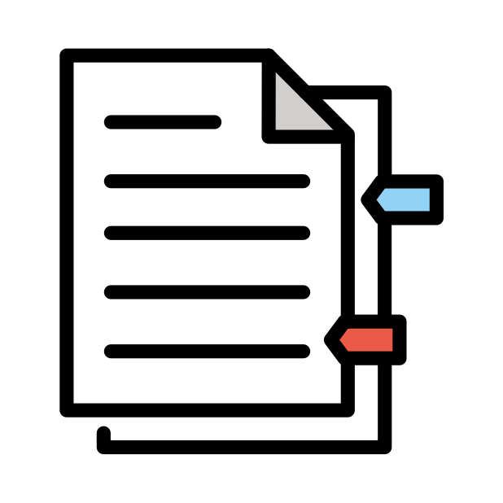



GOALS FOR WORK PACKAGE
Evaluate and select a platform Test digital objects (LOD sources and media), and queries Product PoC publication demo
Workshop with NFDI4C collection scholars
COPIM conference workshop Feb 23
Make plan for ADA integration

Slide 4
OUR QUESTIONS? Do we satisfy publishers needs? How to make it relevant for collection scholars? How to develop this into a ‚publishing from the collection‘ tool?

Slide 5
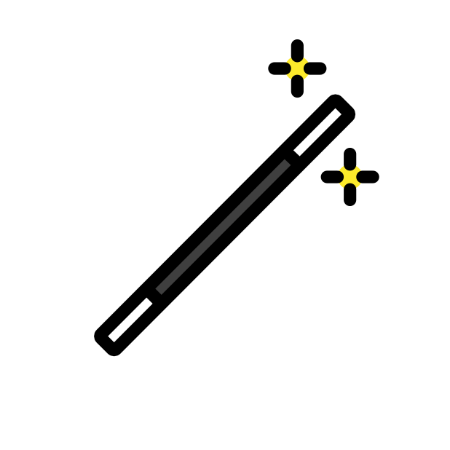
DEMO TIME! COMPUTATIONAL PUBLISHING - QUARTO

Slide 6
LINKS
Open Notebook - xSketchbook: Computational Publishing
Computational Publishing for Archives (Quarto) demo About ADA | ADA Prototype | ADA User Guide EN – DE ADA Style for NFDI4C – Digital Publication EN - DE Blogposts – Computational Publishing Pilot Project. Introducing Our Partners and Communities Nov - ’22 What is computational publishing? July - ‘22

Slide 7

THANK YOU!
CC BY-SA 4.0 | simon.worthington@tib.eu Emojis: https://openmoji.org/
Notes:
The manual and sytstem will be ready in a few weeks for beta testing

