Slide 1
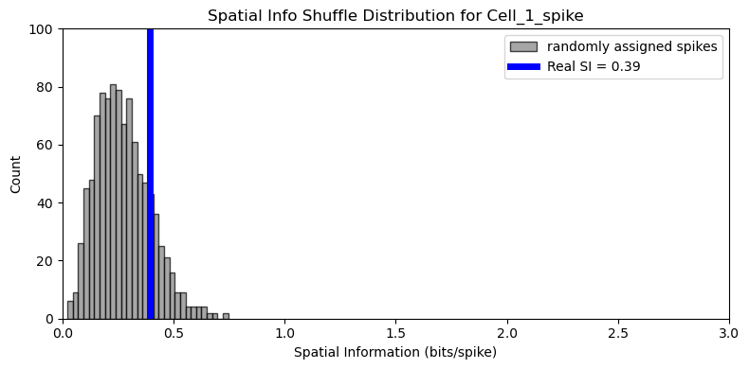
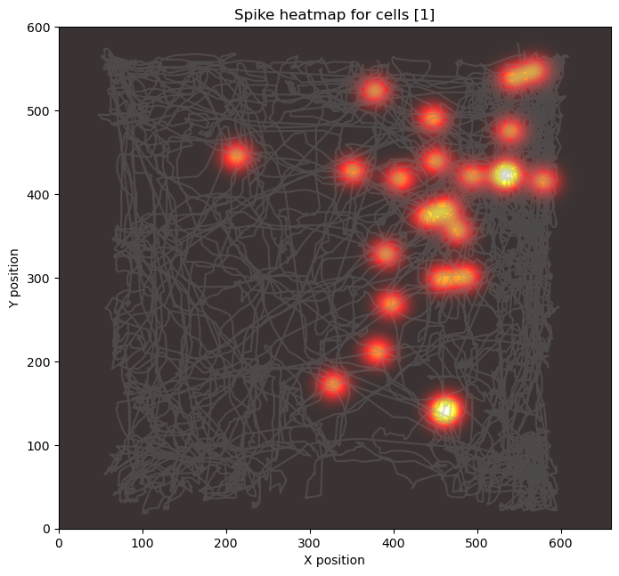
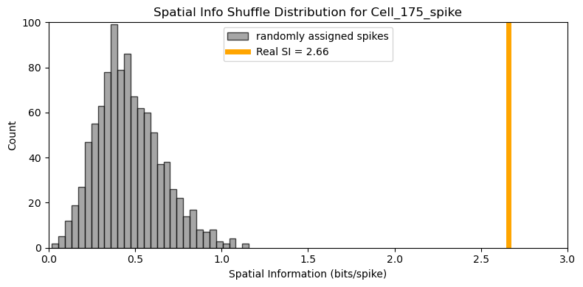
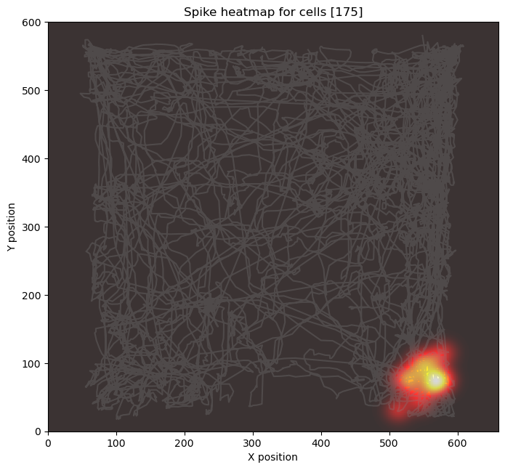
p=0.162
P<0.0001

Slide 2
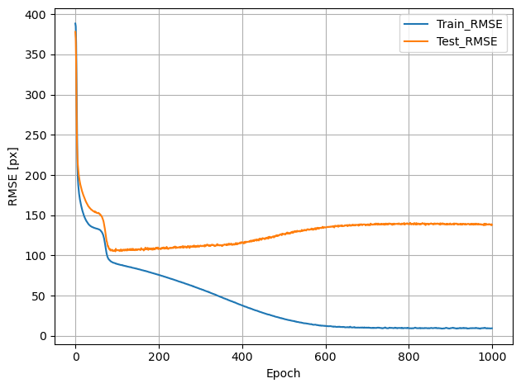
N_bins=3
N_shuffles=10
Sig_level=0.05
Bin_size=1s
Min_active_cells=2
Test_size=0.1
Lr=1e-3

Slide 3
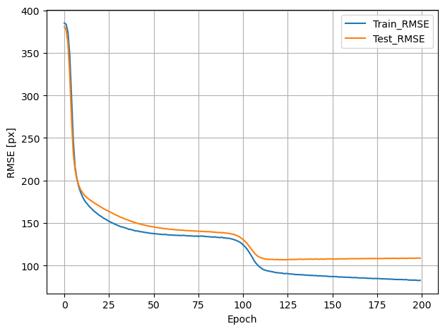
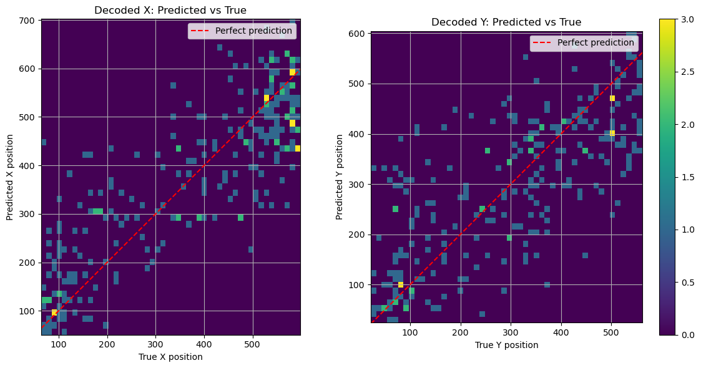
N_bins=3
N_shuffles=1000
Sig_level=0.01
Bin_size=1s
Min_active_cells=2
Test_size=0.2
Lr=1e-3

Slide 4
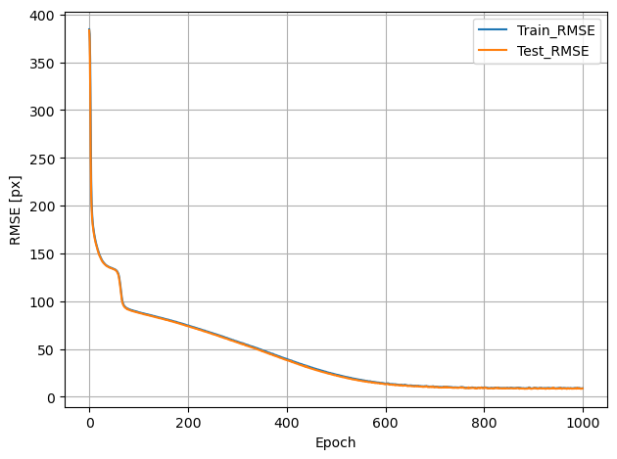
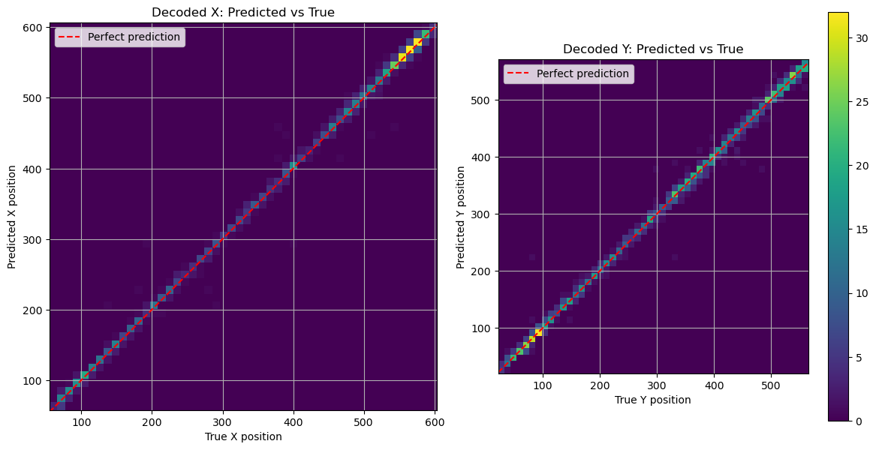
Test_data = train_data
N_bins=3
N_shuffles=1000
Sig_level=0.01
Bin_size=1s
Min_active_cells=2
Test_size= whole dataset
Lr=1e-3

Slide 5
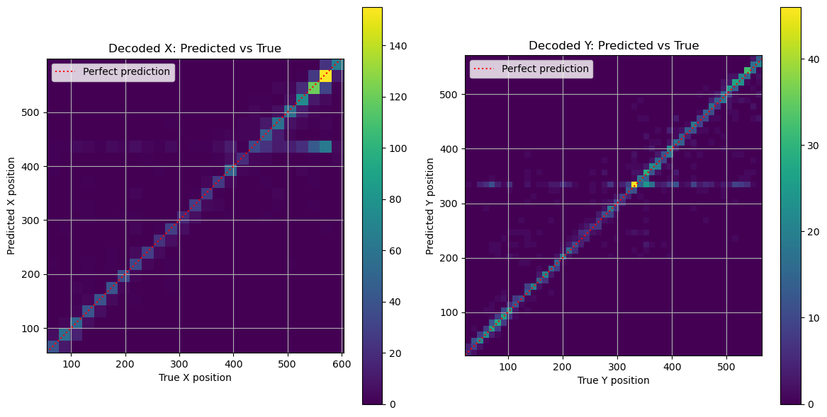
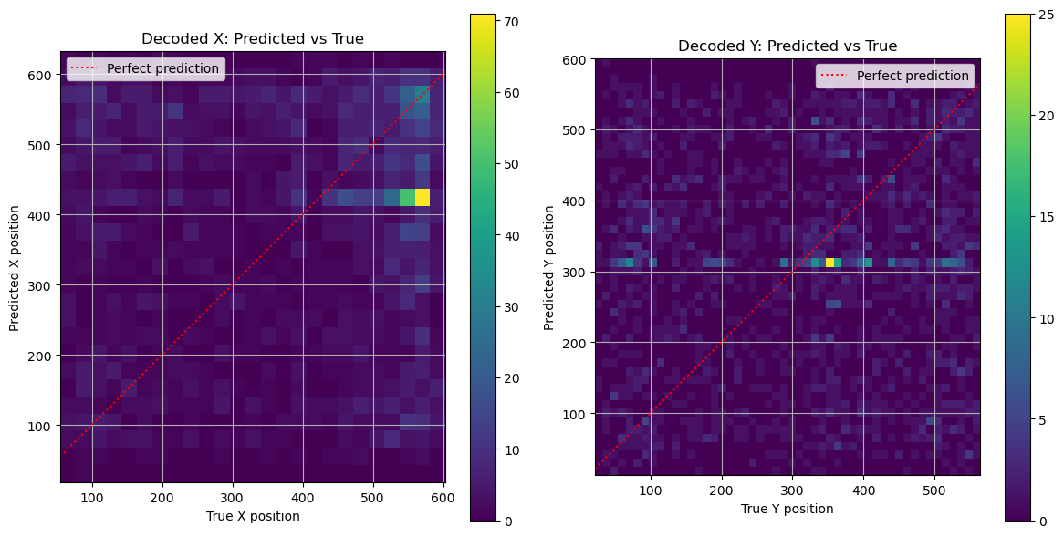
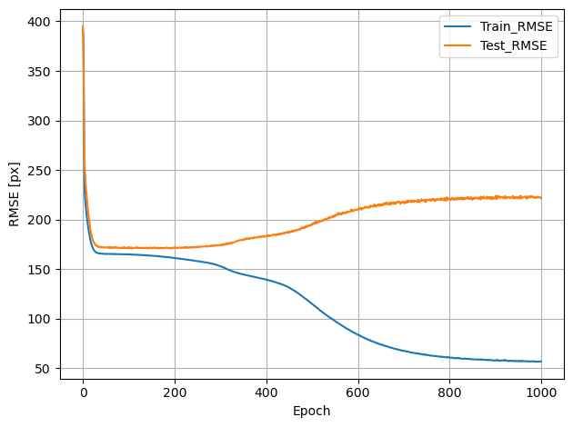
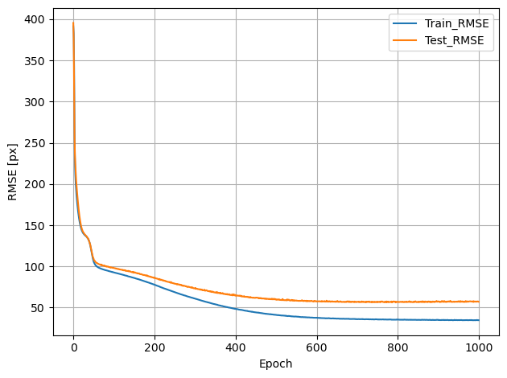
Train_data = shuffled_min1
Test_data = min1
N_bins=3
N_shuffles=1000
Sig_level=0.05 (184 pl.cells)
Bin_size=1s
Lr=1e-3
Train_data = min1
Test_data = min1
N_bins=3
N_shuffles=1000
Sig_level=0.05 (184 pl.cells)
Bin_size=1s
Lr=1e-3
Mean decoding error = 277px
Mean decoding error = 39px

