Slide 1
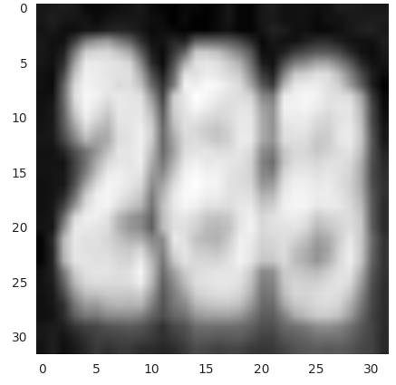
FC - DOUT
LC 1
CONV - RELU - POOL
0
1
2
…
8
9
10
INPUT
LC 2
0
1
2
…
8
9
10
OUTPUT
LC 3
0
1
2
…
8
9
10
Label: [2, 8, 8, 0]
LC 1
0
1
2
…
8
9
10
Label: [2, 8, 8, 0]
x 3 (and x 4)
x 1 (and x 2)

Slide 2
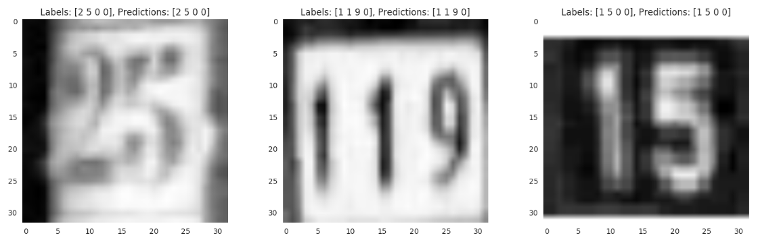
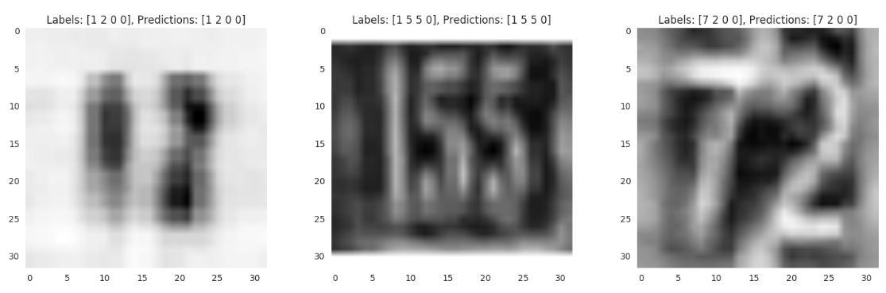

Slide 3
