Slide 1



NFT Dataset Analysis
May 2022
Team Leader: Ziva Grushka-Enav
Team Members:
Meital Shemer
Eli Hirsch

Slide 2



Project Stages
Finding and downloading a relevant dataset
Posing business questions
Creating a warehouse
Analyzing the dataset using SQL
Creating dashboards and visualizations
Producing insights and making recommendations
Platforms:
Database - Kaggle
Analysis & Visualization - Snowflake, Power BI

Slide 3
Glossary
NFT - Non-fungible tokens (NFTs) are cryptographic assets on a blockchain with unique identification codes and metadata that distinguish them from each other. Unlike cryptocurrencies, they cannot be traded or exchanged at equivalency.
OpenSea - An American online non-fungible token marketplace headquartered in New York City. Currently the largest NFT marketplace.
Ethereum - A decentralized, open-source blockchain with smart contract functionality. Ether (ETH) is the cryptocurrency of Ethereum, and is used for buying and selling NFTs.
Wei - Wei is the smallest denomination of Ether - the cryptocurrency coin used on the Ethereum network. One ether = 1,000,000,000,000,000,000 wei (10¹⁸).
NFT Minting - Minting an NFT means converting digital data into crypto collections or digital assets recorded on the blockchain. The digital products or files are stored in a distributed ledger or decentralized database and cannot be edited, modified, or deleted. Each token minted has a unique identifier that is directly linked to one Ethereum address. There are usually fees associated with minting.
Transfer events - Every time an NFT is transferred on the Ethereum blockchain, it emits a Transfer event which is stored on the blockchain.

Slide 4

About the Dataset
The dataset represents the activity of the Ethereum NFT market between April 1, 2021 - September 25, 2021.
The dataset contains 4 tables:
Mints
Transfers
NFTs
ETH-USD
The Mints and Transfers tables have the same schema.
THE ETH-USD table was downloaded from

Slide 5
Mints and Transfers Columns
Column Name | Description
event_id | A unique ID associated with each event, generated when the dataset was created
transaction_hash | The hash of the Ethereum transaction in which the event was observed
block_number | The number of the Ethereum transaction block in which the transaction containing the event was mined
nft_address | The address of the smart contract containing the NFT that the event describes
token_id | The identifier that represents the NFT that the event describes within the context of the smart contract with address nft_address
from_address | The address that owned the NFT before the Transfer event denoted by this row in the relation (it is not the address that initiated the transaction in which the NFT transfer took place)
to_address | The address that owned the NFT after the Transfer event denoted by this row in the relation (it is not the address that was the recipient of the transaction in which the NFT transfer took place)
transaction_value | The amount of WEI that were sent with the transaction in which the Transfer event took place
timestamp | The Unix timestamp at which the Ethereum transaction block with number block_number was mined into the Ethereum blockchain

Slide 6
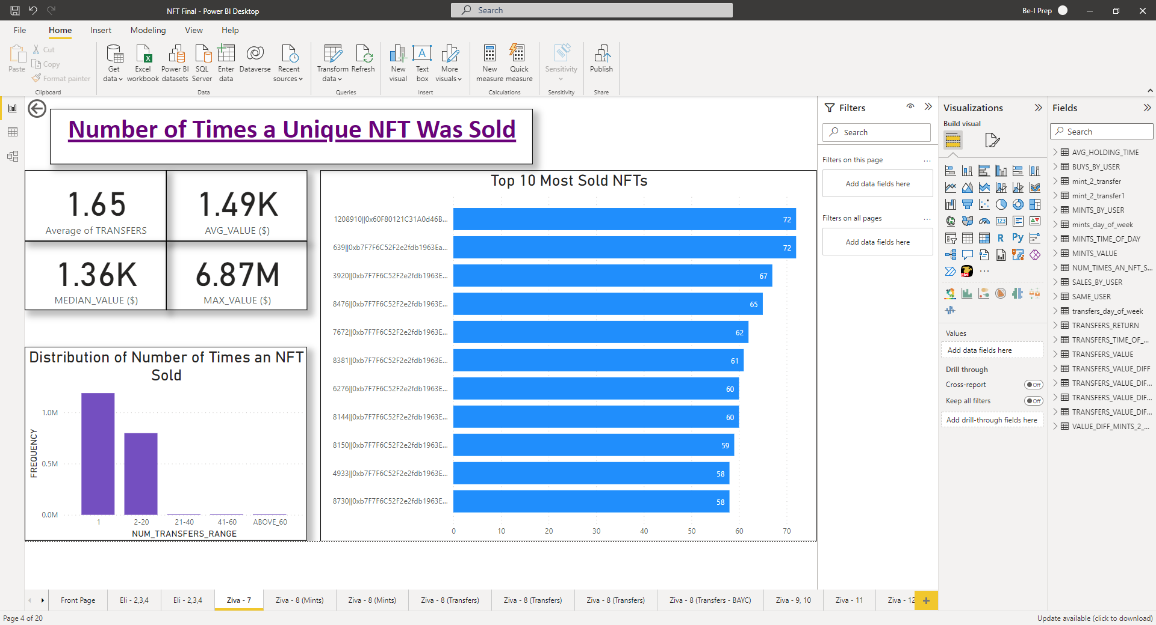
Key Insights and Takeaways
Did most users buy an NFT for personal enjoyment, or as an investment, in order to make a quick flip?
Most NFTs sold were sold only once (93.4%), with 6.6% of NFTs sold between 2 to 20 times, and a negligible percent of NFTs that were sold more than 20 times and up to 72 times, which may suggest that most users buy an NFT for personal enjoyment.

Slide 7
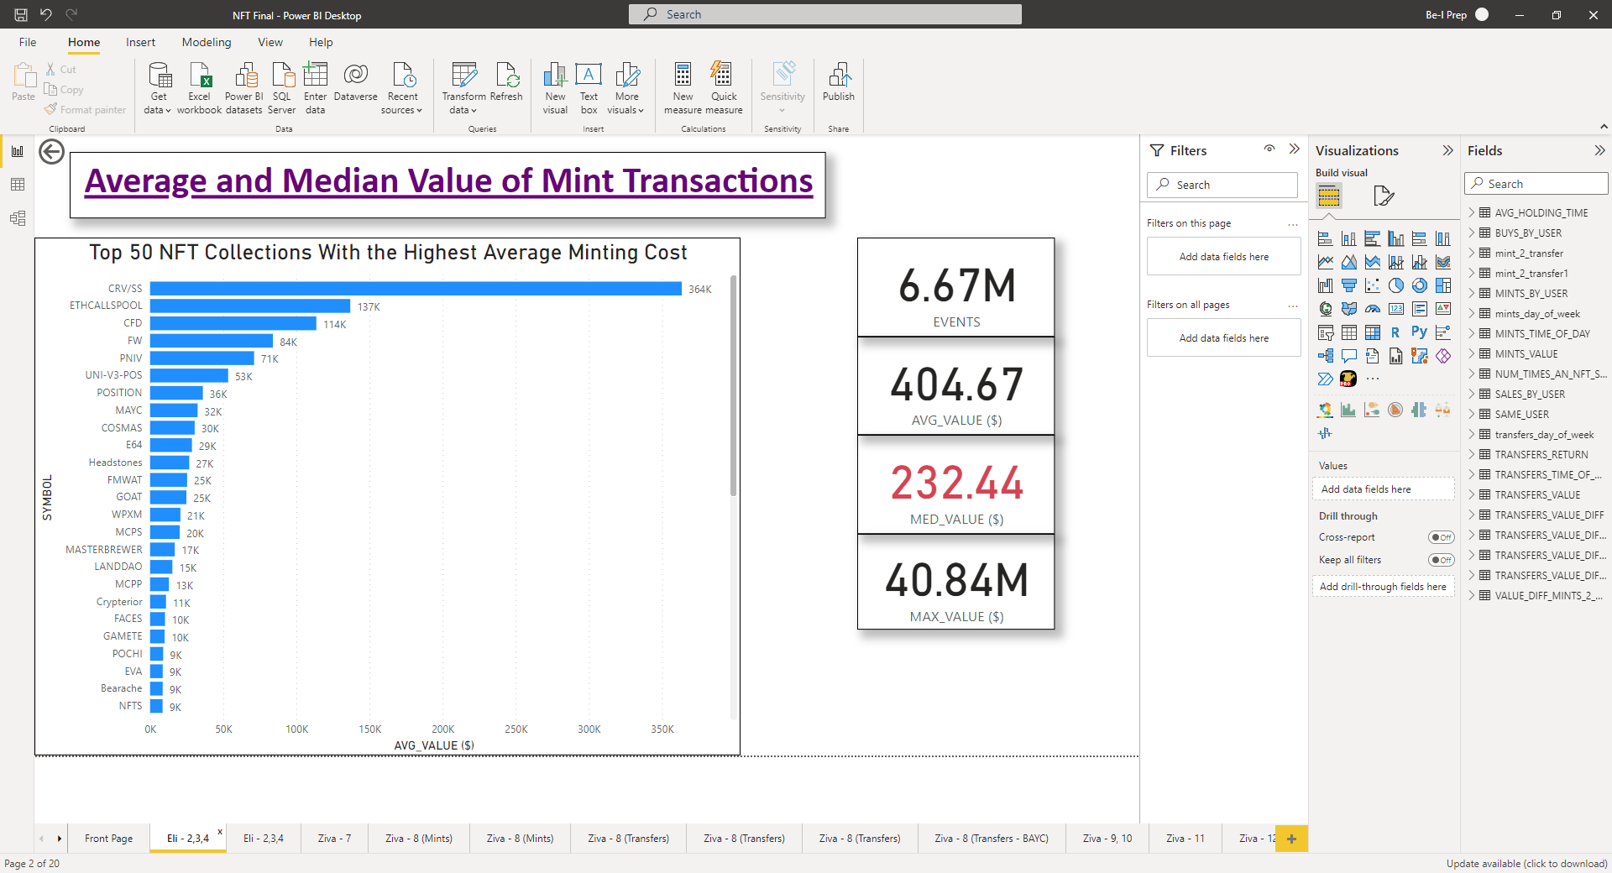
Key Insights and Takeaways (Continued)
What’s the average and median cost to mint an NFT?
The cost of minting an NFT is largely overlooked. It is important to take the minting cost into account, so you can set a profitable selling price.

Slide 8
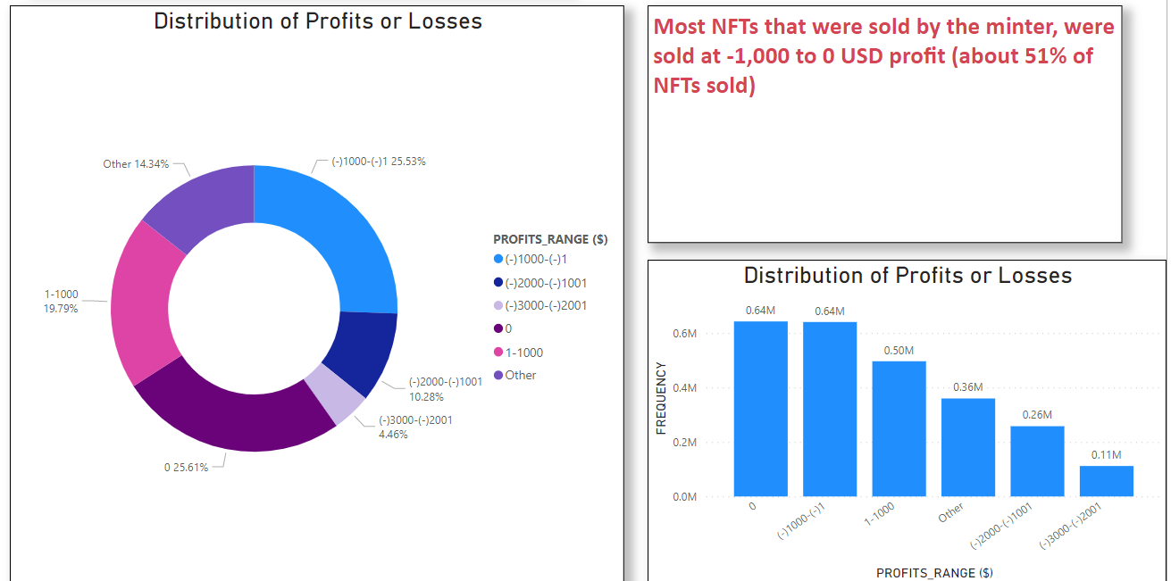
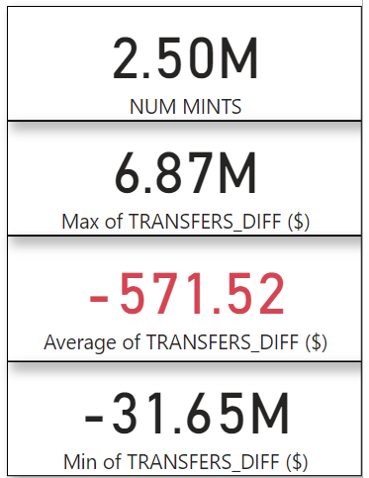
Key Insights and Takeaways (Continued)
Did most minters profit or lose selling an NFT, and how much?

Slide 9
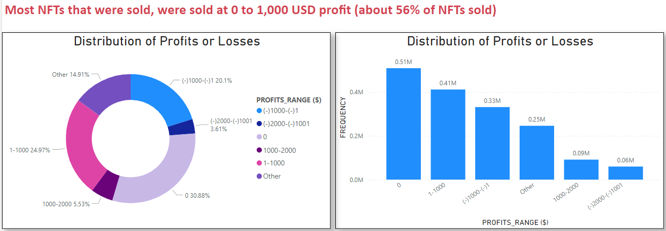
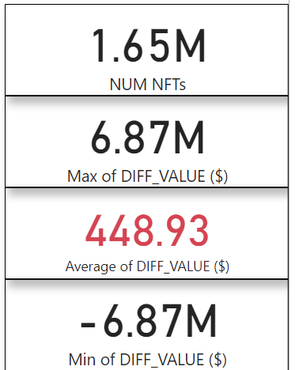
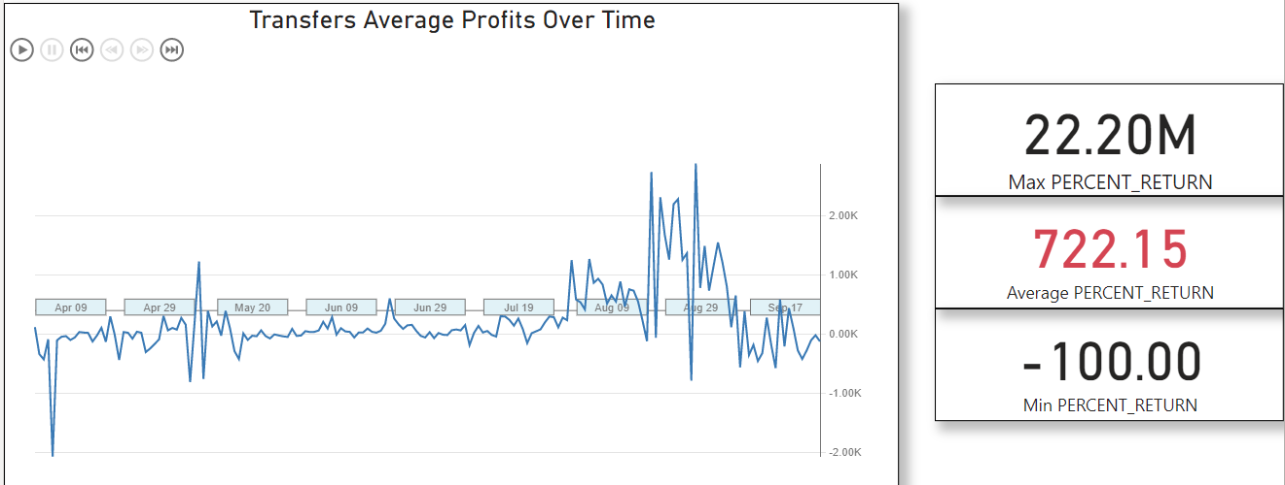
Key Insights and Takeaways (Continued)
Did most sellers profit or lose selling an NFT, and how much?
The average percent return (not including 0 USD profits) is 722.15%, but there are sellers who lost 100% of their investment

Slide 10
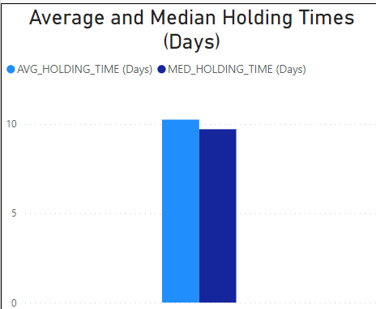
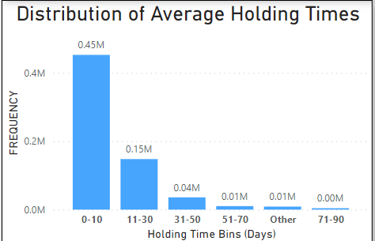
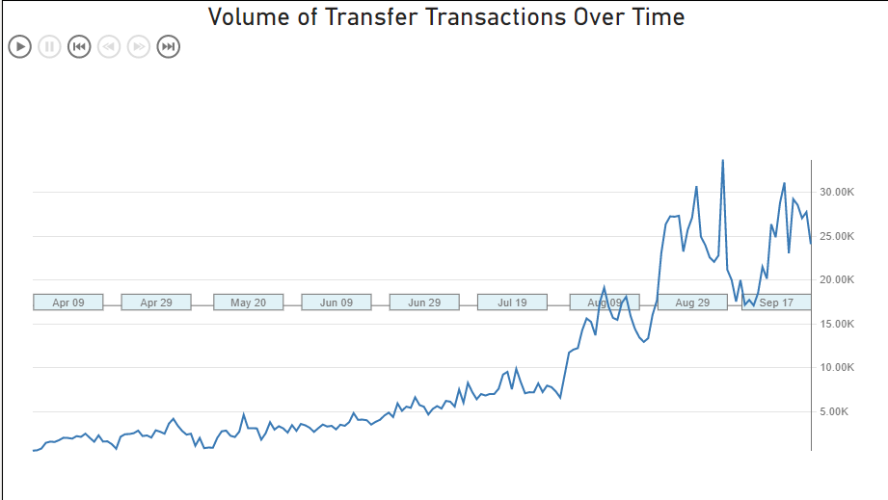
Key Insights and Takeaways (Continued)
What’s the average holding time of an NFT?
The average holding time of an NFT was around 10 days.
This might be due to the huge spike in the volume of transfer transactions towards the end of our dataset.

Slide 11
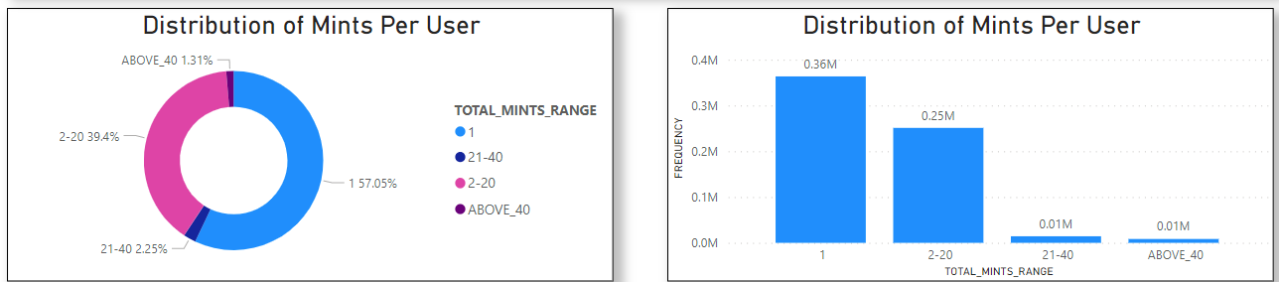
Key Insights and Takeaways (Continued)
How many mints did most users have?
Nearly 60% of users only minted 1 NFT, and around 40% of users minted 2 to 20 NFTS, with a minority of users who minted more than 20 NFTs. OpenSea might want to consider giving an incentive for minting more than 20 NFTs.

Slide 12
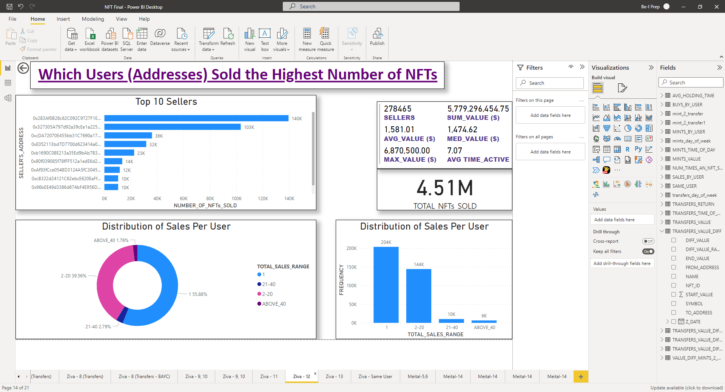
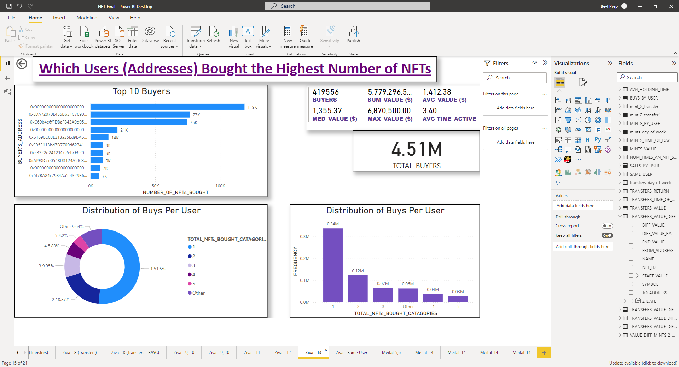
Key Insights and Takeaways (Continued)
How many NFTs did most users sell?
Around 56% of users only sold 1 NFT, and around 40% of users sold 2 to 20 NFTS, with a minority of users who sold more than 20 NFTs.
How many NFTs did most users buy?
Most users bought 1 NFT, and up to 5 NFTs.

Slide 13
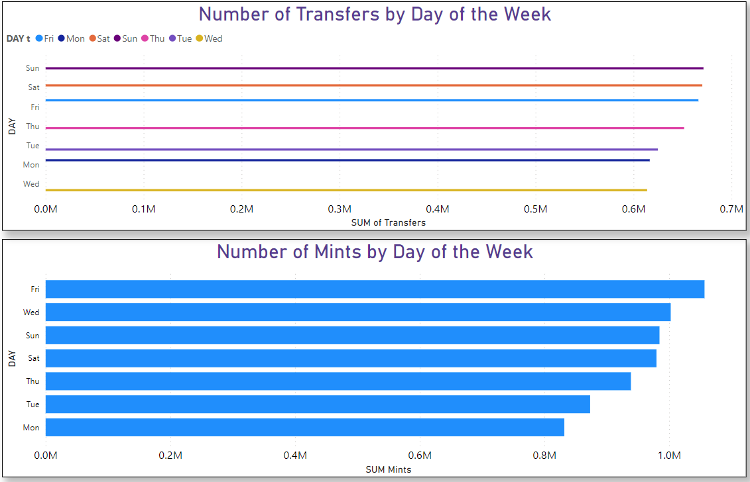
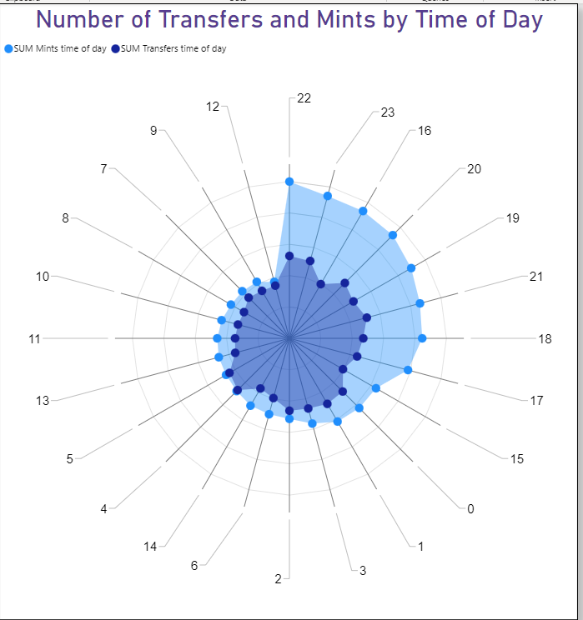
Key Insights and Takeaways (Continued)
Is there a preferred hour in the day or day of the week to mint or to have a transfer transaction?
Most mints occurred on a Friday, and most transfers took place on the weekend (Fri-Sun), which makes sense.
Surprisingly, there were more mints on a Wednesday than on a Sunday or a Saturday.
Both mints’ and transfers’ strongest hour of the day is 22:00.
For the full insights and visualizations, please check our dashboard in the Power BI file.

Slide 14
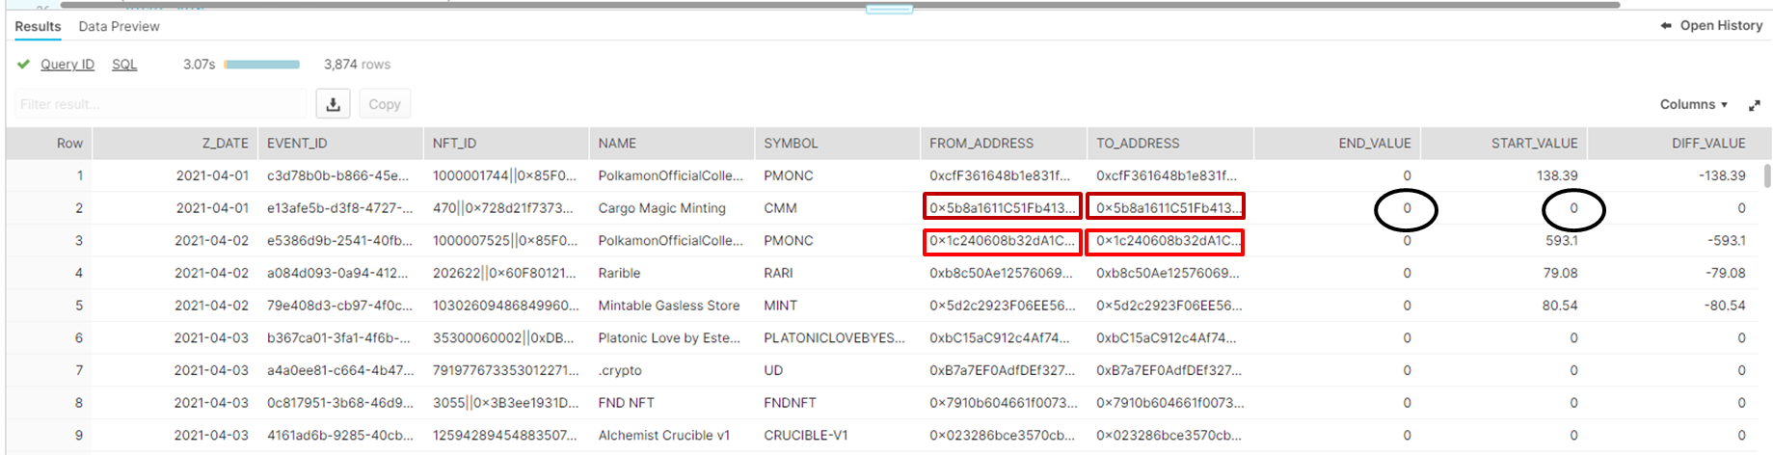
Anomalies in the Dataset That Require Further Investigation
There are many transfer transactions at a 0 USD value (either bought or sold at 0 USD, and around 200,000 transactions at 0 USD value both by the seller and the buyer). This might be due to a technical issue during the creation of the dataset, or a bug in the blockchain. If it’s neither a technical issue nor a bug, we would suggest OpenSea and/ or AML authorities investigate the legitimacy of those transactions.
There are around 3,900 transactions where the seller and buyer are the same user. We would suggest that OpenSea investigate whether those users are trying to inflate the price of the NFTs, and AML authorities should also investigate the legitimacy of those transactions.
Please see the following examples which illustrate these points:

Slide 15
Thank You!

