Slide 1
Autonomous Hierarchical Control and Coordination of UAV Swarms
An onboard algorithm that enables UAV groups to organise themselves hierarchically and to form designated shapes
Yunpeng Yang
11 Sep 2024

Slide 2
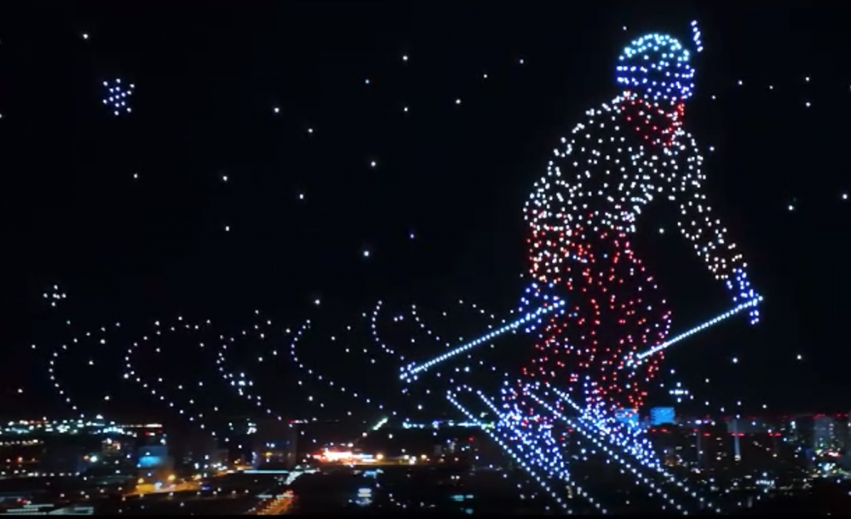
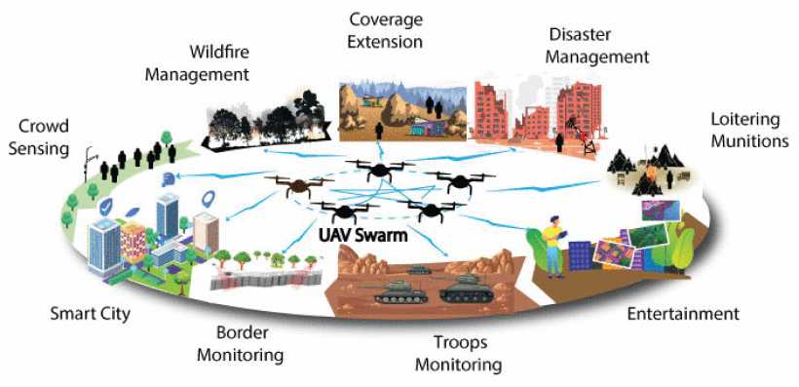
Motivation
Inspired by drone shows
Aims to enhance swarm applications
Image credit: Sadaf Javed, et al., 2024.
Show drones are fully controlled by ground control station.
Image credit: LunaLite Drone Show technologies LLC.

Slide 3
Research Review Relocation of a Swarm
Centralised
Reaction-based
Negotiation-based
L
Single point of failure
High overhead (leader)
Limited Coordination
High overhead

Slide 4
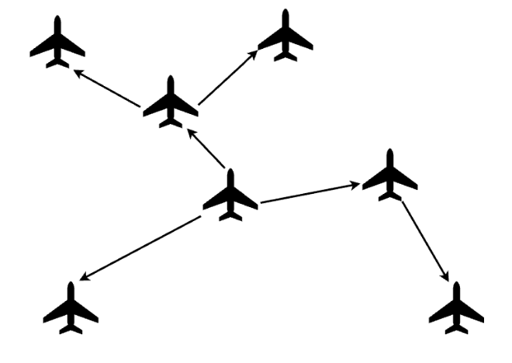
Key Idea Dynamic Hierarchical Swarm
Tree structure : reduced connections
Dynamic organisation : robustness
Divide-and-conquer : reduced computation

Slide 5
Algorithm Design Tree Switching
Initially each UAV is a single-node tree
UAVs on a small tree join the biggest tree nearby
Eventually a single (dynamic hierarchical) tree is formed
4
1
2
5
3

Slide 6
Algorithm Design Recursive Data Flow
Examples of data flow up and down the tree:
Swarm size
Task (shape) division : coordination
Task result
Node state
1
2
3
4
5
Challenge:
Coherence between state of each node and state of the whole swarm

Slide 7
Implementation
GitHub: https://github.com/NGC0001/AutoSwarm
Programming language: Rust
Source code: >2600 lines
Implementation details:
Message design
Shape division
Task velocity vs parent-tracking velocity
Collision avoidance
……

Slide 8
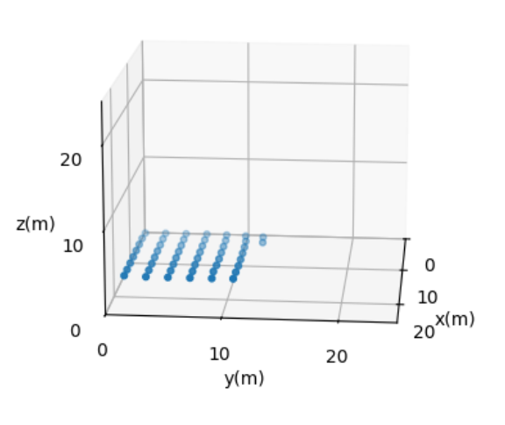
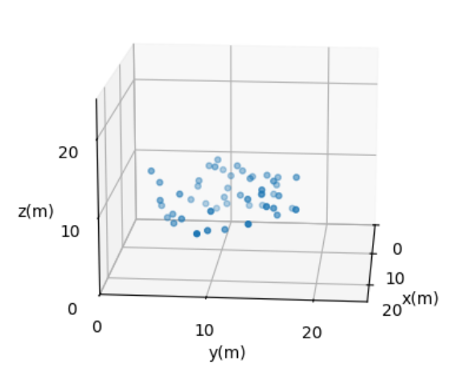
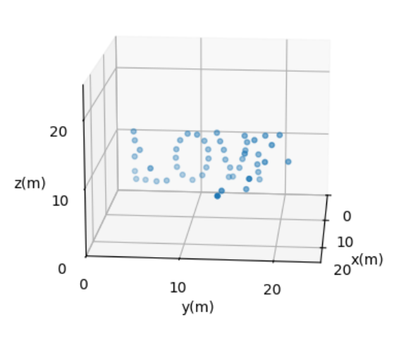
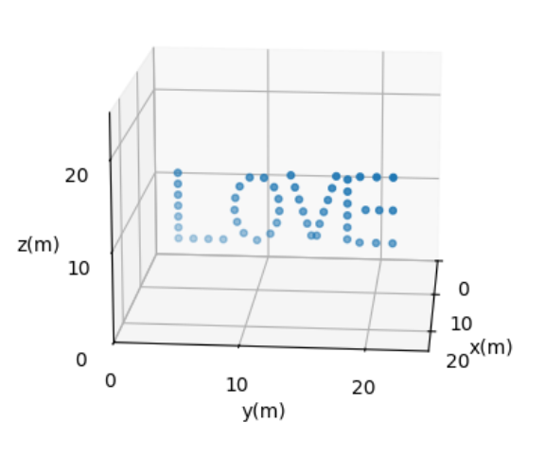
Simulation Result
50 UAVs to form letters

