Slide 1

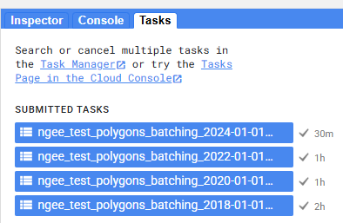
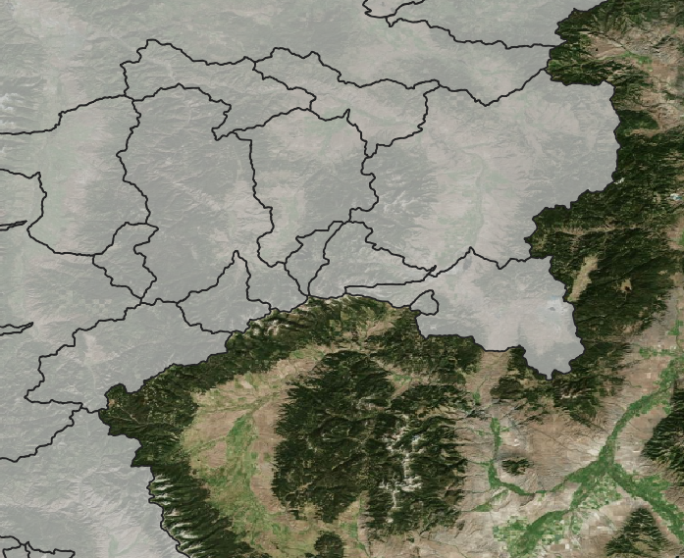
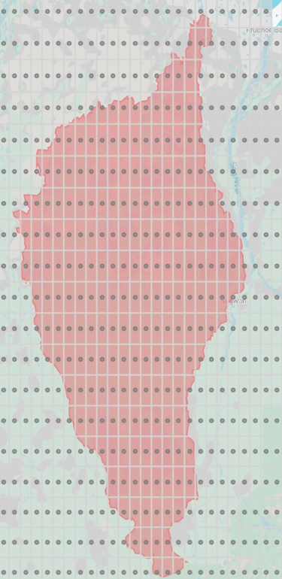
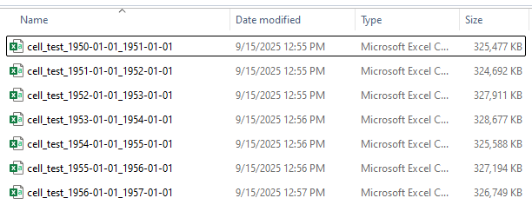
1. User provides geometry(ies)
2. Google Earth Engine samples ERA5-Land
3. Exporting to ELM-ready netCDF
dapper accepts any number of geometries.
Geometries may be any type (point, polygon, multi-types)
dapper.utils.gee_utils.sample_e5lh()
dapper.met.exporter.Exporter()
3 types of exports:
1) sites_file – all geometries are stored in the same netCDF files; one file per variable
2) site_dirs – each geometry is stored in an individual directory, with one netCDF file per variable
3) gridded - a rectangular grid is assumed within the netCDF; all grid cells have a value (even if it’s NaN)
Point(s)
to polygons
(optional)
Polygon(s)
“raw” csvs will be exported from GEE to the GDrive folder you specify. You must download these to your local storage (GDrive app is easiest if you can get it to work).
watersheds
grid cells

