Slide 1
PHẠM BÌNH NGHĨA
GRADUATION THESIS
Improving Sample Selection for
Test-Time Adaptation with Binary Feedback
A calibration-based query strategy for query-efficient binary feedback in BiTTA
PAPER
BiTTA — Lee et al., ICML 2025
FEEDBACK BUDGET
3 / 64 images per batch (<5%)
KEY IMPROVEMENT
Which samples to ask for feedback

Slide 2
01 · MOTIVATION
The problem TTA — and BiTTA — set out to solve
⬤ In real-world deployment, a model constantly meets data unlike what it saw in training: blur, noise, style shift, weather changes.
⬤ Left to adapt entirely on its own, a model can fall into a feedback loop of confidently reinforcing its own mistakes.
UNSUPERVISED
Standard TTA — 0% labels
BiTTA
Binary feedback, <5% labels
FULLY SUPERVISED
100% labeled data
02 / 10

Slide 3





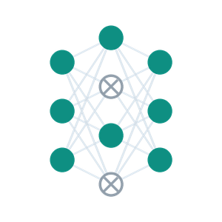

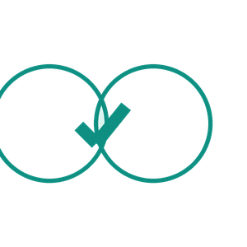

02 · ORIGINAL BITTA WORKFLOW
Two adaptation paths driven by one Monte Carlo estimate
M_C
Lowest Confidence
Query Human
M_I
Test Batch
(64 images)
MC-Dropout
Update θ
Agreement Check
Confident Set
Top — Binary Feedback-guided Adaptation (BFA): query the human on the most uncertain images. Bottom — Agreement-based self-Adaptation (ABA): self-train on remaining images where the model already agrees with itself, no oracle needed.
03 / 10

Slide 4
03 · WHERE IT FALLS SHORT
Asking about the "least confident" sample isn't always the "most valuable" question
Image A
Confidence: 31%
This image was almost ALWAYS wrong in the past.
→ Asking barely tells us anything new — wastes a query.
Image B
Confidence: 31%
This image was correct/incorrect 50-50 in the past.
→ This is the sample worth asking about.
The original rule only looks at the raw number "31%" — it cannot tell A and B apart, because it never checks that number against what actually happened in past queries.
04 / 10

Slide 5
04 · PROPOSED IDEA
Calibrate confidence against real feedback history, instead of trusting it at face value
⬤ Every time feedback comes back correct/incorrect, record the pair: confidence score – correct/incorrect.
⬤ After enough feedback, fit a "calibration curve": raw confidence → true probability of being correct.
⬤ This curve keeps updating — the more feedback collected, the more accurate the calibration becomes.
Example: a raw confidence of 50% actually corresponds to only ~17% true correctness probability — showing the model's raw confidence is inflated under distribution shift.
05 / 10

Slide 6
MATHEMATICAL FOUNDATION · 1/2
Turning raw confidence into a real probability of being correct
// map raw confidence C(x) ∈ (0,1) onto an unbounded real value
z = logit(C(x)) = ln( C(x) / (1 − C(x)) )
// linear rescale, then squash back into (0,1)
p̂ = sigmoid( a·z + b )
Worked example
With a ≈ 4.0, b ≈ −1.6 learned from past batches:
Raw confidence C(x) | Calibrated p̂
10% | ≈ 0%
30% | ≈ 1%
50% | ≈ 17%
70% | ≈ 86%
90% | ≈ 100%
⬤ a (slope): controls how strong the correction is — a large a means a small change in raw confidence swings the calibrated probability sharply.
⬤ b (bias): shifts the whole curve up or down — a negative b means raw confidence is systematically over-optimistic.
⬤ Cold start: until enough data exists to estimate a, b reliably, selection falls back to the original paper's rule.
→ A raw confidence of 50% maps to only 17% true correctness — raw confidence alone cannot measure uncertainty.
06 / 10

Slide 7
MATHEMATICAL FOUNDATION · 2/2
Binary entropy — measuring the true information value of one yes/no question
h_b(p̂) = −p̂·log(p̂) − (1−p̂)·log(1−p̂)
// binary entropy — reaches its maximum exactly at p̂ = 0.5
⬤ This is the standard information-theory formula for measuring the uncertainty of a two-outcome event.
⬤ By the entropy grouping rule: H(y|x) = h_b(p̂) + (1−p̂)·H(the rest) — asking one yes/no question reduces expected uncertainty by exactly h_b(p̂).
⬤ This is the "expected information gain" of one feedback query — maximized precisely when p̂ = 0.5, i.e. when the answer is genuinely unknown.
The peak of the curve (p̂ = 0.5) is exactly where the true answer is still unknown — precisely where the 3 questions should be aimed.
07 / 10

Slide 8
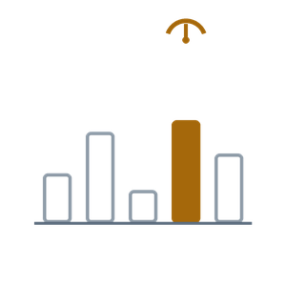
05 · UPDATED BITTA WORKFLOW
Only one step changes — everything else stays exactly the same
M_C
Calibrated Pick
Query Human
M_I
PROPOSED
Test Batch
(64 images)
MC-Dropout
Update θ
Agreement Check
Confident Set
UNCHANGED — identical to the original
PROPOSED CHANGE — calibrated sample selection
08 / 10

Slide 9
06 · WORKED EXAMPLE
Same batch, two different picks
IMAGE | RAW CONFIDENCE | CALIBRATED P(CORRECT) | ORIGINAL PICK? | PROPOSED PICK?
Image 1 | 31% | ≈1% | ● selected | —
Image 2 | 42% | ≈10% | ● selected | —
Image 3 | 55% | ≈31% | — | ● selected
Image 4 | 58% | ≈42% | — | ● selected
Image 5 | 62% | ≈59% | — | ● selected
Image 1 has the lowest raw confidence, but history shows it is almost certainly wrong (only ~1% correctness) — feedback on it is nearly meaningless. Images 4 and 5 are where the model is truly torn (~42–59%) → the proposed rule asks exactly there.
09 / 10

Slide 10
07 · SUMMARY
The learning algorithm is unchanged — only the question-asking strategy improves
UNCHANGED
How the model learns from correct/incorrect answers, and how it self-trains on its own confident predictions, stay 100% identical to the original.
IMPROVEMENT #1
Select images to query based on their REAL calibrated correctness probability (checked against feedback history), not raw confidence alone.
IMPROVEMENT #2
A more careful confidence estimate (more prediction passes) used only at the selection step — no added cost anywhere else.
EVALUATED ON 4 IMAGE BENCHMARKS
CIFAR-10-C
CIFAR-100-C
Tiny-ImageNet-C
PACS
Expected outcome: extract more value from every feedback answer, while preserving the full correctness of the original algorithm.
10 / 10

Slide 11
Hỏi anh Đức
Tên đề tài
Setting,…
Chạy
10 / 10

