Slide 1
C369 Graded Assignment
Embedded Finance
By: NG JIA HENG

Slide 2

Heng Ah Got Insurance
Meet
Your one-stop middle-man insurance company!

Slide 3
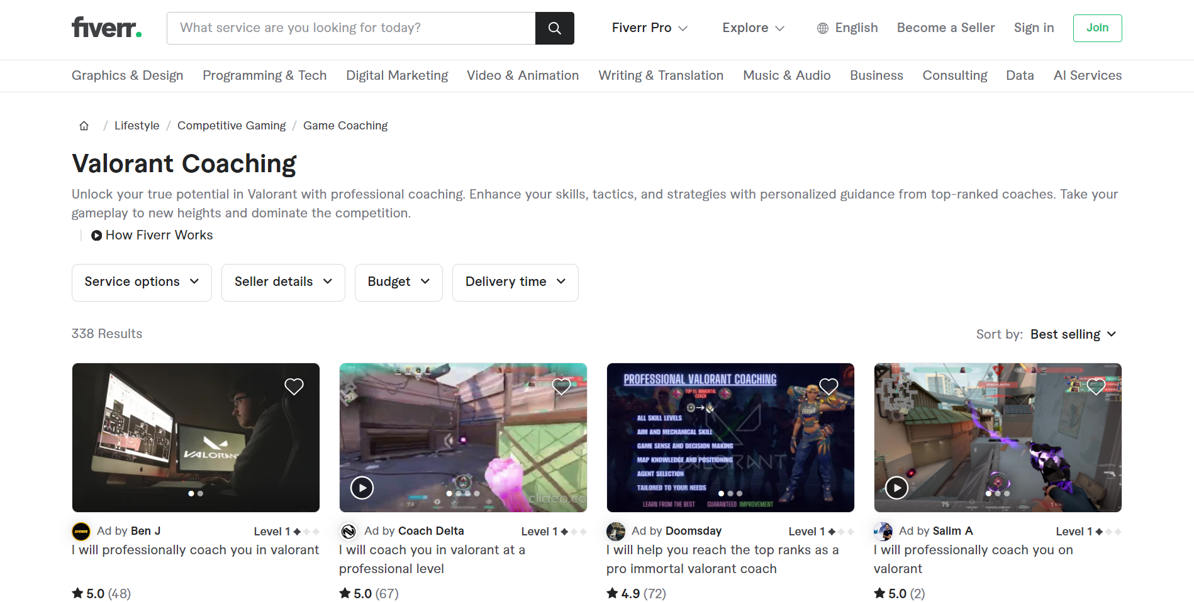
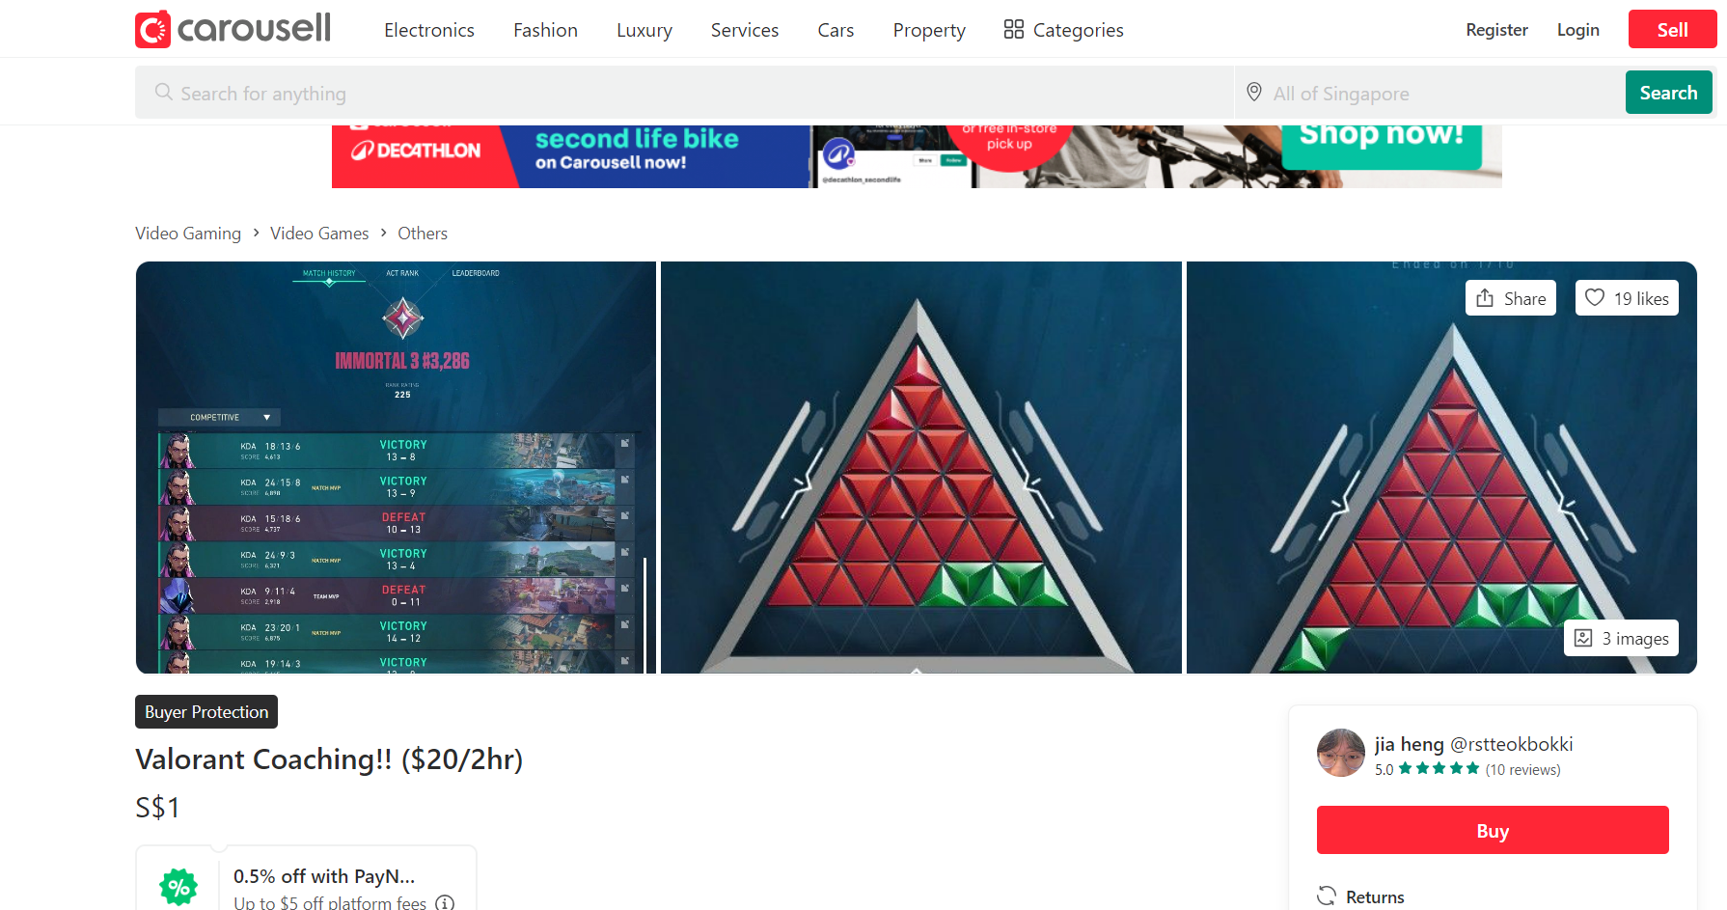

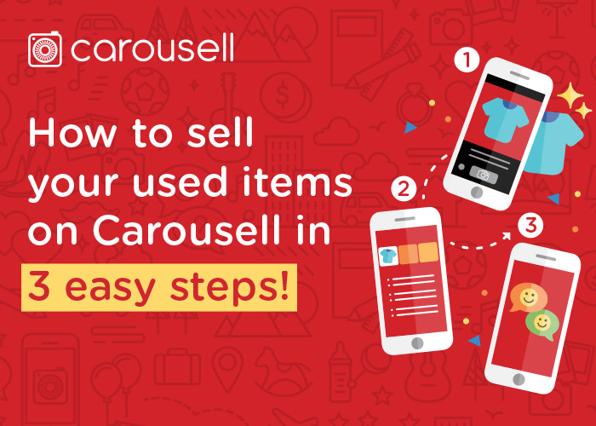
Have you ever wanted to purchase online services?
^ Valorant coaching on Fiverr ^
^ Valorant coaching on Carousell ^
Valorant – Online Computer Game

Slide 4
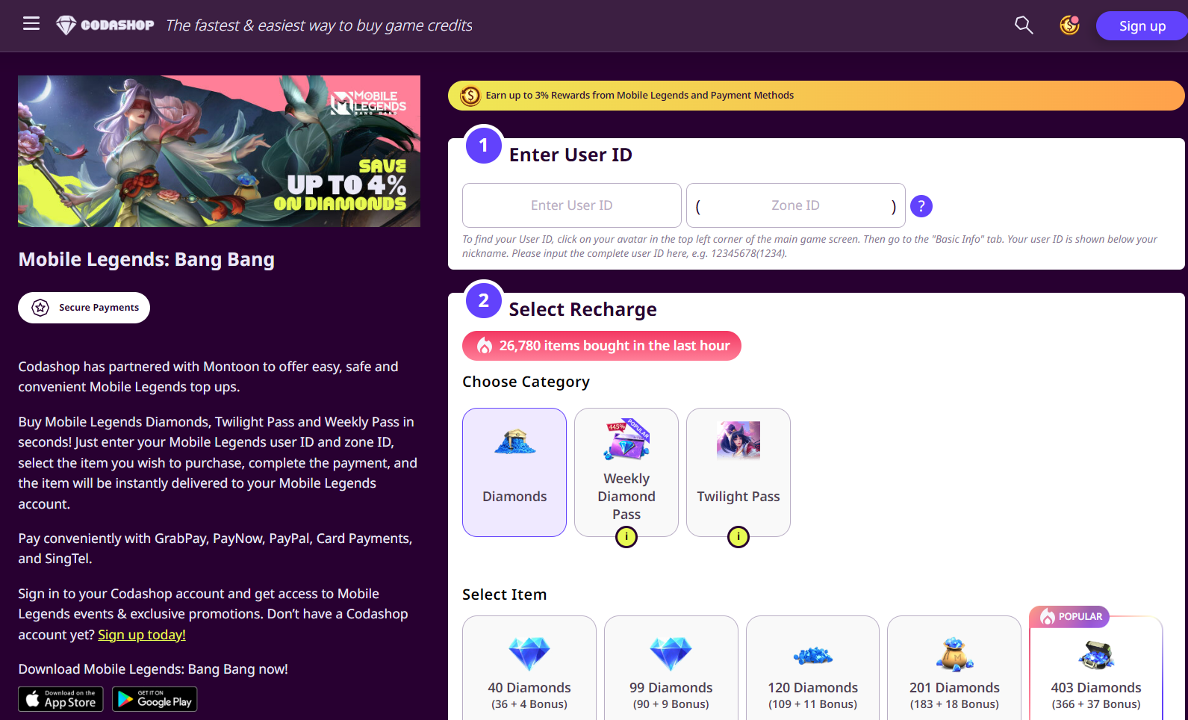
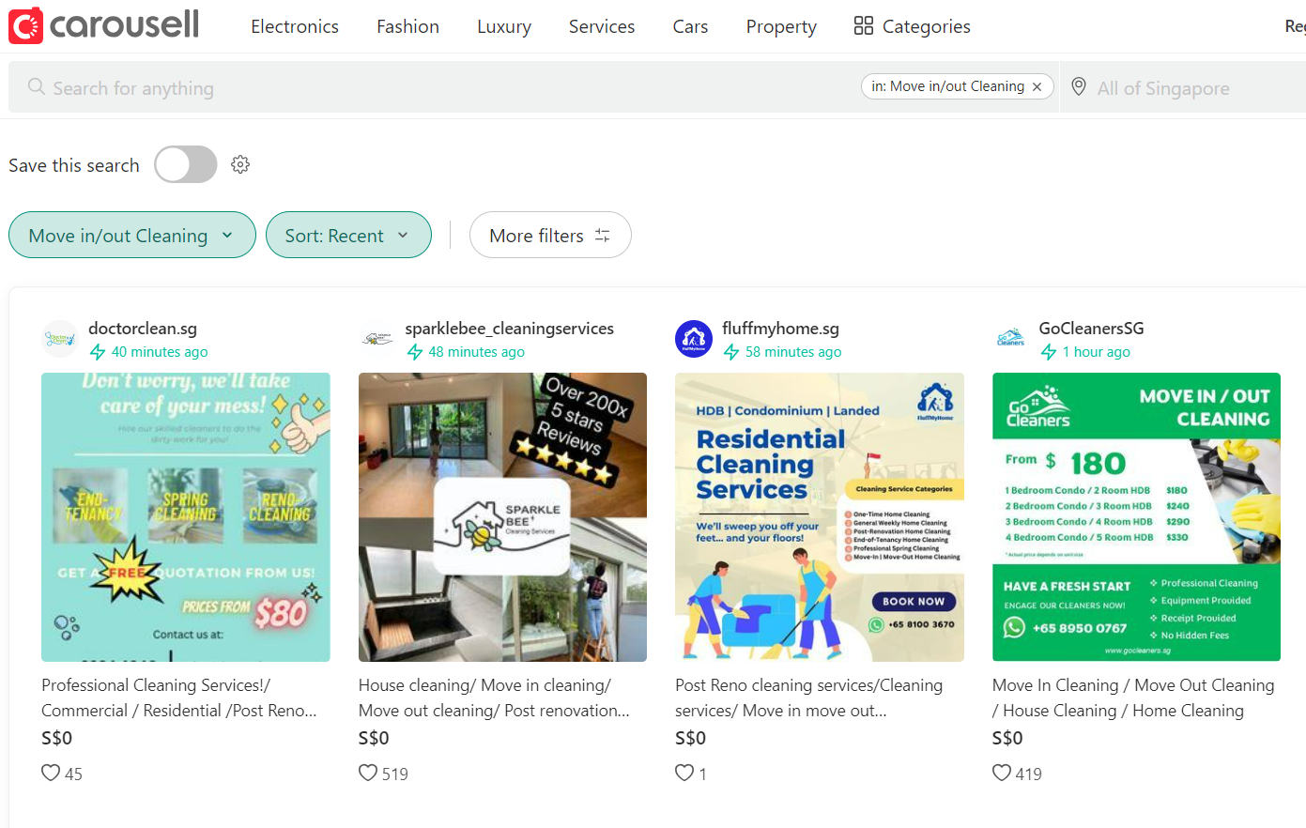

Other types of online services you may have purchased before
^ Topping up of in-game currency Mobile Legends^
^ Cleaning services by free lancers on Carousell ^
Mobile Legends – Online Mobile Game

Slide 5
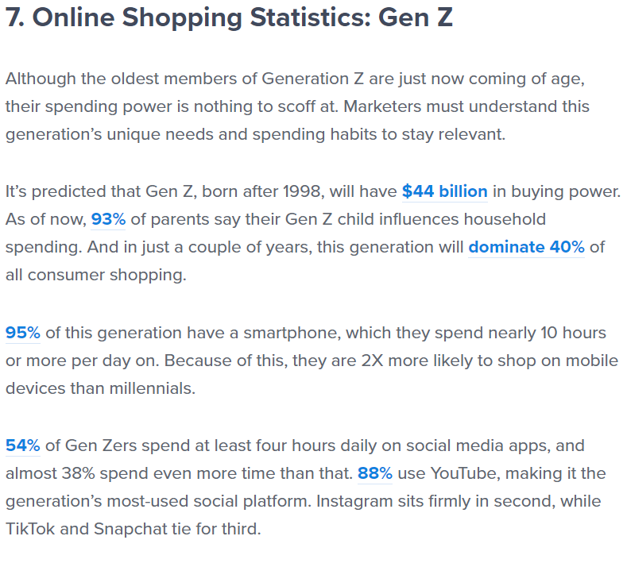


Purchasing of Online Services. Why?
The current state of our world is going through a revolution of technology that started from 1971
Everything is going digital, including services like hiring someone to clean your house online straight from your phone.
On the flipside, gaming is becoming more popular also, with correlation to the rise of E-Commerce, Online gaming services are very common nowadays.

Slide 6


The Problem
Purchase of Online Services does not guarantee refunds or value of purchase.
Is this service worth it?
Is it a scam?
This will result in skepticism in customers thinking the service might be a scam, even though there might be word of mouth or great reviews/feedback on said service, it is not 100% safe until purchased.
Not all online services are licensed and regulated also, meaning even if a customer requested for a refund, they are not obliged to proceed with the request if terms and conditions are not met.
Majority of online gaming services are purchased by teenagers, which most does not have a lot of money to work with, so being extra cautious with transactions involving money is imperative.

Slide 7

The Solution
How does it work?
Heng Ah Got Insurance provides insurance services to customer who wants to purchase online services.
We act as a middle-man to your purchases
We will create a contract with the vendor you are purchasing from
After the vendor has signed the contract, you can relax and be stress-free as your purchase is insured
If anything happens and the contract breaks, you will be refunded by us
Mostly targeted to customers who wants a 100% Safe online shopping experience
You
Us
Vendor

Slide 8

Why Us?
If anything happens and the contract breaks, you will be refunded by us
We settle with the up-front dealing
Our service is cheap and easy to use
We are legalized and licensed by MAS
What are you waiting for?

Slide 9
Embedded Finance
As part of embedded finance, integrating insurance with day-to-day purchases can help improve the overall shopping experience for customers which will then encourage more people to start using online e-commerce platforms.
Which will ultimately result in higher and increased sales to vendors and merchants who benefit from these e-commerce platforms.

Slide 10
MAS Regulations
Personal Data Protection Act (PDPA)
The Personal Data Protection Act (PDPA) provides a baseline standard of protection for personal data in Singapore. It complements sector-specific legislative and regulatory frameworks such as the Banking Act and Insurance Act.
It comprises various requirements governing the collection, use, disclosure and care of personal data in Singapore.
It also provides for the establishment of a national Do Not Call (DNC) Registry. Individuals may register their Singapore telephone numbers with the DNC Registry to opt out of receiving unwanted telemarketing messages from organisations.
Objectives of the PDPA
The PDPA recognises both the need to protect individuals’ personal data and the need of organisations to collect, use or disclose personal data for legitimate and reasonable purposes.
A data protection regime is necessary to safeguard personal data from misuse and to maintain individuals’ trust in organisations that manage their data.
By regulating the flow of personal data among organisations, the PDPA also aims to strengthen Singapore’s position as a trusted hub for businesses.

Slide 11
MAS Regulations
Anti-Money Laundering and Countering the Financing of Terrorism (AML/CFT)
the business are subject to AML/CFT regulations aimed at preventing money laundering and terrorist financing activities. They must conduct customer due diligence (CDD) measures, including customer identification and verification, and monitor and report suspicious transactions to the relevant authorities.
Objectives of the AML/CFT
Policy Statement
Singapore’s AML/CFT policy objectives are to: i) detect, deter and prevent money laundering, associated predicate offences and terrorism financing; and ii) protect the integrity of its financial system from illegal activities and illicit fund flows.
Overarching Strategy
To adequately focus on money laundering investigations in Singapore, regardless whether the money laundering offence arose from a domestic or foreign predicate offence.
To deprive criminals of the proceeds and instrumentalities of their crimes (both domestic and foreign), or of property of an equivalent value.

Slide 12
MAS Regulations
Capital Markets Services (CMS) License
A company must hold a capital markets services (CMS) licence to conduct activities regulated under the Securities and Futures Act 2001 (SFA) . Individuals representing CMS licensees or exempt financial institutions need to be appointed as representatives.
Objectives of the AML/CFT
These regulated activities are:
Dealing in capital markets products
Advising on corporate finance
Fund management
Real estate investment trust management
Product financing
Providing credit rating services
Providing custodial services for securities
Capital markets products include securities, units in a collective investment scheme (CIS), over-the-counter (OTC) derivatives, exchange-traded derivatives and spot foreign exchange for the purposes of leveraged foreign exchange trading.
This will allow our company to provide insurance to online services that aren’t based in Singapore’s currency.

Slide 13
References
https://www.mas.gov.sg/regulation/capital-markets/apply-for-licensing-or-registration-of-capital-market-entities/cms-licence
https://www.police.gov.sg/Advisories/Crime/Commercial-Crimes/AML-CFT#:~:text=Singapore's%20AML%2FCFT%20policy%20objectives,activities%20and%20illicit%20fund%20flows.
https://www.pdpc.gov.sg/overview-of-pdpa/the-legislation/personal-data-protection-act

