Slide 1

Next generation sequencing read alignment and data processing
Thomas Keane,
Head of European Genome-phenome Archive and European Variation Archive
EMBL-EBI
@drtkeane
tk2@ebi.ac.uk

Slide 2
Read alignment
Sequence alignment in NGS is:
Process of determining the most likely source of the observed DNA sequencing read within the reference genome sequence

Slide 3
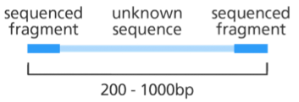
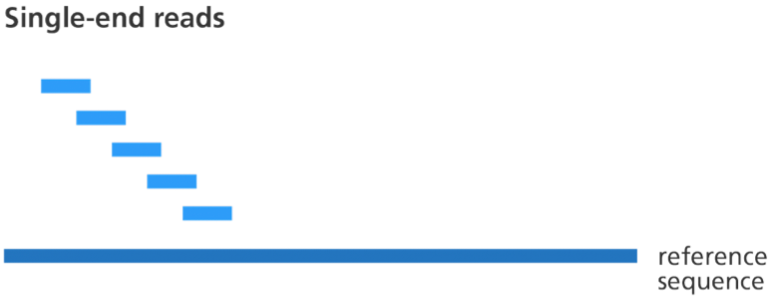
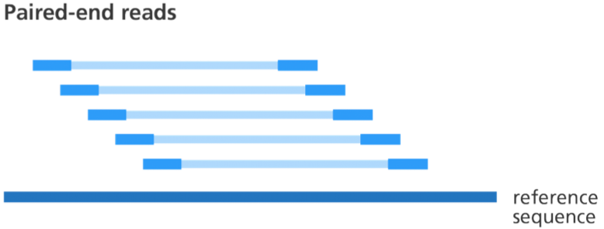
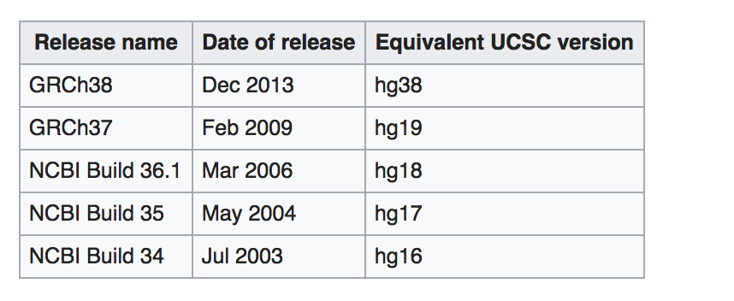
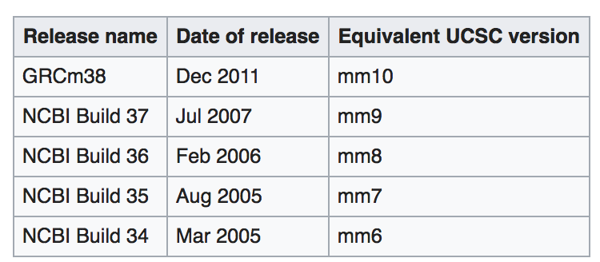
The reference genome
Image credit: Genome Research Limited
HUMAN reference sequences
MOUSE reference sequences
The actual reference is a just a (big) sequence (fasta) file: $ ls –h GRCh38.fa
> 3.1G GRCh38.fa

Slide 4
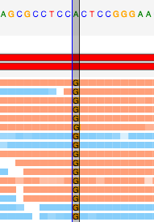
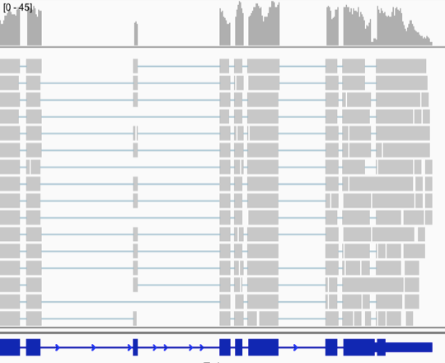
Why align?
Image credit: Genome Research Limited
Align DNA: Identify variation
ALIGN RNA: Transcript abundance

Slide 5
Sequence Alignment
Sequence alignment in NGS is
Process of determining the most likely source within the reference genome sequence that the observed DNA sequencing read is derived from
Principles and approaches to sequence alignment have not changed much since 80's
Basic Local Alignment Search Tool (BLAST)
‘Seed and extend’ approach
Query sequences vs. larger database of sequences
Split query sequences into short sequences (~10bp) and search for locations where these cluster in the larger database of sequences
Nucleotide blast, protein blast, blastx, tblastn, tblastx….
NGS: Nucleotide based alignment
Very small evolutionary distances (human-human, or related strains of the reference genome)
Allows for assumptions about the number of expected mismatches to speedup alignment programs
Gapped vs ungapped alignment
Typically want to allow for possibility of indels: gapped alignment
NGS has just massively scaled up a challenge that has existed since the inception of bioinformatics

Slide 6
Hash Table Alignment
k-mer is a short fixed sequence of nucleotides
e.g. a 31-mer is a string of 31 nucleotides
Typical algorithm
Build a profile (index) of all possible k-mers of length n and the locations in the reference genome they occur
Several Gbytes in size for human genome
Foreach sequence read
Split into k-mers of length n
Lookup the locations in the reference via the index (seed phase)
Pick location on the genome with most k-mer hits
Perform Smith-Waterman alignment to fully align the read to the region
Output the alignment of each read onto the reference in BAM (or equivalent) format
Hash of the reads: MAQ, ELAND, ZOOM and SHRiMP
Smaller but more variable memory requirements
Hash the reference: SOAP, BFAST and MOSAIK
Advantage: constant memory cost

Slide 7



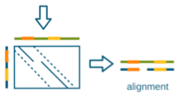
Hash Table Alignment
Sequencing reads
k-mer hash
Reference Genome

Slide 8
Hash Table Alignment
Sequencing reads
k-mer hash
Reference Genome

Slide 9
Hash Table Alignment
Sequencing reads
k-mer hash
Reference Genome

Slide 10
Hash Table Alignment
Sequencing reads
k-mer hash
Reference Genome

Slide 11
Hash Table Alignment
Sequencing reads
k-mer hash
Reference Genome

Slide 12
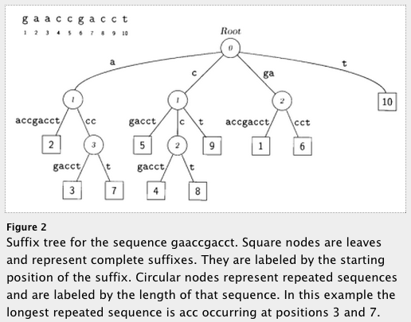
Suffix/Prefix Tree Based Aligners
Store all possible suffixes or prefixes to enable fast string matching
A suffix trie, or simply a trie, is a data structure that stores all the suffixes of a string, enabling fast string matching. To establish the link between a trie and an FM-index, a data structure based on Burrows-Wheeler Transform (BWT)
FM-Index based
Small memory footprint
Examples
MUMmer, BWA, bowtie
Still require a final step to generate local alignment
Delcher et al (1999) NAR

Slide 13
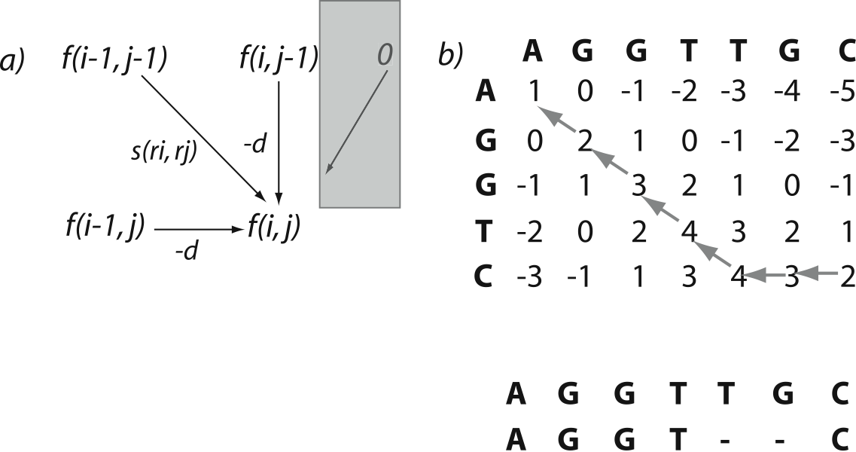
Local Alignment: Smith-Waterman Algorithm (1981)
Take approximate location of where read aligns to and refine the precise alignment to determine the cigar string
Generates the optimal pairwise alignment between two sequences
Time consuming to carry out for every read
Only applied to a small subset of the reads that don’t have an exact match
Important for correctly aligning reads with insertions/deletions
Match: +1
Mismatch: 0
Gap open: -1

Slide 14
Mapping Qualities
Mapping quality is a measure of how confident the aligner is that the read is corresponds to this location in the reference genome
Genomes contain many different types of repeated sequences
Transposable elements (40-50% of vertebrate genomes)
Low complexity sequence
Reference errors and gaps
Typically represented as a phred score (log scale)
Q10 = 1 in 10 incorrect
Q20 = 1 in 100 incorrect
Q0 used to indicate no confidence in the alignment of the read to this location
Paired-end sequencing is useful
One end maps inside a repetitive elements and one outside in unique sequence
Then the combined mapping quality can still be high
Hence prefer paired-end sequencing

Slide 15
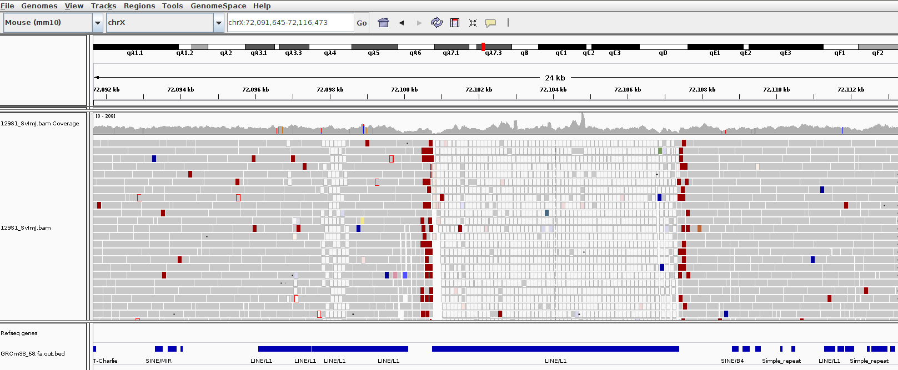
Mapping Qualities

Slide 16
Mapping Qualities

Slide 17
Mapping Qualities
MapQ: 0
MapQ: 60

Slide 18
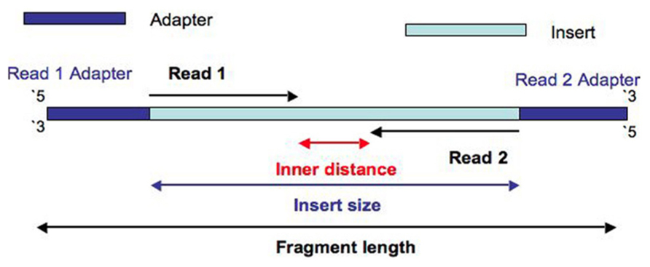
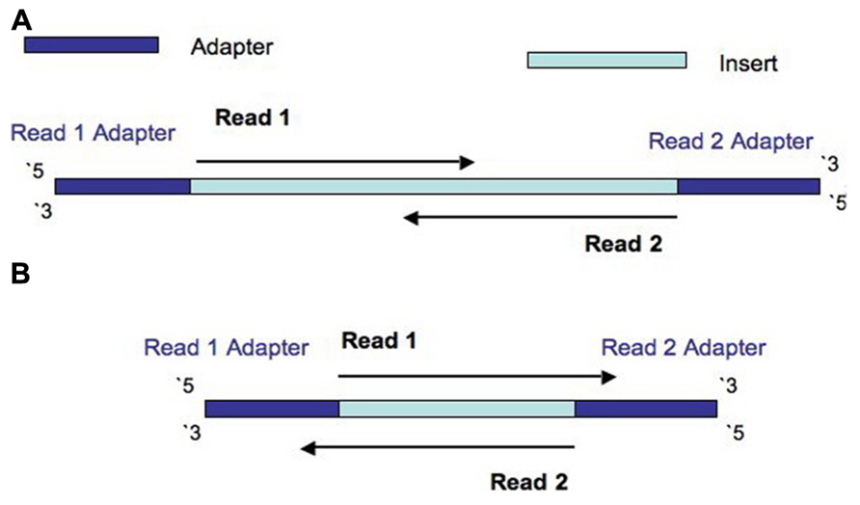
Some Terminology
Insert size > length(read 1 + read 2)
Insert size < length(read 1 + read 2)
Insert size < length(read 1); Insert size < length(read 2)
Turner, 2014. PMID:24523726

Slide 19
Some Terminology
Insert size > length(read 1 + read 2)
Both reads in a pair get the same “name”
Insert size < length(read 1 + read 2)
Insert size < length(read 1); Insert size < length(read 2)
Turner, 2014. PMID:24523726

Slide 20
Alignment Limitations
Read Length and complexity of the genome
Very short reads difficult to align confidently to the genome
Low complexity genomes present difficulties
Malaria is 80% AT - lots of low complexity AT stretches
Alignment around indels
Next-gen alignments tend to accumulate false SNPs near true indel positions due to misalignment
Smith-Waterman scoring schemes generally prefer a SNP rather than a gap open
New tools developed to do a second pass on a BAM and locally realign the reads around indels and ‘correct’ the read alignments
High density SNP regions
Seed and extend based aligners can have an upper limit on the number of consecutive SNPs in seed region of read (e.g. Maq - max of 2 mismatches in first 28bp of read)
BWT based aligners work best at low divergence

Slide 21
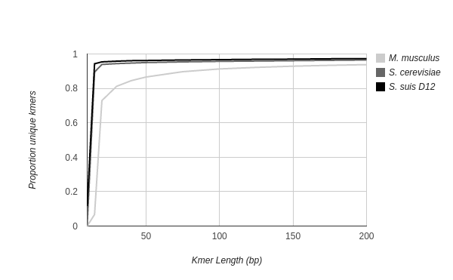
Read Length vs. Uniqueness
Reference genome mappability: Proportion of reads/kmers unique with error-free reads at various read lengths for M. musculus, S. cerevisiae, S. suis genomes

Slide 22
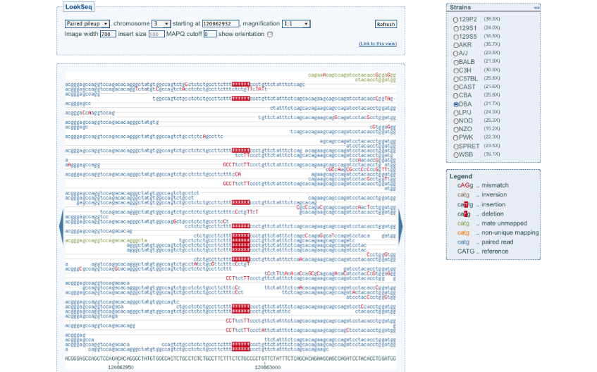
Example Indel - 2010

Slide 23
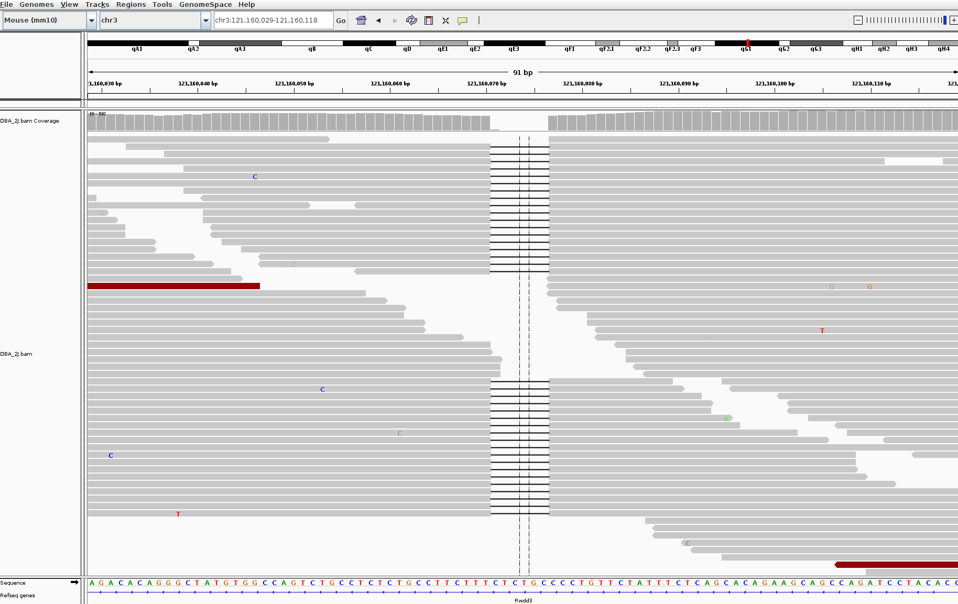
Same Indel - 2014

Slide 24
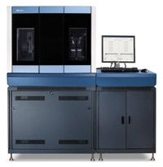
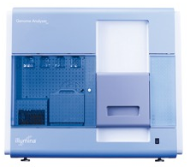
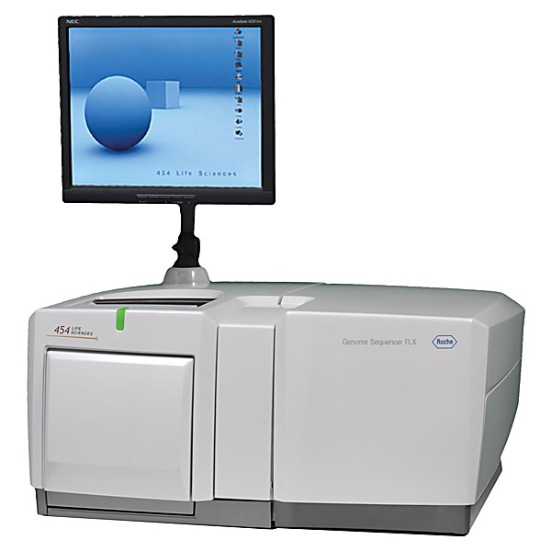
Data Production Workflow
Sample
merge
BAM
BAM
Sample/Platform
Library
merge
BAM
BAM
BAM
Library
BAM
BAM
BAM
BAM
BAM
BAM
Improvement
BAM
BAM
BAM
BAM
BAM
Lane/Plex
Alignment
(bwa, smalt etc)
Fastq
Fastq
Fastq
……
Fastq
Fastq

Slide 25
Base Quality Recalibration
Each base call has an associated base call quality
What is the chance that the base call is incorrect?
Illumina evidence: intensity values + cycle
Phred values (log scale)
Q10 = 1 in 10 chance of base call incorrect
Q20 = 1 in 100 chance of base call incorrect
Accurate base qualities essential measure in variant calling
Rule of thumb: Anything less than Q20 is not useful data
Illumina sequencing
Control lane or spiked control used to generate a quality calibration table
If no control – then use pre-computed calibration tables
Quality recalibration
1000 genomes project sequencing carried out on multiple platforms at multiple different sequencing centres
Are the quality values comparable across centres/platforms given they have all been calibrated using different methods?

Slide 26
Base Quality Recalibration
Original recalibration algorithm
Align subsample of reads from a lane to human reference
Exclude all known dbSNP+1000G pilot SNP sites
Assume all other mismatches are sequencing errors
Compute a new calibration table bases on mismatch rates per position on the read
Pre-calibration sequence reports Q25 base calls
After alignment - it may be that these bases actually mismatch the reference at a 1 in 100 rate, so are actually Q20
Recent improvements – GATK package
Reported/original quality score
The position within the read
The preceding and current nucleotide (sequencing chemistry effect) observed by the sequencing machine
Probability of mismatching the reference genome
NOTE: requires a reference genome and a catalog of variant sites

Slide 27
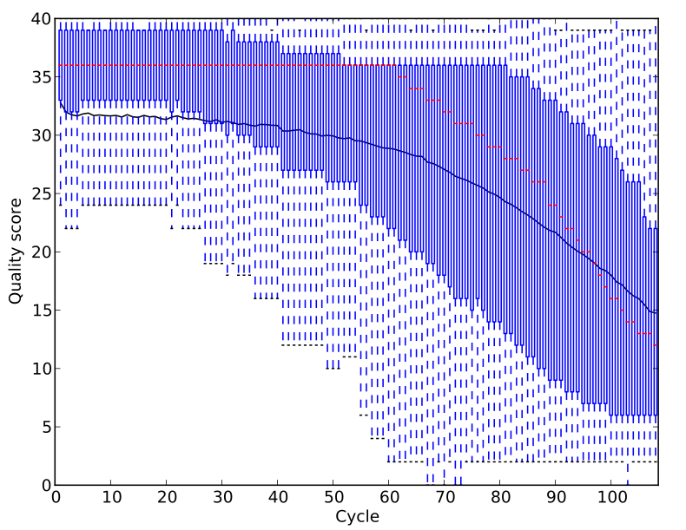
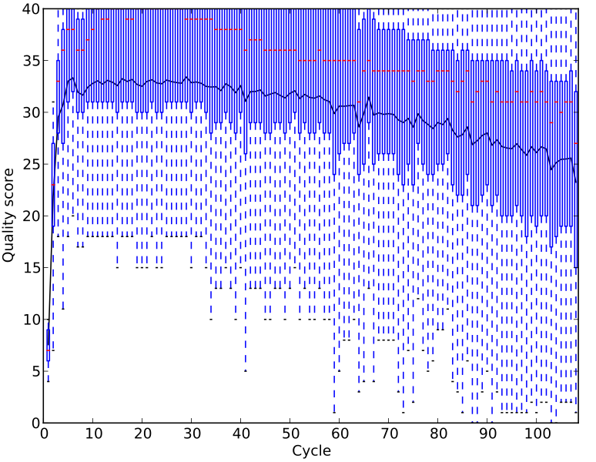
Base Quality Recalibration Effects
N.B. Always replot quality values when trying BQSR on a new set of samples or species

Slide 28
Library Duplicates
All second-gen sequencing platforms are NOT single molecule sequencing
PCR amplification step in library preparation
Can result in duplicate DNA fragments in the final library prep.
PCR-free protocols do exist – require larger volumes of input DNA
Generally low number of duplicates in good libraries (<5%)
Align reads to the reference genome
Identify read-pairs where the outer ends map to the same position on the genome and remove all but 1 copy
Samtools: samtools rmdup or samtools rmdupse
GATK: MarkDuplicates
Can result in false SNP calls
Duplicates manifest themselves as high read depth support

Slide 29
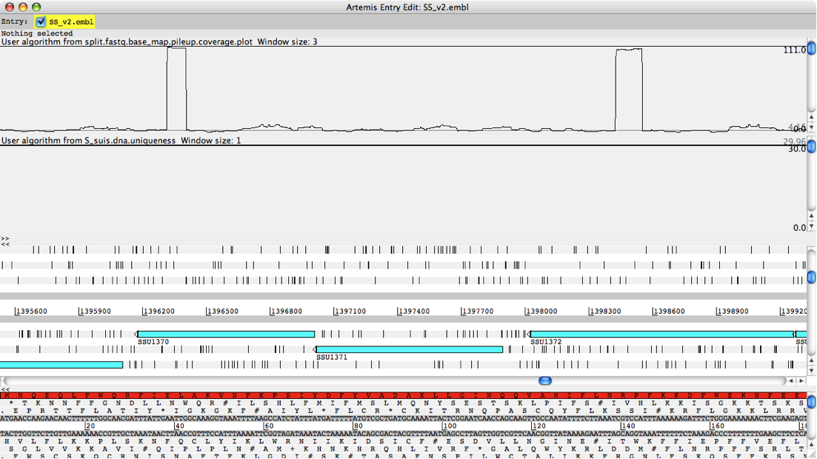
Library Duplicates

Slide 30
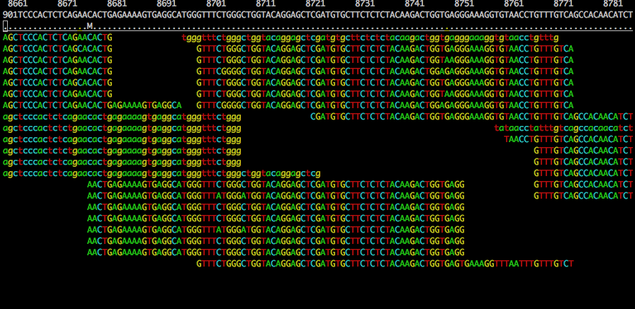
Duplicates and False SNPs

Slide 31
Duplicates and False SNPs

Slide 32

Alignment - Scaling Up
50-60 Gbp per HiSeq lane
Aligning a single lane of reads can take a long time on a single computer
Parallel computing
A form of computation in which many calculations are carried out simultaneously
@read1
ACGTANATCN
+
$$%SSG$%££@
@read2
AGCNTNCTCA
+
£$$%£$%%^&
@read1
ACGTANATCN
+
$$%SSG$%££@
@read2
AGCNTNCTCA
+
£$$%£$%%^&
BAM
BAM

Slide 33
Alignment - Scaling Up
Two main approaches to speeding up read alignment
Simple parallelism by splitting the data
Split lane into 1Gbp chunks and align independently on different processors
BWA ~8 hours per 1Gbp chunk
Merge chunk BAM files back into single lane BAM
‘samtools merge’ command
@read1
ACGTANATCN
+
$$%SSG$%££@...
Sequencing Lane
(Fastq, 30-40Gbp)
Utilise multiple processors on single computer
Modern computers have >1 processing core or CPU
Most aligners can use more than one processor on same computer
Much easier for user
Just supply the number of processors to use (e.g. bwa-mem -t option)
Fastq
split1
Fastq
split2
Fastq
split3
Fastq
split4
Split
(1Gbp)
Align
BAM1
BAM2
BAM3
BAM4
Merge
@read1
ACGTANATCN
+
$$%SSG$%££@
@read2
AGCNTNCTCA
+
£$$%£$%%^&
BAM
BAM

Slide 34
IT Costs of NGS
NGS generates a LOT of sequencing data
HiSeq lane ~60 Gbp, X10 lane ~100 Gbp, MiSeq lane ~15 Gbp
Two main components for estimating IT costs
Compute - number of computers/server (CPUs) required to do data processing in a reasonable amount of time
Storage - the physical disks that your sequencing data is stored on (including backup copies)
Estimating storage requirements
BAM ~1 byte per bp sequenced
1 primary copy, 1 backup copy of raw data: 2 bytes per bp
1 processed/merged copy of the data: 1 byte per bp
Output from variant calling programs: 1-2 bytes per bp
4-5 bytes per bp in total
e.g. experiment will generate 10 HiSeq lanes of sequencing: 10 x 60 x 5 = 3000 Gbytes = 3 Tbytes
Estimating compute requirements
More difficult to estimate as it depends on the type of analysis being carried out and the software being used
Estimate 20-40 CPU hours per Gbp
e.g. experiment will generate 10 HiSeq lanes of sequencing: 10 x 60 x 40 = 24,000 CPU hours

