Slide 1

Why Gifted Education Matters (and what to do about it)
Matthew J. Zakreski, PsyD

Slide 2
Our Goals for Today
1. Understand why Gifted Education is necessary and vital for the development of gifted learners
1
2. Understand your rights to Gifted Education (504 Plans and IEPs)
2
3. Explore advocacy techniques
3

Slide 3
Important Caveats
I am a psychologist and an expert in gifted students
I am NOT an educator
I am NOT a lawyer
I am NOT a trained educational advocate
This advice is based on publicly available documents, my own clinical and professional experience, and consultation with professionals
THIS IS NOT LEGAL ADVICE

Slide 4
Definition
The term "gifted and talented" when used in respect to students, children, or youth means students, children, or youth who give evidence of high-performance capability in areas such as intellectual, creative, artistic, or leadership capacity, or in specific academic fields, and who require services or activities not ordinarily provided by the school in order to fully develop such capabilities.
Susan Johnsen

Slide 5

Giftedness is a distinct neurological profile
  Efficient brains (better pruning of neurons)
    Much larger corpus callosum
  Poor self-regulation and organization skills (overwhelmed pre-frontal cortex)
  Emotional intensity (larger amygdala)
  Reactive in social situations (hypothalamus / limbic system)
  Perfectionism (overactive basal ganglia)
  Creativity (supramarginal gyrus / right parietal lobe interconnectivity)
  Thickness of cortex changes
  Over-excitabilities

Slide 6
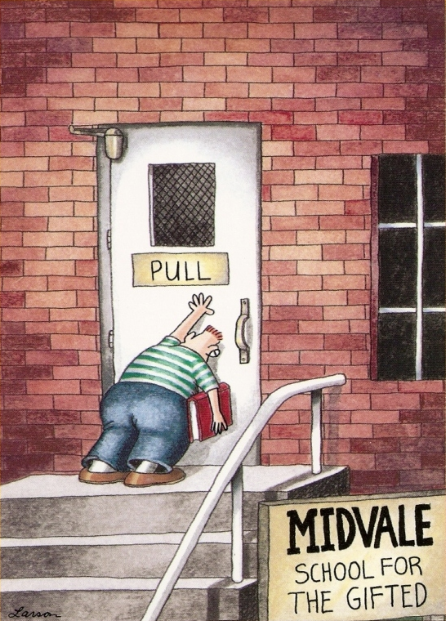
Do Gifted Students Struggle?

Slide 7
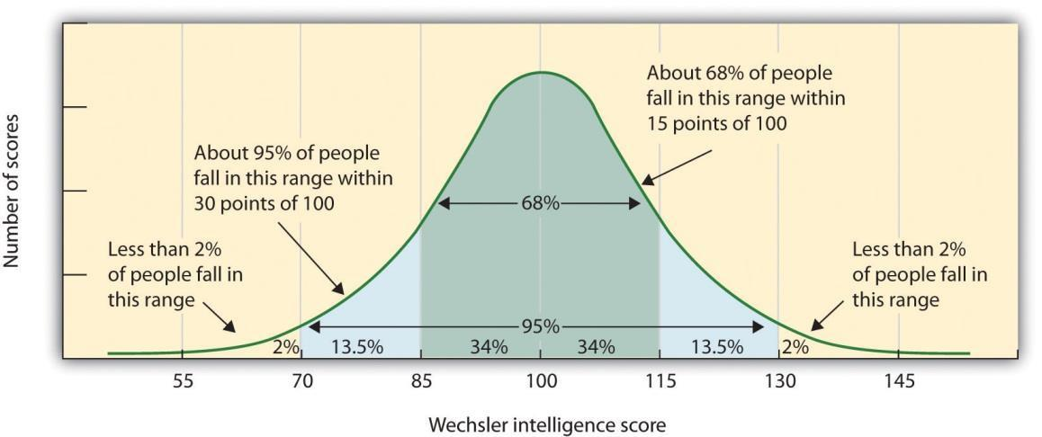

Slide 8
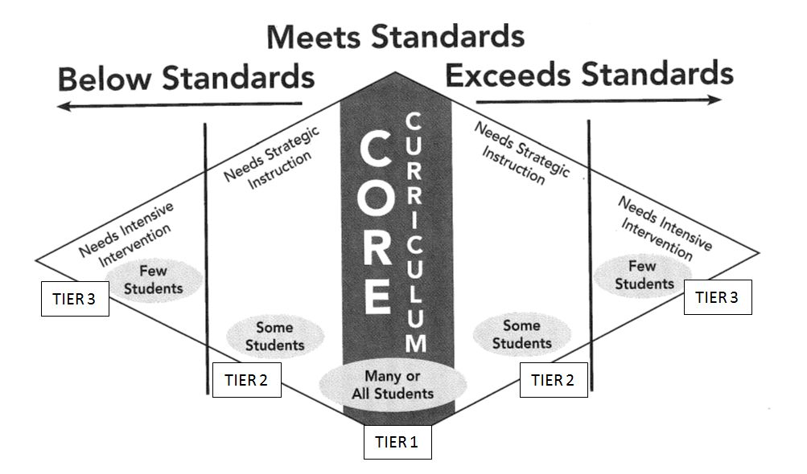
Gifted Education is Special Education

Slide 9
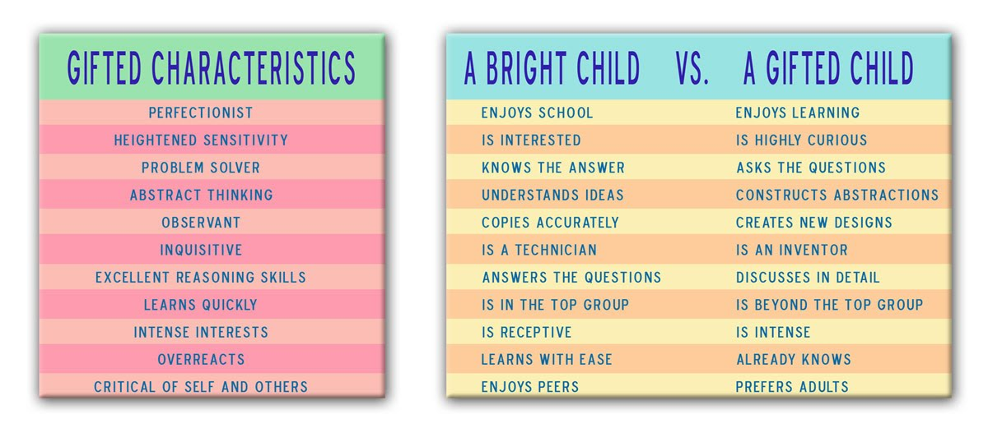

Slide 10
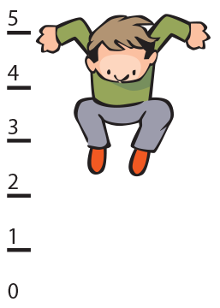
Gifted Education
Regular education is about following the rules and doing what is expected of you – doesn’t work for gifted/2e learners!
Gifted education is about doing the unexpected
Gifted education is about moving through what you already know so we can get to what you don’t know
Gifted education is about meaningful challenge - how high can you jump?

Slide 11
Good Gifted Instruction
Rich curriculum organized around core learning concepts rather than memorizing facts
Pacing instruction to the student’s individual needs
Opportunities to perform at a higher “degree of difficulty”
F.A.I.L. – Frequent Attempts in Learning
Pre-test and post-test
As little “filler time” as possible

Slide 12
Teaching Techniques
Curriculum Compacting – if they show you that they can do it, let them move on to the next thing
Differentiation – can you teach/assess the same content in a different/deeper way?
Project-Based Learning (PBL) – let’s learn by doing/building!
Independent studies – a great way for gifted kids to take “a deep dive” and really explore a topic of interest
Acceleration – where’s the next place that this student can go to get what they really need?
Social and Emotional Learning (SEL) – find ways for your gifted kids to engage socially in class (www.casel.org or email me)

Slide 13
How this impacts schools
There are gifted kids in EVERY classroom (and they might not know it)
Supporting our best and brightest is very important
Pushes the boundaries of pedagogy and praxis
Integration of social/emotional needs and education
High-level collaboration
Individualized Education Plans (IEP)
Gifted-IEP
504 Plans
Gifted education is a great career prospect

Slide 14
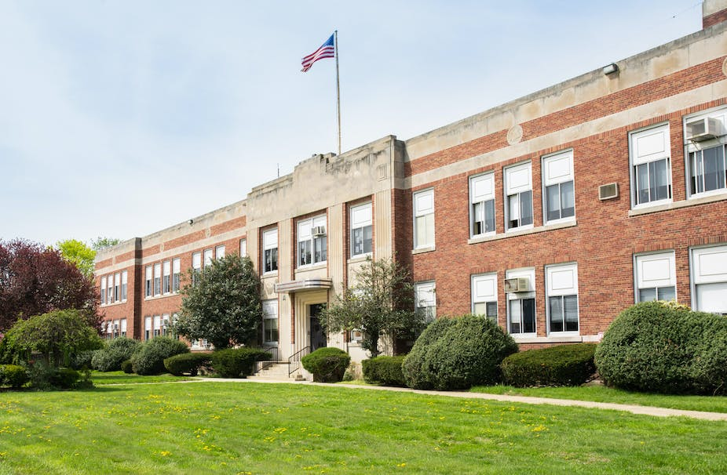
At school
Nurture the strengths and interests
Foster social and emotional learning (SEL)
Identify weaknesses early and develop strategies
Strengths-based instruction – be creative!
  Example: a math tutor that will use the child’s interest in Pokemon
The use of technology (i.e., scribes in class or dictation software)
504 Plans
Gifted/Individualized Education Plans (G/IEPs)
When is it time for a new school?

Slide 15
How to Reach Gifted Students
We Need to ACHIEVE!
Be Authentic
Be Creative
Be Humble
Be Investigatory
Be Explicit
Be Very Communicative
Be Empathetic

Slide 16
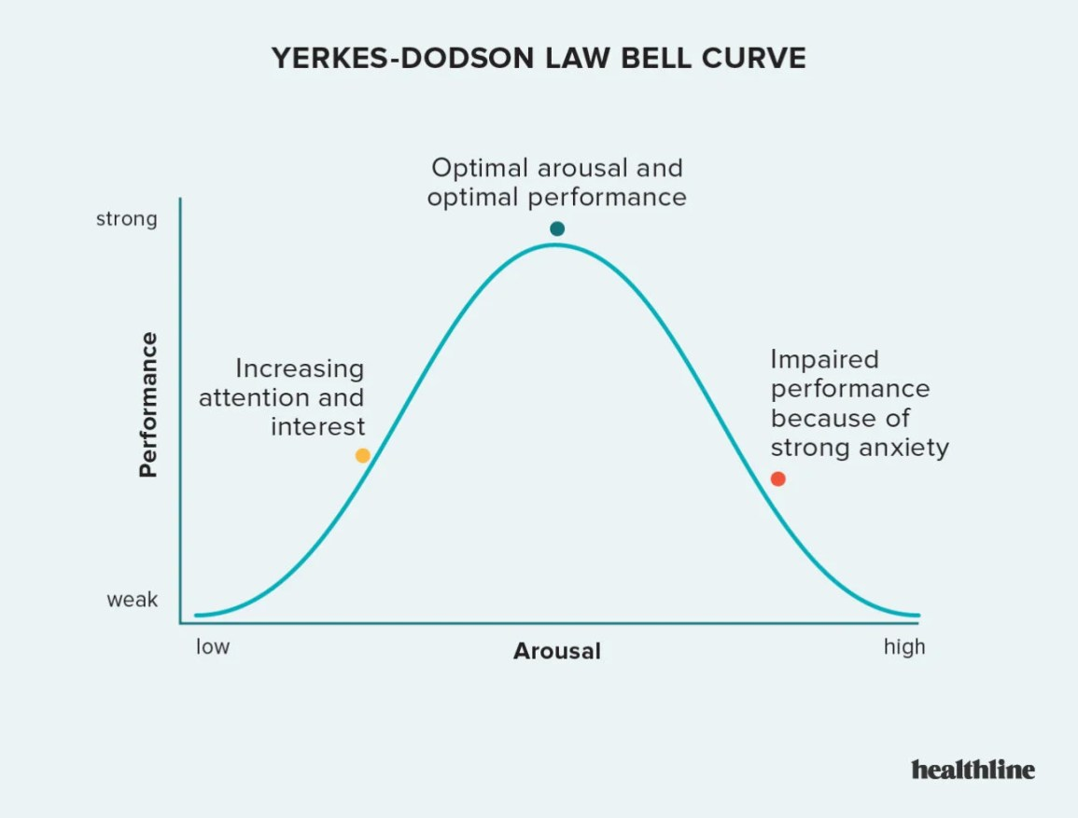

Slide 17

Therapeutic Supports
Psychotherapy – focus on skill-building and emotional processing
Coaching – in specific lagging academic skills (i.e., reading)
Occupational Theory – kinesthetic skills, organization, time management
Speech-Language Pathology – as needed
Educational Advocate – to help with asking for/receiving appropriate accommodations in the G/IEP world
When it doubt – follow the child’s interest(s)!

Slide 18
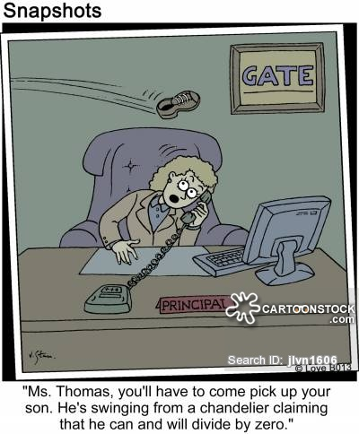

Slide 19
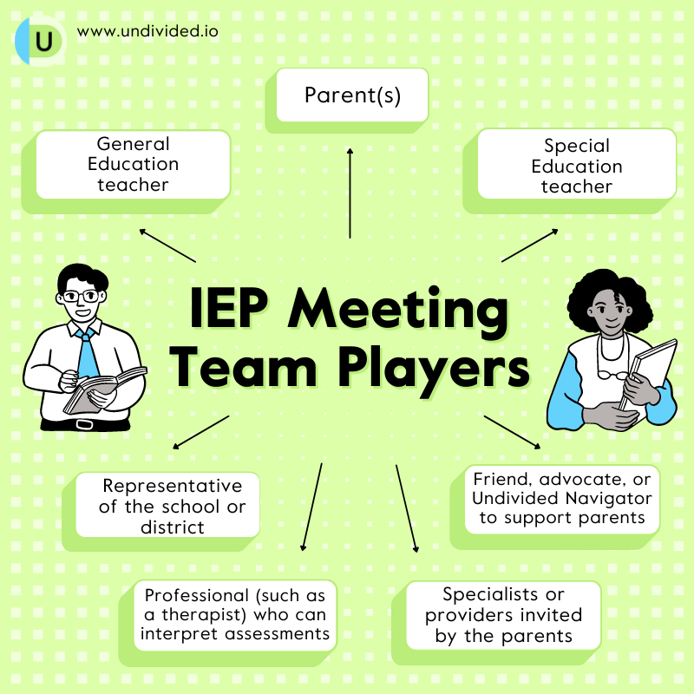
IEP Team

Slide 20

G-IEP
The Gifted IEP (Individualized Education Plan) can be thought of as a framework that generally guides the teachers rather than forcing the teacher to teach to a set of specific actions that was decided on months earlier.

Slide 21
Why do I need an IEP/GIEP?
Matching your child’s educational experience at school to be more in line with their needs
In educational terms, 'Gifted' means that the child has an educational need in one or more subject areas.
For the purposes of education law in Pennsylvania the term "gifted" applies to a child who learns differently enough from most other children to require measures and methods beyond those used in the normal grade-level taken in the classroom.
A gifted child's educational needs must be identified using a calculation that is reasonable and met through a plan called the Gifted IEP designed to provide an education of meaningful benefit to the child.
The school must plan to meet the needs of each gifted child based on each child's individual needs.

Slide 22
How do I make this happen?
Request an evaluation in writing
The District may ask for a gifted screener
The District will send a Permission to Evaluate (PTE)
Once the District receives the signed PTE, they have 60 days to
Evaluate the student
Have the completed report in your possession
The evaluation results are put into a Gifted Written Report (GWR)
If the GWR shows the need for specialized instruction, a G-IEP meeting will be convened

Slide 23
Chapter 16
The State Department of Education (PDE) – gifted students need specially designed instruction
No money is (or ever has been) earmarked in the State budget for gifted education
A Gifted Individualized Education Plan (G-IEP) must be
Written to the specific needs of the child
Based on objective data
MORE than a “pull-out program”

Slide 24
Gifted in the Regular Classroom
Where the G-IEP should be focused
Gifted students need specific educational techniques in regular ed
Curriculum compacting
Acceleration
Differentiation
Different (not more) extra work
Accommodations should be
Trackable
Strengths-based
Started as early as possible

Slide 25
Four Main G-IEP Sections
Present Levels of Educational Performance
  Where are they now?
Goals
  Where do we want them to be?
Short Term Learning Outcomes
  How do we know that it is working?
Specially Designed Instruction
  How will we get there?

Slide 26
What about 2e?
Each District handles 2e differently
The question is how to meet the need of “the whole child”
Educational
Emotional
Social
Behavioral
The same guidelines are valid in IEP/GIEP meetings
The CONTENT of the Plan is what matters

Slide 27
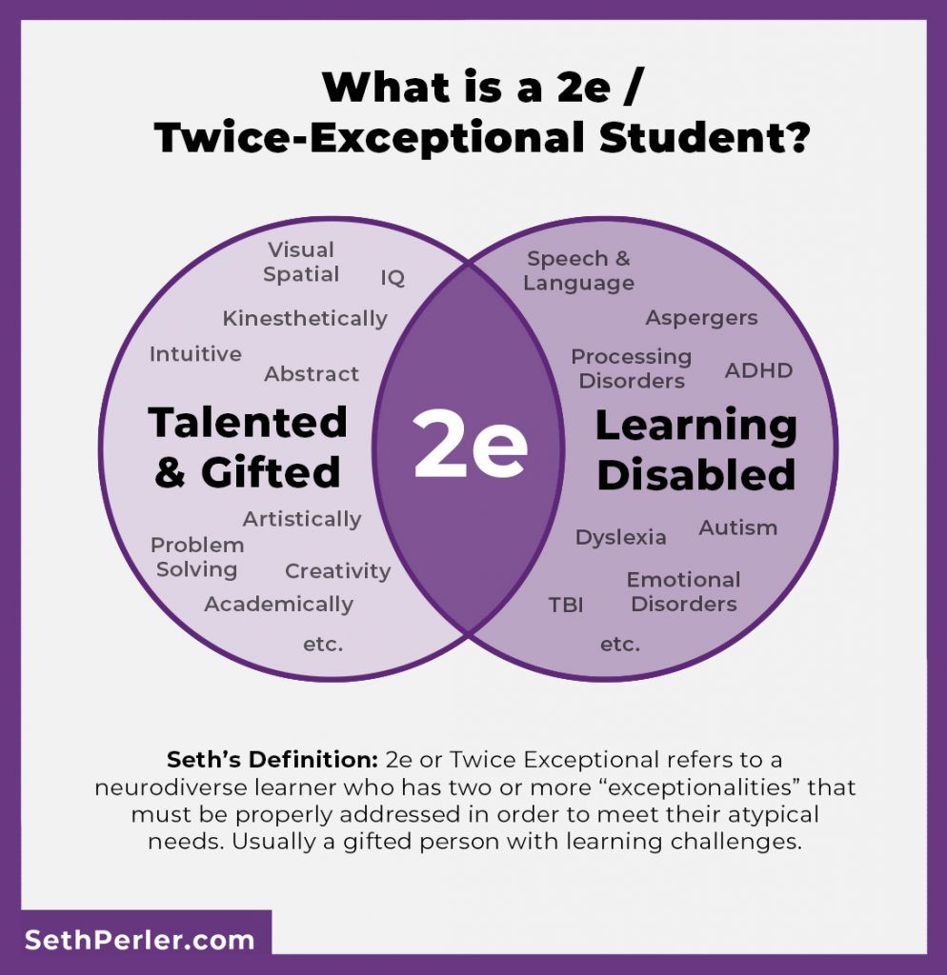
Types of 2E
The child’s strengths (i.e., giftedness) overshadow their challenges
The child’s weaknesses (i.e., ADHD) overshadow their strengths
The child’s strengths and weaknesses balance each other out and makes the child look “average” in sum

Slide 28
Things to be aware of
The G-IEP proposed by the Team and approved by you MUST be implemented as it is written
The school/district’s gifted pull-out program (GATE, Challenge, etc.) is NOT the extent of the gifted education accommodation available
Grades are NOT a reason to deny/exclude a child from a gifted program or a psycho-educational evaluation
Present Level of Educational Performance (PLEP)
Many school districts are NOT aware of the extent of the laws regarding gifted education
The G-IEP does NOT go into effect until it is signed by you. Take as much time as you need to go over it and ask questions/clarification

Slide 29
If you disagree
During the evaluation and/or annual planning process, the parents receive the Notice of Parental Rights for Gifted Students.
If a disagreement exists between the parents and the district, the parents must note their disagreement on the Notice of Recommended Assignment (NORA) and request either mediation or due process hearing, as outlined in the Notice of Parental Rights for Gifted Students.
If, after mediation, the conflict is still not resolved, or if the school district refuses to accede to a request to mediate the dispute, it may be forwarded to a due process hearing.
Can include a Lawyer, Expert Witness in Gifted Education, and/or an Advocate

Slide 30
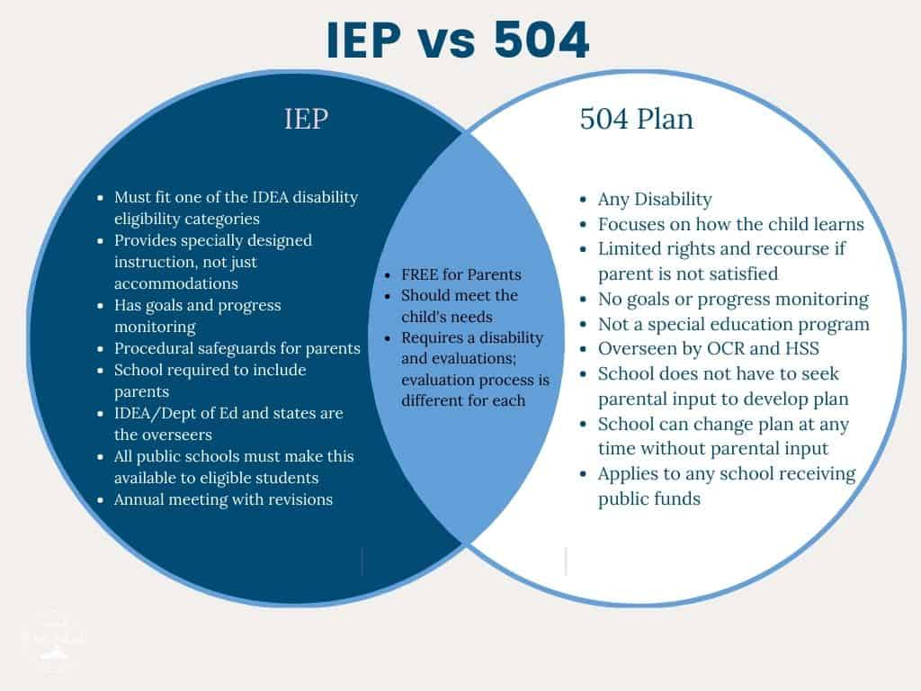

Slide 31
504 Plan
A 504 plan is covered under Section 504 of the Rehabilitation Act, which is a federal civil rights law that ensures an individual cannot be discriminated against due to their disability.
These plans provide support and accommodations but do not include goals and objectives.
504 plans are reviewed periodically based on need.
The rule of thumb for most states is every three years (the only caveat is if the medical condition is no longer “substantially limiting one or more basic life functions or activities”), but parents have the right to request a meeting to discuss the plan more often if they feel the need.

Slide 32
Who Needs a 504 Plan?
Section 504 broadly defines someone who qualifies for a 504 plan as an “individual with a disability … which substantially limits one or more of such person’s major life activities.”
Plans are often granted to students who may have medical needs or a disability that requires support but not specialized instruction.
Some students who don’t qualify for special education services through an IEP do qualify for services through a 504 plan. For example, a student may have a disability that carries into schoolwork and needs to use a word processor instead of handwriting assignments, but doesn’t benefit from strategic personalized instruction in an academic area.

Slide 33
What’s in my 504 Plan?
Whatever you want! There are very few limitations
Schools use 504 Plans to create personalized accommodations to address the needs of a child based on their disability.
Accommodations can include:
  assistive technology
  preferential seating
  getting a written list of instructions
  receiving class notes prior to the lesson
  larger text
  Emailing assignments home

Slide 34
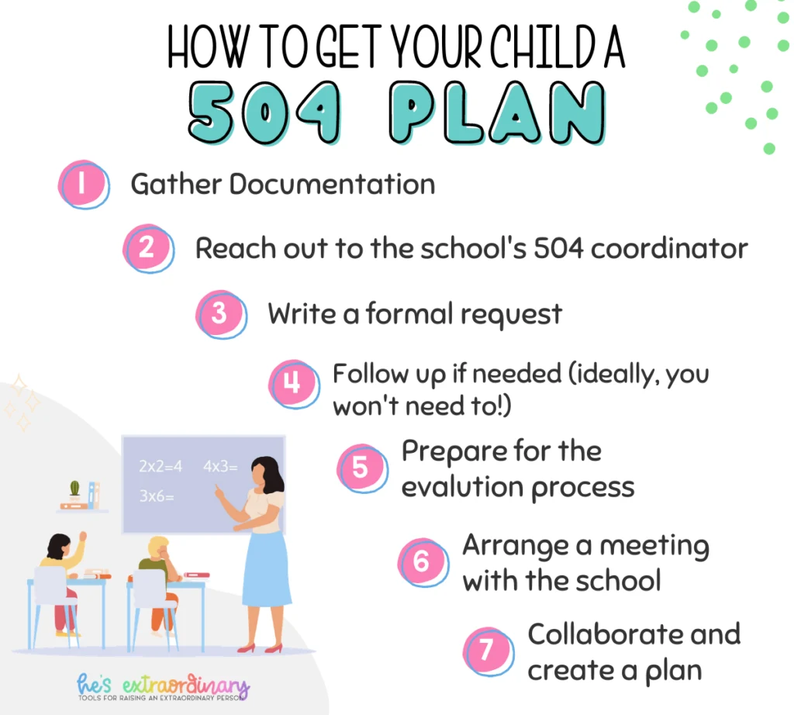

Slide 35


Slide 36

Find your Super-Friends
Psychologist/Therapist
Psychiatrist/PCP
Advocate
Documentation
Your kid?
Lawyer?

Slide 37
Common Complaints
1. This kid can’t be gifted – they’re getting terrible grades! (Not all gifted kids get good grades)
2. This kid needs to get their behavior under control before we let them into the gifted program
  A. Behavior cannot be a disqualifying factor in GATE acceptance
  B. Many kids have better behavior when they are in GATE classes because they’re being challenged
3. Let’s get the ADHD/Autism/Dysgraphia under control FIRST, and then…
  A. This is an ableist mindset – neurodivergence is about accepting the whole child
  B. If you want to motivate behavior change, you need to give kids a reason
4. Our Gifted program is “All or nothing” – not true, kids are allowed to engage in whatever parts they qualify for

Slide 38
Advocacy 101
1. Document – send emails and letters, rather than leaving messages
2. Be clear – come in with a list of goals and information
3. Be collaborative – remember, you are in this together (who is the expert in what?)
4. Be calm – the angrier we get, the more defensive they can
5. Be reasonable – there is a difference between best practice and possible practice
6. Be patient – you have a right to the information, and they will get it to you when they can
7. Be informed – know your rights

Slide 39
Resources
https://peatc.org/wp-content/uploads/2020/12/How-to-Prepare-for-Your-Childs-IEP-Meeting.pdf
https://www.parentcenterhub.org/meetings/
https://www.ed.gov/sites/ed/files/policy/speced/guid/idea/tb-iep-meetings.pdf
https://undivided.io/resources/preparing-for-your-first-iep-elementary-1234
https://www.pattan.net/getmedia/ba6f35f7-42f6-4915-941e-60862e6a8241/TDR_42PrepIEPMtg0415

Slide 40
Questions?
Email: drmatt@theneurodiversitycollective.com
Facebook: www.facebook.com/drmattzakreski
Website: www.theneurodiversitycollective.com

