Slide 1
THE ICT UNIVERSITY • FACULTY OF INFORMATION AND COMMUNICATION TECHNOLOGY
SmartCAMPOST
An Intelligent Parcel Tracking, Collection, and Delivery System
Using QR Codes, GPS, and Artificial Intelligence
PRESENTED BY
MATRICULE
SUPERVISOR
DEFENSE DATE
Nguend Arthur Johann
ICTU20223180
Eng. TANWI NKIAMBOH
2026

Slide 2
PLAN OF PRESENTATION
What I Will Cover
01
02
03
Motivational Example & Problem
Domain & Core Innovations
Aim, Objectives & Research Question
04
05
06
Literature & Similar Projects
Methodology
Architecture, Use Case & Class Diagrams
07
08
09
Database Design
Implementation & Testing
Results, Limitations & Conclusion
02

Slide 3
MOTIVATIONAL EXAMPLE & PROBLEM STATEMENT
Why This Project: A Visibility Gap I Saw Firsthand
During fieldwork at two CAMPOST agencies in Yaoundé, the same question came up again and again at the counter: “Where is my parcel?” Staff could only answer with a phone call to another office or by searching a paper logbook. That visibility gap was not a hypothetical for me — it is what I personally watched customers and staff struggle with, and it is what motivated SmartCAMPOST.
CAMPOST, the national postal operator, still runs largely on manual, paper-based processes: handwritten pickup receipts, manual data entry at the counter, and phone calls as the only way to check where a parcel is. Meanwhile, mobile money penetration in Cameroon has reached over 65% of adults, yet no integrated platform connects parcel tracking with MTN MoMo or Orange Money payment.
THE CORE PROBLEM
Customers, agents, and CAMPOST staff have no shared, real-time view of where a parcel is, or how to pay for it digitally.
65%+
0
100%
Mobile money adoption among Cameroonian adults
Integrated digital tracking + payment platforms for CAMPOST today
Manual, paper-based proof of pickup and delivery
03

Slide 4
DOMAIN & CORE INNOVATIONS
An Intelligent Logistics Platform for the Cameroonian Postal Sector
DOMAIN: Intelligent multi-platform logistics software engineering — combining QR identification, GPS geolocation, mobile payments, and AI-assisted operations within a single postal-tracking system.
Two-Step QR Verification
OTP-Confirmed Delivery
USSD for Feature Phones (Designed)
Partial QR on creation, HMAC-SHA256-signed final QR on agency intake — tamper-proof at every handoff.
Courier scans final QR, then a recipient OTP via SMS proves physical receipt before status flips to DELIVERED.
*123# menu architected against the NPSI switch for non-smartphone tracking and payment access — implementation scheduled for the next phase.
Native Mobile Money
Self-Healing AI
Seven-Role RBAC
MTN MoMo and Orange Money behind one provider-agnostic gateway with async webhook confirmation.
A LangGraph-style agent monitors congestion and recommends re-routing without human prompting.
CLIENT, AGENT, COURIER, STAFF, ADMIN, FINANCE, RISK — each with method-level @PreAuthorize boundaries.
04

Slide 5
AIM AND OBJECTIVES
One General Objective, Four Targets — All Fulfilled
GENERAL OBJECTIVE
To design and implement SmartCAMPOST, an intelligent multi-platform parcel tracking, collection, and delivery management system that extends the digital capabilities of CAMPOST by integrating QR codes, GPS, and Artificial Intelligence. (Erl, 2005)
01
02
03
04
Design
Implement
Develop
Evaluate
a relational data model and a layered system architecture supporting seven distinct operational roles.
QR-based parcel verification, GPS delivery tracking, and MTN/Orange Money payment integration.
an AI-assisted operations layer for risk alerts, recommendations, and self-healing congestion handling.
the platform through automated testing and a bilingual user-acceptance survey.
FULFILLED — Ch.4 architecture + 45-table schema
FULFILLED — live in deployed system
FULFILLED — multi-agent AI module
FULFILLED — 99.4% test pass rate, 50-respondent survey
05

Slide 6
RESEARCH QUESTION & LITERATURE REVIEW
What We Asked, and What Existing Research Misses
OVERARCHING RESEARCH QUESTION
How can QR Code technology, GPS geolocation, Artificial Intelligence, and multi-platform software development be integrated to design an intelligent parcel system that is operationally suitable for the Cameroonian postal context?
Postal Digitalisation in Africa
QR Code Tracking
GPS Delivery Tracking
Mobile Money Adoption
Kuteyi & Winkler (2022) document weak digital infrastructure across Sub-Saharan postal operators.
Ashtekar & Kunnurkar (2022) show QR-based location detection improves transport visibility.
Multiple studies confirm GPS reduces delivery disputes, but few integrate it with local payment rails.
Ahmad, Green & Jiang (2020) establish mobile money as Africa's dominant financial-inclusion channel.
THE RESEARCH GAP
No existing platform combines real-time GPS tracking, two-step QR verification, mobile money payment, USSD access for feature phones, and AI-assisted operations within a single system designed for the Cameroonian postal context. SmartCAMPOST's design and current implementation close most of this gap; the USSD channel is architected but not yet built (see Limitations).
06

Slide 7
REVIEW OF SIMILAR PROJECTS
Named Platforms, and the Gaps SmartCAMPOST Closes
System
QR Tracking
GPS Real-Time
AI Features
Mobile Payment
Offline Mode
Roles
DHL Express App
Yes
Yes
ETA only
Limited (cards)
No
2
PostNL (Netherlands)
Yes
Yes
Route optimisation
EU-only
No
3
India Post eParcel
Yes
No
None
UPI only
No
2
Jumia Logistics (Africa)
Partial
Yes
None
Mobile Money
No
3
SmartCAMPOST (this work)
Dual QR
Yes (live)
Multi-agent AI
MTN/Orange/CAMPOST
Yes (sync)
7
Gap: no competitor offers offline sync, three of four have no or limited AI, three of four are payment region-locked, and the maximum competitor role count is 3 versus SmartCAMPOST's 7. (Source: dissertation Ch.2, Table 2)
07

Slide 8
METHODOLOGY
A Hybrid of Merise and Agile Scrum
Four methodologies were evaluated. Three were rejected; their weaknesses justify the hybrid choice.
Waterfall
V-Shape
Spiral
Merise + Agile
REJECTED
REJECTED
REJECTED
SELECTED
Rigid, sequential, no room for changing requirements
Same rigidity, late user involvement
Complex, expensive, unpredictable timelines
Rigorous data modelling, iterative delivery
Merise structured the 45-table relational schema through rigorous MCD and MLD modelling before any code was written. Agile Scrum then drove 12 iterative sprints (Nov 2025 – Feb 2026), accommodating evolving requirements discovered during MTN MoMo API integration and testing.
12 SPRINTS · NOV 2025 — FEB 2026
S1
S2
S3
S4
S5
S6
S7
S8
S9
S10
S11
S12
Design & Setup
Core Development
Hardening & Deployment
08

Slide 9
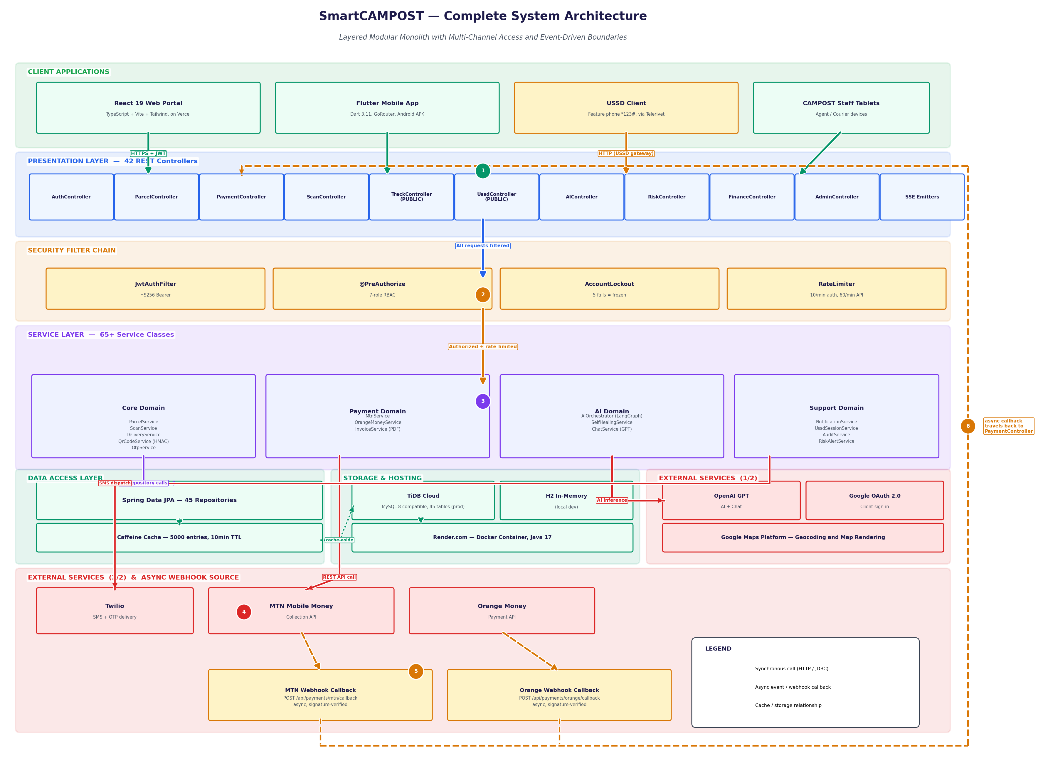
SYSTEM ARCHITECTURE
Layered Modular Monolith with Multi-Channel Access and Event-Driven Boundaries
09

Slide 10
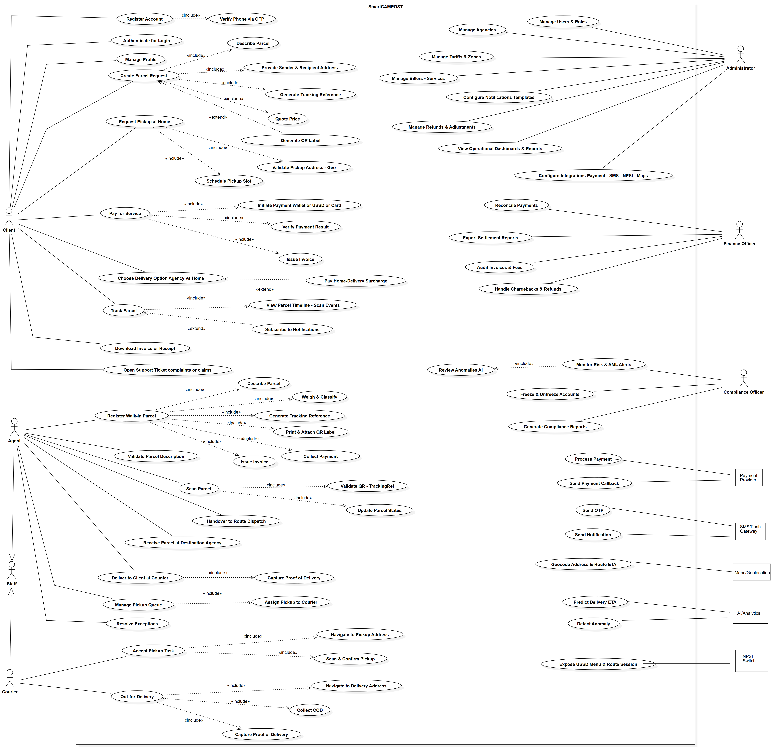
USER ROLES & USE CASE DIAGRAM
Seven Roles, Five External Systems, One Shared Platform
10

Slide 11
CLASS DIAGRAM
Object-Oriented Domain Model
Parcel, Client, Courier, Agent, Staff, Payment, Invoice, DeliveryOtp, ScanEvent, Agency, RiskAlert, AuditLog — with typed attributes and labelled multiplicities. (Gamma et al., 1994; source: dissertation Ch.4)
11

Slide 12
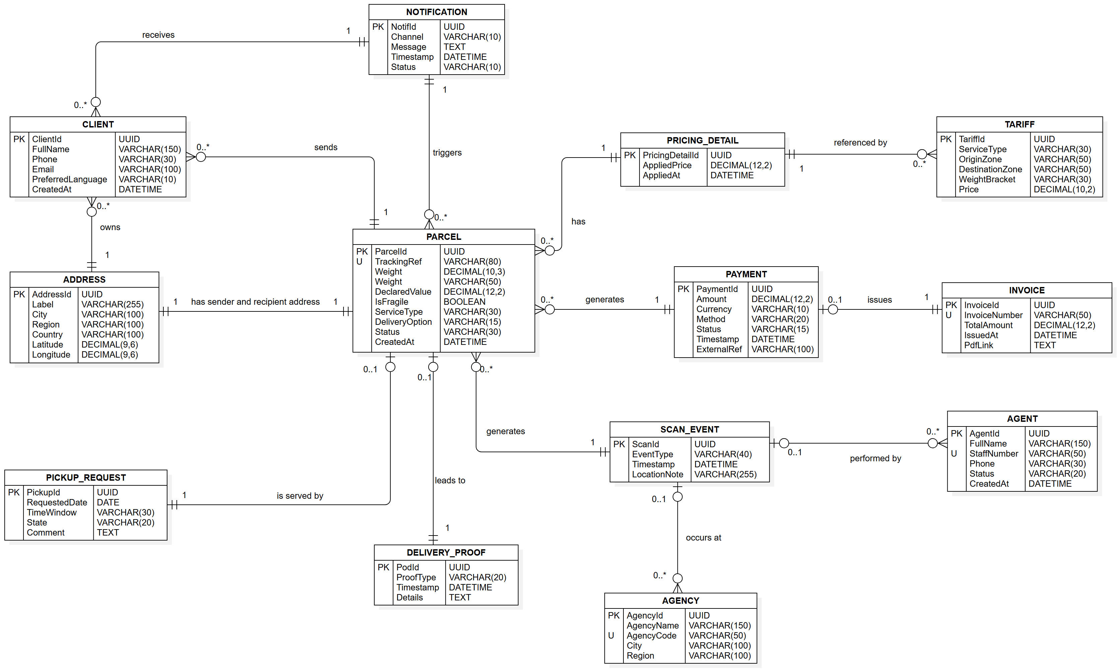
DATABASE DESIGN
Merise-Modelled Relational Schema
45
42
65+
7
Database tables
REST controllers
Service classes
Distinct user roles
Key entities: Parcel, ScanEvent, Payment, Invoice, DeliveryOtp, RiskAlert, AuditLog, UssdSession, AiAgentState
12

Slide 13
IMPLEMENTATION & TESTING
Technology Stack, Verified Across Every Layer
Backend
Frontend
Mobile
Data & Cache
AI & Integration
Payments & Deploy
• Java 17
• Spring Boot 3.5
• Spring Security (JWT)
• Spring Data JPA
• React 19
• TypeScript
• Vite
• Tailwind CSS
• Flutter / Dart 3.11
• GoRouter
• Provider state mgmt
• MySQL 8 / TiDB Cloud
• H2 (local dev)
• Caffeine cache
• OpenAI GPT
• LangGraph-style orchestrator
• Twilio SMS
• MTN MoMo API
• Orange Money API
• Render + Vercel
99.4%
Unit Testing
Integration Testing
End-to-End Testing
Manual & Exploratory
AUTOMATED TEST PASS RATE
JUnit 5 + Mockito covering service-layer business logic, QR signing, and OTP expiry rules.
Spring Boot Test against an in-memory H2 database, validating repository and controller wiring.
Playwright automated flows across CLIENT, COURIER, and ADMIN roles in the deployed web portal.
Structured manual passes logged bugs found and fixed prior to defense, tracked in Table 13.
Across unit, integration, and end-to-end suites covering all seven roles.
13

Slide 14
USER VALIDATION & RESULTS
Survey Evidence, Project Metrics, and Objectives Fulfilled
50 respondents · English and French questionnaires · Distributed across client, agent, and staff profiles
Would use mobile money for parcel payment
88%
Want real-time GPS tracking of their parcel
“Participants overwhelmingly confirmed the problem is real and that they would adopt a digital, mobile-money-enabled alternative.”
92%
Rate current CAMPOST tracking as poor or very poor
76%
Would use a USSD option if no smartphone available
81%
Survey synthesis, Chapter 4
General + 4 Specific
45
99.4%
12
50
Objectives — all fulfilled
Database tables modelled
Automated test pass rate
Agile sprints on schedule
Survey respondents
14

Slide 15
LIMITATIONS & CHALLENGES
An Honest Account of What the Pilot Does Not Yet Cover
Pilot Scope
USSD Not Yet Implemented
Piloted and validated against 2-3 CAMPOST agencies in Yaoundé, not the full national network.
The *123# channel was designed and modelled (NPSI switch integration) but not built — feature-phone users without a smartphone or web access cannot yet track or pay independently.
No Push Notifications
GPS Is Phone-Based, Not Dedicated Hardware
Status updates rely on in-app polling and SMS today; native push (FCM) is designed but not yet wired in.
Courier location comes from the Flutter app's phone GPS, not a dedicated GPS/GSM tracker module. 2026-grade dedicated trackers give continuous satellite+LTE updates (2-5m accuracy) independent of phone battery or app state; sourcing such devices (~$100-400/unit) was outside this project's budget.
Single-Region Hosting
Token Refresh
Render and TiDB Cloud deployment has not been load-tested for nationwide concurrent traffic.
JWT access tokens are short-lived but automatic refresh-token rotation is not yet implemented.
15

Slide 16
CONCLUSION & RECOMMENDATIONS
What SmartCAMPOST Contributes to CAMPOST, and Where It Goes Next
CONTRIBUTION TO CAMPOST
RECOMMENDATIONS
Operational Efficiency
For Practice
Pilot the system across 2-3 Yaoundé agencies with structured staff training before wider rollout.
Real-time tracking, dual-QR verification, and OTP-confirmed delivery replace paper logbooks and phone-call status checks — cutting counter time and reconciliation errors agency-wide.
For Further Study
Competitive Edge
Build the *123# USSD channel to reach feature-phone users
Source dedicated GPS/GSM tracker hardware for couriers
Implement FCM push notifications to replace polling
Load-test Render + TiDB Cloud for national-scale concurrency
Add JWT refresh-token rotation for stronger session security
Matches the digital tracking and mobile-money experience customers already get from DHL and Jumia — letting CAMPOST compete on service quality, not just price, against private couriers.
Customer Reach & Inclusion
Native MTN MoMo / Orange Money payment reaches the 65%+ of Cameroonians already using mobile money; a designed USSD channel extends that reach further to feature-phone and rural users once built — turning a state postal service into a platform people choose, not just default to.
16

Slide 17
Thank You
Questions and Discussion
PRESENTED BY
Nguend Arthur Johann
MATRICULE
ICTU20223180
SUPERVISOR
Eng. TANWI NKIAMBOH
CITATION
Kuteyi, D., & Winkler, H. (2022). Logistics challenges in Sub-Saharan Africa and opportunities for digitalisation. Sustainability, 14(4), 2399. https://doi.org/10.3390/su14042399
17

