Slide 1


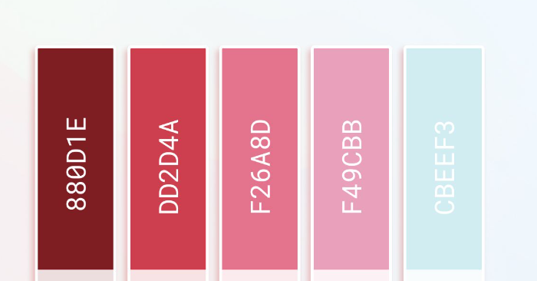
BomBig Font: .VnBodoni Size: 120 Sexy All Day Font: .VnBodoni Size: 32
BomBig
Bảng hồng kết hợp xanh da trời
Sexy All Day
https://onlinepngtools.com/change-png-color

Slide 2

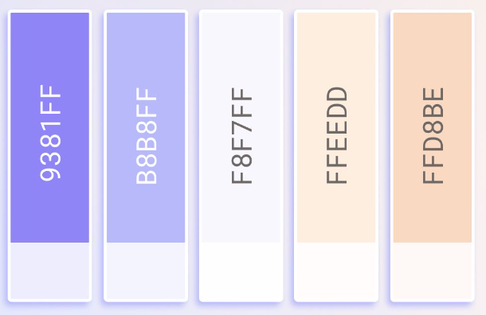
BomBig
Bảng màu tím mộng mơ, trẻ trung
Sexy All Day
https://onlinepngtools.com/change-png-color

Slide 3

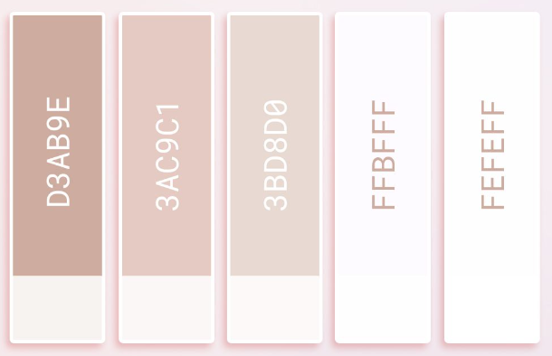
BomBig
Bảng màu nude
Sexy All Day
RGB(229,202,195) E5CAC3
https://onlinepngtools.com/change-png-color

Slide 4


BomBig Font: .VnBodoni Size: 120 Sexy All Day Font: .VnBodoni Size: 32
BomBig
Sexy All Day

Slide 5
BomBig Font: .VnBodoni Size: 120 Sexy All Day Font: .VnBodoni Size: 32
BomBig
Sexy All Day

Slide 6
BomBig Font: .VnBodoni Size: 120 Sexy All Day Font: .VnBodoni Size: 32
BomBig
Sexy All Day

Slide 7

https://onlinepngtools.com/change-png-color
BomBig
#fcb4e3
Sexy All Day

Slide 8

BomBig
Sexy All Day

Slide 9
BomBig
Sexy All Day

Slide 10
BomBig
Sexy All Day

Slide 11
BomBig
Sexy All Day

Slide 12


BOMBIG

Slide 13
BomBig
Sexy All Day

Slide 14


Slide 17
favicon_BomBig_Gray.png

Slide 18
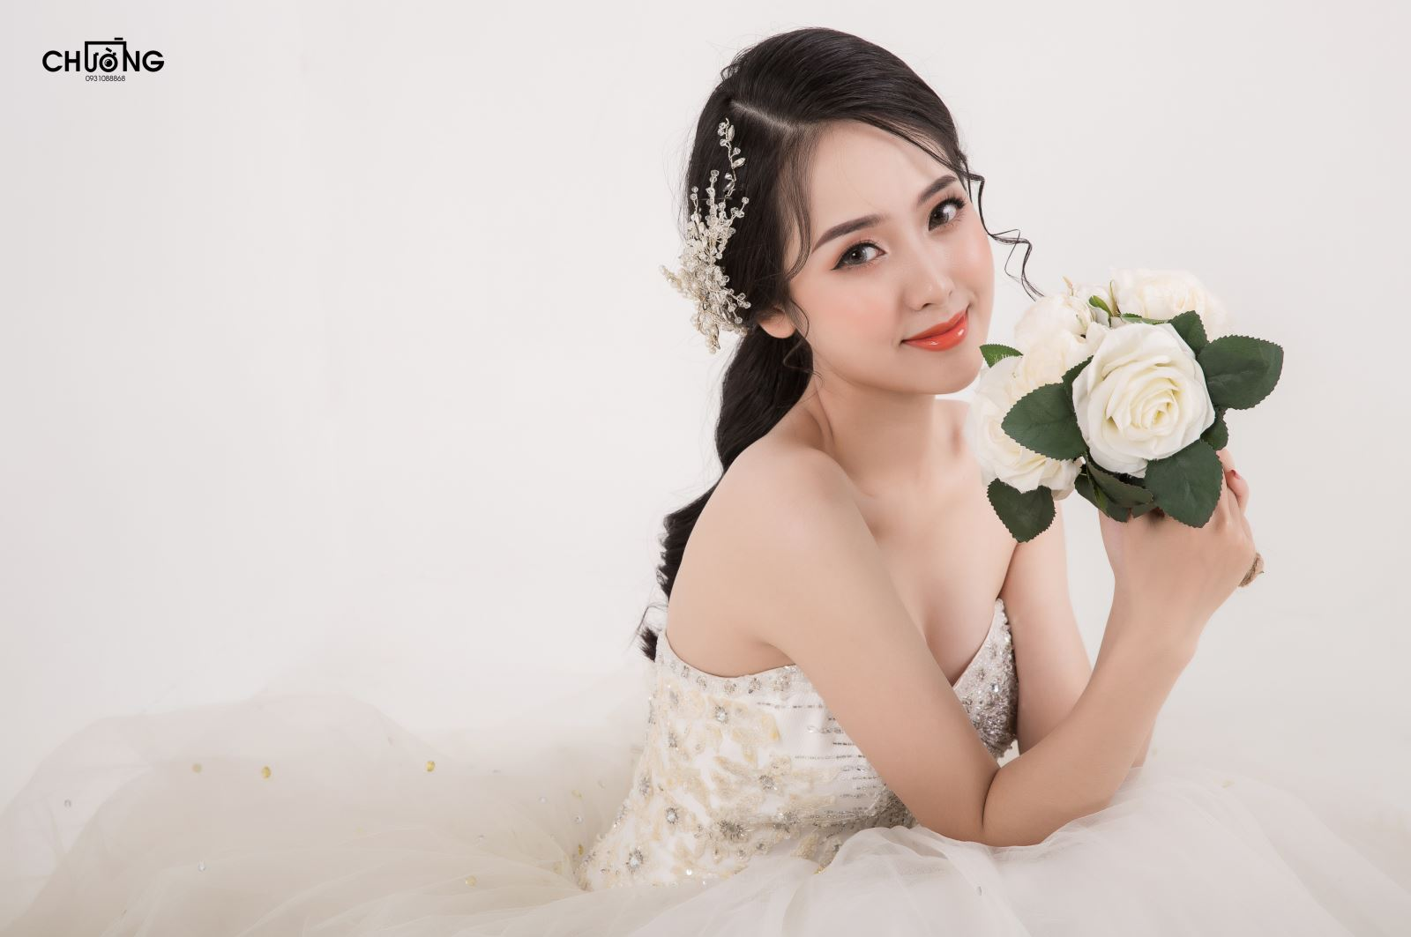

BomBig
Sexy All Day

