Slide 1
Soteria SOW Guardian
Jurisdiction-Aware AI Governance Monitor for KYC Source-of-Wealth Review
Entity: OCBC Bank Ltd | Jurisdictions: Singapore and United States | Option B - Architecture Design
Core thesis
Primary buyer
Main output
AI can assist source-of-wealth review, but it should not convert uncertainty into false confidence.
Chief Compliance Officer, Financial Crime Compliance, Model Risk, and AI Governance Committee.
Green, Amber, Red Friction, and jurisdiction-specific governance gap warnings.

Slide 2
1. Why this product is right for Soteria RegTech
A governance layer, not a replacement KYC system
Company fit
Market wedge
Boundary choice
Soteria is good at translating regulatory expectations into controls, evidence checks, audit trails, and jurisdiction-aware workflow logic.
Banks are already deploying AI into KYC workflows. The speed gain creates a governance problem that spreadsheets cannot monitor continuously.
The product does not sell a simple "compliant" badge. It surfaces uncertainty and forces review.
Bank of Singapore has publicly described an agentic AI Source of Wealth Assistant that reduces report preparation from about 10 days to one hour while retaining human review. This makes the governance problem realistic, not hypothetical. [R2]

Slide 3
2. Problem: polished AI narratives can hide weak evidence
The tool is designed to test evidence, not just document workflow completion
The operational risk
What a memo misses
What the tool adds
AI can create a coherent source-of-wealth report even when sale proceeds, ownership records, tax documents, or bank transfers do not support the story.
A memo records that review happened, but not whether each material claim maps to evidence or whether contradictions remain unresolved.
Claim-to-document mapping, contradiction detection, rule versioning, human challenge monitoring, and model drift alerts.
Design principle: automation can organise evidence, but accountable humans own judgment.
Red Friction blocks straight-through approval when unsupported claims or material contradictions remain.
The tool does not reduce escalations as a success metric unless evidence quality improves.

Slide 4
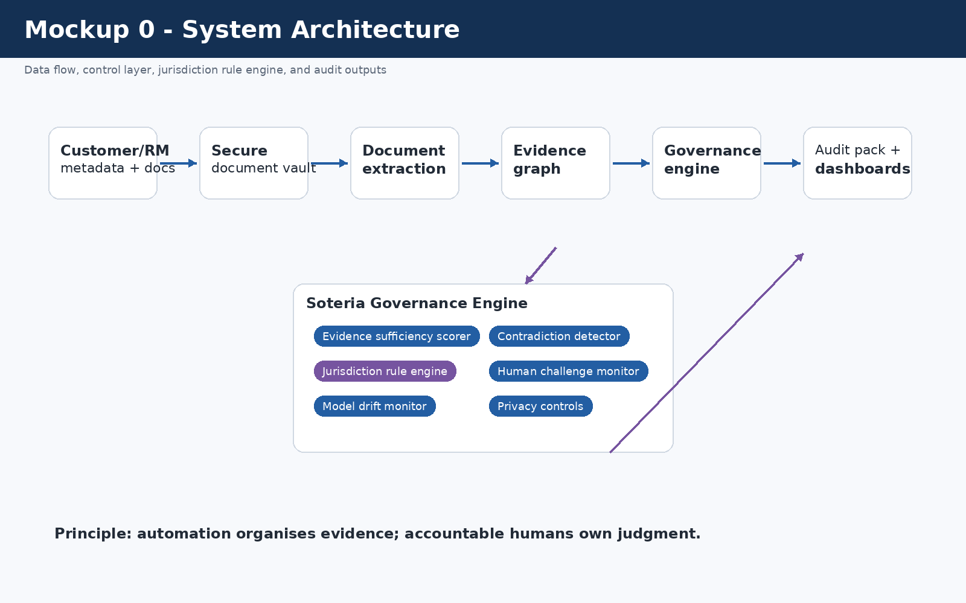
3. Architecture overview
Data flow, evidence scoring, jurisdiction logic, human review, audit pack

Slide 5
4. Regulatory divergence handled
Same AI-assisted workflow, different Singapore and US control logic
Issue | Singapore mode | US mode
Agentic AI in KYC | MAS AI MRM + FEAT/Veritas controls | SR 26-2/OCC 2026-13 governance gap warning
SoW evidence incomplete | MAS Notice 626 CDD/EDD review | FinCEN CDD/customer risk profile review
Human rubber-stamping | Accountability weakness flagged | Effective challenge/internal governance weakness flagged
Cross-border case | Dual-rule review | Dual-rule review; no silent downgrade
Jurisdiction awareness is not a country label. It changes rule modules, warnings, owners, and review requirements. [R3-R9]

Slide 6
5. Scoring methodology and synthetic data
The architecture includes simulated inputs and threshold logic
Metric | Formula / meaning | Why it matters
Evidence Coverage Ratio | supported material claims / total material claims | Tests whether the narrative is substantively supported
Unsupported Claim Rate | unsupported AI claims / total AI claims | Detects hallucination and overconfidence
Contradiction Count | material conflicts between AI report and documents | Detects unreliable KYC conclusions
Human Challenge Rate | reviewer amendments/rejections/escalations / AI-assisted cases | Detects rubber-stamping
Model Drift Flag | change in output quality or review corrections | Triggers model-risk review
Synthetic data
Threshold output
Limit
30 simulated source-of-wealth cases are included in /data with a data dictionary.
Green, Amber, Red Friction, Amber + Governance Gap, Red Friction + Governance Gap.
Thresholds are illustrative and not calibrated against real OCBC data.

Slide 7
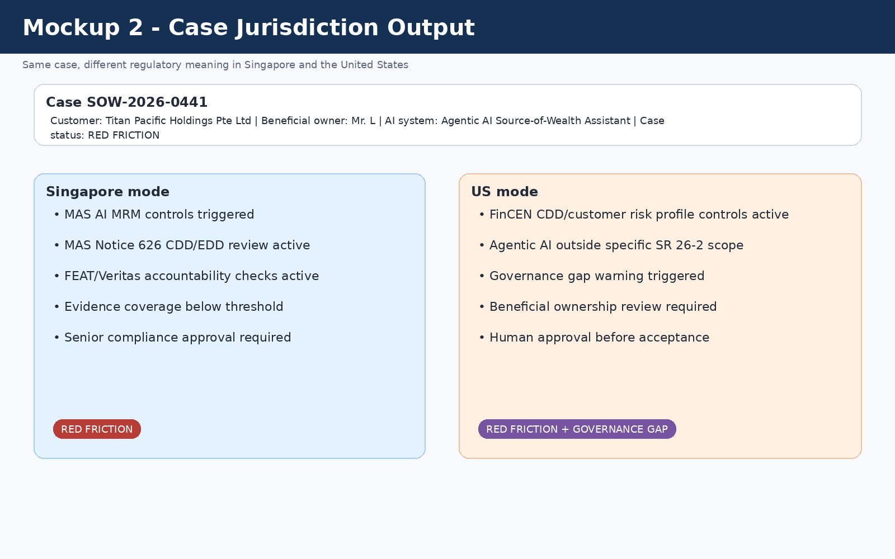
6. Same case, different jurisdiction output
A synthetic red-friction case shows the rule engine in action

Slide 8
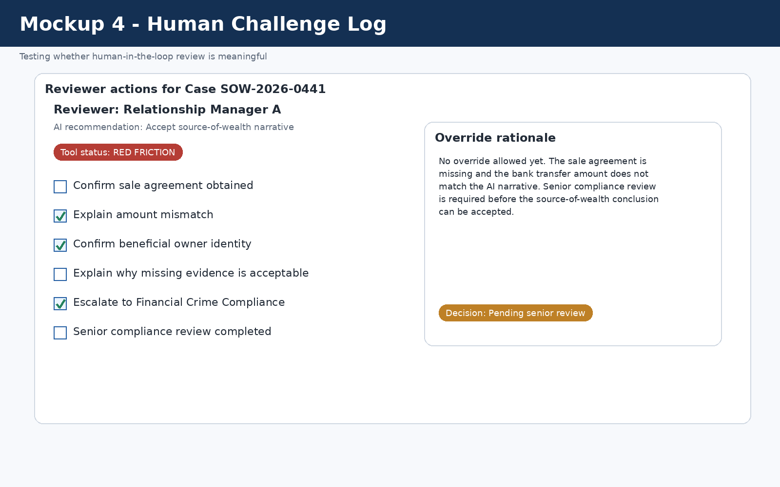
7. Human judgment cannot be outsourced
Human challenge is measured, not assumed

Slide 9
8. Failure modes and owners
The design names who owns the failure response
Failure mode | Severity | Control | Owner
Rule changes mid-period | High | Versioning, rule-diff alert, open-case impact analysis | Compliance rule owner
Model drift | High | Drift thresholds and model-risk review | Model Risk Manager
Human rubber-stamping | High | Human Challenge Log and reviewer-pattern monitoring | Compliance Head
Jurisdictional misconfiguration | High | Booking-location check, dual-rule activation | Compliance Operations
False negative | Very High | Red Friction + senior compliance approval | Financial Crime Compliance
Privacy failure | Very High | Secure vault, access logs, no uncontrolled model training | Technology Risk / DPO
Failure-mode logic is part of the product, not an afterthought.

Slide 10
9. What the tool does not do - and why
Clarity and honesty for senior management
Boundary | Why this boundary is necessary
No automatic customer approval | Source-of-wealth judgment requires accountable human review
No automatic STR/SAR filing | Reporting decisions require legal/compliance judgment
No simple MAS/US compliant badge | Would hide uncertainty and encourage false confidence
No full transaction monitoring | Scope is AI governance for KYC/source-of-wealth review
No general model training on customer documents | Source-of-wealth data is highly sensitive
No claim that wealth is legitimate | The tool assesses support, contradictions, governance, and auditability
With more time/data, I would calibrate thresholds using real outcomes, validate drift against production AI outputs, test sensitivity to distribution shifts, and integrate with live KYC systems.

Slide 11
10. Senior-management takeaway
Control layer for AI-assisted KYC, not a faster writing tool
Business value
Regulatory value
Risk value
Faster onboarding can be supported without turning source-of-wealth review into a rubber-stamp process.
Different Singapore and US logic is visible, versioned, and auditable.
Weak evidence, contradictions, model drift, and human over-reliance are surfaced early.
Final position: AI may assist compliance work, but it should not convert uncertainty into false confidence.
References [R1]-[R10] are listed in sources/references.md and in the Architecture Design document.

