Slide 1
Peripherals on the DE2 Development Board
Presented by: Nathan Genetzky
For EE492-Advanced Digital Design, instructed by Dr. Robert Fourney

Slide 2
Introduction
Memory
Input / Output
Signal Interfaces
Communication Interfaces
GPIO Protection
Pin Electrical Characteristics
GPIO capability
UART with RS232
Character LCD
Contains exerts from Cyclone II Device Handbook.

Slide 3
Memory and Basic Input/Output
Memory
8Mbyte (1M x 4 x 16) SDRAM
512K byte(256K X16) SRAM
4Mbyte Flash Memory (upgradeable to 4Mbyte)
SD Card Socket
Basic Input/Output
4 Push-button switches
18 DPDT switches
9 Green User LEDs
18 Red User LEDs

Slide 4
Signal and Communication Interfaces
Signal Interfaces
24-bit CD-Quality Audio CODEC with line-in, line-out, and microphone-in jacks
VGA DAC (10-bit high-speed triple DACs) with VGA out connector
TV Decoder (NTSC/PAL) and TV in connector
Communication Interfaces
10/100 Ethernet Controller with socket.
USB Host/Slave Controller with USB type A and type B connectors.
RS-232 Transceiver and 9-pin connector

Slide 5

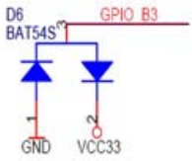
GPIO Protection
Each pin on the expansion headers is connected to two diodes and a resistor that provide protection from high and low voltages.

Slide 6
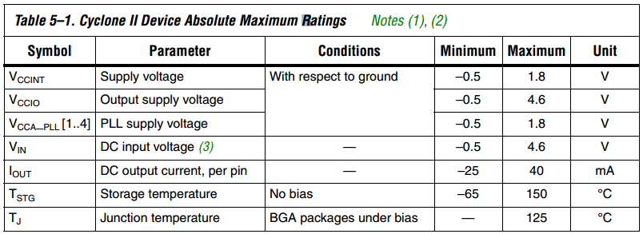
Pin Electrical Characteristics
There is a current limit of 240 mA per 12 consecutive output side (left and right) pins per power pair.
Table 5-1 from Cyclone II Device Handbook.

Slide 7
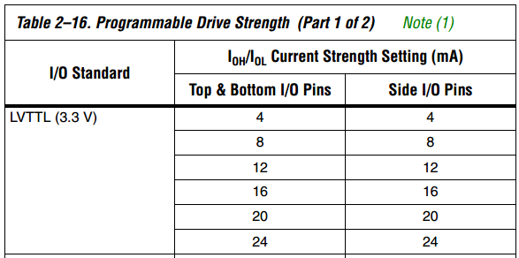
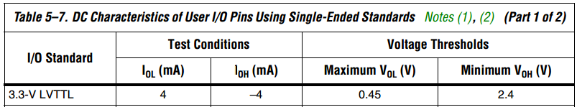
GPIO capability
Cyclone II device can drive a 5.0-V LVTTL device, (A Cyclone II device cannot drive a 5.0-V LVCMOS device.)
To drive a Cyclone II device with a 5.0-V device, you must connect a resistor (R2) between the Cyclone II device and the 5.0-V device.

Slide 8
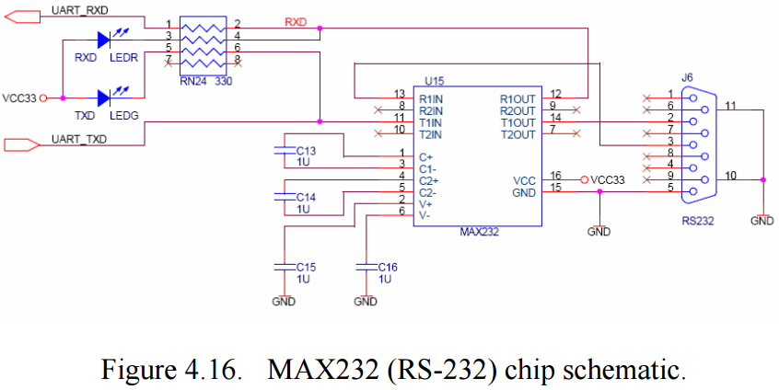
UART with MAX232 for RS232
RS232
RX (red) and TX (green) LEDs near DB9
DB9 ( .TX(2), .RX(3), GND(5) )

Slide 9
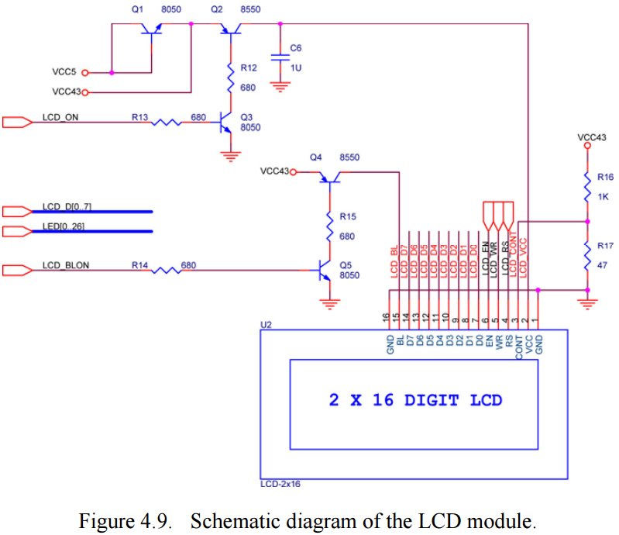
16x2 Character LCD
LCD Demo
lcd_example
lcd_program
LCD_Controller

