Slide 1
Design and Verification of a
SPI to JTAG Interface Adapter
Jordan Ulmer and Nathan Genetzky
2017-05-01

Slide 2
Overview
Theory
SPI vs JTAG
HDL
hipe_spi
Jtag_tap
Spi2jtag
QSYS
NIOS BSP (dependent on system.h)
Jtag
spi2jtag
altera_avalon_spi_command -> altera_spi_transfer
NIOS APP
Testing jtag tap transitions and working with hipe_spi

Slide 3
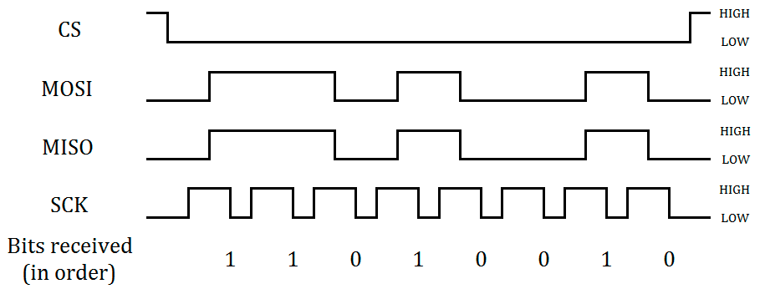
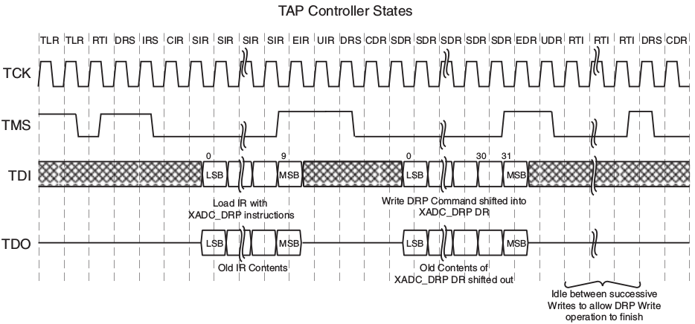
Theory - SPI Waveform (SCK, CS, MOSI, MISO)

Slide 4
Theory - JTAG Waveform (TCK,TMS, TDI, TDO)

Slide 5
Theory - SPI vs. JTAG
SPI (Master) | JTAG Tap (Slave) | JTAG Dev (Slave)
SCK | TCK | TCK
cs[0:9]* | -* | -**
MOSI | TMS* | TDI**
MISO | TDO | TDO
*More than one chip select allows MOSI to be muxed into TMS **Operation of the JTAG Device depends on the STATE of the JTAG Tap

Slide 6
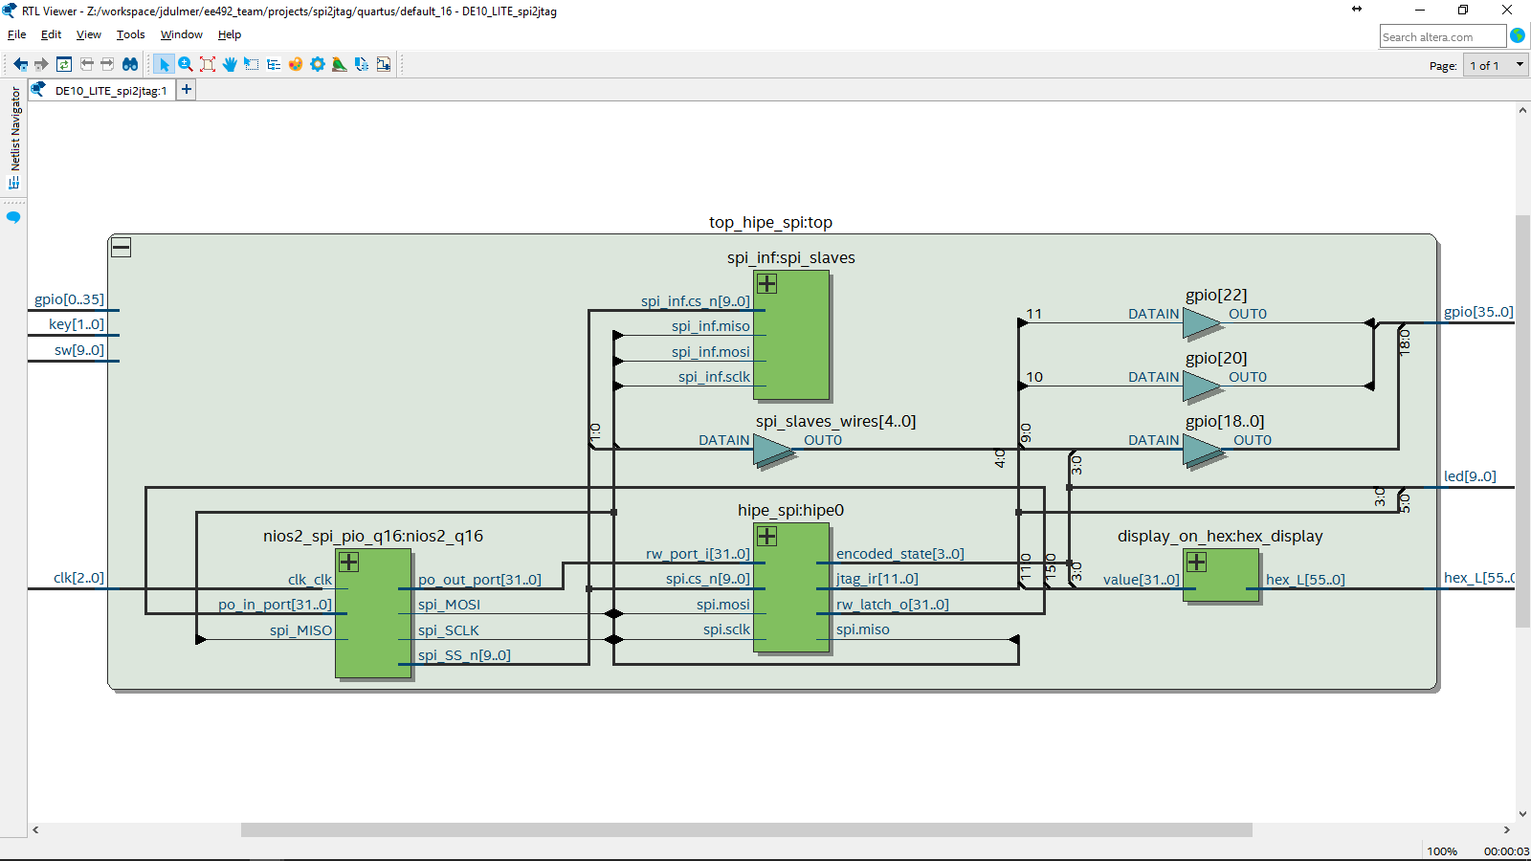
RTL - top_hipe_spi - Inside

Slide 7
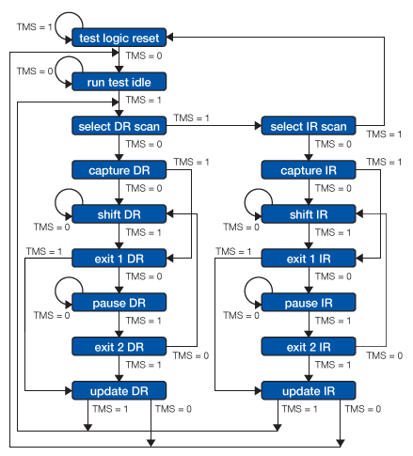
HDL - jtag_tap_ctrl , jtag_tap_fsm
jtag_tap_fsm
IEEE 1149.1 Standard JTAG Tap FSM
One hot state
Encoded state
jtag_tap_ctrl
Owns Jtag Instruction Register
Owns an FSM
*** SHIFT_IR / DR states ( shift_en = sir & tms )

Slide 8
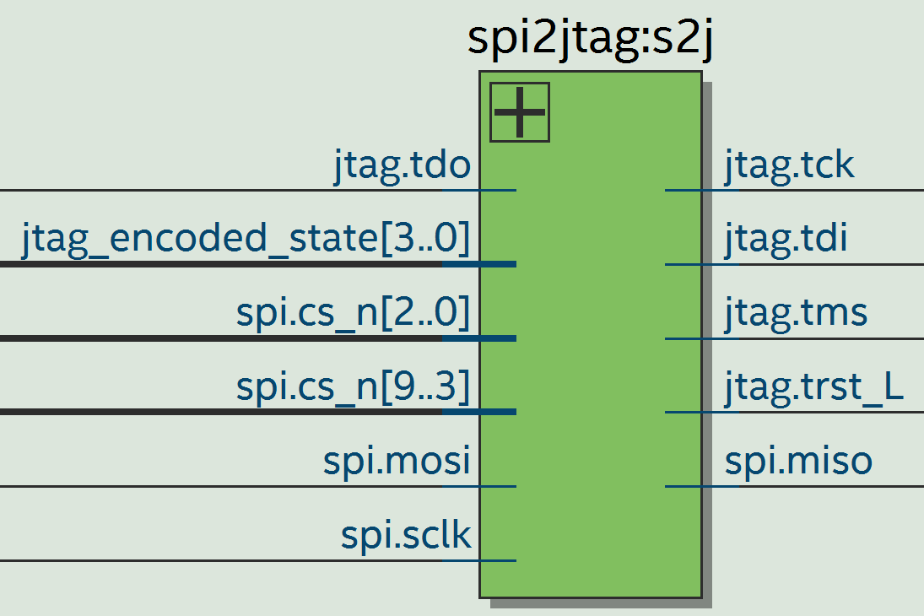
HDL - spi2jtag
CS Decoding
CS_TAP = 0
CS_JTAG = 1
CS_LOOPBACK = 2
Shift In
Jtag tms
Jtag tdi (IR / DR)
Shift out
Jtag_encoded_state
Jtag tdi (IR / DR)
*** Remember Active Low Reset in JTAG
jtag.trst_L = 1’b1;

Slide 9
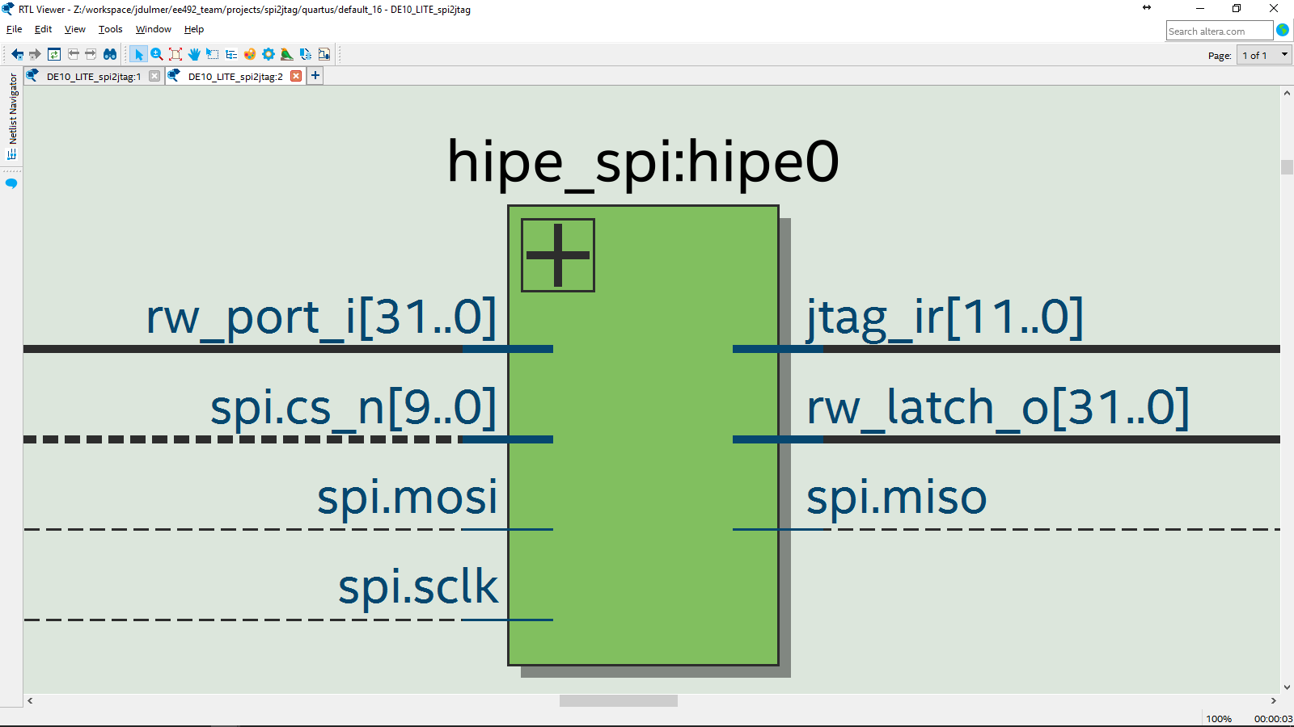
HDL - hipe_spi

Slide 10
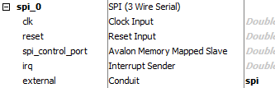
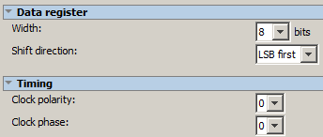
Altera QSYS IP
SPI (3-wire) IP
Conduit (Connect to SPI signals)
MISO, MOSI, SCLK
[N-1:0] cs
SPI Mode 0
See next slide.
“LSB first” to match Jtag IR endianess.
8 bit width, longer is handled in software.

Slide 11
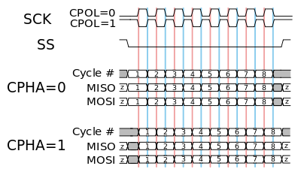
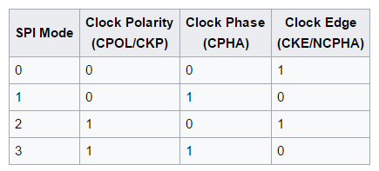
SPI - Mode 0
Data is valid on the negedge of sck.
Data is sampled on the posedge of sck.

Slide 12
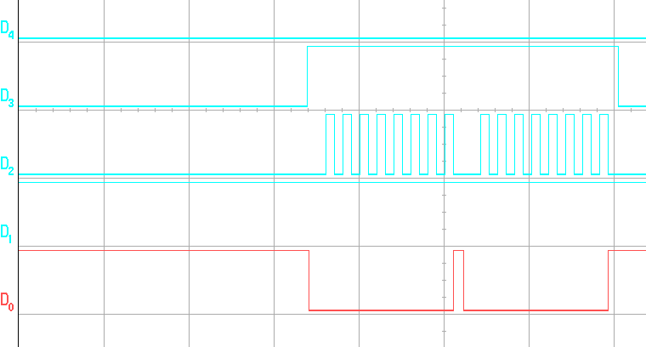

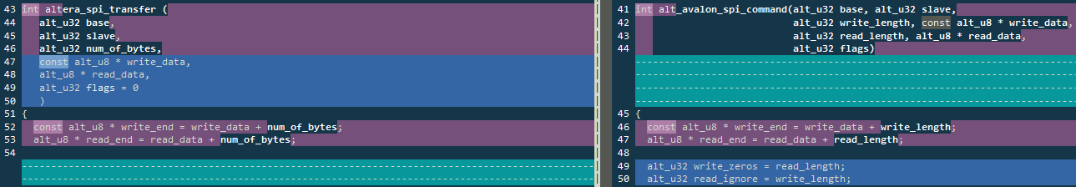
Altera QSYS SPI (altera_avalon_spi_command)
D4=spi_slave.cs[1] D3=spi_slave.cs[0] D2=spi_slave.sclk D1=spi_slave.miso D0=spi_slave.mosi
SPI (From Lib)
altera_avalon_spi_command
Separate TX/RX
SPI (Re-Write)
Simultaneous TX/RX
SPI Tx/Rx(From Lib)

Slide 13
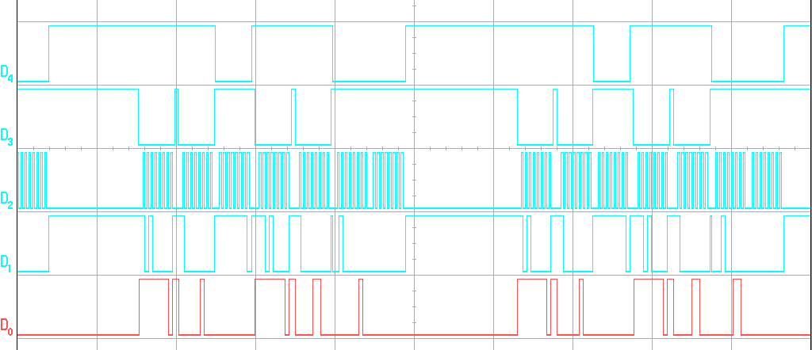
Spi2Jtag Communication TAP/DR/IR
TAP
DR
IR
D4=spi_slave.cs[1] D3=spi_slave.cs[0] D2=spi_slave.sclk D1=spi_slave.miso D0=spi_slave.mosi
Notes:
Scope_21 =

Slide 14

Tap State Transition
CS_TAP
D4=spi_slave.cs[1] D3=spi_slave.cs[0] D2=spi_slave.sclk D1=spi_slave.miso D0=spi_slave.mosi
TMS

Slide 16
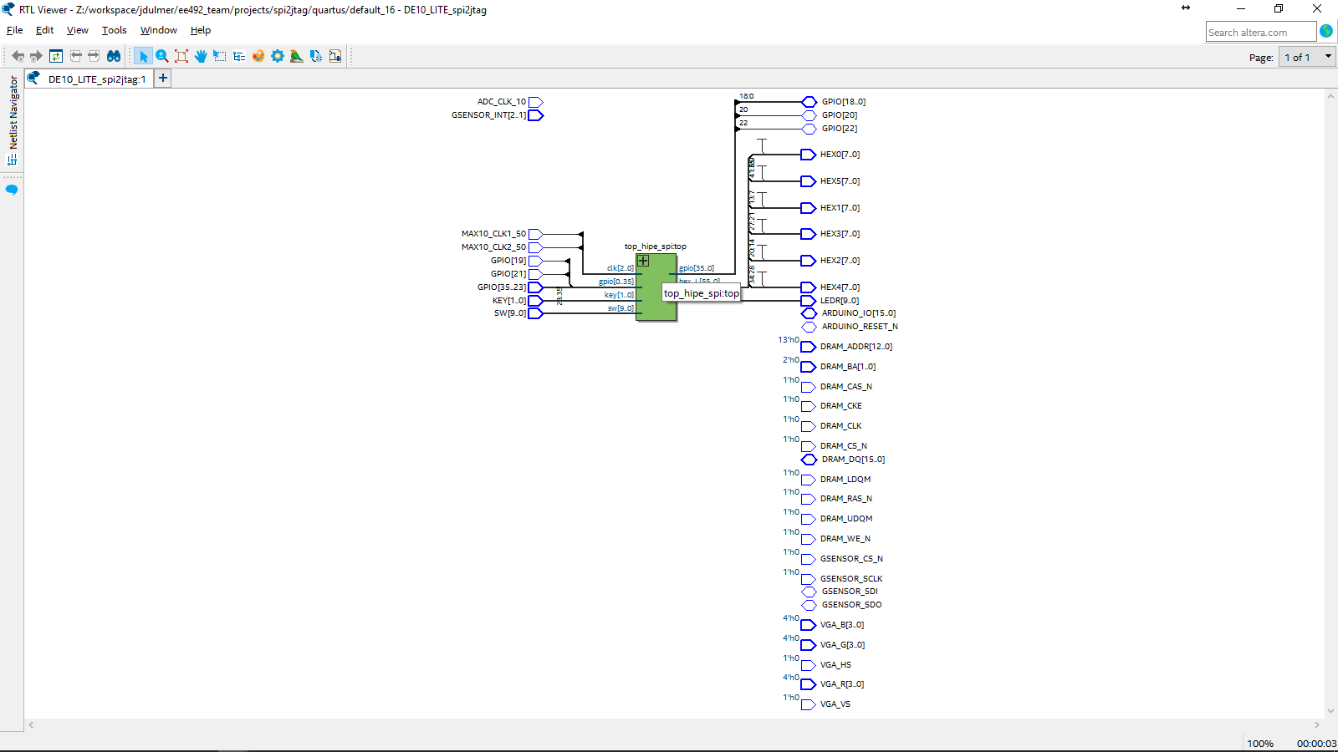
RTL - top_hipe_spi - Outside

Slide 17
RTL - top_hipe_spi - Inside

Slide 18
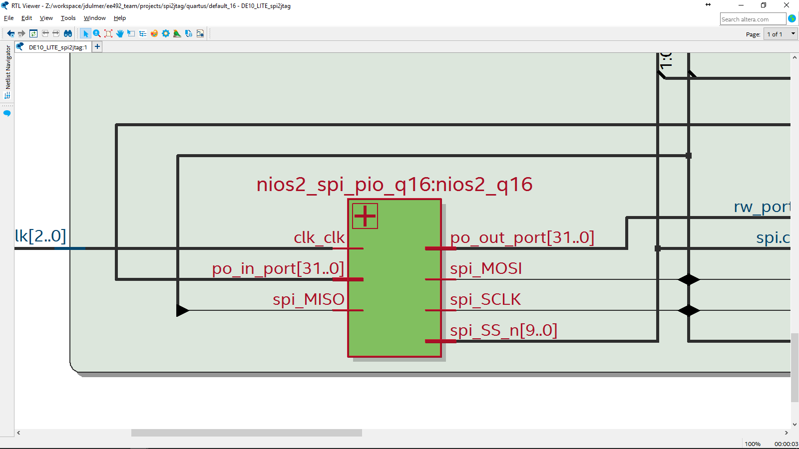
RTL - nios2_spi_pio - Outside

Slide 19
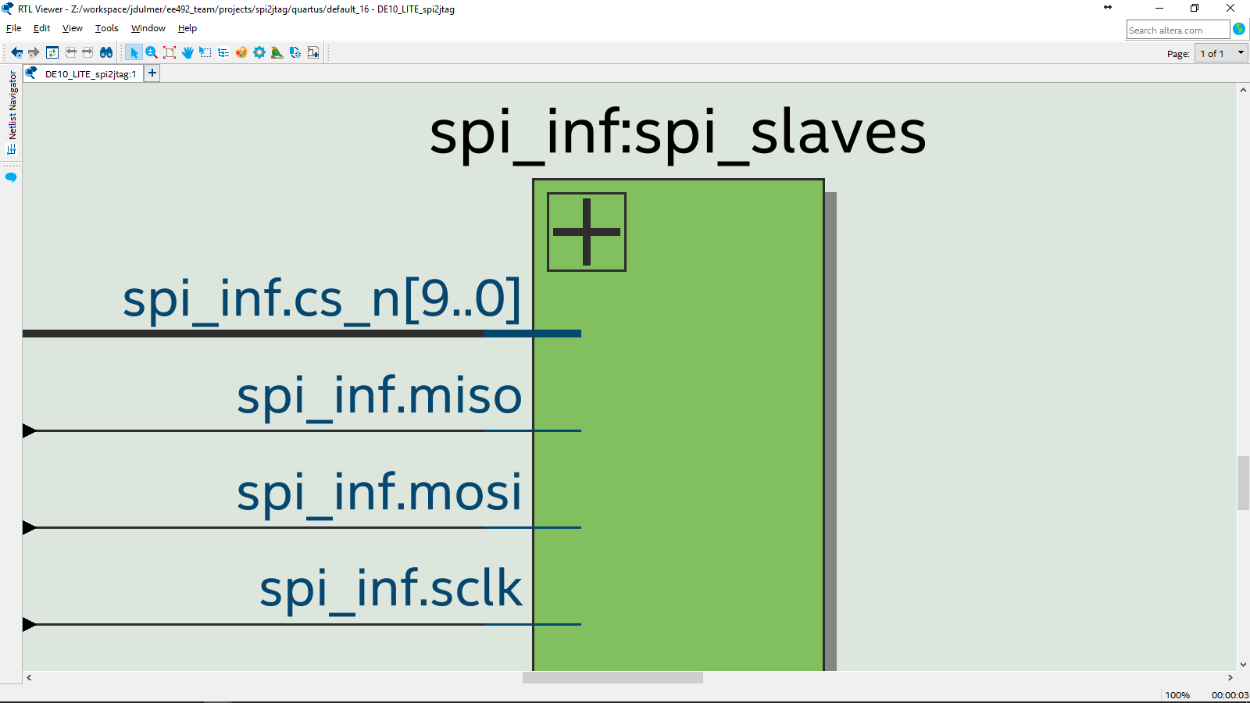
RTL - spi_inf - Outside

Slide 20
RTL - hipe_spi - Outside

Slide 21
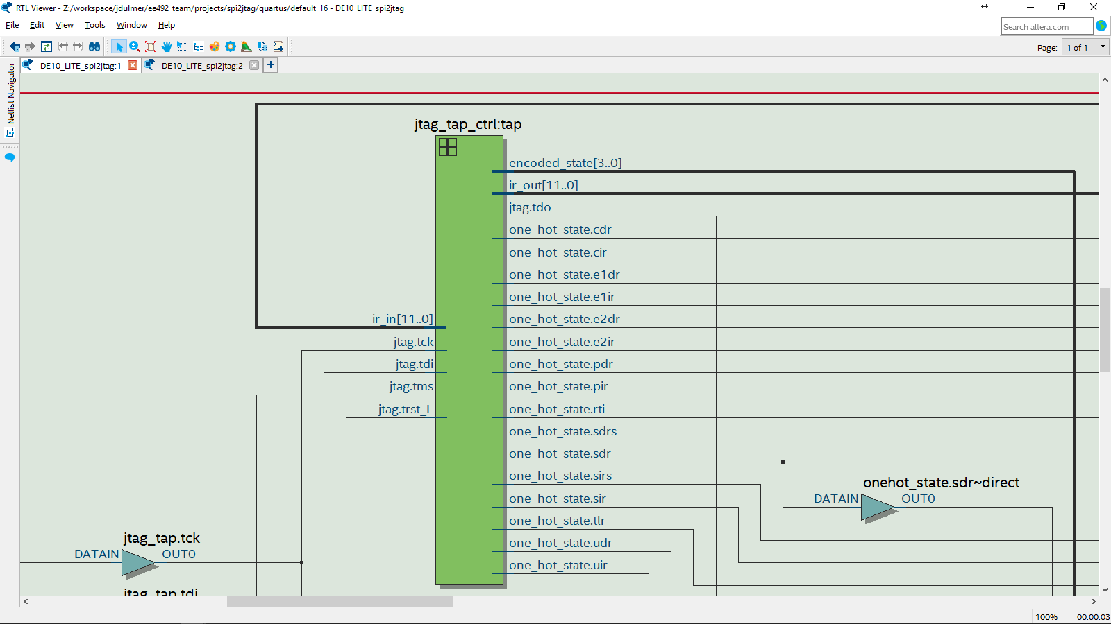
RTL - jtag_tap_ctrl - Outside

Slide 22
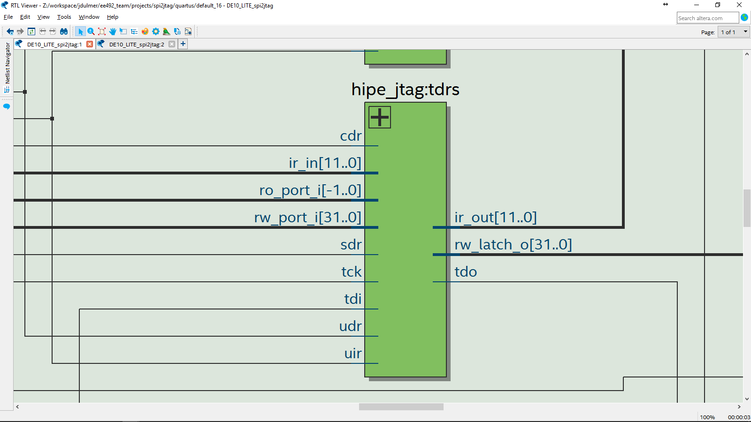
RTL - hipe_spi - Outside

