Slide 1
Project Plan

Slide 2
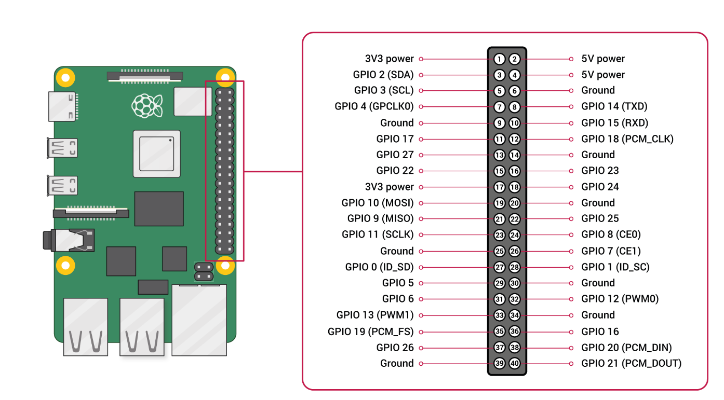

Slide 3
Basic arm
Wave
Control
arm
Picup
object
Enviromental
detection

