Slide 1
I2C to Motor
With a PWM driver :: https://www.trab.dk/da/breakout/64-16-kanals-12bit-pwm-servo-driver.html?search_query=PCA9685&results=1
We simply need to make the RPI communicate through I2C to the driver

Slide 2
RPI
PWM
Driver (tlc5940)
I2C
I2C
Motor Array

Slide 3
OLD BELOW

Slide 4
start
start
Init arm
Move to
location
stop
stop

Slide 5
ITR : 1
Controller
EZ CLAP MODE::
no current sensor
using arduino api
Robot Arm
MG966
MG966
MG966
MG966
MG966
MG966

Slide 6
ITR : 2
Hardmode::
homemade
threads with pwm
And current sensing
Superviser
Robot Arm
Stepping
motor
Stepping
motor
Stepping
motor
Stepping
motor
Stepping
motor
Stepping
motor

Slide 7
Hardmode::
homemade
threads with pwm
And current sensing
start
Stepping
motor
New
position?
While()
MG966
ACS712
Current
flag
raised
GoTo
Position
Stop
ERROR

Slide 8
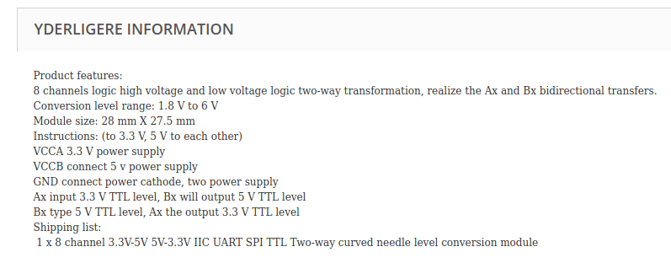
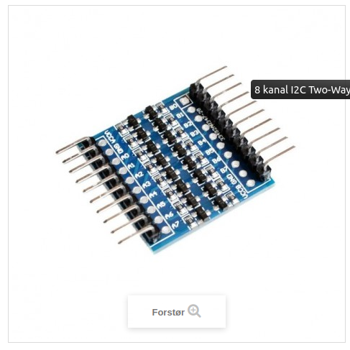
Logic 3.3 to 5.0 converter
https://www.trab.dk/da/breakout/398-8-kanal-i2c-two-way-bidi-logic-level-converter.html?search_query=converter&results=7

