Slide 1

Politics and Perplexity in Python
Sentiment Analysis on the Clean Water Rule
April 2020

Slide 2
SECTION 1
Project Overview

Slide 3
Project Overview
Project examines comments that were submitted during a 60-day public comment period in response to a proposed environmental rule change
Polarized dataset
In general either supported the rule change or opposed it
Goal: see if a machine learning model can properly classify comments
2015
Clean Water Rule: Def of “WOTUS” (Obama Administration)
2017
Trump Executive Order: Revise/Repeal 2015 Rule
2019
60 Day Public Comment Period Final Decision

Slide 4
Different Players and Viewpoints
Generally Supportive of Rule Change
Generally Opposed to Rule Change
Industry players who operate under these regulations
Landowners/property rights enthusiasts
Environment and conservation groups
Outdoor recreation industry
Generally concerned individuals
Politically Motivated Folks
Hate certain president and oppose whichever rule fell under their administration

Slide 5
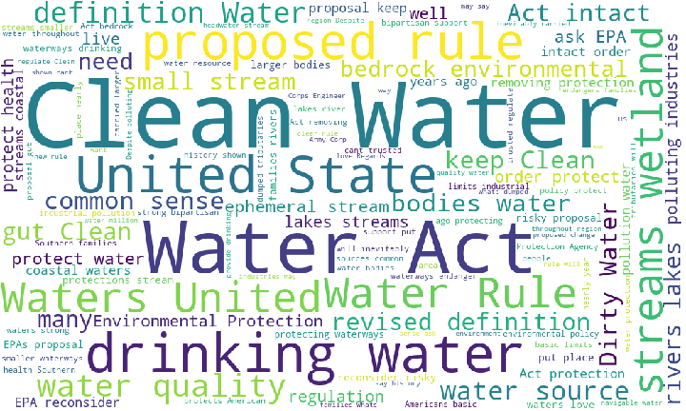
It’s Not NLP without a Word Cloud!
Provides a quick sanity check of the most frequent phrases in the dataset

Slide 6
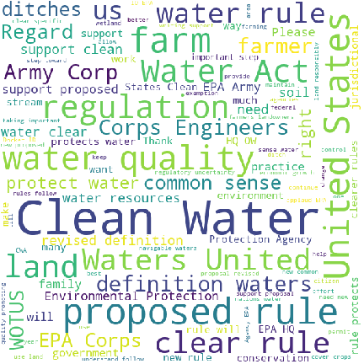
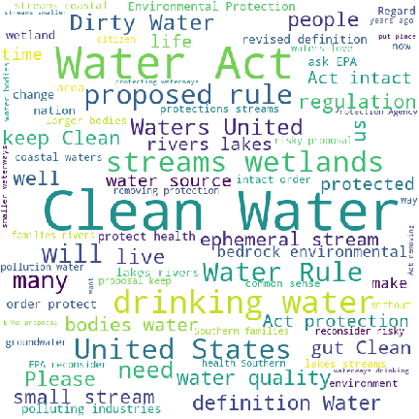
Word Clouds by Group
Supportive Comment Language
Opposed Comment Language

Slide 7
Comparison of Top 20 Words
Generally Supportive of Rule Change
Generally Opposed to Rule Change
Clear
Corp
Definition
Farm
Farmer
Land
Need
New
Quality
Regulation
Support
Unite
Community
Drink
Health
Lake
Pollution
Proposal
Protection
River
Small
Stream
Waterway
Wetland
Act
Clean
EPA
Propose
Protect
Rule
State
Water

Slide 8
Potential Hazard: Similar Language across Opposing Viewpoints
“
 | I support clean water. We need clear rules on how this is to be accomplished. I personally try hard to have as little erosion as possible. Terraces, grass waterways, contour farming, no-till, headlands, etc. As hard as I and other farmers try to conserve and keep waters clean, we need clear rules with common sense to provide us direction. Hopefully this is a step in that direction and we all can work together to feed the world.
 |  | ”
Example Supportive Comment
“
 | I stand for clean water! Clean and healthy waterways are key to western agriculture, recreation and tourist economies that support our communities. These wholesale changes to the Clean Water Act to limit its jurisdiction provide loopholes in the law and give polluters incentives to discharge dangerous pollutants into unprotected waterways. Please protect our water - the essence of life upon which we all depend!
 |  | ”
Example Opposed Comment

Slide 9
SECTION 2
Machine Learning and NLP in Python

Slide 10
What is Machine Learning?
In short, machine learning is building a model (with a twist)
Creating a simplified representation of a real-word system that still captures the main underlying rules, relationships, or patterns of that system
But the “learning” part is where it differs from traditional model building
Traditional Model Flow
MODEL: USER-DEFINED RULES OR FORMULAS
INPUT
OUTPUT

Slide 11
Machine Learning Model Flow
The machine learns the underlying relationships, structure, and patterns in the data based on examples (the input)
DATA (INPUT)
LABELS
MACHINE LEARNING!
NEW DATA
MODEL
PREDICTION/ CLUSTER/ TASK

Slide 12
General Machine Learning Tasks
SUPERVISED LEARNING
Prediction tasks
Classification (predicts a class) and Regression (predicts a numeric value)
UNSUPERVISED LEARNING
Clustering tasks (group examples by their similarity)
Dimensionality reduction tasks
OTHER
Recommender systems
Reinforcement learning
Self-supervised and semi-supervised learning

Slide 13
Where Does NLP Fit into Machine Learning?
Natural Language Processing (NLP) is a branch of Artificial Intelligence that helps computers to interpret and understand human language
Used for speech recognition, translation, text analysis
Languages are rule-based, but lots of exceptions
Text is everywhere and contains a lot of valuable information
News articles and blog posts
Forum discussions and comment threads
Social media posts
Product reviews
Etc…
Applying NLP techniques in a machine learning system helps access and leverage that information

Slide 14
How Do Machine Learning Models Consume Data?
Delicious!
________________ 10 … 0.045 9.4 12 … 0.162 5.0 …. … …. … 32 … 0.741 8.1 ________________
✓
MODEL
Ew, gross
________________ “The Clean Water Act is a bedrock environmental policy… ________________
MODEL
ML models are very picky about the type and format of data they can handle

Slide 15





Python Data Science “Stack” for this Project
Data Analysis: NumPy, pandas, Jupyter
Visualizations: matplotlib, seaborn, WordCloud, pyLDAvis
NLP: spaCy
Models: scikit learn, XGBoost
Attributions:
Jupyter logo: By Cameron Oelsen - https://github.com/jupyter/jupyter.github.io/blob/master/assets/main-logo.svg, BSD, https://commons.wikimedia.org/w/index.php?curid=68763478

Slide 16
Project Workflow
Collect Data
Process Text
Run Models
Interpret Results
We hereby decree you: NLP CHAMPION!
Tokenize Text
Lemmatize Tokens
Remove Stop Words
“Bag of Words”
Vectorize Tokens
Pre-Trained Word Vectors

Slide 17
Vectorizer Overview
PROS
CONS
CountVectorizer
Simple to understand and explain
Saves vocab in memory
Doesn’t normalize counts for document length
TFIDFVectorizer
Normalizes count data for length of document and (optionally) inversely for how common a word is in the corpus
Saves vocab in memory
State associated with IDF calculation
HashingVectorizer
Portable, no state
No in-memory vocab
No way to reverse hashed value back to feature (token)
Pre-Trained Word Vectors
Leverages sophisticated pre-trained models that maintain word semantics
Good when little labeled data is available
Needs access to (potentially very large) language model

Slide 18
SECTION 3
Clustering Analysis

Slide 19
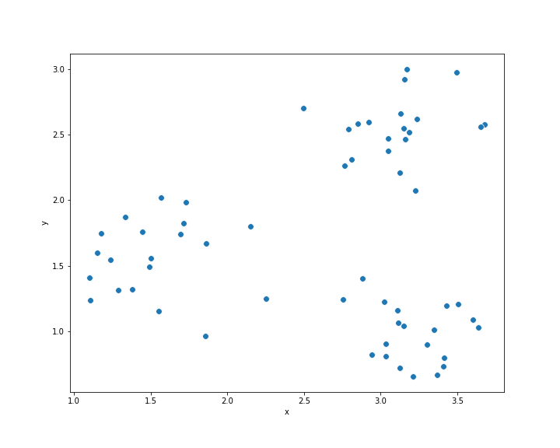
Clustering Overview
Clustering models group examples based on their similarity
Will the clusters that the model finds distinguish comments by sentiment?
Step 1: Find the right number of clusters – is there evidence to support two?
Step 2: Run clustering algorithm using different vectorized data
Step 3: Examine the best model’s clusters
Example Data

Slide 20
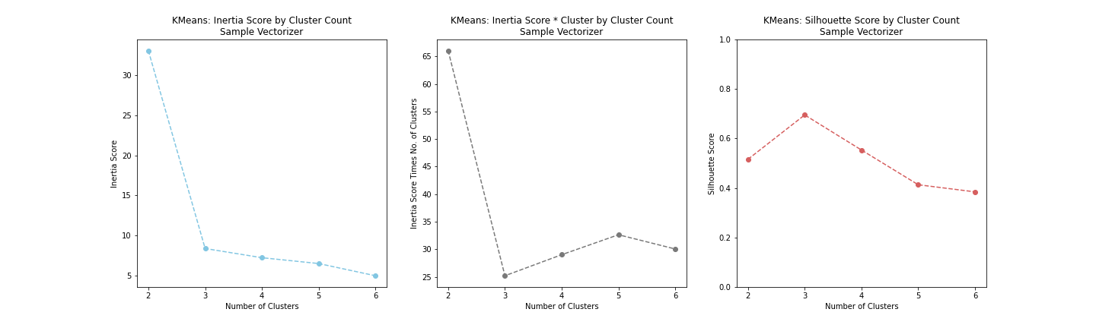
How to Examine the Clusters – Example Data
Left plot is inertia: generally lower is better, use “elbow method” to find trade-off where adding new cluster doesn’t reduce metric much
Middle plot is inertia * number of clusters: look for the minimum value
Right plot is silhouette score: look for maximum value (closest to 1)
Clustering the actual comment data favored silhouette scores

Slide 21
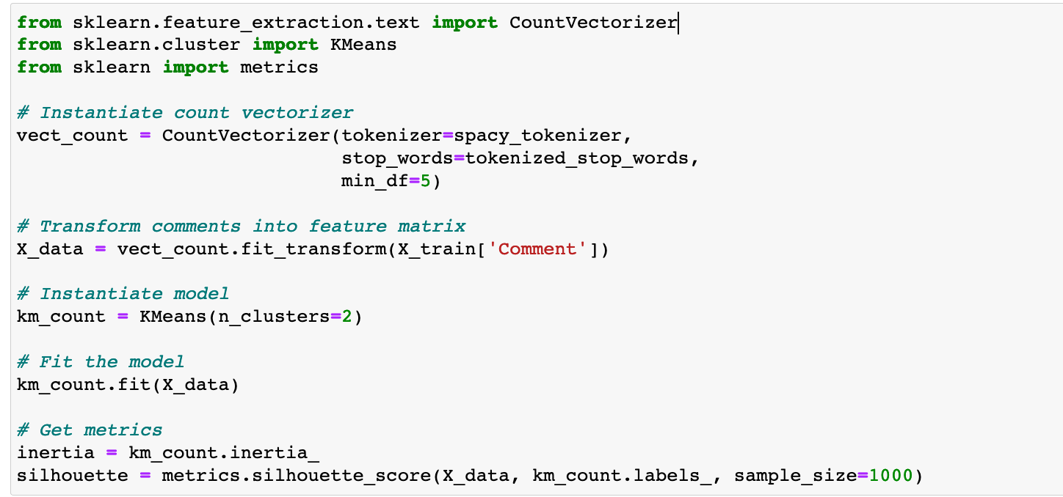
Code Example

Slide 22
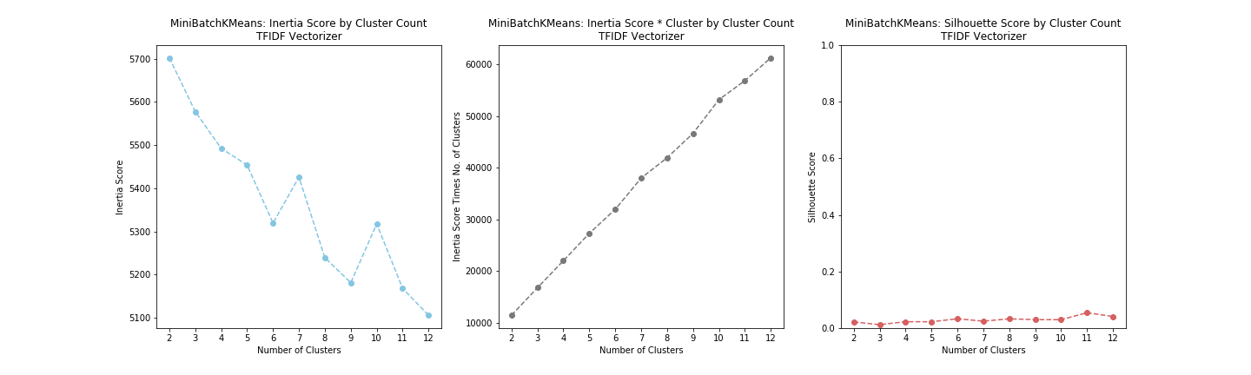
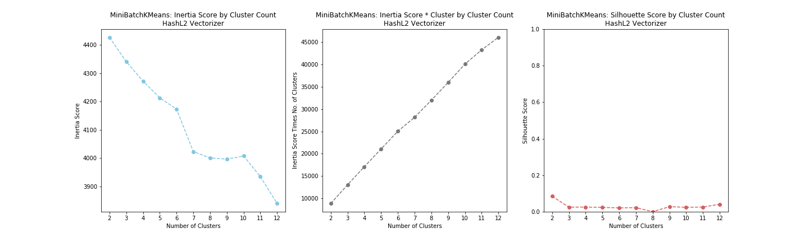
Chart Comparison for Different Vectorizers
TF-IDF Vectorized Data
Hashing Vectorized Data (L2 Norm)

Slide 23
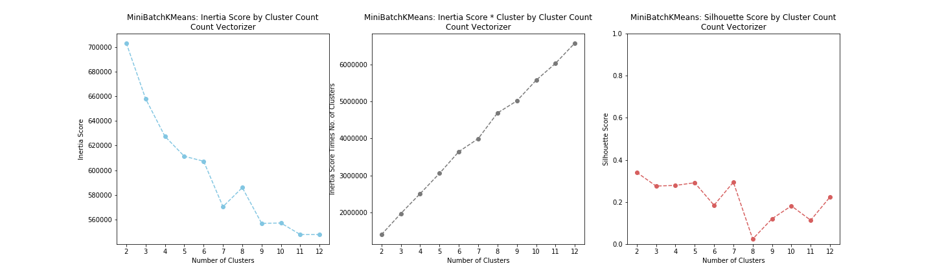
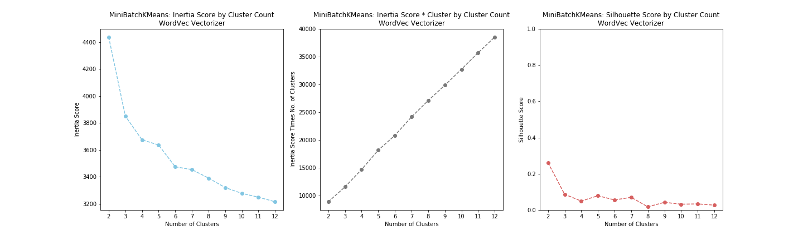
Chart Comparison for Different Vectorizers
Count Vectorized Data
Word Vectors

Slide 24
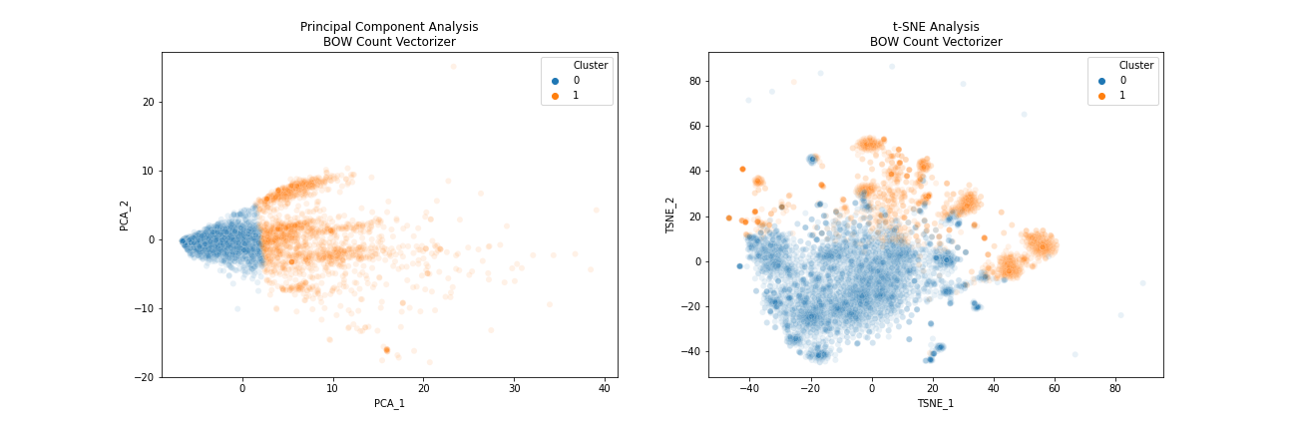
Examine those Clusters!
Sample of comments from each cluster (from both Count and Word Vector models) showed heavy overlap of comments based on sentiment
Dimensionality reduction techniques (Principal Component Analysis and t-SNE) help visualize the cluster splits

Slide 25

Cluster Assignments vs. Labeled Data
Key Takeaways
The clusters the model found using various vectorizing techniques did not separate the data based on sentiment
The evidence supporting two clusters also indicated overlapping clusters
Clustering model found structure, most likely more aligned by topic than by sentiment

Slide 26
SECTION 4
Sentiment Analysis

Slide 27
Sentiment Classification Overview
Supervised models require labeled data
Pick relevant evaluation metrics (to compare models): accuracy and F1
Two rounds:
Round I: five classes of models, various vectorized data for each
Top three models move on to round II
Round II: top models from round I tuned
Final evaluation on test data

Slide 28
Round I: Pick your Horse!
Model
Vectorizers Run
Multinomial Naïve Bayes | Count, TFIDF
Logistic Regression | Count, TFIDF, Word Vectors
Support Vector Machine - Linear | Count, TFIDF, Word Vectors
Support Vector Machine - Nonlinear | Count, TFIDF, Word Vectors
Random Forest | Count, TFIDF, Word Vectors
XGBoost | Count, TFIDF, Word Vectors

Slide 29
Round I Performance Comparison (Accuracy)
Model | Accuracy |  | Model | Accuracy
Linear SVM – TFIDF | 99.80% |  | XGBoost – TFIDF | 98.17%
Nonlinear SVM – TFIDF | 99.54% |  | Linear SVM – WordVec | 97.97%
Random Forest – Count | 99.41% |  | XBGoost – WordVec | 97.97%
Random Forest – TFIDF | 99.35% |  | Multinomial NB – Count | 97.91%
Logistic Regression – TFIDF | 99.15% |  | XGBoost – Count | 97.91%
Logistic Regression – Count | 99.02% |  | Log. Regression – WordVec | 96.54%
Multinomial NB – TFIDF | 98.63% |  | Nonlinear SVM – Count | 96.54%
Linear SVM – Count | 98.63% |  | Nonlinear SVM - WordVec | 95.82%
Random Forest – WordVec | 98.30%
Models moving to Round II:
SVM TFIDF (linear and nonlinear)
Random Forest (TFIDF and Count)
Logistic Regression (TFIDF and Count)

Slide 30
Round II: Pick your Horse!
Models
Model Parameters Tuned
Support Vector Machine | Kernel (linear, nonlinear), C (regularization)
Random Forest (TFIDF) | n_estimators, max_features, min-samples_leaf
Random Forest (Count) | n_estimators, max_features, min-samples_leaf
Logistic Regression (TFIDF) | C (regularization)
Logistic Regression (Count) | C (regularization)

Slide 31
Round II Performance Comparison (Accuracy)
Model | Accuracy | F1 | AUROC
Logistic Regression – TFIDF | 97.50% | 93.75% | 99.75%
SVM (Linear Kernel) – TFIDF | 97.50% | 93.75% | 99.67%
Logistic Regression – Count | 95.83% | 90.20%
Random Forest – TFIDF | 95.42% | 88.89%
Random Forest – Count | 95.00% | 87.76%
WINNER:
Logistic Regression with TFIDF Vectorizer!

Slide 32
Demo of the Winning Model
Comment
LogReg
Prediction

Slide 33
Conclusions
Language is nuanced – training a model to determine a person’s opinion from their comment was difficult in an unsupervised task, easier for the supervised models
Vectorization methods all removed the context the language occurred in
Unsupervised model: no context, no labels -> not a suitable proxy for sentiment classification
Seemed to cluster comments more by topic than by sentiment
Supervised model: no context, labels -> able to find alternative patterns
Simpler linear models using simple vectorization techniques came out on top
Areas for further exploration:
Apply pre-trained language models for sentiment classification (transfer learning) like ULMFiT, BERT, GPT-2, etc.

Slide 34
APPENDIX A
Resources

Slide 35
Resources
Project repository (GitHub)
Install packages and use virtual environments:
Anaconda package manager (download page)
PIP (Python package installer)
New to Data Science “stack”:
Python Data Science Handbook by Jake VanderPlas (free ebook)
NLP:
Fast AI NLP course (YouTube)

