Slide 1
CSIM 3 LAB 2 Project Simulating the FHP 1 model
Md Nahin Hossain Uday, 2225968
Haider Hussain, 2131610

Slide 2
Introduction
The FHP models are a class of lattice gas automata used to simulate fluid dynamics.
Why FHP:
Efficiency.
Parallelizability.
Insight into Fluid Behavior.
Foundation for Lattice Boltzmann Methods

Slide 3
Background and objective
FHP 1 Model:
Implemented in C, the model simulates fluid behavior effectively.
MPI (Message Passing Interface):
MPI is used to enhance computational efficiency.
The simulation is parallelized to optimize execution across multiple processors.
MATLAB used for Visualizing the simulation results.
Strong Scaling to evaluate the impact of parallelization on simulation performance.

Slide 4
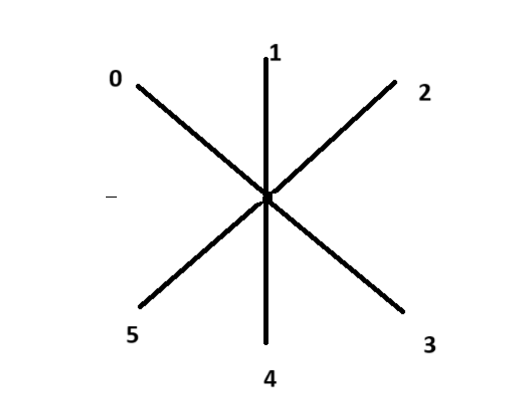
Initialization
Grid Dimensions and Spacing:
Width: 30 units; Height: 10 units; Spacing: 0.1 units; Total Nodes: 300x100.
Particle Representation:
Max. Particles: 6 ; Node Structure: Each node stores particle count and an array of particle directions.
Initialization Process:
Function:`grid_init`
Seeding the random number generator with the current time, grid_init populates lattice nodes with particles.
For each node, initialization occurs based on a fixed 5% probability, resulting in diverse random sequences.

Slide 5
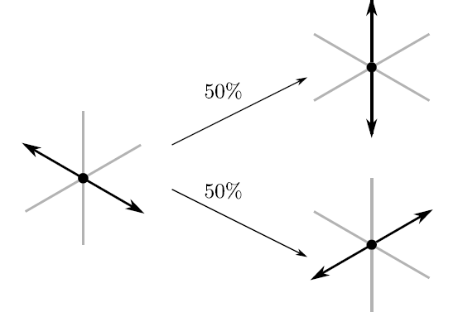
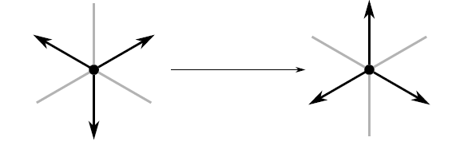
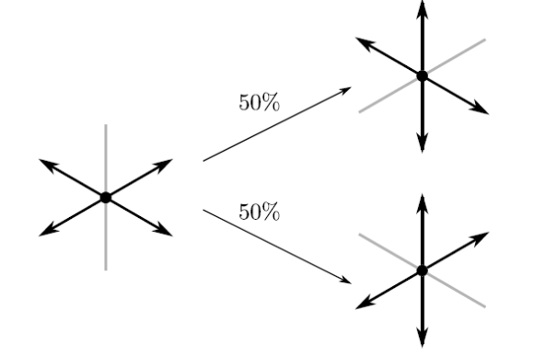
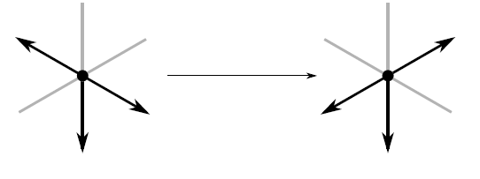
Particle Collisions Phase
Collision Rules:
Back to Back:
Alternately Occupied:
Two Back to Back:
Two Back to Back, a Separator:
Notes:
Collision Rules:
Back to Back: In this transformation, the existing node is replaced, with each direction having an equal probability of 50% for occupation.
Alternately Occupied: Here, the node is modified so that the remaining three directions are occupied, completing the shift of the configuration.
Two Back to Back: The node is updated to have four occupied directions, with one empty back-to-back pair. This change happens with a 50% probability for each of the two possible empty back-to-back pairs.
Two Back to Back, a Separator: In this transformation, the node is replaced with a configuration having three occupied directions. The spectator direction remains the same, while the back-to-back direction is altered.

Slide 6
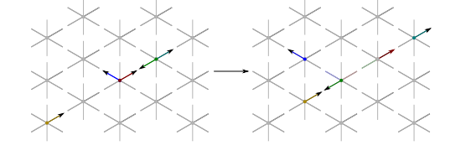
Particle Movement / Streaming Phase
All Occupied Directions
Parallel Processing
New Grid Configuration
Movement Logic
Purpose
Notes:
All Occupied Directions:
During the streaming phase, all occupied directions move to their nearest neighboring nodes in the corresponding directions.
Parallel Processing:
MPI is used to leverage parallel processing for improved efficiency.
Each computing node independently updates its assigned section of the grid, allowing for simultaneous progress across the simulation.
New Grid Configuration:
A new grid structure is created to store the updated positions of particles.
This ensures that particle movements are synchronized and accurately updated across the entire grid.
Movement Logic:
The directions of particles within each grid cell are analyzed.
The grid is updated with the new particle positions based on predefined movement rules.
Purpose:
This phase drives particle movement, a crucial component of the simulation.
It enables the simulation to advance in time by updating particle positions according to the established movement logic.

Slide 7
Boundary Conditions
They define how a system interacts with the environment.
Dirichlet Boundary:
Randomly initializes particles at specific boundary points.
Effect: Simulates an influx or outflux of particles, introducing dynamic conditions at the boundaries.
Used in the top and bottom boundaries. (Note: Considering 300 x 100 vertical matrix)
Slip Boundary:
Handles particles sliding along the boundaries based on specified conditions.
Effect: Manages particle movements without complete obstruction, allowing for a partial flow.
Used in the left and right boundaries. (Note: Considering 300 x 100 vertical matrix)
Notes:
They define how a system interacts with the environment.
Dirichlet Boundary:
Description: Randomly initializes particles at specific boundary points.
Effect: Simulates an influx or outflux of particles, introducing dynamic conditions at the boundaries.
Used in the top and bottom boundaries. (Note: Considering 300 x 100 vertical matrix)
Slip Boundary:
Description: Handles particles sliding along the boundaries based on specified conditions.
Effect: Manages particle movements without complete obstruction, allowing for a partial flow.
Used in the left and right boundaries. (Note: Considering 300 x 100 vertical matrix)

Slide 8
Parallelization with MPI
Process 0
MPI_Send and MPI_Receive
temp_streaming_2layers, temp_streaming_upper_layer, and temp_streaming_lower_layer
Overview
Notes:
The parallelization of the vertical grid was achieved by dividing the grid into horizontal strips, each functioning as a local grid.
Process 0 was designated to collect data from all the processes.
MPI_Send and MPI_Receive were employed for communication between the processes, enabling data transfer.
Functions like ‘temp_streaming_2layers’, ‘temp_streaming_upper_layer’, and ‘temp_streaming_lower_layer’ were utilized to manage communication across the boundaries of each local grid, ensuring proper data exchange between adjacent sections.
The effectiveness of the parallelization was evaluated using a strong scaling plot, assessing the performance improvements as the number of processors increased.

Slide 9
Visualization and Output
Graphical Output:
The stored files (0-99 .txt) were utilized to visually represent the simulation using MATLAB.
Purpose:
It provides visual insights into the simulation's dynamic behavior through grid visualizations, helping to understand how the system evolves.
The graphical output allows for the analysis and interpretation of simulation results by saving configurations at different time steps.

Slide 10
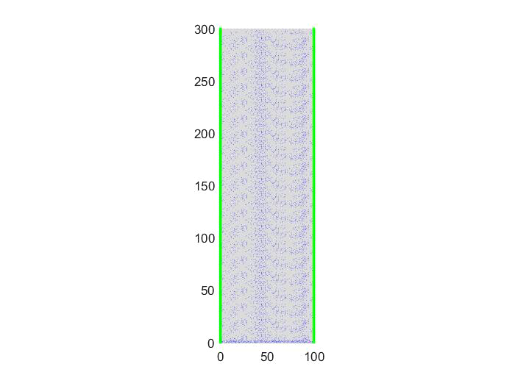
Visual representation of system:

Slide 11
Performance Analysis and Scaling
Strong Scaling Plot:
Illustrates the impact of increasing the number of processes on elapsed time.
Demonstrates the scalability of the simulation across varying process counts.
Purpose:
Evaluates the simulation's performance and scalability under different process configurations.
Guides optimization efforts by identifying trends and areas for improvement.

Slide 12
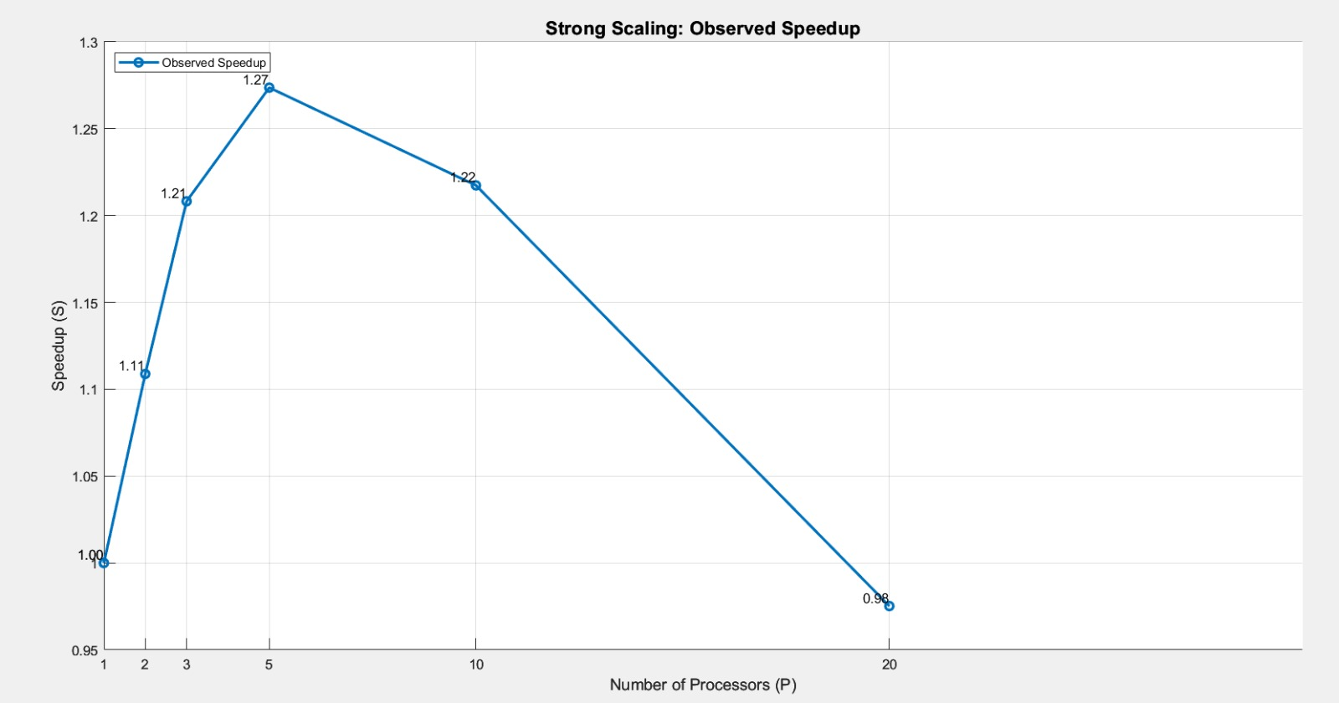
Strong scaling plot:

Slide 13
THANK YOU

