Slide 1

APTECH - HCM
Project semester 1
Project:
Building a website to sell various types of GARMENTS.
Instructor: PHUOC DUONG HUU
Class: C1906L - Group 1

Slide 2
Member List:
TRINH DINH THI THUY Student1200898
- Design Database, Interface of user and admin, Function of Admin.
MAN PHAM MINH Student1209092
- Cut layout, back-end of Index page, Product list page, Product detail page, Search, Compare product.
CUONG NGO HUNG Student1200872
- Database source code, Back-end of User page, Cart page, Check Out page, Invoice Detail page.
BAO NGO GIA Student1219050
- Back end Account Manager page.

Slide 3
The main
Project
Target
Overview
Development Process
Conclusion

Slide 4
Project
GRACIOUS GARMENTS is selling various types of GARMENTS for both MEN and WOMEN. The company advertises by distributing the pamphlets, advertising on television and so on. Due to rapid development in internet field, the company decides to launch a website where people will get all the information about the various products available with them easily.

Slide 5
Target
The website:
Where people will get all the information about the various products available with them easily.
Where customer can buy product online.
Where customer can read Gracious Garments’s information.
Admin or Manager can manage(add, delete, edit) all Product, all Account, All Invoice.

Slide 6
Overview
Program Function
For Customer:
Sign up and Sign in.
Can see and change their profile information.
Can see their old order and old detail invoice.
Can see Product by Product Type and Brand.
Can see Product detail when click on Product.
Can add Product in Cart then review it in Cart.
Can change shipping address when check out.

Slide 7
Overview
For Admin
Manage Account
Manage Product
Manage Product Type
Manage Brand
Manage Invoice
Manage Invoice Detail
Manage Shipping Address

Slide 8
Program Development Process
Requirement analysis
Database design
Theme design
Development
Run and Test

Slide 9
Program Development Process
Requirement analysis
The Home Page should be created making use of Frames with a suitable logo.
Home Page should contain details of different Garments with suitable images.
The site should display a menu which will contain the options for brief introduction about the various garments available, location of the shop and any other information if required.

Slide 10
Program Development Process
When a user selects any particular brand, a list of products for that brand will be displayed
The user should also be able to compare the various products of different as well as similar brands.
There should be a “Contact Us” page which will have the Address of the Company which is as follows and the mail address which when clicked will invoke the local mail client from where they can send an email. Address of the Company should be displayed using GeoLocation API (eg. GoogleMaps).

Slide 11
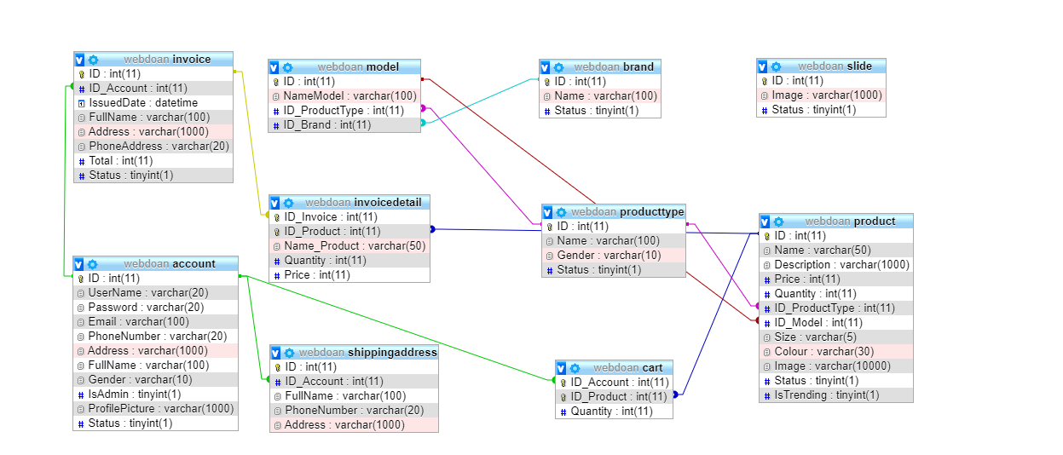
Program Development Process
2. Database design

Slide 12
Program Development Process
3. Theme design
Download a template then cut and edit for E- Project’s Requirement.
Use Bootstrap and J-query.
Add CSS and Javascript.

Slide 13
Program Development Process
4. Development
Build around Three-layer Model
- GUI – Graphical User Interface
- BUS – Business Logic Layer2
- DAO – Data Access Layer3

Slide 14
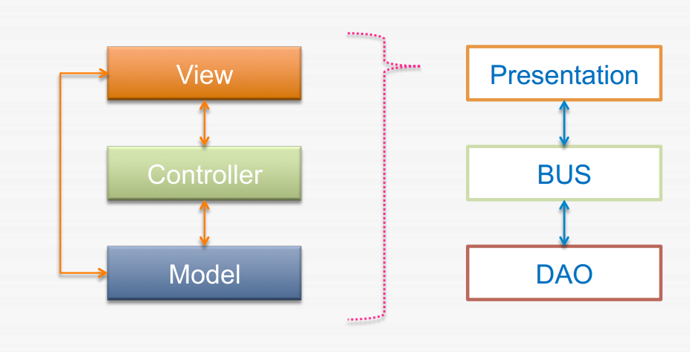
Program Development Process

Slide 15
Program Development Process
5. Run and Test

Slide 16
Conclusion
To accomplished the basic function
A user-friendly interface

