Slide 1

CQRS, DDD &ES
The 3 Musketeers

Slide 2
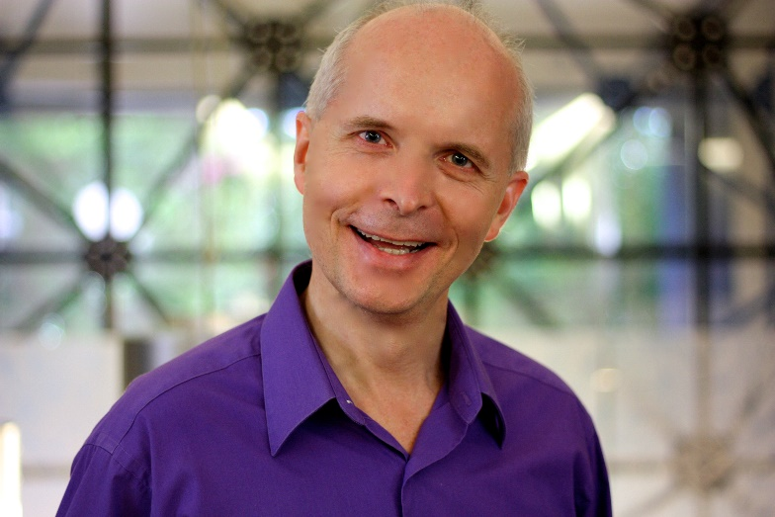




Gabriel N. Schenker
Distinguished Software Architect, Clear Measure
Physicist, PhD in Astrophysics
www.lostechies.com/gabrielschenker
@gnschenker
www.linkedin.com/in/gabrielschenker
https://github.com/gnschenker
Notes:
My name is GNS. I work at Clear Measure as a distinguished sw architect. I also have a background as physicist and have a PhD in Astrophysics. I am a member of LosTechies and have my blog there. You can also see my coordinates on Twitter, LinkedIn and GitHub. I am a father of 4 and some of my hobbies are cooking, scuba diving, skiing, hiking in the mountains,…

Slide 3
Agenda
CQRS – Command Query Responsibility Segregation
DDD – Domain Driven Design
ES – Event Sourcing

Slide 4


CQRS
Command Query Responsibility Segregation
Notes:
Let’s start with CQRS. As simple as it sounds as effective it can be. Separating commands from queries can have a huge impact on the complexity, maintainability and robustness of an application. Commands are the operations that change state in the system and are mostly triggered by some action of a user working with an application. Queries on the other hand are used by an application to populate the screen with useful data. Usually the commands that modify the system need to carry much less information than (the result of) a query. E.g. in a typical e-commerce site I want to add a product to my shopping cart. I only need to send the ID of the cart, the ID of the product and the quantity to the backend. On the other hand if the application needs to populate the view with my shopping cart much more details need to be transferred from the backend to the screen.

Slide 5
Frontend
Frontend
ACK/NACK
DTOs
CQRS
Classical
Command
complicated
Backend
Domain
Query
Thin data layer
Read
Write
DB
DB

Slide 6
Frontend
ACK/NACK
DTOs
Command
Domain
Query
Thin data layer
Write
Read
Write model
Read model
Update
(asynchronous)

Slide 7
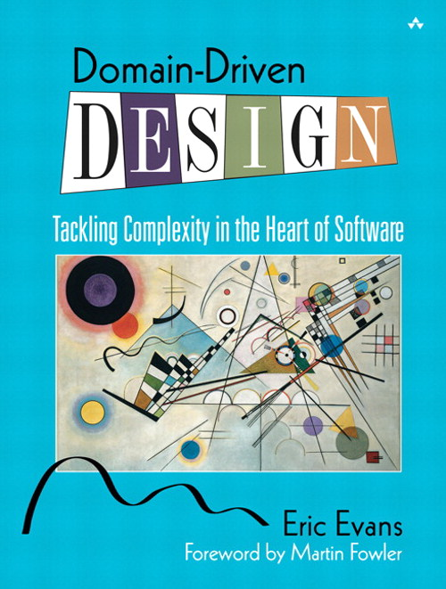
DDD
Ubiquitous Language
Bound context
Aggregate
Service, Factory, Repository
Notes:
In the past and sadly in a lot of companies till this day we have learned that what matters most is a good data model. Thus we all first started with the database design. Everything else had to follow. Luckily we have learned our lesson and found out that this often lead to applications that were sub-optimal at best from a users’ perspective. These days we prefer to implement our mission critical applications by either starting with the UI – a UI or task driven development - or like in this case with the domain model. There is this one blue book that everyone who has professionally worked with DDD has probably read or at least heard of. It is kind of the bible of DDD. When we do DDD then some keywords are very important. I have tried to list them starting with the most important or relevant one and so on.
First we have what is called the ubiquitous language, then we need bound context, aggregate and finally service, factory and repository.
Let me explain those in detail

Slide 8
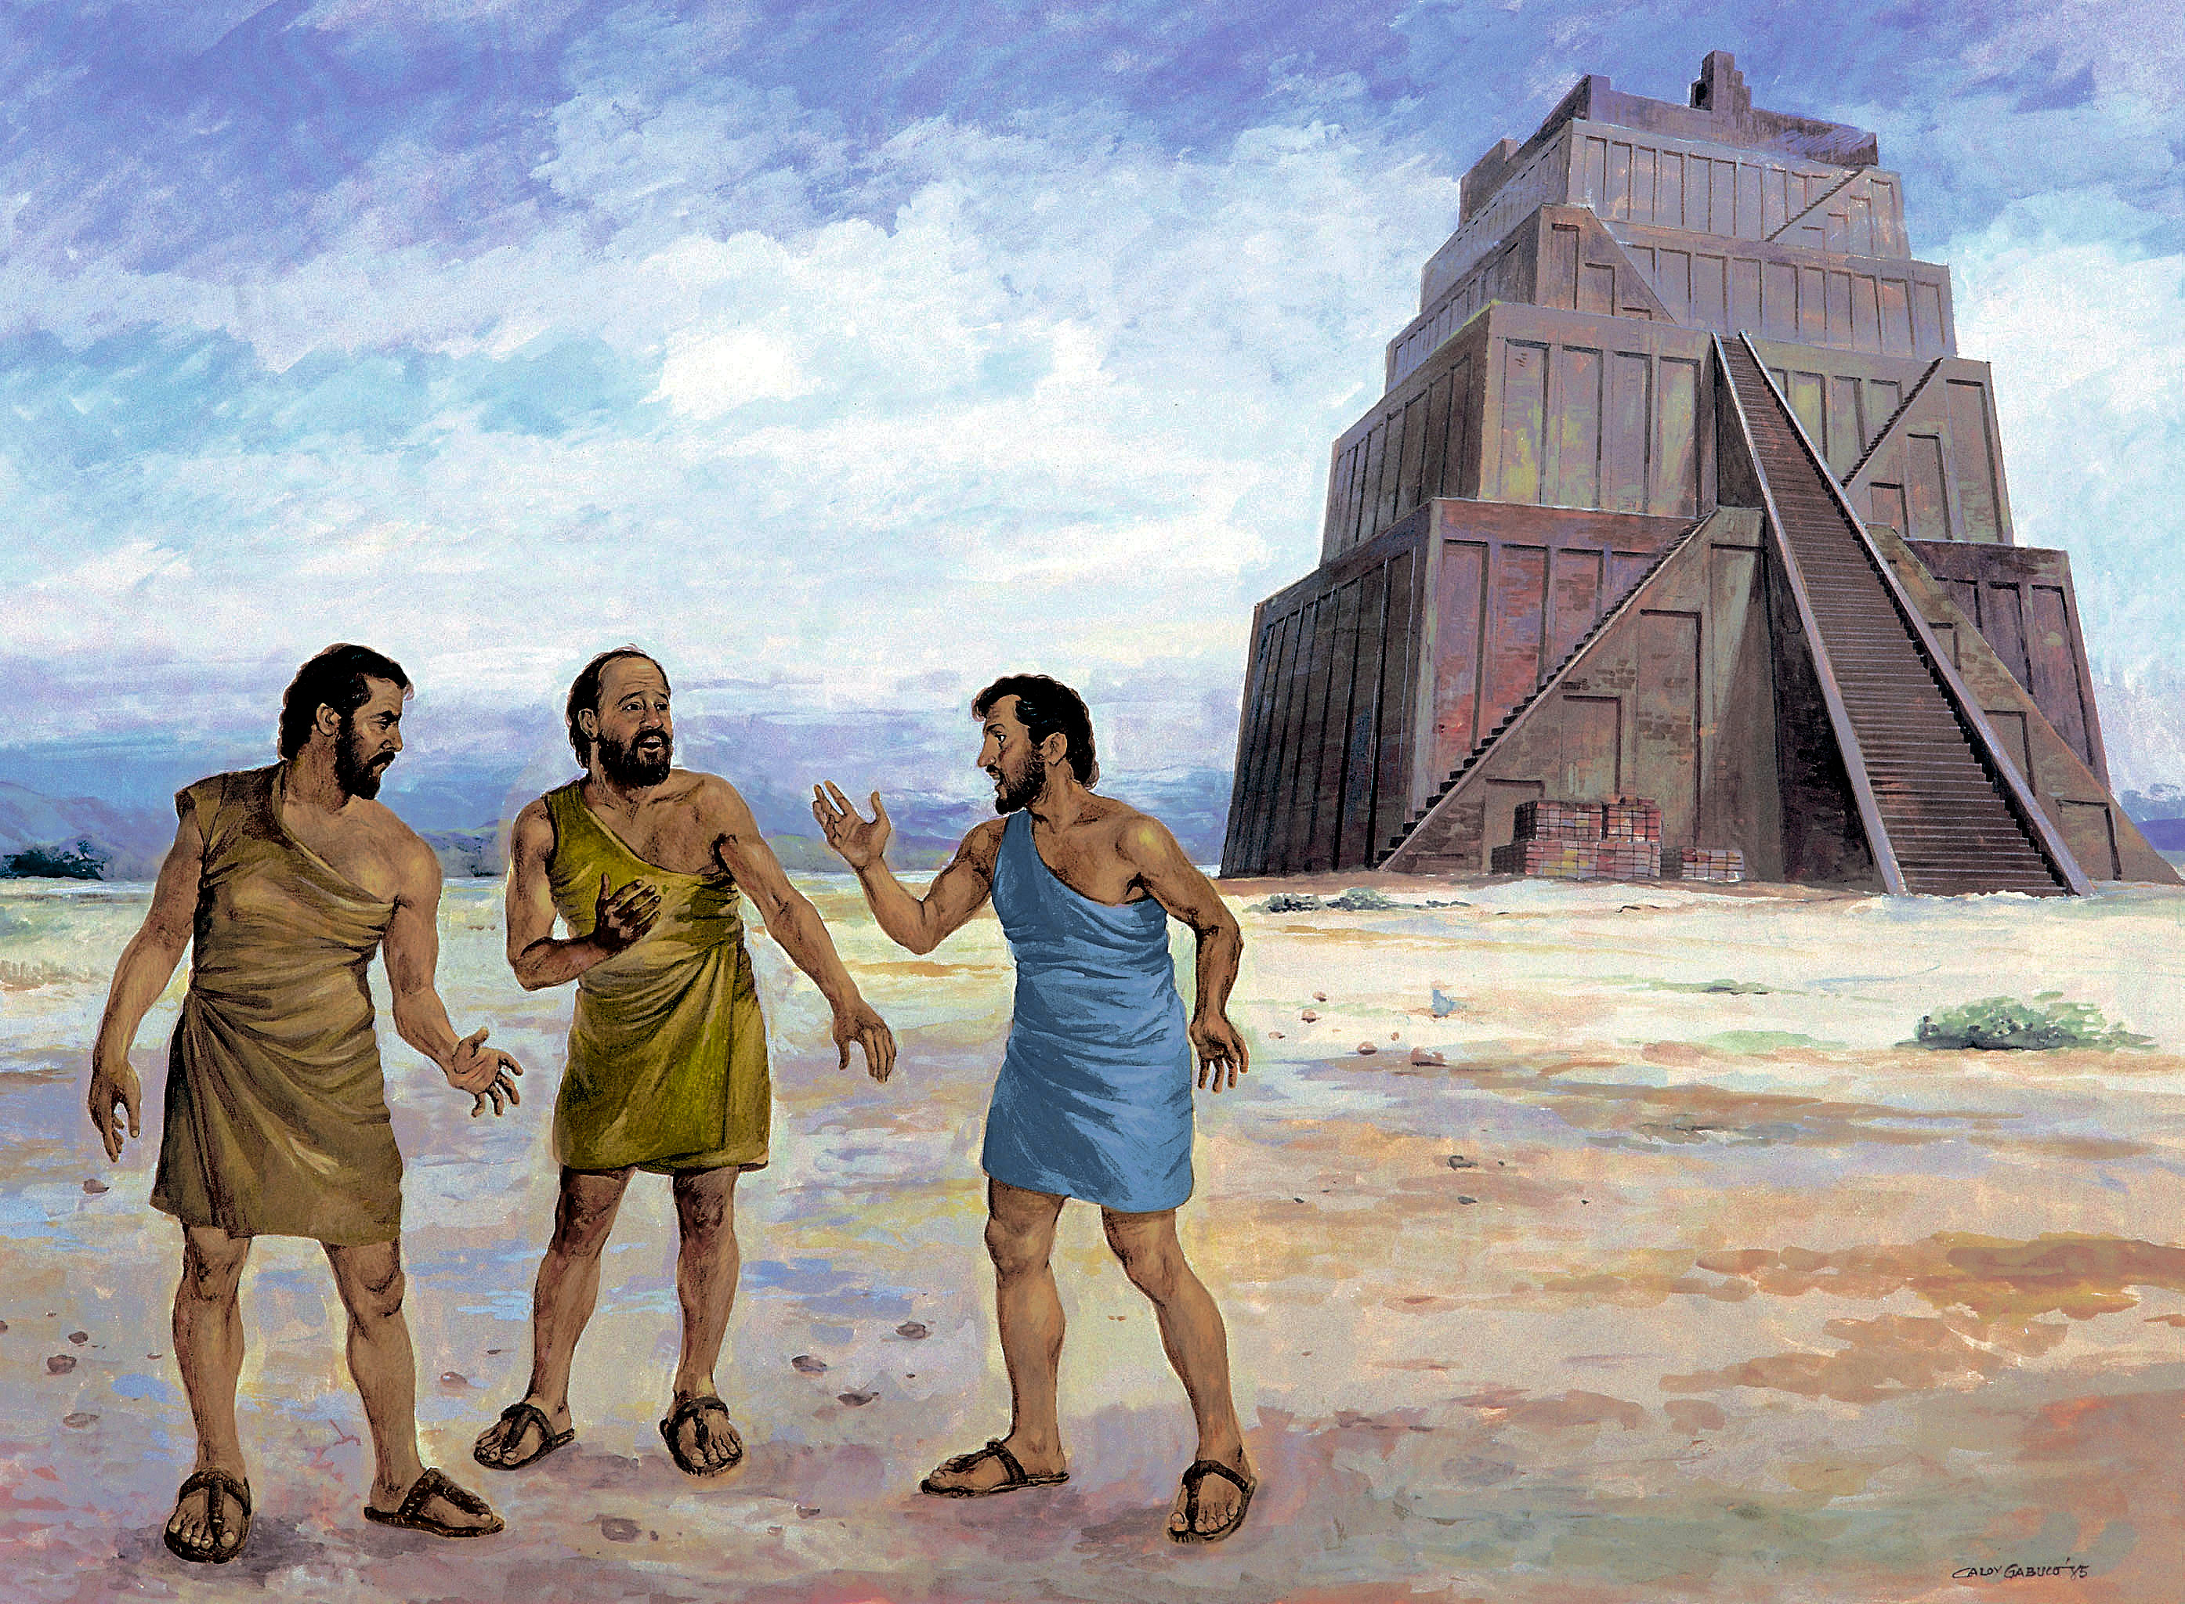
Ubiquitous language
Notes:
Typically when creating business critical software we have many different stakeholders involved. We have business owners, users, and power users, trainers, architects, developers, QA people, DevOps and so on.
One important goal of DDD is to come closer to the ideal that everybody without exception speaks the same language.
In the image you see the builders of the tower of Babylon and how the abandoned their building when everyone spoke in a different language. A very powerful analogy!
Translating from one language to another causes loss and is a source for misunderstanding
I want an architecture that allows me to picture out concepts/features/user stories with the domain experts and without translation implement them in code
That is why the naming of Things and Actions or Events is so important.

Slide 9
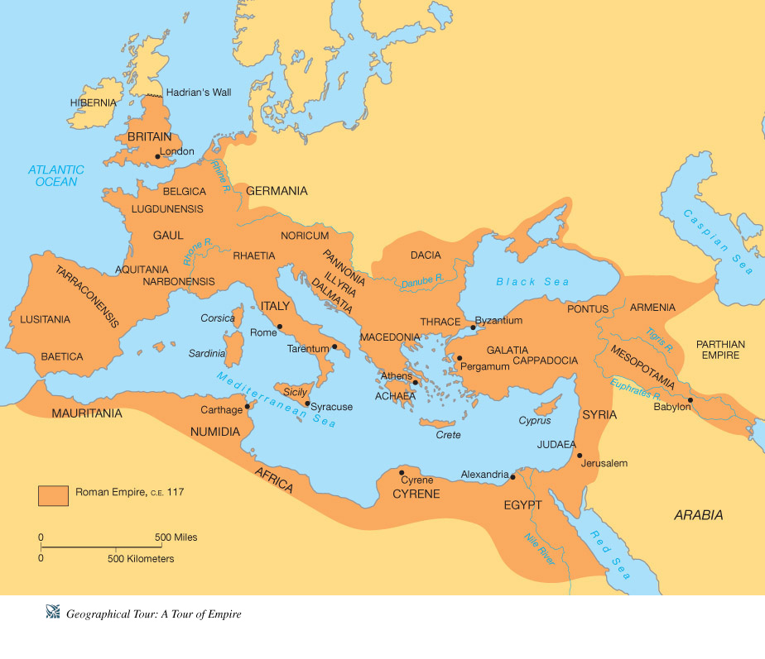
Bound Context
Notes:
As Cesar did with his Roman empire, we divide our complex domain into “regions” and call them “bound contexts”
Each bound context is only loosely coupled with all the other BCs. This allows us to work in parallel in different BCs
No mutual blocking happens.
In a product I helped to architect and build and that is used by all major pharmaceuticals, universities and big hospitals we e.g. had some bound contexts like protocols, reviews, animal orders, animal census, staff training, etc.

Slide 10
Aggregate
Root
ID
ID
Customer
Product
CustomerID
VendorID
…
Name
Name
Name
Address
Name
Name
Category
Name
Name
Phone #
Name
Name
Customer Aggregate
Product Aggregate
Notes:
The aggregate is the next important element in DDD. An aggregate is a logical concept and denotes the boundary of a business transaction. That is quite a mouth full. But what does it mean? In a business – even without computers – we can identify tasks that are executed at certain times. Those tasks have a limited scope. For example I might want to add the details of a new customer to the system could be one task. Or I could do inventory and change the properties, say prices of some of our products. Ideally I do not do those tasks at the very same time. They are different concerns. Similarly I try to model my aggregates. Am I doing inventory or am I doing customer (phone) support or am I billing? Thus we could have a customer aggregate which contains objects for the various properties of a customer that I might need to change like names, phone numbers, physical addresses, etc. On the other hand I have an Order aggregate which will contain all information regarding an order that was made by a customer. This order will not contain the customer as an object but rather refer to it by using a unique ID. As I said, we usually do not place an order and at the very same time modify the names or phone numbers of the customer.

Slide 11
Public
interfaces
Domain
host
persistance
Web API
Application Service
Aggregate
Repository
Data Store
Message Queue Handler
uses
Services & Factories
Aggregate
Aggregate
State &
business logic
(infrastructure agnostic)
Single
responsibility
Notes:
Of course the aggregate does not live alone and thus in a typical application we have all these other elements. We have Web APIs and/or message queue handlers that serve as the public interface to the application. Then we have the application service which hosts an aggregate and provides it the necessary infrastructure specific environment. We have a repository to provide persistence to the aggregate. Finally to adhere to the single responsibility principle the aggregate (and sometimes the application service) uses services and factories to get the job done.

Slide 12
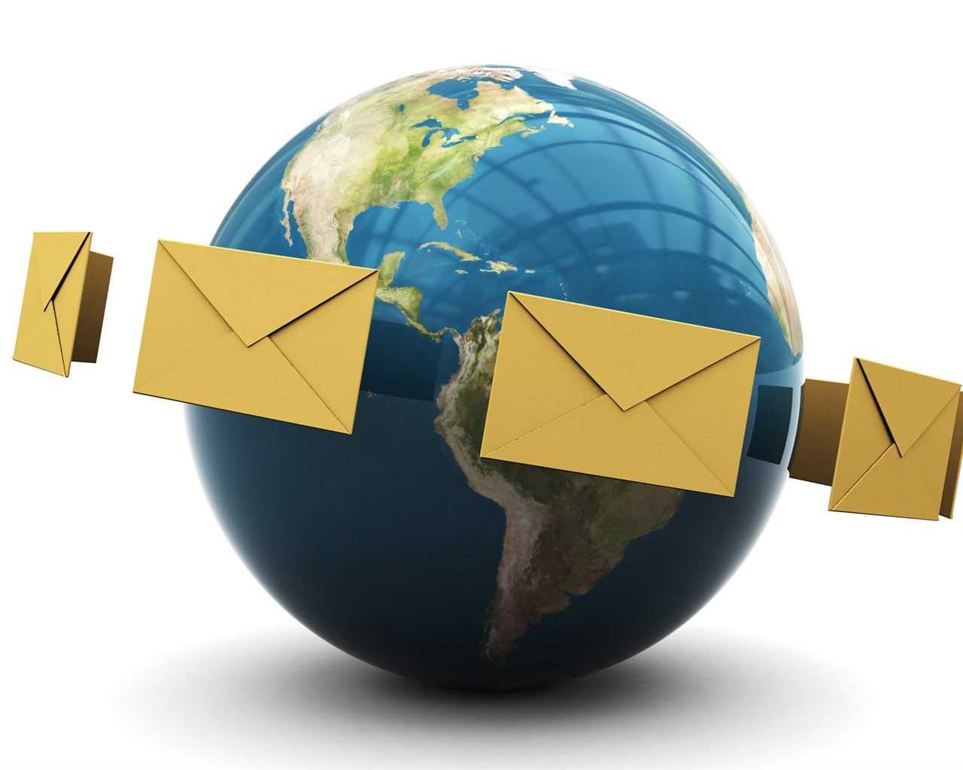
ES
Event Sourcing

Slide 13
Magic triangle
Client
ACK/NACK
DTOs
Command
Queries
Domain
Read Model
Events
Events
3
Event Store
Replay
2
1

Slide 14
Event store
time
Append only
No change, no delete
Full history
Truth
Replay
Open for the unknown
Event n+1
Event n
Event 3
Event 2
Event 1
Notes:
-as users work with the system and add or change data events are created. These events are stored.
-Events are always appended to the set of already existing events. Never is an event changed or even deleted
-By having the set of all events we have full knowledge of the history of the system. We can not only answer questions about the current state of some elements like protocols or order
but also how it came that e.g. a protocol is in the current state
-The list of events represent the full truth of the system. They are basically the only thing that really matters
-If something goes wrong we can always replay events to get projections
-If some new (previously unknown) requirements surface we can create new or modified projections and “just replay” the events

Slide 15
Events of a single aggregate instance
n - TaskCompleted
Stream
⁞
3 - TaskAccepted
2 - TaskPublished
1 - NewTaskScheduled
Event Store

Slide 16

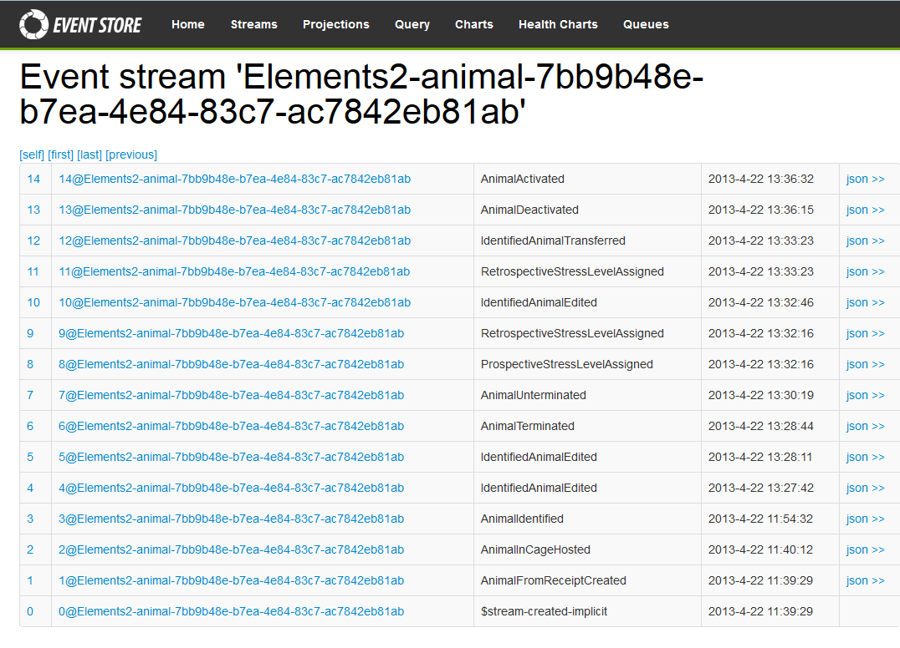
Streams

Slide 17
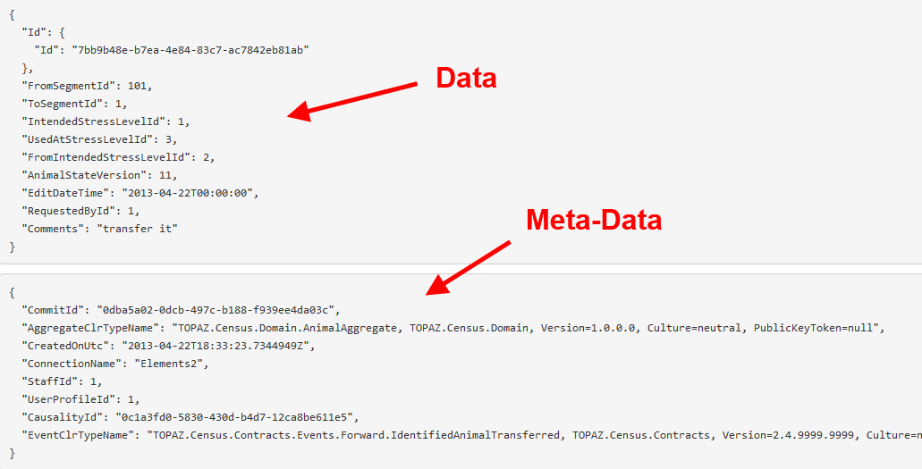
Events
JSON

Slide 18





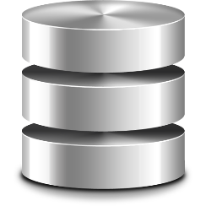


Topology
Lucene Indices
Observer
Event Store
Dispatcher
Mongo DB
Schedule queue
RDBMS

Slide 19
Commands
Queries
Web API
Web API
Domain
Light weight DAL
RDBMS
Observers
Repository
Events
Dispatcher
Document
DB
Events
Async.
Event
Store
Elastic
Search
Read Model

Slide 20
Demo
https://github.com/gnschenker/ES-and-DDD.git
Notes:
Let’s first clone the repo from the given address. Then I can use git to move the HEAD to the first step.
In this first step I just lay ground for the whole sample. This is an ASP.NET Web API project and I have added a simple controller to the project. We can run the project and test if it is working
In the second step I will introduce the Application Service which will host the aggregate. The application service provides the infrastructure to the aggregate
Step 3: Adding state to the aggregate; adding pre-condition checks to the aggregate. Also handling another command. Trigger events from aggregate
Step 4: Implementing IAggregate interface; implemented repository for GetEventStore; implemented aggregate factory
Step 5: Define events dispatcher infrastructure. Implement projection writer

Slide 21
Web Server
Application
Read/write
read
write
Message
Dispatcher
RDBMS
RDBMS
Event
Store
Document DB
Elastic Search
Read/Write Model
Write Model
Read Model
Legacy

