Slide 1
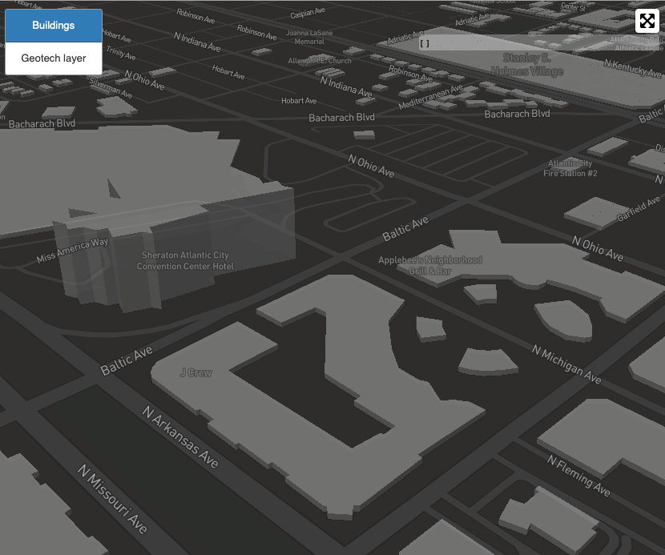
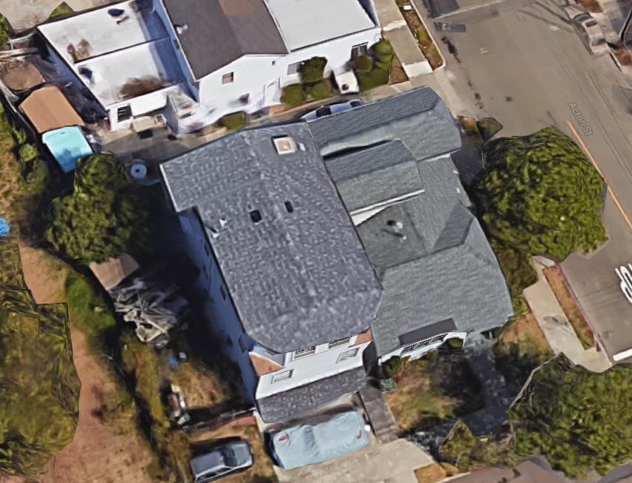
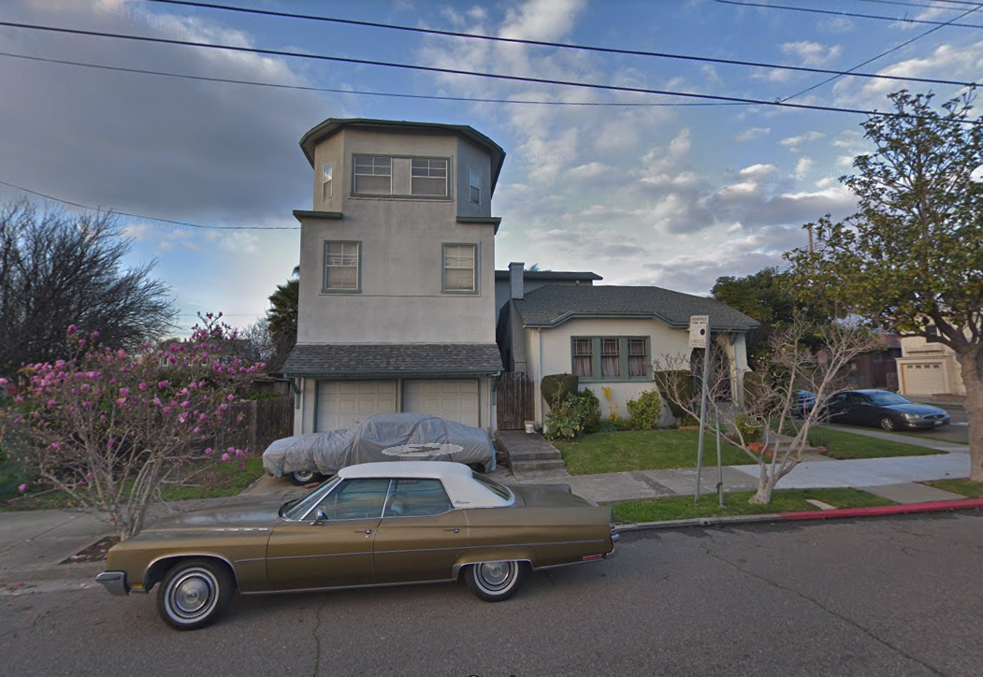
City Name
CNN
BIM For Individual Bldgs
Geocoding
Spatial Uncertainty Quantification
Satellite and Street Images
Regional-scale Building Inventory Database
Building Inventory

Slide 2
City Name
CNN
Metadata collection
BIM For Individual Bldgs.
Geocoding
Spatial Uncertainty Quantification
Satellite / Street Images
Regional-scale Building Inventory Database
Building Inventory

Slide 3
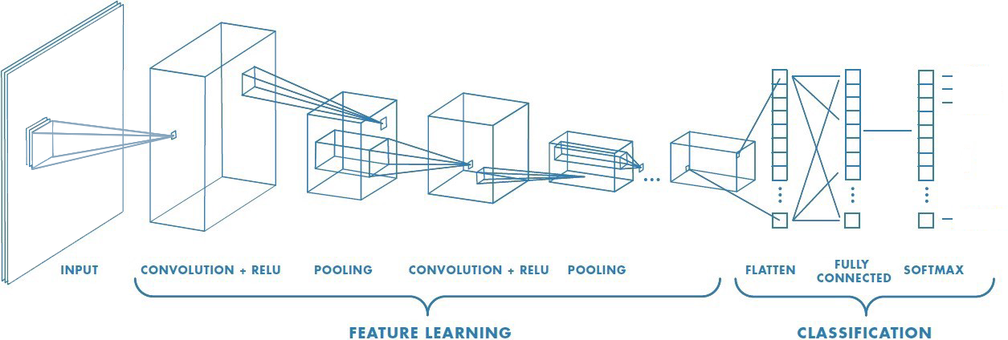
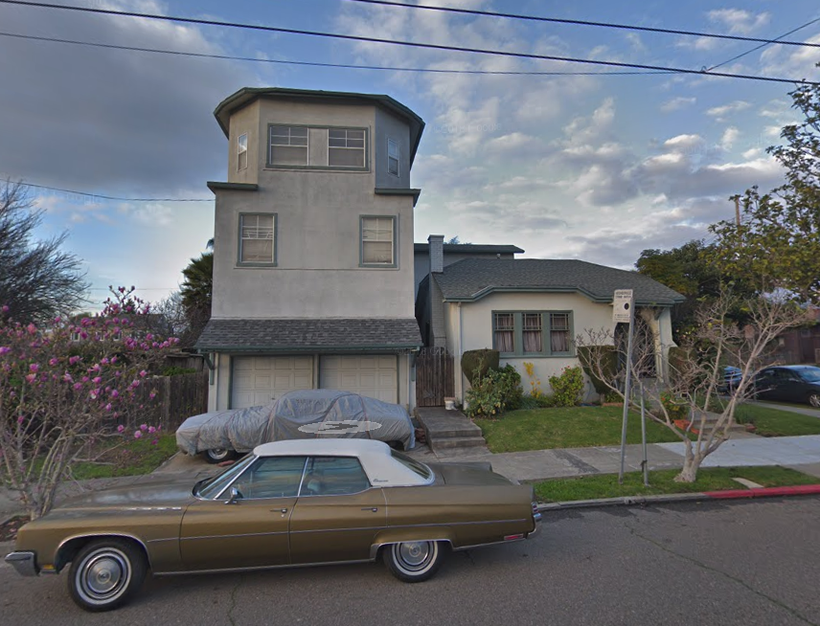

Slide 4
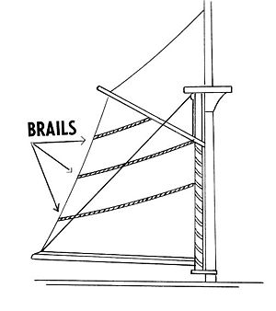

Slide 5
BRAILS

