Slide 1

User Input Handling
UI Events and Touch Input

Slide 2
Learning Objectives
Understand the significance of user input in game development.
Learn how to handle UI events for responsive interfaces.
Gain hands-on experience in implementing touch input functionality.
Notes:
Online tutorial for this lesson:
https://www.youtube.com/watch?v=b0O2CRSdiOA&list=PLX2vGYjWbI0S-LEFR59E2B347w2HbjiJv
https://docs.unity3d.com/Manual/AnimationOverview.html

Slide 3
Unity Input System Overview
Input allows the user to control your application using a device, touch, or gestures. You can program in-app elements, such as the graphic user interface (GUI) or a user avatar, to respond to user input in different ways.
Unity supports input through two separate systems:
The Input Manager is part of the core Unity platform and available by default.
The Input System is a package that needs to be installed via the Package Manager before you can use it. It requires the .NET 4 runtime, and doesn’t work in projects that use the old .NET 3.5 runtime.
Reference: https://docs.unity3d.com/Manual/Input.html
8: Unity Technologies, Unity Manual, 2023
Notes:
• Brief recap of fundamental animation scripting concepts covered in previous sessions.
• Reminder of the importance of scripting for dynamic and controlled movement.

Slide 4
Unity Input System Overview
Unity's Input Manager
Legacy Architecture:
The Input Manager is part of Unity's legacy architecture.
Often uses functions like Input.GetKey, Input.GetKeyUp, and Input.GetKeyDown to handle keyboard events.
Limited Capabilities:
The Input Manager can be limited in handling complex input devices such as gamepads and VR controllers.
Managing multiple input types simultaneously might be challenging.
Hard to Modify and Extend:
Modifying or extending input configurations in the Input Manager can be challenging and may require direct intervention in the project

Slide 5
Unity Input System Overview
Unity's Input System
Modern Architecture:
The Input System is a new architecture introduced by Unity to replace the Input Manager in new projects.
Provides a unified and extensible solution for handling input from various sources.
Enhanced Support:
Better support for various input devices, including gamepads, VR controllers, sensors, and more.
Easily integrates with other systems, such as event systems.
Natural Management:
Offers flexible data structures and APIs to manage and process input more naturally.
Easily configurable and adjustable from the Inspector in the Unity Editor.

Slide 6
Unity Input System Overview
Unity's Input System
Multiplayer and Networking Support:
Better support for multiplayer features and networking, facilitating input handling across multiple players.
Easy to Expand and Customize:
Highly extensible and customizable, allowing projects to flexibly respond to specific requirements.
The Input System represents a significant advancement over the Input Manager in managing and processing input in Unity, bringing flexibility, scalability, and higher performance, especially for projects requiring diverse and highly interactive input.

Slide 7
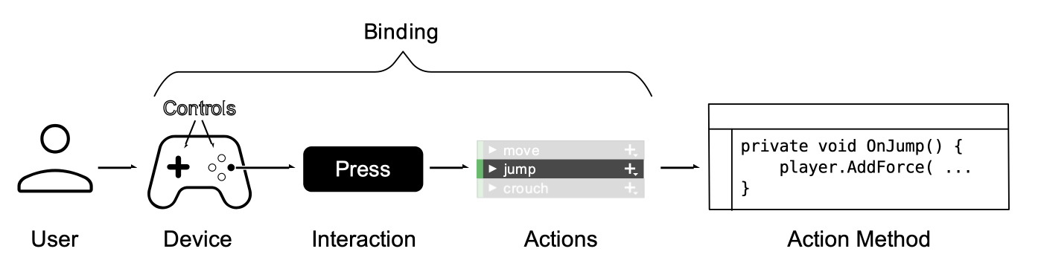
Unity Input System Concepts
Basic Concept
These fundamental concepts and terms relate to the sequence of events when a user inputs commands into your game or app. The Input System offers built-in features to execute these steps, or you have the option to implement certain steps independently.
8: Unity Technologies, Unity Manual, 2023
Notes:
https://docs.unity3d.com/Packages/com.unity.inputsystem@1.7/manual/Concepts.html

Slide 8
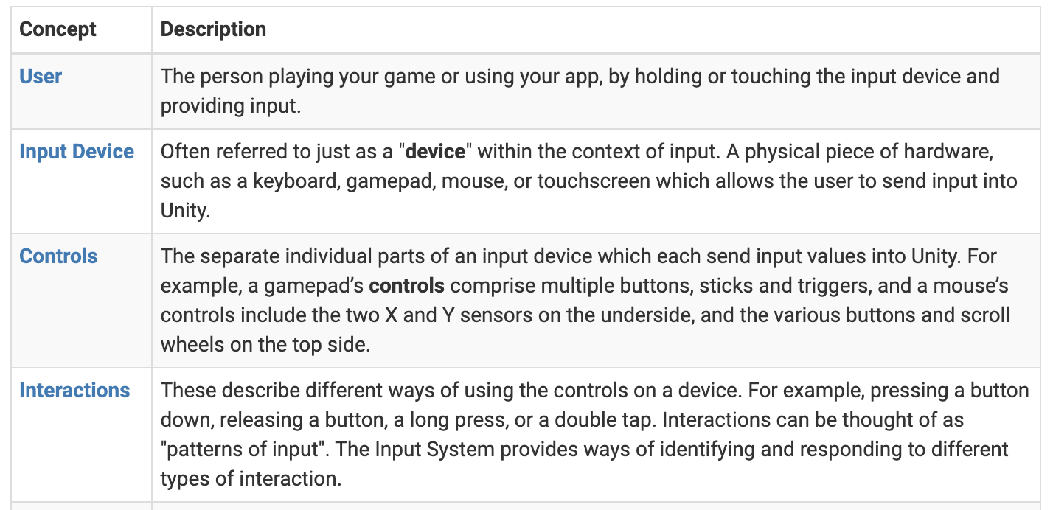
Unity Input System Concepts
Basic Concept
8: Unity Technologies, Unity Manual, 2023

Slide 9
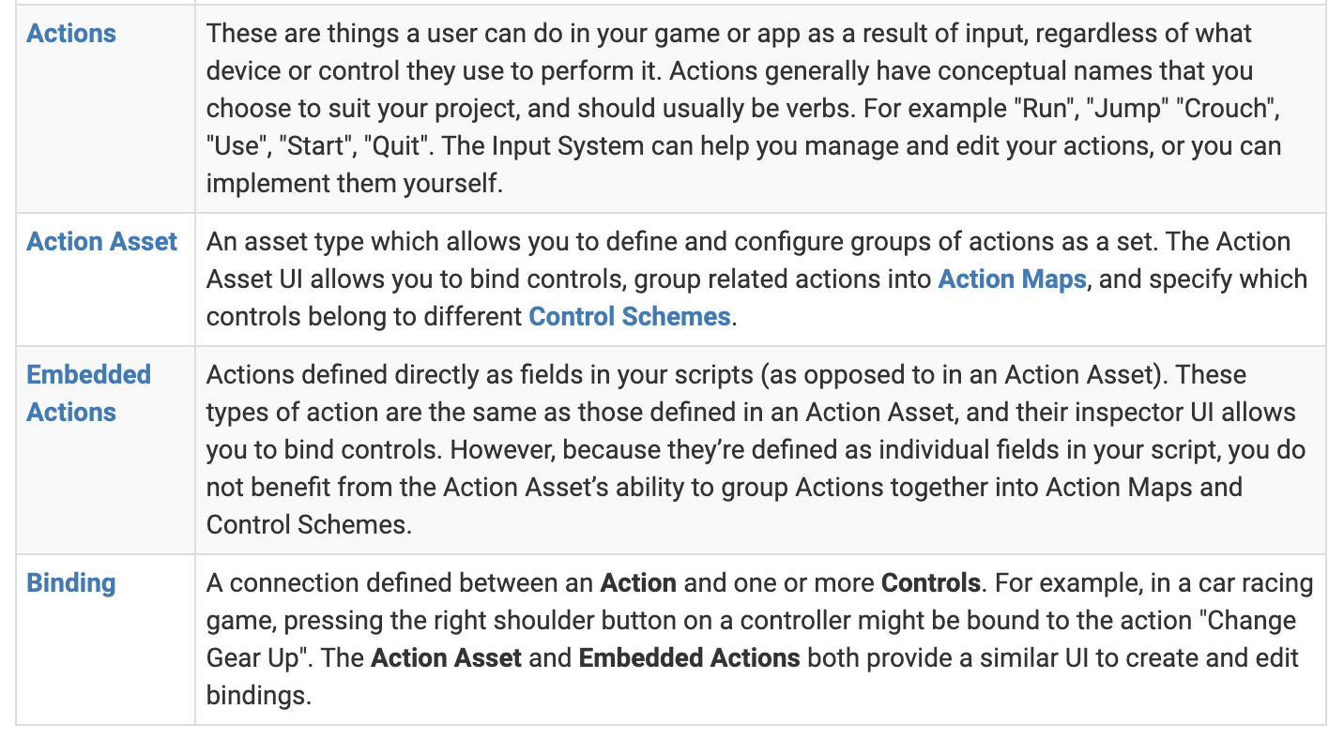
Unity Input System Concepts
Basic Concept
8: Unity Technologies, Unity Manual, 2023

Slide 10
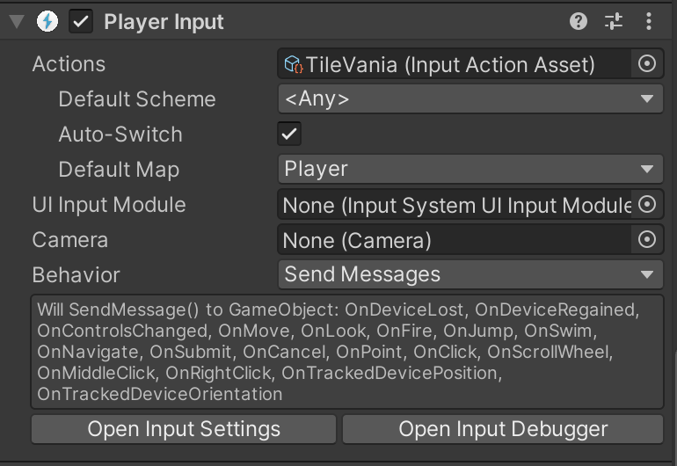
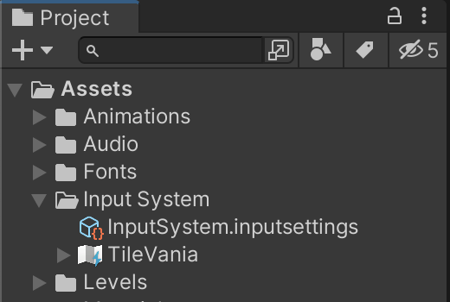
Unity Input System – An Example
(Install Input System from Package Manager if needed)
Setting the “Player Input” component:
Select the Player GameObject and add the "Player Input" component.
Create an Action from the "Player Input" component, save it in the Assets/Input System folder, and name it "TileVania".
Select the Player GameObject, drag and drop the "TileVania" action to the Actions field of the "Player Input" component.

Slide 11
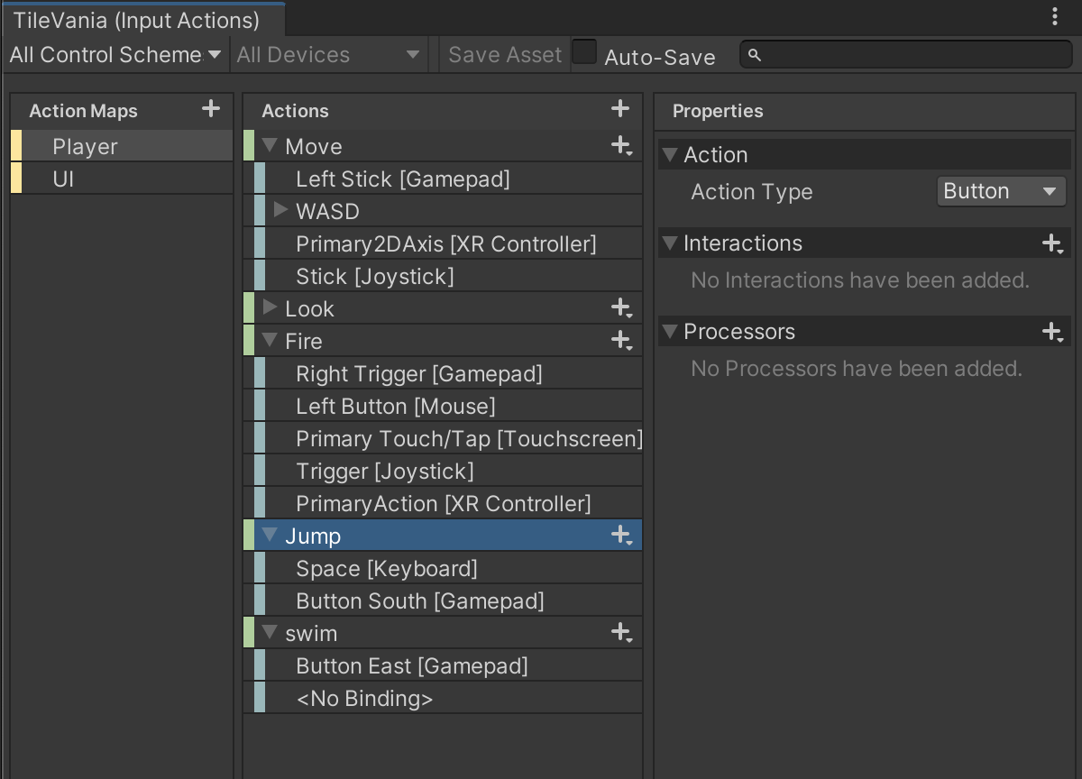
Unity Input System – An Example
Setting the Input Action:
Double-click on the "TileVania" action in the Assets/Input System folder to edit the Input Actions (open the Input Actions window).
Click the Add button (+), set the action name to "Jump":
Action Type = Button
Binding = Keyboard & Mouse
Path = Space [Keyboard]
Add another binding type to the Jump action:
Binding = GamePad;
Path = Button South [GamePad].

Slide 12
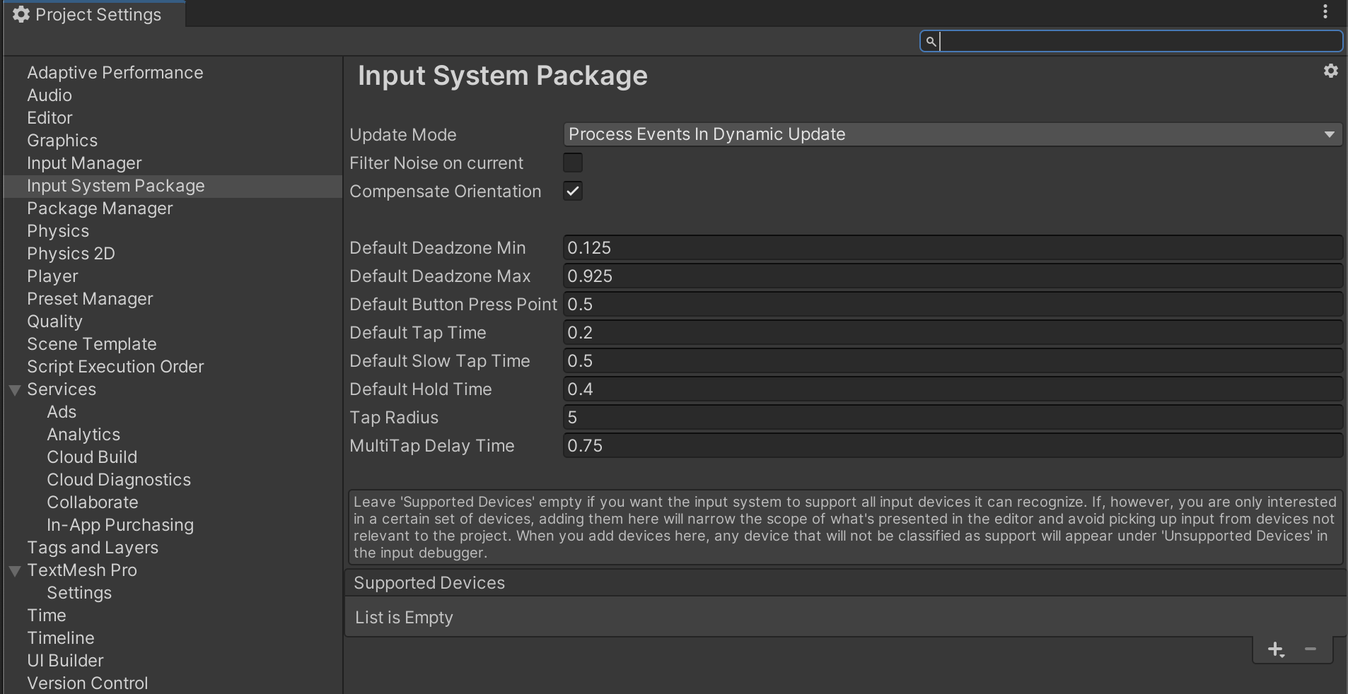
Unity Input System – An Example
Select the Player, click on "Open Input Settings" to open the Project Settings - Input System Package setting window. Click on "Create Setting Assets". Drag the "InputSystem.asset" file to the Assets/Input System folder.

Slide 13
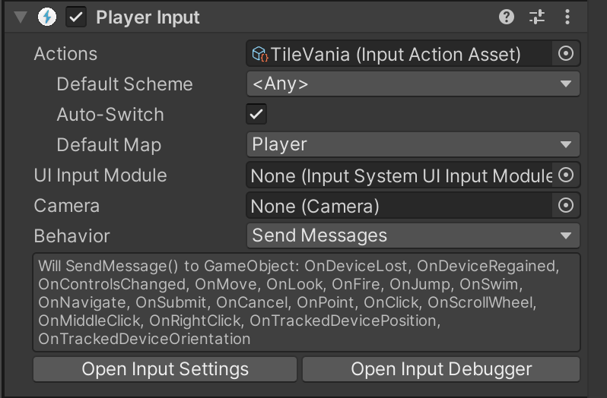
Unity Input System – An Example
Create a C# script to set behavior for the input event.
[SerializeField] float runSpeed = 10f;
Vector2 moveInput;
Rigidbody2D myRigidbody;
void Update()
{
if (!isAlive) { return; }
Run();
}
void OnMove(InputValue value)
{
if (!isAlive) { return; }
moveInput = value.Get<Vector2>();
}
void Run()
{
Vector2 playerVelocity = new Vector2 (moveInput.x * runSpeed, myRigidbody.velocity.y);
myRigidbody.velocity = playerVelocity;
bool playerHasHorizontalSpeed = Mathf.Abs(myRigidbody.velocity.x) > Mathf.Epsilon;
myAnimator.SetBool("isRunning", playerHasHorizontalSpeed);
}

Slide 14
Unity Input System – An Example
Create a C# script to set behavior for the input event.
[SerializeField] float jumpSpeed = 5f;
void OnJump(InputValue value)
{
if (!isAlive) { return; }
if (!myFeetCollider.IsTouchingLayers(LayerMask.GetMask("Ground"))) { return;}
if(value.isPressed)
{
myRigidbody.velocity += new Vector2 (0f, jumpSpeed);
}
}

Slide 15
UI Events Handling
The Event System is a way of sending events to objects in the application based on input, be it keyboard, mouse, touch, or custom input. The Event System consists of a few components that work together to send events.
The primary roles of the Event System are as follows:
Manage which GameObject is considered selected
Manage which Input Module is in use
Manage Raycasting (if required)
Updating all Input Modules as required
Canvas uses the EventSystem object to help the Messaging System.
Notes:
https://docs.unity3d.com/Packages/com.unity.ugui@2.0/manual/EventSystem.html

Slide 16
UI Events Handling – Event System
Input Modules
An Input Module is where the main logic of how you want the Event System to behave lives, they are used for:
Handling Input
Managing event state
Sending events to scene objects.
Only one Input Module can be active in the Event System at a time, and they must be components on the same GameObject as the Event System component.

Slide 17
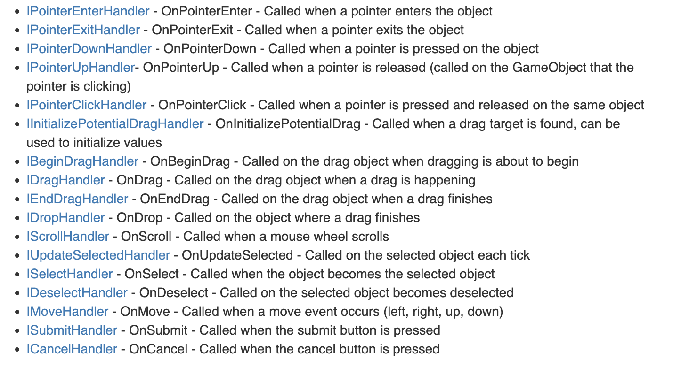
UI Events Handling – Event System
Supported Events
The Event System supports a number of events, and they can be customized further in user custom user written Input Modules.
The events that are supported by the Standalone Input Module and Touch Input Module are provided by interface and can be implemented on a MonoBehaviour by implementing the interface.

Slide 18
Touch Input Basics
Touch input in Unity refers to the ability to handle interactions on touch-enabled devices, such as smartphones and tablets. Unity provides several methods and modules to facilitate touch input in your games or applications.
Input System: Unity's Input System is a comprehensive solution that supports touch input along with other input types. It offers a unified approach to handle various input devices, including touchscreens.
Input.GetTouch Method (Input manager) The Input.GetTouch method is part of the legacy Input Manager and allows you to retrieve touch information. It returns a Touch object, providing details such as position, phase (begin, move, end), and finger ID.
Event System: Unity's Event System is designed to handle various types of user inputs, including touch. It uses interfaces like IPointerDownHandler, IPointerUpHandler, and IPointerClickHandler to respond to touch events on UI elements.

Slide 19
Touch Input Basics
Mobile Input Module: Unity's UI system includes the Mobile Input Module, specifically designed for touch interactions. It translates touch gestures into UI events, making it easier to create touch-friendly user interfaces.
TouchScript: TouchScript is a third-party touch input library for Unity. It provides a high-level abstraction for touch interactions, making it easier to implement gestures, touch handling, and multi-touch support.
When working with touch input in Unity, you can choose the method or module that best fits your project's needs. Whether you prefer the new Input System, traditional Input.GetTouch method, or specialized modules like the Mobile Input Module or third-party libraries like TouchScript, Unity offers flexibility in implementing touch input based on your preferences and requirements

Slide 20
Multi-Touch Handling
Multi-touch handling in Unity involves managing multiple simultaneous touch inputs on touch-enabled devices. Unity provides various methods and modules to facilitate multi-touch interactions in your games or applications.
Input System: Unity's Input System is a modern and comprehensive solution that seamlessly supports multi-touch input. It offers a unified approach to handle various input devices, including touchscreens, and simplifies the implementation of multi-touch gestures.
Input.touches Array: The Input.touches array is part of the legacy Input Manager. It allows you to access information about multiple touch inputs simultaneously. Each element in the array represents a different touch, providing details such as position, phase, and finger ID.
Event System: Unity's Event System, particularly the PointerEventData structure, supports multi-touch handling for UI elements. It allows you to track and respond to multiple touch inputs through interfaces like IPointerDownHandler, IPointerUpHandler, and IPointerClickHandler.

Slide 21
Multi-Touch Handling
Mobile Input Module: The Mobile Input Module is a part of Unity's UI system and is designed specifically for touch interactions. It translates touch gestures into UI events, facilitating the creation of touch-friendly user interfaces with multi-touch support.
TouchScript: TouchScript, a third-party touch input library for Unity, provides a high-level abstraction for multi-touch interactions. It simplifies the implementation of gestures, touch handling, and multi-touch support with a focus on ease of use.
When dealing with multi-touch handling in Unity, you can choose the method or module that aligns with your project's requirements. Whether you opt for the new Input System, the traditional Input.touches array, specialized modules like the Mobile Input Module, or third-party libraries like TouchScript, Unity offers flexibility to accommodate various multi-touch scenarios in your application or game.

Slide 22
Mobile UI Best Practices
Implementing an on-screen joystick with Input System
To implement this on-screen joystick, we will utilize two images: a background image and then a joystick image placed on top of it. We will then write code to allow the player to simulate that they are physically moving the joystick.
4: Doran John P., Unity 2022 mobile game development, 2023
Notes:
https://docs.unity3d.com/Manual/UIToolkits.html
https://docs.unity3d.com/Manual/UI-system-compare.html

Slide 23
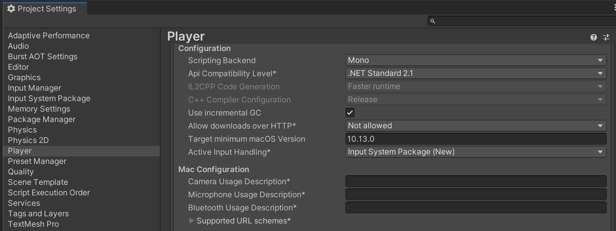
Mobile UI Best Practices
Implementing an on-screen joystick with Input System
Import Input System package.
And set Player “Active Input Handling” config to “Input System Package (new)”.
4: Doran John P., Unity 2022 mobile game development, 2023
Notes:
https://docs.unity3d.com/Manual/UIToolkits.html
https://docs.unity3d.com/Manual/UI-system-compare.html

Slide 24
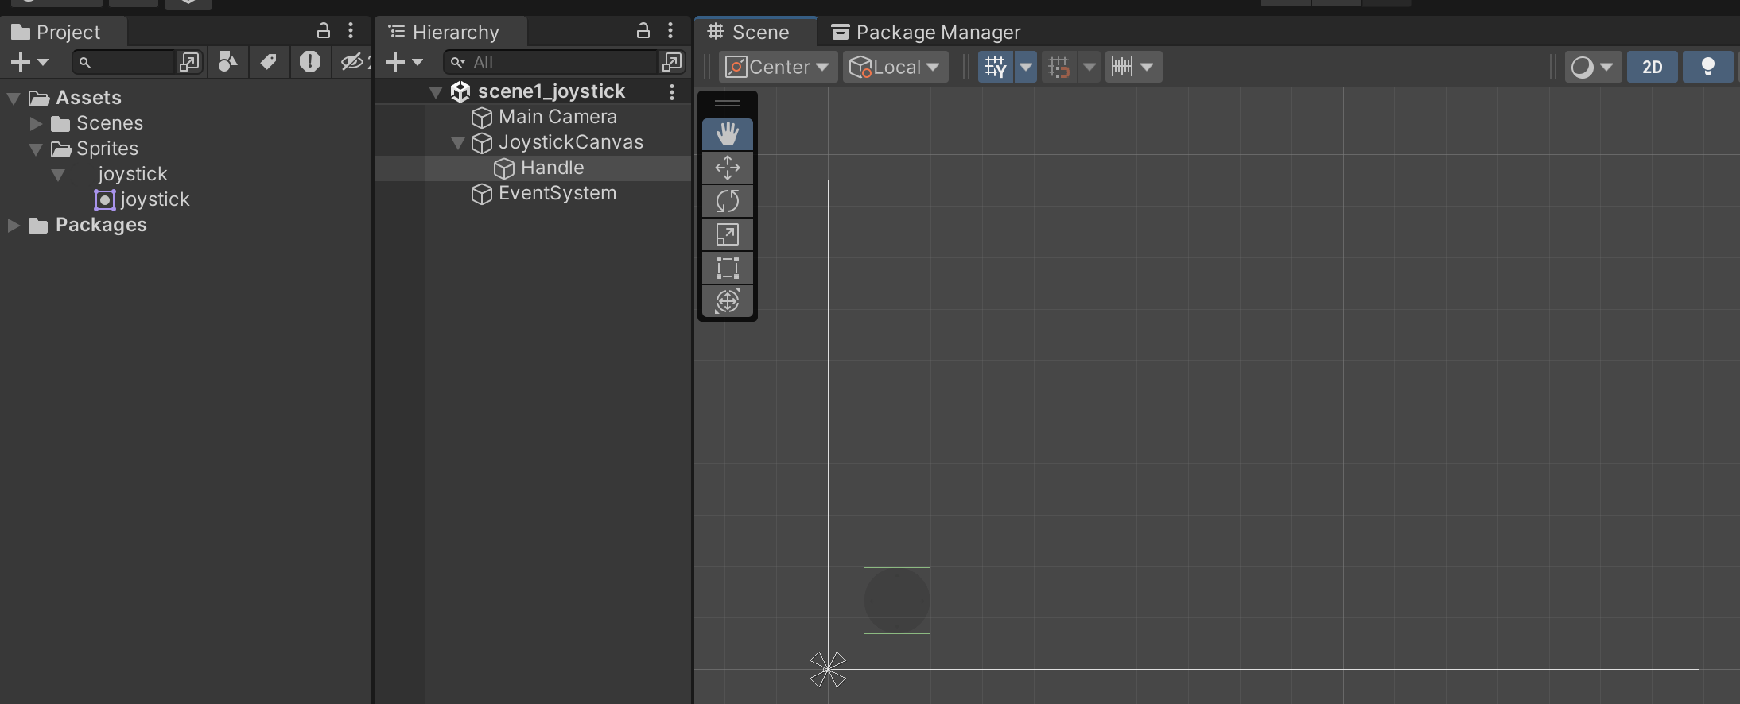
Mobile UI Best Practices
Implementing an on-screen joystick with Input System
Create the UI for joystick
Add a canvas.
In canvas, and an UI > Image game Object and set joystick image for this object. Set name is ‘Handle’

Slide 25
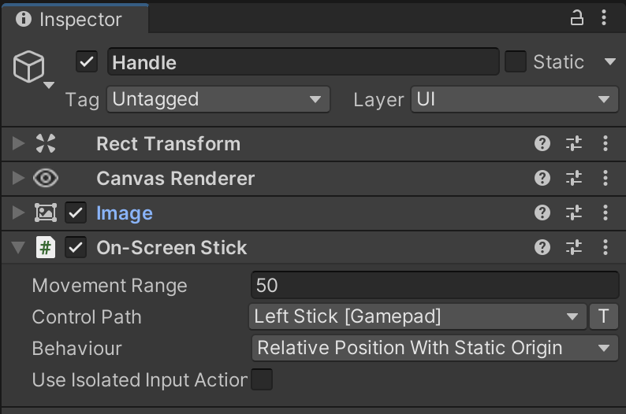
Mobile UI Best Practices
Implementing an on-screen joystick with Input System
Add On-Screen Stick component
Select Handle GameObject, click add component and select “On-Screen Stick”.
Set param: Movement Range = 50; Path = LeftStick [Gamepad].

Slide 26
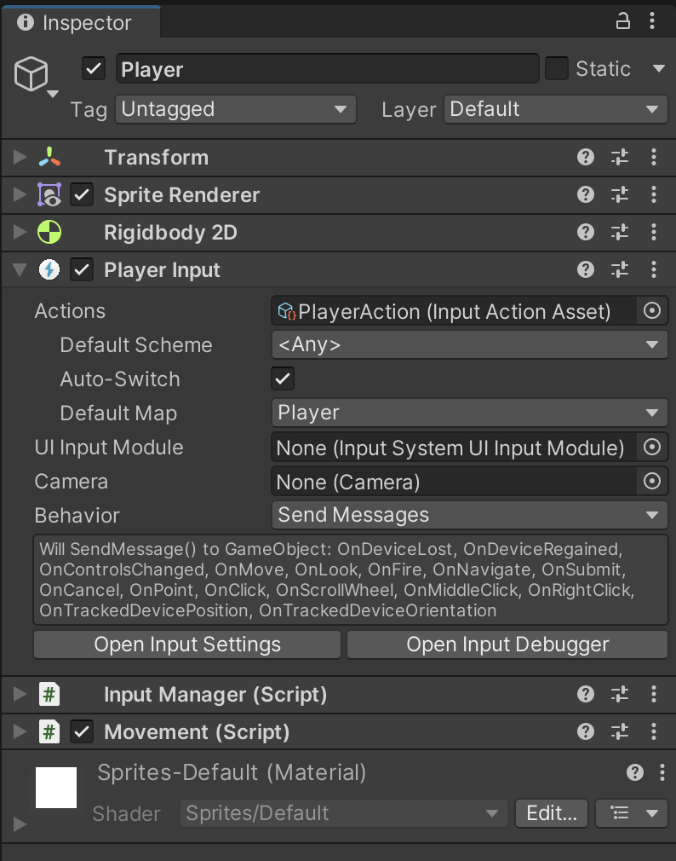
Mobile UI Best Practices
Implementing an on-screen joystick with Input System
Add Player and its component
Add 2D Object > Sprites > Triangle GameObject. Set its name to Player.
Add Rigidbody 2D component to Player.
Select Player, add “Player Input” component (NOT player input manager).

Slide 27
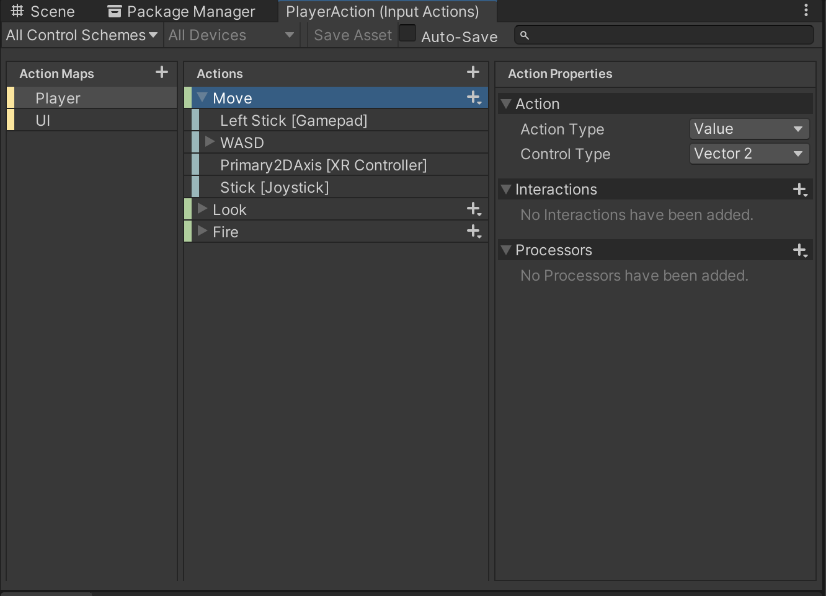
Mobile UI Best Practices
Implementing an on-screen joystick with Input System
Add Input Actions for Player Input component
Select Player, in Player Input component, click Create Actions. Set name is PlayerAction and save to Scenes / InputSystem folder.
Double click on PlayerAction Object to open Input Actions window. Set value for Move action.
Action Type: Value
Control Type: Vector 2

Slide 28
Mobile UI Best Practices
Implementing an on-screen joystick with Input System
Add the InputManager.cs and Movement.cs C# scripts and attach them to Player.
Add 2D Object > Sprites > Triangle GameObject. Set its name to Player.
Select Player, add “Player Input” component (NOT player input manager).
using UnityEngine;
using UnityEngine.InputSystem;
public class InputManager : MonoBehaviour
{
public Vector2 MoveInput;
public void OnMove(InputValue input) => MoveInput = input.Get<Vector2>();
}

Slide 29
void Update()
{
moveDir = inputs.MoveInput.normalized;
isMoving = Convert.ToBoolean(moveDir.magnitude);
Rotate();
}
void FixedUpdate()
{
if (rb != null)
{
rb.MovePosition(rb.position + moveDir * Speed * Time.fixedDeltaTime);
}
}
void Rotate()
{
if (isMoving)
{
float angle = Mathf.Atan2(moveDir.y, moveDir.x) * Mathf.Rad2Deg - 90f;
transform.rotation = Quaternion.Euler(0, 0, angle);
}
}
}
Update Movement.cs script
using System;
using UnityEngine;
public class Movement : MonoBehaviour
{
private InputManager inputs;
private Rigidbody2D rb;
public float Speed;
Vector2 moveDir;
bool isMoving;
void Awake()
{
inputs = GetComponent<InputManager>();
rb = GetComponent<Rigidbody2D>();
}

Slide 30
Conclusion and Next Steps
Unity Input Systems:
Essential for user interaction, enabling control through devices, touch, or gestures.
Replaces the legacy Input Manager with a modern, extensible solution for better flexibility.
Input Manager vs. Input System:
Legacy Input Manager may have limitations, whereas the Input System offers enhanced support, flexibility, and scalability.
Particularly advantageous for modern projects requiring advanced input handling.
Unity Input System Concepts:
Fundamental concepts, actions, and methods efficiently managed for user input.
Demonstrated through practical setups and scripting examples.

Slide 31
Conclusion and Next Steps
Touch Input in Unity:
Unity provides a comprehensive approach to touch input using methods like Input System, Input.GetTouch, Event System, and specialized modules.
Flexibility allows developers to choose methods based on project requirements.
Multi-Touch Handling:
Unity simplifies the management of multiple simultaneous touch inputs through methods like Input System, Input.touches array, and specialized modules.
Offers adaptability for different multi-touch scenarios.

