Slide 1

Designing Interactive UI Systems

Slide 2
Learning Objectives
Understand the role of interactive UI in enhancing user experience.
Learn how to design and implement responsive UI systems.
Gain hands-on experience in creating interactive UI elements.
Notes:
Online tutorial for this lesson:
https://www.youtube.com/watch?v=b0O2CRSdiOA&list=PLX2vGYjWbI0S-LEFR59E2B347w2HbjiJv
https://docs.unity3d.com/Manual/AnimationOverview.html

Slide 3
Principles of Interactive UI Design
The "Principles of Interactive UI Design" encompass fundamental guidelines for creating user interfaces that prioritize positive and efficient user interactions. These principles shape the design process to ensure usability, consistency, immediate feedback, efficiency, learnability, flexibility, guidance, and engagement. By adhering to these principles, designers aim to deliver interfaces that are intuitive, seamless, and enjoyable for users, enhancing overall user experience and satisfaction.
Notes:
• Brief recap of fundamental animation scripting concepts covered in previous sessions.
• Reminder of the importance of scripting for dynamic and controlled movement.

Slide 4
Principles of Interactive UI Design
Usability:
Usability focuses on creating interfaces that are user-friendly and easy to navigate, ensuring a seamless and efficient user experience.
Consistency:
Consistency involves maintaining uniformity in design elements and interactions across an interface, promoting predictability and ease of use.
Immediate Feedback:
Immediate feedback provides users with instant responses to their actions, enhancing user confidence and clarity about the outcomes of their interactions.
Efficiency:
Efficiency aims to optimize the interface, reducing the time and effort users need to accomplish tasks and improving overall workflow.

Slide 5
Principles of Interactive UI Design
Learnability:
Learnability emphasizes designing interfaces that are easy for users to understand and use without extensive training, facilitating a quick and intuitive learning curve.
Flexibility:
Flexibility allows interfaces to adapt to different user needs and situations, accommodating a variety of preferences and usage scenarios.
Guidance:
Guidance involves providing clear instructions, cues, or assistance within the interface to help users navigate and understand complex features or processes.
Engagement:
Engagement focuses on creating interfaces that captivate users, encouraging active participation and interaction to enhance overall user satisfaction and enjoyment.

Slide 6
Unity UI Components Recap
Unity UI Components are essential elements that empower developers to create interactive and visually appealing user interfaces in Unity game development. These components offer a range of tools to design and customize UI elements seamlessly. Key Unity UI Components include:
Canvas:
The Canvas is a fundamental component that serves as the container for all UI elements. It provides a space where UI elements are rendered and positioned.
Text:
The Text component allows the display of textual information in various fonts and styles. It is commonly used for labels, titles, and other text-based content.
Image:
The Image component enables the display of 2D images and sprites. It is commonly used for icons, buttons, and other graphical elements.
Button:
The Button component facilitates user interaction by responding to clicks or taps. It is often used to create interactive elements like menus or in-game buttons.

Slide 7
Unity UI Components Recap
Slider:
The Slider component provides a draggable handle along a bar, allowing users to select a value within a specified range. It is useful for settings or volume controls.
Input Field:
The Input Field component allows users to input text or numeric values. It is commonly used for forms, search bars, or other text entry purposes.
Toggle:
The Toggle component represents a binary switch that users can toggle on or off. It is useful for options, settings, or checkboxes.
Dropdown:
The Dropdown component provides a list of selectable options in a dropdown menu. It is used for presenting a set of choices to the user.
These components, among others, form the building blocks for creating dynamic and responsive user interfaces in Unity, contributing to a polished and immersive gaming experience.

Slide 8
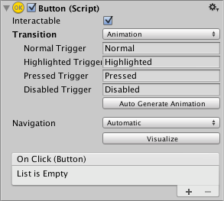
UI Animation and Feedback
Unity UI Animation refers to the dynamic movement, transition, and transformation of Unity UI components to enhance the visual appeal and interactivity of user interfaces. By incorporating animations, developers can create engaging and immersive user experiences.
Animation allows for each transition between control states to be fully animated using Unity's animation system. This is the most powerful of the transition modes due to the number of properties that can be animated simultaneously.
8: Unity Technologies, Unity Manual, 2023
Notes:
https://docs.unity3d.com/Packages/com.unity.ugui@2.0/manual/UIAnimationIntegration.html

Slide 9
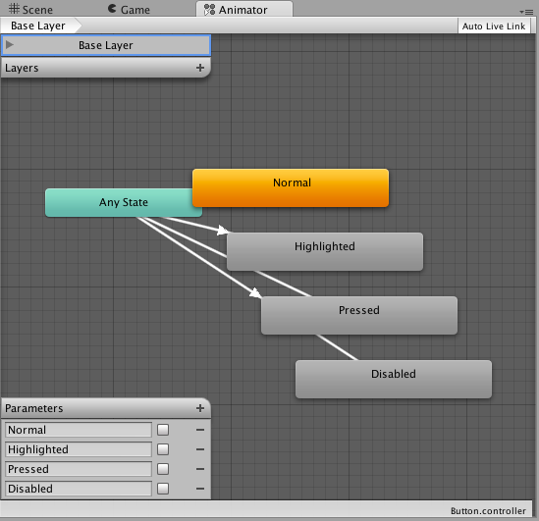
UI Animation and Feedback
To use the Animation transition mode, an Animator Component needs to be attached to the controller element. This can be done automatically by clicking "Auto Generate Animation". This also generates an Animator Controller with states already set up, which will need to be saved.
8: Unity Technologies, Unity Manual, 2023
Notes:
https://www.youtube.com/watch?v=oMbEe0DBQnQ

Slide 10
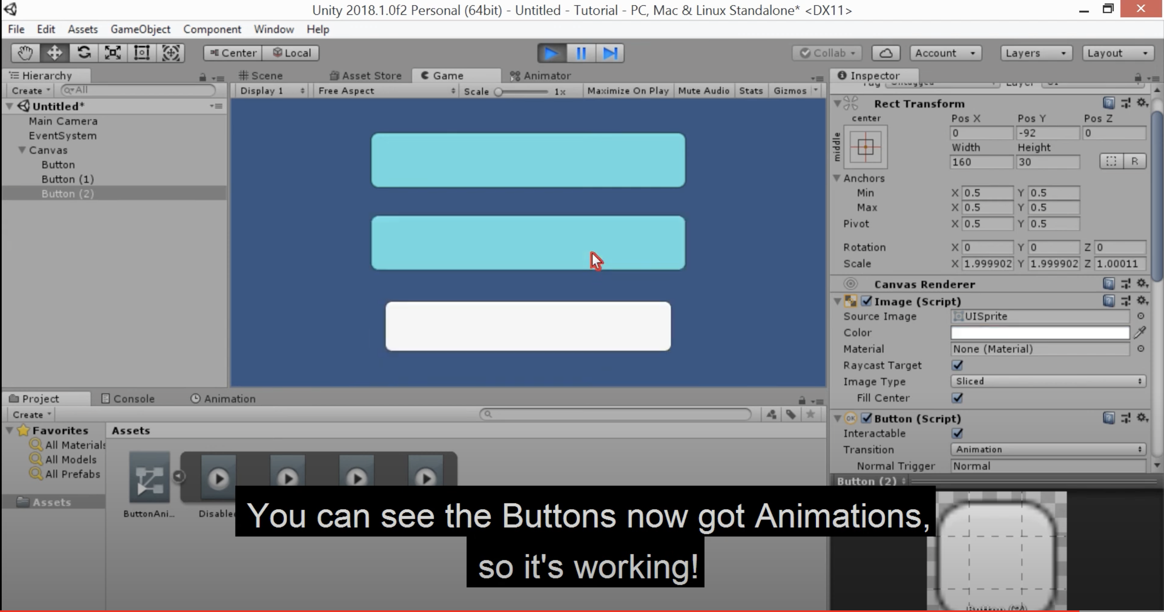
UI Animation – An example
Source: https://www.youtube.com/watch?v=oMbEe0DBQnQ

Slide 11
Responsive Layouts
Unity provides various methods and tools to create responsive UIs and flexible layouts for different devices and screen sizes. Here are some key methods and tools that Unity utilizes to achieve this:
Canvas Scaler:
Canvas Scaler is a component of the Canvas that automatically adjusts the size of the UI to fit the screen resolution. Options like Constant Pixel Size, Scale With Screen Size, and Constant Physical Size offer control over adapting to different screen sizes.
Layout Groups:
Layout Groups, such as Vertical Layout Group and Horizontal Layout Group, automatically arrange and resize child elements within a UI element. Elements adapt to fit the size of the parent.

Slide 12
Responsive Layouts
Flexible UI Components:
Use UI components like RectTransform and UI Layout Element to create elements that can stretch and adapt to available space.
Aspect Ratio Fitter:
Aspect Ratio Fitter is a component that ensures the frame ratio of a UI element remains constant as the screen size changes, preventing distortion.
Anchors and Pivot Points:
Utilize Anchors to determine a fixed position for an element on the Canvas. Pivot Points determine the rotation point of an element when resizing.

Slide 13
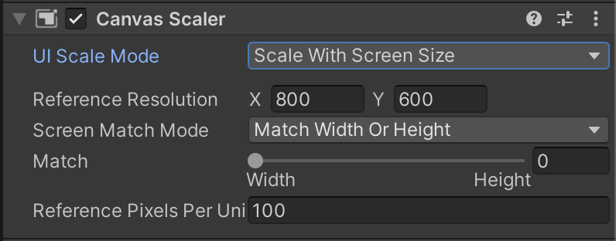
Responsive Layouts
Canvas Scaler
The Canvas Scaler component is used for controlling the overall scale and pixel density of UI elements in the Canvas. This scaling affects everything under the Canvas, including font sizes and image borders.
In the Canvas Scaler component, you can set its UI Scale Mode to Scale With Screen Size.
With this scale mode you can specify a resolution to use as reference. If the current screen resolution is smaller or larger than this reference resolution, the scale factor of the Canvas is set accordingly, so all the UI elements are scaled up or down together with the screen resolution.
Notes:
https://docs.unity3d.com/Packages/com.unity.ugui@2.0/manual/script-CanvasScaler.html

Slide 14
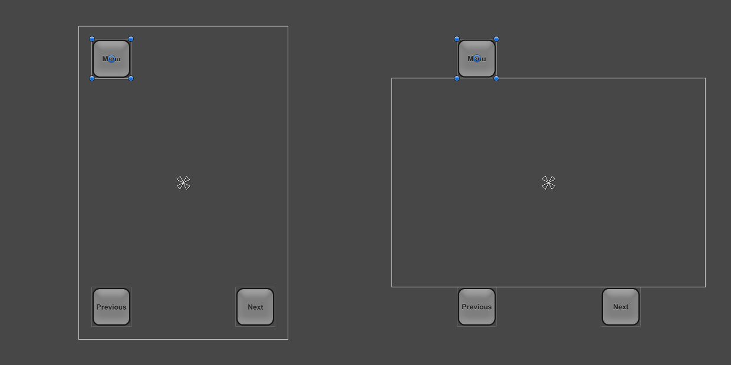
Responsive Layouts
Using anchors to adapt to different aspect ratios
UI elements are by default anchored to the center of the parent rectangle. This means that they keep a constant offset from the center.
If the resolution is changed to a landscape aspect ratio with this setup, the buttons may not even be inside the rectangle of the screen anymore.
Notes:
https://docs.unity3d.com/Packages/com.unity.ugui@2.0/manual/script-CanvasScaler.html

Slide 15
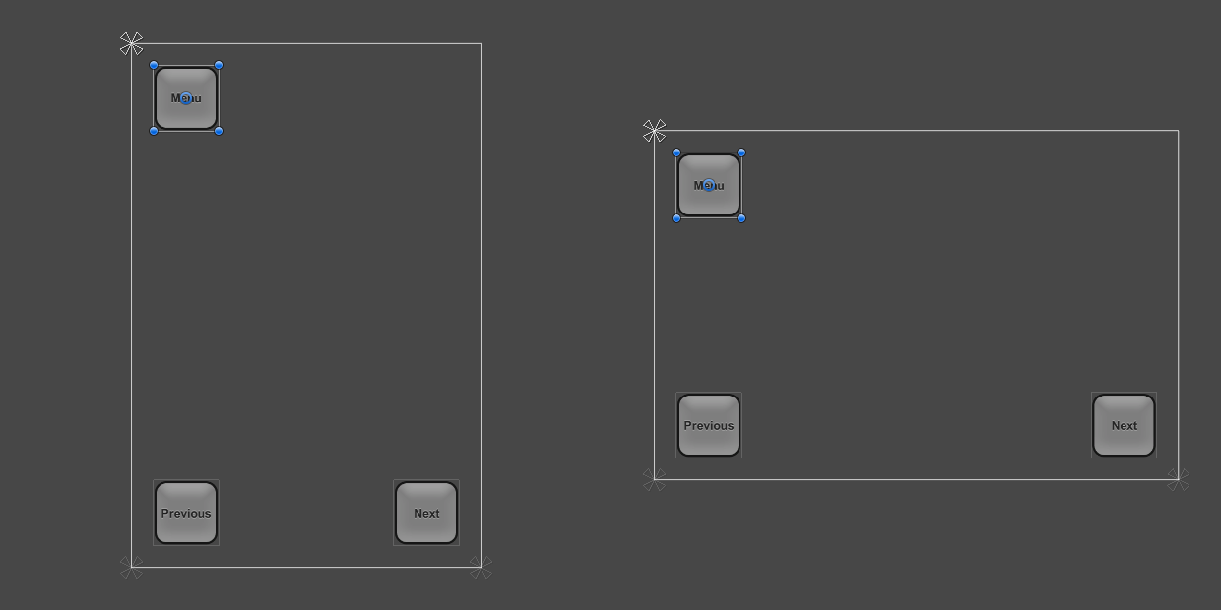
Responsive Layouts
Using anchors to adapt to different aspect ratios
One way to keep the buttons inside the screen is to change the layout such that the locations of the buttons are tied to their respective corners of the screen. The anchors of the top left button can be set to the upper left corner using the Anchors Preset drop down in the Inspector, or by dragging the triangular anchor handles in the Scene View.
Notes:
https://docs.unity3d.com/Packages/com.unity.ugui@2.0/manual/script-CanvasScaler.html

Slide 16
Contextual UI
Contextual User Interface, refers to a design approach in Unity where the user interface elements dynamically change based on the context or state of the application. This means that the displayed UI elements are tailored to the specific situation, providing users with relevant and actionable information.
Key Features:
Dynamic Adaptation:
Contextual UI adapts in real-time to the changing conditions of the application. It ensures that users are presented with only the information and controls that are pertinent to their current activities.
Relevance to User Actions:
UI elements are designed to align with the user's actions or interactions within the application. This ensures that users see options that are directly related to what they are doing at any given moment.

Slide 17
Contextual UI
Situational Awareness:
Contextual UI enhances situational awareness by providing users with visual cues and information that are context-specific. This helps users understand the current state of the application and make informed decisions.
Efficient Interaction:
By showing only relevant UI elements, Contextual UI reduces clutter and streamlines the user experience. Users can interact more efficiently without unnecessary distractions.
Adaptive Content Presentation:
Content presentation, such as menus, buttons, or information displays, adapts dynamically based on the user's location, progress, or the specific phase of the application.

Slide 18
Contextual UI in Unity
Implementation in Unity:
State-Based UI Management:
Use state machines or state-based systems to manage different contexts in your Unity application. Switch UI configurations based on the current state.
Event-Driven UI Updates:
Utilize Unity's event system to trigger UI updates in response to specific events or interactions, ensuring that UI elements reflect the ongoing actions of the user.
Scripting and Animation:
Employ C# scripts to dynamically modify UI elements based on runtime conditions. Animation and transitions can be used to create smooth changes between different UI contexts.
Data Binding:
Implement data binding techniques to connect UI elements directly to underlying data sources. This allows UI to update automatically as the data changes.

Slide 19
Mobile Notifications
The Unity Mobile Notifications package adds support for scheduling local one-time or repeatable notifications on Android and iOS.
Notification functionality works differently on Android and iOS platforms. The mobile notifications package provides features in three sets of APIs for your convenience.
Android specific APIs in Unity.Notifications.Android namespace.
iOS specific APIs in Unity.Notifications.iOS namespace.
Unified APIs that provide Android and iOS specific common functionalities in Unity.Notifications namespace.
For more information: https://docs.unity3d.com/Packages/com.unity.mobile.notifications@2.3/manual/index.html

Slide 20
Conclusion and Next Steps
Understand the role of interactive UI in enhancing user experience.
Learn how to design and implement responsive UI systems.
Gain hands-on experience in creating interactive UI elements.

