Slide 1
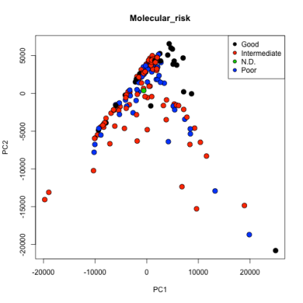
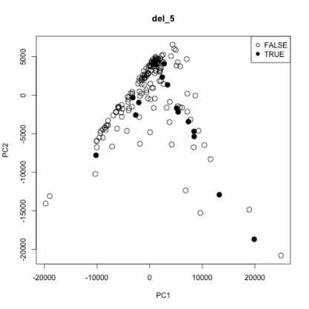
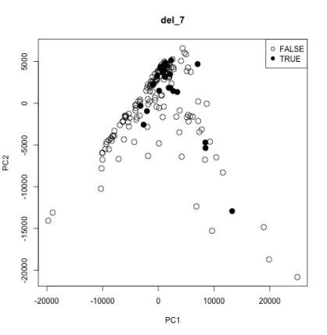
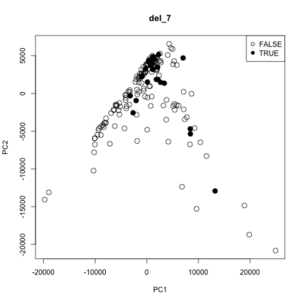
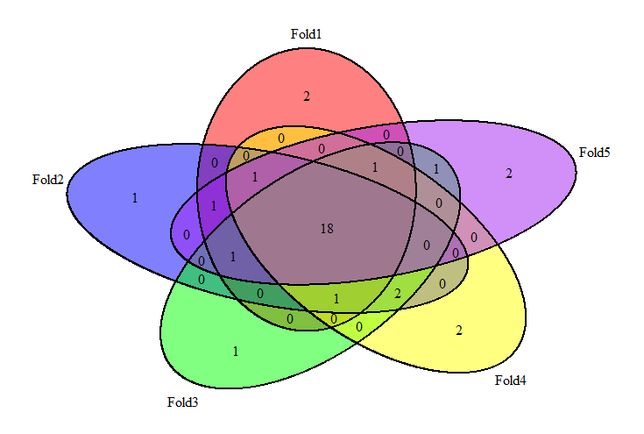
Unsupervised feature selection
PCA
PCA + SVM
 | Support vector machine
 | Basic PCA |  | Kernelized PCA
 | Sens. | Spec. | Sens. | Spec.
Poor | 0.45 | 0.84 | 0.31 | 0.80
Intermediate | 0.70 | 0.66 | 0.60 | 0.67
Good | 0.64 | 0.96 | 0.58 | 0.91
Trisomy_8 | 0.26 | 0.91 | 0.11 | 0.92
Del_5 | 0.44 | 0.94 | 0.13 | 0.94
Del_7 | 0.44 | 0.94 | 0.26 | 0.91
Supervised feature selection
 | Random forest |  |  |  | Support vector machine
 | Linear model |  | Correlation |  | Linear model |  | Correlation
 | Sens. | Spec. | Sens. | Spec. | Sens. | Spec. | Sens. | Spec.
Poor | 0.52 | 0.94 | 0.38 | 0.96 | 0.55 | 0.96 | 0.45 | 0.94
Intermediate | 0.90 | 0.81 | 0.90 | 0.61 | 0.87 | 0.87
Good | 0.99 | 0.85 | 0.99 | 0.85 | 0.99 | 0.94
Trisomy_8 | 0.68 | 0.99 | 0.68 | 0.99 | 0.68 | 0.97 | 0.58 | 0.99
Del_5 | 0.81 | 0.99 | 0.44 | 0.99 | 0.63 | 0.99 | 0.19 | 0.99
Del_7 | 0.71 | 0.98 | 0.71 | 0.98 | 0.71 | 0.99 | 0.67 | 0.98

