Slide 1
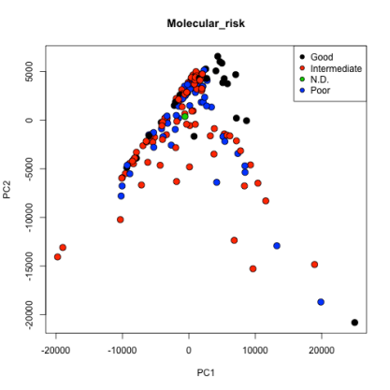
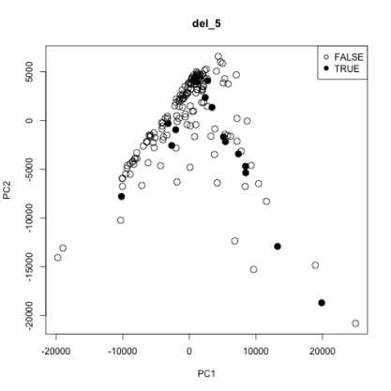
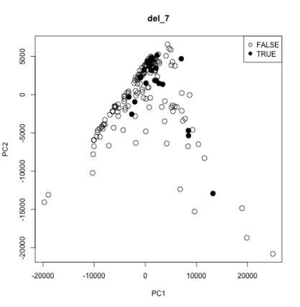
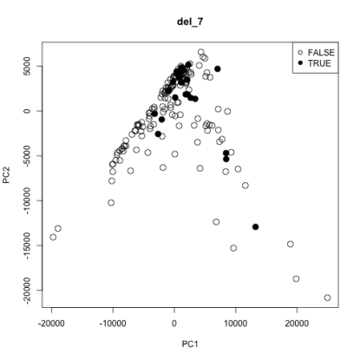
Unsupervised feature selection
PCA
PCA + SVM
 | Support vector machine
 | Basic PCA |  | Kernelized PCA
 | Sens. | Spec. | Sens. | Spec.
Poor | 0.45 | 0.84 | 0.31 | 0.80
Intermediate | 0.70 | 0.66 | 0.60 | 0.67
Good | 0.64 | 0.96 | 0.58 | 0.91
Trisomy_8 | 0.26 | 0.91 | 0.11 | 0.92
Del_5 | 0.44 | 0.94 | 0.13 | 0.94
Del_7 | 0.38 | 0.98 | 0.29 | 0.95
Figure 2. Unsupervised principal components analysis of all data demonstrates that the first two components do not separate samples by cytogenetic risk category. A similar result is shown for the three large-scale copy number alterations (del_5, del_7, trisomy_8).
Table 1. Kernelized SVMs trained using the first 20 principal components as features showed generally poor performance at predicting cytogenetic risk and copy number alterations.
Supervised feature selection
 | Random forest |  |  |  | Support vector machine
 | Linear model |  | Correlation |  | Linear model |  | Correlation
 | Sens. | Spec. | Sens. | Spec. | Sens. | Spec. | Sens. | Spec.
Poor | 0.57 | 0.94 | 0.38 | 0.96 | 0.55 | 0.96 | 0.45 | 0.94
Intermediate | 0.90 | 0.81 | 0.90 | 0.61 | 0.87 | 0.87 | 0.85 | 0.69
Good | 0.99 | 0.85 | 0.99 | 0.85 | 0.99 | 0.94 | 0.99 | 0.82
Trisomy_8 | 0.68 | 0.99 | 0.68 | 0.99 | 0.68 | 0.97 | 0.58 | 0.99
Del_5 | 0.81 | 0.99 | 0.44 | 0.99 | 0.63 | 0.99 | 0.19 | 0.99
Del_7 | 0.71 | 0.98 | 0.71 | 0.98 | 0.71 | 0.99 | 0.67 | 0.98
Table 2. Random forests and SVMs were trained using two different supervised feature selection methods: 1) Taking the top 25 differentially expressed genes using voom+limma; 2) Taking the 25 genes whose expression are most correlated with the outcomes. The random forests slightly outperformed the SVMs, and the most sensitive classifiers were those trained to predict the “Good” cytogenetic risk class. The random forest classifiers for CNA events also showed good performance.
Figure 3. A 5-fold cross validation was performed for the classifier to predict the del_5 CNA using the 25 most differentially expressed genes (voom+limma). Of the 25 genes selected in each fold, 12 were common to all 5.

