Slide 1

Deep Learning Crash Course
Notes for derivative of CE loss
Hui Xue
Fall 2021
www.deeplearningcrashcourse.org

Slide 2
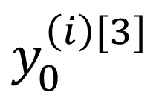
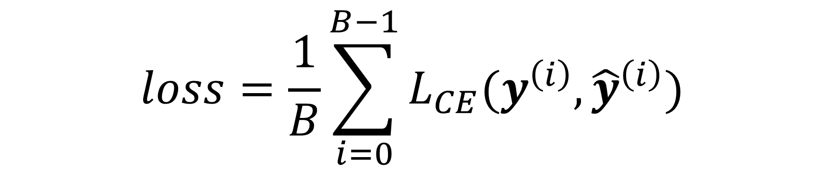
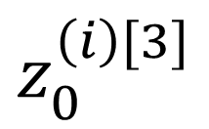
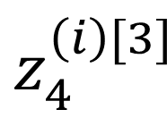
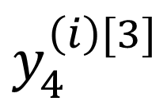
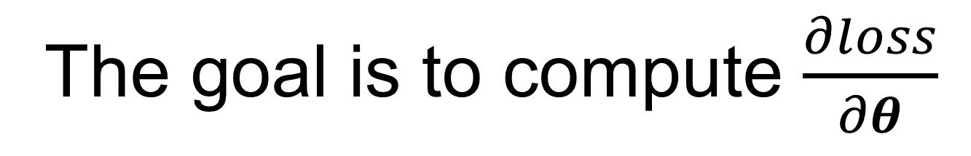


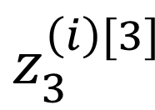
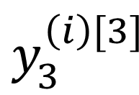
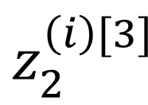
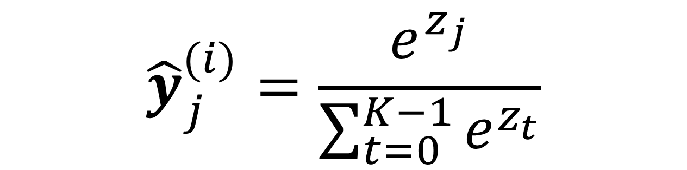
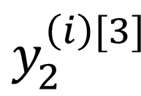
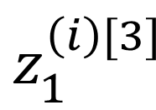
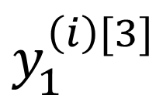
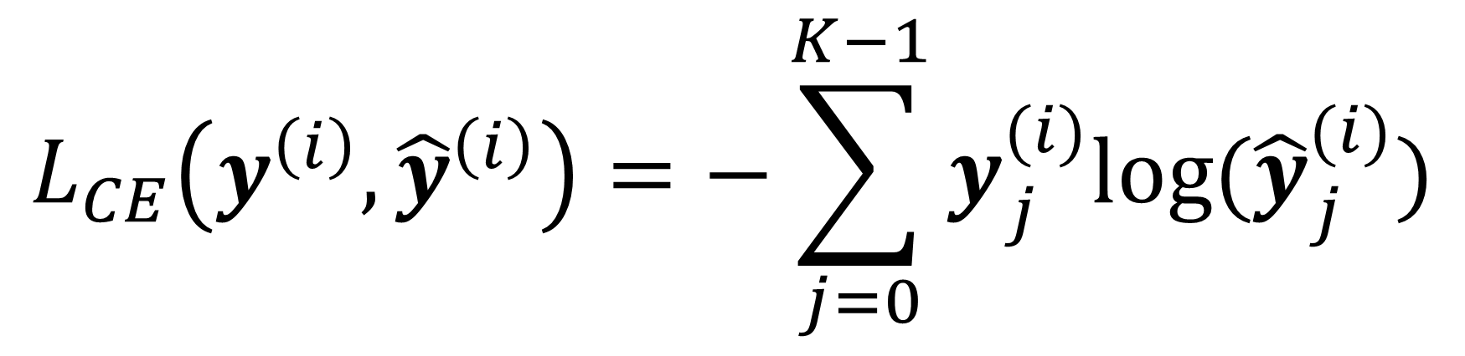
CE-Loss
K=5, 5 class classification
$$loss=\frac{1}{B}\sum_{i=0}^{B−1}{L_{CE}(y^{\left(i\right)},{\hat{y}}^{\left(i\right)})}$$
softmax
W₀^{[3]}
$$z_{0}^{\left(i\right)[3]}$$
$$y_{0}^{\left(i\right)[3]}$$
$${\hat{y}}^{\left(i\right)}=\hat{y}(X^{\left(i\right)}; θ)$$
W₁^{[3]}
$$z_{1}^{\left(i\right)[3]}$$
$$y_{1}^{\left(i\right)[3]}$$
$$L_{CE}\left(y^{\left(i\right)},{\hat{y}}^{\left(i\right)}\right)=−\sum_{j=0}^{K−1}{y_{j}^{(i)}log⁡({\hat{y}}_{j}^{(i)})}$$
W₀^{[1]}
f
W₀^{[2]}
f
$$y_{2}^{\left(i\right)[3]}$$
W₂^{[3]}
$$z_{2}^{\left(i\right)[3]}$$
$$X^{(i)}$$
W₁^{[1]}
f
W₁^{[2]}
f
$$z_{3}^{\left(i\right)[3]}$$
$$y_{3}^{\left(i\right)[3]}$$
$${\hat{y}}_{j}^{(i)}=\frac{e^{z_{j}}}{\sum_{t=0}^{K−1}{e^{z_{t}}}}$$
W₃^{[3]}
W₂^{[1]}
f
W₄^{[3]}
$$z_{4}^{\left(i\right)[3]}$$
$$y_{4}^{\left(i\right)[3]}$$
The goal is to compute $\frac{∂loss}{∂θ}$

Slide 3
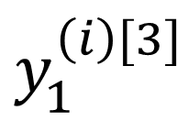
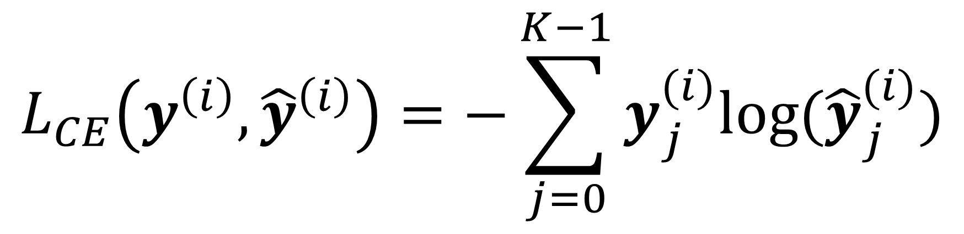
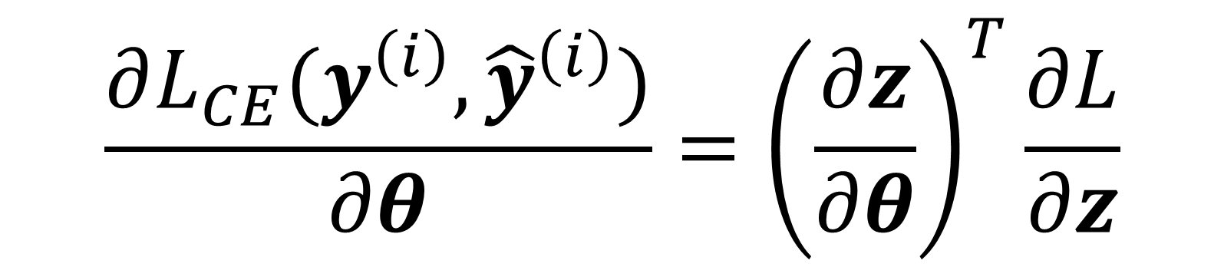
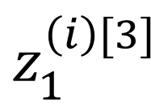
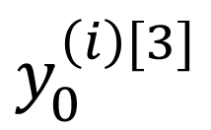
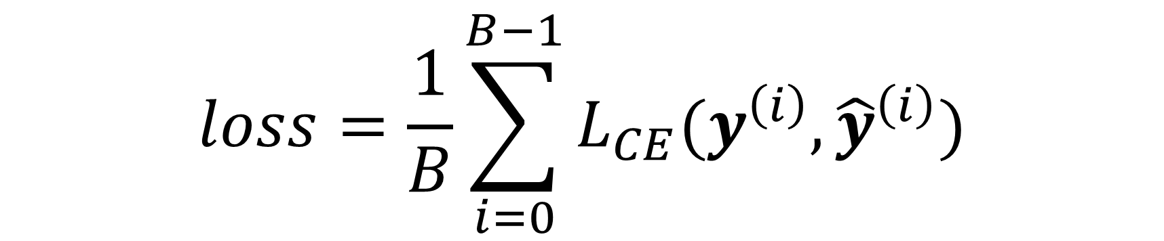
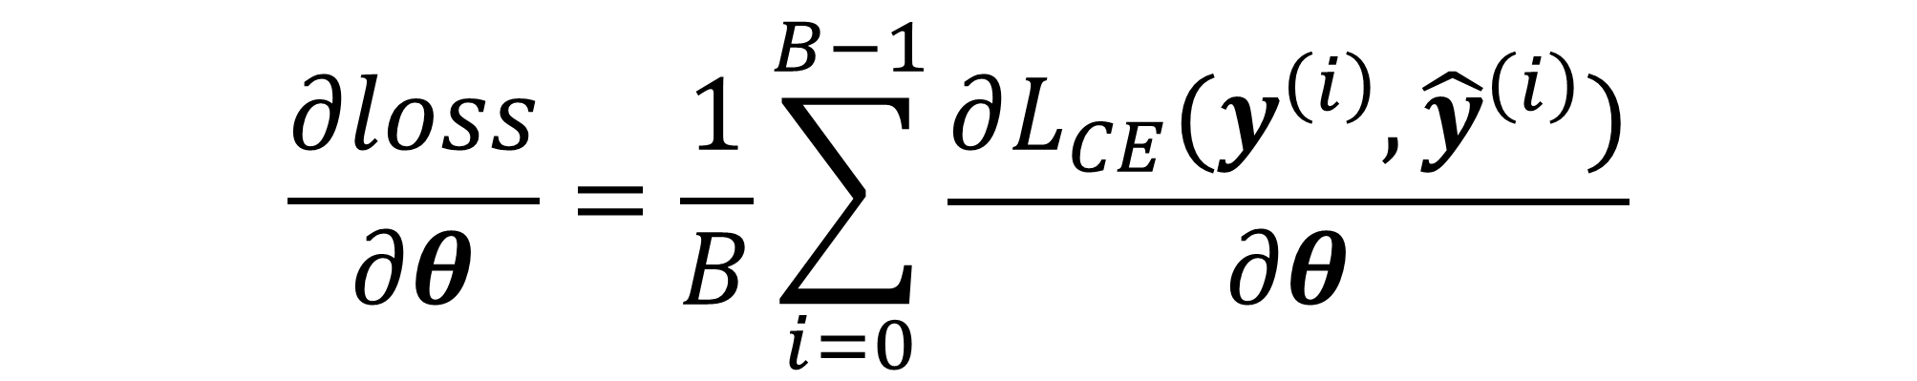
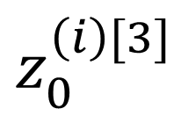
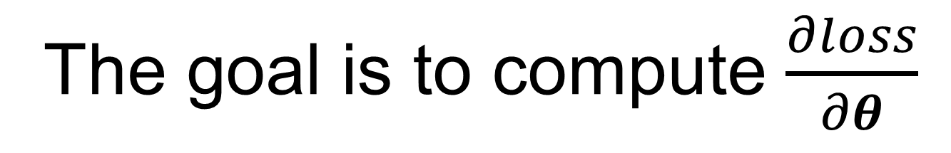
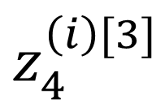
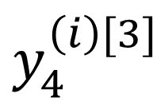
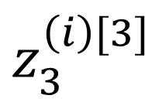

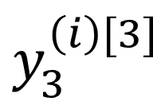
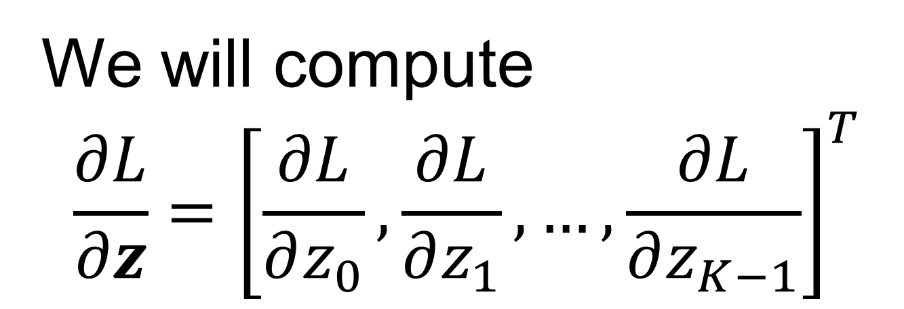
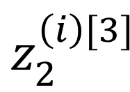
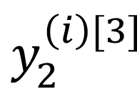
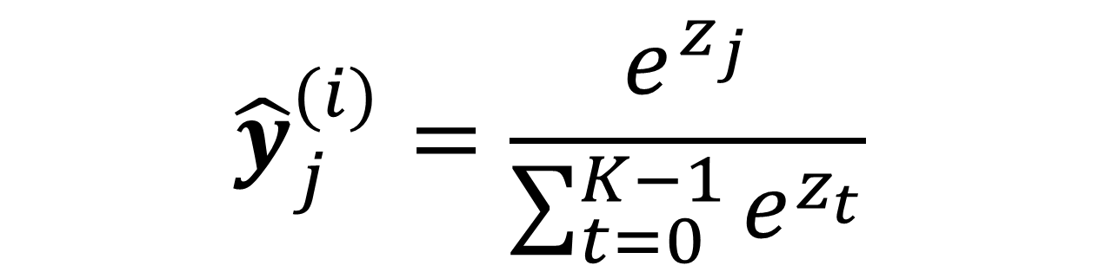
CE-Loss
K=5, 5 class classification
$$loss=\frac{1}{B}\sum_{i=0}^{B−1}{L_{CE}(y^{\left(i\right)},{\hat{y}}^{\left(i\right)})}$$
$$\frac{∂loss}{∂θ}=\frac{1}{B}\sum_{i=0}^{B−1}{\frac{∂L_{CE}(y^{\left(i\right)},{\hat{y}}^{\left(i\right)})}{∂θ}}$$
softmax
$$z_{0}^{\left(i\right)[3]}$$
$$y_{0}^{\left(i\right)[3]}$$
$${\hat{y}}^{\left(i\right)}=\hat{y}(X^{\left(i\right)}; θ)$$
$$z_{1}^{\left(i\right)[3]}$$
$$y_{1}^{\left(i\right)[3]}$$
$$L_{CE}\left(y^{\left(i\right)},{\hat{y}}^{\left(i\right)}\right)=−\sum_{j=0}^{K−1}{y_{j}^{(i)}log⁡({\hat{y}}_{j}^{(i)})}$$
$$\frac{∂L_{CE}(y^{\left(i\right)},{\hat{y}}^{\left(i\right)})}{∂θ}={\left(\frac{∂z}{∂θ}\right)}^{T}\frac{∂L}{∂z}$$
… …
$$z_{2}^{\left(i\right)[3]}$$
$$y_{2}^{\left(i\right)[3]}$$
$$y_{3}^{\left(i\right)[3]}$$
$${\hat{y}}_{j}^{(i)}=\frac{e^{z_{j}}}{\sum_{t=0}^{K−1}{e^{z_{t}}}}$$
$$z_{3}^{\left(i\right)[3]}$$
We will compute
$$\frac{∂L}{∂z}={\left[\frac{∂L}{∂z_{0}},\frac{∂L}{∂z_{1}},…,\frac{∂L}{∂z_{K−1}}\right]}^{T}$$
$$z_{4}^{\left(i\right)[3]}$$
$$y_{4}^{\left(i\right)[3]}$$
The goal is to compute $\frac{∂loss}{∂θ}$

Slide 4
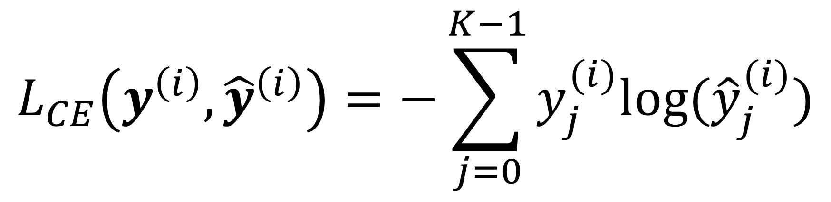
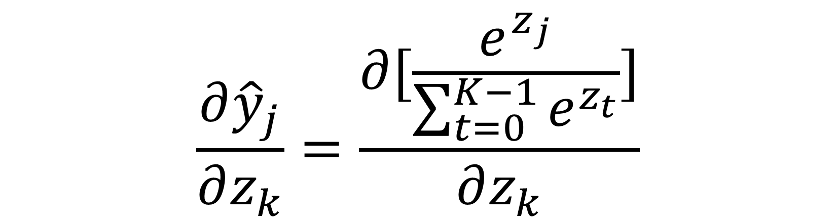
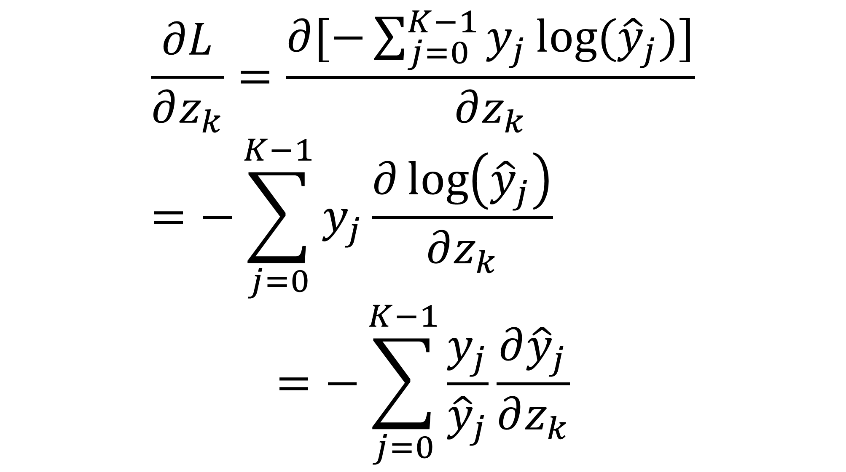
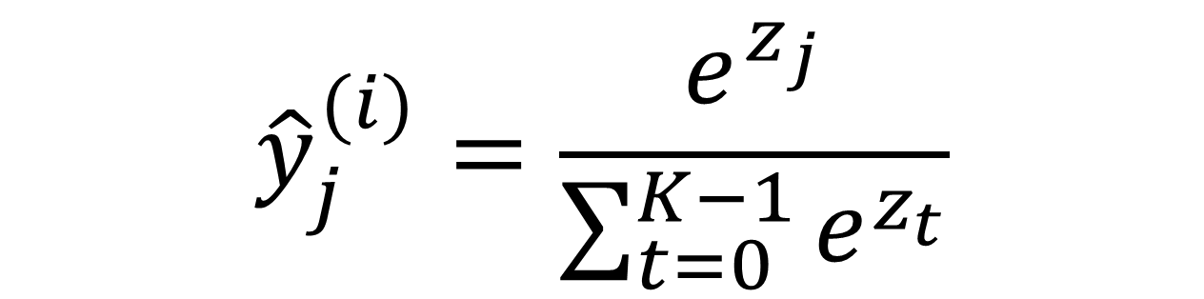
CE-Loss
K=5, 5 class classification
$$loss=\frac{1}{B}\sum_{i=0}^{B−1}{L_{CE}(y^{\left(i\right)},{\hat{y}}^{\left(i\right)})}$$
$$\frac{∂L}{∂z_{k}}=\frac{∂[−\sum_{j=0}^{K−1}{y_{j}\log{({\hat{y}}_{j})}}]}{∂z_{k}}=−\sum_{j=0}^{K−1}{y_{j}\frac{∂\log\left({\hat{y}}_{j}\right)}{∂z_{k}}}$$
$$=−\sum_{j=0}^{K−1}{\frac{y_{j}}{{\hat{y}}_{j}}\frac{∂{\hat{y}}_{j}}{∂z_{k}}}$$
softmax
$$z_{0}^{\left(i\right)[3]}$$
$$y_{0}^{\left(i\right)[3]}$$
$${\hat{y}}^{\left(i\right)}=\hat{y}(X^{\left(i\right)}; θ)$$
$$z_{1}^{\left(i\right)[3]}$$
$$y_{1}^{\left(i\right)[3]}$$
$$L_{CE}\left(y^{\left(i\right)},{\hat{y}}^{\left(i\right)}\right)=−\sum_{j=0}^{K−1}{y_{j}^{(i)}log⁡({\hat{y}}_{j}^{(i)})}$$
… …
$$z_{2}^{\left(i\right)[3]}$$
$$y_{2}^{\left(i\right)[3]}$$
$$y_{3}^{\left(i\right)[3]}$$
$${\hat{y}}_{j}^{(i)}=\frac{e^{z_{j}}}{\sum_{t=0}^{K−1}{e^{z_{t}}}}$$
$$\frac{∂{\hat{y}}_{j}}{∂z_{k}}=\frac{∂[\frac{e^{z_{j}}}{\sum_{t=0}^{K−1}{e^{z_{t}}}}]}{∂z_{k}}$$
$$z_{3}^{\left(i\right)[3]}$$
$$z_{4}^{\left(i\right)[3]}$$
$$y_{4}^{\left(i\right)[3]}$$
The goal is to compute $\frac{∂loss}{∂θ}$

Slide 5

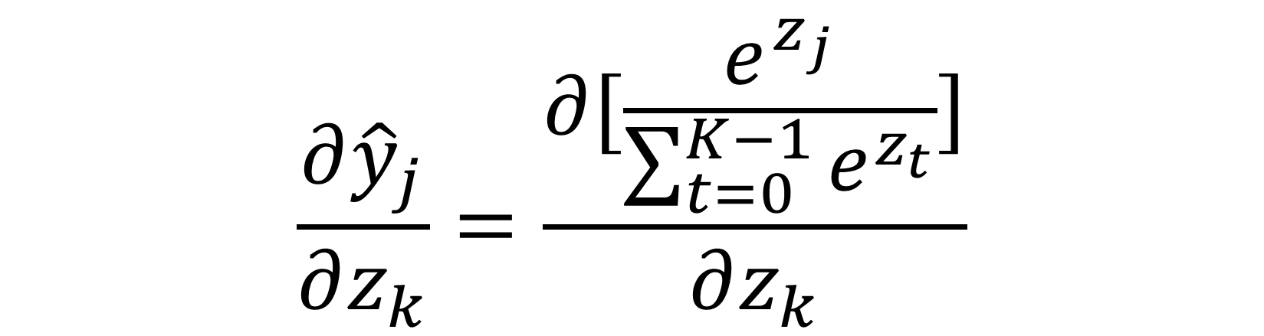

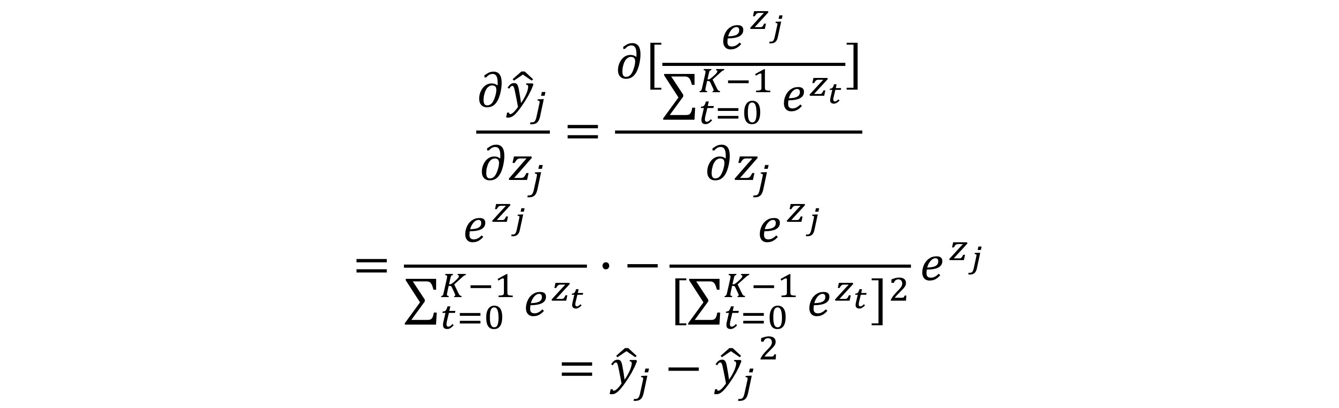

CE-Loss
$$\frac{∂{\hat{y}}_{j}}{∂z_{k}}=\frac{∂[\frac{e^{z_{j}}}{\sum_{t=0}^{K−1}{e^{z_{t}}}}]}{∂z_{k}}$$
If $k=j$
If $k≠j$
$$\frac{∂{\hat{y}}_{j}}{∂z_{j}}=\frac{∂[\frac{e^{z_{j}}}{\sum_{t=0}^{K−1}{e^{z_{t}}}}]}{∂z_{j}}$$
$$=\frac{e^{z_{j}}}{\sum_{t=0}^{K−1}{e^{z_{t}}}}∙−\frac{e^{z_{j}}}{{\left[\sum_{t=0}^{K−1}{e^{z_{t}}}\right]}^{2}}e^{z_{j}}$$
$$={\hat{y}}_{j}−{{\hat{y}}_{j}}^{2}$$
$$\frac{∂{\hat{y}}_{j}}{∂z_{k}}=\frac{∂[\frac{e^{z_{j}}}{\sum_{t=0}^{K−1}{e^{z_{t}}}}]}{∂z_{k}}$$
$$=−\frac{e^{z_{j}}}{{\left[\sum_{t=0}^{K−1}{e^{z_{t}}}\right]}^{2}}e^{z_{k}}$$
$$={−\hat{y}}_{j}{\hat{y}}_{k}$$

Slide 6
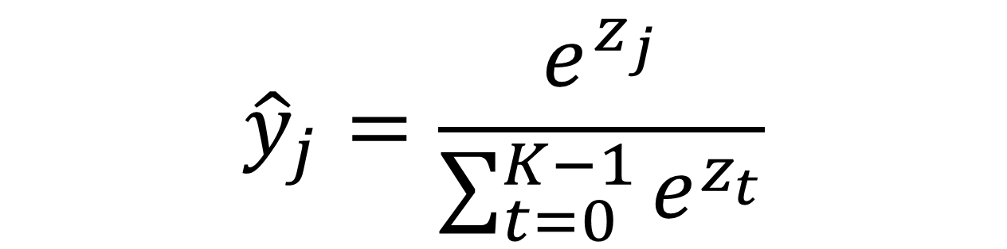

Jacobian
$$\frac{∂\hat{y}}{∂z}=\left[\begin{matrix}\frac{∂{\hat{y}}_{0}}{∂z_{0}} & ⋯ & \frac{∂{\hat{y}}_{0}}{∂z_{k−1}} \\ ⋮ & ⋱ & ⋮ \\ \frac{∂{\hat{y}}_{K−1}}{∂z_{0}} & ⋯ & \frac{∂{\hat{y}}_{K−1}}{∂z_{K−1}}\end{matrix}\right]=\left[\begin{matrix}{\hat{y}}_{0}−{{\hat{y}}_{0}}^{2} & ⋯ & −{\hat{y}}_{0}{\hat{y}}_{K−1} \\ ⋮ & ⋱ & ⋮ \\ −{\hat{y}}_{k−1}{\hat{y}}_{0} & ⋯ & {\hat{y}}_{K−1}−{{\hat{y}}_{K−1}}^{2}\end{matrix}\right]$$
$${\hat{y}}_{j}=\frac{e^{z_{j}}}{\sum_{t=0}^{K−1}{e^{z_{t}}}}$$
A symmetric jacobian

Slide 7


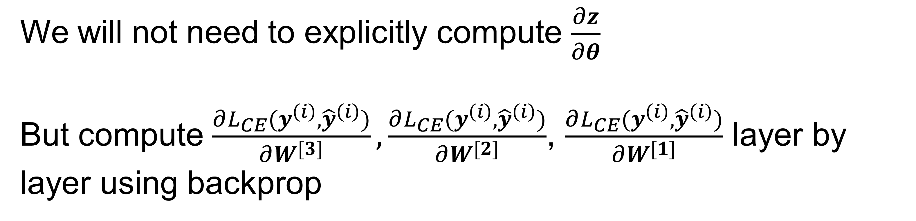

CE-Loss
$$\frac{∂L}{∂z_{k}}=−\sum_{j=0}^{K−1}{\frac{y_{j}}{{\hat{y}}_{j}}\frac{∂{\hat{y}}_{j}}{∂z_{k}}}$$
$$=−\frac{y_{k}}{{\hat{y}}_{k}}\left({\hat{y}}_{k}−{{\hat{y}}_{k}}^{2}\right)−\sum_{j=0,j≠k}^{K−1}{\frac{y_{j}}{{\hat{y}}_{j}}\left(−{\hat{y}}_{j}{\hat{y}}_{k}\right)}$$
$$=−y_{k}\left(1−{\hat{y}}_{k}\right)+\sum_{j=0,j≠k}^{K−1}{y_{j}{\hat{y}}_{k}}$$
$$=−y_{k}{+y}_{k}{\hat{y}}_{k}+\sum_{j=0,j≠k}^{K−1}{y_{j}{\hat{y}}_{k}}$$
$$=−y_{k}+\sum_{j=0}^{K−1}{y_{j}{\hat{y}}_{k}}$$
$$=−y_{k}+{\hat{y}}_{k}\sum_{j=0}^{K−1}{y_{j}}={\hat{y}}_{k}−y_{k}$$
So we get:
$$\frac{∂L}{∂z}={\left[{\hat{y}}_{0}−y_{0},{\hat{y}}_{1}−y_{1},…,{\hat{y}}_{k−1}−y_{k1}\right]}^{T}$$
$$\frac{∂L_{CE}(y^{\left(i\right)},{\hat{y}}^{\left(i\right)})}{∂θ}={\left(\frac{∂z}{∂θ}\right)}^{T}\frac{∂L}{∂z}$$
We will not need to explicitly compute $\frac{∂z}{∂θ}$
But compute $\frac{∂L_{CE}(y^{\left(i\right)},{\hat{y}}^{\left(i\right)})}{∂W^{[3]}},\frac{∂L_{CE}(y^{\left(i\right)},{\hat{y}}^{\left(i\right)})}{∂W^{[2]}}$, $\frac{∂L_{CE}(y^{\left(i\right)},{\hat{y}}^{\left(i\right)})}{∂W^{[1]}}$ layer by layer using backprop

