Slide 1

Deep Learning Crash Course
Hui Xue
Fall 2021
www.deeplearningcrashcourse.org

Slide 2
Outline
Loss function for classification
Gradient descent
Bias and variance

Slide 3
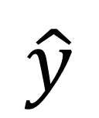

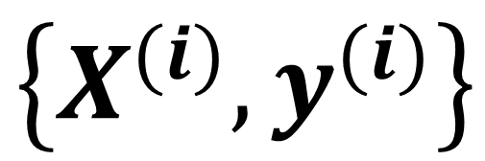
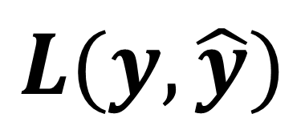
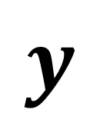
How do we know a model is good?
Given a model and its parameters, how do we know this model gives correct prediction?
Model
(para)
$$X$$
$$\hat{y}$$
$$\left\{X^{(i)}, y^{(i)}\right\}$$
Ground-truth
Loss func
the i-th sample
$$y$$
$$L(y, \hat{y})$$
a sample

Slide 4
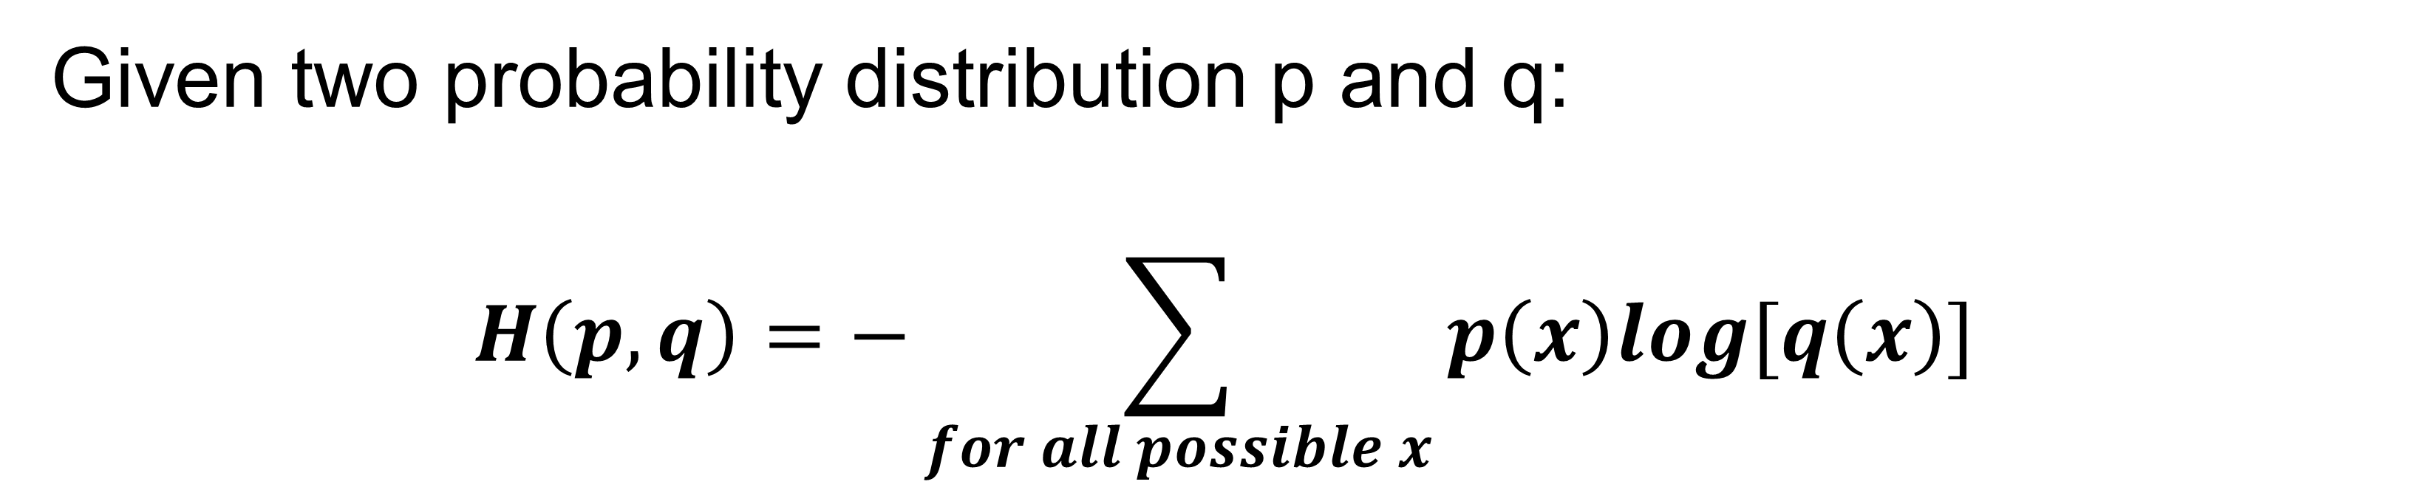
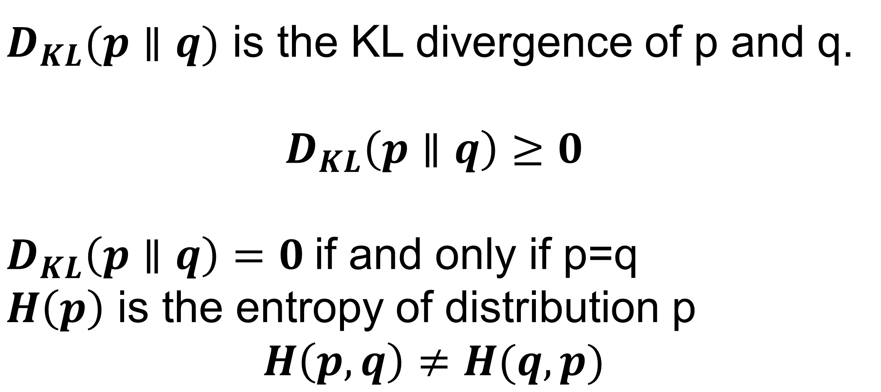
Cross-entropy
Given two probability distribution p and q:
$$H\left(p,q\right)=−\sum_{for all possible x}{p\left(x\right)log[q\left(x\right)] }$$
Measure how close two distributions are (not 100% rigorous)
Minimized if p=q
$$H\left(p,q\right)=H\left(p\right)+D_{KL}(p∥q)$$
$D_{KL}(p∥q)$ is the KL divergence of p and q.
$$D_{KL}\left(p∥q\right)≥0$$
$D_{KL}\left(p∥q\right)=0$if and only if p=q
$H\left(p\right)$ is the entropy of distribution p
$$H\left(p,q\right)≠H(q,p)$$

Slide 5
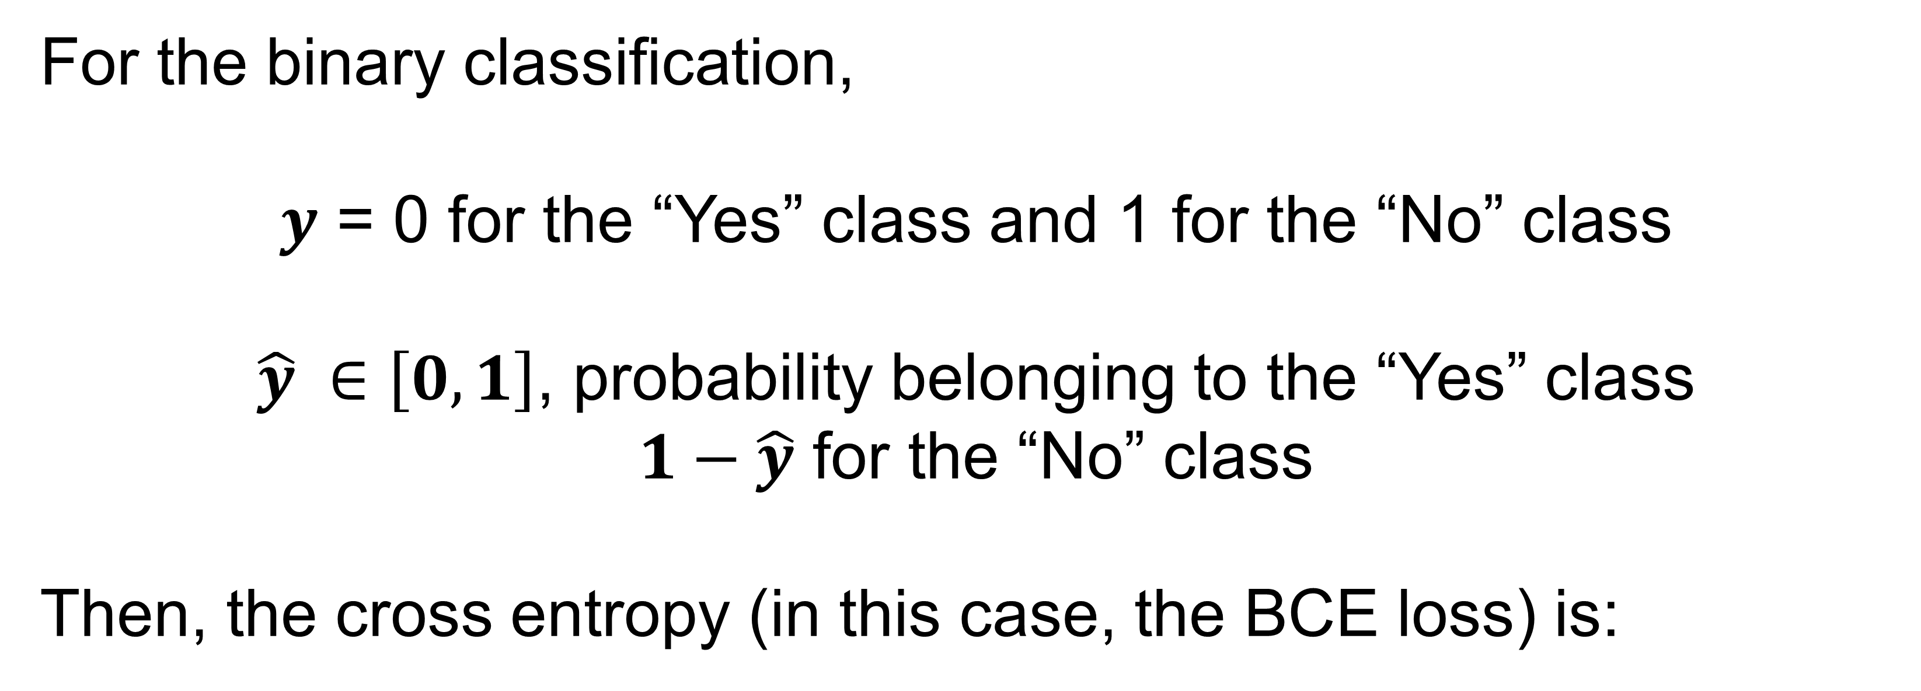
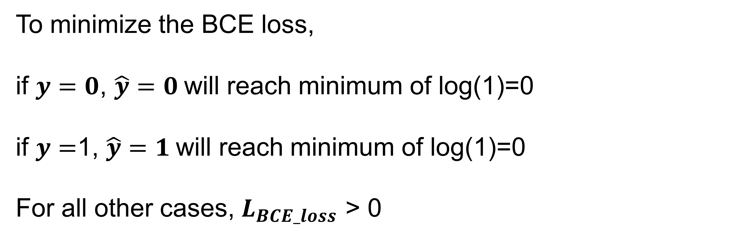
Binary Cross-entropy loss
For the binary classification,
$y$ = 0 for the “Yes” class and 1 for the “No” class
$\hat{y} ∈\left[0, 1\right]$, probability belonging to the “Yes” class
$1−\hat{y}$ for the “No” class
Then, the cross entropy (in this case, the BCE loss) is:
$$L_{BCE_loss}\left(y, \hat{y}\right)=−[y∙log\left(\hat{y}\right)+(1−y)∙log(1−\hat{y})]$$
To minimize the BCE loss,
if $y=0$, $\hat{y}=0$will reach minimum of log(1)=0
if $y=$1, $\hat{y}=1$will reach minimum of log(1)=0
For all other cases, $L_{BCE_loss}$ > 0

Slide 6
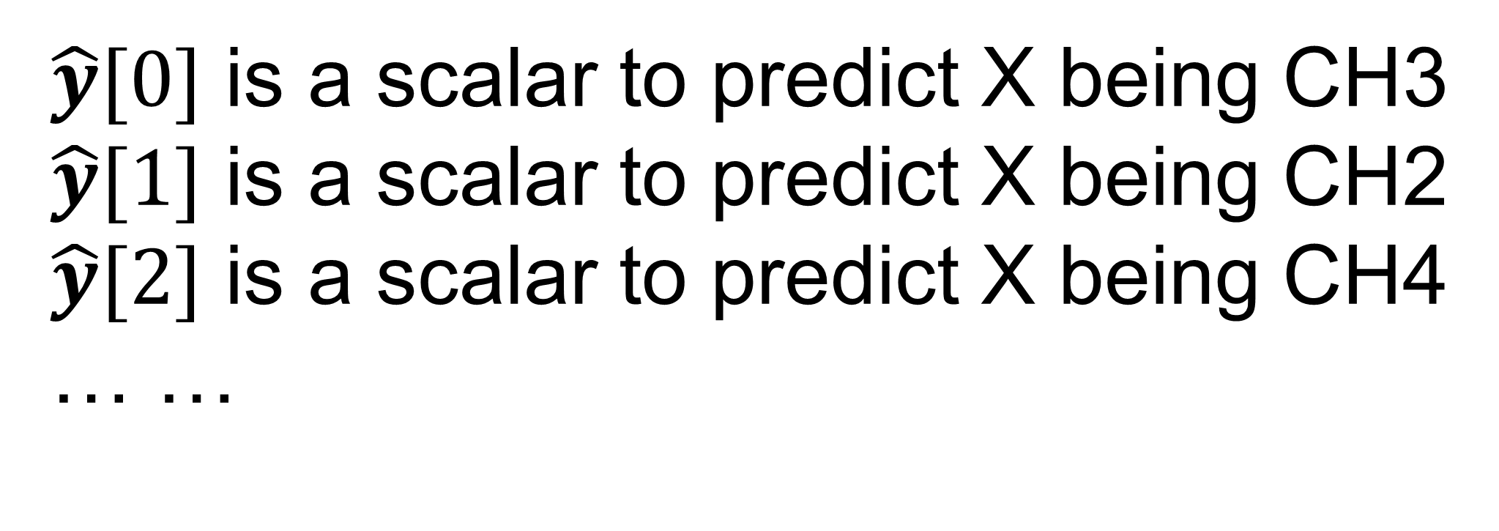
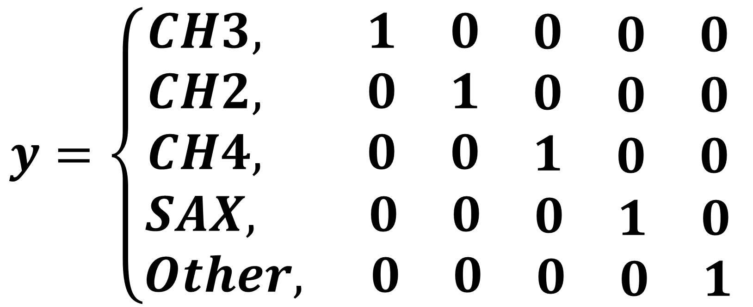
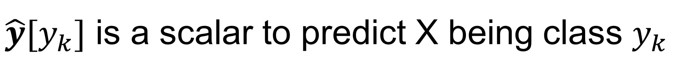
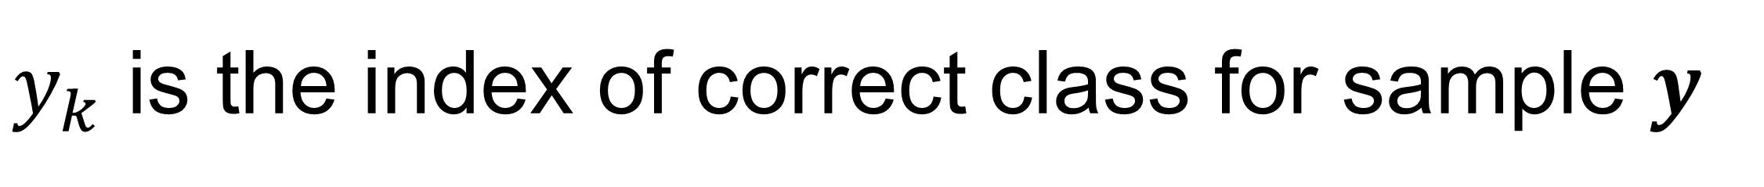
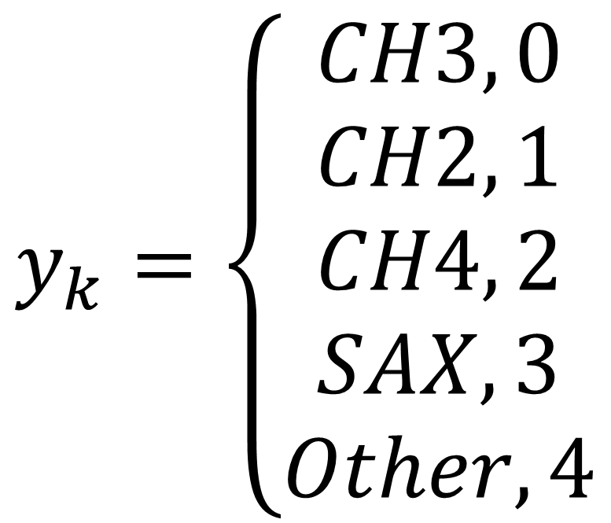
Cross-entropy loss for multi-class
For the multi-class classification,
$$y=\left\{\begin{aligned}\begin{matrix}CH3, 1 & 0 & \begin{matrix}0 & \begin{matrix}0 & 0\end{matrix}\end{matrix} \end{matrix} \\ \begin{matrix}CH2, 0 & 1 & \begin{matrix}0 & \begin{matrix}0 & 0\end{matrix}\end{matrix} \end{matrix} \\ \begin{matrix}CH4, 0 & 0 & \begin{matrix}1 & \begin{matrix}0 & 0\end{matrix}\end{matrix} \end{matrix} \\ SAX, \begin{matrix} 0 & 0 & \begin{matrix}0 & \begin{matrix}1 & 0\end{matrix}\end{matrix} \end{matrix} \\ Other, \begin{matrix} 0 & 0 & \begin{matrix}0 & \begin{matrix}0 & 1\end{matrix}\end{matrix} \end{matrix}\end{aligned}\right.$$
$\hat{y}$ is a [K,1] vector for the probability of X being each lass
$\hat{y}[0]$ is a scalar to predict X being CH3
$\hat{y}[1]$ is a scalar to predict X being CH2
$\hat{y}[2]$ is a scalar to predict X being CH4
… …
y is one-hot encoding for the correct class
$$y_{k}=\left\{\begin{aligned}CH3, 0 \\ CH2, 1 \\ CH4, 2 \\ SAX, 3 \\ Other, 4\end{aligned}\right.$$
$\hat{y}[y_{k}]$ is a scalar to predict X being class $y_{k}$
$y_{k}$ is the index of correct class for sample $y$

Slide 7

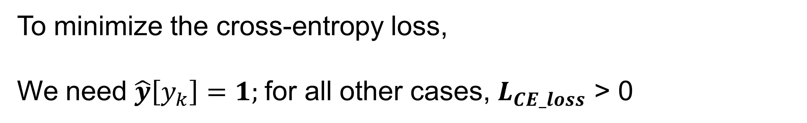
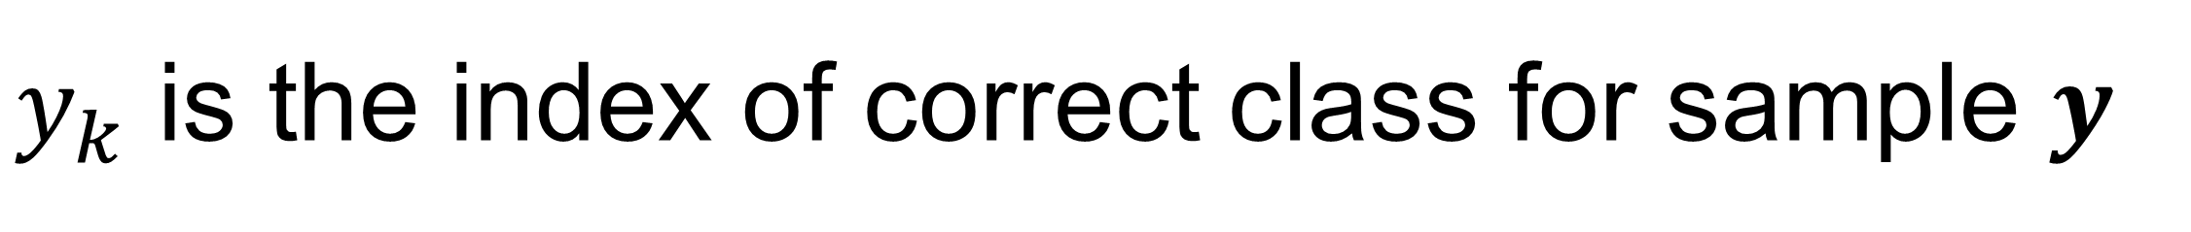
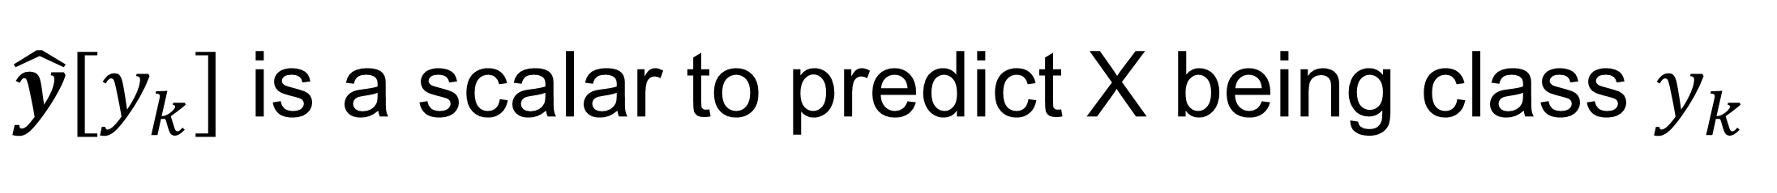
Cross-entropy loss
For the multi-class classification,
$$L_{CE_loss}\left(y, \hat{y}\right)=−\sum_{k=0}^{4}{y[k]}log\left(\hat{y}[k]\right)$$
$\hat{y}$ is a [K,1] vector for the probability of X being each lass
$\hat{y}[y_{k}]$ is a scalar to predict X being class $y_{k}$
y is one-hot encoding for the correct class
$y_{k}$ is the index of correct class for sample $y$
$$L_{CE_loss}\left(y, \hat{y}\right)=−log\left(\hat{y}[y_{k}]\right)$$
To minimize the cross-entropy loss,
We need $\hat{y}\left[y_{k}\right]=1;$for all other cases, $L_{CE_loss}$ > 0
Only one term left!

Slide 8
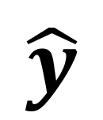
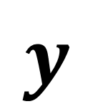
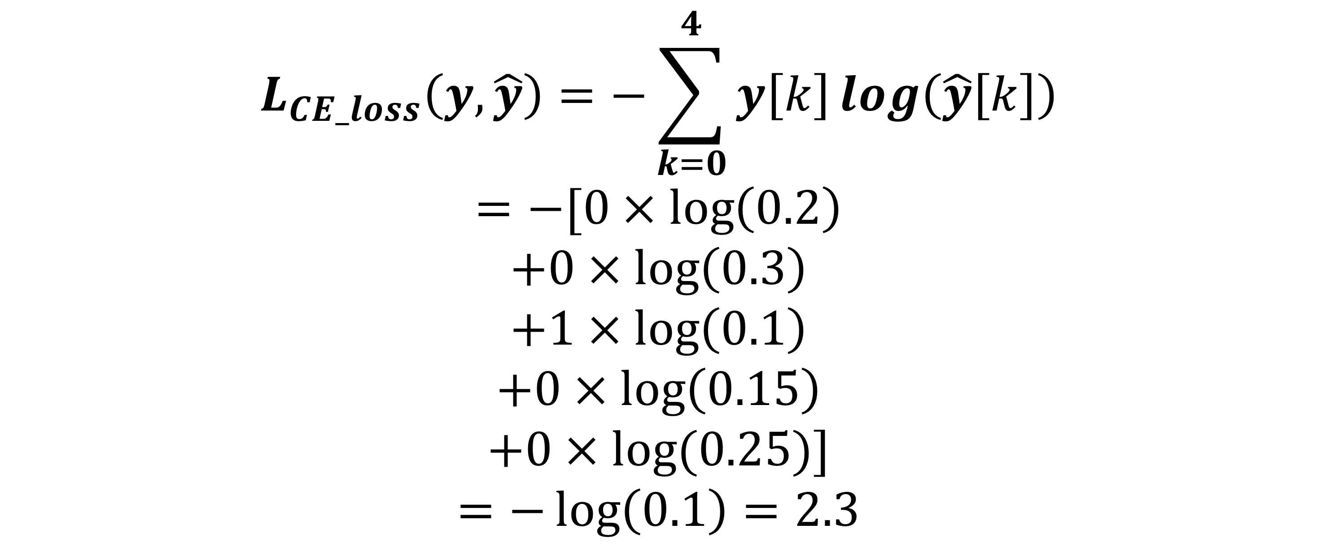
Cross-entropy loss
$$y$$
$$\hat{y}$$
$$L_{CE_loss}\left(y, \hat{y}\right)=−\sum_{k=0}^{4}{y\left[k\right]}log\left(\hat{y}\left[k\right]\right)$$
$$=−[0×\log\left(0.2\right)$$
$$+0×\log\left(0.3\right)$$
$$+1×\log\left(0.1\right)$$
$$+0×\log\left(0.15\right)$$
$$+0×log⁡(0.25)]$$
$$=−\log\left(0.1\right)=2.3$$
CH2
CH3
CH4
SAX
Other
0
0
1
0
0
0.2
0.3
0.1
0.15
0.25

Slide 9
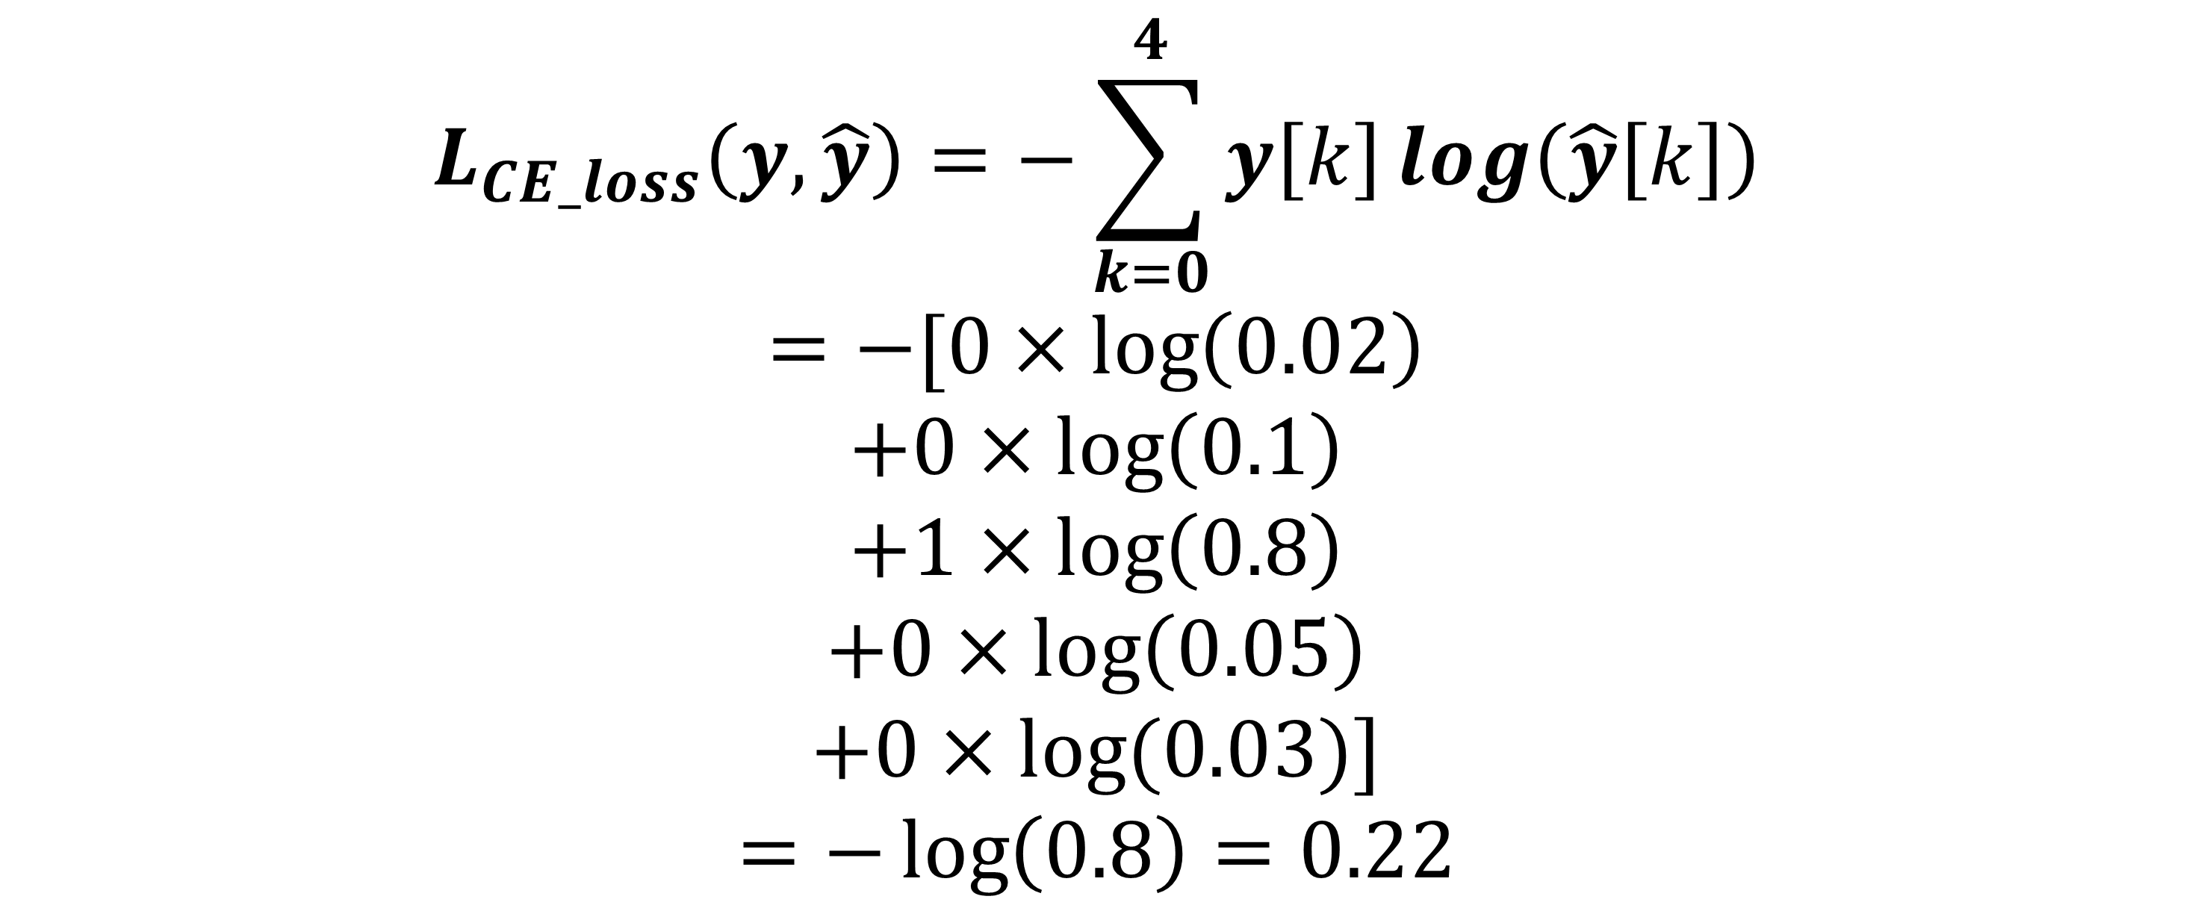
Cross-entropy loss
$$y$$
$$\hat{y}$$
$$L_{CE_loss}\left(y, \hat{y}\right)=−\sum_{k=0}^{4}{y\left[k\right]}log\left(\hat{y}\left[k\right]\right)$$
$$=−[0×\log\left(0.02\right)$$
$$+0×\log\left(0.1\right)$$
$$+1×\log\left(0.8\right)$$
$$+0×\log\left(0.05\right)$$
$$+0×log⁡(0.03)]$$
$$=−\log\left(0.8\right)=0.22$$
CH2
CH3
CH4
SAX
Other
0
0
1
0
0
0.02
0.1
0.8
0.05
0.03

Slide 10

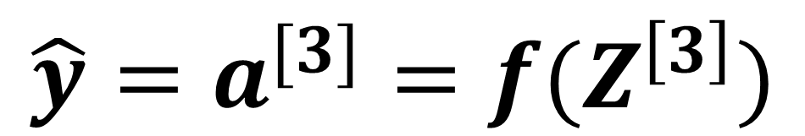
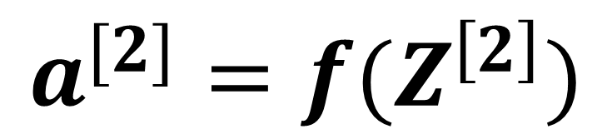
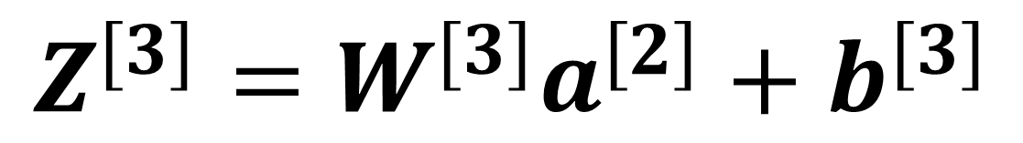
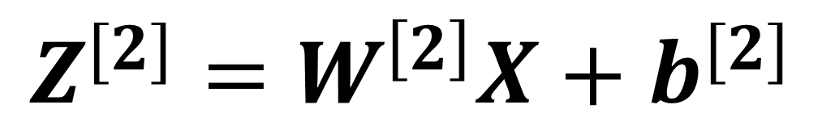
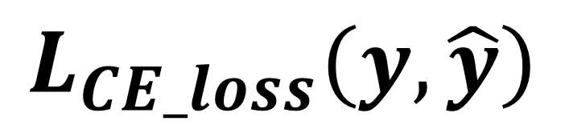
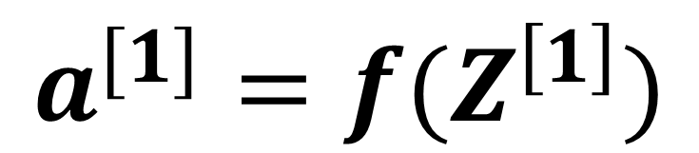
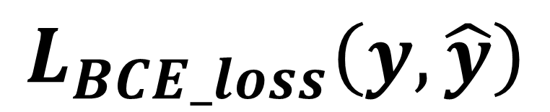
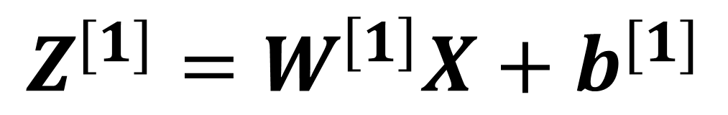

Where we are
$$Z^{[1]}=W^{\left[1\right]}X+b^{[1]}$$
W₁^{[1]}
f
$$a^{[1]}=f(Z^{\left[1\right]})$$
W₁^{[2]}
f
$$L_{BCE_loss}\left(y, \hat{y}\right)$$
$$Z^{[2]}=W^{\left[2\right]}X+b^{[2]}$$
$$X$$
W₂^{[1]}
f
W₁^{[3]}
f
$$a^{[3]}$$
$$a^{[2]}=f(Z^{\left[2\right]})$$
$$L_{CE_loss}\left(y, \hat{y}\right)$$
W₂^{[2]}
f
W₃^{[1]}
f
$$Z^{[3]}=W^{[3]}a^{[2]}+b^{[3]}$$
$${\hat{y}=a}^{[3]}=f(Z^{\left[3\right]})$$
Model : map input to output
Loss : how good the output is

Slide 11
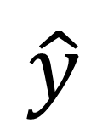


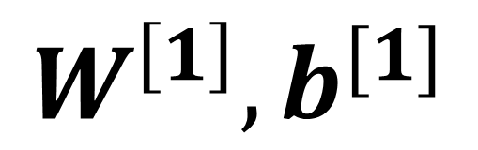
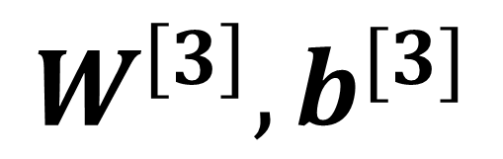
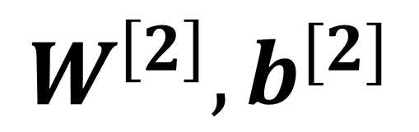
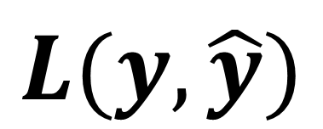

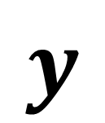
How do we determine the model parameters?
Update model paras
Optimization
W₁^{[1]}
f
$$W^{\left[1\right]}, b^{[1]}$$
Model
(para)
W₁^{[2]}
f
$$X$$
$$\hat{y}$$
$$X$$
W₂^{[1]}
f
W₁^{[3]}
f
$$a^{[3]}$$
$$W^{\left[2\right]}, b^{[2]}$$
Backprop: Compute gradient
W₂^{[2]}
f
$$W^{\left[3\right]}, b^{[3]}$$
f
Loss func
W₃^{[1]}
$$y$$
$$L(y, \hat{y})$$
Model : map input to output

Slide 12
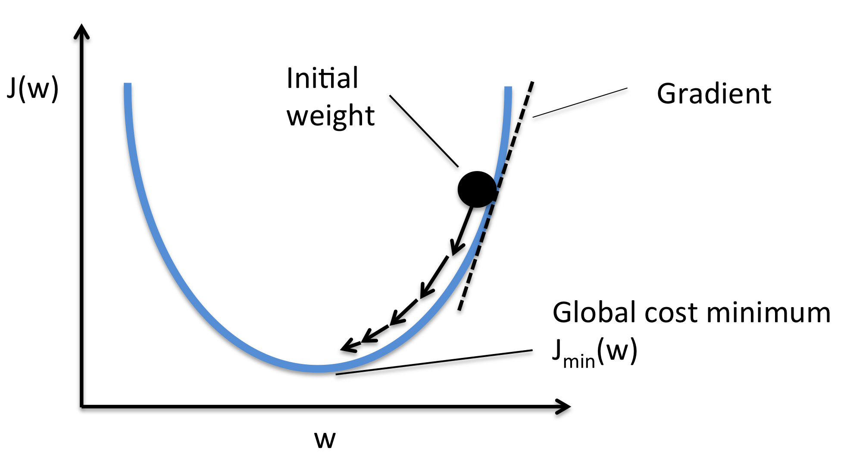
Gradient descent
To fine minimal point of a function
Start from an initial point
Follow the negative gradient direction
https://www.quora.com/Whats-the-difference-between-gradient-descent-and-stochastic-gradient-descent

Slide 13
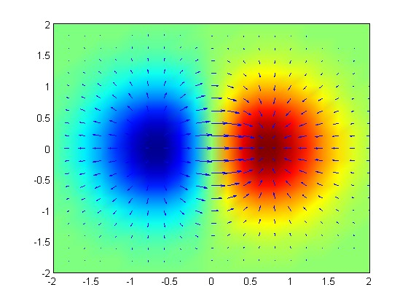
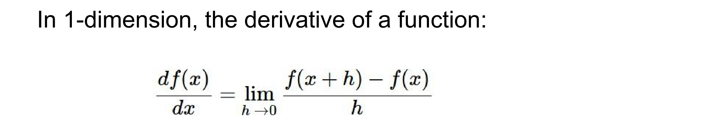
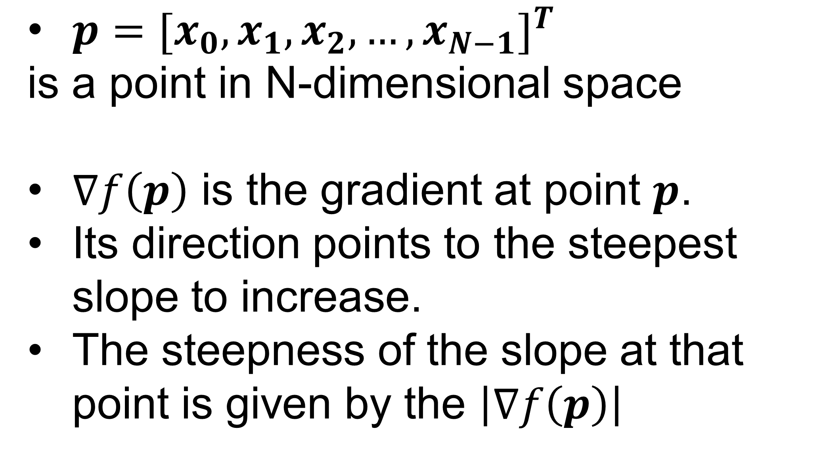
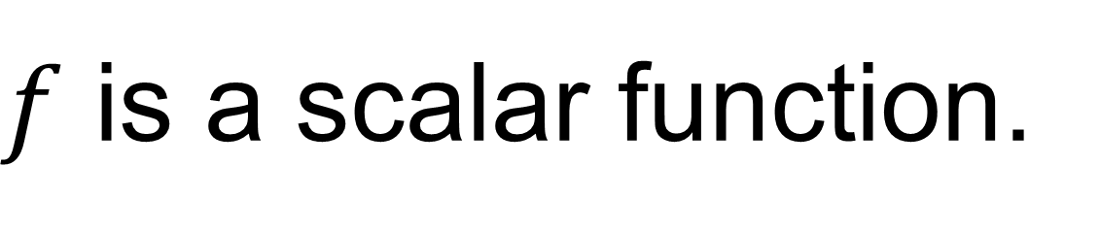
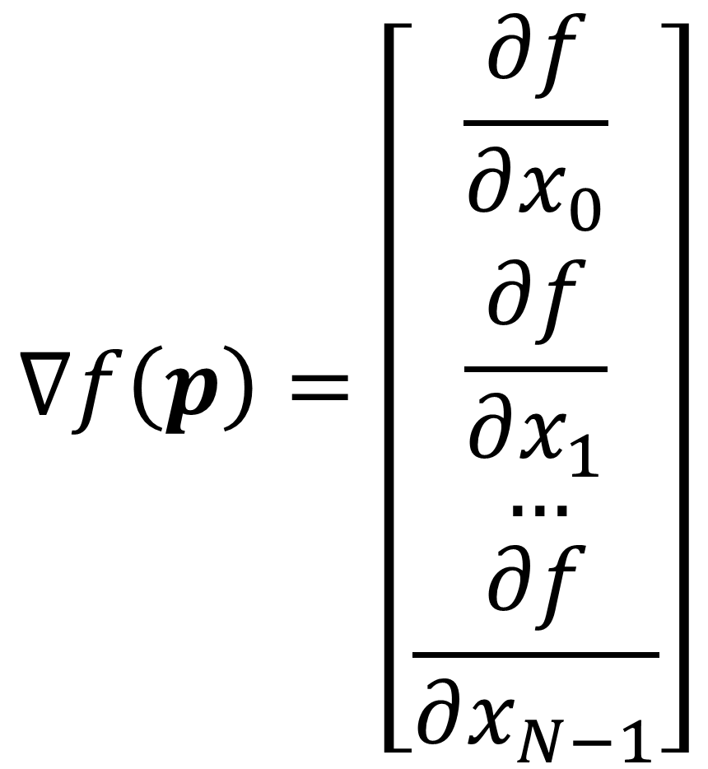
Gradient of a function
Gradient of a function indicates the steepest direction to increase this function in a neighborhood.
Negative gradient of a function indicates the steepest direction to decrease this function in a neighborhood.
$f$ is a scalar function.
$p={[x_{0},x_{1},x_{2},…,x_{N−1}]}^{T}$
is a point in N-dimensional space
$∇f\left(p\right)$ is the gradient at point $p$.
Its direction points to the steepest slope to increase.
The steepness of the slope at that point is given by the $\left|∇f\left(p\right)\right|$
$$∇f\left(p\right)=\left[\begin{matrix}\frac{∂f}{∂x_{0}} \\ \frac{∂f}{∂x_{1}} \\ \begin{aligned}… \\ \frac{∂f}{∂x_{N−1}}\end{aligned}\end{matrix}\right]$$
https://en.wikipedia.org/wiki/Gradient#/media/File:Gradient_of_a_Function.tif

Slide 14
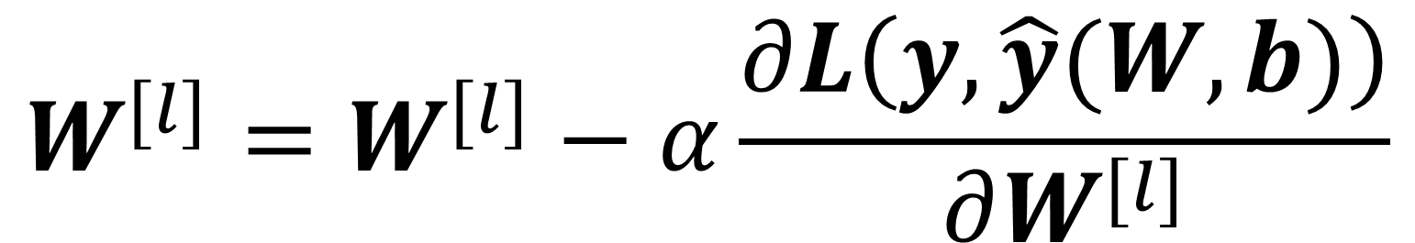
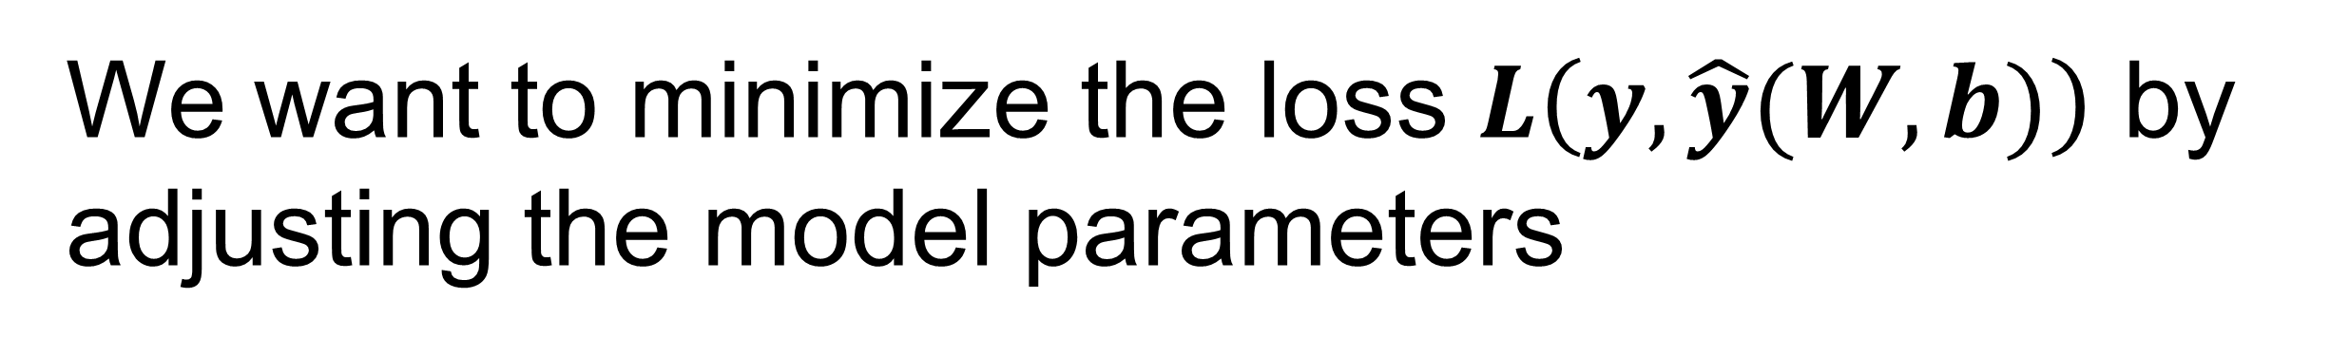
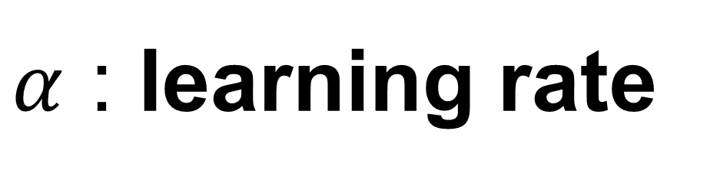

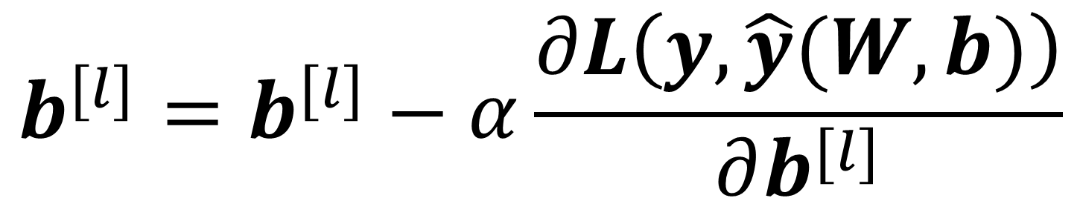
Gradient descent
Gradient direction
is
the steepest direction to increase this function
local minima
For every layer $l :$
$$W^{[l]}=W^{[l]}−α\frac{∂L\left(y, \hat{y}(W, b)\right)}{∂W^{[l]}}$$
$$b^{[l]}=b^{[l]}−α\frac{∂L\left(y, \hat{y}(W, b)\right)}{∂b^{[l]}}$$
We want to minimize the loss $L\left(y, \hat{y}(W, b)\right)$ by adjusting the model parameters
$α$ : learning rate
Guarantee to find a local minima

Slide 15
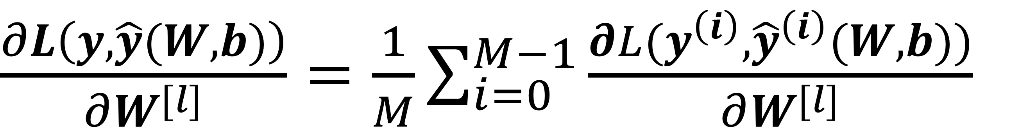
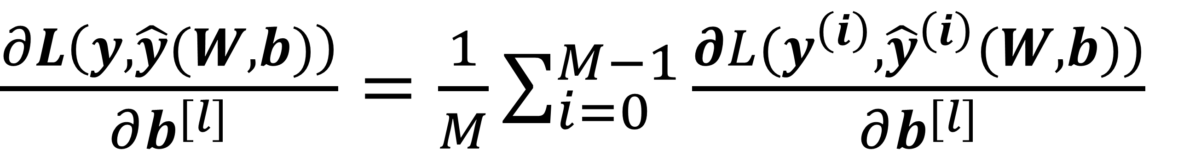
Gradient Descent (GD) over a set of samples
We have $M$ samples
Empirical loss on measured data = $\frac{1}{M}\sum_{i=0}^{M−1}{L(y^{\left(i\right)}, {\hat{y}}^{\left(i\right)}(W, b))}$
Find best parameters to minimize the mean loss across all training samples
$\frac{∂L\left(y, \hat{y}(W, b)\right)}{∂W^{[l]}}=$ $\frac{1}{M}\sum_{i=0}^{M−1}{\frac{∂L(y^{\left(i\right)}, {\hat{y}}^{\left(i\right)}(W, b))}{∂W^{[l]}}}$
$\frac{∂L\left(y, \hat{y}(W, b)\right)}{∂b^{[l]}}=$ $\frac{1}{M}\sum_{i=0}^{M−1}{\frac{∂L(y^{\left(i\right)}, {\hat{y}}^{\left(i\right)}(W, b))}{∂b^{[l]}}}$

Slide 16
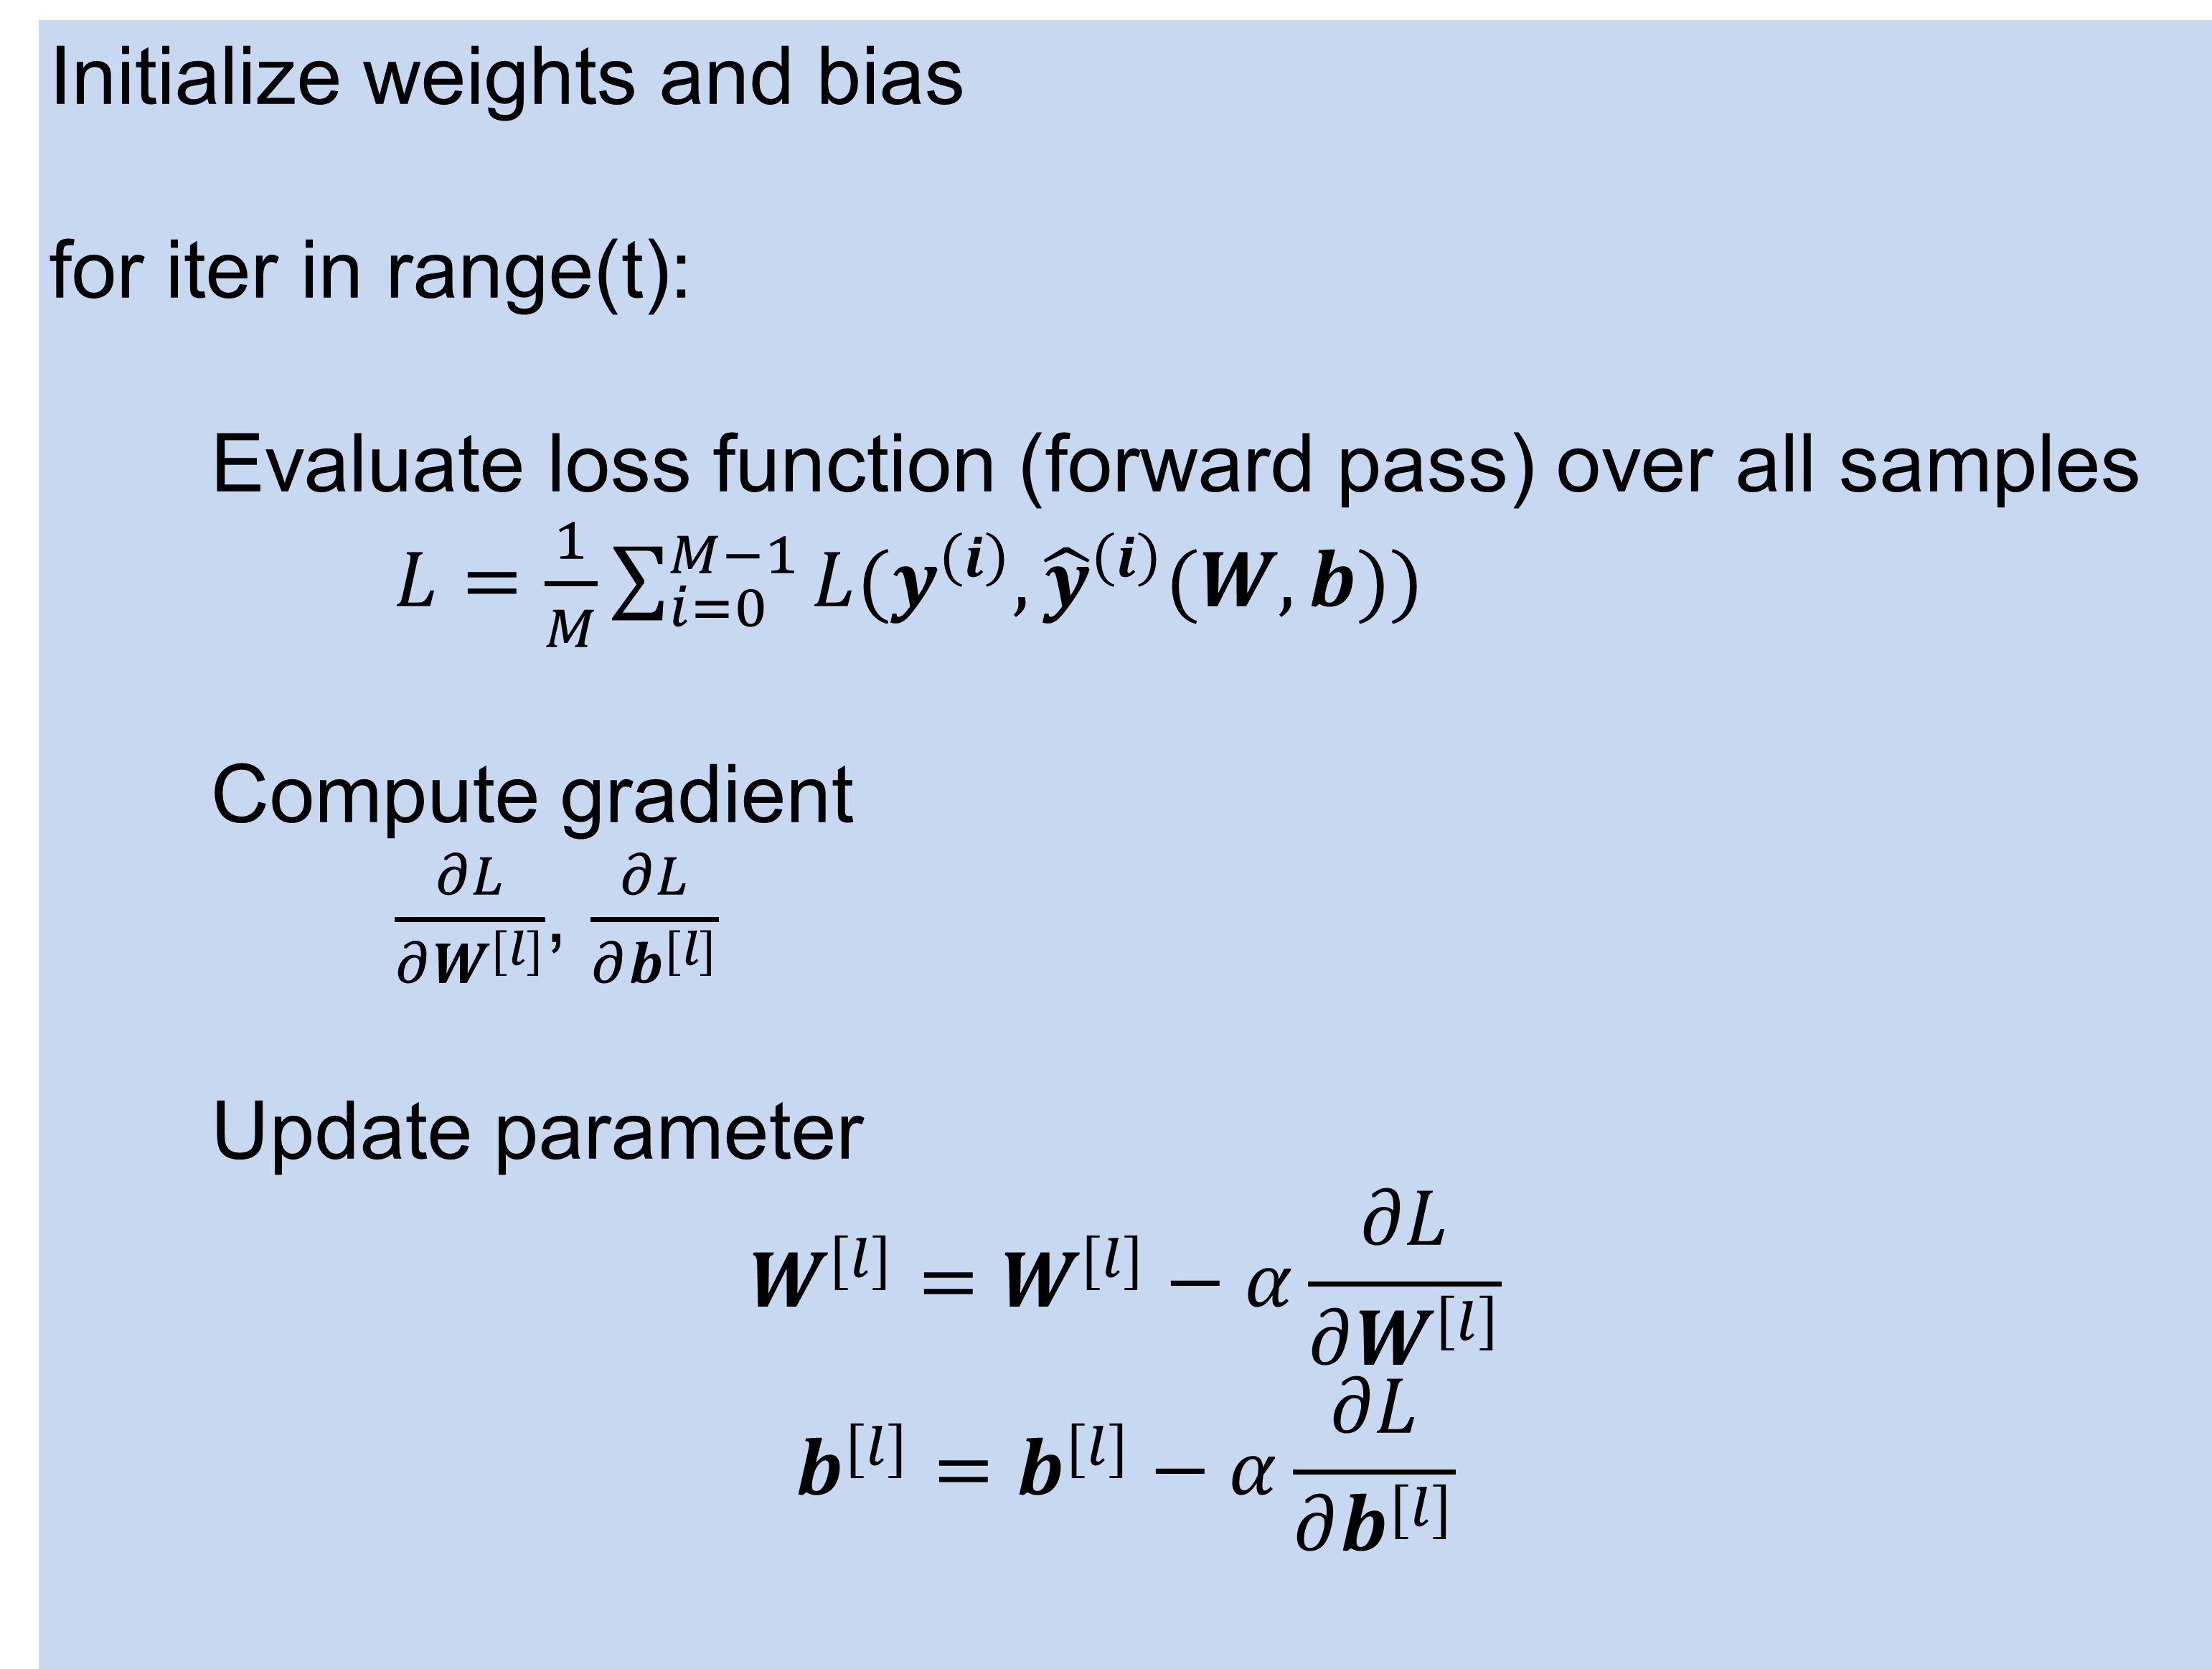
Gradient descent
Initialize weights and bias
for iter in range(t):
Evaluate loss function (forward pass) over all samples
$L=\frac{1}{M}\sum_{i=0}^{M−1}{L(y^{\left(i\right)}, {\hat{y}}^{\left(i\right)}(W, b))}$
Compute gradient
$\frac{∂L}{∂W^{[l]}}$, $\frac{∂L}{∂b^{[l]}}$
Update parameter
$$W^{[l]}=W^{[l]}−α\frac{∂L}{∂W^{\left[l\right]}}$$
$$b^{[l]}=b^{[l]}−α\frac{∂L}{∂b^{[l]}}$$

Slide 17
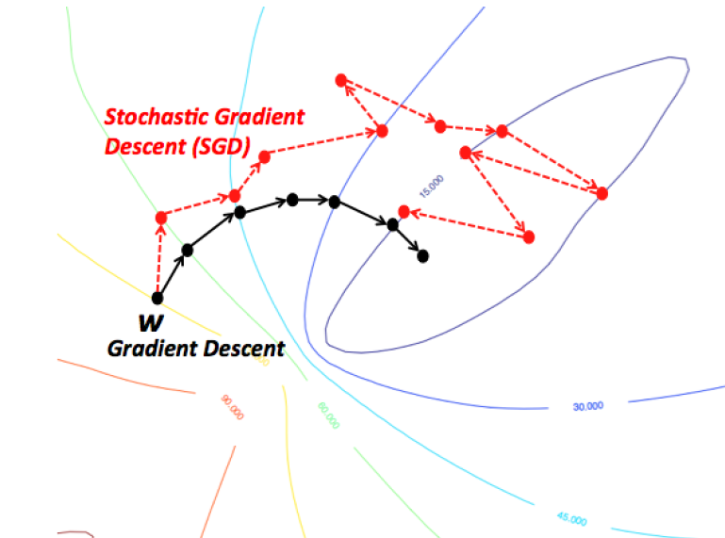
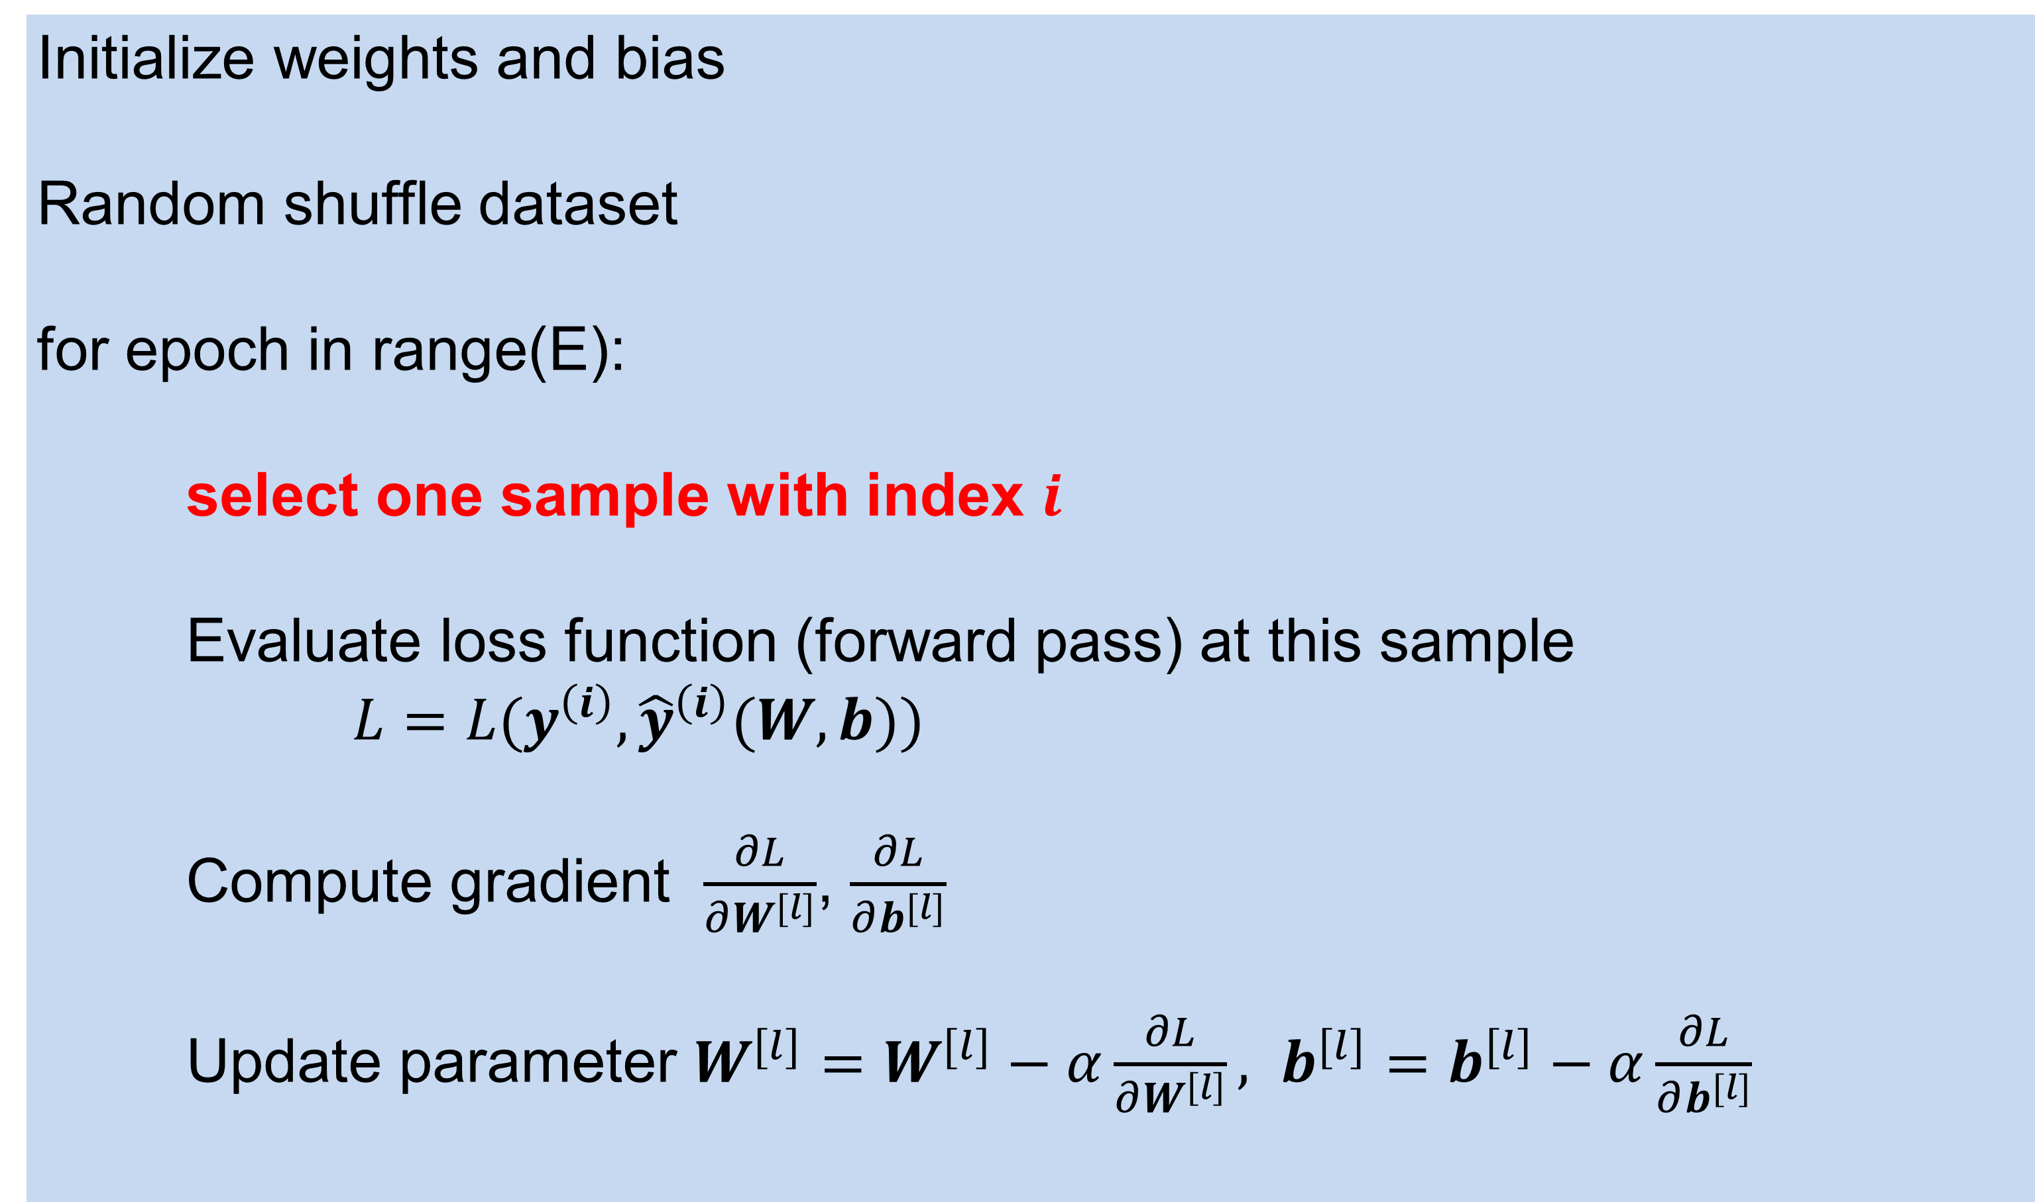
Stochastic Gradient Descent (SGD)
GD performs one parameter update step after going through entire training set
Slow if M is large
Gradient update may lack “exploration”
Initialize weights and bias
Random shuffle dataset
for epoch in range(E):
select one sample with index $i$
Evaluate loss function (forward pass) at this sample
$L=L(y^{\left(i\right)}, {\hat{y}}^{\left(i\right)}(W, b))$
Compute gradient $\frac{∂L}{∂W^{[l]}}$, $\frac{∂L}{∂b^{[l]}}$
Update parameter $W^{[l]}=W^{[l]}−α\frac{∂L}{∂W^{\left[l\right]}}, b^{[l]}=b^{[l]}−α\frac{∂L}{∂b^{[l]}}$
https://data-notes.co/the-10-deep-learning-methods-ai-practitioners-need-to-apply-885259f402c1

Slide 18

Mini-Batch SGD
SGD can have too much “noise” during convergence
Not fully utilize the computing hardware
Initialize weights and bias
Random shuffle dataset
BatchSize = 32
for epoch in range(E):
select #BatchSize samples
Evaluate loss function (forward pass) at this sample batch
$L=\frac{1}{B}\sum_{i=0}^{B−1}{L(y^{\left(i\right)}, {\hat{y}}^{\left(i\right)}(W, b))}$
Compute gradient $\frac{∂L}{∂W^{[l]}}$, $\frac{∂L}{∂b^{[l]}}$
Update parameter $W^{[l]}=W^{[l]}−α\frac{∂L}{∂W^{\left[l\right]}}, b^{[l]}=b^{[l]}−α\frac{∂L}{∂b^{[l]}}$
Batch size often is limited by the GPU RAM
Different way to select a batch, e.g. sequential, random, fixed step size etc.

Slide 19

Bigger batch size bigger learning rate
Larger BatchSize, better estimation of gradient
Large learning rate for small BatchSize can lead to failed convergence
More on how to find good learning rate …
B=64
B=4
B=32
B=16
B=8
https://miguel-data-sc.github.io/2017-11-05-first/#:~:text=For%20the%20ones%20unaware%2C%20general,descent%20(batch%20size%201).
https://arxiv.org/abs/1506.01186

Slide 20

Model Generalization
Training
set
Model
(para)
Training loss
Training accuracy
Underlying data distribution
Trained model
Test
set
Inference
Test loss
Test accuracy
Generalization loss …
We don’t have this distribution!
Training and test sets are sampled from the same distribution, i.i.d. (independent and identically distributed)
We care test/generalization performance; that is, the performance of training model on a new dataset

Slide 21


Model error
Given the underlying function $f(x)$, the model $M(x;D)$ to approximate $f\left(x\right)$
$D$ is a data set sampled from function $f\left(x\right)$. $D=\left[\left(x_{0},y_{0}\right), \left(x_{1},y_{1}\right), …, (x_{N−1},y_{N−1})\right]$
Every sample $\left(x_{i},y_{i}\right)$ is contaminated by noise: $y_{i}=f\left(x\right)+ε$, $ε$ is the random noise
We want to know the expected error of model, given the dataset D:
$$E_{D}[{(y−M(x;D))}^{2}]$$
This error consists of three parts:
$E_{D}\left[{\left(y−M\left(x;D\right)\right)}^{2}\right]={\{E_{D}\left[M\left(x;D\right)\right]−f\left(x\right)\}}^{2}+$ $E_{D}\left[{(E_{D}\left(M\left(x;D\right)\right)−M\left(x;D\right))}^{2}\right]+σ^{2}$
http://statweb.stanford.edu/~tibs/ElemStatLearn/

Slide 22


Model error
This error consists of three parts:
$E_{D}\left[{\left(y−M\left(x;D\right)\right)}^{2}\right]={\{E_{D}\left[M\left(x;D\right)\right]−f\left(x\right)\}}^{2}+$ $E_{D}\left[{(E_{D}\left(M\left(x;D\right)\right)−M\left(x;D\right))}^{2}\right]+σ^{2}$
$$Bias\left(M, D\right)=E_{D}\left[M\left(x;D\right)\right]−f\left(x\right)$$
This is the Bias, for the difference between the mean model performance and ground-truth
$E_{D}\left[M\left(x;D\right)\right]$ is the expected model performance over many datasets.
$$Var\left(M, D\right)=E_{D}\left[{(E_{D}\left(M\left(x;D\right)\right)−M\left(x;D\right))}^{2}\right]$$
This is the Variance, measuring model performance fluctuation due to different datasets.
http://statweb.stanford.edu/~tibs/ElemStatLearn/

Slide 23

Underfitting and overfitting
Model cannot represent the data distribution
Model well represents the data distribution, and does not capture data noise
Model is so flexible that it captures unwanted fluctuation due to noise
https://ascpt.onlinelibrary.wiley.com/doi/10.1002/cpt.1796

Slide 24

Underfitting and overfitting
Increasing model capacity/complexity can lead to overfitting
When applying trained model to a new dataset, e.g. test set, model performance can decrease, as a result of overfitting, indicated by the high generalization loss
Model can also underfitting the data, indicated by the high training loss
https://ja.d2l.ai/chapter_deep-learning-basics/underfit-overfit.html

Slide 25

In Deep Learning set up
We train on Training set and use training accuracy to estimate model performance ← Bias.
We apply the trained model on Testing set. Performance difference between training accuracy and test accuracy gives an estimation of Variance.

Slide 26
Bias and variance
Bayes error is the best possible error rate if we knew true data distribution. It will not be zero :
Overlap between class distribution
Noise
Test error
Test error
error
error
Training error
Variance
Bias
Lowest error possible (Bayes error)
Training error
Training data size
Training data size

Slide 27

Regularization to control model complexity
Deep learning model is very powerful, that it may overfit training data → degraded generalization
IDEA: change loss function to control model complexity
$$L=\frac{1}{B}\sum_{i=0}^{B−1}{L^{\left(i\right)}}+λR(W)$$
Data loss: how well model fits the data
Regularization loss: prevent model from fitting training data too well

Slide 28




L2 Regularization, weight decay
$$L=\frac{1}{B}\sum_{i=0}^{B−1}{L^{\left(i\right)}}+\frac{λ}{2}{\left\|W\right\|}_{2}^{2}$$
$${\left\|W\right\|}_{2}^{2}=\sum_{k=0}^{P−1}{{w_{k}}^{2}}$$
For all parameters in the model, flatten them and computing the element-wise L2 norm
$$\frac{∂L}{∂w_{k}}=\frac{1}{B}\sum_{i=0}^{B−1}{\frac{∂L^{(i)}}{∂w_{k}}}+λw_{k}$$
$$w_{k}=w_{k}−α(\frac{1}{B}\sum_{i=0}^{B−1}{\frac{∂L^{\left(i\right)}}{∂w_{k}})}−αλw_{k}$$
weight decay

Slide 29




L1 Regularization
$$L=\frac{1}{B}\sum_{i=0}^{B−1}{L^{\left(i\right)}}+\frac{λ}{2}{\left\|W\right\|}_{1}$$
$${\left\|W\right\|}_{1}=\sum_{k=0}^{P−1}{\left|w_{k}\right|}$$
For all parameters in the model, flatten them and computing the element-wise absolute value
$$\frac{∂L}{∂w_{k}}=\frac{1}{B}\sum_{i=0}^{B−1}{\frac{∂L^{(i)}}{∂w_{k}}}+λsign(w_{k})$$
$$sign\left(w_{k}\right)=\left\{\begin{aligned}1,w_{k}>0 \\ 0,w_{k}==0 \\ −1,w_{k}<0\end{aligned}\right.$$

Slide 30
Other operations with regularization effects
Regularization will:
Increase training error
Decrease testing error
Introduce new hyper-parameters
Often requires experiments
More on this topic in later lecturers
Other operations to improve test error:
Data augmentation
Drop out, drop connection, random connection
Batch/Layer/Channel normalization
Early stopping
…

