Slide 1
NHLBI
Deep Learning Crash Course
National Heart, Lung, and Blood Institute
Fall 2021

Slide 2
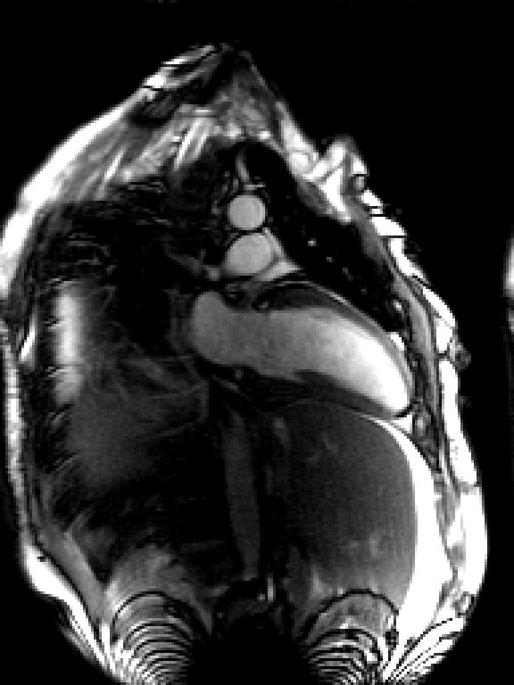
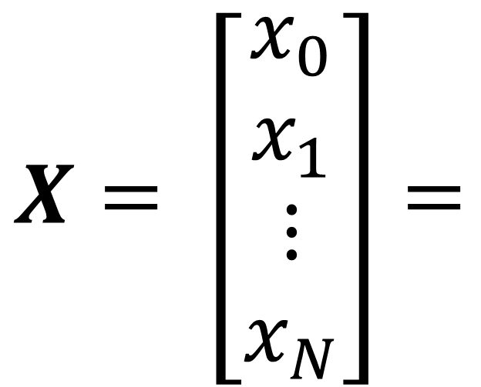
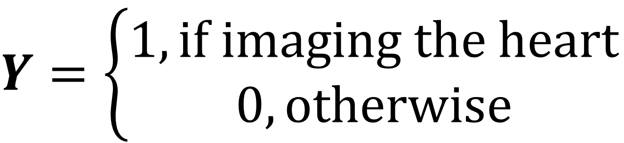
Recap
A running example : heart finding from MRI images
$$X= \left[\begin{matrix}x_{0} \\ x_{1} \\ \begin{matrix}⋮ \\ x_{N}\end{matrix}\end{matrix}\right]=$$
$Y=$ $\left\{\begin{aligned}1, if imaging the heart \\ 0,otherwise\end{aligned}\right.$

Slide 3
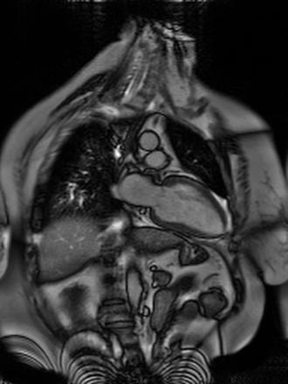
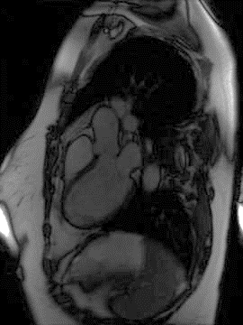
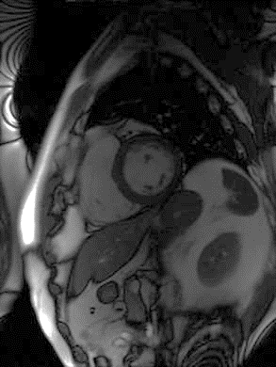
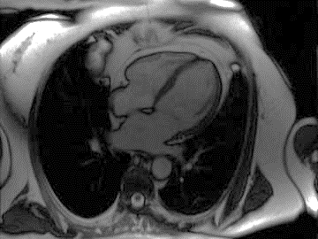
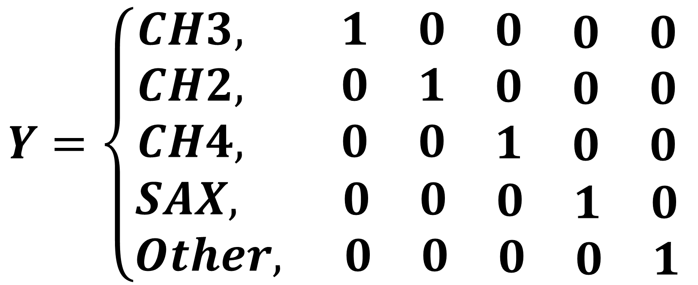
Recap
Cardiac view detection
E
2 chamber view – CH2
D
3 chamber view – CH3
$$Y=\left\{\begin{aligned}\begin{matrix}CH3, 1 & 0 & \begin{matrix}0 & \begin{matrix}0 & 0\end{matrix}\end{matrix} \end{matrix} \\ \begin{matrix}CH2, 0 & 1 & \begin{matrix}0 & \begin{matrix}0 & 0\end{matrix}\end{matrix} \end{matrix} \\ \begin{matrix}CH4, 0 & 0 & \begin{matrix}1 & \begin{matrix}0 & 0\end{matrix}\end{matrix} \end{matrix} \\ SAX, \begin{matrix} 0 & 0 & \begin{matrix}0 & \begin{matrix}1 & 0\end{matrix}\end{matrix} \end{matrix} \\ Other, \begin{matrix} 0 & 0 & \begin{matrix}0 & \begin{matrix}0 & 1\end{matrix}\end{matrix} \end{matrix}\end{aligned}\right.$$
A
Short-axis view SAX
B
4 chamber view – CH4

Slide 4
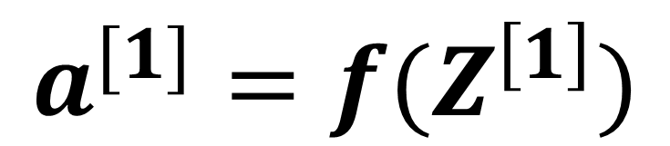

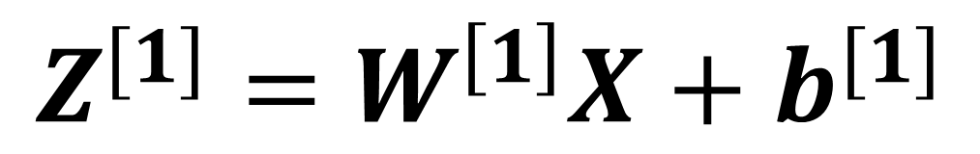
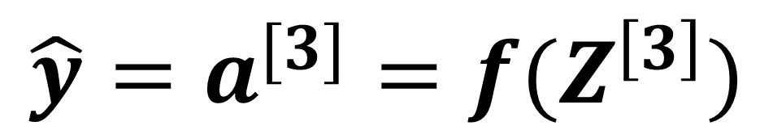

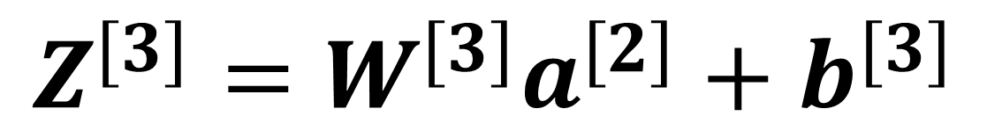
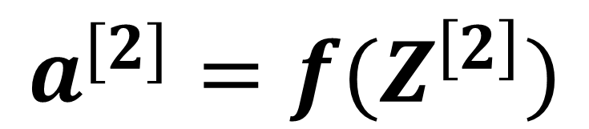
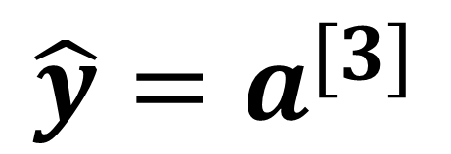
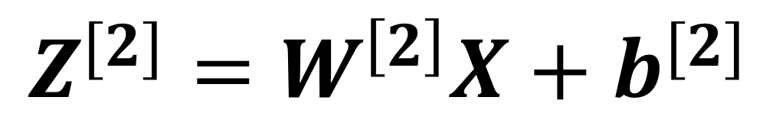
Recap : MLP
Index of layer
W₁^{[2]}
W₁^{[1]}
f
Index of neuron
W₁^{[2]}
f
flatten
f
f
$$\hat{y}=a^{[3]}$$
$$Z^{[1]}=W^{\left[1\right]}X+b^{[1]}$$
$$X$$
W₂^{[1]}
W₁^{[3]}
$$a^{[1]}=f(Z^{\left[1\right]})$$
W₂^{[2]}
f
$$Z^{[2]}=W^{\left[2\right]}X+b^{[2]}$$
$$a^{[2]}=f(Z^{\left[2\right]})$$
W₃^{[1]}
f
$$Z^{[3]}=W^{[3]}a^{[2]}+b^{[3]}$$
$${\hat{y}=a}^{[3]}=f(Z^{\left[3\right]})$$
The i-th sample $(X^{\left(i\right)},y^{(i)}$)

Slide 5

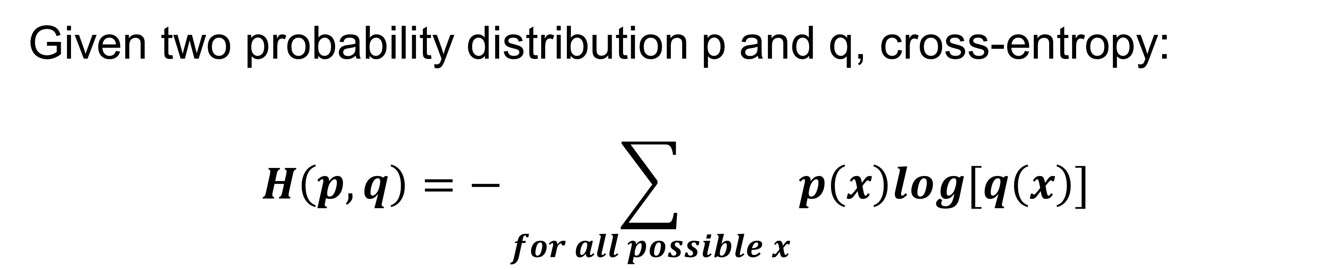
Recap : Cross-Entropy Loss
Multi-class classification:
$$L_{CE_loss}\left(y, \hat{y}\right)=−\sum_{k=0}^{4}{y[k]}log\left(\hat{y}[k]\right)$$
Given two probability distribution p and q, cross-entropy:
$$H\left(p,q\right)=−\sum_{for all possible x}{p\left(x\right)log[q\left(x\right)] }$$
$$L_{CE_loss}\left(y, \hat{y}\right)=−log\left(\hat{y}[y_{k}]\right)$$
Binary classification:
$$L_{BCE_loss}\left(y, \hat{y}\right)=−[y∙log\left(\hat{y}\right)+(1−y)∙log(1−\hat{y})]$$

Slide 6
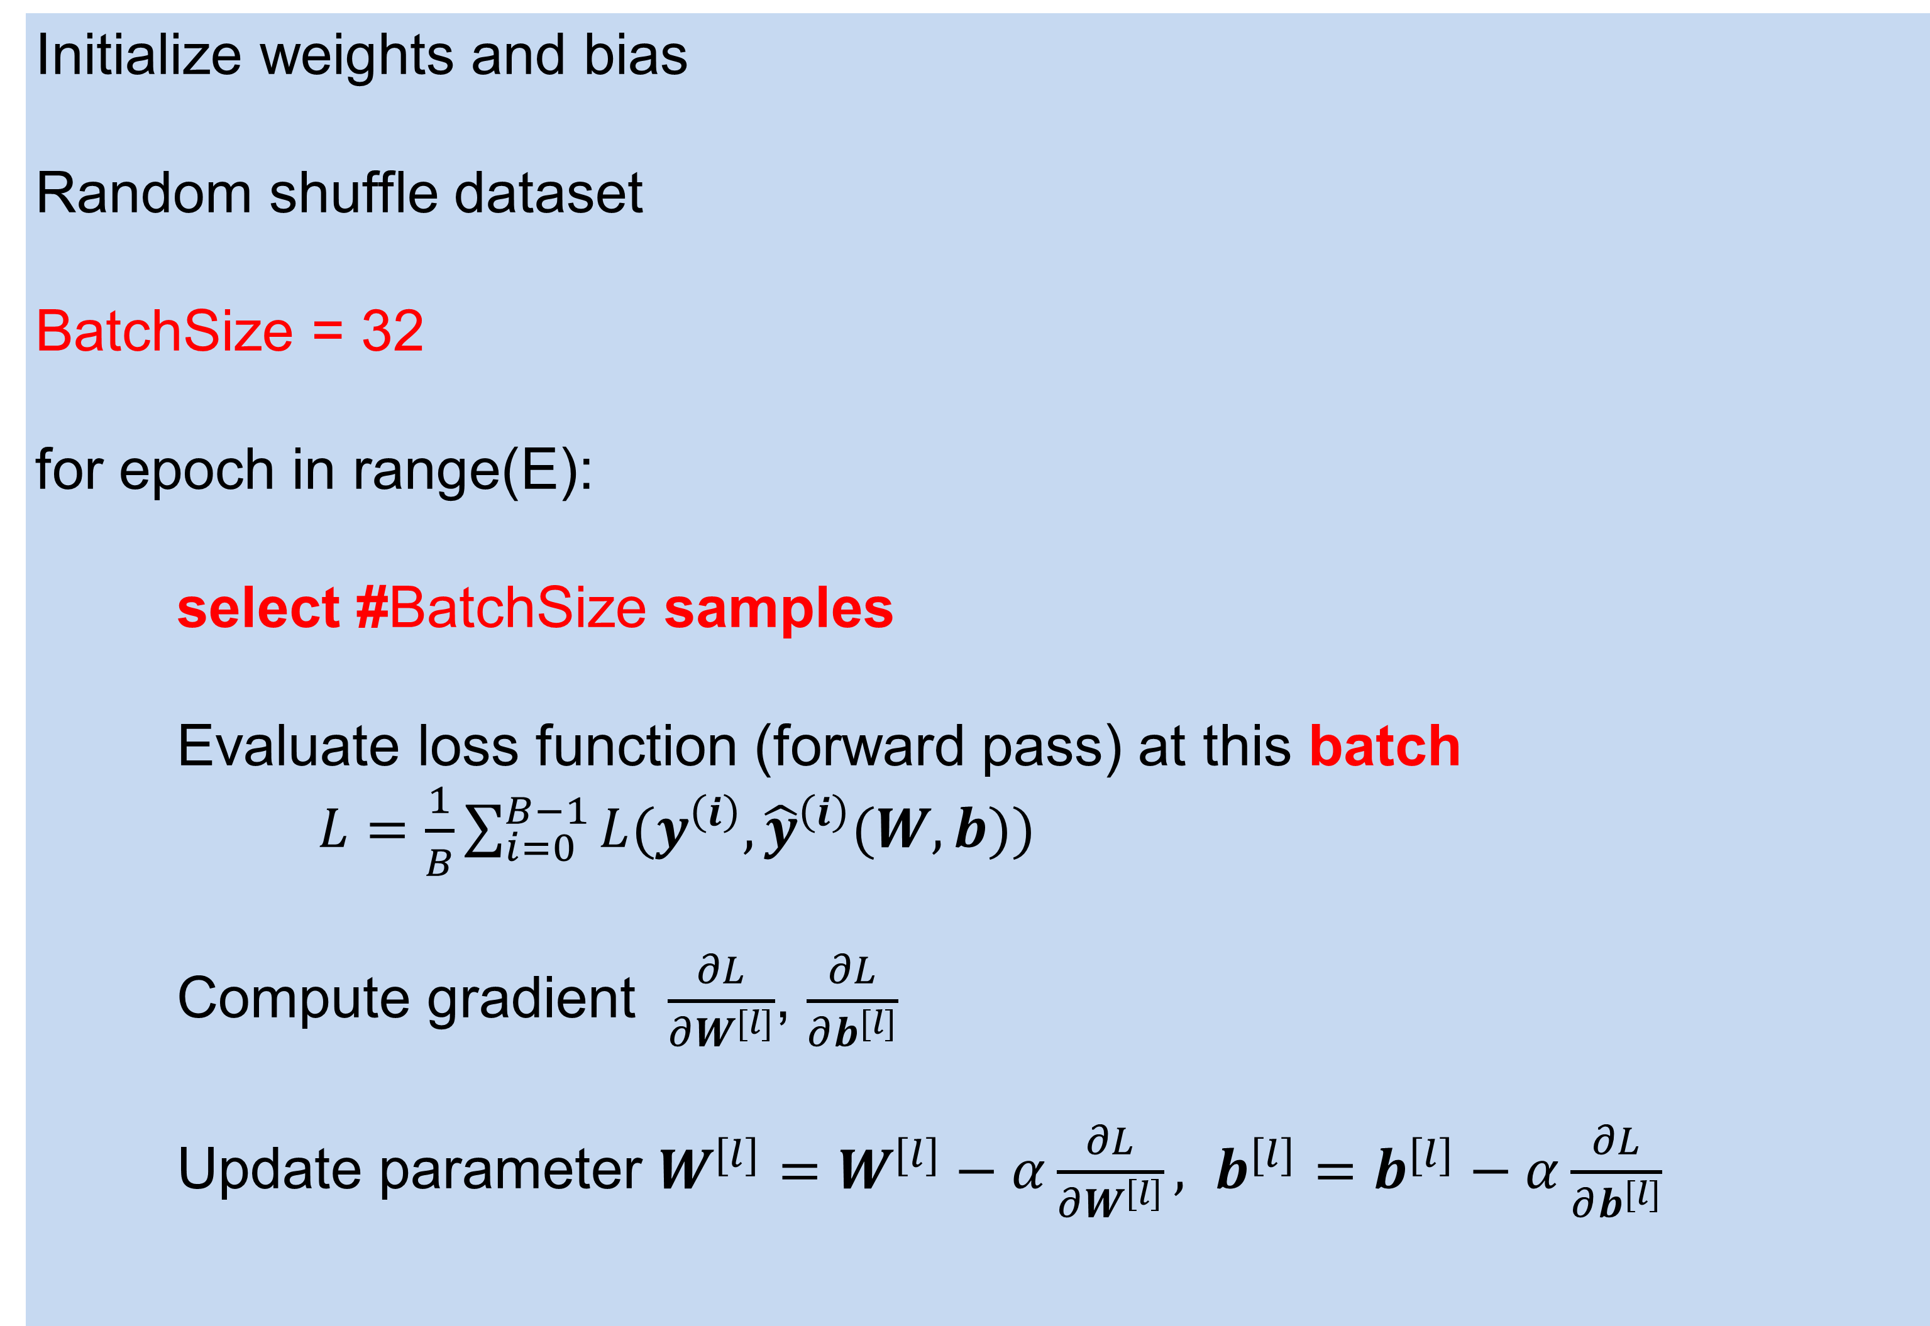
Recap : Mini-batch Gradient Descent
Initialize weights and bias
Random shuffle dataset
BatchSize = 32
for epoch in range(E):
select #BatchSize samples
Evaluate loss function (forward pass) at this batch
$L=\frac{1}{B}\sum_{i=0}^{B−1}{L(y^{\left(i\right)}, {\hat{y}}^{\left(i\right)}(W, b))}$
Compute gradient $\frac{∂L}{∂W^{[l]}}$, $\frac{∂L}{∂b^{[l]}}$
Update parameter $W^{[l]}=W^{[l]}−α\frac{∂L}{∂W^{\left[l\right]}}, b^{[l]}=b^{[l]}−α\frac{∂L}{∂b^{[l]}}$

Slide 7
Lecture 3
Backprop

Slide 8
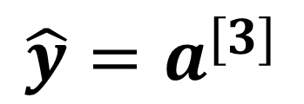

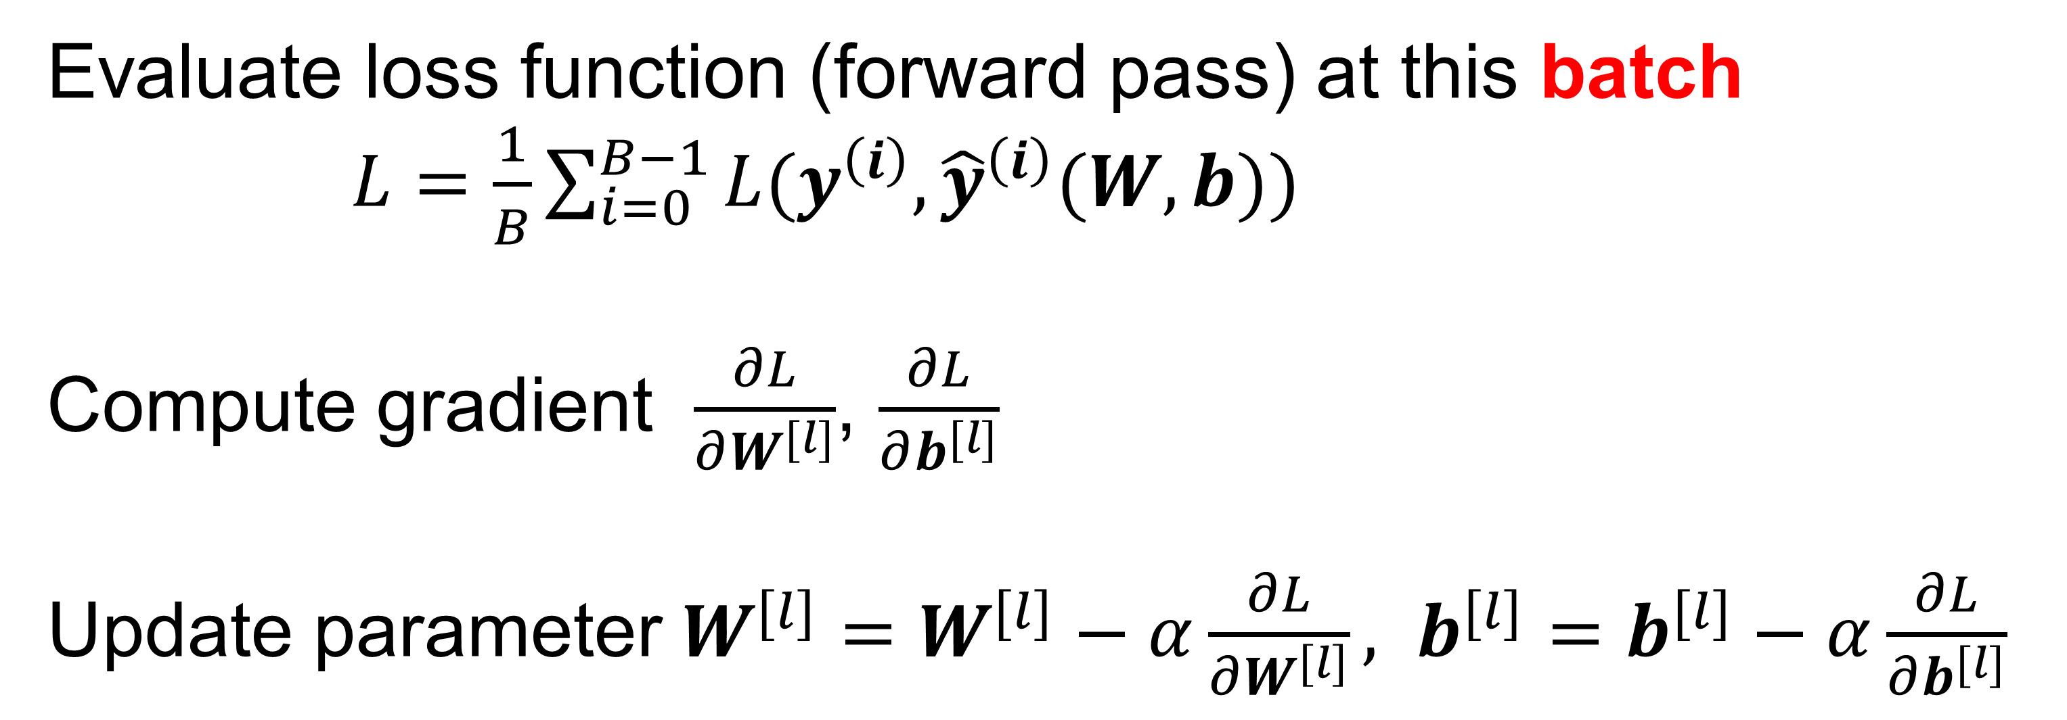
To find the good model parameter
W₁^{[1]}
f
Evaluate loss function (forward pass) at this batch
$L=\frac{1}{B}\sum_{i=0}^{B−1}{L(y^{\left(i\right)}, {\hat{y}}^{\left(i\right)}(W, b))}$
Compute gradient $\frac{∂L}{∂W^{[l]}}$, $\frac{∂L}{∂b^{[l]}}$
Update parameter $W^{[l]}=W^{[l]}−α\frac{∂L}{∂W^{\left[l\right]}}, b^{[l]}=b^{[l]}−α\frac{∂L}{∂b^{[l]}}$
W₁^{[2]}
f
$$X$$
W₂^{[1]}
f
W₁^{[3]}
f
$$\hat{y}=a^{[3]}$$
W₂^{[2]}
f
W₃^{[1]}
f

Slide 9
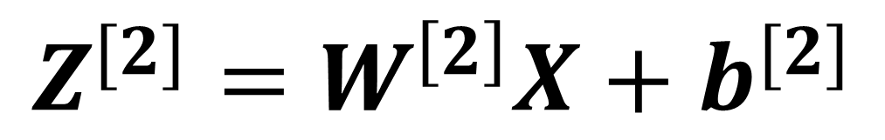
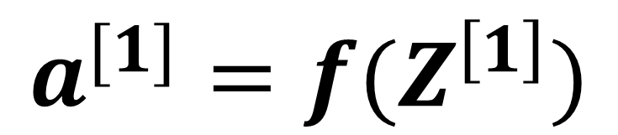

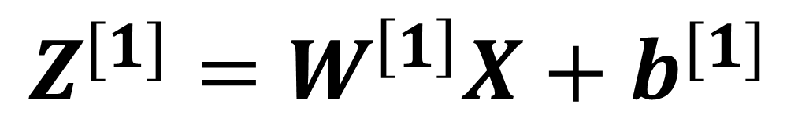
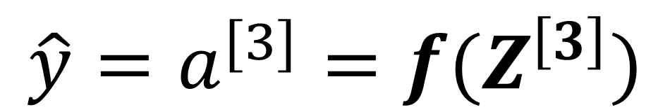
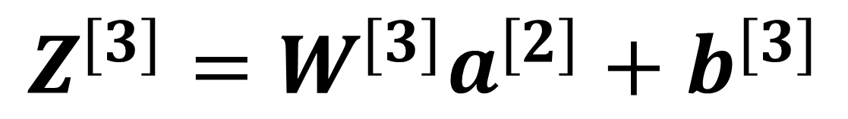
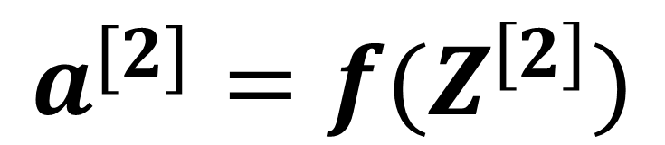
Evaluate loss function : A forward pass
Evaluate loss function (forward pass) at this batch
$L=\frac{1}{B}\sum_{i=0}^{B−1}{L(y^{\left(i\right)}, {\hat{y}}^{\left(i\right)}(W, b))}$
$$Z^{[1]}=W^{\left[1\right]}X+b^{[1]}$$
$$a^{[1]}=f(Z^{\left[1\right]})$$
$$Z^{[2]}=W^{\left[2\right]}X+b^{[2]}$$
Let’s look at one sample and write $y^{\left(i\right)}$ as $y:$
$$a^{[2]}=f(Z^{\left[2\right]})$$
$$L\left(y,\hat{y}\left(W, b\right)\right)=−[ylog\left(\hat{y}\right)+\left(1−y\right)log(1−\hat{y})]$$
$$Z^{[3]}=W^{[3]}a^{[2]}+b^{[3]}$$
$${\hat{y}=a}^{[3]}=f(Z^{\left[3\right]})$$
For every sample, we input $(X, y)$ and model outputs $\hat{y}$

Slide 10
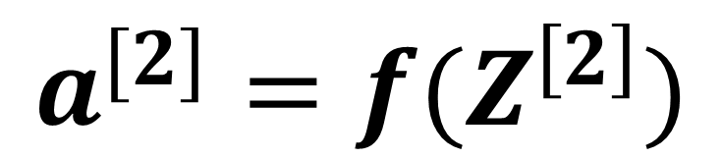
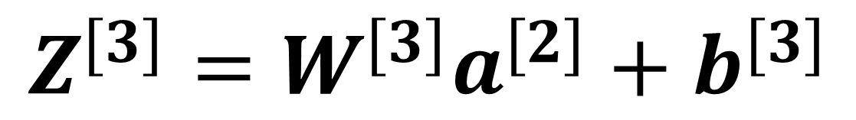
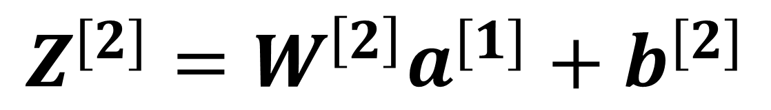
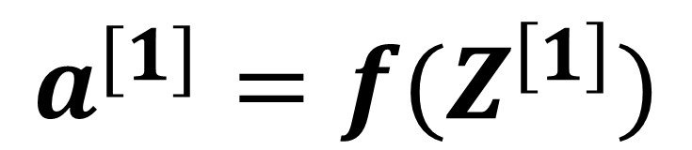
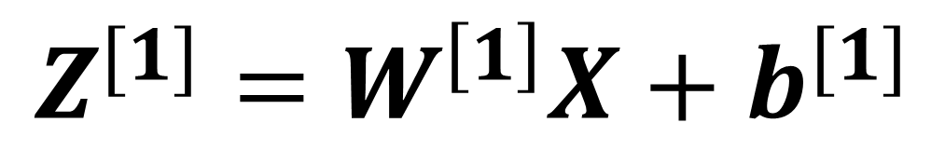
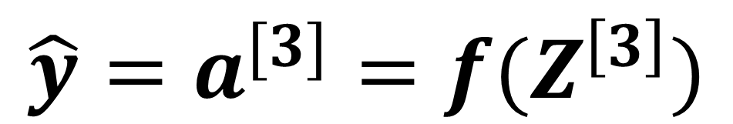
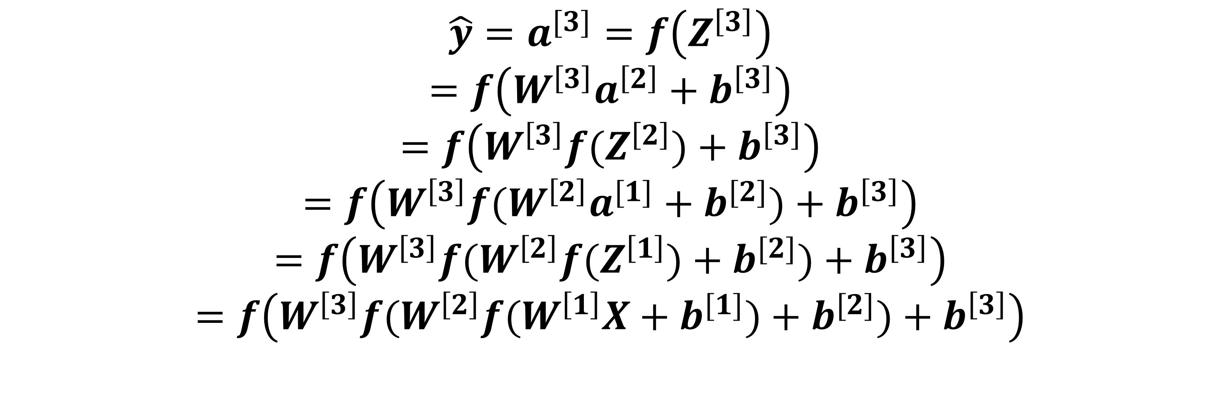
Compute gradient : Is it easy to do?
Compute gradient $\frac{∂L}{∂W^{[1]}}$, $\frac{∂L}{∂b^{[1]}}$, $\frac{∂L}{∂W^{[2]}}$, $\frac{∂L}{∂b^{[2]}}$, $\frac{∂L}{∂W^{[3]}}$, $\frac{∂L}{∂b^{[3]}}$
First idea, compute analytical derivative
$$Z^{[1]}=W^{\left[1\right]}X+b^{[1]}$$
$$a^{[1]}=f(Z^{\left[1\right]})$$
$${\hat{y}=a}^{[3]}=f\left(Z^{\left[3\right]}\right)$$
$$=f\left(W^{\left[3\right]}a^{\left[2\right]}+b^{\left[3\right]}\right)$$
$$=f\left(W^{\left[3\right]}f(Z^{\left[2\right]})+b^{\left[3\right]}\right)$$
$$=f\left(W^{\left[3\right]}f(W^{\left[2\right]}a^{[1]}+b^{[2]})+b^{\left[3\right]}\right)$$
$$=f\left(W^{\left[3\right]}f(W^{\left[2\right]}f(Z^{\left[1\right]})+b^{[2]})+b^{\left[3\right]}\right)$$
$$=f\left(W^{\left[3\right]}f(W^{\left[2\right]}f(W^{\left[1\right]}X+b^{[1]})+b^{[2]})+b^{\left[3\right]}\right)$$
$$Z^{[2]}=W^{\left[2\right]}a^{[1]}+b^{[2]}$$
$$a^{[2]}=f(Z^{\left[2\right]})$$
$$Z^{[3]}=W^{[3]}a^{[2]}+b^{[3]}$$
$${\hat{y}=a}^{[3]}=f(Z^{\left[3\right]})$$

Slide 11
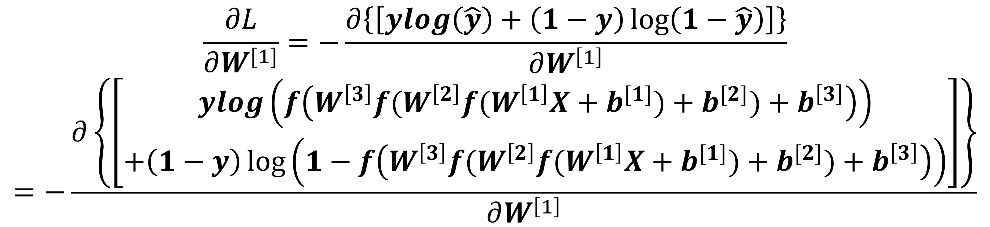
Compute analytical gradient : hard to do
Compute gradient $\frac{∂L}{∂W^{[1]}}$, $\frac{∂L}{∂b^{[1]}}$, $\frac{∂L}{∂W^{[2]}}$, $\frac{∂L}{∂b^{[2]}}$, $\frac{∂L}{∂W^{[3]}}$, $\frac{∂L}{∂b^{[3]}}$
So, let’s compute:
$$Z^{[1]}=W^{\left[1\right]}X+b^{[1]}$$
$$a^{[1]}=f(Z^{\left[1\right]})$$
$$\frac{∂L}{∂W^{[1]}}=−\frac{∂\left\{\left[ylog\left(\hat{y}\right)+\left(1−y\right)\log\left(1−\hat{y}\right)\right]\right\}}{∂W^{\left[1\right]}}$$
$$=−\frac{∂\left\{\left[\begin{aligned}ylog\left(f\left(W^{\left[3\right]}f(W^{\left[2\right]}f(W^{\left[1\right]}X+b^{[1]})+b^{[2]})+b^{\left[3\right]}\right)\right) \\ +\left(1−y\right)\log\left(1−f\left(W^{\left[3\right]}f(W^{\left[2\right]}f(W^{\left[1\right]}X+b^{[1]})+b^{[2]})+b^{\left[3\right]}\right)\right)\end{aligned}\right]\right\}}{∂W^{\left[1\right]}}$$
$$Z^{[2]}=W^{\left[2\right]}a^{[1]}+b^{[2]}$$
$$a^{[2]}=f(Z^{\left[2\right]})$$
$$Z^{[3]}=W^{[3]}a^{[2]}+b^{[3]}$$
$${\hat{y}=a}^{[3]}=f(Z^{\left[3\right]})$$
Compute derivative gradient is hard … for this small MLP

Slide 12
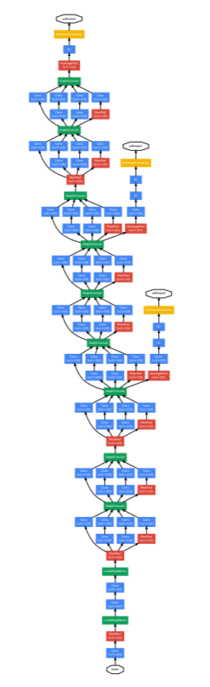
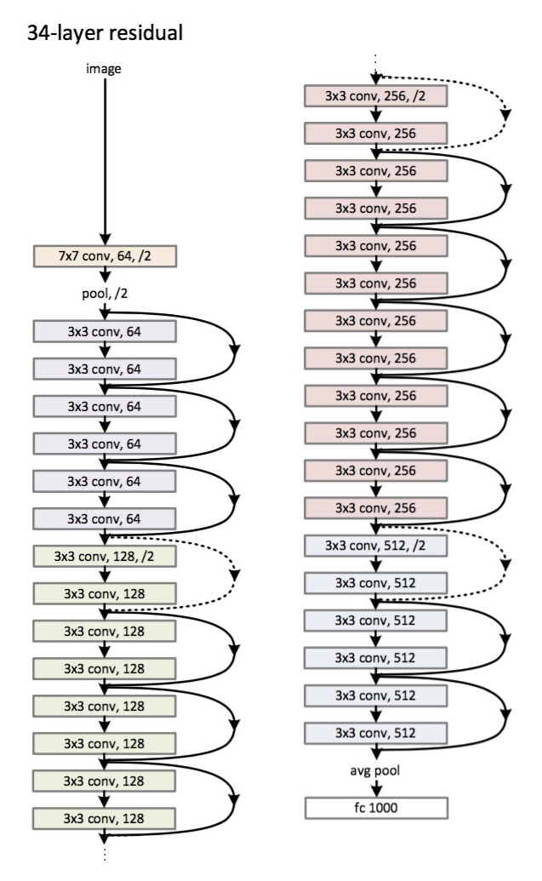
Compute derivative gradient : cannot be done
Compute analytical gradient becomes impossible for deep neural networks
Deep Residual Learning for Image Recognition. https://arxiv.org/pdf/1512.03385.pdf
Going Deeper with Convolutions. CVPR 2015

Slide 13
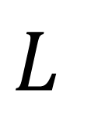
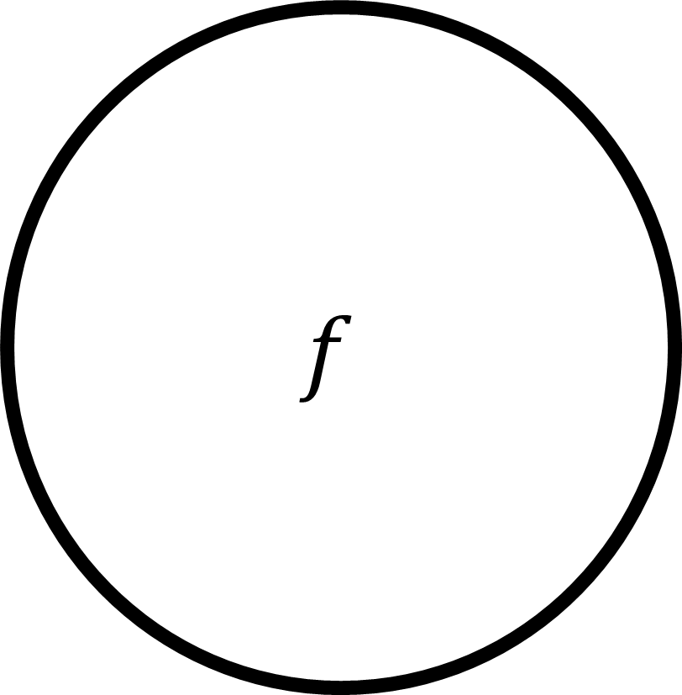
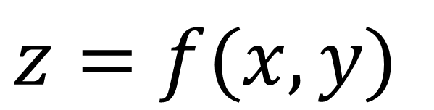
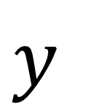
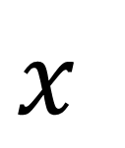
Compute gradient : Back propagation
Compute derivative gradient becomes impossible for deep neural networks. We need back prop.
Divide and conquer
Use chain-rule
Let computer do the job
$$x$$
$$f$$
$$z=f(x,y)$$
… …
$$L$$
Loss
Other layers
$$y$$
Current layer

Slide 14


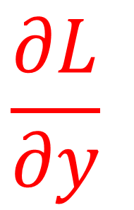
Compute gradient : Back propagation
Compute derivative gradient becomes impossible for deep neural networks. We need back prop.
Given the gradient from the loss to output parameter z
Compute gradient from the loss to input x and y
$$x$$
$$\frac{∂L}{∂x}$$
$$f$$
$$z=f(x,y)$$
… …
$$L$$
Loss
$\frac{∂L}{∂z}$ is given
$$y$$
$$\frac{∂L}{∂y}$$
Current layer

Slide 15

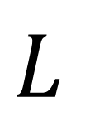

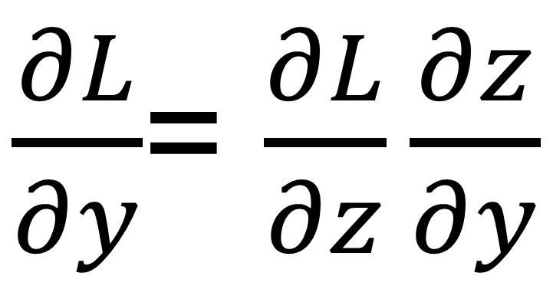
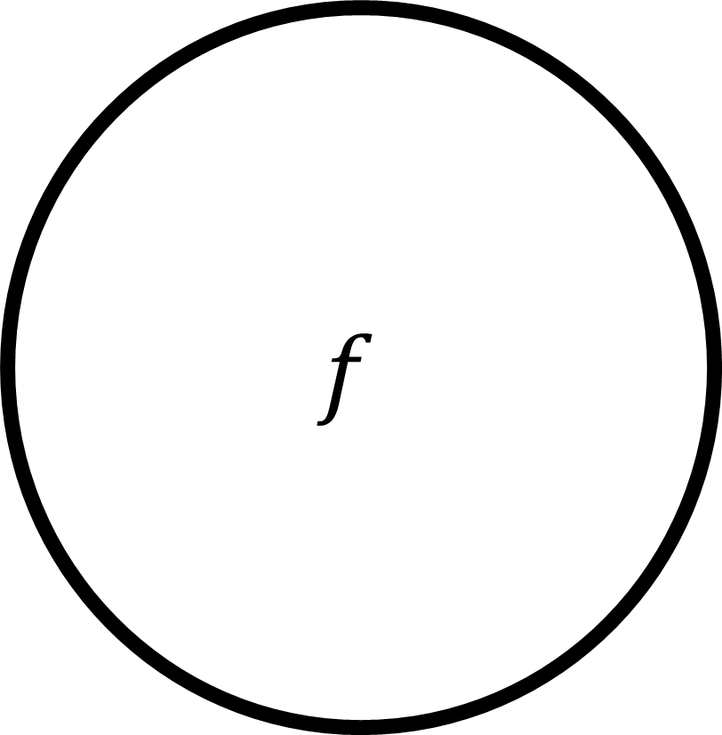
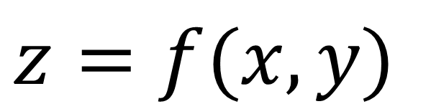
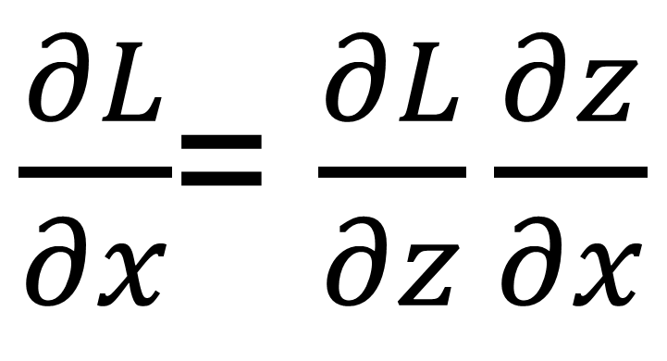
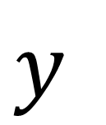
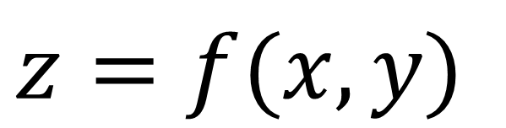
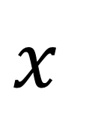

Compute gradient : Back propagation
Chain rule
$\frac{∂L}{∂x}$= $\frac{∂L}{∂z}\frac{∂z}{∂x}$
$$x$$
$$\frac{∂L}{∂x}$$
$$f$$
$\frac{∂L}{∂y}$= $\frac{∂L}{∂z}\frac{∂z}{∂y}$
$$z=f(x,y)$$
… …
$$L$$
Loss
$\frac{∂L}{∂z}$ is given
Divide and conquer
We know the current layer to produce z from x and y
$$y$$
$$\frac{∂L}{∂y}$$
Current layer
$$z=f(x,y)$$

Slide 16












Compute gradient : Back propagation
$$x$$
Divide and conquer
We know the current function to compute z from x and y
We know the gradient of loss to output z
Enough information to compute derivative of loss to input x and y
$$\frac{∂L}{∂x}$$
$$f$$
$$z=f(x,y)$$
… …
$$L$$
Loss
$\frac{∂L}{∂z}$ is given
$$y$$
$$\frac{∂L}{∂y}$$
Current layer
Chain rule
$\frac{∂L}{∂x}$= $\frac{∂L}{∂z}\frac{∂z}{∂x}=\frac{∂L}{∂z}$ $\frac{∂f(x,y)}{∂x}$
$\frac{∂z}{∂x}$= $\frac{∂f(x,y)}{∂x}$
$\frac{∂z}{∂y}$= $\frac{∂f(x,y)}{∂y}$
$\frac{∂L}{∂y}$= $\frac{∂L}{∂z}\frac{∂z}{∂y}=\frac{∂L}{∂z}$ $\frac{∂f(x,y)}{∂y}$

Slide 17










Compute gradient : Back propagation
To compute current gradient, only need upstream gradient and local function
$$x$$
$\frac{∂L}{∂y}$= $\frac{∂L}{∂z}\frac{∂z}{∂y}=\frac{∂L}{∂z}$ $\frac{∂f(x,y)}{∂y}$
$$\frac{∂L}{∂x}$$
$$f$$
$$z=f(x,y)$$
… …
$$L$$
Loss
$\frac{∂L}{∂z}$ is given
$\frac{∂L}{∂x}$= $\frac{∂L}{∂z}\frac{∂z}{∂x}=\frac{∂L}{∂z}$ $\frac{∂f(x,y)}{∂x}$
gradient flow
$$y$$
$$\frac{∂L}{∂y}$$
Current layer

Slide 18










Compute gradient : Back propagation
To compute current gradient, only need upstream gradient and local gradient
$$x$$
Local gradient
$$\frac{∂L}{∂x}$$
$$f$$
$$\frac{∂f(x,y)}{∂x}$$
$$z=f(x,y)$$
downstream gradient flow
… …
$$L$$
Loss
$$\frac{∂f(x,y)}{∂y}$$
$\frac{∂L}{∂z}$ is given
Upstream gradient flow
$$y$$
$$\frac{∂L}{∂y}$$
Current layer
Inputs flow through the model to compute loss
Gradient of loss flows back to compute gradient to inputs (and all others …)
Upstream gradient is combined with local gradient to compute downstream gradient

Slide 19




Computational Graph
$$L=x^{2}+2xy$$
$x=1$, $y=4$
$$\frac{∂L}{∂x}=2x+2y=2+8=10$$
$$\frac{∂L}{∂y}=2x=2$$

Slide 20













Computational Graph
$$L=x^{2}+2xy$$
$x=1$, $y=4$
$$f(t)=t^{2}$$
$$f\left(t1,t2\right)$$
$$=t1+t2$$
$$x^{2}$$
$$x^{2}+2xy$$
$$x$$
$$L=x^{2}+2xy$$
$$2xy$$
$$f\left(t1,t2\right)$$
$$=t1×t2$$
$$f\left(t\right)$$
$$=2×t$$
$$xy$$
$$y$$

Slide 21







Computational Graph
$$L=x^{2}+2xy$$
Forward pass
$x=1$, $y=4$
$$f(t)=t^{2}$$
$$f\left(t1,t2\right)$$
$$=t1+t2$$
$$x^{2}=1$$
$$x^{2}+2xy=9$$
$$x=1$$
$$L=9$$
$$2xy=8$$
$$f\left(t1,t2\right)$$
$$=t1×t2$$
$$f\left(t\right)$$
$$=2×t$$
$$xy=4$$
$$y=4$$

Slide 22









Computational Graph
$$L=x^{2}+2xy$$
Local gradient
$x=1$, $y=4$
$$f(t)=t^{2}$$
$$\frac{df}{dt}=2t$$
$$f\left(t1,t2\right)$$
$$=t1+t2$$
$\frac{∂f}{∂t1}=1,$ $\frac{∂f}{∂t2}=1$
$$x=1$$
$$x^{2}=1$$
$$x^{2}+2xy=9$$
$$L=9$$
$$f\left(t1,t2\right)$$
$$=t1×t2$$
$\frac{∂f}{∂t1}=t2,$ $\frac{∂f}{∂t2}=t1$
$$2xy=8$$
$$y=4$$
$$xy=4$$
$$f\left(t\right)$$
$$=2×t$$
$$\frac{df}{dt}=2$$

Slide 23

















Computational Graph
$$L=x^{2}+2xy$$
Back prop
$x=1$, $y=4$
$$f(t)=t^{2}$$
$$\frac{df}{dt}=2t$$
$$f\left(t1,t2\right)$$
$$=t1+t2$$
$\frac{∂f}{∂t1}=1,$ $\frac{∂f}{∂t2}=1$
$$x^{2}=1$$
$$x=1$$
$$x^{2}+2xy=9$$
$$\frac{∂L}{∂x}=\frac{∂L}{∂x^{2}}\frac{df}{dt}=2$$
$$L=9$$
$\frac{∂L}{∂x^{2}}=\frac{∂L}{∂L}$ $\frac{∂f}{∂t1}=1$
$$\frac{∂L}{∂L}=1$$
$$\frac{∂L}{∂x}=\frac{∂L}{∂xy}\frac{∂f}{∂t1}=2y=8$$
$$f\left(t1,t2\right)$$
$$=t1×t2$$
$\frac{∂f}{∂t1}=y,$ $\frac{∂f}{∂t2}=x$
$$2xy=8$$
$\frac{∂L}{∂2xy}=\frac{∂L}{∂L}$ $\frac{∂f}{∂t2}=1$
$$xy=4$$
$$y=4$$
$$f\left(t\right)$$
$$=2×t$$
$$\frac{df}{dt}=2$$
$$\frac{∂L}{∂y}=\frac{∂L}{∂xy}\frac{∂f}{∂t2}=2x=2$$
$\frac{∂L}{∂xy}=\frac{∂L}{∂2xy}$ $\frac{df}{dt}=2$

Slide 24










Computational Graph
$$L=x^{2}+2xy$$
Back prop
$$f(t)=t^{2}$$
$$\frac{df}{dt}=2t$$
$x=1$, $y=4$
$$x=1$$
$$\frac{∂L}{∂x}=\frac{∂L}{∂x^{2}}\frac{df}{dt}=2$$
$$\frac{∂L}{∂x}=2x+2y=2+8=10$$
$$\frac{∂L}{∂x}=\frac{∂L}{∂xy}\frac{∂f}{∂t1}=2y=8$$
… …
$$\frac{∂L}{∂y}=2x=2$$
$$f\left(t1,t2\right)$$
$$=t1×t2$$
$\frac{∂f}{∂t1}=t2,$ $\frac{∂f}{∂t2}=t1$
$$y=4$$
$$\frac{∂L}{∂y}=\frac{∂L}{∂xy}\frac{∂f}{∂t2}=2x=2$$

Slide 25





Computational Graph
$$L=x^{2}+2xy$$
Back prop
$$f(t)=t^{2}$$
$$\frac{df}{dt}=2t$$
$x=1$, $y=4$
$$x=1$$
$$\frac{∂L}{∂x}=\frac{∂L}{∂x^{2}}\frac{df}{dt}=2$$
$$\frac{∂L}{∂x}=2x+2y=2+8=10$$
$$\frac{∂L}{∂x}=\frac{∂L}{∂xy}\frac{∂f}{∂t1}=2y=8$$
… …
$$f\left(t1,t2\right)$$
$$=t1×t2$$
$\frac{∂f}{∂t1}=t2,$ $\frac{∂f}{∂t2}=t1$
Two paths contribute to one variable :
Sum contributions from all paths

Slide 26










Derivative of Scalar to Vector and Matrix
$$L∈ℝ$$
Loss is a scalar
If $x$ is a scalar, then
If $x$ is a vector, $x∈ℝ^{N×1}$
If $x$ is a matrix, $x∈ℝ^{N×M}$
$\frac{∂L}{∂x}$ is a scalar
$\frac{∂L}{∂x}$ is a vector in the same shape as $x$
$\frac{∂L}{∂x}$ still has in the same shape as $x$
$x=$ $[\begin{matrix}x_{00} & x_{01} & \begin{matrix}… & x_{0,M−1}\end{matrix} \\ x_{10} & x_{11} & \begin{matrix}… & x_{1,M−1}\end{matrix} \\ \begin{matrix}… \\ x_{N−1,0}\end{matrix} & \begin{matrix}… \\ x_{N−1,M−1}\end{matrix} & \begin{matrix}\begin{matrix}… \\ …\end{matrix} & \begin{matrix}… \\ x_{N−1,M−1}\end{matrix}\end{matrix}\end{matrix} ]$
Derivative of a scalar function to a scalar variable is a scalar.
$$x={[\begin{matrix}x_{0} & x_{1} & ….\end{matrix} \begin{matrix}x_{N−2} & x_{N−1}\end{matrix}]}^{T}$$
$$\frac{∂L}{∂x}={[\begin{matrix}\frac{∂L}{∂x_{0}} & \frac{∂L}{∂x_{1}} & …. \end{matrix}\begin{matrix}\frac{∂L}{∂x_{N−2}} & \frac{∂L}{∂x_{N−1}}\end{matrix}]}^{T}$$
$$\frac{∂L}{∂x}={[\frac{∂L}{∂x_{ij}}]}_{i=0:N−1, j=0:M−1}$$

Slide 27








Vector to Vector : Jacobian matrix
$$f∈ℝ^{N}→ℝ^{M}$$
$$y=f(x)$$
$$x∈ℝ^{N}$$
$$y∈ℝ^{M}$$
$x$is a vector of length N
$$x={[\begin{matrix}x_{0} & x_{1} & ….\end{matrix} \begin{matrix}x_{N−2} & x_{N−1}\end{matrix}]}^{T}$$
$y$is a vector of length N
$$y={[\begin{matrix}y_{0} & y_{1} & ….\end{matrix} \begin{matrix}y_{M−2} & x_{M−1}\end{matrix}]}^{T}$$
$$\left[\begin{matrix}\frac{∂y_{0}}{∂x_{0}} & ⋯ & \frac{∂y_{0}}{∂x_{N−1}} \\ ⋮ & ⋱ & ⋮ \\ \frac{∂y_{M−1}}{∂x_{0}} & ⋯ & \frac{∂y_{M−1}}{∂x_{N−1}}\end{matrix}\right]$$
Jacobian matrix
MxN
output length by input length
$$\frac{∂y}{∂x}={[\frac{∂y_{i}}{∂x_{j}}]}_{i=0:M−1, j=0:N−1}$$
Derivative of every element of y to every element of x

Slide 28













Backprop for Vector
Apply Jacobian matrix as local gradient
$$x∈ℝ^{K}$$
$$z∈ℝ^{N}$$
$\frac{∂Z}{∂x}$ is the Jacobian matrix NxK
$$x$$
$\frac{∂L}{∂x}$ is Kx1 vector
$$f$$
$$\frac{∂Z}{∂x}$$
Unlike the scalar case, backprop for vectors requires matrix multiplication
Only one way to put together equation
$$z=f(x,y)$$
… …
$$L$$
$\frac{∂L}{∂z}$ is Nx1 vector
$$y$$
$$\frac{∂L}{∂x}={\left[\frac{∂Z}{∂x}\right]}^{T}∙\frac{∂L}{∂z}$$
$$\frac{∂L}{∂y}={\left[\frac{∂Z}{∂y}\right]}^{T}∙\frac{∂L}{∂z}$$

Slide 29







Backprop for Matrix and Tensors
$$x∈ℝ^{K×P}$$
$$z∈ℝ^{N×M}$$
$\frac{∂Z}{∂x}$ is the Jacobian Tensor
(NxM) x (KxP)
$$x$$
$\frac{∂L}{∂x}$ is KxP matrix
$$f$$
$$\frac{∂Z}{∂x}$$
Often use backprop to computer Jacobian Tensor
Still only one way to put together equation
$$z=f(x,y)$$
… …
$$L$$
$\frac{∂L}{∂z}$ is NxM matrix
$$y$$
$$\frac{∂L}{∂x}={\left[\frac{∂z}{∂x}\right]}^{T}∙\frac{∂L}{∂z}$$
$$\frac{∂L}{∂y}={\left[\frac{∂z}{∂y}\right]}^{T}∙\frac{∂L}{∂z}$$

Slide 30












Backprop for Matrix multiplication
$$x∈ℝ^{K×P}$$
$$w∈ℝ^{N×K}$$
$$z∈ℝ^{N×P}$$
Matrix multiplication formula is useful
Only one way to put together them
$$x$$
$\frac{∂L}{∂x}$ is KxP matrix
$$f=wx$$
$$z=wx$$
… …
$$L$$
$\frac{∂L}{∂z}$ is NxP matrix
$\frac{∂L}{∂w}$ is NxK matrix
$$w$$
$$\frac{∂L}{∂x}=w^{T}∙\frac{∂L}{∂z}$$
$$\frac{∂L}{∂w}={\frac{∂L}{∂z}∙x}^{T}$$

Slide 31










Backprop for Element-wise operation
$$x∈ℝ^{N×1}$$
$$z∈ℝ^{N×1}$$
$$z_{0}=f\left(x_{0}\right)$$
$$z_{1}=f(x_{1})$$
…
$$z_{N−1}=f(x_{N−1})$$
$$z$$
Simply compute backprop element by element
… …
$$x$$
$$L$$
$\frac{∂L}{∂x}$ is Nx1 vector
$\frac{∂L}{∂z}$ is Nx1 vector
$\frac{∂L}{∂x_{i}}=\frac{df(x_{i}) }{dx_{i}}$ $\frac{∂L}{∂z_{i}}$
$$i=0:N−1$$

Slide 32







Backprop for Sigmoid
$\frac{∂L}{∂x_{i}}=\frac{df(x_{i}) }{dx_{i}}$ $\frac{∂L}{∂z_{i}}$
$$x∈ℝ^{N×1}$$
$$z∈ℝ^{N×1}$$
$$i=0:N−1$$
$$z_{i}=σ\left(x_{i}\right)$$
$$z$$
Simply compute backprop element by element
$$x$$
$$\frac{dσ(t)}{dt}=σ\left(t\right)[1−σ(t)]$$
$$\frac{∂L}{∂x_{i}}=σ\left(x_{i}\right)[1−σ(x_{i})]\frac{∂L}{∂z_{i}}$$

Slide 33






Backprop for ReLU activation function
$\frac{∂L}{∂x_{i}}=\frac{df(x_{i}) }{dx_{i}}$ $\frac{∂L}{∂z_{i}}$
$$x∈ℝ^{N×1}$$
$$z∈ℝ^{N×1}$$
$$i=0:N−1$$
$$z_{i}=max\left(0, x_{i}\right)$$
$$z$$
$$x$$
compute backprop element by element
$$\frac{∂L}{∂x_{i}}=\left\{\begin{aligned}\frac{∂L}{∂z_{i}},x_{i}>0 \\ \frac{∂L}{2∂z_{i}},x_{i}=0 \\ 0,x_{i}<0\end{aligned}\right.$$
$$\frac{dmax(0,t)}{dt}=\left\{\begin{aligned}1, t>0 \\ 0.5, t=0 \\ 0, otherwise\end{aligned}\right.$$

Slide 34


































Computational Graph for MLP
Compute gradient $\frac{∂L}{∂W^{[1]}}$, $\frac{∂L}{∂b^{[1]}}$, $\frac{∂L}{∂W^{[2]}}$, $\frac{∂L}{∂b^{[2]}}$, $\frac{∂L}{∂W^{[3]}}$, $\frac{∂L}{∂b^{[3]}}$
W₁^{[1]}
f
W₁^{[2]}
f
$$\frac{∂L}{∂x}=w^{T}∙\frac{∂L}{∂z}$$
$$\frac{∂L}{∂w}={\frac{∂L}{∂z}∙x}^{T}$$
$$W^{\left[1\right]}t+b^{[1]}$$
$$z=wx$$
$$X$$
W₂^{[1]}
f
W₁^{[3]}
f
$$\hat{y}=a^{[3]}$$
$$z^{[1]}$$
$$f^{[1]}$$
$$x$$
W₂^{[2]}
f
W₃^{[1]}
f
$$a^{[1]}$$
$X$ : NxB
$$W^{\left[2\right]}t+b^{[2]}$$
$$Z^{[1]}=W^{\left[1\right]}X+b^{[1]}$$
$$z^{[2]}$$
$$f^{[2]}$$
$W^{\left[1\right]}$: 3xN, $b^{[1]}$ : 3x1
$Z^{\left[1\right]}$: 3xB, $a^{\left[1\right]}$: 3xB
$$a^{[1]}=f(Z^{\left[1\right]})$$
$$a^{[2]}$$
$$\frac{∂L}{∂a^{[2]}}={W^{\left[3\right]}}^{T}\frac{∂L}{∂z^{[3]}}$$
$$Z^{[2]}=W^{\left[2\right]}a^{[1]}+b^{[2]}$$
$W^{\left[2\right]}$: 2x3, $b^{[2]}$ : 2x1
$Z^{\left[2\right]}$: 2xB, $a^{\left[2\right]}$: 2xB
$$a^{[2]}=f(Z^{\left[2\right]})$$
$$W^{\left[3\right]}t+b^{[3]}$$
$$z^{[3]}$$
$$f^{[3]}$$
$$\hat{y}$$
$W^{\left[3\right]}$: 1x2, $b^{[3]}$ : 1x1
$Z^{\left[3\right]}$: 1xB, $a^{\left[3\right]}$: 1xB
$\frac{∂L}{∂W^{[3]}}=\frac{∂L}{∂z^{[3]}}$ ${a^{[2]}}^{T}$
$$L$$
$$Z^{[3]}=W^{[3]}a^{[2]}+b^{[3]}$$
$$\frac{∂L}{∂\hat{y}}$$
$${\hat{y}=a}^{[3]}=f(Z^{\left[3\right]})$$
$$\frac{∂L}{∂b^{[3]}}=\sum_{sum for all samples}{\frac{∂L}{∂z^{[3]}}}$$
$$\frac{∂L}{∂z^{[3]}}=\frac{∂f^{[3]}}{∂z^{[3]}}°\frac{∂L}{∂\hat{y}}$$

Slide 35




Computational Graph for MLP
Compute gradient $\frac{∂L}{∂W^{[1]}}$, $\frac{∂L}{∂b^{[1]}}$, $\frac{∂L}{∂W^{[2]}}$, $\frac{∂L}{∂b^{[2]}}$, $\frac{∂L}{∂W^{[3]}}$, $\frac{∂L}{∂b^{[3]}}$
W₁^{[1]}
f
W₁^{[2]}
f
$$\frac{∂L}{∂x}=w^{T}∙\frac{∂L}{∂z}$$
$$\frac{∂L}{∂w}={\frac{∂L}{∂z}∙x}^{T}$$
$$W^{\left[1\right]}t+b^{[1]}$$
$$z=wx$$
$$X$$
W₂^{[1]}
f
W₁^{[3]}
f
$$\hat{y}=a^{[3]}$$
$$z^{[1]}$$
$$f^{[1]}$$
$$x$$
W₂^{[2]}
f
$$\frac{∂L}{∂a^{[1]}}={W^{\left[2\right]}}^{T}\frac{∂L}{∂z^{[2]}}$$
W₃^{[1]}
f
$$a^{[1]}$$
$$W^{\left[2\right]}t+b^{[2]}$$
$$Z^{[1]}=W^{\left[1\right]}X+b^{[1]}$$
$\frac{∂L}{∂W^{[2]}}=\frac{∂L}{∂z^{[2]}}$ ${a^{[1]}}^{T}$
$$z^{[2]}$$
$$f^{[2]}$$
$$a^{[1]}=f(Z^{\left[1\right]})$$
$$\frac{∂L}{∂b^{[2]}}=\sum_{sum for all samples}{\frac{∂L}{∂z^{[2]}}}$$
$$\frac{∂L}{∂z^{[2]}}=\frac{∂f^{[2]}}{∂z^{[2]}}°\frac{∂L}{∂a^{[2]}}$$
$$\frac{∂L}{∂a^{[2]}}={W^{\left[3\right]}}^{T}\frac{∂L}{∂z^{[3]}}$$
$$Z^{[2]}=W^{\left[2\right]}a^{[1]}+b^{[2]}$$
$$a^{[2]}$$
$$a^{[2]}=f(Z^{\left[2\right]})$$
$$W^{\left[3\right]}t+b^{[3]}$$
$$z^{[3]}$$
$$f^{[3]}$$
$$\hat{y}$$
$\frac{∂L}{∂W^{[3]}}=\frac{∂L}{∂z^{[3]}}$ ${a^{[2]}}^{T}$
$$L$$
$$Z^{[3]}=W^{[3]}a^{[2]}+b^{[3]}$$
$$\frac{∂L}{∂\hat{y}}$$
$${\hat{y}=a}^{[3]}=f(Z^{\left[3\right]})$$
$$\frac{∂L}{∂b^{[3]}}=\sum_{sum for all samples}{\frac{∂L}{∂z^{[3]}}}$$
$$\frac{∂L}{∂z^{[3]}}=\frac{∂f^{[3]}}{∂z^{[3]}}°\frac{∂L}{∂\hat{y}}$$

Slide 36
















Backprop for MLP
Compute gradient $\frac{∂L}{∂W^{[1]}}$, $\frac{∂L}{∂b^{[1]}}$, $\frac{∂L}{∂W^{[2]}}$, $\frac{∂L}{∂b^{[2]}}$, $\frac{∂L}{∂W^{[3]}}$, $\frac{∂L}{∂b^{[3]}}$
$$W^{\left[1\right]}t+b^{[1]}$$
def backward(L, y, y_hat, buffer):
z1, a1, z2, a2, z3 = buffer
dL_dy_hat = compute_loss_gradient(L, y, y_hat)
dL_da = dL_dy_hat
for level in range(3,0, -1):
compute dL_dz
compute dL_dW, dL_db
compute new dL_da
$$x$$
$$z^{[1]}$$
$$f^{[1]}$$
$$\frac{∂L}{∂x}$$
$$a^{[1]}$$
$$W^{\left[2\right]}t+b^{[2]}$$
$$z^{[2]}$$
$$f^{[2]}$$
$$a^{[2]}$$
$$W^{\left[3\right]}t+b^{[3]}$$
$$z^{[3]}$$
$$f^{[3]}$$
$$\hat{y}$$
$$L$$
$$\frac{∂L}{∂\hat{y}}$$

Slide 37




Compute gradient of loss
Given a batch $\left(x,y\right),$the mini-batch loss is:
$$L=\frac{1}{B}\sum_{i=0}^{B−1}{L^{(i)} (y^{\left(i\right)}, {\hat{y}}^{\left(i\right)})}$$
$$L^{(i)} (y^{\left(i\right)}, {\hat{y}}^{\left(i\right)})=−[y^{\left(i\right)}log\left({\hat{y}}^{\left(i\right)}\right)+\left(1−y^{\left(i\right)}\right)log(1−{\hat{y}}^{\left(i\right)})]$$
$$\frac{∂L}{∂\hat{y}}={\left[\frac{∂L}{∂{\hat{y}}^{\left(i\right)}}\right]}_{i=0:B−1}$$
$\frac{∂L}{∂{\hat{y}}^{\left(i\right)}}=\frac{1}{B}\frac{∂L^{(i)} (y^{\left(i\right)}, {\hat{y}}^{\left(i\right)}) }{∂{\hat{y}}^{\left(i\right)}}$= $\frac{1}{B}\left[\frac{y^{\left(i\right)}}{{\hat{y}}^{\left(i\right)}}−\frac{1−y^{\left(i\right)}}{1−{\hat{y}}^{\left(i\right)}}\right]$

Slide 38

We have all ingredients for MB-SGD
Initialize weights and bias
Random shuffle dataset
BatchSize = 32
for epoch in range(E):
select #BatchSize samples
1. Evaluate loss function (forward pass) at this batch
$L=\frac{1}{B}\sum_{i=0}^{B−1}{L(y^{\left(i\right)}, {\hat{y}}^{\left(i\right)}(W, b))}$
2. Compute gradient $\frac{∂L}{∂W^{[l]}}$, $\frac{∂L}{∂b^{[l]}}$
3. Update parameter $W^{[l]}=W^{[l]}−α\frac{∂L}{∂W^{\left[l\right]}}, b^{[l]}=b^{[l]}−α\frac{∂L}{∂b^{[l]}}$
Forward pass
Run data through model to compute output
Backward pass or backprop
Starting from loss, compute gradient to all parameters
Update
Use gradient information to update parameters

