Slide 1

Deep Learning Crash Course
Hui Xue
Fall 2021
www.deeplearningcrashcourse.org

Slide 2
Outline
Loss function for classification
Gradient descent
Bias and variance

Slide 3
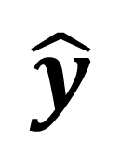
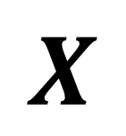
How do we know a model is good?
Given a model and its parameters, how do we know this model gives correct prediction?
Model
(para)
$$X$$
$$\hat{y}$$

Slide 4
How do we know a model is good?
Given a model and its parameters, how do we know this model gives correct prediction?
Model
(para)
$$X$$
$$\hat{y}$$

Slide 5
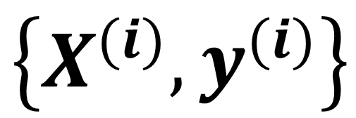
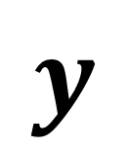
How do we know a model is good?
Given a model and its parameters, how do we know this model gives correct prediction?
Model
(para)
$$X$$
$$\hat{y}$$
$$\left\{X^{(i)}, y^{(i)}\right\}$$
Ground-truth
the i-th sample
$$y$$
a sample

Slide 6
How do we know a model is good?
Given a model and its parameters, how do we know this model gives correct prediction?
Model
(para)
$$X$$
$$\hat{y}$$
$$\left\{X^{(i)}, y^{(i)}\right\}$$
Ground-truth
the i-th sample
$$y$$
a sample

Slide 7
How do we know a model is good?
Given a model and its parameters, how do we know this model gives correct prediction?
Model
(para)
$$X$$
$$\hat{y}$$
$$\left\{X^{(i)}, y^{(i)}\right\}$$
Ground-truth
Loss func
the i-th sample
$$y$$
a sample

Slide 8
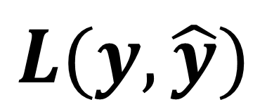
How do we know a model is good?
Given a model and its parameters, how do we know this model gives correct prediction?
Model
(para)
$$X$$
$$\hat{y}$$
$$\left\{X^{(i)}, y^{(i)}\right\}$$
Ground-truth
Loss func
the i-th sample
$$y$$
$$L(y, \hat{y})$$
a sample

Slide 9
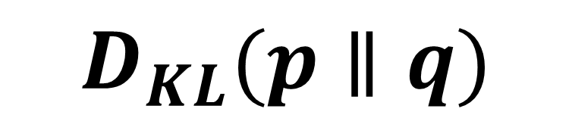
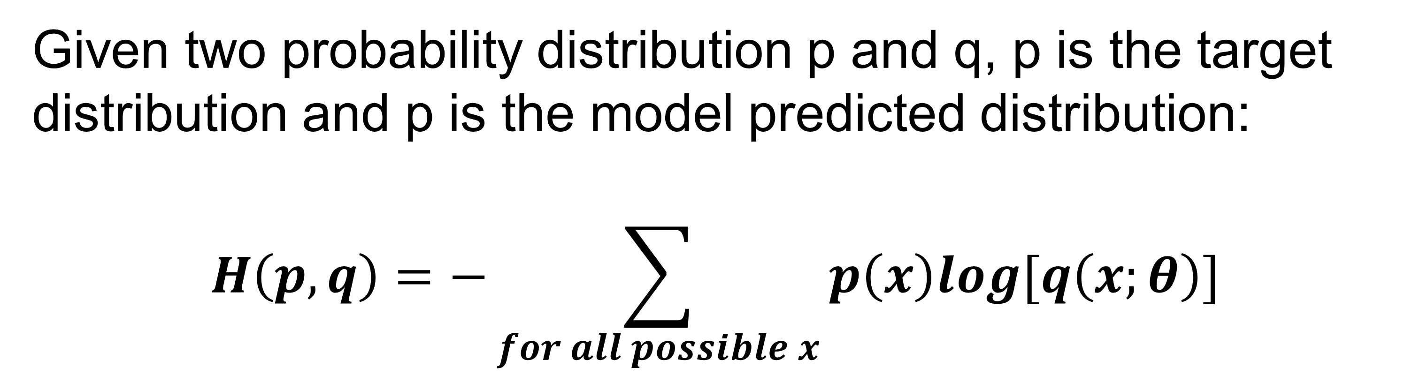
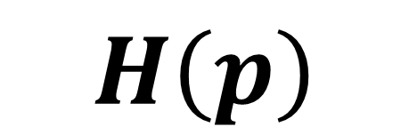
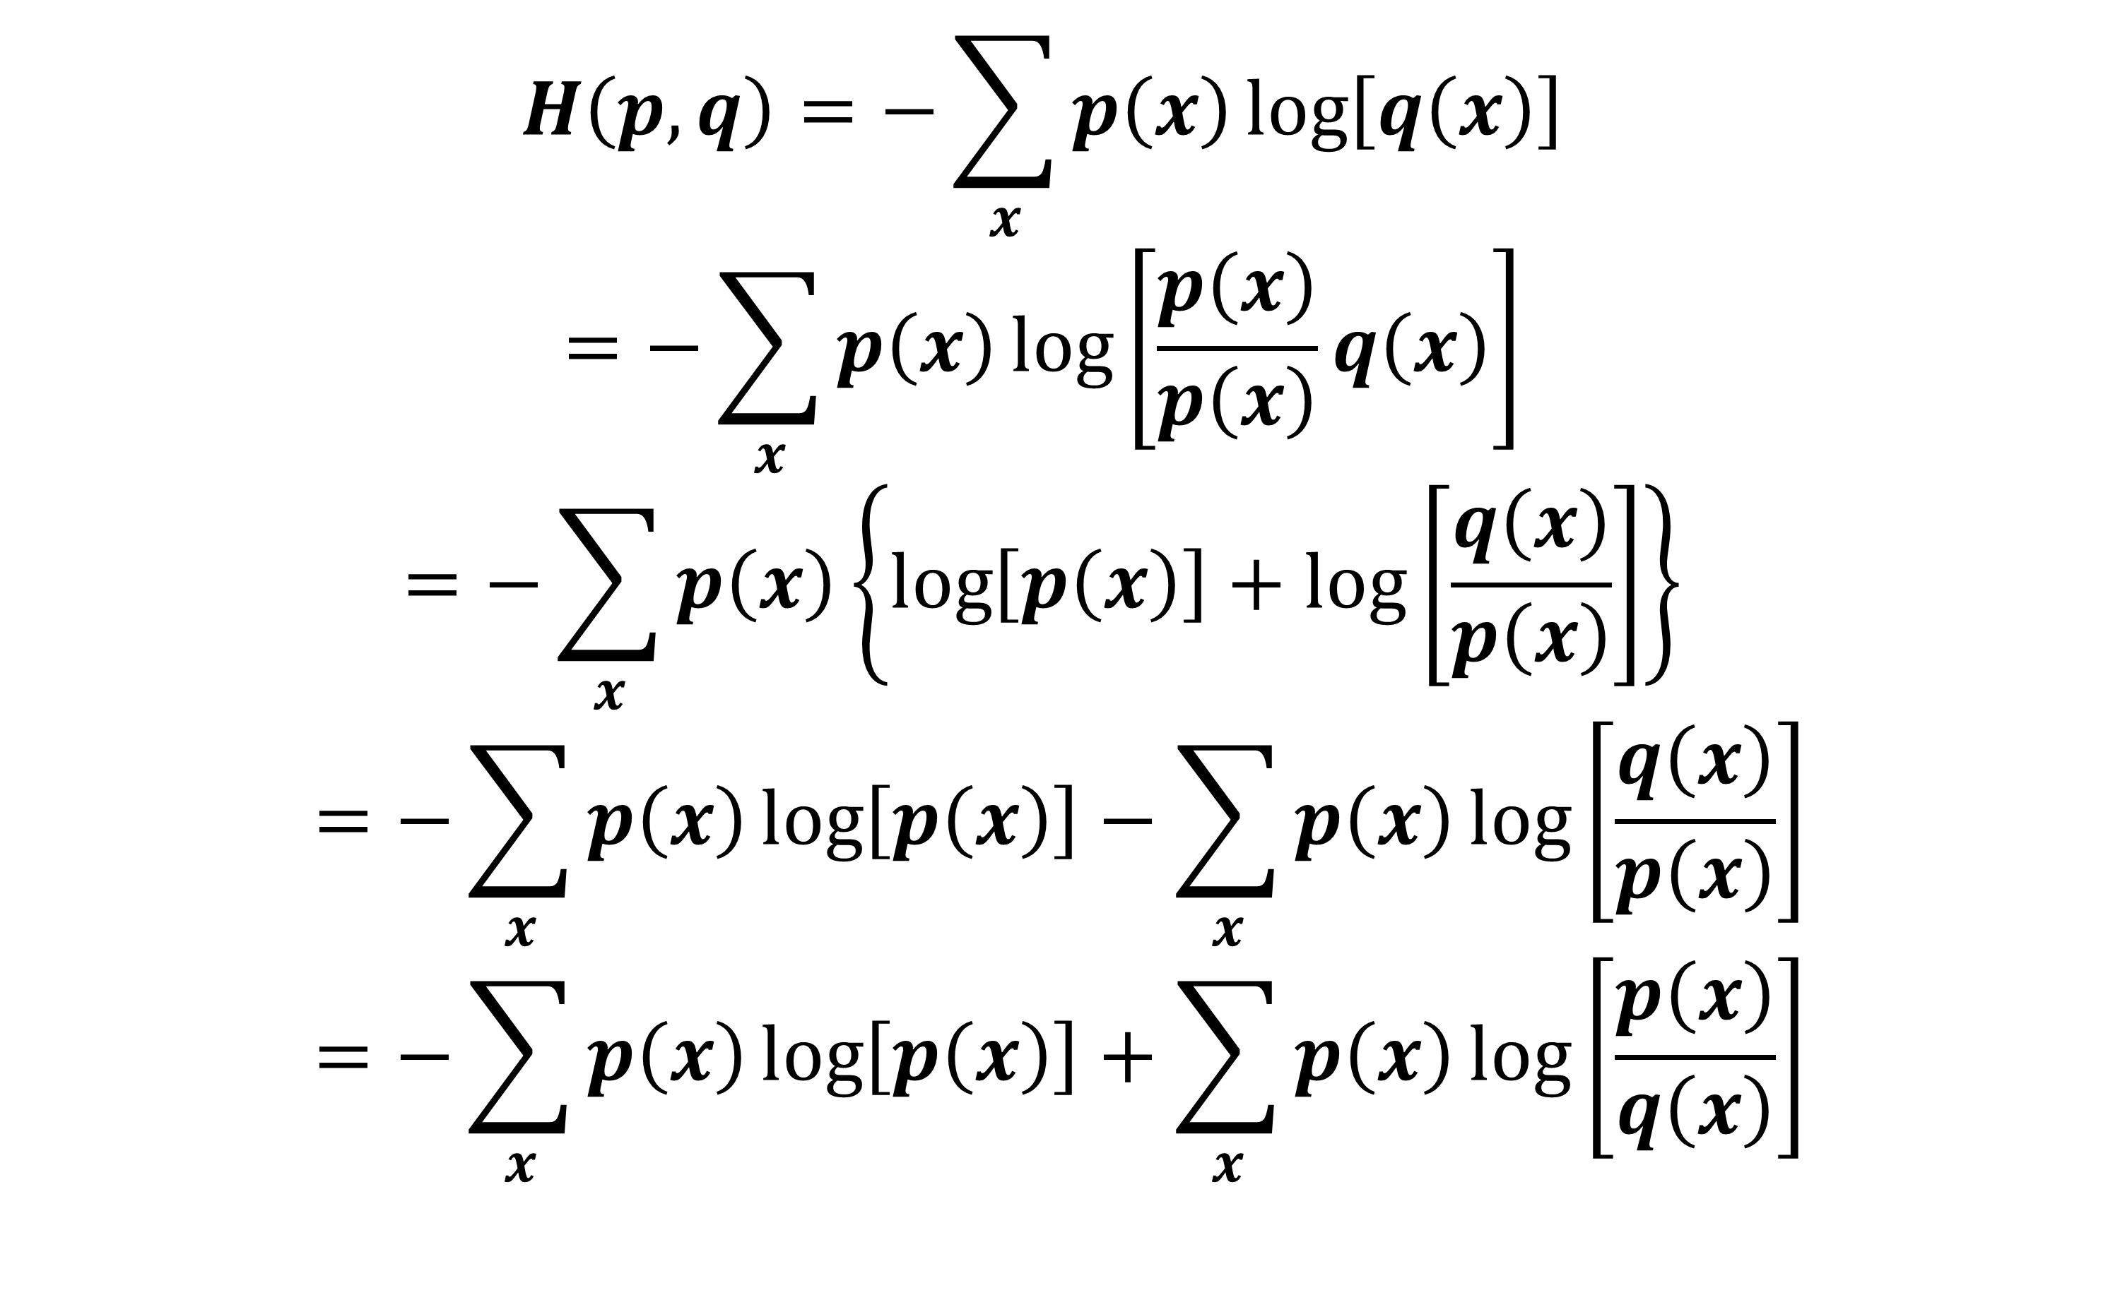
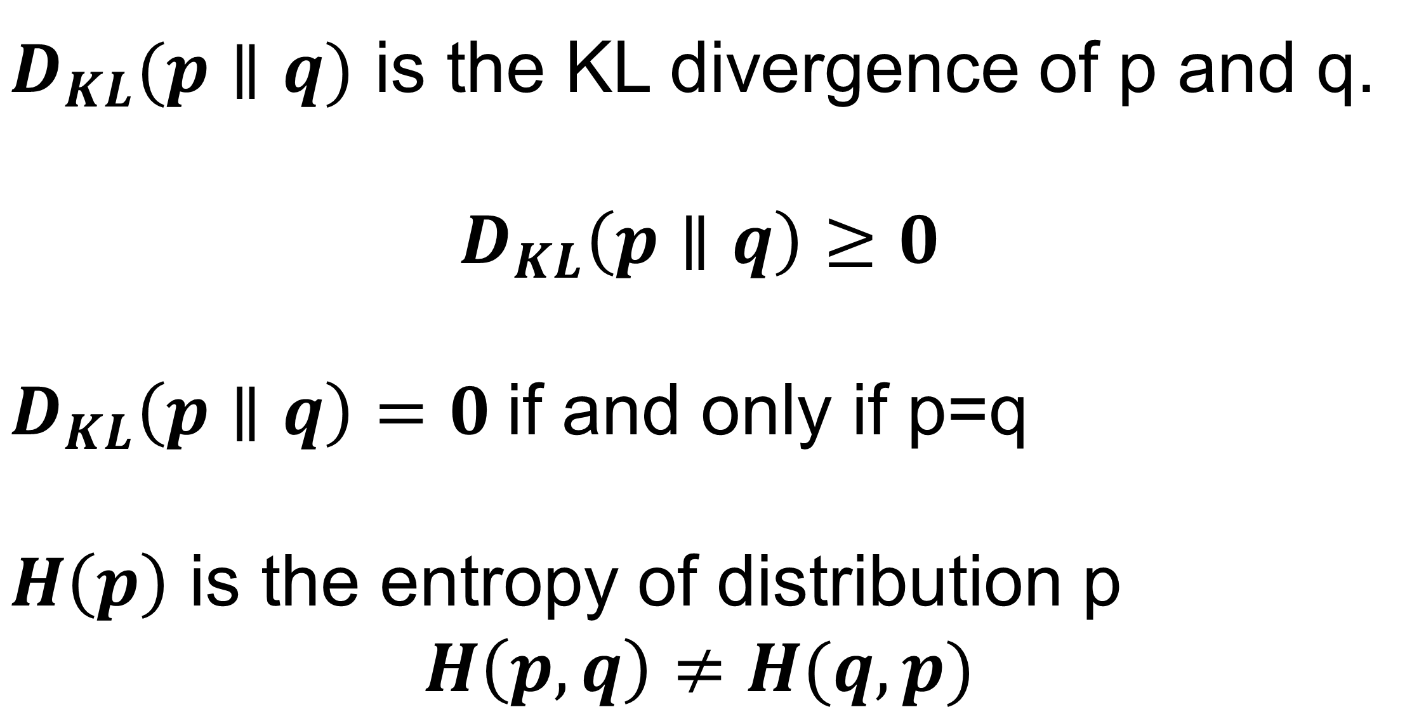
Cross-entropy
Given two probability distribution p and q, p is the target distribution and p is the model predicted distribution:
$$H\left(p,q\right)=−\sum_{for all possible x}{p\left(x\right)log[q\left(x;θ\right)] }$$
$$H\left(p,q\right)=−\sum_{x}{p\left(x\right)\log\left[q\left(x\right)\right] }$$
$$=−\sum_{x}{p\left(x\right)\log\left[\frac{p\left(x\right)}{p\left(x\right)}q\left(x\right)\right] }$$
$$=−\sum_{x}{p\left(x\right)\left\{\log\left[p\left(x\right)\right]+\log\left[\frac{q\left(x\right)}{p\left(x\right)}\right]\right\} }$$
$$=−\sum_{x}{p\left(x\right)\log\left[p\left(x\right)\right]}−\sum_{x}{p\left(x\right)\log\left[\frac{q\left(x\right)}{p\left(x\right)}\right]}$$
$$=−\sum_{x}{p\left(x\right)\log\left[p\left(x\right)\right]}+\sum_{x}{p\left(x\right)\log\left[\frac{p\left(x\right)}{q\left(x\right)}\right]}$$
Measure how close two distributions are (not 100% rigorous)
Minimized if p=q
$$H\left(p,q\right)=H\left(p\right)+D_{KL}(p∥q)$$
$D_{KL}(p∥q)$ is the KL divergence of p and q.
$$D_{KL}\left(p∥q\right)≥0$$
$D_{KL}\left(p∥q\right)=0$if and only if p=q
$H\left(p\right)$ is the entropy of distribution p
$$H\left(p,q\right)≠H(q,p)$$
$$H\left(p\right)$$
$$D_{KL}(p∥q)$$
Entropy of distribution p

Slide 10
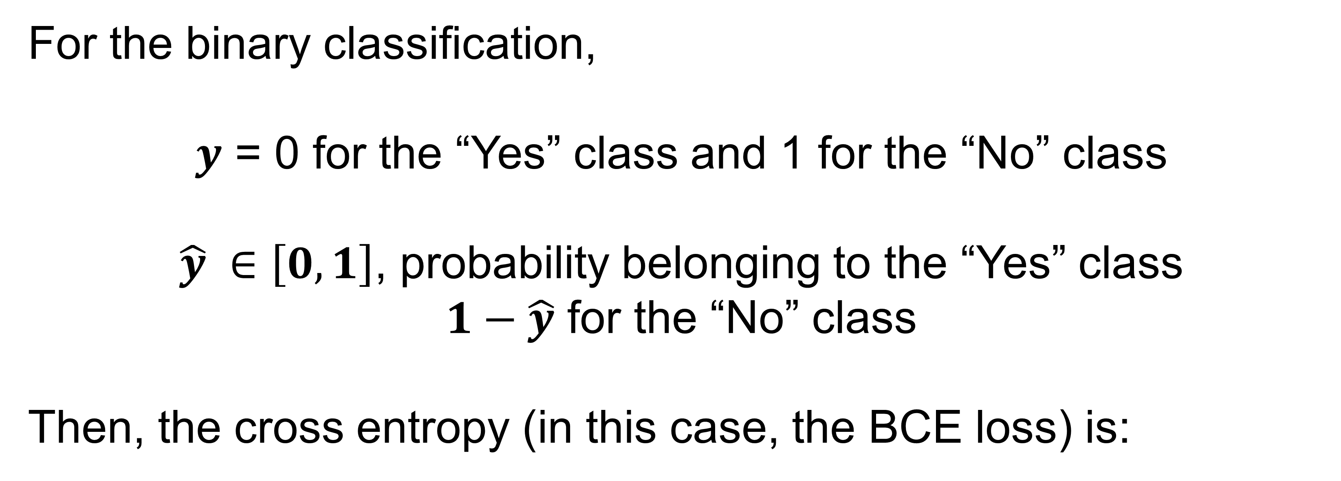
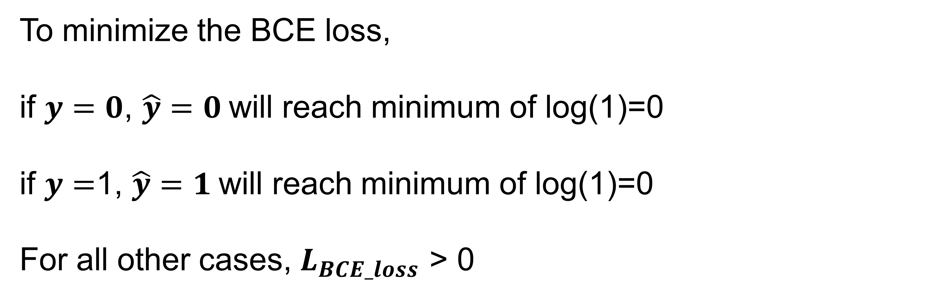
Binary Cross-entropy loss
For the binary classification,
$y$ = 0 for the “Yes” class and 1 for the “No” class
$\hat{y} ∈\left[0, 1\right]$, probability belonging to the “Yes” class
$1−\hat{y}$ for the “No” class
Then, the cross entropy (in this case, the BCE loss) is:
$$L_{BCE_loss}\left(y, \hat{y}\right)=−[y∙log\left(\hat{y}\right)+(1−y)∙log(1−\hat{y})]$$
To minimize the BCE loss,
if $y=0$, $\hat{y}=0$will reach minimum of log(1)=0
if $y=$1, $\hat{y}=1$will reach minimum of log(1)=0
For all other cases, $L_{BCE_loss}$ > 0

Slide 11
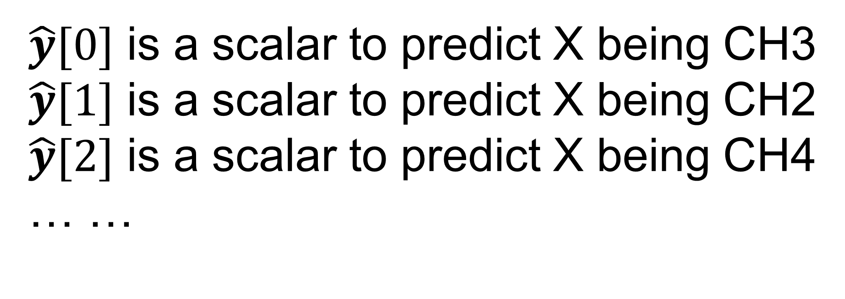
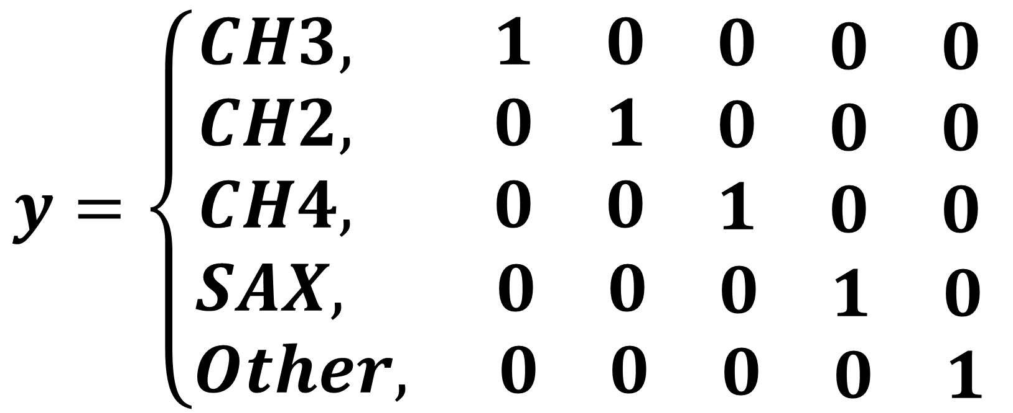
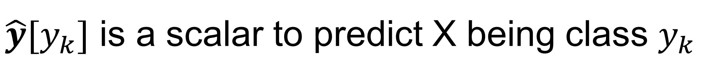
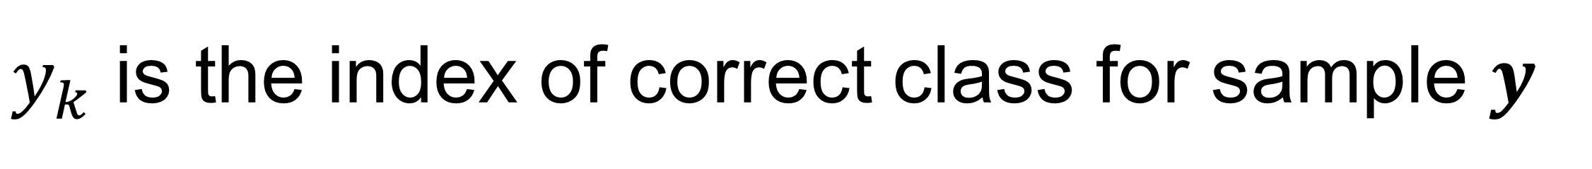
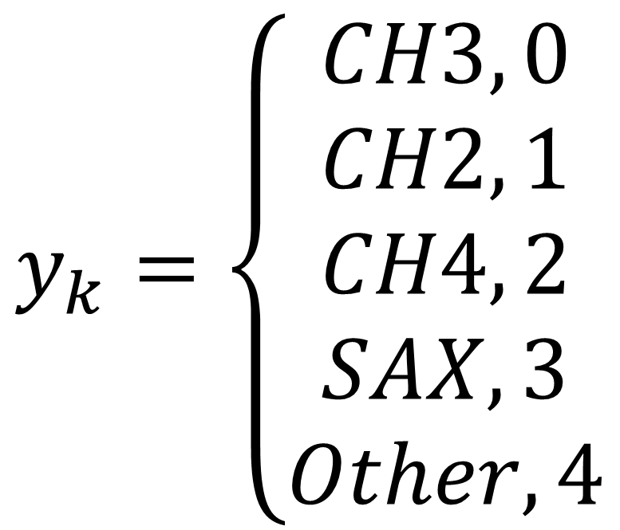
Cross-entropy loss for multi-class
For the multi-class classification,
$$y=\left\{\begin{aligned}\begin{matrix}CH3, 1 & 0 & \begin{matrix}0 & \begin{matrix}0 & 0\end{matrix}\end{matrix} \end{matrix} \\ \begin{matrix}CH2, 0 & 1 & \begin{matrix}0 & \begin{matrix}0 & 0\end{matrix}\end{matrix} \end{matrix} \\ \begin{matrix}CH4, 0 & 0 & \begin{matrix}1 & \begin{matrix}0 & 0\end{matrix}\end{matrix} \end{matrix} \\ SAX, \begin{matrix} 0 & 0 & \begin{matrix}0 & \begin{matrix}1 & 0\end{matrix}\end{matrix} \end{matrix} \\ Other, \begin{matrix} 0 & 0 & \begin{matrix}0 & \begin{matrix}0 & 1\end{matrix}\end{matrix} \end{matrix}\end{aligned}\right.$$
$\hat{y}$ is a [K,1] vector for the probability of X belonging to each lass
$\hat{y}[0]$ is a scalar to predict X being CH3
$\hat{y}[1]$ is a scalar to predict X being CH2
$\hat{y}[2]$ is a scalar to predict X being CH4
… …
y is one-hot encoding for the correct class
$$y_{k}=\left\{\begin{aligned}CH3, 0 \\ CH2, 1 \\ CH4, 2 \\ SAX, 3 \\ Other, 4\end{aligned}\right.$$
$\hat{y}[y_{k}]$ is a scalar to predict X being class $y_{k}$
$y_{k}$ is the index of correct class for sample $y$

Slide 12
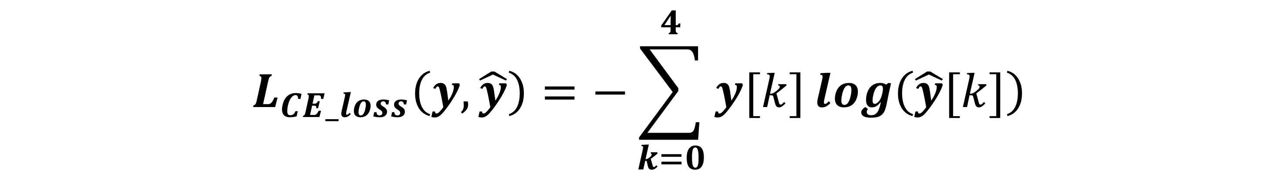
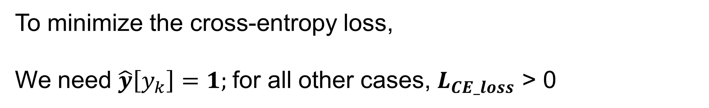
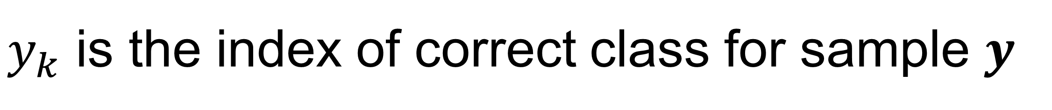
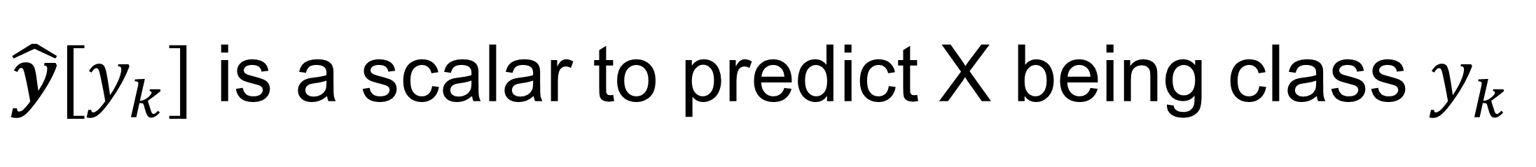
Cross-entropy loss
For the multi-class classification,
$$L_{CE_loss}\left(y, \hat{y}\right)=−\sum_{k=0}^{4}{y[k]}log\left(\hat{y}[k]\right)$$
$\hat{y}$ is a [K,1] vector for the probability of X being each lass
$\hat{y}[y_{k}]$ is a scalar to predict X being class $y_{k}$
y is one-hot encoding for the correct class
$y_{k}$ is the index of correct class for sample $y$
$$L_{CE_loss}\left(y, \hat{y}\right)=−log\left(\hat{y}[y_{k}]\right)$$
To minimize the cross-entropy loss,
We need $\hat{y}\left[y_{k}\right]=1;$for all other cases, $L_{CE_loss}$ > 0
Only one term left!

Slide 13
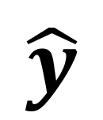
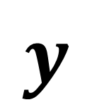
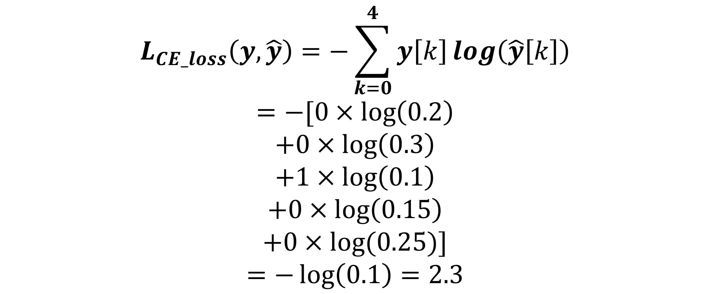
Cross-entropy loss
$$y$$
$$\hat{y}$$
$$L_{CE_loss}\left(y, \hat{y}\right)=−\sum_{k=0}^{4}{y\left[k\right]}log\left(\hat{y}\left[k\right]\right)$$
$$=−[0×\log\left(0.2\right)$$
$$+0×\log\left(0.3\right)$$
$$+1×\log\left(0.1\right)$$
$$+0×\log\left(0.15\right)$$
$$+0×log⁡(0.25)]$$
$$=−\log\left(0.1\right)=2.3$$
CH2
CH3
CH4
SAX
Other
0
0
1
0
0
0.2
0.3
0.1
0.15
0.25

Slide 14
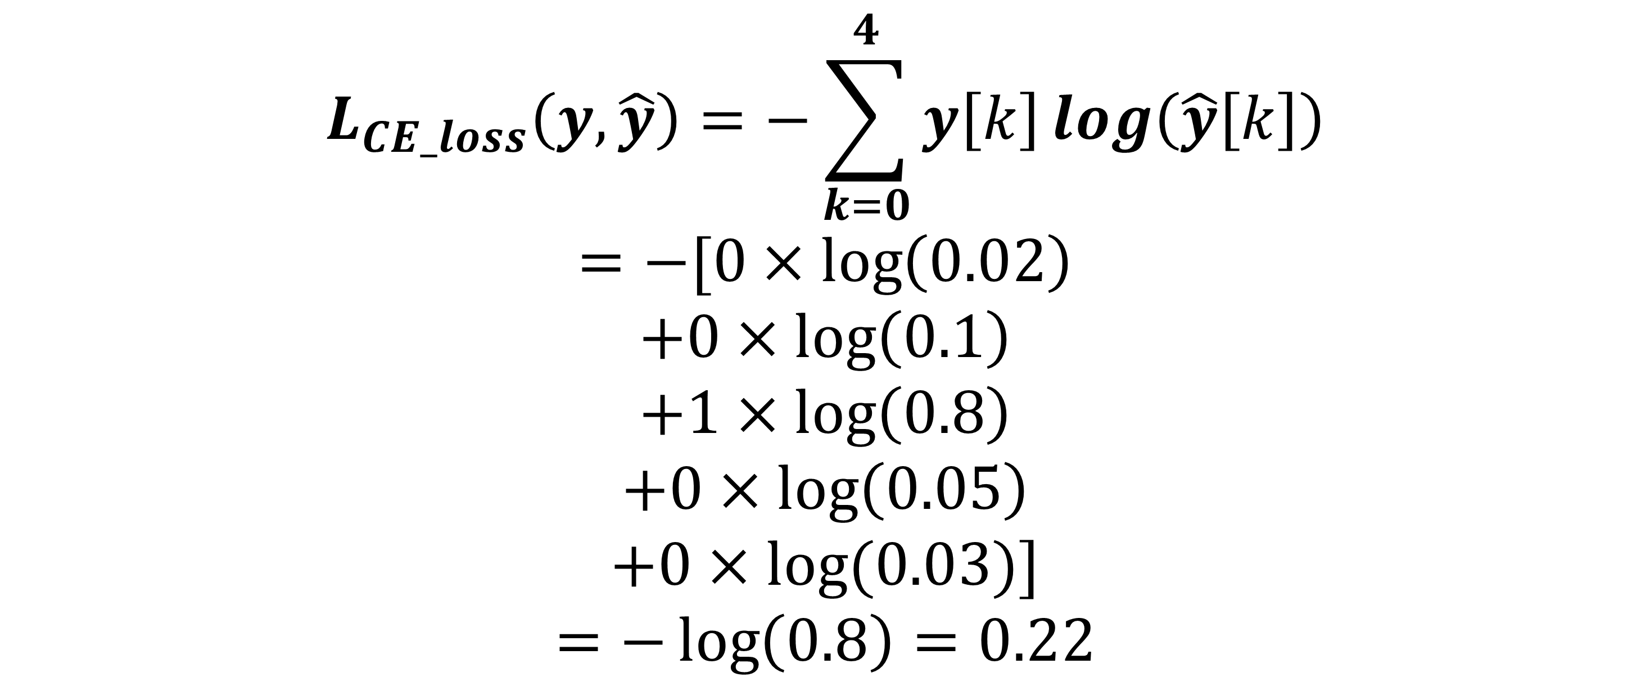
Cross-entropy loss
$$y$$
$$\hat{y}$$
$$L_{CE_loss}\left(y, \hat{y}\right)=−\sum_{k=0}^{4}{y\left[k\right]}log\left(\hat{y}\left[k\right]\right)$$
$$=−[0×\log\left(0.02\right)$$
$$+0×\log\left(0.1\right)$$
$$+1×\log\left(0.8\right)$$
$$+0×\log\left(0.05\right)$$
$$+0×log⁡(0.03)]$$
$$=−\log\left(0.8\right)=0.22$$
CH2
CH3
CH4
SAX
Other
0
0
1
0
0
0.02
0.1
0.8
0.05
0.03

Slide 15

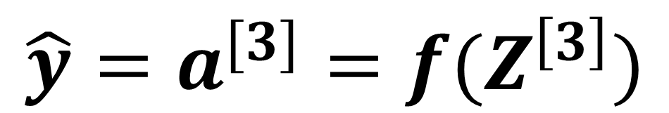
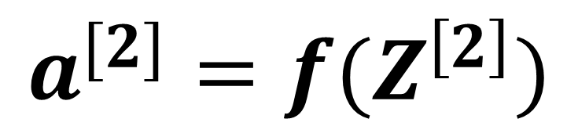
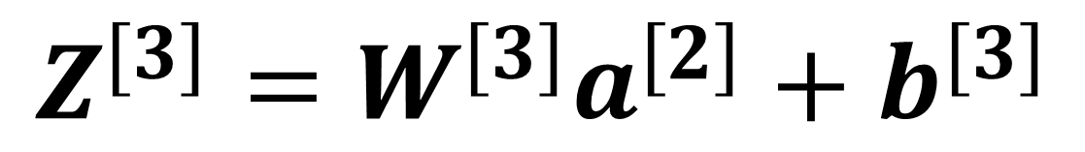
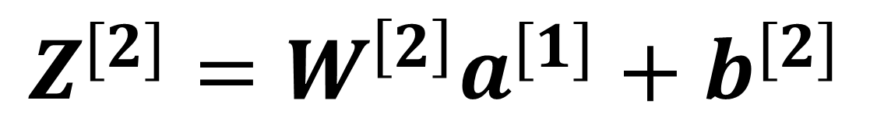
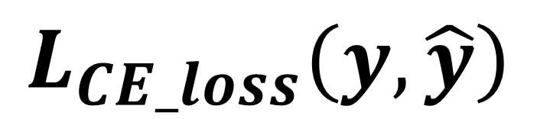
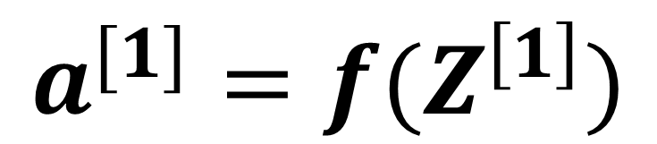
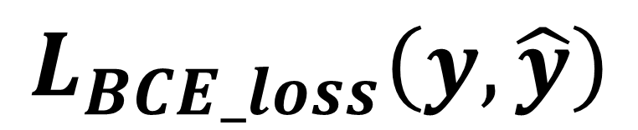
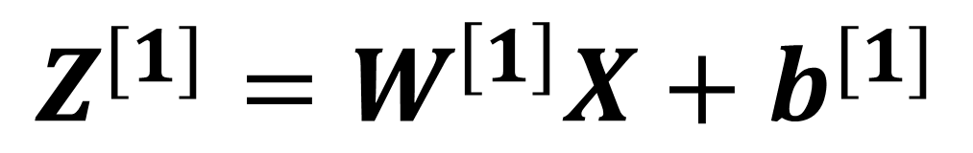

Where we are
$$Z^{[1]}=W^{\left[1\right]}X+b^{[1]}$$
W₁^{[1]}
f
$$a^{[1]}=f(Z^{\left[1\right]})$$
W₁^{[2]}
f
$$L_{BCE_loss}\left(y, \hat{y}\right)$$
$$Z^{[2]}=W^{\left[2\right]}a^{[1]}+b^{[2]}$$
$$X$$
W₂^{[1]}
f
W₁^{[3]}
f
$$a^{[3]}$$
$$a^{[2]}=f(Z^{\left[2\right]})$$
$$L_{CE_loss}\left(y, \hat{y}\right)$$
W₂^{[2]}
f
W₃^{[1]}
f
$$Z^{[3]}=W^{[3]}a^{[2]}+b^{[3]}$$
$${\hat{y}=a}^{[3]}=f(Z^{\left[3\right]})$$
Model : map input to output
Loss : measure how good the output is, compared to the label

Slide 16
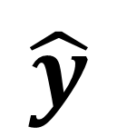


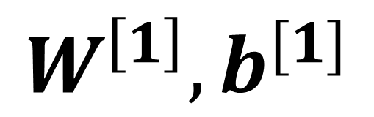
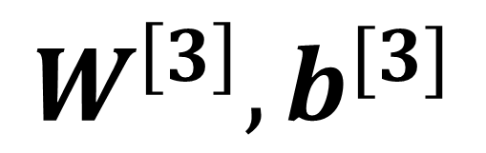
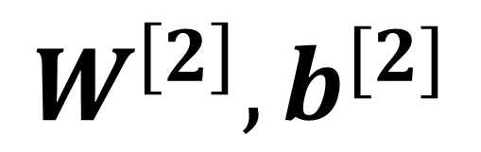
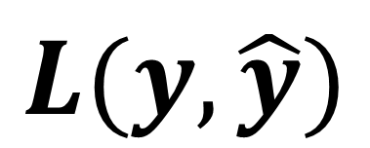

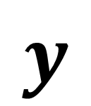
How do we determine the model parameters?
W₁^{[1]}
f
$$W^{\left[1\right]}, b^{[1]}$$
Model
(para)
W₁^{[2]}
f
$$X$$
$$\hat{y}$$
$$X$$
W₂^{[1]}
f
W₁^{[3]}
f
$$a^{[3]}$$
$$W^{\left[2\right]}, b^{[2]}$$
W₂^{[2]}
f
$$W^{\left[3\right]}, b^{[3]}$$
f
Loss func
W₃^{[1]}
$$y$$
$$L(y, \hat{y})$$
Model : map input to output

Slide 17
How do we determine the model parameters?
Optimization
W₁^{[1]}
f
$$W^{\left[1\right]}, b^{[1]}$$
Model
(para)
W₁^{[2]}
f
$$X$$
$$\hat{y}$$
$$X$$
W₂^{[1]}
f
W₁^{[3]}
f
$$a^{[3]}$$
$$W^{\left[2\right]}, b^{[2]}$$
W₂^{[2]}
f
$$W^{\left[3\right]}, b^{[3]}$$
f
Loss func
W₃^{[1]}
$$y$$
$$L(y, \hat{y})$$
Model : map input to output

Slide 18
How do we determine the model parameters?
Optimization
W₁^{[1]}
f
$$W^{\left[1\right]}, b^{[1]}$$
Model
(para)
W₁^{[2]}
f
$$X$$
$$\hat{y}$$
$$X$$
W₂^{[1]}
f
W₁^{[3]}
f
$$a^{[3]}$$
$$W^{\left[2\right]}, b^{[2]}$$
W₂^{[2]}
f
$$W^{\left[3\right]}, b^{[3]}$$
f
Loss func
W₃^{[1]}
$$y$$
$$L(y, \hat{y})$$
Model : map input to output

Slide 19
How do we determine the model parameters?
Optimization
W₁^{[1]}
f
$$W^{\left[1\right]}, b^{[1]}$$
Model
(para)
W₁^{[2]}
f
$$X$$
$$\hat{y}$$
$$X$$
W₂^{[1]}
f
W₁^{[3]}
f
$$a^{[3]}$$
$$W^{\left[2\right]}, b^{[2]}$$
Backprop: Compute gradient
W₂^{[2]}
f
$$W^{\left[3\right]}, b^{[3]}$$
f
Loss func
W₃^{[1]}
$$y$$
$$L(y, \hat{y})$$
Model : map input to output

Slide 20
How do we determine the model parameters?
Update model paras
Optimization
W₁^{[1]}
f
$$W^{\left[1\right]}, b^{[1]}$$
Model
(para)
W₁^{[2]}
f
$$X$$
$$\hat{y}$$
$$X$$
W₂^{[1]}
f
W₁^{[3]}
f
$$a^{[3]}$$
$$W^{\left[2\right]}, b^{[2]}$$
Backprop: Compute gradient
W₂^{[2]}
f
$$W^{\left[3\right]}, b^{[3]}$$
f
Loss func
W₃^{[1]}
$$y$$
$$L(y, \hat{y})$$
Model : map input to output

Slide 21
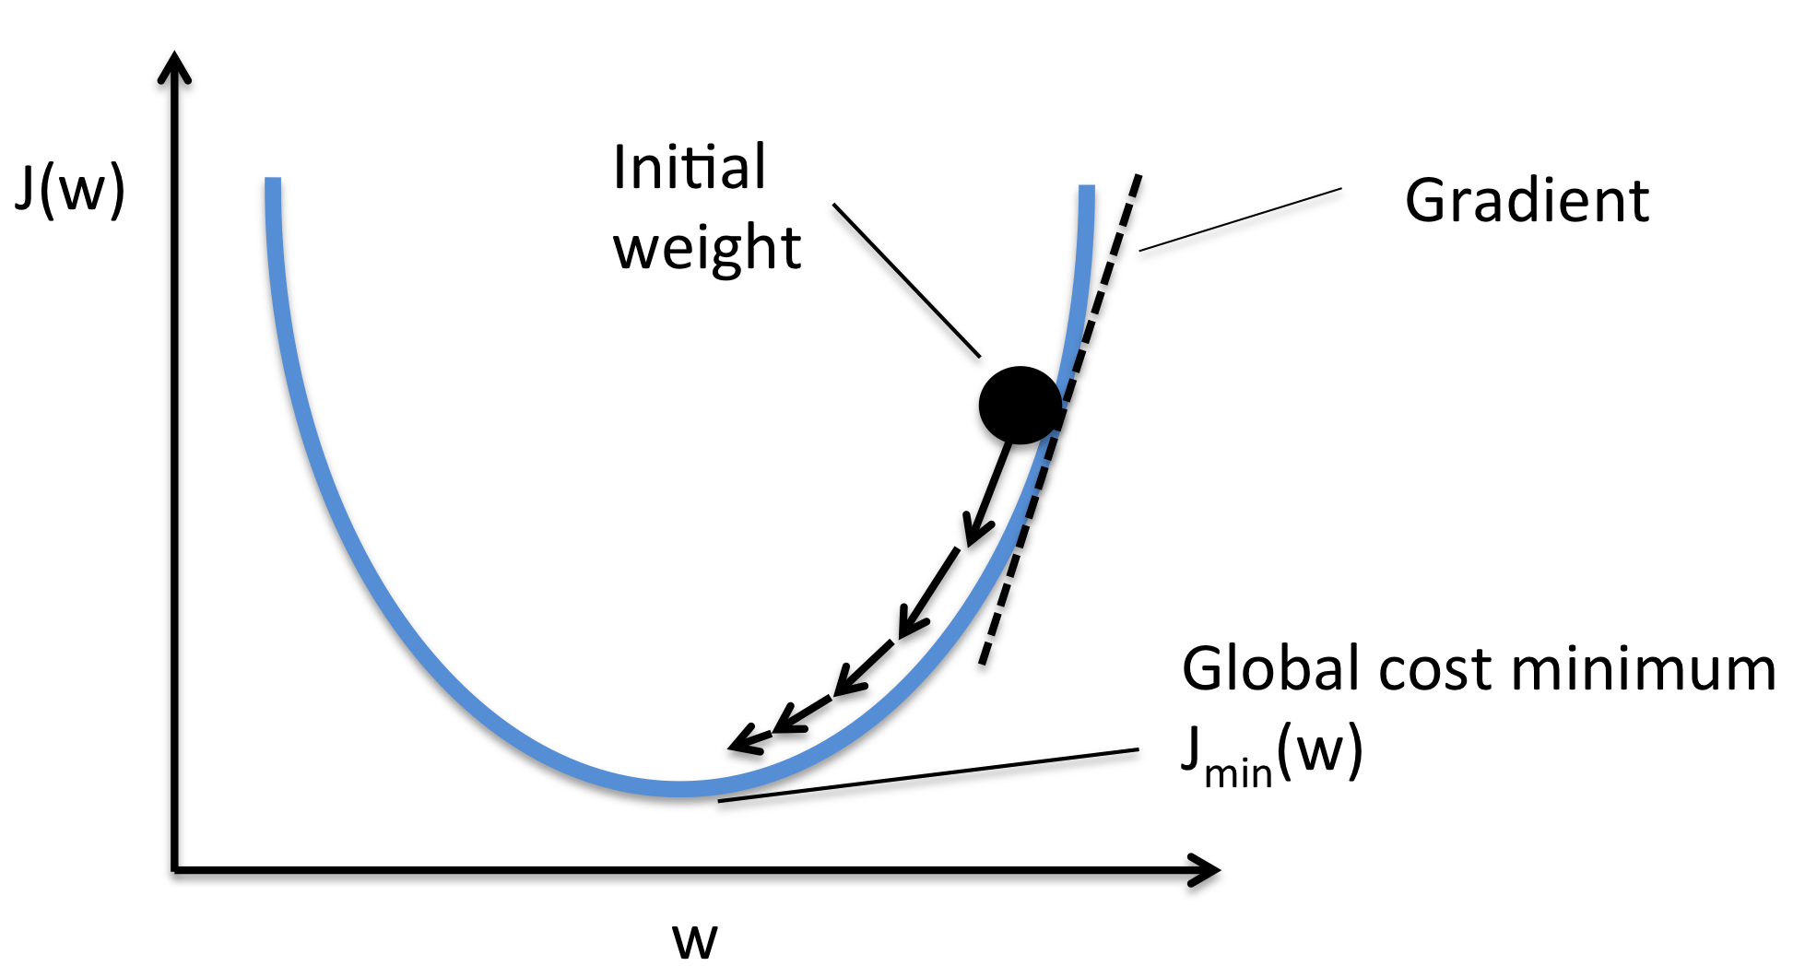
Gradient descent
To fine minimal point of a function
Start from an initial point
Follow the negative gradient direction
https://www.quora.com/Whats-the-difference-between-gradient-descent-and-stochastic-gradient-descent

Slide 22
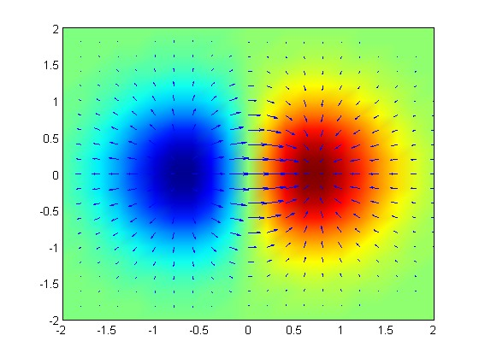
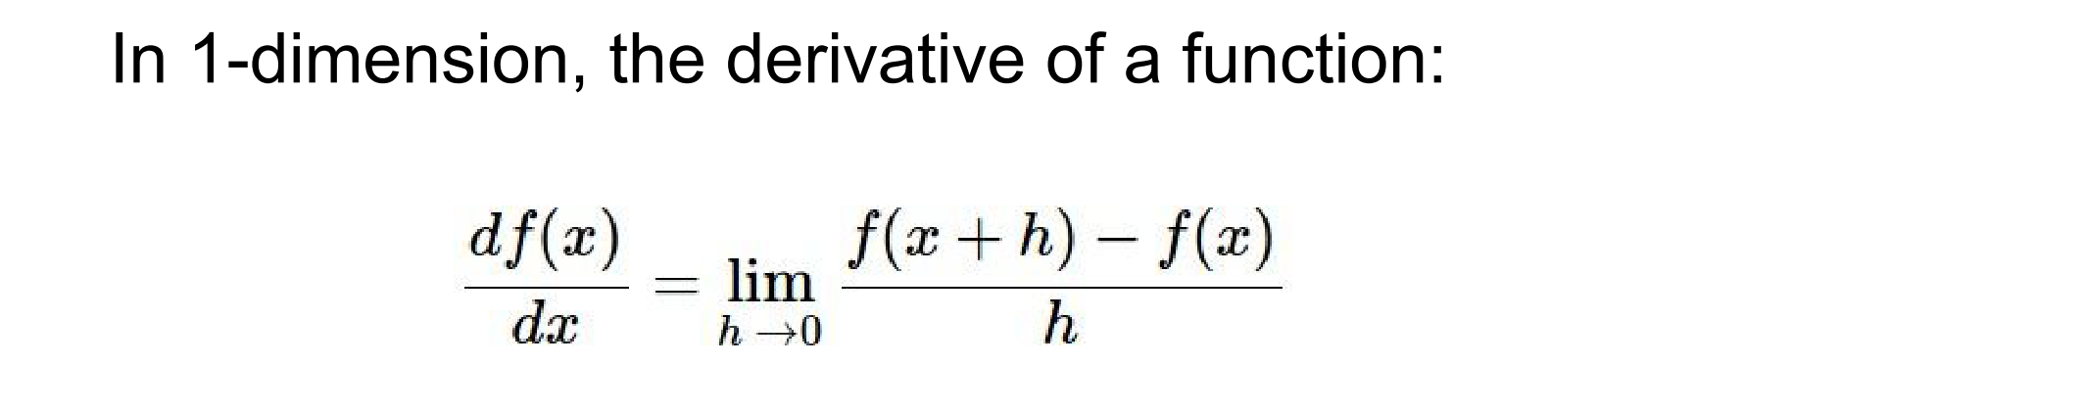
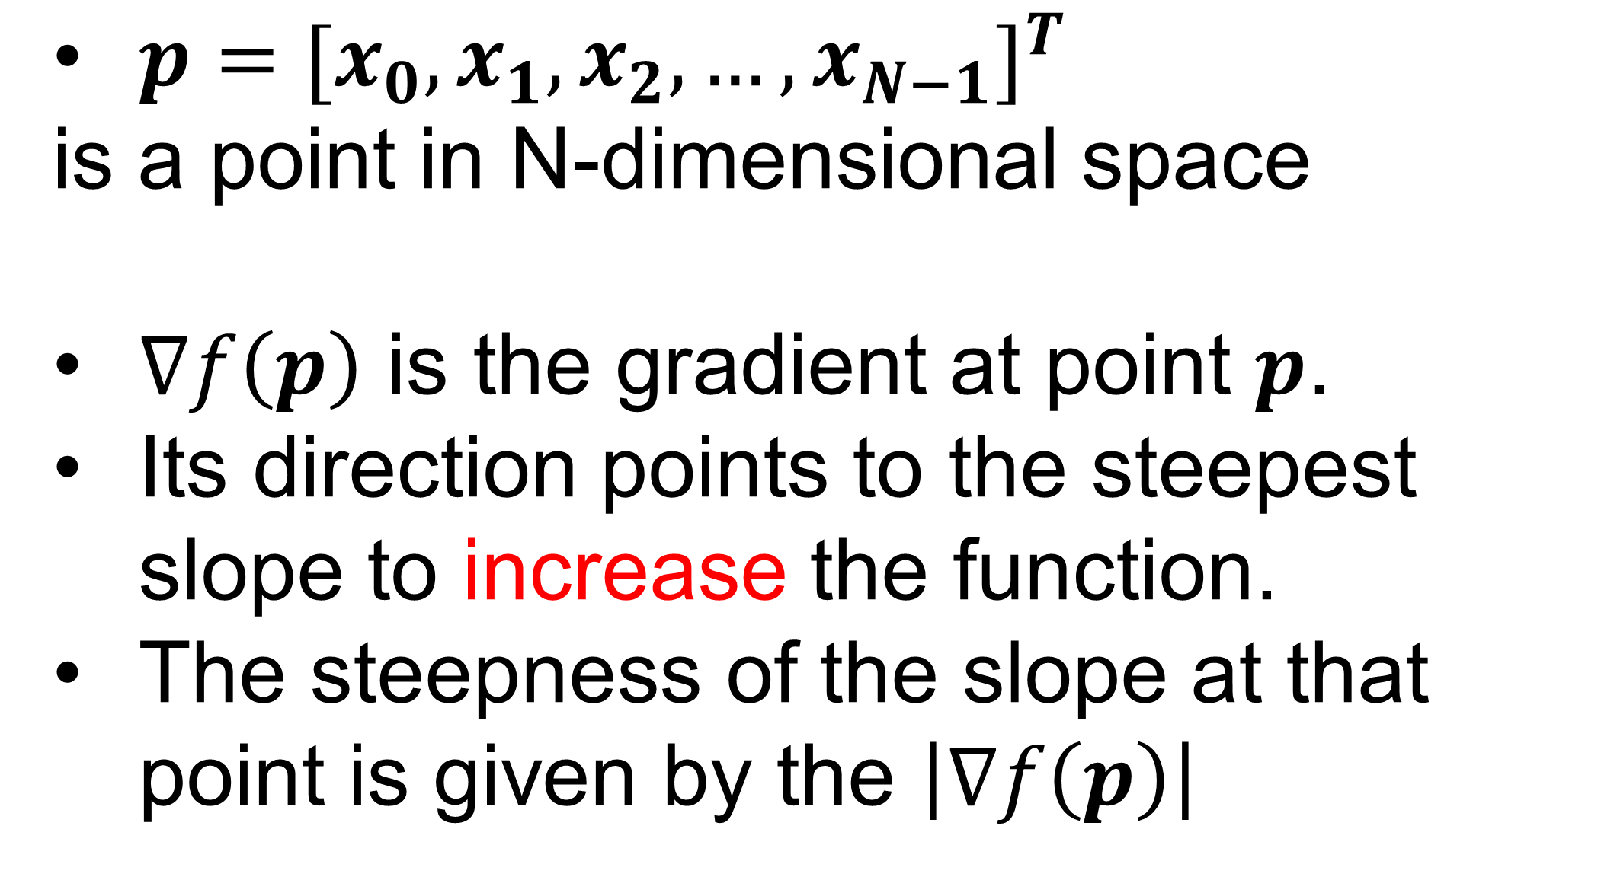
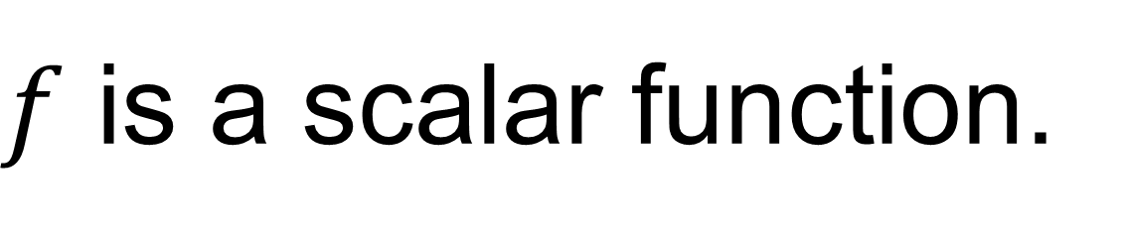
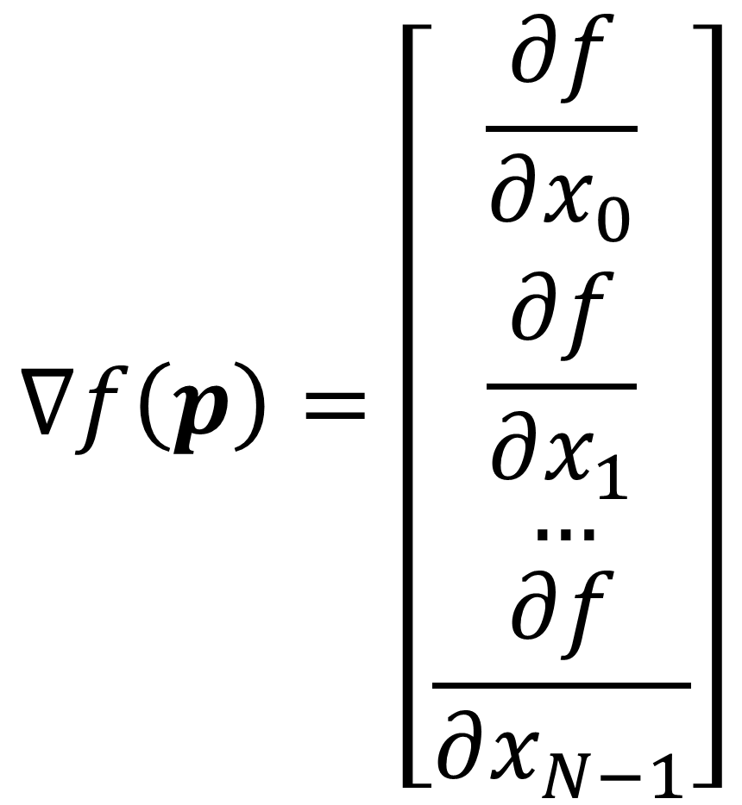
Gradient of a function
Gradient of a function indicates the steepest direction to increase this function in a neighborhood.
Negative gradient of a function indicates the steepest direction to decrease this function in a neighborhood.
$f$ is a scalar function.
$p={[x_{0},x_{1},x_{2},…,x_{N−1}]}^{T}$
is a point in N-dimensional space
$∇f\left(p\right)$ is the gradient at point $p$.
Its direction points to the steepest slope to increase the function.
The steepness of the slope at that point is given by the $\left|∇f\left(p\right)\right|$
$$∇f\left(p\right)=\left[\begin{matrix}\frac{∂f}{∂x_{0}} \\ \frac{∂f}{∂x_{1}} \\ \begin{aligned}… \\ \frac{∂f}{∂x_{N−1}}\end{aligned}\end{matrix}\right]$$
https://en.wikipedia.org/wiki/Gradient#/media/File:Gradient_of_a_Function.tif

Slide 23
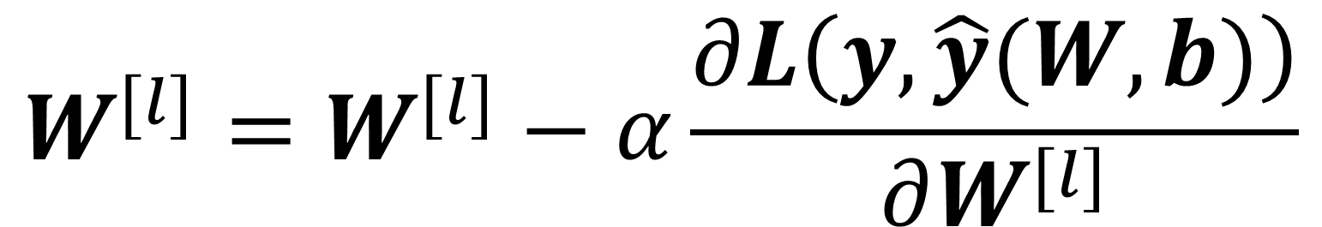
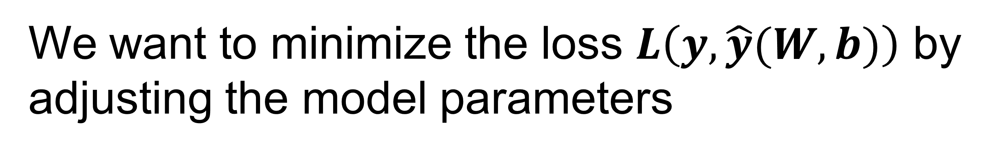
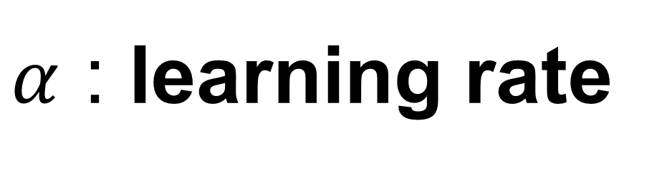
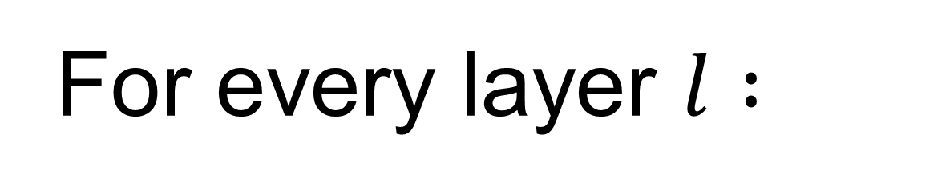

Gradient descent
Gradient direction
is
the steepest direction to increase this function
local minima
For every layer $l :$
$$W^{[l]}=W^{[l]}−α\frac{∂L\left(y, \hat{y}(W, b)\right)}{∂W^{[l]}}$$
$$b^{[l]}=b^{[l]}−α\frac{∂L\left(y, \hat{y}(W, b)\right)}{∂b^{[l]}}$$
We want to minimize the loss $L\left(y, \hat{y}(W, b)\right)$ by adjusting the model parameters
$α$ : learning rate
Guarantee to find a local minima

Slide 24


Gradient Descent (GD) over a set of samples
We have $M$ samples
Empirical loss on measured data = $\frac{1}{M}\sum_{i=0}^{M−1}{L(y^{\left(i\right)}, {\hat{y}}^{\left(i\right)}(W, b))}$
Find best parameters to minimize the mean loss across all training samples
$\frac{∂L\left(y, \hat{y}(W, b)\right)}{∂W^{[l]}}=$ $\frac{1}{M}\sum_{i=0}^{M−1}{\frac{∂L(y^{\left(i\right)}, {\hat{y}}^{\left(i\right)}(W, b))}{∂W^{[l]}}}$
$\frac{∂L\left(y, \hat{y}(W, b)\right)}{∂b^{[l]}}=$ $\frac{1}{M}\sum_{i=0}^{M−1}{\frac{∂L(y^{\left(i\right)}, {\hat{y}}^{\left(i\right)}(W, b))}{∂b^{[l]}}}$

Slide 25

Gradient descent
Initialize weights and bias
for iter in range(t):
Evaluate loss function (forward pass) over all samples
$L=\frac{1}{M}\sum_{i=0}^{M−1}{L(y^{\left(i\right)}, {\hat{y}}^{\left(i\right)}(W, b))}$
Compute gradient
$\frac{∂L}{∂W^{[l]}}$, $\frac{∂L}{∂b^{[l]}}$
Update parameter
$$W^{[l]}=W^{[l]}−α\frac{∂L}{∂W^{\left[l\right]}}$$
$$b^{[l]}=b^{[l]}−α\frac{∂L}{∂b^{[l]}}$$

Slide 26


Stochastic Gradient Descent (SGD)
GD performs one parameter update step after going through entire training set
Slow if M is large
Gradient update may lack “exploration”
Initialize weights and bias
Random shuffle dataset
for epoch in range(E):
select one sample with index $i$
Evaluate loss function (forward pass) at this sample
$L=L(y^{\left(i\right)}, {\hat{y}}^{\left(i\right)}(W, b))$
Compute gradient $\frac{∂L}{∂W^{[l]}}$, $\frac{∂L}{∂b^{[l]}}$
Update parameter $W^{[l]}=W^{[l]}−α\frac{∂L}{∂W^{\left[l\right]}}, b^{[l]}=b^{[l]}−α\frac{∂L}{∂b^{[l]}}$
https://data-notes.co/the-10-deep-learning-methods-ai-practitioners-need-to-apply-885259f402c1

Slide 27

Mini-Batch SGD
SGD can have too much “noise” during convergence
Not fully utilize the computing hardware
Initialize weights and bias
Random shuffle dataset
BatchSize = 32
for epoch in range(E):
select #BatchSize samples
Evaluate loss function (forward pass) at this sample batch
$L=\frac{1}{B}\sum_{i=0}^{B−1}{L(y^{\left(i\right)}, {\hat{y}}^{\left(i\right)}(W, b))}$
Compute gradient $\frac{∂L}{∂W^{[l]}}$, $\frac{∂L}{∂b^{[l]}}$
Update parameter $W^{[l]}=W^{[l]}−α\frac{∂L}{∂W^{\left[l\right]}}, b^{[l]}=b^{[l]}−α\frac{∂L}{∂b^{[l]}}$
Batch size often is limited by the GPU RAM
Different way to select a batch, e.g. sequential, random, fixed step size etc.

Slide 28

Larger batch size, higher learning rate
Larger BatchSize, better estimation of gradient
Larger BatchSize, less exploration
High learning rate for small BatchSize can lead to failed convergence
Overall, set BatchSize large, subject to the GPU RAM limit
More on how to find good learning rate …
B=64
B=4
B=32
B=16
B=8
https://miguel-data-sc.github.io/2017-11-05-first/#:~:text=For%20the%20ones%20unaware%2C%20general,descent%20(batch%20size%201).
https://arxiv.org/abs/1506.01186

Slide 29

Model Generalization
Training
set
Model
(para)
Training loss
Training accuracy
Underlying data distribution
We don’t have this distribution or an effective way to compute it!
Training and test sets are sampled from the same distribution, i.i.d. (independent and identically distributed)
We care test/generalization performance; that is, the performance of training model on a new dataset

Slide 30
Model Generalization
Training
set
Model
(para)
Training loss
Training accuracy
Underlying data distribution
We don’t have this distribution or an effective way to compute it!
Training and test sets are sampled from the same distribution, i.i.d. (independent and identically distributed)
We care test/generalization performance; that is, the performance of training model on a new dataset

Slide 31
Model Generalization
Training
set
Model
(para)
Training loss
Training accuracy
Underlying data distribution
Test
set
We don’t have this distribution or an effective way to compute it!
Training and test sets are sampled from the same distribution, i.i.d. (independent and identically distributed)
We care test/generalization performance; that is, the performance of training model on a new dataset

Slide 32
Model Generalization
Training
set
Model
(para)
Training loss
Training accuracy
Underlying data distribution
Trained model
Test
set
Inference
We don’t have this distribution or an effective way to compute it!
Training and test sets are sampled from the same distribution, i.i.d. (independent and identically distributed)
We care test/generalization performance; that is, the performance of training model on a new dataset

Slide 33
Model Generalization
Training
set
Model
(para)
Training loss
Training accuracy
Underlying data distribution
Trained model
Test
set
Inference
Test loss
Test accuracy
Generalization loss …
We don’t have this distribution or an effective way to compute it!
Training and test sets are sampled from the same distribution, i.i.d. (independent and identically distributed)
We care test/generalization performance; that is, the performance of training model on a new dataset

Slide 34


Model error
Given the underlying function $f(x)$, the model $M(x;D)$ to approximate $f\left(x\right)$
$D$ is a data set sampled from function $f\left(x\right)$. $D=\left[\left(x_{0},y_{0}\right), \left(x_{1},y_{1}\right), …, (x_{N−1},y_{N−1})\right]$
Every sample $\left(x_{i},y_{i}\right)$ is contaminated by noise: $y_{i}=f\left(x\right)+ε$, $ε$ is the random noise
We want to know the expected error of model, given the dataset D:
$$E_{D}[{(y−M(x;D))}^{2}]$$
This error consists of three parts:
$E_{D}\left[{\left(y−M\left(x;D\right)\right)}^{2}\right]={\{E_{D}\left[M\left(x;D\right)\right]−f\left(x\right)\}}^{2}+$ $E_{D}\left[{(E_{D}\left(M\left(x;D\right)\right)−M\left(x;D\right))}^{2}\right]+σ^{2}$
http://statweb.stanford.edu/~tibs/ElemStatLearn/, section 2.9
https://en.wikipedia.org/wiki/Bias%E2%80%93variance_tradeoff

Slide 35


Model error
Model prediction error consists of three parts:
$E_{D}\left[{\left(y−M\left(x;D\right)\right)}^{2}\right]={\{E_{D}\left[M\left(x;D\right)\right]−f\left(x\right)\}}^{2}+$ $E_{D}\left[{(E_{D}\left(M\left(x;D\right)\right)−M\left(x;D\right))}^{2}\right]+σ^{2}$
$$Bias\left(M, D\right)=E_{D}\left[M\left(x;D\right)\right]−f\left(x\right)$$
This is the Bias, for the difference between the mean model performance and ground-truth
$E_{D}\left[M\left(x;D\right)\right]$ is the expected model performance over all possible datasets <- the best model we can get
http://statweb.stanford.edu/~tibs/ElemStatLearn/

Slide 36
Model error
Model prediction error consists of three parts:
$E_{D}\left[{\left(y−M\left(x;D\right)\right)}^{2}\right]={\{E_{D}\left[M\left(x;D\right)\right]−f\left(x\right)\}}^{2}+$ $E_{D}\left[{(E_{D}\left(M\left(x;D\right)\right)−M\left(x;D\right))}^{2}\right]+σ^{2}$
$$Var\left(M, D\right)=E_{D}\left[{(E_{D^{′}}\left(M\left(x;D^{′}\right)\right)−M\left(x;D\right))}^{2}\right]$$
This is the Variance, measuring model performance fluctuation due to different datasets.
Measure how much the model prediction can change, after trained with different training sets
http://statweb.stanford.edu/~tibs/ElemStatLearn/

Slide 37


Model error
Model prediction error consists of three parts:
$E_{D}\left[{\left(y−M\left(x;D\right)\right)}^{2}\right]={\{E_{D}\left[M\left(x;D\right)\right]−f\left(x\right)\}}^{2}+$ $E_{D}\left[{(E_{D}\left(M\left(x;D\right)\right)−M\left(x;D\right))}^{2}\right]+σ^{2}$
$$σ^{2}$$
Bayes error, irreducible error
lowest possible error rate for any classifier
If one would know exactly what process/distribution generates the data, one still cannot achieve 100% accuracy, due to randomness
Distribution of two classes can overlap
http://www.alanfielding.co.uk/multivar/dawords.htm
http://statweb.stanford.edu/~tibs/ElemStatLearn/

Slide 38

Underfitting and overfitting
Model cannot represent the data distribution
Model well represents the data distribution, and does not capture data noise
Model is so flexible that it captures unwanted fluctuation due to noise
https://ascpt.onlinelibrary.wiley.com/doi/10.1002/cpt.1796

Slide 39

Underfitting and overfitting
Increasing model capacity/complexity can lead to overfitting
When applying trained model to a new dataset, e.g. test set, model performance can decrease, as a result of overfitting, indicated by the high generalization loss
Model can also underfitting the data, indicated by the high training loss
https://ja.d2l.ai/chapter_deep-learning-basics/underfit-overfit.html

Slide 40

In Deep Learning set up
We train on Training set and use training accuracy to estimate model performance ← Bias.
We apply the trained model on Testing set. Performance difference between training accuracy and test accuracy gives an estimation of Variance.

Slide 41
Bias and variance
Bayes error is the best possible error rate if we knew true data distribution. It will not be zero :
Overlap between class distribution
Noise
Test error
Test error
error
error
Training error
Variance
Bias
Lowest error possible (Bayes error)
Training error
Training data size
Training data size

Slide 42

Regularization to control model complexity
Deep learning model is very powerful, that it may overfit training data → degraded generalization
IDEA: change loss function to control model complexity
$$L=\frac{1}{B}\sum_{i=0}^{B−1}{L^{\left(i\right)}}+λR(W)$$
Data loss: how well model fits the data
Regularization loss: prevent model from fitting training data too well

Slide 43




L2 Regularization, weight decay
$$L=\frac{1}{B}\sum_{i=0}^{B−1}{L^{\left(i\right)}}+\frac{λ}{2}{\left\|W\right\|}_{2}^{2}$$
$${\left\|W\right\|}_{2}^{2}=\sum_{k=0}^{P−1}{{w_{k}}^{2}}$$
For all parameters in the model, flatten them and computing the element-wise L2 norm
$$\frac{∂L}{∂w_{k}}=\frac{1}{B}\sum_{i=0}^{B−1}{\frac{∂L^{(i)}}{∂w_{k}}}+λw_{k}$$
$$w_{k}=w_{k}−α(\frac{1}{B}\sum_{i=0}^{B−1}{\frac{∂L^{\left(i\right)}}{∂w_{k}})}−αλw_{k}$$
weight decay

Slide 44




L1 Regularization
$$L=\frac{1}{B}\sum_{i=0}^{B−1}{L^{\left(i\right)}}+\frac{λ}{2}{\left\|W\right\|}_{1}$$
$${\left\|W\right\|}_{1}=\sum_{k=0}^{P−1}{\left|w_{k}\right|}$$
For all parameters in the model, flatten them and computing the element-wise absolute value
$$\frac{∂L}{∂w_{k}}=\frac{1}{B}\sum_{i=0}^{B−1}{\frac{∂L^{(i)}}{∂w_{k}}}+λsign(w_{k})$$
$$sign\left(w_{k}\right)=\left\{\begin{aligned}1,w_{k}>0 \\ 0,w_{k}==0 \\ −1,w_{k}<0\end{aligned}\right.$$

Slide 45

Drop Out
Randomly drop out a set of neurons during training phase, with a probability of 1-p (e.g. p=0.5)
It means to randomly select different rows in the W matrix, for every batch, every epoch
During the test time, use all neurons, but scale the score by p
Or, in training time, scale the score by 1/p ← inverse dropout
Often used with linear layer, not for convolution
Require more epochs to train
Jointly train many smaller network, randomly selected
Implicitly combine exponentially many different neural network architectures efficiently
Nitish Srivastava, Geoffrey Hinton, Alex Krizhevsky, Ilya Sutskever, Ruslan Salakhutdinov. Dropout: a simple way to prevent neural networks from overfitting. JMLR, 15(56):1929−1958, 2014.

Slide 46
Other operations with regularization effects
Regularization will:
Increase training error
Decrease testing error
Introduce new hyper-parameters
Often requires experiments
More on this topic in later lecturers
Other operations to improve test error:
Data augmentation
Drop connection, random connection
Batch/Layer/Channel normalization
Early stopping
…

