Slide 1


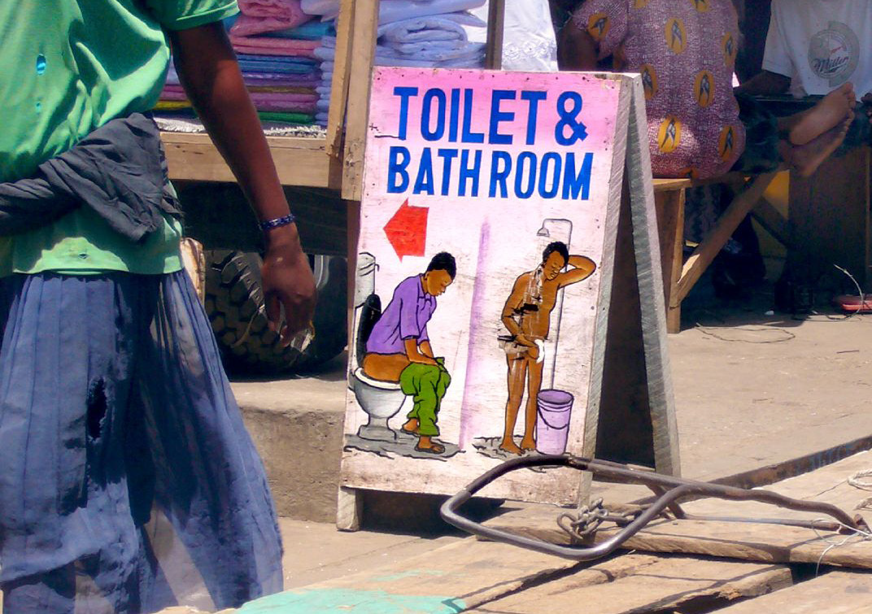
The Contribution of Civil Society-generated Evidence to the Improvement of Sanitation Services in Ghana
ICED Evidence to Action 2019 Conference
Panel on Evidence Use
ISSER, Accra, July 12, 2019
Dede Bedu-Addo,
Ghana Monitoring & Evaluation Forum (GMEF)
on behalf of
Anthony Mensah, Director, EHSD, MSWR, Accra
Notes:
Didn’t get logo

Slide 2
The Case
Environment where consultation and participation of CSOs in policy processes is valued and enabled
Effective waste management and access to improved sanitation services is a major challenge in urban and rural Ghana
Historically low levels of attention to sanitation by the state (limited budget allocation, limited capacity)
Space created was taken up by diverse CSOs, who are major evidence generators but operate at project level
Civil Society have been key change agents in getting government to use evidence for service delivery improvements
International pressure, with evidence-based advocacy campaigns driven by large INGOs, such as WaterAid, UNICEF, SNV, Coalitions like CONIWAS and local CSOs led to increased Presidential commitment to sanitation reforms
As part of civil society advocacy, CDD-Ghana began 2 projects: the “I am Aware” (IAA) and the District League Table (DLT) projects

Slide 3
Evidence Generation Process
Various surveys, studies, evaluations of donor-funded programmes have fed into policy process
CDD-Ghana’s IAA and DLT projects disseminate up-to-date, government-produced information on the state of public goods and service delivery in Ghana, including sanitation
They use administrative data collected at national level, as certified by central government agents from district regional national levels.
The IAA project has a data facility centre that helps assemble, archive, and disseminate the information

Slide 4
Consequently …
Interventions
Leading to
Access to data and analysis in user-friendly formats
Mechanisms
Leading to
Individuals understand data and analysis (evidence) related to their own priorities
Outcomes
Increased collaboration and use of the evidence for social accountability
Etc.
CSOs use information for advocacy through social marketing
Government officials motivated to recognise value evidence for their own performance
District Assemblies take critical actions for more equitable distribution of national resources
Government officials are aware of sanitation priorities and needs
Evidence generation directly linked to service delivery performance
Increased use of evidence in decision making, in planning and budgetary allocation
Notes:
Use Interventions
Access to IAA and DLT Working with various CSO partners and government agencies throughout the country, the DLT and IAA empower citizens with sanitation information
Social marketing through radio, internet, telephone, Town Hall meetings, and other community engagements.
Further analysis of the context for fact sheets, briefing reports and local language dissemination for citizens’ discussions with government officials
ICT dissemination in user-friendly formats, making it easily accessible to the citizenry, linking data use to standards for quality service delivery, accountability, governance.
Use
Individuals understand the data and analysis (evidence) and relate it to their own priorities
Government officials made aware of sanitation needs and more equitable distribution of national resources
Leading to increased government understanding of value of evidence in assessing performance and motivation to use it
Increased sense of competition amongst District Assemblies
Increased information transparency for decisonmaking
Increased collaboration and use of the evidence to demand for social accountability and increased responsiveness in service delivery

Slide 5
Facilitators and Barriers to Evidence Use
FACILITATORS | BARRIERS
CSO consultation and active participation in policy processes | Inter-agency coordination problems
Popular pressure for change (both international and internal) | Outsourcing of service delivery responsibility to private sector with limited support and oversight
Prevailing policy narratives (including President’s statement) | Limited resources and administrative red tape on generation of data
Established mechanisms to enable flow of information and involvement of CSOs in decision making processes (eg. Water Conference) | Knowledge that evidence is not always used for decision making is a disincentive
Building Capacities (of CSOs and Development Partners) to use evidence | Lack of sustained advocacy
Incentives (allocation of budgetary resources based on provision of data & reports) | Timeliness of data generation
Receptiveness of District Assembly personnel to use evidence in developing their plans
Evidence champions and mentors

Slide 6
Lessons for Ghana and Beyond…
Strengthen and harmonise the data ecosystem
Non-state data producers (CSOs/academia) need to improve their understanding of how, when and which government institutions and other actors use evidence for policy design, implementation and monitoring for better use of these opportunities
Need for increased recognition and use of CSO-generated evidence in policy interventions by state institutions
Evidence is used when government and key stakeholders are involved in the evidence use change process from the design stage.
Developing and building on an inclusive culture is paramount in promoting evidence use at all levels of society.
Uptake of evidence is better when championed by a senior Statesman, eg. the President, with adequate resources and institutions to sustain it.
Notes:
Red font need strengthening and/or removal?!

Slide 7

ME DA MO ASE! THANK YOU

